Slide 1
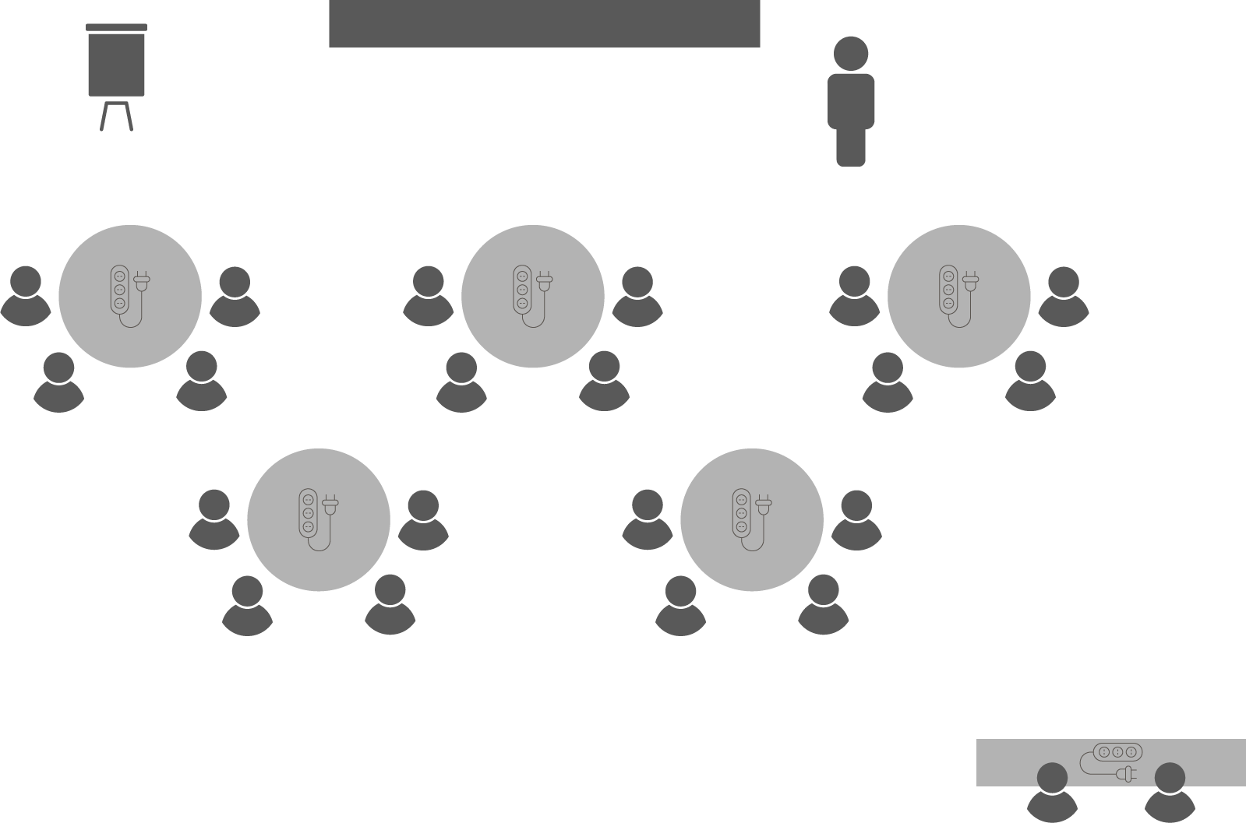
Opening checklist
Your preparation
Review notes, run a technical rehearsal
Rehearse examples / cases / stories to stimulate discussion
Classroom
Ensure students seated at tables of 3-5 and all facing the front
Have student name cards in place and ensure all sign in
Zoom
Rename yourself as host (under participants)
Set-up breakout rooms
https://support.zoom.us/hc/en-us/articles/206476313-Managing-Video-Breakout-Rooms
Welcome students as they arrive, let them know when starting
Notes:
Good luck!

Slide 2
Agile
Project
Management

Slide 3
Agile history
Agile is not new – discussed as early as 1970
Popularised in software development as an alternative to traditional ‘waterfall’ approaches to project management
Iterative development
Continuous customer involvement
Originally known as lean PM or rolling wave planning
An ‘open-source’ methodology

Slide 4
Agile manifesto
Agile values:
Individuals and interactions over processes and tools
Working software over comprehensive documentation
Customer collaboration over contract negotiation
Responding to change over following a plan
See also the twelve underpinning principles
https://agilemanifesto.org/

Slide 5
Agile differences
Traditional (waterfall)
Iterative (agile)
Delivers stakeholder requirements as a single project
Plan updated in response to changing environment
MYTH: Traditional methods cope poorly with opportunity realisation
Variations include PMBOK, PRINCE2, ISO21500
Delivers stakeholder requirements in small, successive mini-projects
Requirements updated in response to iterative feedback
MYTH: You must choose either agile or waterfall
Variations include Kanban, Scrum, Extreme Programming (XP)

Slide 6
SIMPLE Short and easy to memorise
PRECISE Ambiguity is the enemy of project management
INSPIRING Take people on the journey
RELEVANT Contextualised to their needs
IN-SYNC Aligned to organisational objectives
TRENDING Anticipate future opportunities

Slide 7
Activity 8.1 – There’s an app for that!
Using the following statement, articulate your vision for a new software application
For… (target customers)
…who are dissatisfied with… (the current situation / alternative)
…the… (project name) …is a … (type or category of product)
…that provides… (key benefits / compelling reasons to buy or use)
…unlike… (similar, competing products)
Notes:
Example (Google Maps): For people on the go who are dissatisfied with getting lost, Google Maps app is a phone-based app that provides real-time navigation guidance unlike street directories and paper maps.

Slide 8
Features
Also called outputs or initiatives – must directly relate to the project vision
Includes new features, changes to existing features and bug fixes
Defined by end-users (not by what the project team wants)
User stories
Short, simple descriptions of a feature
Told from the perspective of the person who desires the new capability
For example: As a <type of user>, I want <some goal> so that <some reason>

Slide 9
Activity 8.2
Define the features of your app with user stories
As a… (type of user)
…I want… (a specific product / service / result)
…so that… (outcome / benefit / value)
Notes:
Example (Google Maps): As a coffee connoisseur, I want Google Maps to show me nearby coffee shops with community reviews so that I can find the best coffee near me.

Slide 10
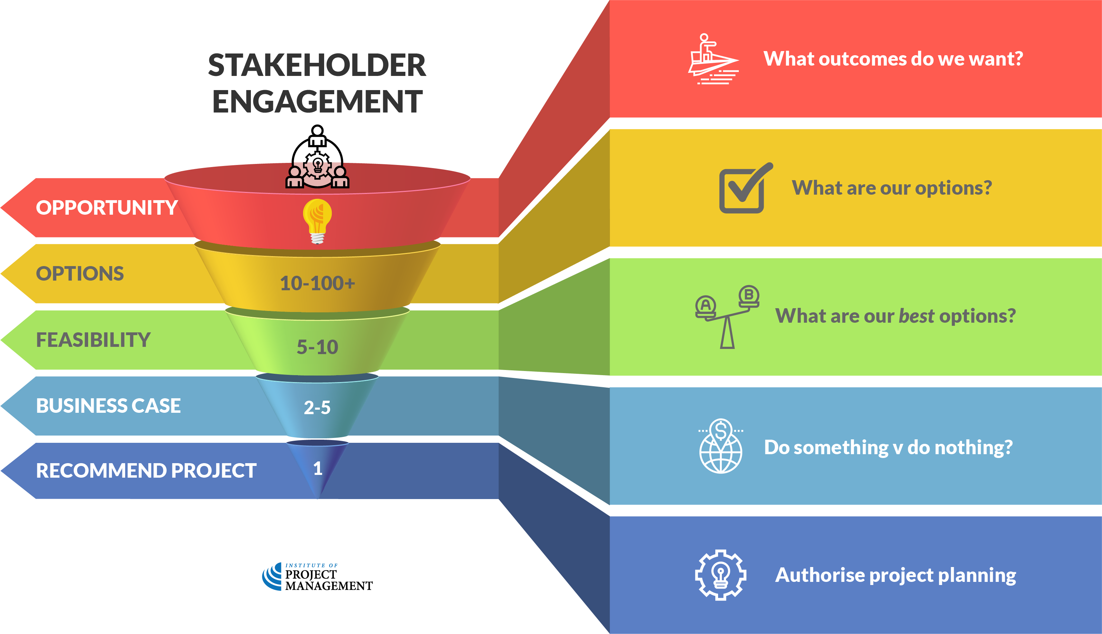
Discussion
What are some of the similarities / differences between how agile and traditional projects are initiated?

Slide 11
Notes:
Before breaking, ask students if there are any questions about what has been covered in the session so far.
Once answered, encourage students to stand up, get a drink, go outside and stretch.
If they are on Zoom, tell them to turn their camera and microphone off (you do the same)!
Make sure you tell them the precise time you will be restarting (eg 10:10am)
Don’t check your email – take a proper break!!

Slide 13
Product backlog
Prioritised list of features for development
Single, authoritative source maintained by the product owner (client)
Sprint
A short race at full speed
An iteration of feature development delivered by the agile team
A mini-project (with its own scope, time and cost constraints)

Slide 15
Discussion
What are some of the things you should consider when planning a sprint?

Slide 16
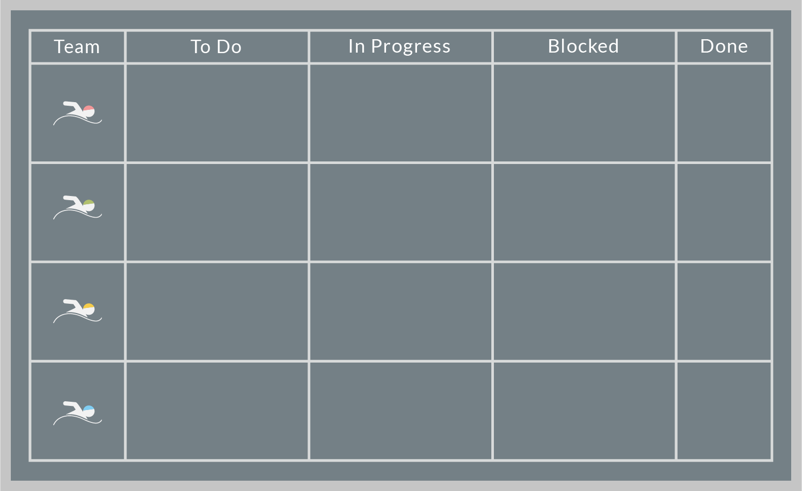
Kanban board
Highly visual scheduling technique

Slide 17
Kanban board
Highly visual scheduling technique
Limits work in progress

Slide 18
Kanban board
Highly visual scheduling technique
Limits work in progress
Teams expected to jump in and clear others’ bottlenecks when they have excess capacity

Slide 19
Kanban board
Highly visual scheduling technique
Limits work in progress
Teams expected to jump in and clear others’ bottlenecks when they have excess capacity
Dependencies not explicit

Slide 20
Kanban board
Highly visual scheduling technique
Limits work in progress
Teams expected to jump in and clear others’ bottlenecks when they have excess capacity
Dependencies not explicit
Good tool for managing stakeholder expectations

Slide 21
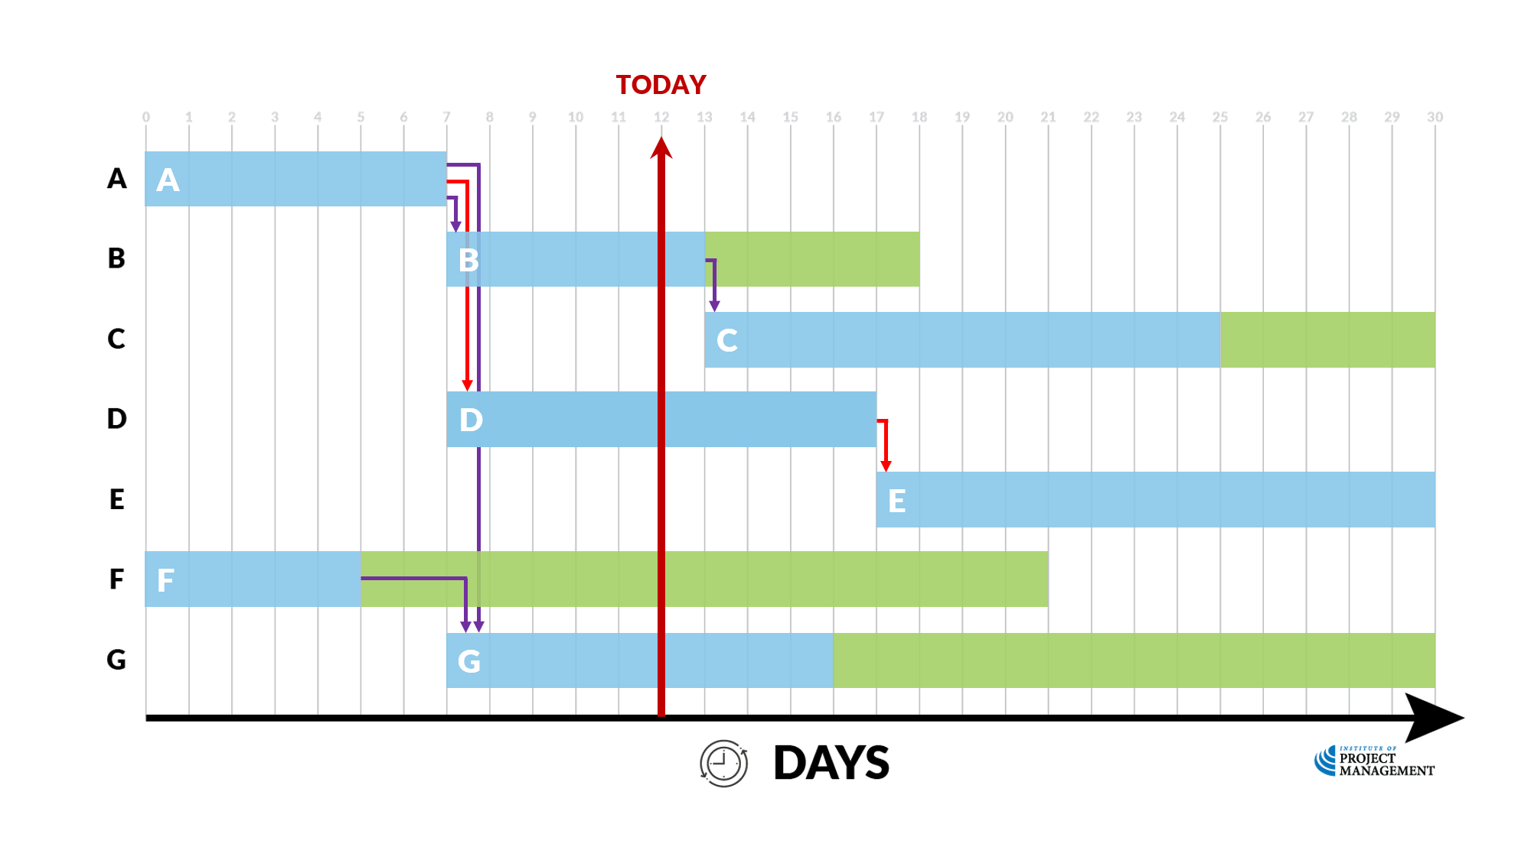
Activity 8.3
What should our Kanban board look like on Day 12?
Everything is
going to plan!
Notes:
All tasks are on schedule and float is not being used

Slide 22
Activity 8.3 – answer
Planned | In progress | Done
C
E
B
D
A
F
G

Slide 24
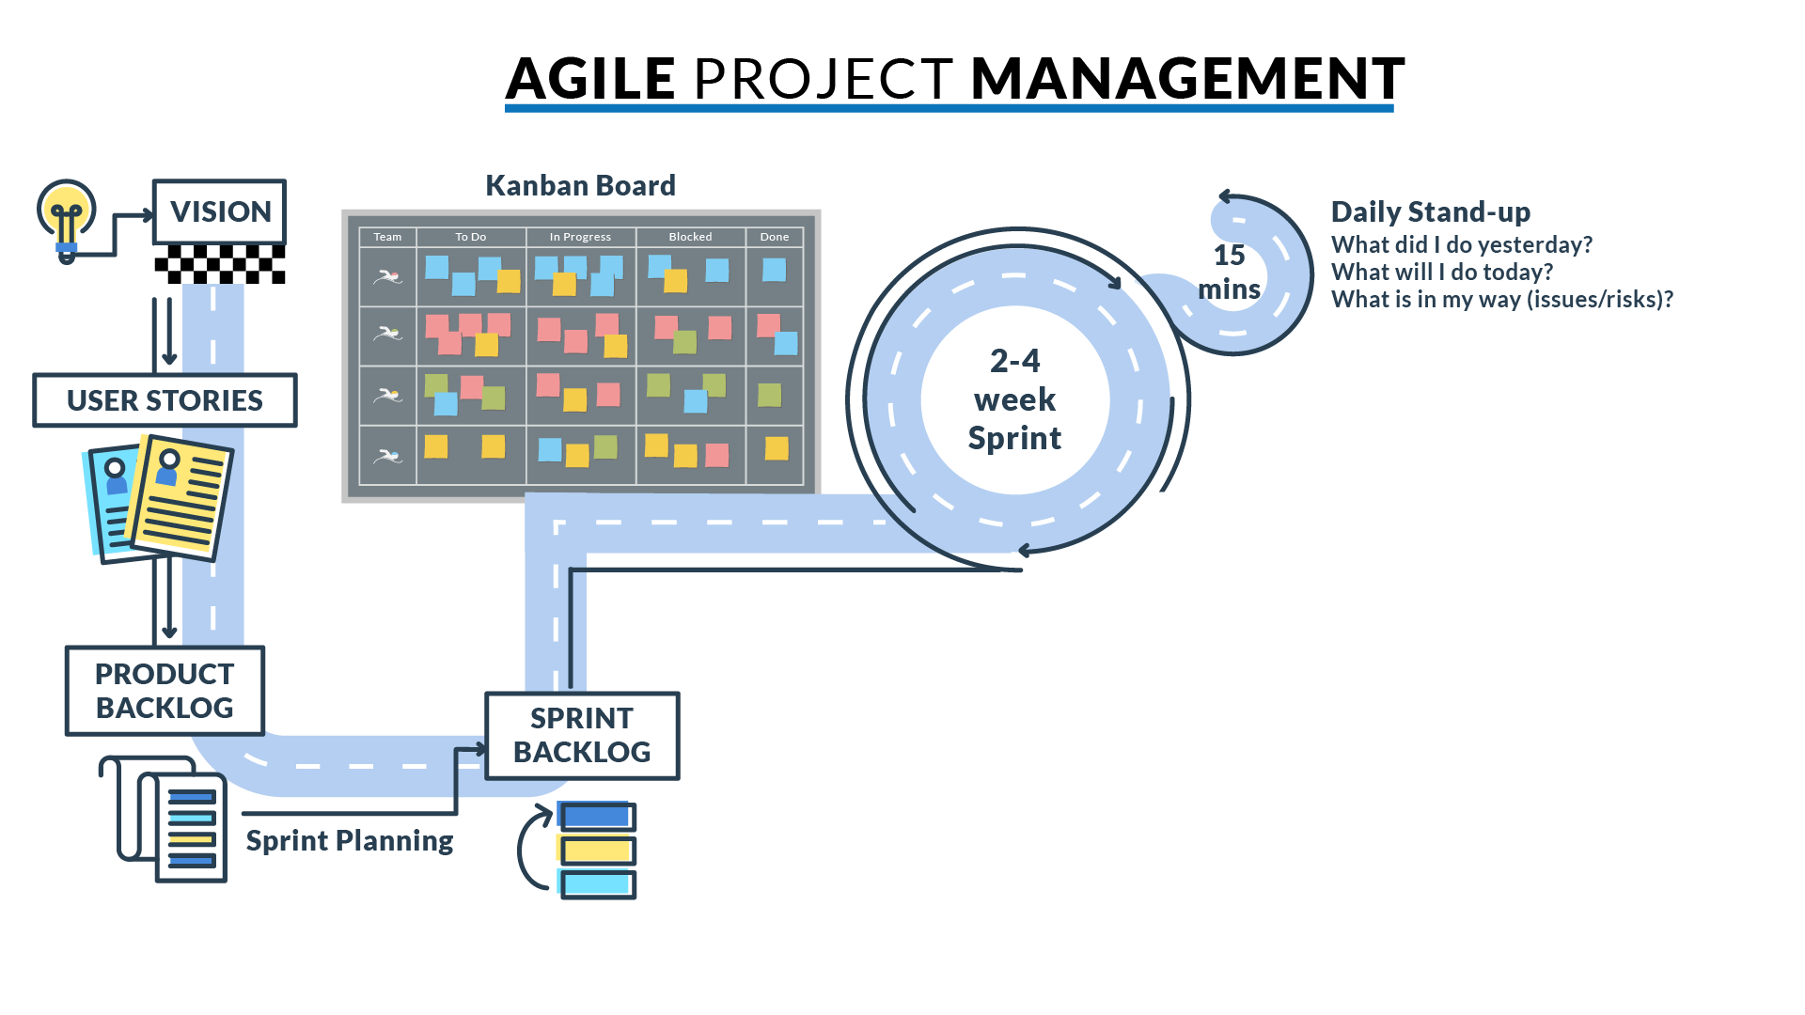
Scrum master
Meeting facilitator
Interface with product owner and the organisation
Project manager

Slide 25
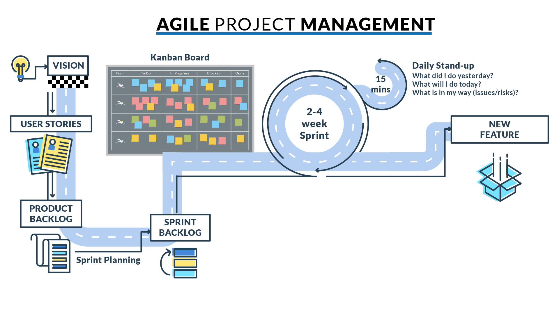

Slide 26
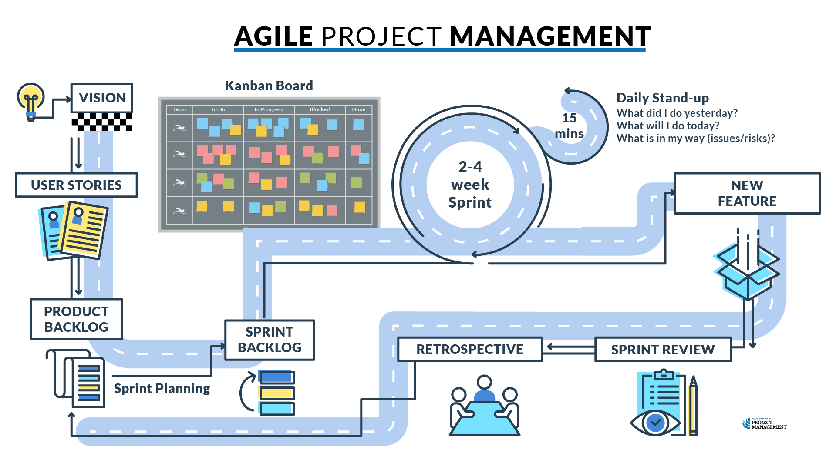

Slide 27
Closing the sprint
Sprint review (inspect)
Sprint retrospective (adapt)
New functionality presented to product owner (handover)
What has been done?
What has not been done?
What was added / removed?
User acceptance test (UAT)
Post-mortem reflection
What should we…
…start doing?
…stop doing?
…continue doing?

Slide 28
Discussion
Are you (formally or informally) using any agile processes in your workplace?

Slide 29
Activity 8.4
What do you think are the pros and cons of agile project management?

Slide 30
Activity 8.4 – answer
Agile pros
Agile cons
Effective meeting methodology
Encourages creativity
Simplifies complexity
Gets on with it
Quicker to market – faster returns
Highly responsive to market
Dynamic prioritisation of tasks
Better allows for real-time opportunity realisation
Tolerant of failure – easy to unwind
Vulnerable to key dependencies
Key people and critical inputs
Integration challenges at scale
Lack of documentation
Infinite scope creep
Projects end when money runs out, not when project is complete
Buzz-words, blind adherence

Slide 31
When to go agile
Agile best fit
Agile worst fit
Certain outcomes, uncertain scope
Projects with service deliverables
Projects with open-ended timelines
Stand-alone projects
Software development
Policy / procedure development
Research and innovation projects
Novel projects
Certain outcomes, certain scope
Projects with product deliverables
Construction
Manufacturing
Projects with fixed deadlines
Events
Projects with complex dependencies
Repeat projects

Slide 32
Critical success factors
Strong business case – clearly defined and measurable outcomes
Acceptance of uncertainty
Effective risk management
High levels of intra-team communication and collaboration
Co-location is best
Full focus (no business as usual tasks or other projects)
Good cultural fit
Follow process over (artificial) timelines

Slide 33
Time to catch-up
No homework this week!
Get up-to-date with your:
Stakeholder register
Concept canvas & risk profile
Gantt chart
Request for proposal
Risk register
Coming soon… leadership case study
Notes:
Cert IV PMP students only

Slide 34
Reflection
What is the most interesting thing you learned today?
What is one thing you will start, stop or continue doing?
What is one thing you would like to learn more about?
Notes:
Reflection questions not only highlight key learnings; they drive the continual improvement of our teaching and learning resources

Slide 35
Questions?
Coming next… project teams
Notes:
Stay around until everyone leaves the session to ensure they all get the chance to ask their questions.

Slide 36
Closing checklist
Student administration
Mark participating students as complete
Email absent students and notify of gap requirements
Facilitator feedback – email paul@institute.pm
What worked well today?
How can we improve?

