Slide 1
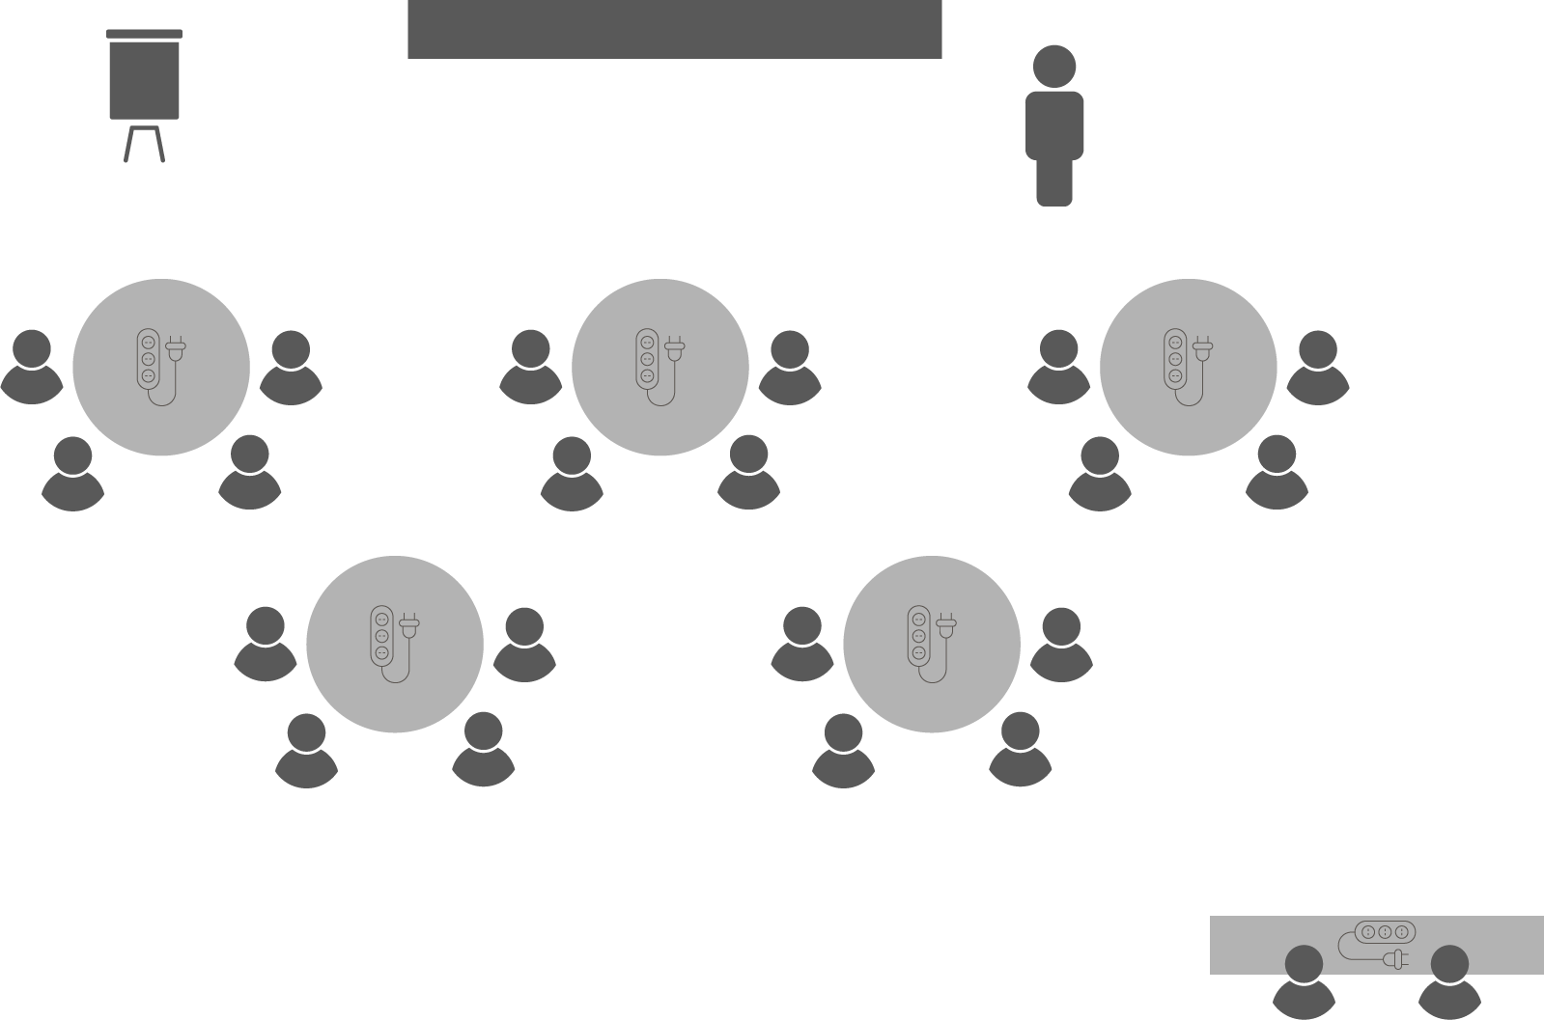
Opening checklist
Your preparation
Review notes, run a technical rehearsal
Rehearse examples / cases / stories to stimulate discussion
Classroom
Ensure students seated at tables of 3-5 and all facing the front
Have student name cards in place and ensure all sign in
Zoom
Rename yourself as host (under participants)
Set-up breakout rooms
https://support.zoom.us/hc/en-us/articles/206476313-Managing-Video-Breakout-Rooms
Welcome students as they arrive, let them know when starting
Notes:
Good luck!

Slide 2
Choosing the
Right Project

Slide 3
Project initiation
OPEN 3.0
Doing the
project right
Doing the
right project
Notes:
The study of project management has traditionally focused on ‘doing the project right’.
Without over-simplifying things, this means planning the project in sufficient detail so that delivery is assured – we hit our time, cost and scope targets.
That is why when people think of project management, they most immediately think of tools like Gantt charts, risk registers and status reports.
Yet if projects are just a means to an end – in other words, the project output is merely the vehicle we use to achieve our intended project outcomes – then a perfectly planned, delivered and closed project is a waste of time and money if no one asked for it, no one wants it and/or it doesn’t deliver on its promise.
For that reason, the process of project initiation – making sure we are ‘doing the right project’ before we even start planning – matters.
Projects are typically initiated by clients, who request a product, service or result that they are expected to find the time and money for.
However, if the client or sponsoring organisation rush this process, at best they miss opportunities; at worst they make a series of wild assumptions that ignore the reality of the world in which the project will be delivered.
And as we know from the cost of change, it becomes exponentially more expensive to correct these errors the further you get into the project’s life.
So how can we prevent this?
How can we ensure, before we start committing our finite time and resources to a project, that it is the best possible response to the problem we are trying to solve or the benefits we are trying to achieve?
Let’s start with our stakeholders…

Slide 4
Initiation process
Notes:
A project doesn’t start with a plan; as with all innovations, a project actually starts with an idea.

Slide 5
Initiation process
Notes:
Having a good idea is the first step on the path to project success; however, this is not (by itself) enough to get us started.
Before progressing the idea, we should be able to articulate its benefits (outcomes) and show their linkage to the strategic objectives of the organisation or entity we are asking to pay for it as a project.
We might also like to start highlighting some broad delivery constraints: how long it might take to realise, what it might cost, and what is intentionally out-of-scope.
Theoretically at least, we should be open to opportunities from anyone in our community of stakeholders.

Slide 6
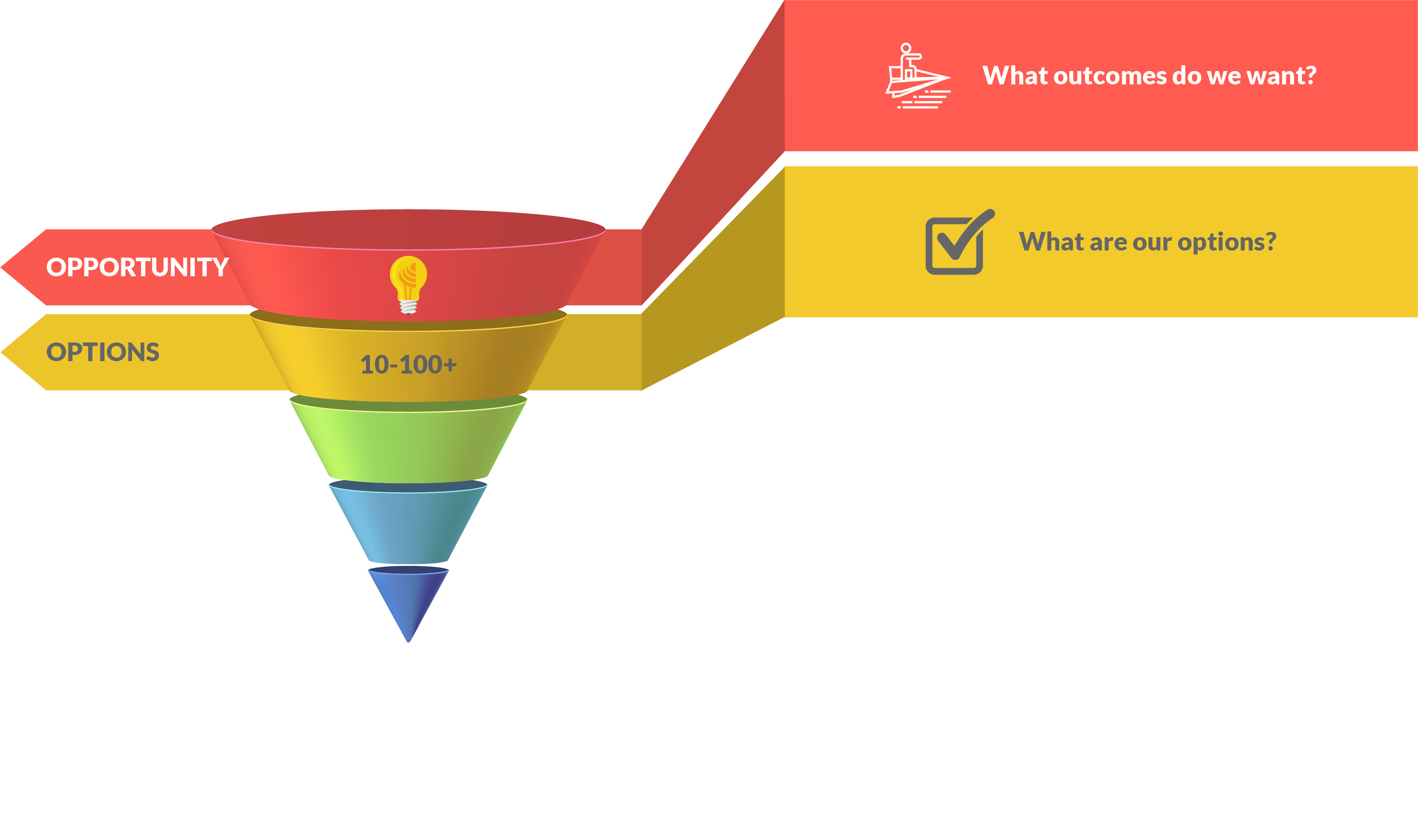
Initiation process
Notes:
Our good idea is probably not the only way we can achieve the outcomes defined by our opportunity; in fact there may be 10, 20, 100 or more different ways (projects) to achieve the same or closely related benefits.
By researching and brainstorming across our relevant stakeholder community, we should be able to arrive at a range of project solutions that traverse the sublime to the ridiculous.

Slide 7
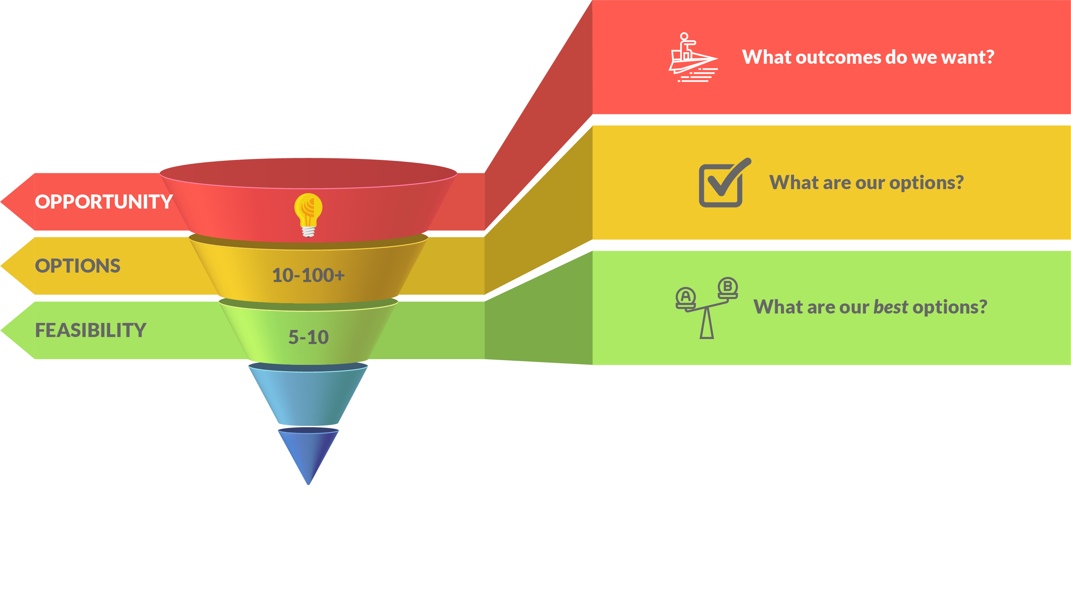
Initiation process
Notes:
Thinking critically about our broad of options, we should be able to reduce them to a handful (no more than 10) that really stand out.
These options can now be subject to a more detailed feasibility analysis at the hands of a more expert and/or interested group of stakeholders.
Ideally, we would like to arrive at no more than 3-4 options that we will subject to the more labour and cost intensive process of business case development.

Slide 8
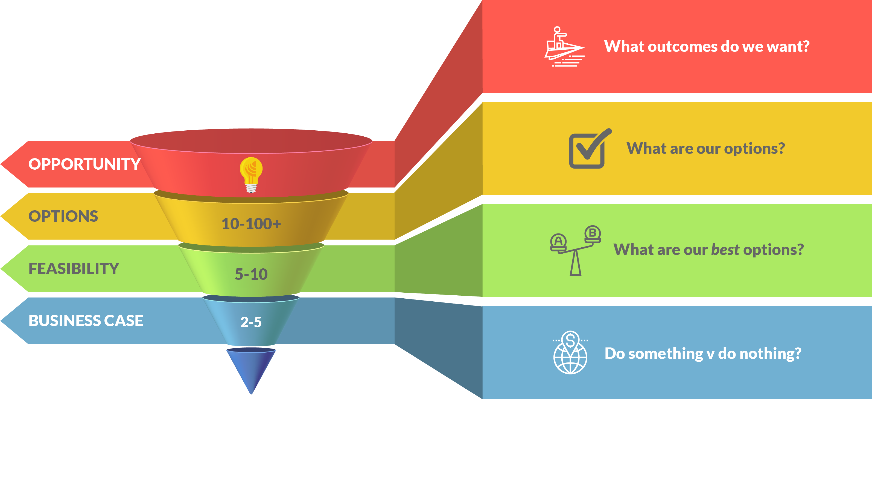
Initiation process
Notes:
The business case is currently the most under-valued tool in the project manager’s arsenal.
It not only compares the remaining, high-potential options against each other across a range of predefined criteria; it challenges the sponsoring organisation to consider the relative costs and benefits of doing nothing at all.
A good business case lays bare the decision logic for preferring one project option above all others, stipulates what project success should ultimately look like, and makes the final argument for investment.
As the specific, documented link between project outputs, their intended outcomes and the strategic objectives of the organisation, it will also guide future planning and delivery decisions around change.

Slide 9
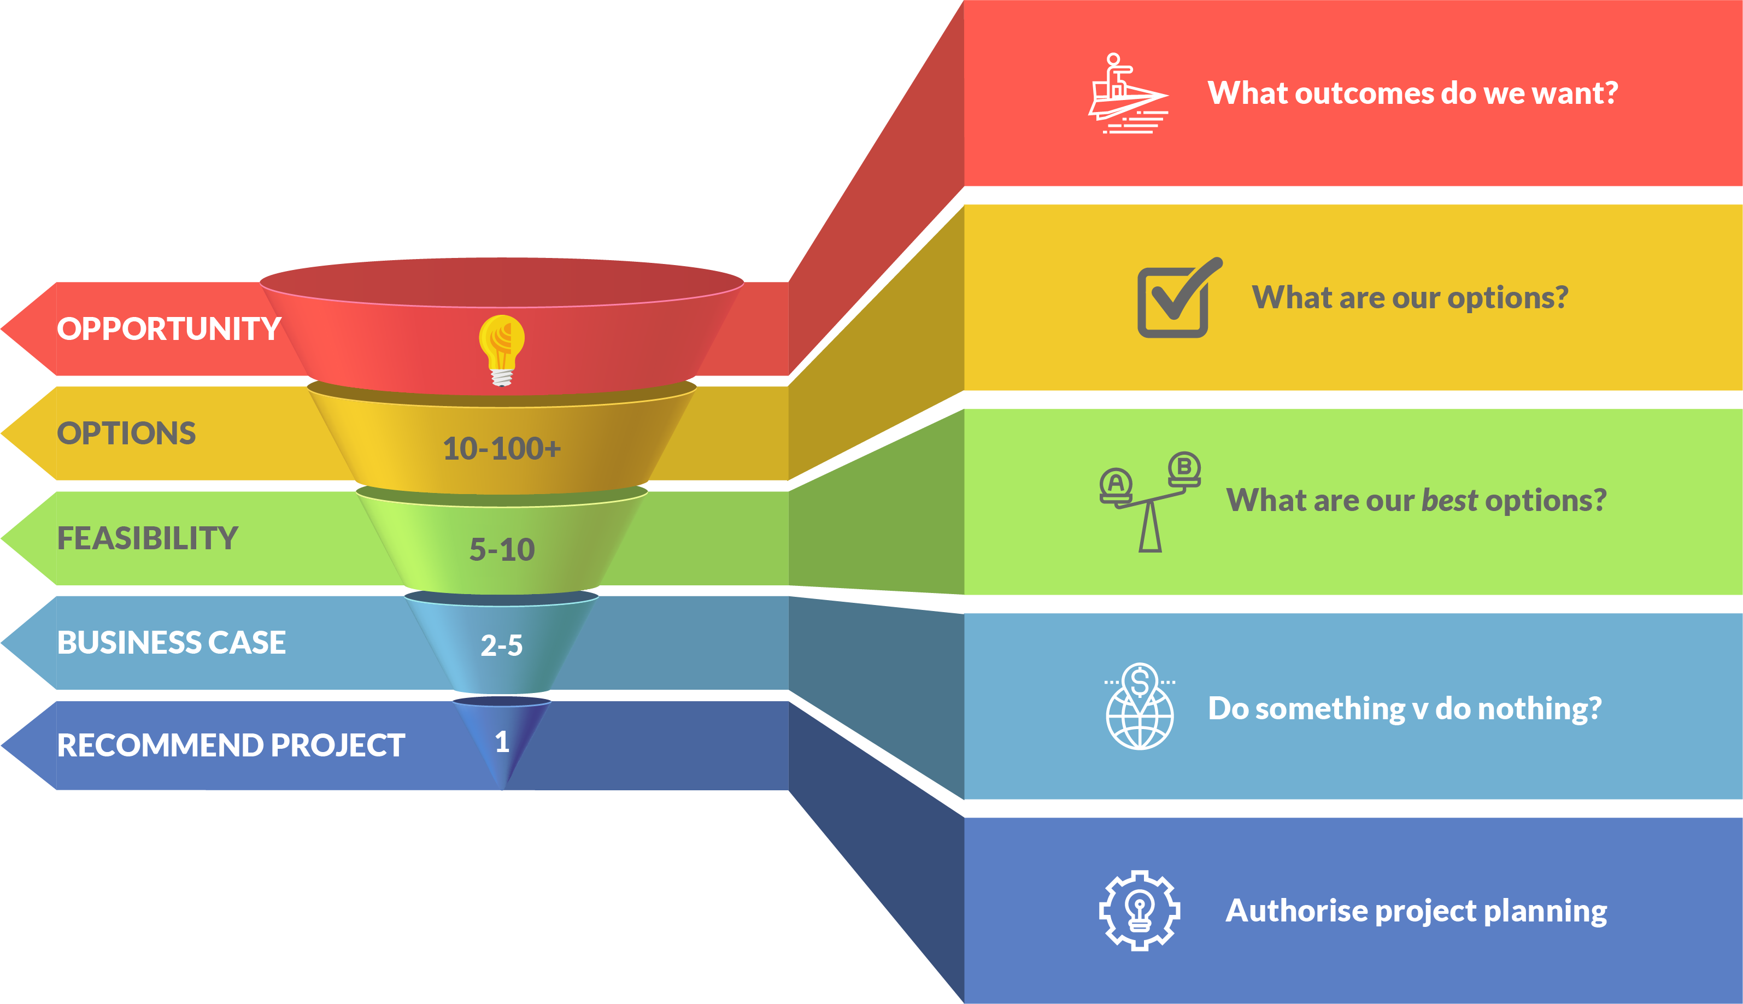
Initiation process
Notes:
In either short or long form, the business case ultimately recommends a course of action for the organisation or individual it is addressed to.
At their discretion, that organisation or individual can accept (or reject) the option proposed by the business case and authorise the commencement of planning this activity as a project.
This process is called chartering the project, and can be fast-tracked by the preparation of a simple project charter where it is felt that the development of a full business case is neither necessary nor appropriate.

Slide 10
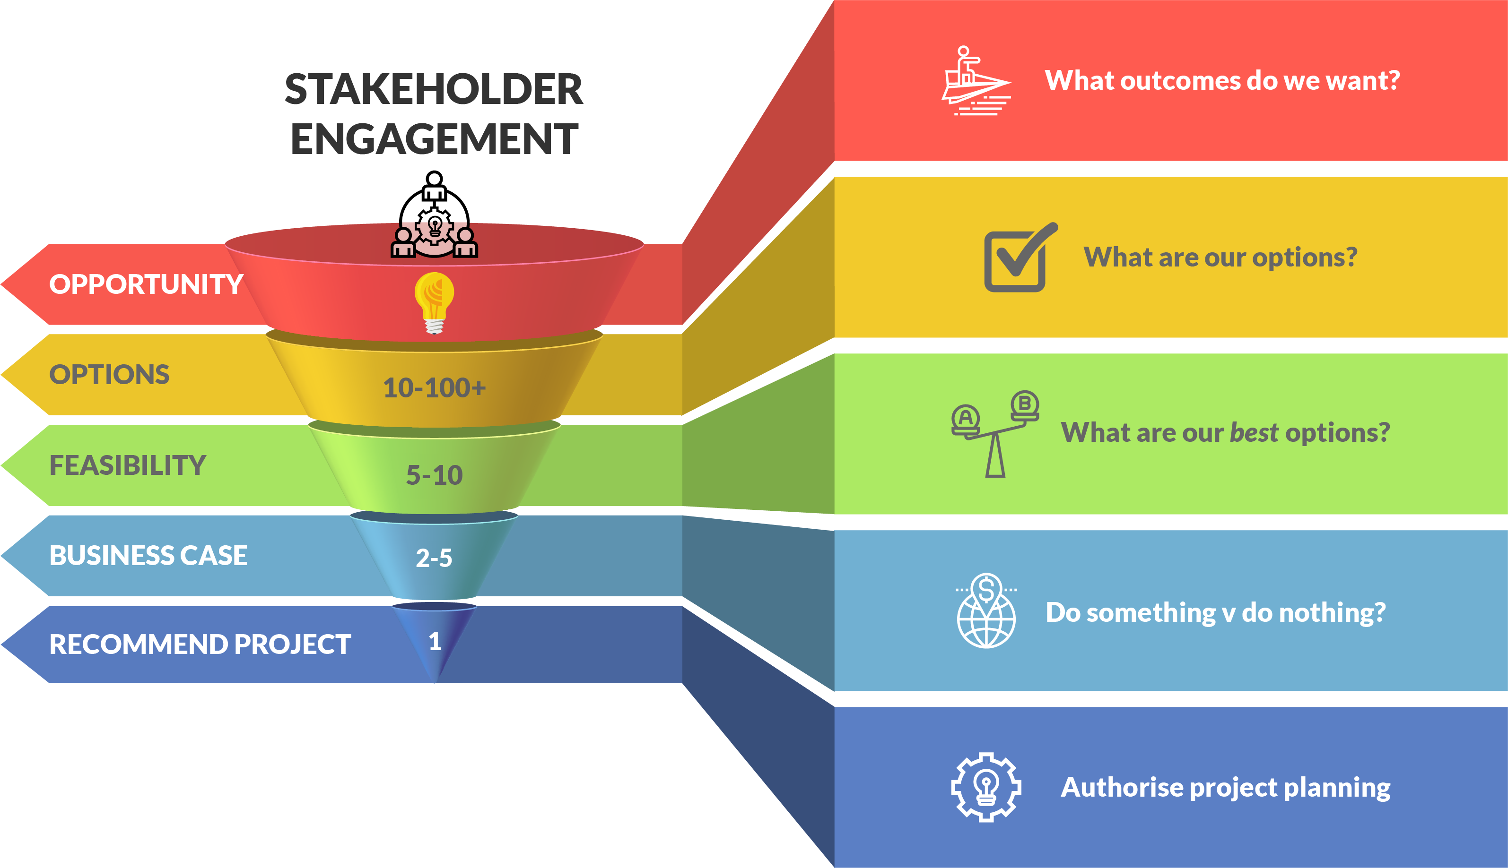
Initiation process
OPEN 3.1
Notes:
All of this depends on early, iterative and robust stakeholder engagement to ensure our assumptions are challenged and no opportunities are missed.

Slide 11
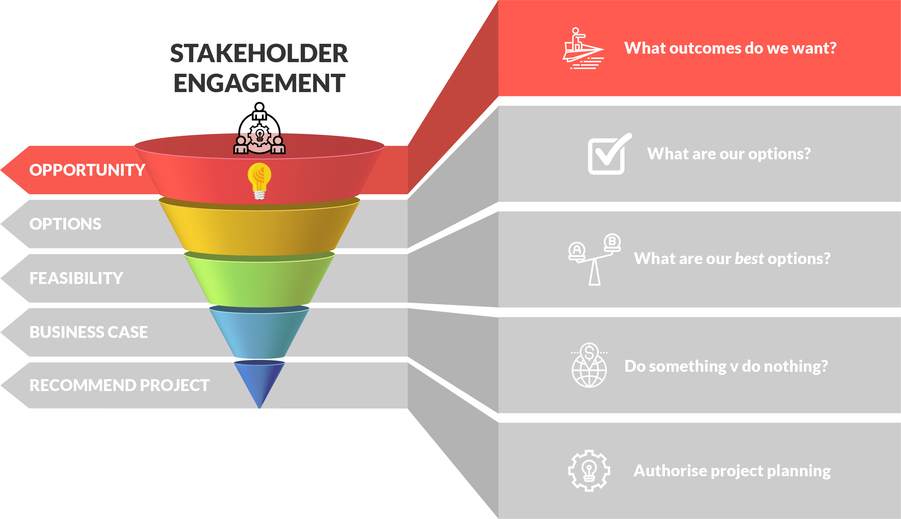
Opportunity definition
OPEN 3.1
Notes:
A project concept canvas is a simple, visual and effective way to define project opportunities.
The purpose of the concept canvas is to provide organisations with a low-cost, standardised way of comparing opportunities.
Stakeholders who identify opportunities are encouraged to put them forward for consideration using the listed fields on what is usually a one-page document.
Organisations use the concept canvas to make efficient and effective priority decisions about:
which opportunities to advance to more detailed (read: expensive) analysis
which opportunities need to go back for more conceptual development, and
which opportunities to drop (before any more time and money is invested in them).

Slide 12
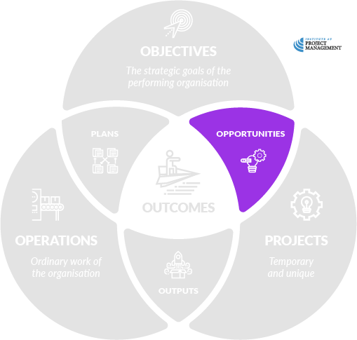
Current v ideal state
Notes:
When describing the opportunity, you should contrast the current state of affairs with an ideal future state.

Slide 13
Upgrade office technology
Notes:
You should also use positive phrasing in your description.
Instead of using the language of problems (for example, our office technology is terrible), start to up-sell your proposal (upgrade office technology).
After all, for every $1 million an organisation has to spend on projects, it probably has $10 million worth of good ideas!
Your idea will inevitably be competing with other proposals, so you need to make it stand out.

Slide 14
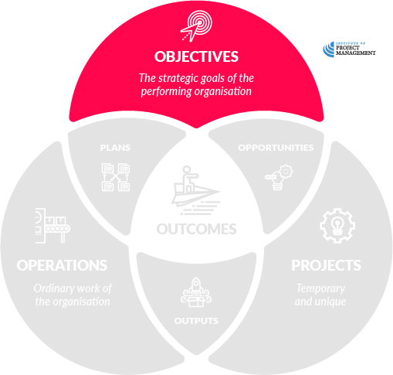
Upgrade office technology
Link to the objectives of the organisation paying for it
Notes:
Here is where you link opportunity (and outcomes, below) to the strategic objectives of the organisation you are presenting this to – the one you would like to pay for it!

Slide 15
Increase profit
Improve productivity
Enhance corporate culture
Improve customer satisfaction
Positive community contribution
Upgrade office technology
Notes:
As stated earlier, an organisation’s objectives can often be found in its strategic plan, or inferred from what it does on a day-to-day basis.
Objectives may also include cultural goals, such as values or behaviours that the organisation aspires to, or more detailed goals such as the key performance indicators (KPIs) set out in a department or team’s annual plan.
Explicitly reminding decision-makers of why this opportunity matters to the business is a great way of promoting the relative importance of your potential project.

Slide 16
Increase profit
Improve productivity
Enhance corporate culture
Improve customer satisfaction
Positive community contribution
Upgrade office technology
Notes:
Generic, sample objectives are shown here – although we’ve selected the one most aligned to our example, depending on your project you might see alignment with more than one.

Slide 17
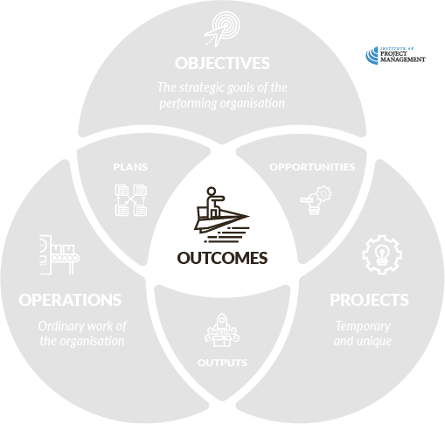
Increase profit
Improve productivity
Enhance corporate culture
Improve customer satisfaction
Positive community contribution
Upgrade office technology
What outcomes / benefits do we need to have?
Notes:
Instead of focusing on the project deliverables (outputs), turn your attention here to what outcomes or benefits the project will realise post-delivery.

Slide 18
Increase profit
Improve productivity
Enhance corporate culture
Improve customer satisfaction
Positive community contribution
Upgrade office technology
Improve productivity
Be scalable for growth
Integrate with existing technology
Notes:
In other words, instead of proposing a specific technology or solution, list here the benefits that upgrading the technology might bring.
It’s ok if you don’t capture every outcome on the concept canvas, or even if some outcomes end up being unrealistic.
It is far more important that you don’t lock yourself into a project / output solution at this stage (for reasons that will become obvious in this session).

Slide 19
Increase profit
Improve productivity
Enhance corporate culture
Improve customer satisfaction
Positive community contribution
Upgrade office technology
Improve productivity
Be scalable for growth
Integrate with existing technology
What outcomes / benefits would be nice to have?
Notes:
Not every outcome might be realistic for your opportunity.
Here you could list some ‘nice’ to have (as opposed to ‘need’ to have) benefits that may result from realising this opportunity.

Slide 20
Increase profit
Improve productivity
Enhance corporate culture
Improve customer satisfaction
Positive community contribution
Upgrade office technology
Improve productivity
Be scalable for growth
Integrate with existing technology
Enable new service channels
Reduce energy costs
Notes:
These outcomes would be great if our project can deliver on them, but if we can’t find a project solution that also achieves them, our project should still go ahead.

Slide 21
Increase profit
Improve productivity
Enhance corporate culture
Improve customer satisfaction
Positive community contribution
Upgrade office technology
Improve productivity
Be scalable for growth
Integrate with existing technology
Enable new service channels
Reduce energy costs
What is out of scope?
Notes:
Now you should start to explicitly address what is out-of-scope of your opportunity / solution.
In other words, what (possibly related) problems are we not trying to solve here?
Ruling things out-of-scope assists decision makers by clarifying what exact problem your solution is intended to address.

Slide 22
Increase profit
Improve productivity
Enhance corporate culture
Improve customer satisfaction
Positive community contribution
Upgrade office technology
Improve productivity
Be scalable for growth
Integrate with existing technology
Enable new service channels
Reduce energy costs
Office furniture
Telephones
Notes:
Here is where you would list things that people might try to sneak into the project that you don’t want or need. These could include:
Things that will blow your budget or timeline
Things that are very low priority and don’t add in a meaningful way to the benefits
Things that are being (or should be) delivered by other projects

Slide 23
Activity 3.1
OPEN 3.2
Brainstorm benefits before you decide whether they are ‘must’ or ‘might’ have outcomes for your solution!
There are 250 staff in our organisation
The boss wants to recognise and reward the achievements of the team over the last 12 months
Prepare a project concept canvas for this opportunity
https://open.institute.pm/free-project-management-resources/
Notes:
Be clear that at this stage we don’t care what you do to recognize and reward the staff (eg bonuses).
What we are interested in is why you would recognize them in the first place.

Slide 24
Increase profit
Improve productivity
Enhance corporate culture
Improve customer satisfaction
Positive community contribution
Upgrade office technology
Improve productivity
Be scalable for growth
Integrate with existing technology
Enable new service channels
Reduce energy costs
Office furniture
Telephones
12 24
now March
Notes:
Be realistic about when and by when you need this opportunity to occur.
Although you might feel the need to create a sense of urgency by explicitly naming start and end dates, being too rigid this early in the project development phase may alienate potential backers.
Instead, propose a reasonable time-frame for project delivery – between 6-12 months, as an example – making doubly sure you leave enough time for the decision-makers to go through the necessary approvals process.

Slide 25
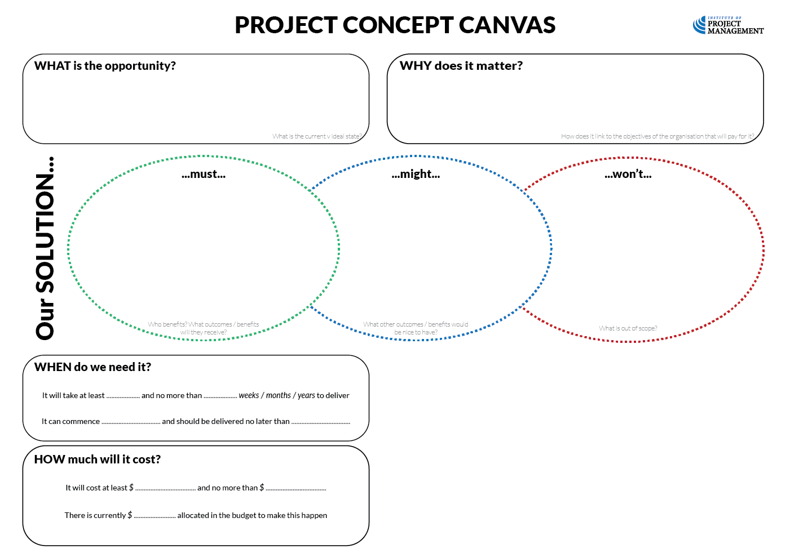
Increase profit
Improve productivity
Enhance corporate culture
Improve customer satisfaction
Positive community contribution
Upgrade office technology
Improve productivity
Be scalable for growth
Integrate with existing technology
Enable new service channels
Reduce energy costs
Office furniture
Telephones
12 24
now March
40,000 75,000
50,000
Notes:
As with time, provide a range of cost estimates that keeps as many options open as possible.
Ideally you should propose a cost estimate within ±30-50% of a median price.
For example, the project should cost between $40,000 and $75,000.
If you under-estimate here, you may not have enough money later to realise your opportunity; however, if you over-estimate potential costs, the opportunity may be viewed as too expensive to pursue.
Organisations might also put aside money in their annual plans for as yet undefined projects – if that is the case, you should document the amount here.
Sometimes there is a big difference between what was allocated and what the project will actually cost!

Slide 26
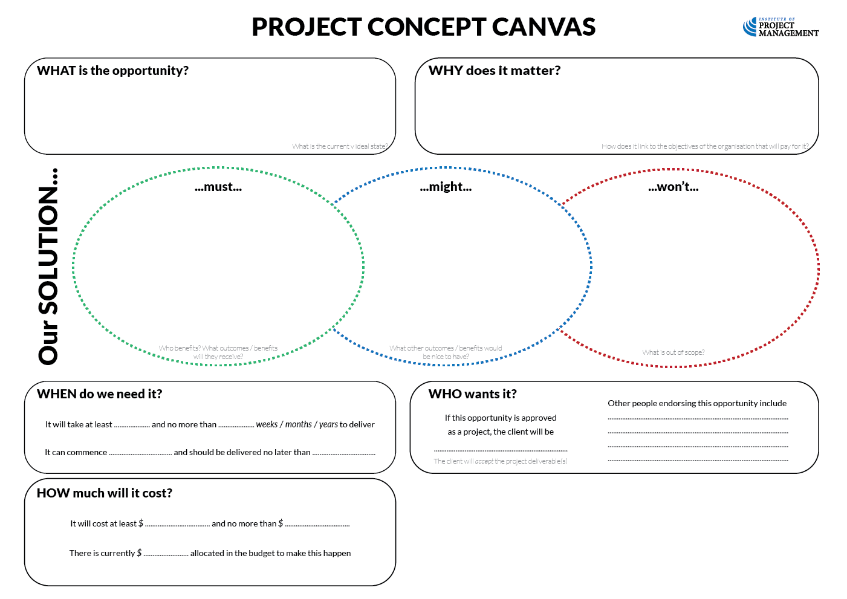
Increase profit
Improve productivity
Enhance corporate culture
Improve customer satisfaction
Positive community contribution
Upgrade office technology
Improve productivity
Be scalable for growth
Integrate with existing technology
Enable new service channels
Reduce energy costs
Office furniture
Telephones
12 24
now March
Daphne P.
Elmer F.
Jane S.
40,000 75,000
50,000
Notes:
Alright! Stakeholders!! You know what to do here :)
It is firstly important to note who is the client requesting the project (in other words, the person who will accept the final project deliverables).
You can then start to list some of the high power / high interest stakeholders who are supportive of your project.
Although the list does not need to be comprehensive at this early stage, you may want to reference your organisation’s stakeholder taxonomy to ensure none of the major players are missed.
A robust list of supportive stakeholders should start to give your investors confidence that the opportunity is achievable and that you are the right person to see it through – especially if you have had some initial conversations with them.

Slide 27
Discussion
OPEN 3.3
What are the risks to our organisation of this opportunity?
The risks to project delivery are analysed in the project plan
Notes:
Organizational risk will not only determine our next steps in initiation, it will guide the level of detail we apply to our project planning, delivery and close processes.
Risk factors include:
Project cost – greater cost = greater exposure (risk) if the project fails
Project time – short projects with flexible deadlines are less risky than long, complex projects with fixed deadlines
Confidence in our time and cost estimates – wild guesses are riskier than more precise figures
A history of successful delivery of like projects is less risky than novel projects
Impact – a project with lots of dependencies, broad organizational impact and major health and safety risks is riskier than stand-alone, local and safe projects
Working with new, untested contractors and stakeholders is riskier than working in well established relationships
Reputation - High profile projects (with lost of high power/interest stakeholders) are riskier than projects of minor interest only
Project risk includes things like rain delaying our schedule, price over-runs etc

Slide 28
Risk profile – cost

Slide 29
Risk profile – time

Slide 30
Risk profile – scope

Slide 31
Risk profile – impact

Slide 32
Risk profile – stakeholders

Slide 33
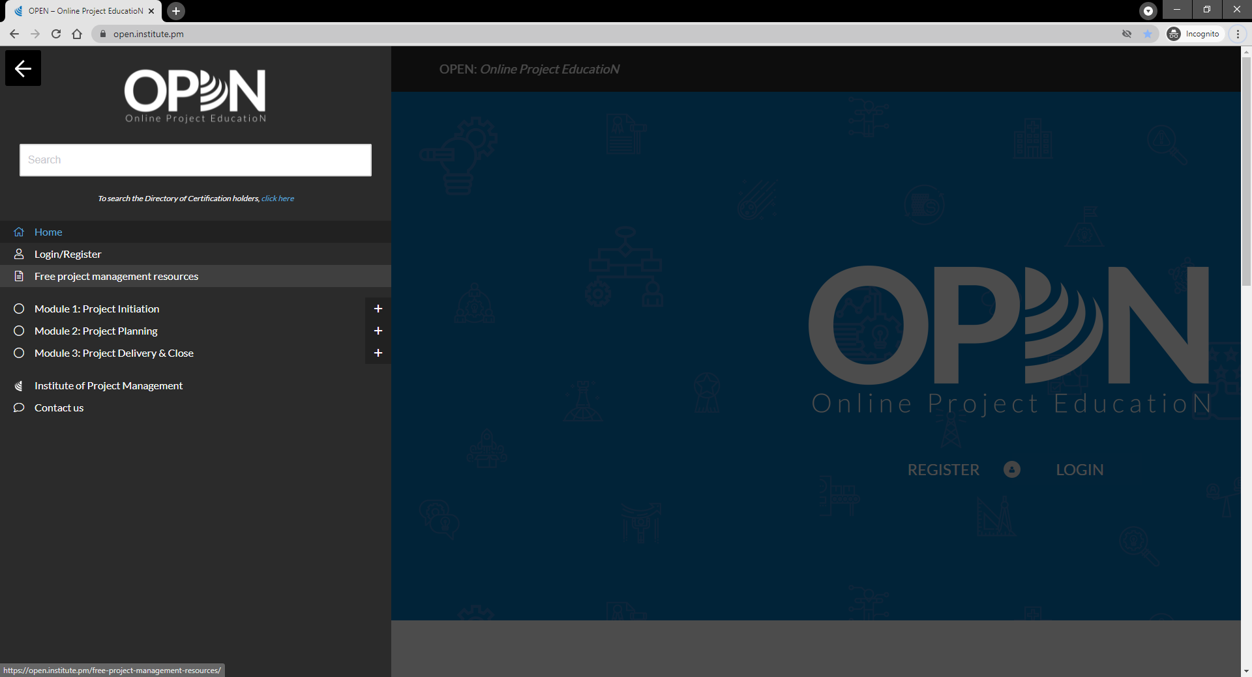

Slide 34
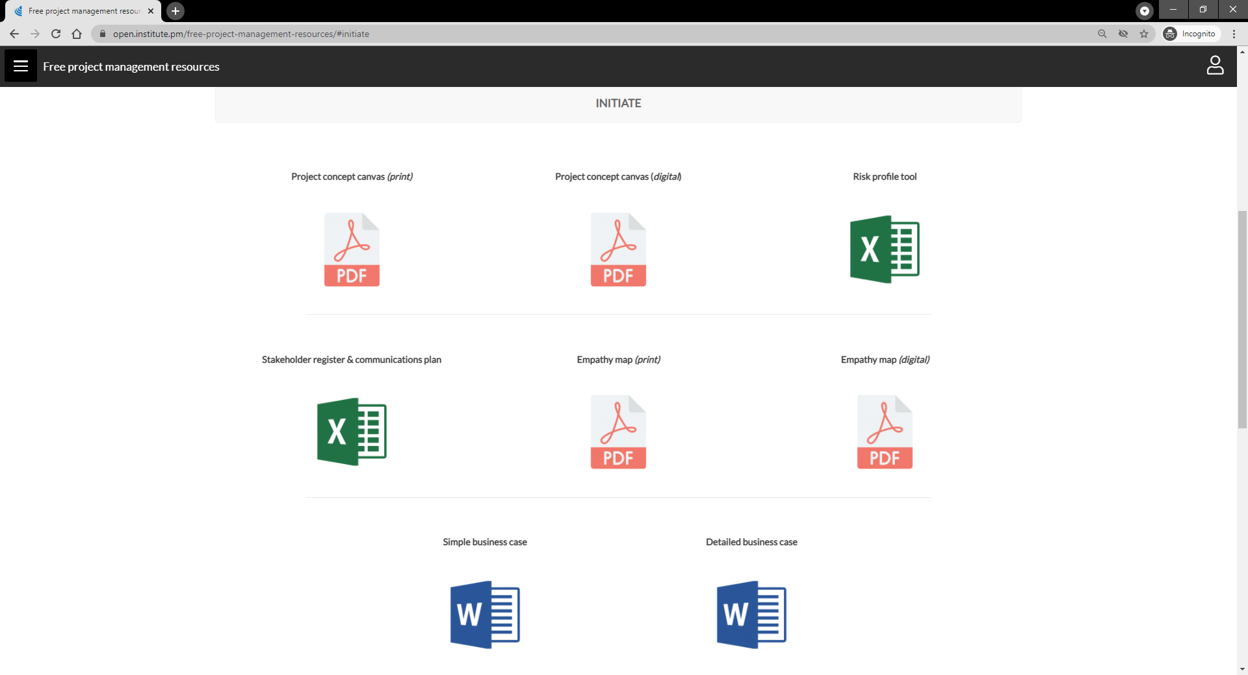
Notes:
Note the empathy map is for inclusion in our course on design thinking

Slide 35
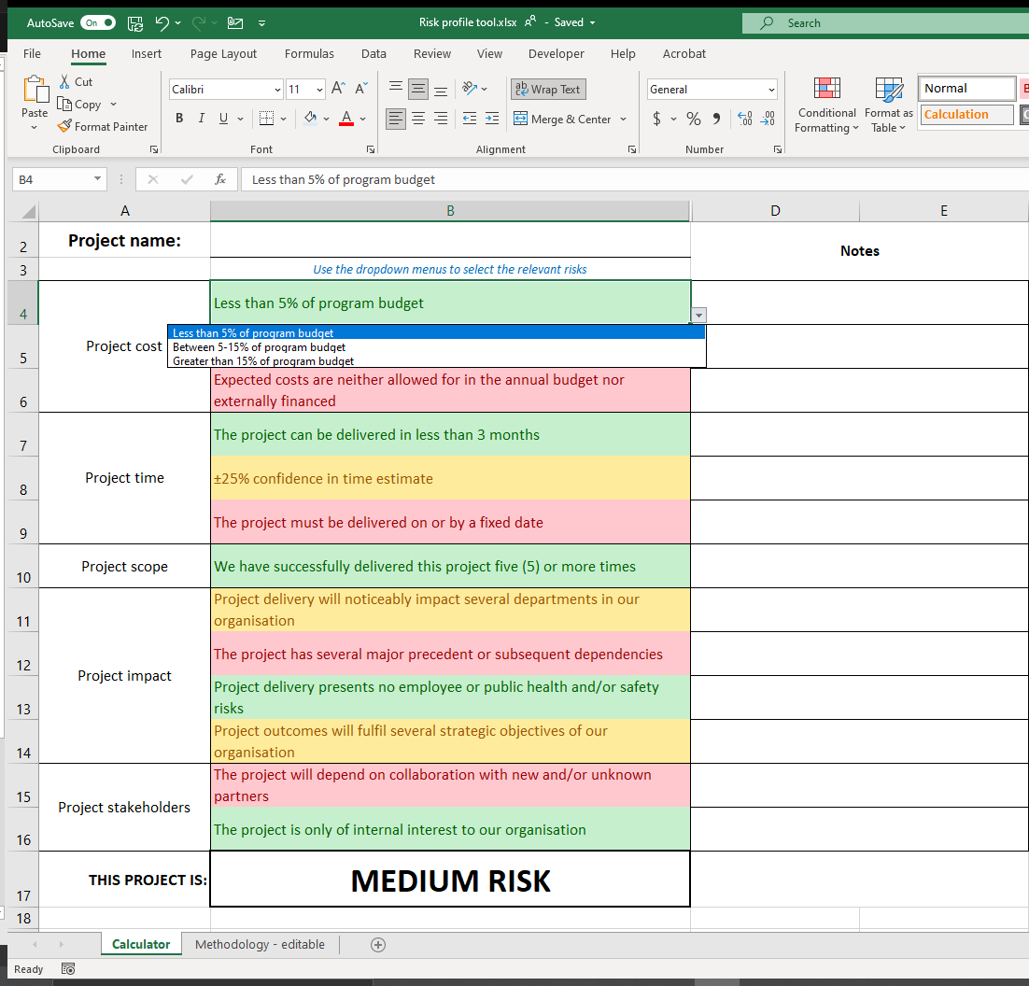
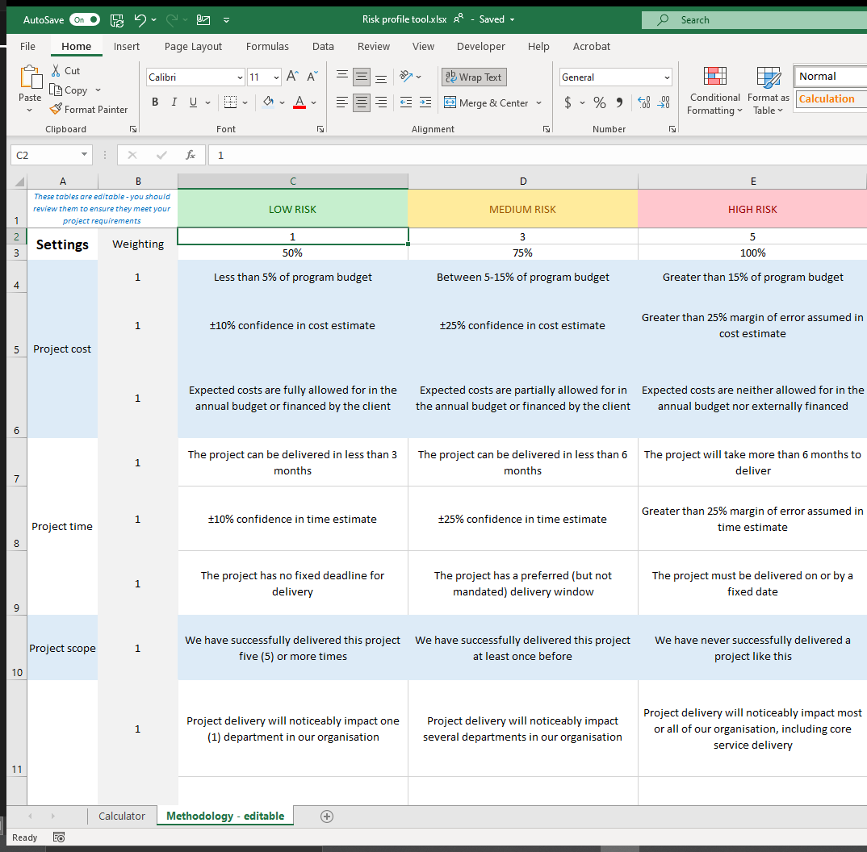
https://open.institute.pm/
free-project-management-resources/

Slide 36
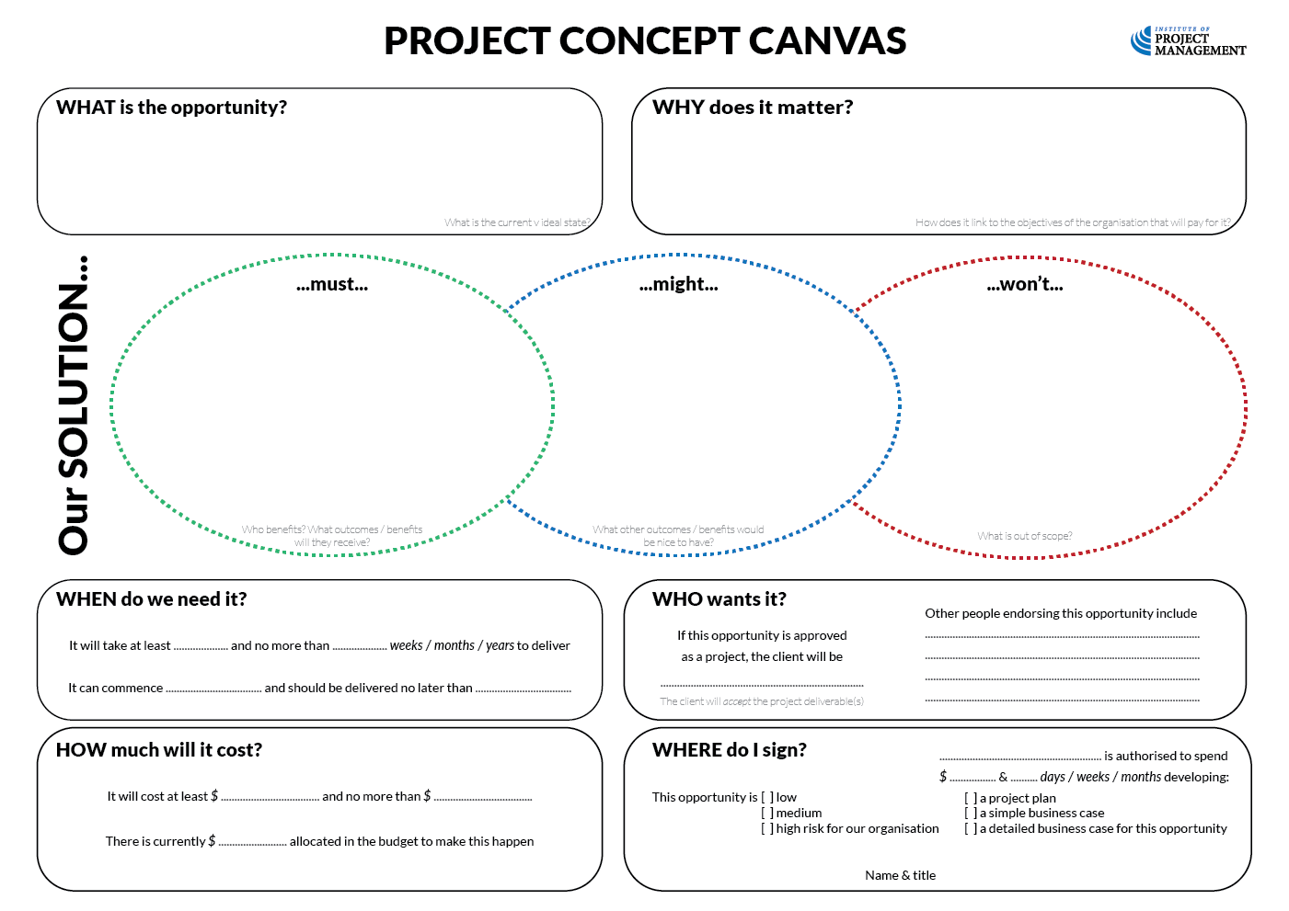
OPEN 3.2
Increase profit
Improve productivity
Enhance corporate culture
Improve customer satisfaction
Positive community contribution
Upgrade office technology
Improve productivity
Be scalable for growth
Integrate with existing technology
Enable new service channels
Reduce energy costs
Office furniture
Telephones
12 24
now March
Daphne P.
Elmer F.
Jane S.
Wendy Q.
1,000 10
40,000 75,000
50,000
✔
✔
Albus D.
Notes:
If your opportunity is accepted, an approved decision-maker will sign on the dotted line.
Don’t get too excited, though – your project is not approved just yet!
Depending on the level of risk attached to the opportunity (something we look at in the next topic), this approval authorises you or an in-house business analyst to prepare an appropriately detailed business case for more comprehensive and formal approval.
This approval is necessary, as the preparation of a robust business case depends on a significant commitment of organisational resources.
These resources should only be expended on opportunities that pass this first semi-formal test of the proposal’s value.
Yet even if a business case is not required, acceptance of the opportunity would only authorise commencement of the planning phase; again, with an appropriate commitment of time and money.
Listing these resources and the person responsible for their use completes the final section of the concept canvas.

Slide 37
Notes:
Note the empathy map is for inclusion in our course on design thinking

Slide 38
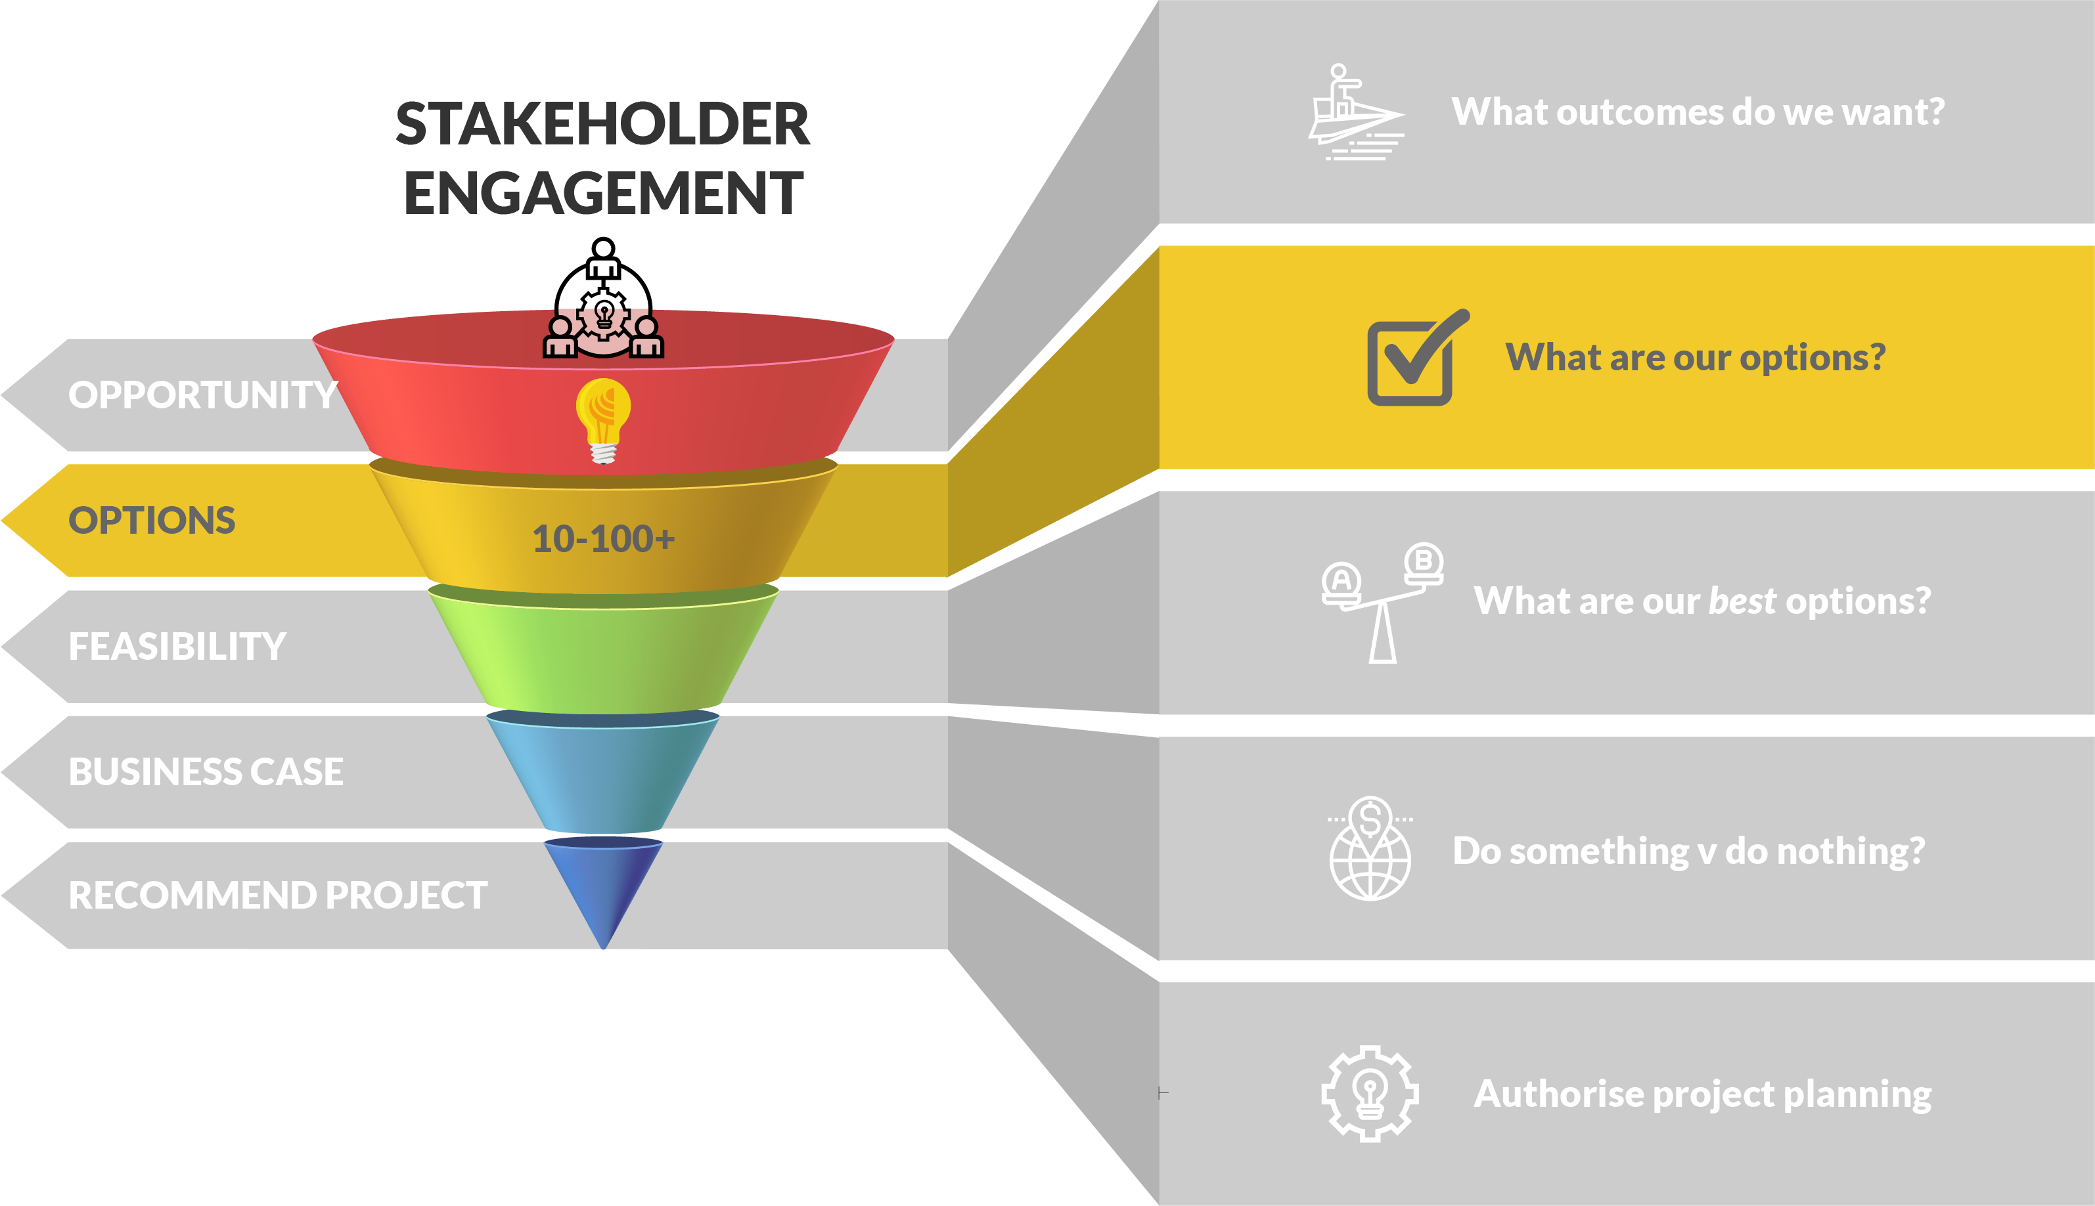
OPEN 3.4
Options identification
Notes:
It is all too easy to skip straight from good idea to project.
After all, good ideas often come to us as well-formed project solutions.
For example, we might know that the best way to recognise and reward high performing project managers is to give them a cash bonus.
Yet is this really the best way to achieve our intended outcomes – outcomes we defined in our project concept canvas?
Is it the most cost-effective solution? And if it is, how do we know?
How do we prove it?
Before we start digging holes or writing code or booking talent, our project solution needs to be critically evaluated against a range of options.
It is also arrogant to assume that yours is the only mind that can turn to this problem. Given the same time and money, someone else may arrive at a more elegant solution.
And even if they don’t, they may believe their solution is better, unless you can prove otherwise.
Even when acting under a contract for services or just following the boss’s direction, you should always aim to identify and consider a range of options that maximise the project’s potential benefits.

Slide 39
OPEN 3.4
Creative thinking
Options identification
Critical thinking
Options analysis
Generating ideas
Reflection
Brainstorming
Secondary sources
Organising ideas
Lists
Mind-maps
Flowcharts
Threshold feasibility
Is this something people want?
Is this something we can do?
Is this something we can afford?
Is this something we are allowed to do?
Notes:
When it comes to identifying options, it is important that we are as creative in our quest for ideas as we are critical in our evaluation of them.
If we are insufficiently creative, we might miss genuine opportunities to save time and money or add value; whereas if we are not critical enough, we can waste effort or increase the risk of (expensive) error.
Creative thinking is the process of generating and organising our ideas (options) in a way that is meaningful and can be acted on.
Reflection – rely on your own observation / experience to come up with options
Brainstorming – consult with others
Secondary sources – research on Google, industry publications etc
Lists, mind-maps and flowcharts are examples of different ways to present and visualize data – we will show PM examples of these later in the course
Critical thinking is the process of reviewing all the options, ideas, or outcomes of our creative processes, and objectively arriving at an optimal decision.
Market analysis answers the question, “Is this something people want?”
It is assumed that the governing question – “Are these outcomes something the organisation wants?” – has been answered in the affirmative by giving the green light to proceed past the opportunity definition (concept canvas) stage.
Now we need to test the demand for each of the options identified.
If you cannot substantiate through research adequate demand for your proposed product or service, then your project option is not feasible.
Some of the questions that might be part of your analysis include:
Who is going to want this deliverable?
What do these potential users have in common?
How many of them are there?
What equivalent products / services already meeting this demand?
How are these factors likely to change in the future?
Importantly, we must be able to evidence demand in some way.
This allows decision-makers to apply the appropriate degree of confidence to our estimates.
Estimating error is something we will consider in much more detail as we go through this course.
Technical feasibility asks, “Is this something we can do?”
In other words, do we have the organisation capability and capacity to supply this option?
The cost and availability of skills, technology and resources are of critical importance to the feasibility of our project options.
Where there is a level of uncertainty about the legal implications of an option, you should also stop to ask, “Is this something we are allowed to do?”
Consulting with relevant regulatory agencies or legal experts may be necessary before proceeding.
You might also have internal policy constraints. For example, your employer or sponsor may have an intellectual property policy that prevents you sharing certain trade secrets with third parties.
If such knowledge-sharing is necessary to the success of your project, it may not be feasible.
It may finally be useful to conduct a basic financial feasibility assessment of the project; in other words, “Is this something we can afford to do?’”
In other words, do we have the working capital needed to deliver this project? If not, how likely is it that we can afford it?
Importantly, at this stage we are only assessing high-level financial feasibility with very rough estimates – we will spend a lot more time and effort examining this with our remaining business case options and again in project planning.

Slide 40
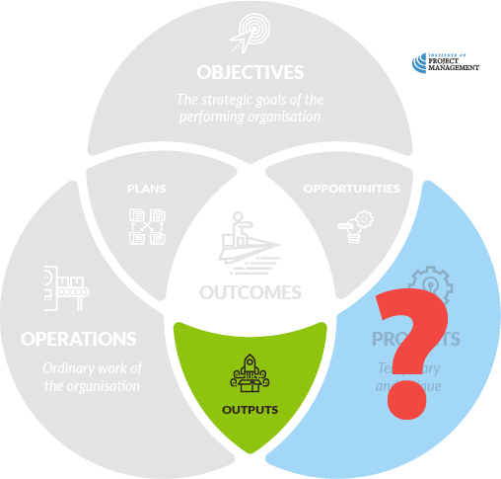
Activity 3.2
OPEN 3.4
The boss wants to give everyone a $500 bonus, but is this the only way to achieve the intended outcomes!?
Identify at least five (5) other ways to realise the outcomes identified in the project concept canvas
Notes:
Look for alternatives within alternatives
For example, what impact would a $5,000 bonus have? $50,000?
Considering combining ideas to arrive at your top 5

Slide 41
Notes:
Before breaking, ask students if there are any questions about what has been covered in the session so far.
Once answered, encourage students to stand up, get a drink, go outside and stretch.
If they are on Zoom, tell them to turn their camera and microphone off (you do the same)!
Make sure you tell them the precise time you will be restarting (eg 10:10am)
Don’t check your email – take a proper break!!

Slide 42
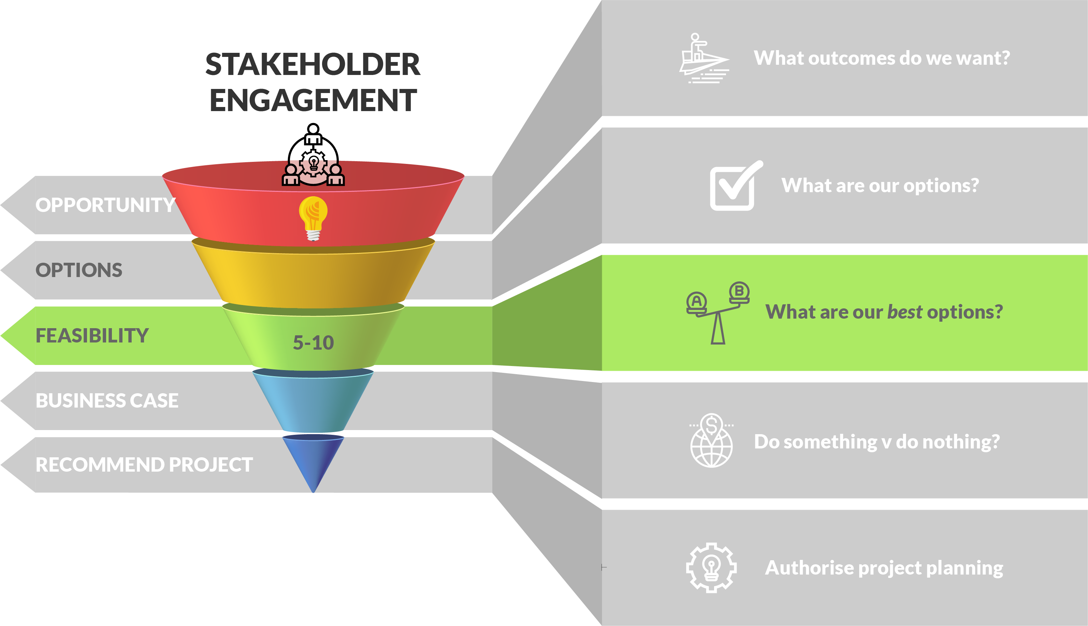
OPEN 3.5
Feasibility analysis
Notes:
Feasibility analysis is often conducted as a two step process.
First, we need to establish threshold feasibility.
This might involve asking some simple yes/no questions of each option along the lines described in the last lesson:
Is this something people want? Yes
Is this something we can do? Yes
Is this something we are allowed to do? Yes
Is this something we can afford to do? No
Taking this approach, we should be able to very quickly discard those options that are not worthy of further consideration.
To some extent, we almost certainly did this intuitively as we were developing our list of options; nonetheless it is always a useful exercise to conduct before proceeding to the next step.

Slide 43
Relative feasibility
OPEN 3.5
Questions to ask…
Do people want Option A more than Option B?
Is it easier for us to produce Option A than B?
Is Option A more affordable than Option B?
Other methods to use…
Pros and cons
SWOT analysis
Notes:
The remaining options are then analysed for their relative feasibility.
This may involve asking similar questions of each option, only this time we are comparing options relative to each other:
Do people want Option A more than Option B?
Is it easier for us to produce Option A than B?
Is Option A more affordable than Option B?
A useful tool for this purpose is the widely employed SWOT analysis technique.
For each option that satisfies our criteria for threshold feasibility we can ask, what are its strengths, weakness, opportunities and threats.
In other words, from our organisational perspective, what are the pros (strengths) or cons (weaknesses) of delivering each alternative as a project?
Similarly, from the market’s point of view, what are the opportunities each project might exploit versus the risks that it might expose us to?

Slide 44
Activity 3.2 (continued)
Rank the feasibility of the options you identified
Notes:
Using the boxes on the assessment pdf, students should rank their options from 1-5
Note that the top 2-3 will be taken to business case, so this isn’t final!
In the discussion, get them to reflect on the criteria they used to rank and the process they followed as a group

Slide 45
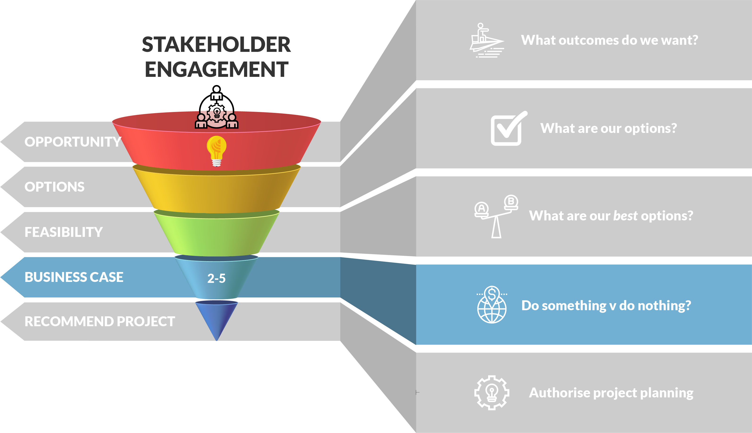
OPEN 3.7
Business case
Notes:
The business case documents the rationale for a project, justifying investments of time and money in pursuit of an opportunity.
Importantly, it challenges the the sponsoring organisation to weigh the merits of doing something (from one or more project options) versus doing nothing and continuing to invest organisational resources into other activities.
By definition, a ‘business case’ that does not evaluate at least one project solution against the null option (doing nothing) is only a project charter.
Even if, as the project manager, you do not prepare the business case – for in many organisations the business case is prepared by the project client or a dedicated business analyst – you should be a key contributing stakeholder in its development or able to critically interpret its findings once they land on your desk.
As you will see, the business case affords our one and only opportunity to benchmark the outcomes intended by the project, linking them to the strategic priorities of the sponsoring organisation.
Without this context, projects can often flounder or fail to meet stakeholder expectations, especially in the face of change.

Slide 46
Business case
For each option (including do nothing):
What are the project (output) costs?
What will our on-going, operating (outcome) costs be?
What other (non-financial) impacts can we expect?
What are the risks to our organisation?
Which is the best / recommended option?

Slide 47
Estimating project (output) costs
How much will it cost to deliver each option as a project?
Analogous method
How much did a similar project cost?
Statistical methods
Mean, median, mode
PERT three-point estimates
Pro rata (parametric)
Consensus method – experts must agree!
Independent cost assessment (quantity surveyor)
Notes:
A good starting point for estimation might be reviewing past project plans or databases that might provide reliable information on past time and cost performance.
We can also consult a variety of other current sources, including supplier catalogues, quotes and good-old Google.
By applying analogous logic, even if we cannot get accurate data on precisely what we want, we can make ‘like-for-like’ assumptions.
For example: If it costs $17 for a tin of red paint, it will probably cost the same amount for a tin of blue paint (of the same quality).
Simple statistics
When working with a range of known data (or expert estimates), we frequently rely on these basic statistical methods to determine the most likely amount:
Mean (the average score)
Median (the ‘middle’ score)
Mode (the most frequently occurring score)
For example: We polled our stakeholders and they arrived at the following cost estimates for a tin of paint: $10, $10, $12, $15, $18.
The mean (average) = ($10 + $10 + $12 + $15 + $18) ÷ 5 = $65 ÷ 5 = $13
The median (‘middle’) = $12
The mode (most frequently occurring) = $10
Old-school project managers will also refer to three-point estimating, which is a weighted average technique that originates from the PERT project methodology.
Parametric estimates
Parametric estimates take uniform (or even reliable analogous) information and apply a consistent multiplier.
For example: if it takes one hour to paint one room, then it should take five hours to paint five rooms of an equivalent size.
More sophisticated parametric models might also apply learning curves that calculate the time gains that can be achieved when specific activities are repeated a number of times.
For example: if it takes one hour to paint one room, then it should take four hours to paint five rooms of an equivalent size, because we will get better at painting over the course of the task.
Consensus method
Although we might consult or involve our expert stakeholders, combining their specialist knowledge to arrive at a range of estimates; the consensus method demands they agree on what the 'true' estimate (or range) might be.
In other words, instead of applying a statistical formula to their estimates, our experts are challenged to justify, defend and affirm their estimate through collaboration.
Although this method is more subjective (and time-intensive), with the right people in the room you can achieve very reliable estimates.
For example: your painting experts might discover hidden or latent conditions in the room that demand a different approach.
Independent cost assessment
On options where there is a high level of complexity, that are particularly specialised, or where the outputs are unique in that they can’t be templated, you may also like to consider getting an independent cost assessment.
An independent cost (or time) assessment can either review and validate your existing estimates, or directly source estimates using methodologies or expertise that is not ordinarily available to you.
The principal role of a quantity surveyor, for example, is to independently assess the materials, time and labour costs of construction projects.
As with all estimation methods, independent assessments can be done at any time during the project’s life, but their optimum value is realised when they are conducted during the initiation or planning phases.

Slide 48
Operating (outcome) costs
OPEN 3.7
Ongoing costs
Occasional costs
Infrastructure
Rent, power, telecoms, water
Labour and materials
Routine maintenance
Interfaces (eg IT)
Compliance and insurance
New user training
Major repairs
Upgrades
Decommissioning
Also known as the Total Cost of Ownership (TCO)
Notes:
For project outputs that are delivered or sold on to an external client, ownership costs are usually limited to service agreements and warranty claims.
For project outputs that are retained by the performing organisation, such as new machinery, networks or infrastructure, operating (or on-going) TCOs are listed in the first column.
These are often annual costs that are multiplied by the number of years the project solution will remain in place (the project output’s useful life).
Occasional (or strategic) TCOs that could also be reasonably (if less reliably) forecast include those listed in the second column.
Strategic TCOs are sometimes called ‘lumpy’, in that their occasional, ad hoc occurrence means they cannot be smoothly apportioned over the life of a project.
It is also important to note that operating and strategic TCOs may increase over time as the solution deteriorates.
Strategic TCOs are added to operating TCOs to estimate the total cost of ownership.
Note too that whereas the ‘do nothing’ option has no project costs (because there is no project output), its TCOs may be quite prohibitive!

Slide 49
Activity 3.3
OPEN 3.7
A new car costs $20,000 to purchase and $5,000 per year to operate
A second-hand car costs $5,000 to purchase and $10,000 per year to operate
Which is the better option over two (2) years?
Which is the better option over four (4) years?
Notes:
Give them no more than 5 minutes to do this activity in groups – at least one person in each group should be able to guide the others to a quick resolution.

Slide 50
Activity 3.3 – answer
Two (2) years | Project | Operating | TCO
New car | $20,000 | $10,000 | $30,000
Second-hand | $5,000 | $20,000 | $25,000
Four (4) years | Project | Operating | TCO
New car | $20,000 | $20,000 | $40,000
Second-hand | $5,000 | $40,000 | $45,000
Notes:
This activity demonstrates the relationship between output (project) and outcome (ownership) costs.
Importantly, the PM doesn't care about outcome costs or benefits – their KPI is project time, cost and scope.
Initiation is the only place we consider this, so we better get it right!

Slide 51
Discussion
OPEN 3.6
What are the potential consequences of under-estimating?
What are the potential consequences of over-estimating?
How accurate do we need to be in the business case?
Notes:
Like all project documents, the quality of the business case depends upon the quality of the data that informs it
This, in turn, depends on the assumptions and estimates made by its author.
If you under-estimate the time and resources required to deliver a task or project, then (as per the triple constraints) you may have to sacrifice either scope or quality to get the project delivered.
This may be difficult to explain to stakeholders, especially if you have a fixed budget and/or delivery date.
Conversely, if you over-estimate the time or costs required, you penalise the organisation by locking away valuable resources that could be spent on other projects or operations.
Even though it might be your best intention to return unspent requirements, Parkinson’s Law suggests that you will still find a way to spend them!
Alternately, at the initiation stage, your project may be rejected on the grounds that it will take too long or be too expensive.
If you are tendering competitively for project work (even within your organisation), this means your over-estimate could cost you the job.
Deliberately over-estimating time or costs is a technique colloquially called padding, and we will discuss the strategic risks of this later in the course.
For now, though, at the business case level, we would like to be as accurate as possible in estimating the time and costs required to deliver each of our three, four or five identified options.

Slide 52
Discussion – answer
How accurate do we need to be in the business case?
-20%
-10%
Actual
+10%
+20%
Business case
Notes:
It is widely held that a 20 percent margin of error is acceptable at this stage; however, your organisation may have its own policy in this regard.
Plus or minus 20% means that we will tolerate our business case cost estimates being 20% ‘wrong’ either way, but any more than that is considered unreliable for decision-making.
Now 20% seems like a big margin of error; however, keep in mind that all we are doing at the business case level is comparing options so as to arrive at a preferred project solution.
When we take this option to project planning – the next stage in the project’s life – we will revisit our cost estimates and refine them to within ±10%.
However this is a much more detailed (that is, expensive to undertake) process, and more effort than it is worth for business case decision-making, as we shall see.
Note, though, that 20% margin of error is a refinement of the ±30-50% we were happy to accept at the opportunity definition / project concept canvas stage.

Slide 53
Other (intangible) impacts
OPEN 3.8
Knowledge and/or skills (which should improve productivity)
The brand (reputation) of our organisation and/or client
Stakeholder networks and relationships
Advantage over competitors
Corporate culture
Community well-being
The physical world.
Notes:
It is reasonable to expect the overall impact of a project to be 'worth' the investment costs.
Yet for many projects – especially those in government and the not-for-profit sectors – there are no direct financial returns.
Indeed, not every impact– nor even the vast majority of impacts for some projects – can be priced.
These impacts are the non-monetary (intangible) outcomes delivered by a project, and can include positive or negative changes to the things listed here.

Slide 54
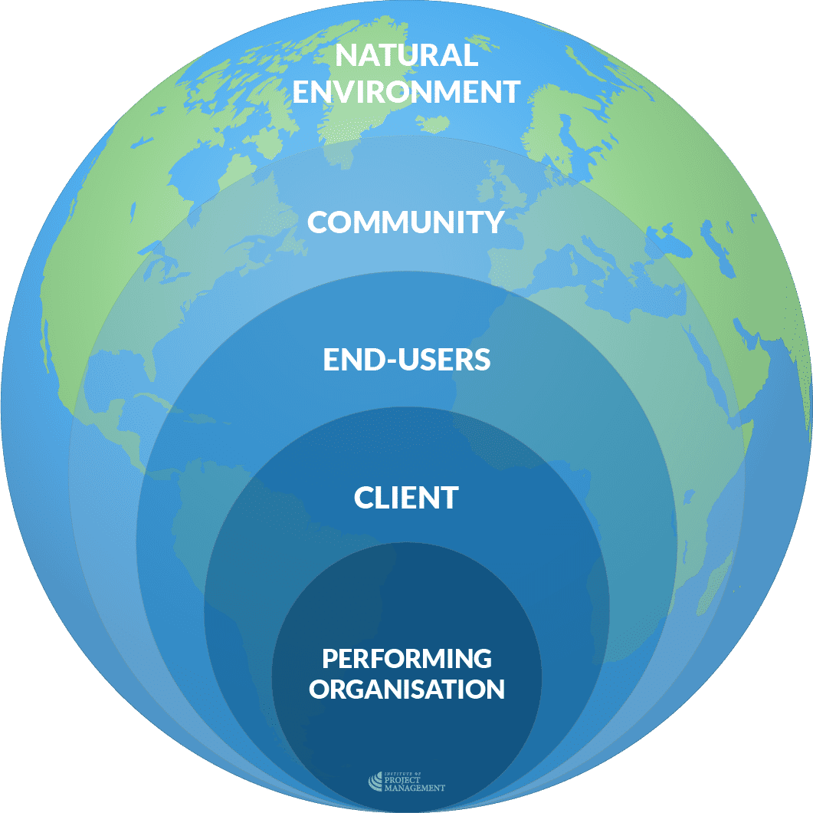
Who is impacted?
OPEN 3.8
Notes:
You should also make an effort to distinguish who benefits from (or is harmed by) each of these impacts.
Stakeholder groups impacted by projects include:
The performing organisation (including their staff and owners)
The project’s client
End users of the project’s outputs, and
The general community (non-users).
By linking impacts to stakeholders you can make more persuasive arguments for each option by directly addressing their specific, motivating needs.
In this instance, it may also be useful to consider the natural environment as a proxy stakeholder (if you have not already done so).
This is because the environment impact of your project has the potential to excite your stakeholders and impact (for better or worse) your social licence.
Critically, the business case is the best (and often only) place in the project lifecycle to discuss and define these impacts.
Once project planning starts, the manager’s focus will shift exclusively to output realisation, without any immediate regard for these broader concerns.

Slide 55
Activity 3.4
OPEN 3.8
What non-financial metrics might you use to baseline and measure…
…improved productivity?
…customer satisfaction?
…employee health and safety?
…corporate culture?
…environmental impact?
Notes:
Unfortunately, whereas many project business cases are quick to state the intended benefits of each option, they quite often fail to describe how these impacts will be measured beyond dollars and cents.
Now it might be possible to say that as a result of this project and the new knowledge it enables, we will increase our productivity by five percent.
Nonetheless, it is not always easy (or even desirable) to definitively state that this project will enhance corporate culture by three percent, which will lead to a 0.5% productivity boost and 0.18% return in profit over three years.
That said, it is still vital to quantify these impacts so that we can:
Compare them at least indirectly to the costs of investment, and
Ultimately evaluate whether our project is a success.
It is equally important to benchmark the impacts of our ‘do nothing’ option as a basis for comparison.
So how can we quantify intangible benefits?

Slide 56
Activity 3.4 – answer
OPEN 3.8
Improved productivity
Clients served / widgets produced / project variances
Customer satisfaction
Customer retention / satisfaction score / net favourable social media mentions
Employee health and safety
Safety incidents / near-misses / sick days
Corporate culture
Diversity metrics / 360 feedback / staff turnover
Environmental impact
Carbon footprint / energy consumption / waste output
Notes:
Critically, the business case is the best (and often only) place in the project lifecycle to discuss and define these impacts.
Once project planning starts, the manager’s focus will shift exclusively to output realisation, without any immediate regard for these broader concerns.
The lesson here is twofold:
Firstly, if you don’t define outcomes and benefits at the initiation stage, it is not clear to stakeholders why the project is being undertaken.
Expecting the project manager to do so in planning – that is, once a high-level scope, time frame and budget have been approved – is distracting at best and more often than not invites a significant level of conflict.
Secondly, if you don’t quantify the benefits now, how will you know if your project is a success?
As we said right at the start of this course, a project is only a means to an end.
Delivering on time, on budget and to scope might be great for the project manager’s résumé, but is meaningless if no-one ever uses (or everyone under-uses) the project’s final product, service or result.

Slide 57
OPEN 3.9
Recommendation
Notes:
Let’s reflect on what we have achieved to this point.
Opportunity definition We started with an idea, visualised its potential and assessed the risk to the organisation of investing it Options identification We then identified a range of different ways to deliver the same or similar outcomes
Feasibility analysis We reduced these options to two, three or four strong potential projects that could be compared against the base case of doing nothing
Business case We estimated the financial and other impacts of proceeding with each remaining option, versus doing nothing at all
We now need to make a recommendation to our decision-makers on the best option and the way forward.
The good news is, as you can see, the hard work has been done.
All that is left is to summarise our findings in a way that highlights the optimal solution.

Slide 58
Multi-criteria analysis (MCA)
OPEN 3.9
Compare options across common criteria
Assign standard scores to each option for each criterion
Best overall score wins!
Criteria should be clearly defined by the organisation
Criteria can also be weighted by the organisation
Notes:
As the name suggests, multi-criteria analysis can include any decision-making factor (or criterion).
When deciding which is the best project option (including the null option), the evaluation criteria might be specific to the outcomes intended by the opportunity.
For example, if the outcomes we desire include:
increasing market share
improving customer satisfaction, and
returning a profit to shareholders…
… then our criteria might explicitly ask to what extent does each option increase market share, improve customer satisfaction and return a profit.
At a higher level, when we are deciding which projects to add to our portfolio from the recommended business cases, we might have some organisationally predefined criteria, such as:
Project costs
Net financial impact
Other intangible impacts
Risk to the organisation
The purpose of MCA is to give each criterion a score – it can be out of three, five, ten, or whatever scale you like – so that when you add each criterion score for each option, you are left with an obvious winner.
Note we look at weighting when doing the unit on procurement.

Slide 59
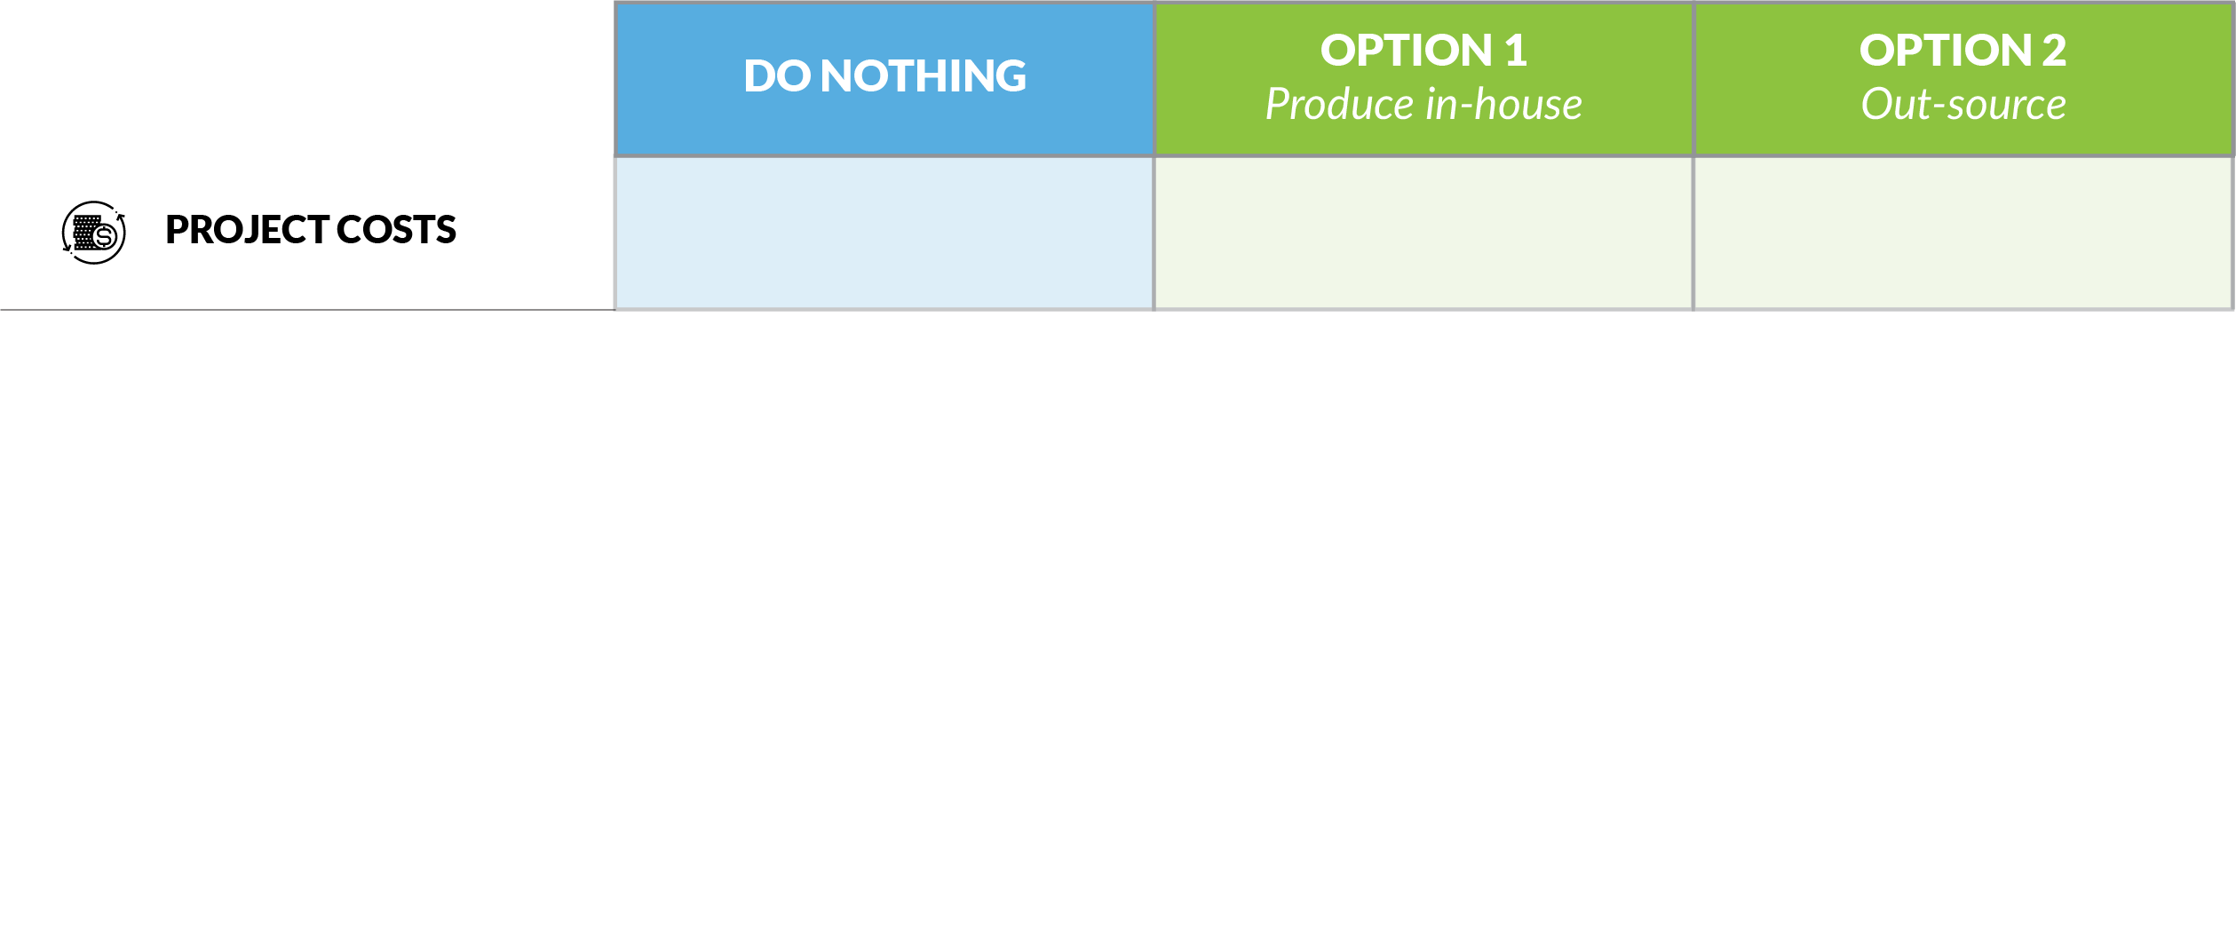
Multi-criteria analysis (MCA)
0
-1
-3
Always zero
Notes:
Let's suppose that we have three project options: do nothing, make something in-house, or outsource production to experts.
Based on our comprehensive analysis of the potential project costs, net financial and other impacts, and the risks to our organisation, we have given each option a score out of five for each criterion.
If everything else is equal, saving money is better than spending money for an organisation. For this reason, expected project costs are assigned a negative score by default.
In this example, outsourcing is more expensive than delivering the project in-house, so it has a larger negative score.
As discussed earlier, though, doing nothing has no project costs, so this option has a default score of zero.

Slide 60
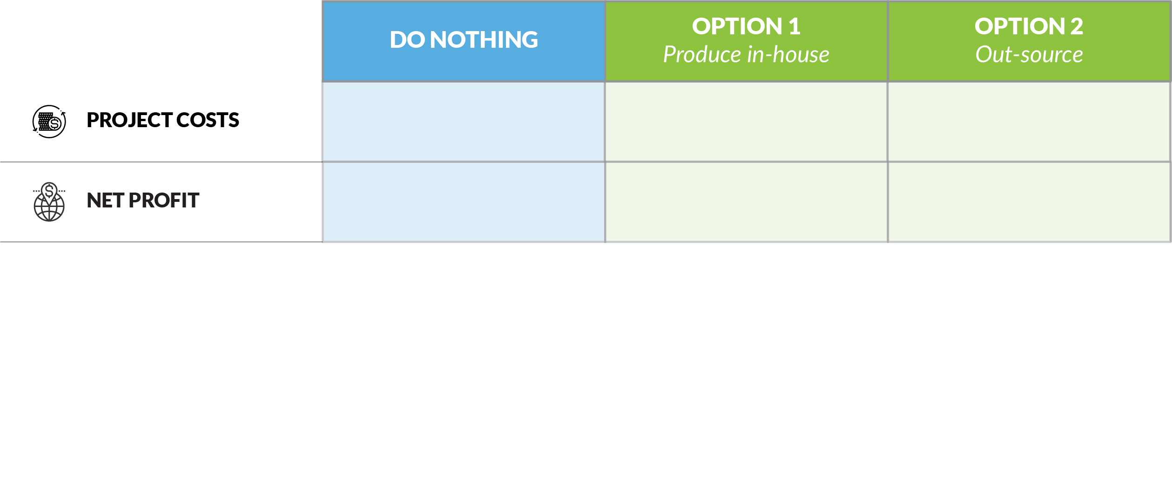
Multi-criteria analysis (MCA)
0
-1
-3
0
1
4
Notes:
A net financial impact can be positive or negative, and this reflects in the score we give.
In our example, both project options are expected to be profitable, so they both receive positive scores. Electing not to pursue this opportunity will have no impact on our profitability.
It can be seen that our business case author believes the outsourced solution will be more profitable than the solution produced in-house.

Slide 61
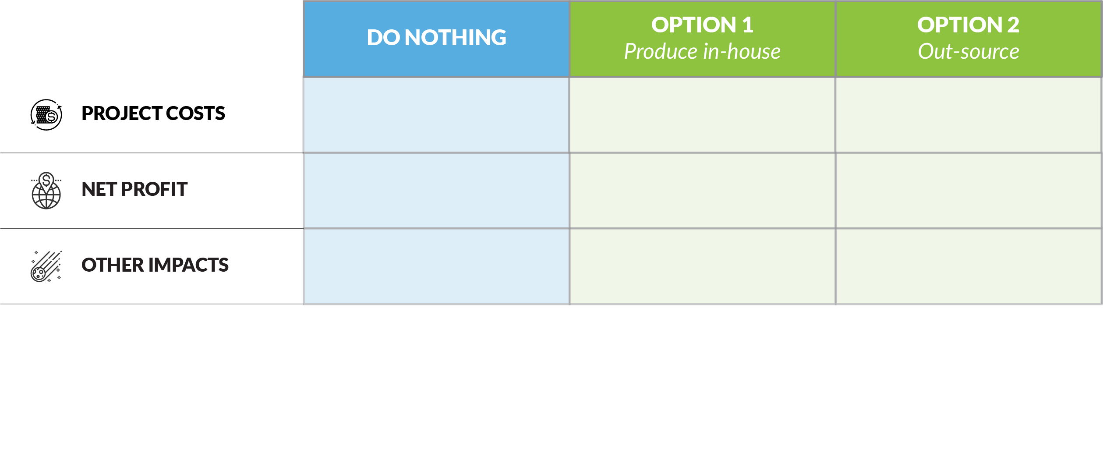
Multi-criteria analysis (MCA)
0
-1
-3
0
1
4
-2
3
2
Notes:
Here is a more complete illustration of the effect of positive and negative scoring.
We can assume from the scores assigned that doing nothing will, on balance, bring harm to our organisation; whereas, proceeding with the project will impact us positively.
We can also infer that delivering our project in-house will deliver a greater sum of intangible benefits than looking to someone else.

Slide 62
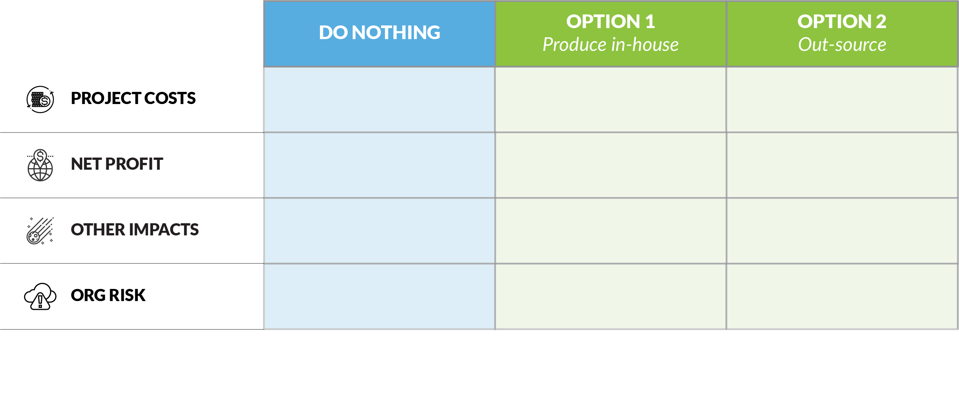
Multi-criteria analysis (MCA)
0
-1
-3
0
1
4
-2
3
2
-1
-3
-1
Notes:
Here is another opportunity to use our risk profile tool!
Risk, as we have defined it in our organisational risk matrix, is inevitably negative; therefore, we have converted our percentages from the risk matrix into a range of scores from -1 (being low risk) to -5 (being high risk).
In our example, doing nothing or outsourcing are seen to carry a low level of risk; whereas, delivering the project in-house carries a moderately higher risk for our organisation.

Slide 63
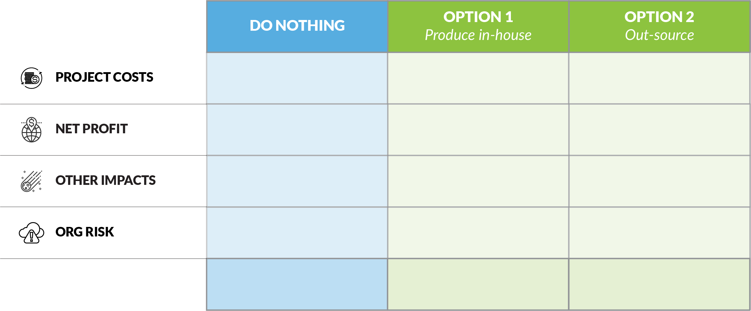
Multi-criteria analysis (MCA)
OPEN 3.9
0
-1
-3
0
1
4
-2
3
2
-1
-3
-1
-3
0
2
Notes:
When we total our scores for each option, we see that do-nothing scores -3 (rank #3), Option 1 scores ±0 (rank #2), and Option 1 scores 2 (rank #1).
Therefore, using these criteria, Option 2 is the best option, and we will recommend outsourcing the project.
Note that the best score is always the highest raw score – even if all the totals are negative, the top ranked option may well be worth proceeding with.
That said, your organisation may have a policy that says only business case options with a positive score will proceed.

Slide 64
Discussion
OPEN 3.9
What other criteria could you use to assess the recognition and reward project?
Notes:
It is important to get stakeholder consensus on what appropriate scores might be, and be able to explicitly justify them when called upon to do so.
Indeed, good practice suggests that you should have clear definitions for each score and apply them consistently when preparing your MCA.
Other, non-generic criteria that you might use could include:
Risk to organisation criteria (each one or more as a separate line item) and/or
The likelihood of each option achieving the intended project outcomes

Slide 65
Sample recommendation
OPEN 3.9
It is recommended that detailed planning commence on Option B.
A complete project plan is to be presented for Board approval in four (4) weeks time
The plan should continue the assumptions made in the business case, and include a detailed WBS, schedule, budget, stakeholder and risk registers and any other documentation deemed relevant by the PMO
The PMO should also immediately appoint a suitably qualified project manager and project steering committee
If the assumptions of the business case are invalidated by the planning process, the Board should be advised and a new course of action recommended
It is proposed that a budget of $15,000 be allocated to planning the project
Notes:
At this point, you are only recommending that the preferred option proceed to detailed project planning.
This is because we still need a lot more certainty about the project and its deliverables.
At a minimum, we want to reduce our business case margin of error of ±20% to a more manageable (for the organisation) ±10%.
By taking a deep, bottom-up dive into our project, we may also reveal new information that invalidates the assumptions of our business case.
For example, we may discover that:
our cost estimates are wildly optimistic
the delivery window is not practical
certain scope elements will be impossible to produce
legitimate stakeholder concerns were ignored, or
other project or business demands conflict with our project.
In that case, we must return the project to initiation, inviting decision-makers to reconsider (or recommit) with the newly available information.

Slide 66
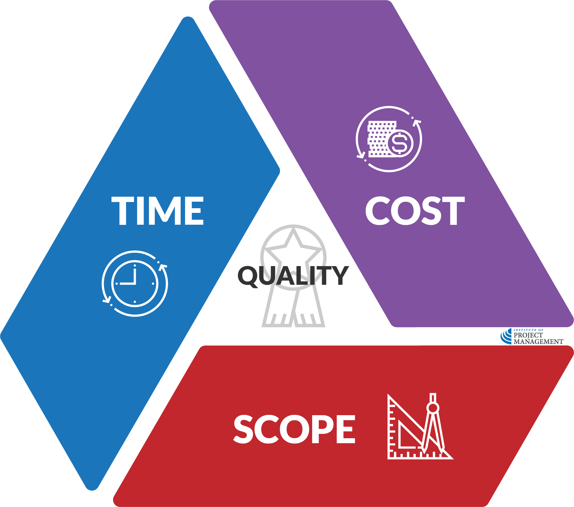
Other recommendation detail
OPEN 3.9
Planning constraints
Critical success factors
Time – key milestones
Cost – high-level budget
Scope – key deliverables
Quality – acceptance criteria
For example…
Resource availability assumptions
Other project dependencies
Key stakeholder relationships
Known project risks
Notes:
A project manager may go their entire career and never prepare a business case or even be involved in project initiation.
Unfortunately, many organisations feel they successfully deliver projects without formally going through these steps, going straight to project planning or even delivery.
We often hear executives say, look – there really is only one option, we don’t need to do anything else… let’s just get on with the project.
And they’re probably right – about five percent of the time.
For even if you have only one standout option, you can almost guarantee there are options within it that are worthy of more detailed consideration.
For example, what if we fast-track delivery by 20%? What do we lose? What do we gain? What if we add a few more features?
Or, more critically, have we under-represented or even missed the input of a certain key stakeholder? Have we assumed they will think one way, without asking?
Following the initiation process should always be the default; you should have a very good justification for skipping this step.
It is far better to explore all options and make relevant discoveries now than when it is too expensive or just too late further down the track.

Slide 68
Notes:
Note the empathy map is for inclusion in our course on design thinking

Slide 69
Concept canvas with risk profile
A good idea that you’d like to make a project!
Can be a personal or professional project
You do not need to be the project manager
You can also use the case study project
Use the templates provided or ones from your workplace
https://open.institute.pm/free-project-management-resources/
Notes:
Cert IV PMP students only

Slide 70
Reflection
What is the most interesting thing you learned today?
What is one thing you will start, stop or continue doing?
What is one thing you would like to learn more about?
Notes:
Reflection questions not only highlight key learnings; they drive the continual improvement of our teaching and learning resources

Slide 71
Questions?
Coming next… project communications
Notes:
Stay around until everyone leaves the session to ensure they all get the chance to ask their questions.

Slide 72
Closing checklist
Classroom
Upload signed attendance sheet and any photos taken of work in progress
Zoom
Upload video with thumbnail and link to workshop
Student administration
Mark participating students as complete
Email absent students and notify of gap requirements (OPEN units)
Facilitator feedback – email paul@institute.pm
What worked well today?
How can we improve?

