Slide 1
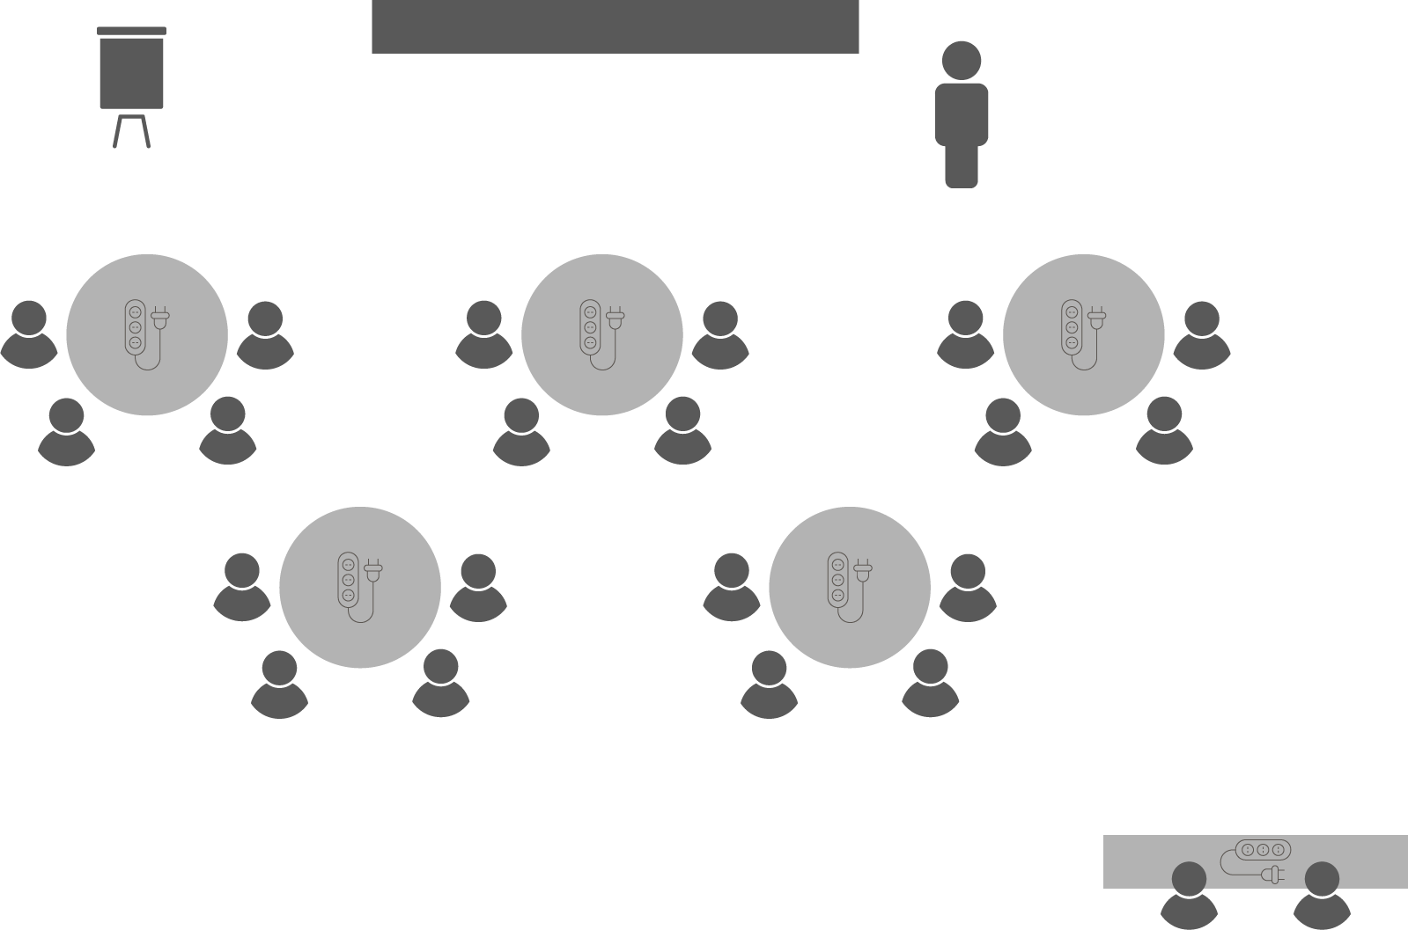
Opening checklist
Your preparation
Review notes, run a technical rehearsal
Rehearse examples / cases / stories to stimulate discussion
Classroom
Ensure students seated at tables of 3-5 and all facing the front
Have student name cards in place and ensure all sign in
Zoom
Rename yourself as host (under participants)
Set-up breakout rooms
https://support.zoom.us/hc/en-us/articles/206476313-Managing-Video-Breakout-Rooms
Welcome students as they arrive, let them know when starting
Notes:
Good luck!

Slide 2
Closing
Projects

Slide 3
Discussion
When is a project complete?
WBS tasks accomplished?
Client acceptance?
Paperwork archived?
Project review completed?
Warranty period ends?
Outcomes are realised?
The party?
Do your projects
END or CLOSE?
Notes:
All of these are end-point milestones for your project.
The important lesson here is that project close is a process, not a single activity.

Slide 4
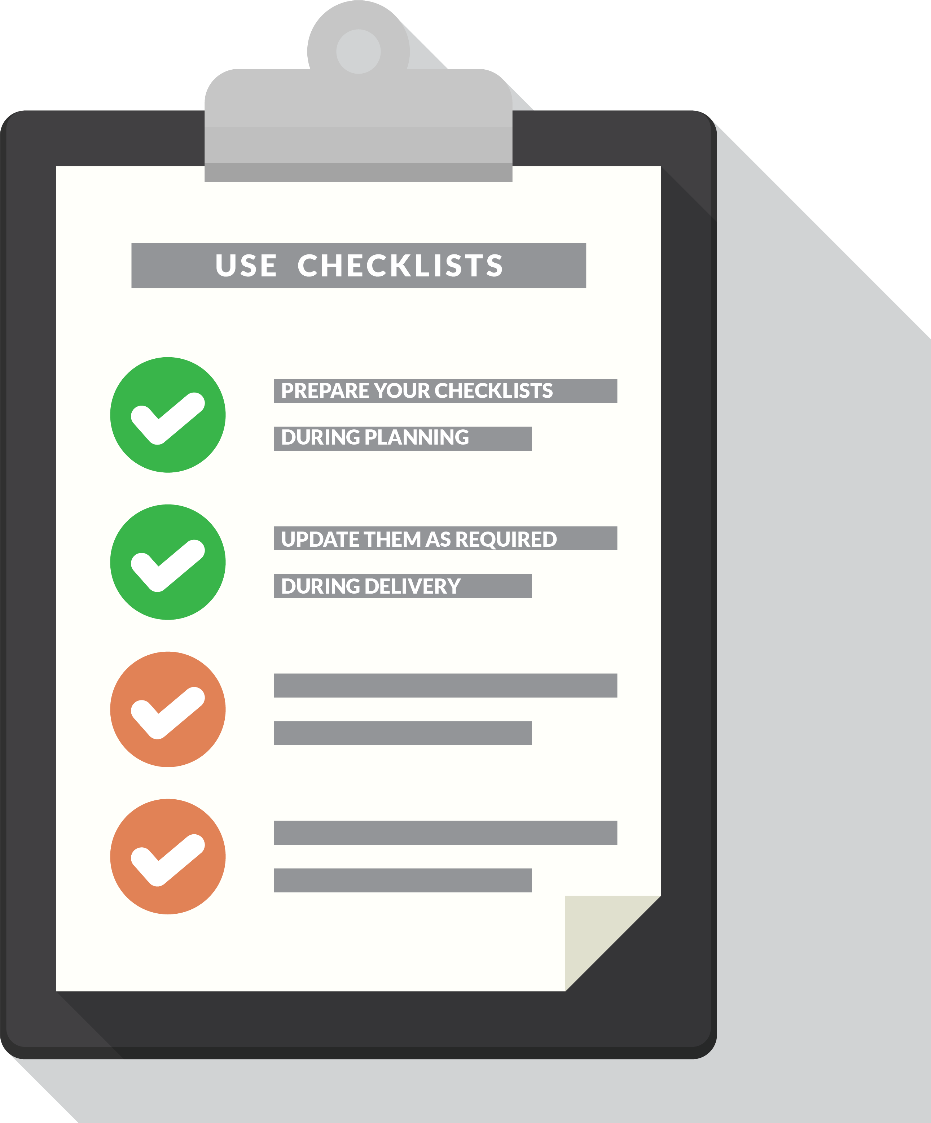
Client acceptance
OPEN 12.1
Verify deliverables
Internal approval
Client walk-through
Clarify uncertainty
Disclose risks
Note open actions
Notify stakeholders
Notes:
Most project team members would say that a project is finished when all the work is done; however, the measure of completion is when the client accepts the deliverables that were agreed to before the project began.
Rather than being surprised, though, how can we anticipate a client's acceptance of the deliverables?
The project plan is built on the work breakdown structure, which is a detailed articulation of the project scope.
Verifying deliverables therefore requires a careful review of the WBS to ensure that all tasks have been completed to what you either know or assume is the client's satisfaction.
If any task is left unfinished, then the project is not complete.
This verification is usually achieved by conducting a technical audit of the project’s outputs, asking does this deliver on the original promise we made – see the project charter if you are unsure.
Once outputs are verified to what you expect is the client's satisfaction, you need to obtain your sponsor's or steering committee’s approval to formally hand them over to the client.’
Every task in a good WBS has its own acceptance criteria, but these criteria are written with a specific purpose: to ensure that each task is ready to be delivered to the next step in the delivery plan.
In other words, they are internally derived, usually without reference to the client.
For that reason, it is a mistake to assume a project is complete just because all WBS tasks have been performed.
Even in the absence of acceptance criteria, a project is not completed until the client accepts the deliverables and responsibility for the outputs of the project.
In a formal contract with a customer outside the organisation, specific acceptance criteria will be included in the contract terms.
However, even these criteria are rarely a full statement of the client's expectations.
A crucial mistake made by inexperienced project managers is not requesting up-front a written agreement of acceptance criteria.
After all, if these criteria do not exist, the client can forever claim that the deliverable is not exactly what was requested and the project continues.
Likewise, projects internal to an organisation – especially those that involve different organisational groups – will suffer the same consequences if there is not a memorandum of agreement among the groups that specifically details the acceptance criteria.
Regardless of whether or not project- (as opposed to task-) level customer acceptance criteria are in place, in handing over you should then walk the client through the deliverable(s), stating why you think the project is fit-for-purpose.
At this time, you should also clarify any uncertainty and disclose any risks.
Only then can formal sign-off and delivery be achieved.
In construction contracts, you might also have a defects liability period.
As with a standard warranty, it typically allows 12 to 24 months from the date of practical completion for the contractor to return to the project and remedy any defects.
Often, a project will also have an option for continuing maintenance and servicing; usually in these instances, a different corporate group is responsible for this function.
As part of handover you should ensure that all the new stakeholders are aware of who the key contacts and players are.
Not only is it good project management practice, it is also good business!

Slide 5
Unsuccessful projects
OPEN 12.2
Terminate
Write off the time and resources spent on the project
Stop throwing good money after bad!
Re-boot
Stop and re-plan (maybe even re-visit the business case)
Often involves bringing in a new project manager / team
Salvage
Finish and deliver the project as-is
Expectations / outcomes need to be adjusted to reflect this
Notes:
Before we get further into the closing processes, it is important to recognise that not every project is successfully completed.
Despite our best intentions, there are also times when projects simply ‘fizzle out’.
Commitment to the original vision fades, resources become impossible to pull together, or requirements become locked into a death spiral of non-commitment and unwillingness to move forward.
When this happens a project manager is looking at a failed project.
When faced with a project in this state, it becomes your responsibility to review what has happened and arrive at recommendations for the best course forward.
Generally there are three options that can be explored:
TERMINATE
This is the scorched-earth option.
If there is no hope of getting the project delivered, or if the business is so disinterested that no further progress is possible, then closing the project may be the best course.
You should also consider terminating a project if the only justification for continuing is that you have already spent so much time and/or money on it. This is known as the sunk cost fallacy.
Any semi-complete outputs are salvaged for scrap if possible, and the rest is junked.
RE-BOOT
Restarting the project so that it delivers what was originally set out to do requires more than dusting off the project plan and restarting work.
Often this involves revisiting the business case, and creating new baselines predicated on the existing work.
This will include detailed analysis of the remaining WBS tasks, and whether resources need to be re-engaged, contracts renegotiated or the project schedule reworked.
Quite often, this process will start with a new project manager or team members, in recognition of the value that fresh eyes can bring to a stalled project.
Usually such project managers are the more experienced campaigners in an organisation, as the level of skill required to successfully reboot a project is significant.
SALVAGE
Somewhere between the two lies this option.
Managing to a profit is a term we use to describe delivering a project that has less value than was originally planned, but at least provides some benefit from what has been done.
In effect, a new project is created with new (reduced) requirements and schedules and budgets to give the business something to be used.
It will deliver business benefit, albeit less than originally intended by the business case.

Slide 6
Administrative close
OPEN 12.4
Business case
Project plan
Registers / logs
Status reports
Change requests / logs
Finalise and transfer resources, assets & liabilities
Complete financial acquittals
Re-assign project team members
Contracts
Maps, plans, technical drawings
Meeting minutes
Correspondence
Notes:
Administrative close refers to the internal processes of an organisation that are necessary to finalise a project.
There are several tasks that need to be completed here.
Document archive
All the project documentation must be formally reviewed for outstanding action, catalogued, and archived. Also check that all relevant information has been disseminated to the stakeholders.
As well as all the initiation and planning documents described elsewhere in this course, documents for review (in all their configurations) might include:
Contracts
Meeting minutes
Status reports
Issue and change logs, and
General correspondence
Resource reassignment
Resources attached to the project also need to be reassigned.
Often, a project also involves buying or renting equipment and facilities, or even using equipment supplied by the client.
All this equipment has to be accounted for and returned, while organisational resources used may need reconditioning and/or depreciating for financial purposes.
Don't forget the people!
As far as project team members are concerned, the project manager is also responsible for either reassigning them (if he or she has that authority) or, at a minimum, making recommendations for their future role within the company.
These recommendations might be part of a formal performance review that attaches to the staff member’s human resource file, or might be a letter of reference for those moving on to other projects in other organisations.
Although conducting these performance reviews might seem an onerous chore when what you really need do is move on to the next three projects that have landed on your desk, these reviews are an essential step in every person’s career progression.
Quite often, people are ‘lost’ to projects, in that their employers do not understand or appreciate the skills they acquire in project delivery.
On returning to general duties, they may be under-utilised at best, or at worst frustrated by what may be in practice a backward step in their career.
Finalise client relationships
Actually, ‘finalising’ is the wrong word here – one of the key organisational objectives of any project should be to make clients so happy they want to come back with other projects!
At the very least, it is the time to extend a relationship that allows periodic discussions about how the deliverables are serving the customer’s needs (outcomes measurement) and whether there might be additional work for the provider organisation in the near future.

Slide 7
Discussion
How and when should you celebrate project success?
Notes:
Finally, it is a mistake not to celebrate success, even if those successes were only few and far between in a failed project.
Many organisations miss out on the opportunity to properly close a project as a team and to acknowledge everyone’s hard work.
Celebrating a project’s close serves four purposes:
It marks the official end of the project for the project team
It provides the opportunity to acknowledge and reward everyone and their individual contributions to the success of the project
It facilitates the lessons learned process we will discuss later in this Unit, and
As a leader, the project manager can only gain by showing appreciation that will pay off the next time you head up a project and need a new team!

Slide 8
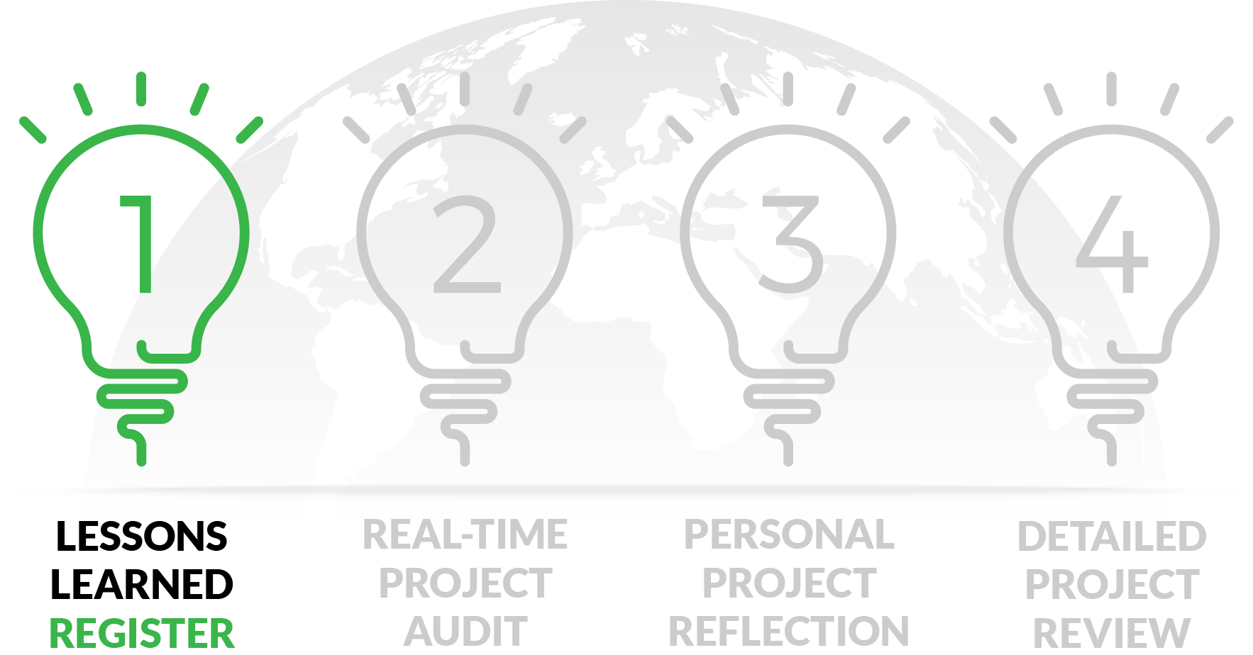
Capturing lessons learned
OPEN 12.5

Slide 9
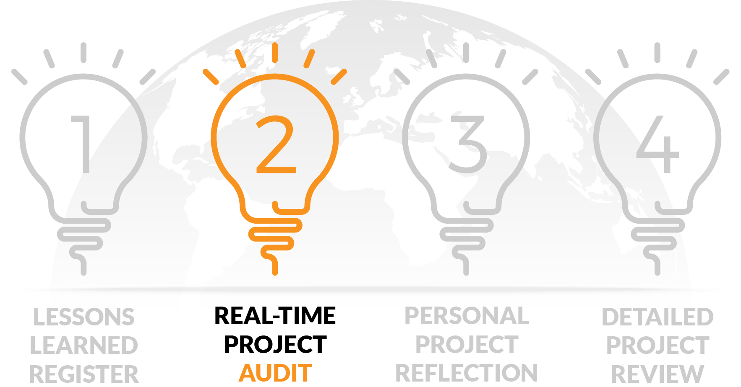
Capturing lessons learned
OPEN 12.5

Slide 10
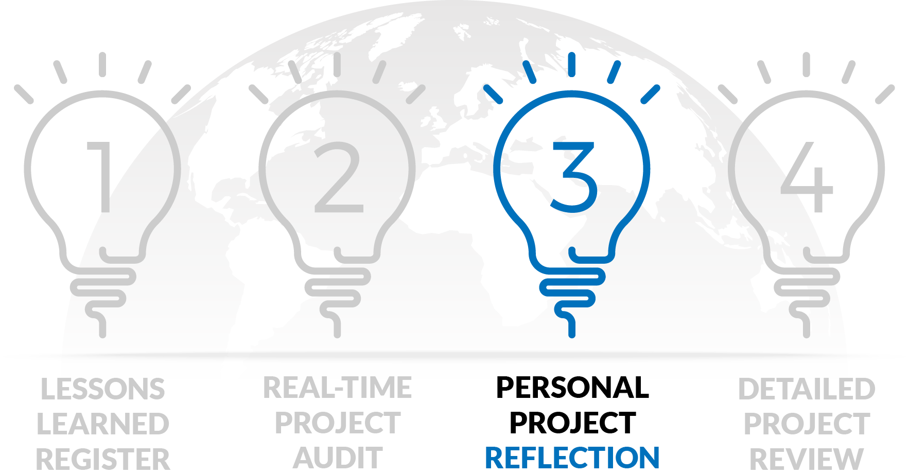
Capturing lessons learned
OPEN 12.5
Notes:
This is a specific type of review that every project manager should undertake as part of their closing process.
Essentially, a reflection involves taking a critical look back at your own performance and your management of the project team in an effort to identify what you did well, and what you could do better next time.
Your reflection might look at how well you executed each project (such as initiation, planning, delivery and close), or it might explore specific aspects of project delivery, such as your management of the triple constraints.
Now although you might also be required to formally present the findings of your reflection back to your organisation, it is important to recognise that a reflection is inherently a biased activity.
In other words, you are subjectively applying your own recall and judgement to events.
So even if you are more than capable of critiquing your own performance, you cannot know what you don’t know; this is why if it is at all possible you should consult the archived project documentation.
It should also be noted that because the reflection depends on recent recall to be successful, the timing of the reflection – immediately post-project – means that at best you can often only reflect on the success of the project from the perspective of project management processes.
Because the use of project outputs and their ultimate outcomes can sometimes take years to materialise, their review is usually out of scope at this stage.

Slide 11
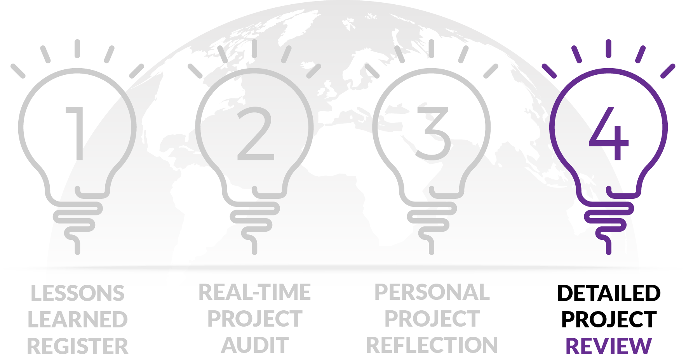
Capturing lessons learned
OPEN 12.5

Slide 12
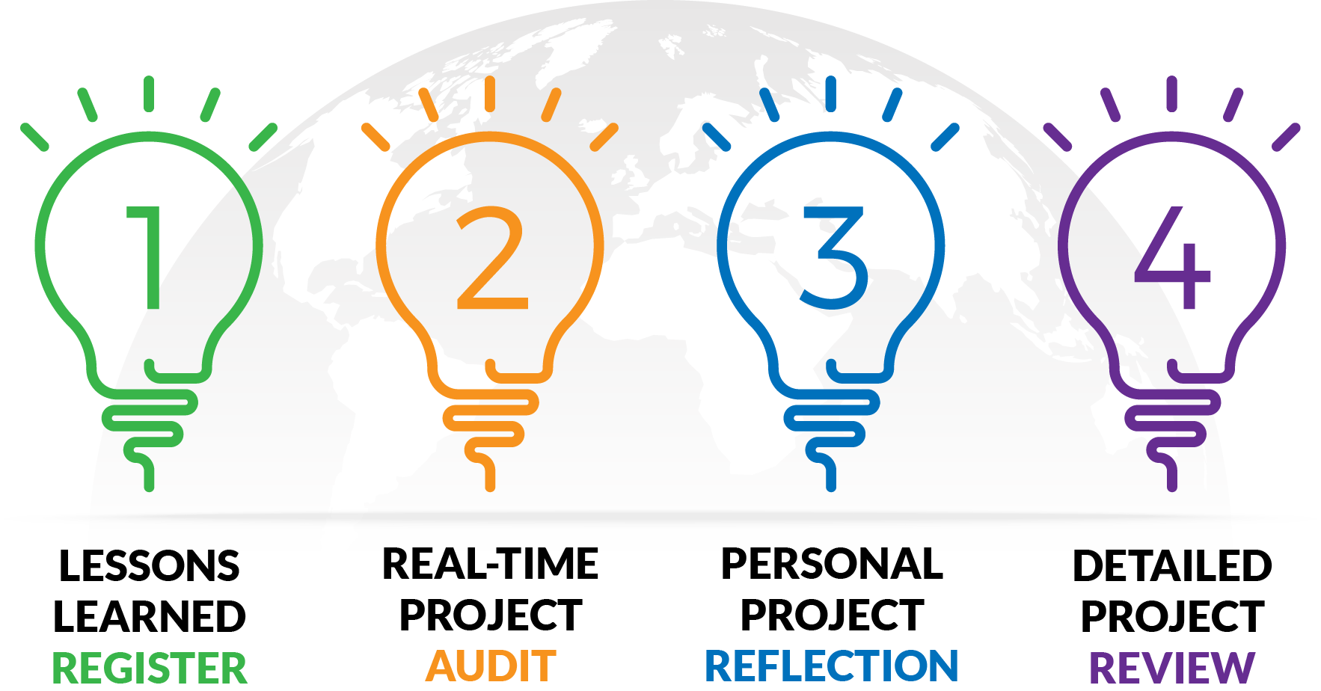
Capturing lessons learned
OPEN 12.5

Slide 13
Activity 12.1
Reflect across all aspects of performance on a project you recently contributed to
What worked well?
What can you do better next time?
https://open.institute.pm/free-project-management-resources

Slide 14
Review process
OPEN 12.7
Initiate review
Define objectives and scope (terms of reference)
Plan review
Develop methodology
Deliver review
Collect data
Identify issues
Close review
Report findings
Integrate learnings
Notes:
There are a number of logical steps to conducting a forensic project review.
Because the forensic review should be treated as a project in its own right, we will not spend too much time on all the steps here; after all, much of this will be more than familiar to you already!
Initiate
Foremost, you will need management sponsorship to:
Acquire the necessary resources to conduct the review
Secure access to information, and
Get commitment to consider / follow up the recommendations.
This may require the development of a business case for a forensic project review, even if policy commitment to a review process is already in place.
Preliminary research should then be conducted to understand the project background, its objectives and the key issues.
Moreover, it is advisable to consult key stakeholders such as the project sponsor, team and client on whether there are any specific areas that need to be addressed in the review.
This process will inform your review's terms of reference (or, as we like to think of it, your project's charter!).

Slide 15
Review process
OPEN 12.7
Initiate review
Define objectives and scope (terms of reference)
Plan review
Develop methodology
Deliver review
Collect data
Identify issues
Close review
Report findings
Integrate learnings
Notes:
Plan
Depending on the complexity of the project, a forensic review's scope can cover the whole project or a specific part(s) of the project.
Given the wide range of review areas, the challenge in this stage is to prioritise and focus on key issues to avoid information overload and ensure that the forensic review can be completed within the time and resource constraints.
You should also distinguish review of the project management processes from product performance and acceptance.
In developing a review methodology, the review team should determine the performance measures to be assessed and the standards they will be assessed against.
This may involve:
Consulting end users on what should be measured
Considering successful cases of similar projects to learn from their experience
Benchmarking against standard values set by specialised agencies, and/or
Discussing with stakeholders the basis for evaluation.
Data on performance measures may be located in readily available sources, such as project documents archived in the project close process, or they may need to be collected from other sources.
Depending on the sensitivity and complexity of the data required, you might consider using any one or combination of stakeholder engagement techniques, including interviews, facilitated workshops and questionnaires.

Slide 16
Review process
OPEN 12.7
Initiate review
Define objectives and scope (terms of reference)
Plan review
Develop methodology
Deliver review
Collect data
Identify issues
Close review
Report findings
Integrate learnings
Notes:
Deliver
Although the review team may be tempted to collect as much data as possible, this may lead to a significant increase in cost, time and complexity with no real gain to achieving the original objectives of the review.
By the same token, the data collection process becomes so tedious that the data owners may not wish to take part in the process.
Before collecting data, the review team should also consider whether it needs to:
Seek clearance and permission from appropriate authorities, in particular when dealing with sensitive information such as personal data
Explain clearly the objectives of the forensic review as well as the purposes of collecting the data to the data owners in order to avoid any misunderstandings, and
Consider the appropriate timing for data collection to avoid the possibility that the data is influenced by other unrelated factors.
For example, measuring public perception of a particular government service during sensitive periods (such as those right after a budget speech or policy address) may unduly influence the results.
You should also regularly report review status to key stakeholders throughout the review process, and appropriately manage any changes to the originally planned work.

Slide 17
Review process
OPEN 12.7
Initiate review
Define objectives and scope (terms of reference)
Plan review
Develop methodology
Deliver review
Collect data
Identify issues
Close review
Report findings
Integrate learnings
Notes:
Close
Based on the issues identified, the review team can develop SMART recommendations with a view to bringing about future improvement.
You should focus on learning points for future improvements instead of fault-finding.
In general, the review team should:
Develop recommendations to rectify the problems identified, to realise benefits not fully met, or to reap extra benefits
Consult relevant stakeholders and the potential users on the practicability of the recommendations
Develop an implementation plan, and
Generalise the lessons learnt for wider application to improve future projects.
This may involve proposals to change policies and procedures.
The review findings and recommendations should then be reported to senior management.
A forensic review report should document the alignment of the project’s output to the original charter, the effectiveness of project management processes, lessons learned, and practice improvements that can be applied to future projects.
For more on report writing and presentation, you should revisit the relevant topics in the project initiation Module.

Slide 18
Root cause analysis
OPEN 12.10
Be prepared to challenge your assumptions / beliefs!
The question is not when to stop, but where to intervene
Mind-map all known causes
Recognise unstated assumptions and values – think critically!
Identify the most significant causes
Consider what interventions could be made
Prioritise (SMART) recommendations
Notes:
There is an old English proverb:
For want of a nail the shoe was lost…
For want of a shoe the horse was lost…
For want of a horse the knight was lost…
For want of a knight the battle was lost…
For want of a battle the kingdom was lost…
…so a kingdom was lost—all for want of a nail.
You might know the same story from King Richard III famously shouting ‘A Horse! A Horse! My Kingdom for a Horse!’ in the Shakespeare play that bears his name.
The last English monarch to die fighting, Richard III perished at the Battle of Bosworth Field in 1485.
When his horse was killed, legend has it he wandered to find it in the battlefield for hours, killing everything coming into his way with fatalistic rage.
So does this mean building lots of nails will win us every future battle? Probably not.
Unfortunately, root cause analysis is not as simple as asking why over and over again like a six-year old until you find the ‘true’ cause of a problem.
As the proverb suggests, multiple causes will contribute to nearly every outcome.
Therefore, the question is not when to stop looking for root causes, but knowing where and when to intervene.
After all, your analysis is meant to help the performing organisation deliver better projects in the future.
It is not a scholarly essay for the benefit of as-yet unborn generations of project historians.
So even though your analysis will start by mapping all the observable causes of project issues, these should be truly considered as the potential future sources of organisational risk.
Your responsibility therefore extends to thinking critically about each of these risks.
In doing so, you should identify the most significant causes, and consider what interventions could be made by the performing organisation or other project managers to avoid, reduce or transfer these risks to others.
This will then allow you to develop a prioritised list of SMART recommendations, in other words, recommendations that are specific, measurable, assignable, realistic for the project and organisation, and time-related, in that they have a set deadline for delivery.
These recommendations are effectively your responses to these risks.
Indeed, your forensic project review will only be as good as the recommendations it arrives at; everything else is merely context and evidence for their presentation and priority.

Slide 19
SMART recommendations
Notes:
What are you recommending?
Your recommendation needs to be specific, in that it targets a specific area for improvement.

Slide 20
SMART recommendations
Notes:
What outputs / outcomes do we expect?
Your recommendation needs to quantify (or at least suggest) indicators of progress and success.

Slide 21
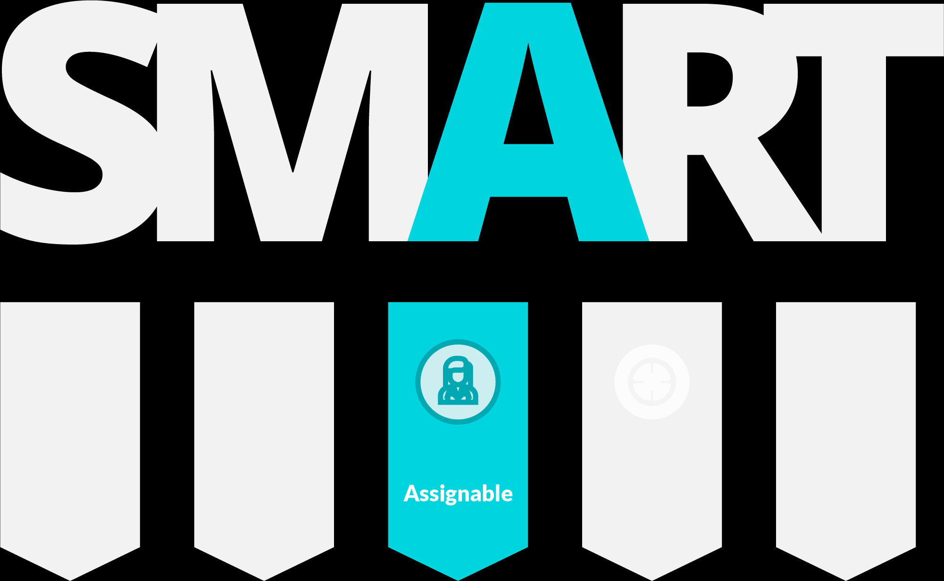
SMART recommendations
Notes:
Who will be actioning this?
Your recommendation needs to specify who is responsible for delivering the recommendation.

Slide 22
SMART recommendations
Notes:
How will we deliver this recommendation?
The result you expect to achieve must be realistically resourced.
Note: some later sources describe A as achievable / attainable and R as relevant / realistic.
Given the interchangeability of these terms, we prefer the original author's intent.

Slide 23
SMART recommendations
Notes:
When can the recommendation be delivered?
Specify the time frame in which the result(s) can be achieved.

Slide 24
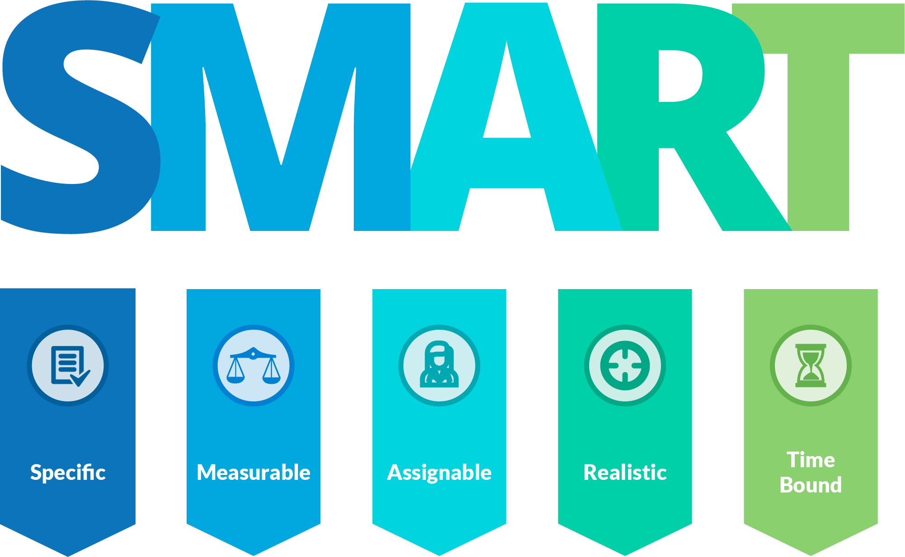
SMART recommendations
Notes:
Regardless of how you present them, your recommendations need to be SMART.
Source: Doran, G. T. (1981). "There's a S.M.A.R.T. way to write management's goals and objectives". Management Review. 70(11): 35–36.

Slide 25
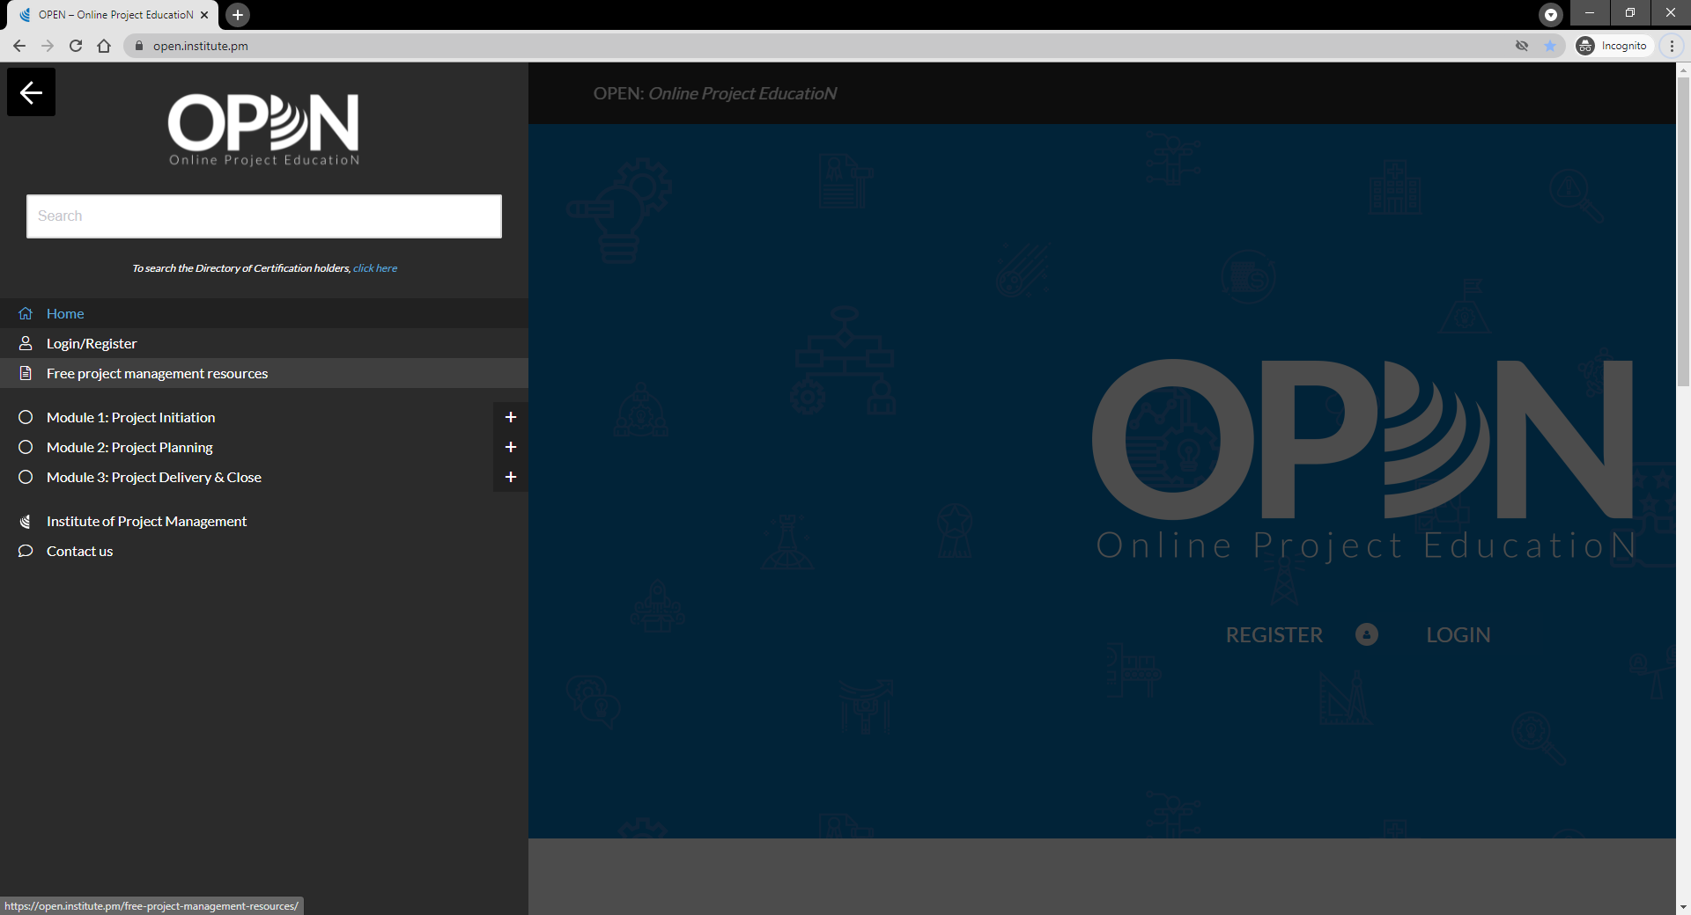

Slide 26
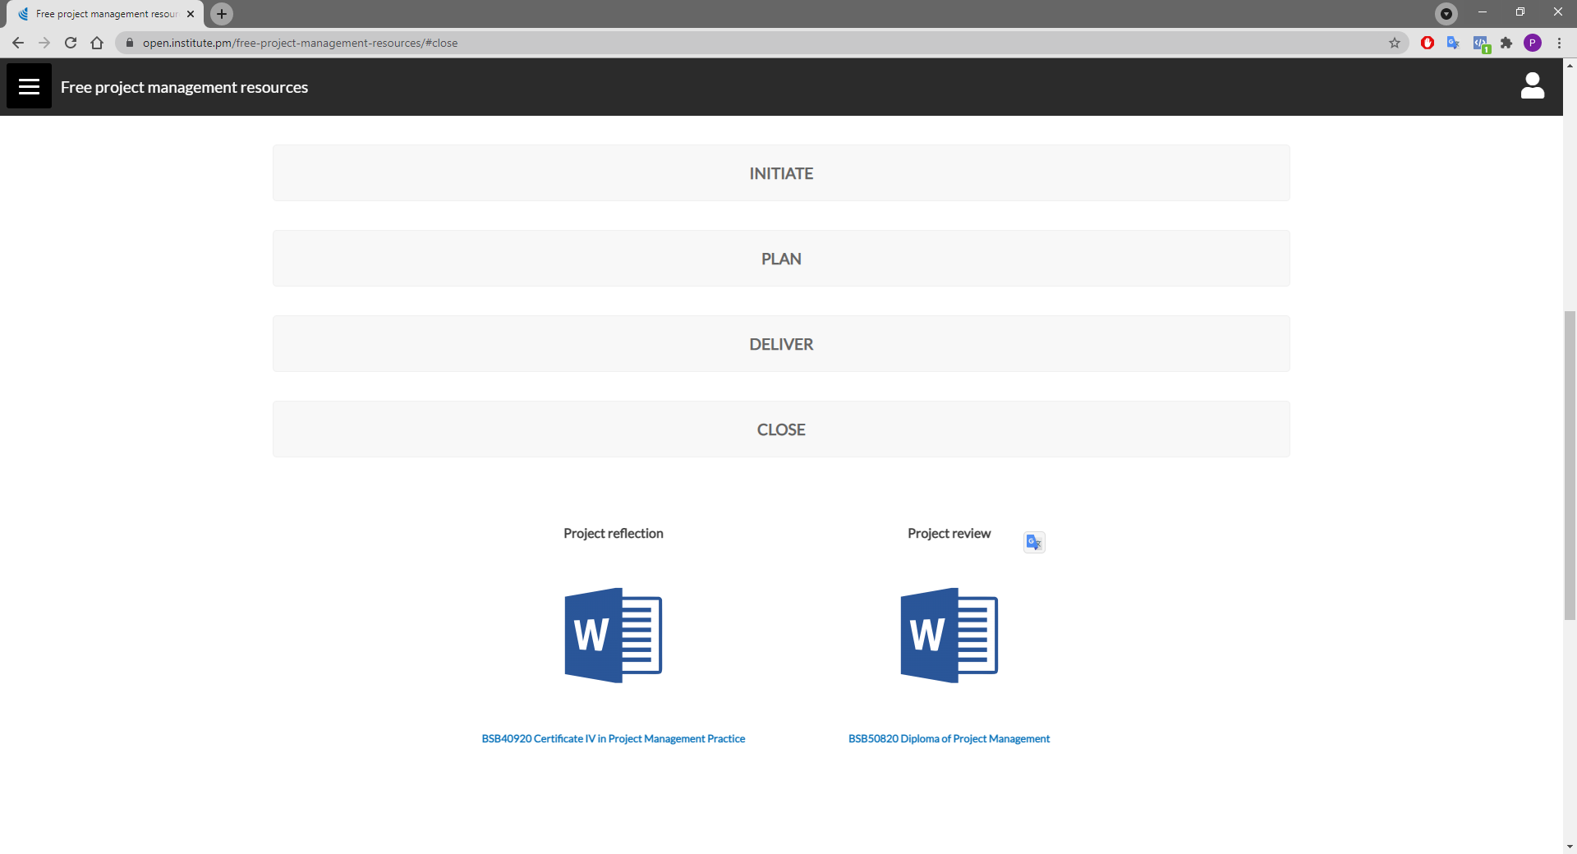

Slide 27
Activity 12.2
Many project reviews ‘gather dust’
What actions will you take to ensure project lessons are actually learned by your organisation?

Slide 28
Activity 12.2 – answer
Technical / process solutions
Human solutions
Maintain searchable project archives
Meta-analyse and baseline review data
Mandate lessons learned search for every new project
Re-engage teams on like projects
Commit to continual improvement
Encourage and incentivise honest reflection / review
Remove ego!
Peer review projects
Create a community of practice
Publish / present findings
Celebrate success

Slide 29
Notes:
Before breaking, ask students if there are any questions about what has been covered in the session so far.
Once answered, encourage students to stand up, get a drink, go outside and stretch.
If they are on Zoom, tell them to turn their camera and microphone off (you do the same)!
Make sure you tell them the precise time you will be restarting (eg 10:10am)
Don’t check your email – take a proper break!!

Slide 30
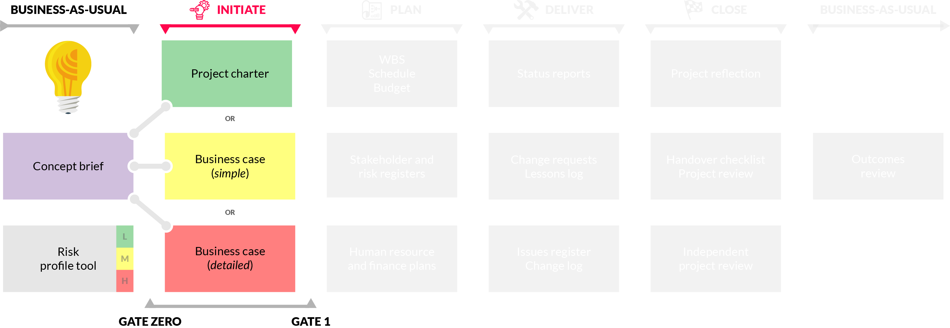
Project sizing
Notes:
Reflect on how far we’ve come – the life cycle and documents that support it.
Gates are the go/no-go decision points
The level of risk to the organisation will guide which documents we use – scale project documentation to the risk of the project

Slide 31
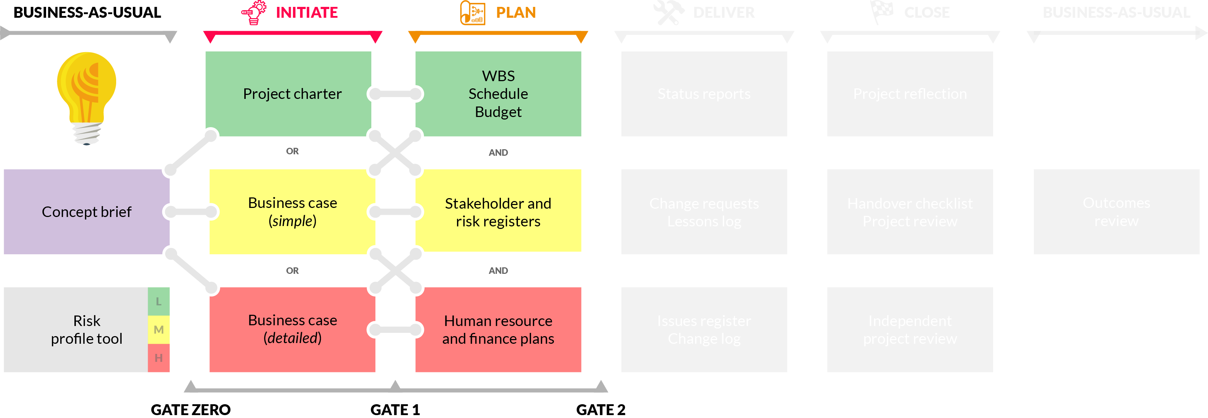
Project sizing

Slide 32
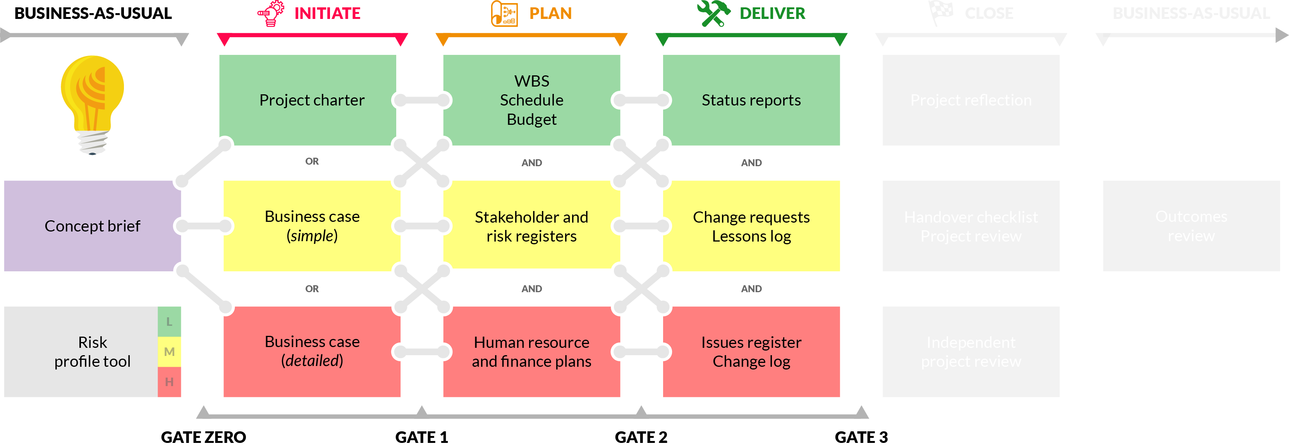
Project sizing

Slide 33
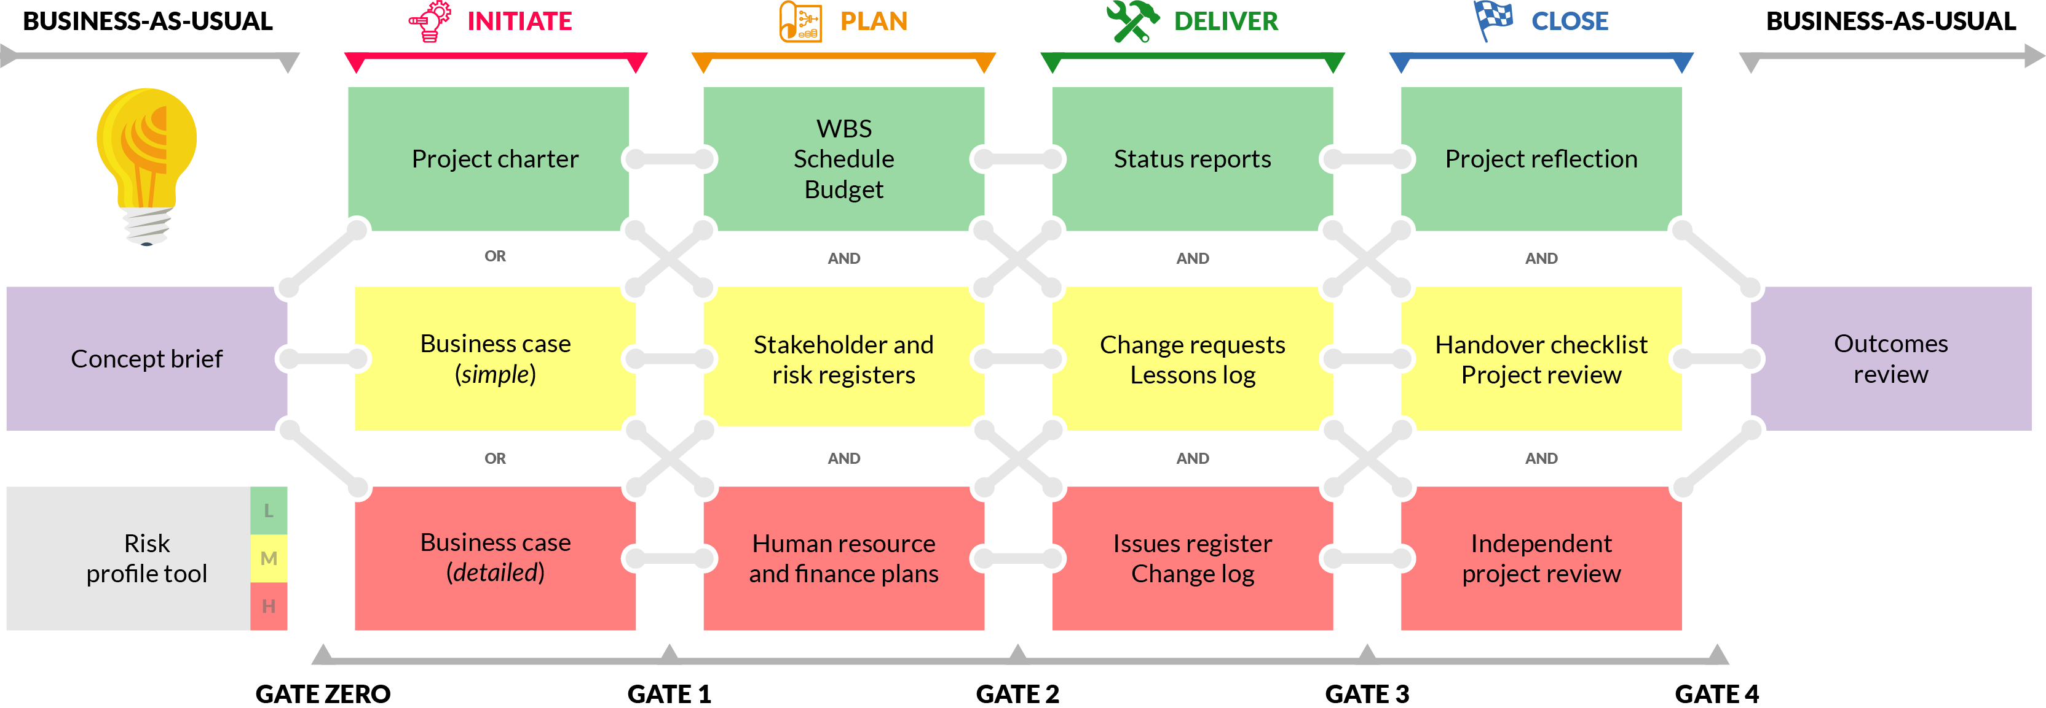
Project sizing

Slide 34
Activity 12.3
How can you create and sustain a culture of project excellence in your organisation?

Slide 35
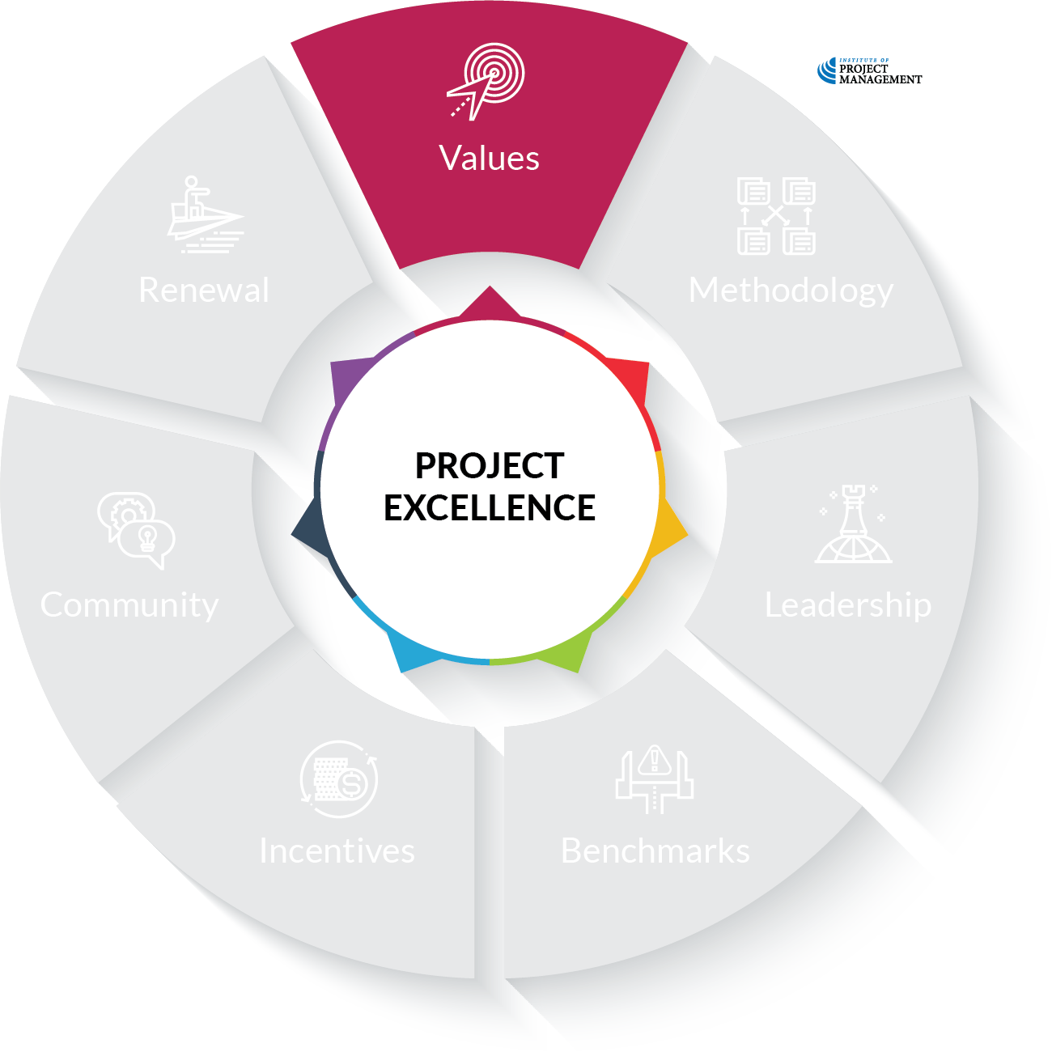
OPEN 12.13
Notes:
Values
Strategic statement of vision/mission/purpose and values
Code of conduct that applies to all project teams, including external contractors and suppliers
Explicit link made with organisational, portfolio, program objectives for every project

Slide 36
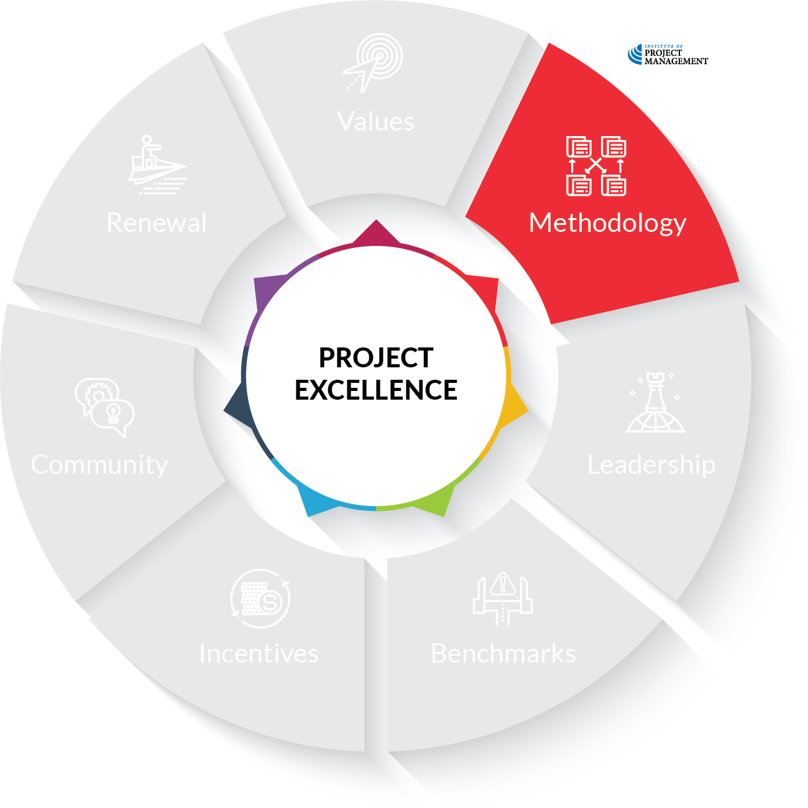
OPEN 12.13
Notes:
Methodology
Policies, processes, tools and templates supporting every stage of a project’s life that are both scalable and contextualised to the organisation, its industry and environment

Slide 37
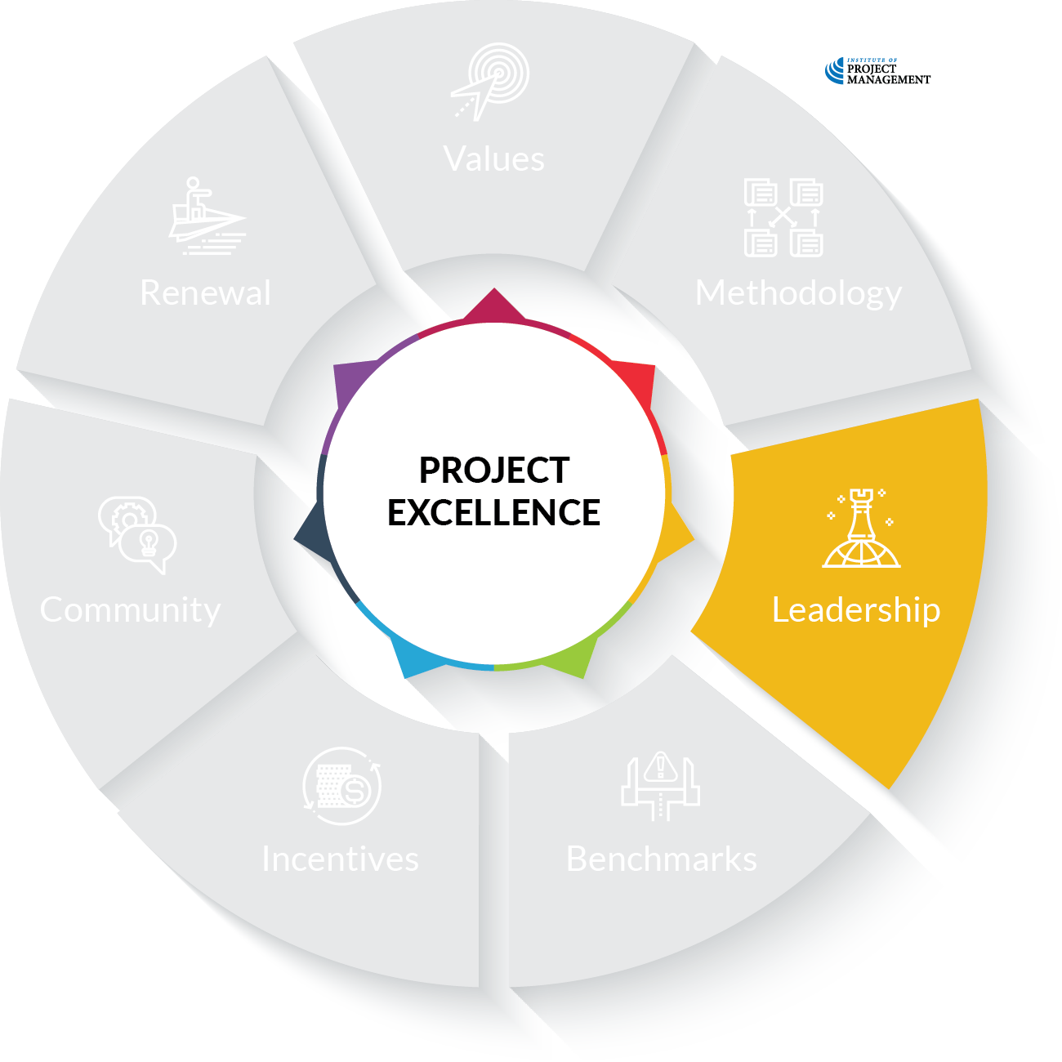
OPEN 12.13
Notes:
Leadership
Governance framework with supporting assets

Slide 38
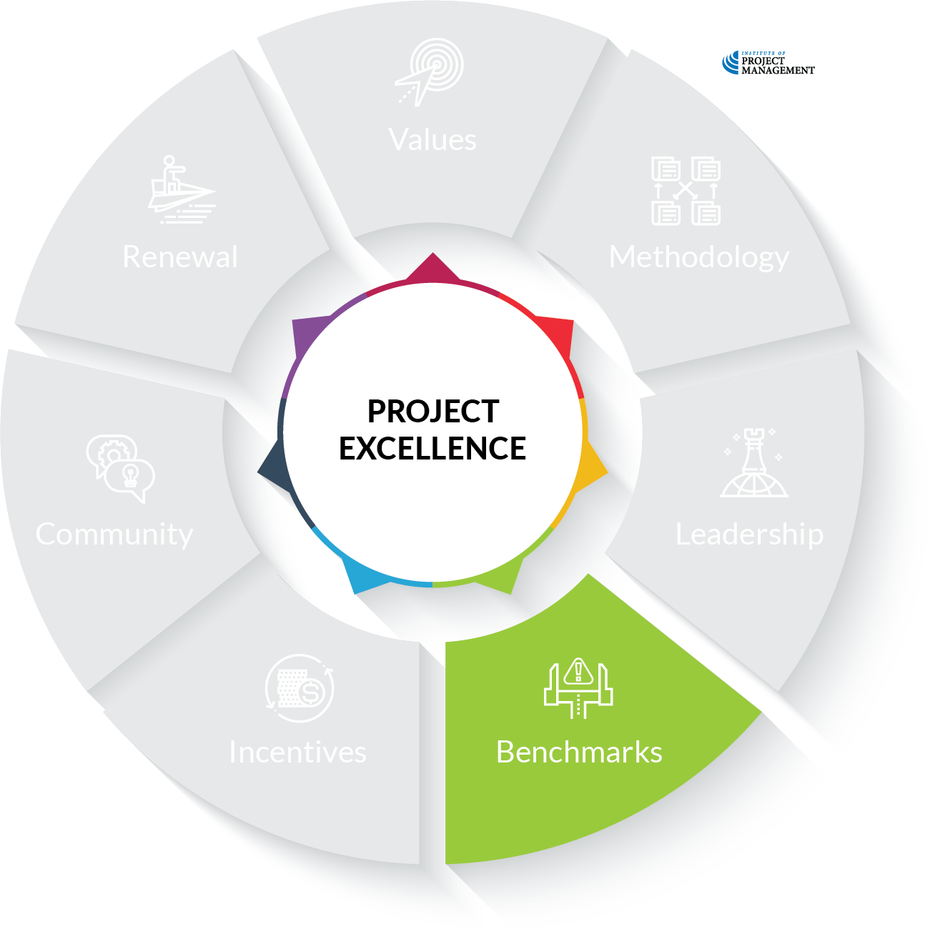
OPEN 12.13
Notes:
Tolerance
Clearly articulated project success metrics that are regularly reported against at the project, program and portfolio level
AIM SMART
(Acceptable-Ideal-Minimum)

Slide 39
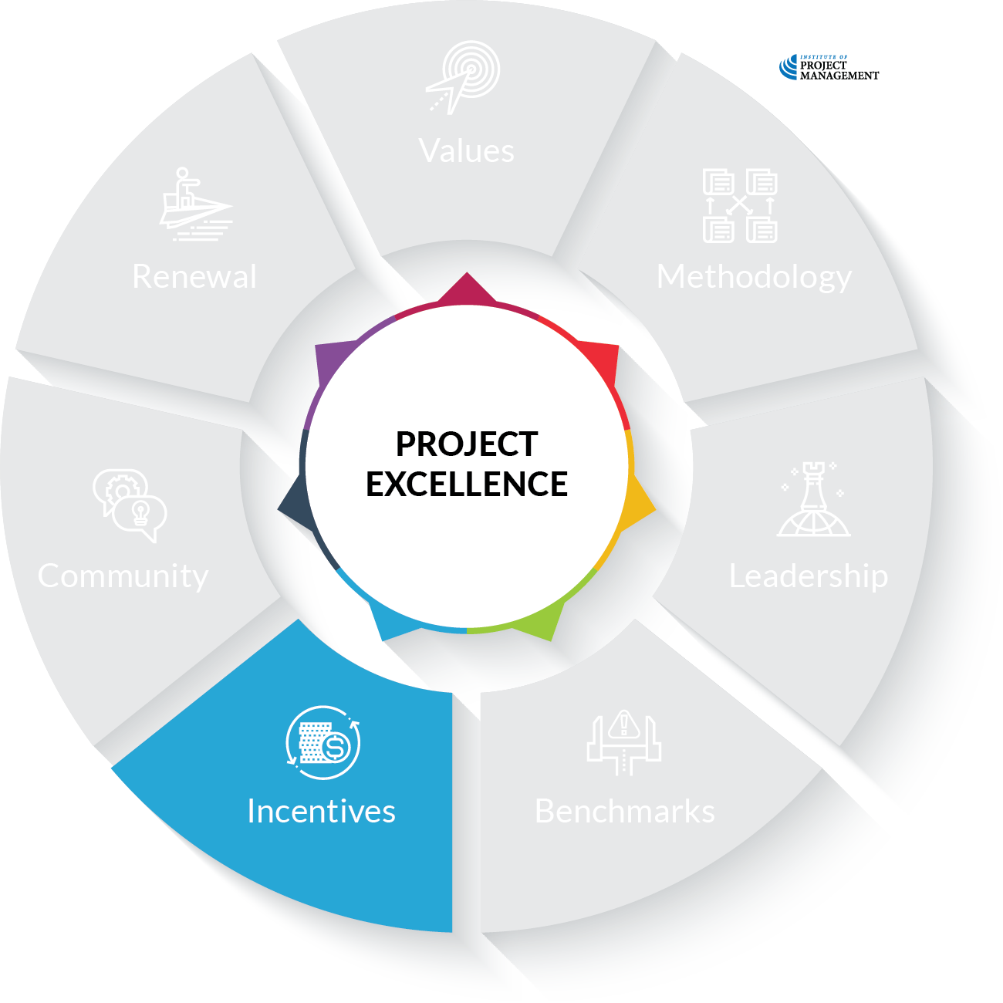
OPEN 12.13
Notes:
Incentives
Role definition and remuneration appropriate to work performed
Formal and semi-formal systems of recognition and reward

Slide 40
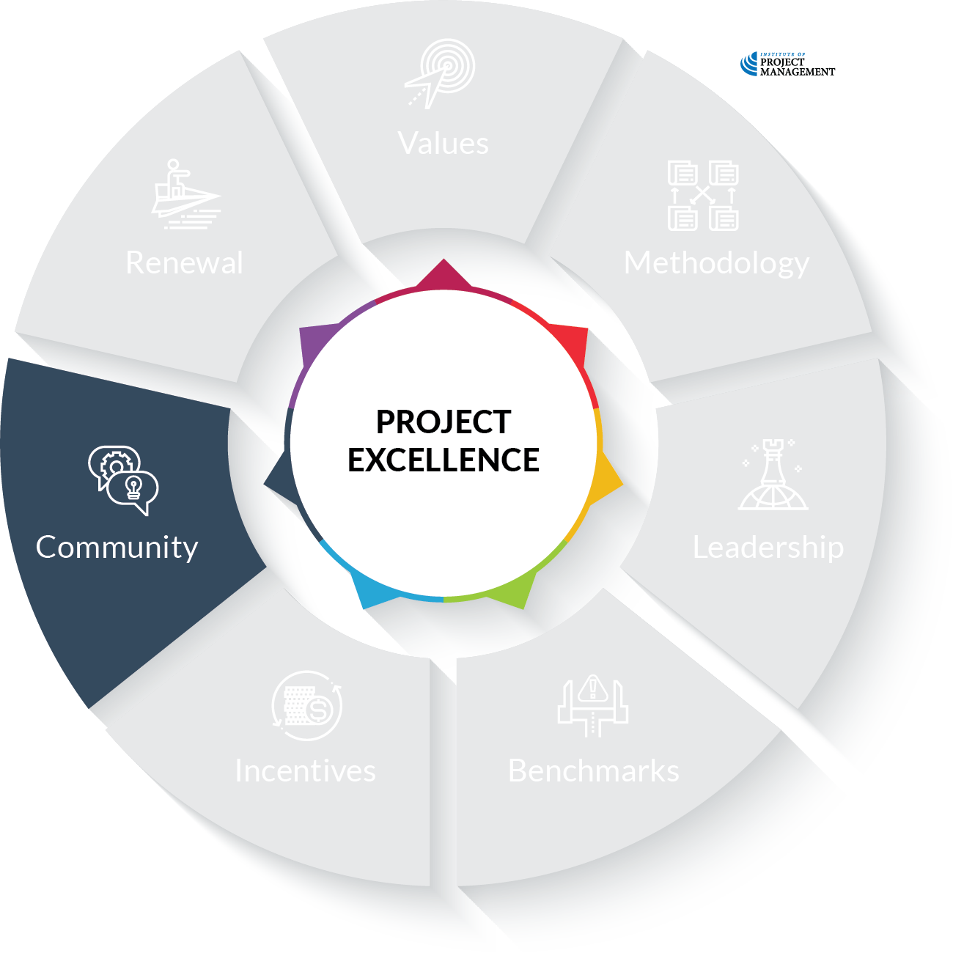
OPEN 12.13
Notes:
Community
Active project management community of practice

Slide 41
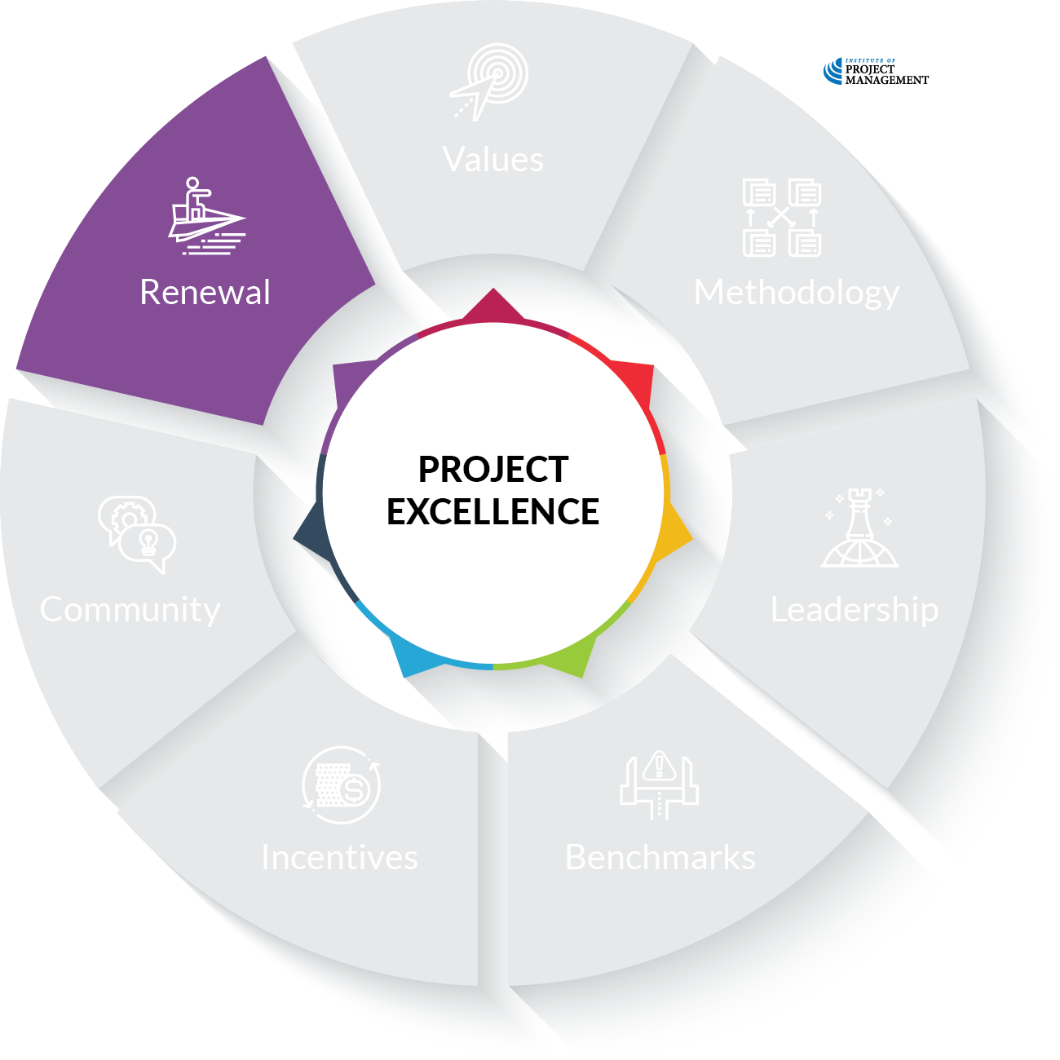
OPEN 12.13
Notes:
Renewal
HR processes supporting recruitment, induction, training, performance management and dissolution of project teams
Project management professional development and career paths
Defined feedback and continual improvement processes

Slide 42
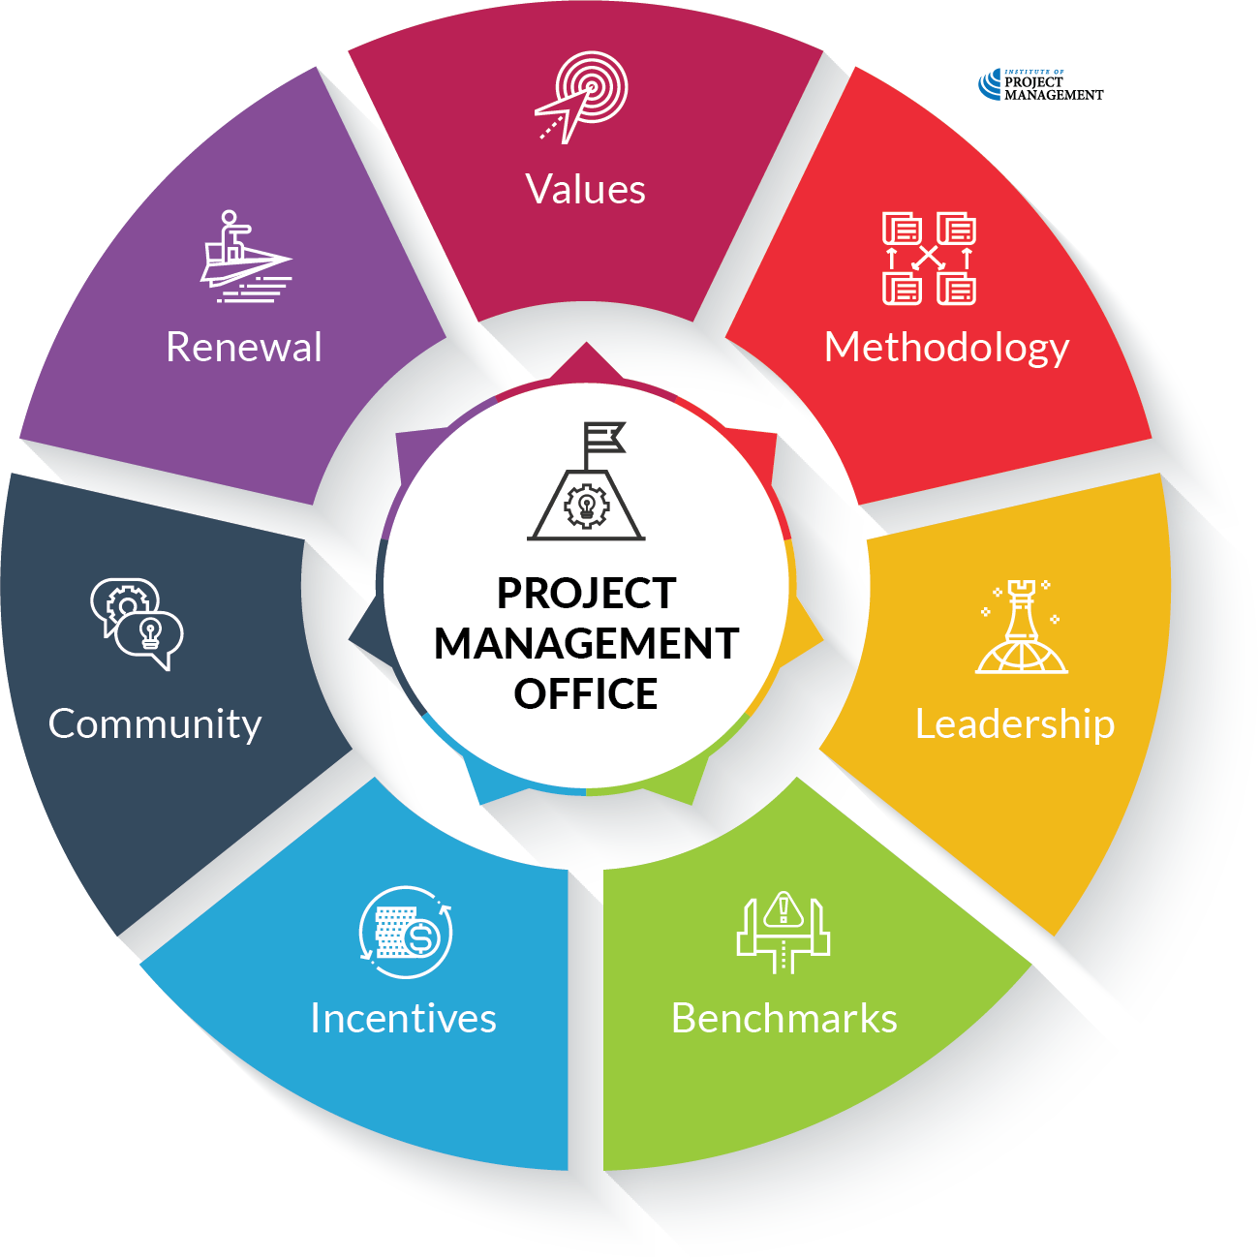
OPEN 12.13
Notes:
Project Management Office
Dedicated ownership of and responsibility for the development, compliance with and renewal of the seven standards

Slide 43
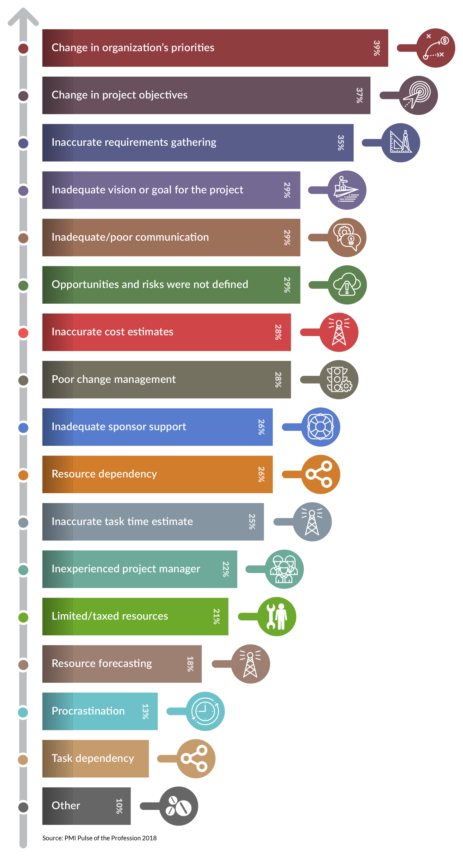
Discussion
How did we go?
Notes:
Reflect on the activity they did in Session 1 re: the causes of project failure – we should have covered them all!
Also acknowledge and praise the volume of learning completed over program – point to this as evidence!

Slide 44
Activity 12.4
Individually:
What are your top three (3) strengths as a project manager?
Where are your biggest three (3) gaps?
As a group:
How will you continue your professional development?
Notes:
Split into 2 parts:
Individual reflection – do not share responses
Group reflection – lead discussion

Slide 45
Activity 12.4 – answer
Education (formal learning) – 10%
Project management courses
Google project management!
Exposure (social learning) – 20%
Engage with project management industry publications and media
Create and publish project management content
Participate in project management conversations (communities of practice)
Find mentors
Experience (applied learning) – 70%
Consciously apply new knowledge
Seek new and challenging projects
Volunteer your project knowledge, experience and skills in the community
Seek feedback and critically reflect and on your performance
Collaborate on organisational improvement
Mentor others
Notes:
In 2000, Lombardo and Eichinger published a seminal work introducing the ‘70:20:10’ learning model. This widely used rule of thumb holds that effective leadership development occurs through a combination of experience, exposure and education, roughly in the proportion of 70-20-10

Slide 46
Reflection
What is the most interesting thing you learned today?
What is one thing you will start, stop or continue doing?
What is one thing you would like to learn more about?

Slide 47
Project reflection
A project you have recently contributed to
Can be a personal or professional project
The project must be complete
You do not need to be the project manager
Use the template provided – 2,000 words minimum
https://open.institute.pm/free-project-management-resources/#close
Notes:
Cert IV PMP students only

Slide 48
Project reflection
PROJECT OVERVIEW (200 words)
1.1 Project description
1.2 Intended outcomes
1.3 Strategic objectives
2 PROJECT PERFORMANCE (300 words)
2.1 Performance against baseline plans
2.2 Outcomes delivered
2.3 Outcomes yet to be realised
2.4 Changes
2.5 Open actions

Slide 49
Lessons learned (1,000 words)
3.1 Stakeholder identification and engagement
3.2 Business case development
3.3 Scope definition and management
3.4 Schedule development and control
3.5 Cost estimating and control
3.6 Procurement and contract management
3.7 Risk identification, prioritisation and treatment
3.8 Project team management and performance
3.9 Project governance and change control
3.10 Project delivery and handover
3.11 Project documentation
3.12 Other lessons learned
What worked well?
What can be improved?

Slide 50
Project reflection
RECOMMENDATIONS / ACTION PLAN (500 words)
Most important part!
How will you (as an individual/organisation) action your lessons learned?
What will you start, stop and continue doing?
Your recommendations should be SMART
Each recommendation is a stand-alone mini-project!

Slide 51
It’s a project!
Plan the work you need to do
Don’t forget to revisit the project documentation
Schedule that work – commit to milestones / due dates
Block the time out in your calendar
Typically takes no more than 3-4 weeks, finding 2-3 hours per week
Send through work in progress – schedule a chat
Dot-point draft

Slide 52
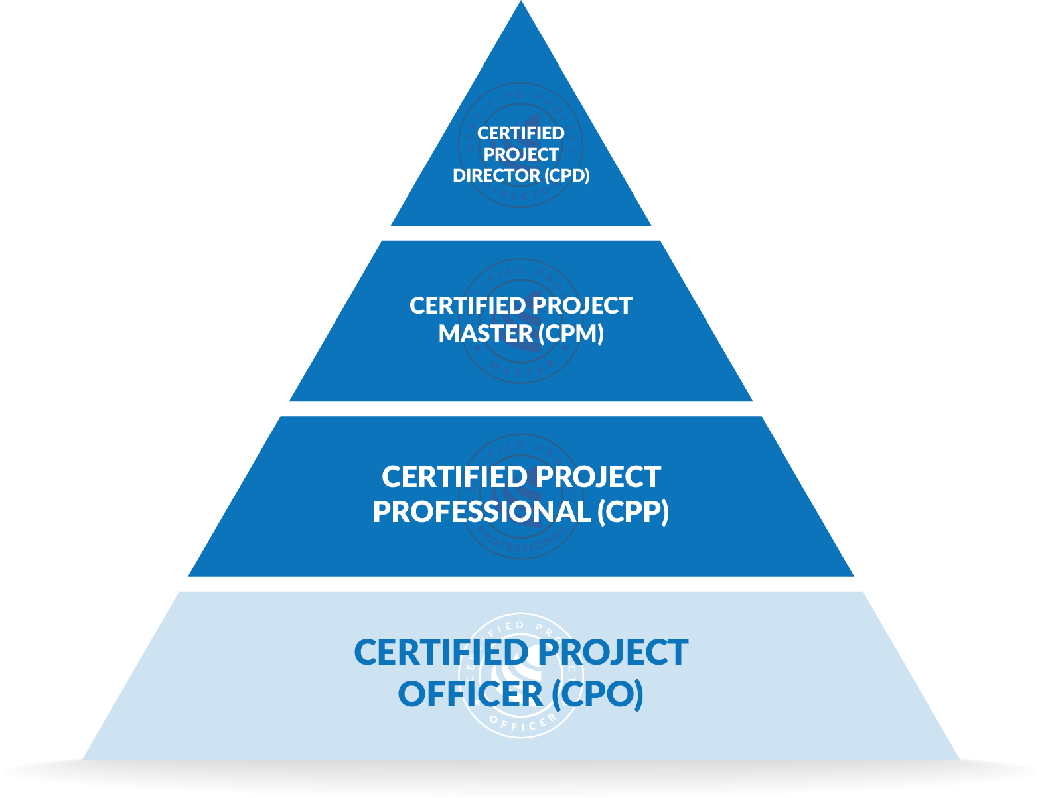
Congratulations!

Slide 53
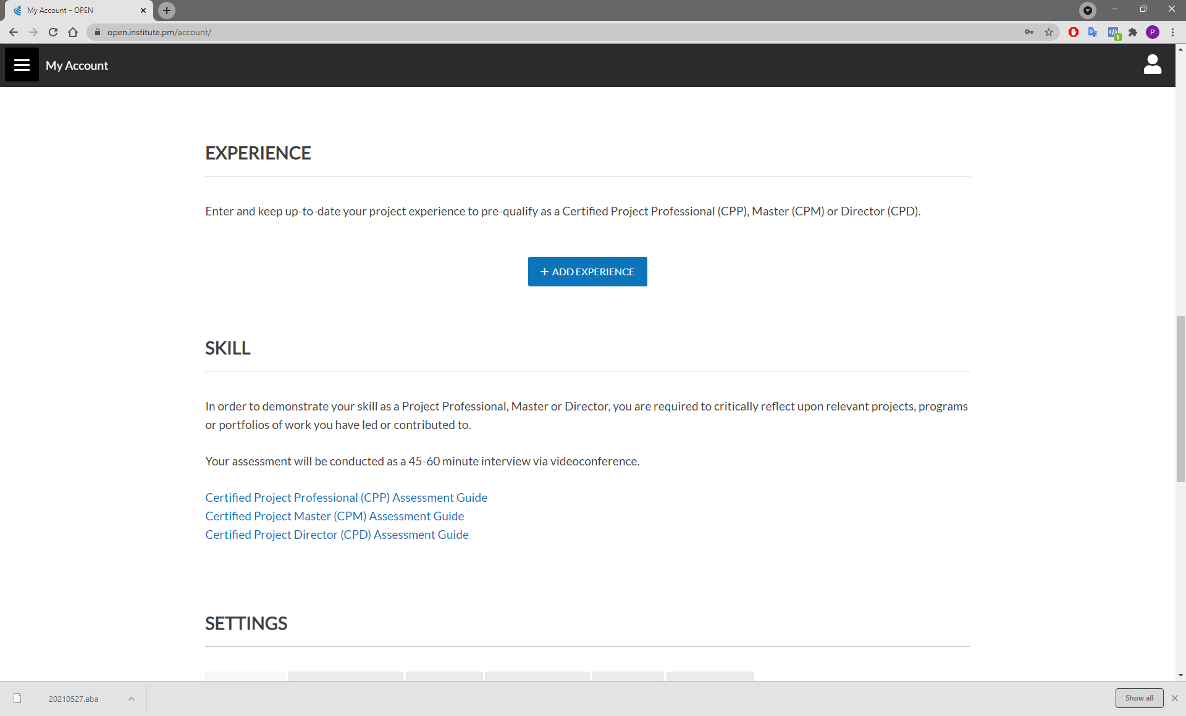
Notes:
To upgrade to a higher-level Certification, visit your account profile page in OPEN and add experience
Note: this is free for Cert IV and ARC students, but costs $500 for vCPO

Slide 54
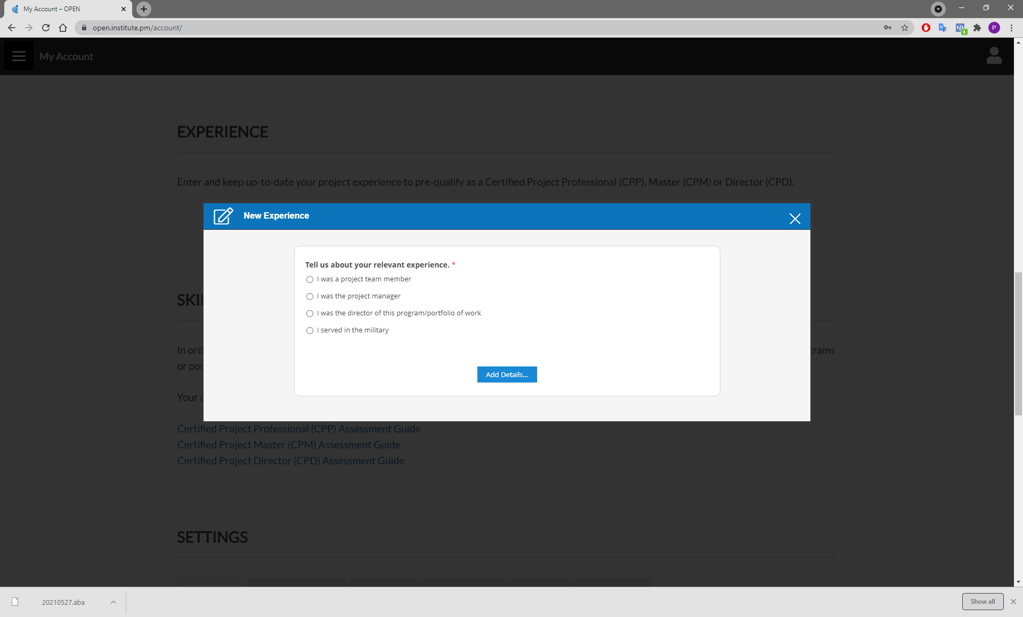
Notes:
Prompts will guide you through the process of adding experience at the appropriate level.
Cert IV and ARC students will receive certification when their experience has been assessed.

Slide 55
What’s next?
BSB50820 Diploma of Project Management
Identify a project (must be a stranger)
Audit project documents
Interview key stakeholders
Prepare review – 4,000 words minimum (template provided)
Full mentor support

Slide 56
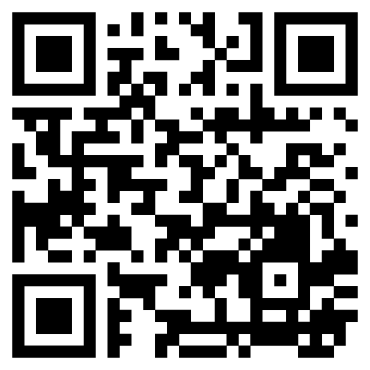
Share your feedback!
https://survey.institute.pm/zs/YxBcop
Notes:
Push link in chat: https://survey.institute.pm/zs/YxBcop

Slide 57
Questions?
Coming next… walk the talk!
Notes:
Stay around until everyone leaves the session to ensure they all get the chance to ask their questions.

Slide 58
Closing checklist
Classroom
Upload signed attendance sheet and any photos taken of work in progress
Zoom
Upload video with thumbnail and link to workshop
Student administration
Mark participating students as complete
Email absent students and notify of gap requirements (OPEN units)
Facilitator feedback – email paul@institute.pm
What worked well today?
How can we improve?

