Slide 1
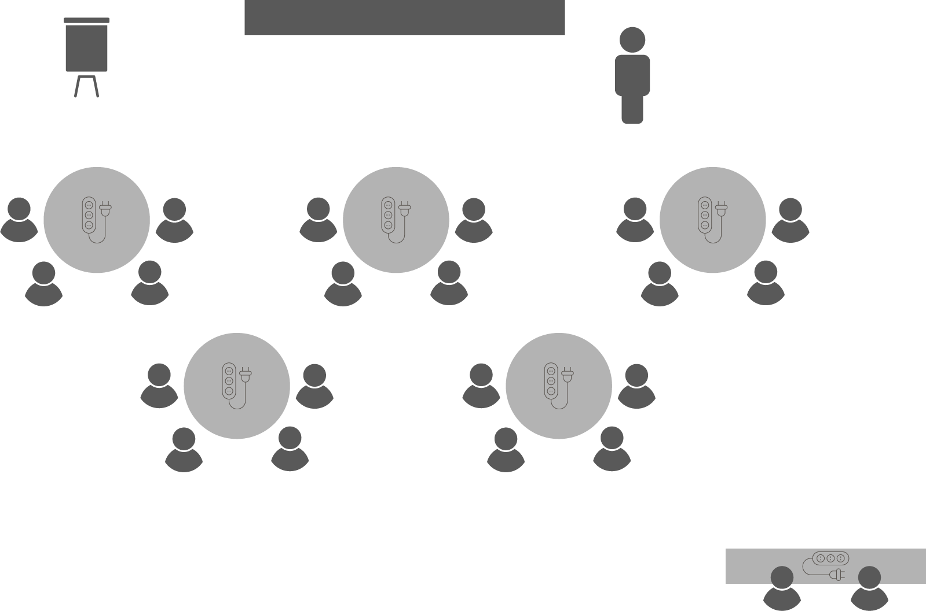
Opening checklist
Your preparation
Review notes, run a technical rehearsal
Rehearse examples / cases / stories to stimulate discussion
Classroom
Ensure students seated at tables of 3-5 and all facing the front
Have student name cards in place and ensure all sign in
Zoom
Rename yourself as host (under participants)
Set-up breakout rooms
https://support.zoom.us/hc/en-us/articles/206476313-Managing-Video-Breakout-Rooms
Welcome students as they arrive, let them know when starting
Notes:
Good luck!

Slide 2
Leading
Successful Projects

Slide 3
Activity 10.1
Who is a leader you personally know and admire?
Choose someone who is not a public figure
What is it about them you admire and/or respect?
Notes:
Just as there is no single, universal method for managing projects, nor is there one perfect leadership style.
In fact, it is not just different projects that require different styles; your style will, can and often should change depending on the individual or group you are engaging with.
Authoritarian leaders provide clear expectations to group members on what should be done, when it should be completed, and how it should be accomplished.
These leaders make decisions without input from group members.
Authoritarian leadership is best used in situations when there is little time for group decision-making or when the leader is the one best equipped to solve the problem or give directions.
Overuse of an authoritarian style can be construed as bossy and controlling.
Worst-case examples of this style can be seen when leaders use bullying techniques such as yelling, abusing power, or demeaning group members.
Participative leaders accept input from one or more group members when making decisions and solving problems, but the leader retains the final say when decisions are made.
Group members tend to be encouraged and motivated by this style of leadership.
This style of leadership often leads to more effective decisions, since no leader can be an expert in all areas.
Input from group members with specialised knowledge and expertise creates a more complete basis for decision-making.
Delegative leaders allow group members to make decisions.
This style is best used in situations where the leader needs to rely on qualified employees.
The leader cannot be an expert in all situations, which is why it is important to delegate certain tasks out to knowledgeable and trustworthy group members.
It is important to note, though, that successful delegation depends on the person you are assigning work to being both capable to complete the task and willing to do the same.
People who lack the necessary context, skills or enthusiasm will require a more direct management style – see the discussion of this in the topic on Delegation the previous Unit.

Slide 4
Activity 10.2
In your experience, what are some of the typical sources of project team conflict?

Slide 5
Activity 10.2 – answer
Divided loyalties
Scarcity of resources
Prioritisation of scheduled tasks
Personal work styles
Poor communication
Lack of openness and honesty
Failure to address commitments
Is all conflict harmful?
Notes:
Conflict is inevitable in projects - sources of conflict include scarce resources, scheduling priorities, personal work styles and culture.
It can be open - with two or more parties actively disagreeing - or it can be passive, whereby an individual is intentionally 'silent', withholding work or decisions.
Team ground rules, group norms, and solid project management practices like communication planning and role definition can all reduce the amount of disruptive conflict, but can conflict be used for constructive ends?
Successful conflict management actually results in greater productivity and positive working relationships.
When managed properly, differences of opinion can lead to increased creativity and better decision-making.
Conflict is in fact necessary for innovation, for without the free exchange and debate of new ideas, processes and practices become rigid and can hold performance back.

Slide 6
Mediating conflict
OPEN 10.6
Notes:
The sooner you recognise conflict, the easier – and more cost effective – it is to manage. The longer conflict goes on, the more stubborn stakeholders become; the larger the circle of people is who are drawn into it; and the more damaging it becomes to productivity. Avoiding conflict, as we will discuss shortly, is rarely the optimal leadership response.

Slide 7
Mediating conflict
OPEN 10.6
Notes:
Choose a good time to approach the affected parties so that no-one is rushed. Don’t start when the one person is in the middle of an important task, or just about to head home – that will only add to the frustration. Find a place where everyone can sit comfortably and quietly for a while. Explain why the conflict is an issue and that you’d like to sort it out.

Slide 8
Mediating conflict
OPEN 10.6
Notes:
This sounds like an obvious step, but often different underlying needs, interests and goals can cause people to perceive problems very differently. You’ll need to agree the problems that you are trying to solve before you’ll find a mutually acceptable solution. Sometimes different people will see different but interlocking problems – if you can’t reach a common perception of the problem, then at the very least, you need to understand what the other person sees as the problem. You should also relate the problem to the project and how it is impacting or likely to impact on the successful delivery of the project.

Slide 9
Mediating conflict
OPEN 10.6
Notes:
Where possible, distinguish the ‘must have’ propositions of stakeholders from things they would merely ‘like to have’ when determining your response. Just be mindful that some people intentionally overstate their demands as a tactic, knowing that many of them are likely to be negotiated away.

Slide 10
Mediating conflict
OPEN 10.6
Notes:
If there is no threat of physical violence, talking it out is the best solution. Face-to-face contact is better than letters and messages – and a good deal better than banging on walls, throwing things, or complaining about it to everyone else. You should also let each party know that you are listening. You may not agree with someone, but there’s nothing more frustrating than trying to talk to someone who doesn’t appear to be listening. Say that you’re glad you’re talking about the problem. This helps to ease the tension and is a great help in moving things towards an agreement.

Slide 11
Mediating conflict
OPEN 10.6
Notes:
Too often, media-driven political debate is about the contest of personalities and not of ideas. That’s because it’s easier and often more penetrating to attack something as simple as style rather than complex substance. As a project manager, however, your priority is the project. Don’t let popular opinion win the day – unless of course you have evidence that it is the best course of action.

Slide 12
Mediating conflict
OPEN 10.6
Notes:
Be outcome-focused. You need to acknowledge the cause of problems; however, publicly berating an individual or group does not actually fix things, and may exacerbate tension. That is to not say that you should ignore root-causes; rather, you should manage blame privately with a view to remediation.

Slide 13
Mediating conflict
OPEN 10.6
Notes:
Ask each participant to describe specific actions they’d like to see the other take that would resolve the differences. From there you can either negotiate or direct a course of action to follow, depending on how much common ground there is between the parties. Both sides need to own their responsibility in the resolution of the conflict and express aloud what they have agreed to. Importantly, it is your role as the mediator to follow up with both parties to ensure these commitments are kept, possibly restarting the process if they are not.

Slide 14
Mediating conflict
OPEN 10.6
Notes:
By encouraging people to openly talk about their different views and disagreements in a calm and structured way, a culture of positive conflict awareness can be created.
Especially in the project environment, it is vital that new ideas and fresh approaches to work are generated and explored by way of vigorous discussion and debate.
It is inevitable and even desirable that different perspectives will lead to conflict at times, which can be framed as creative tension that requires resolution.
Nevertheless, if such conflict is poorly managed and consistently so, it can cause stakeholders to feel there is too much risk involved in contributing new ideas to the team and they may disengage.

Slide 15
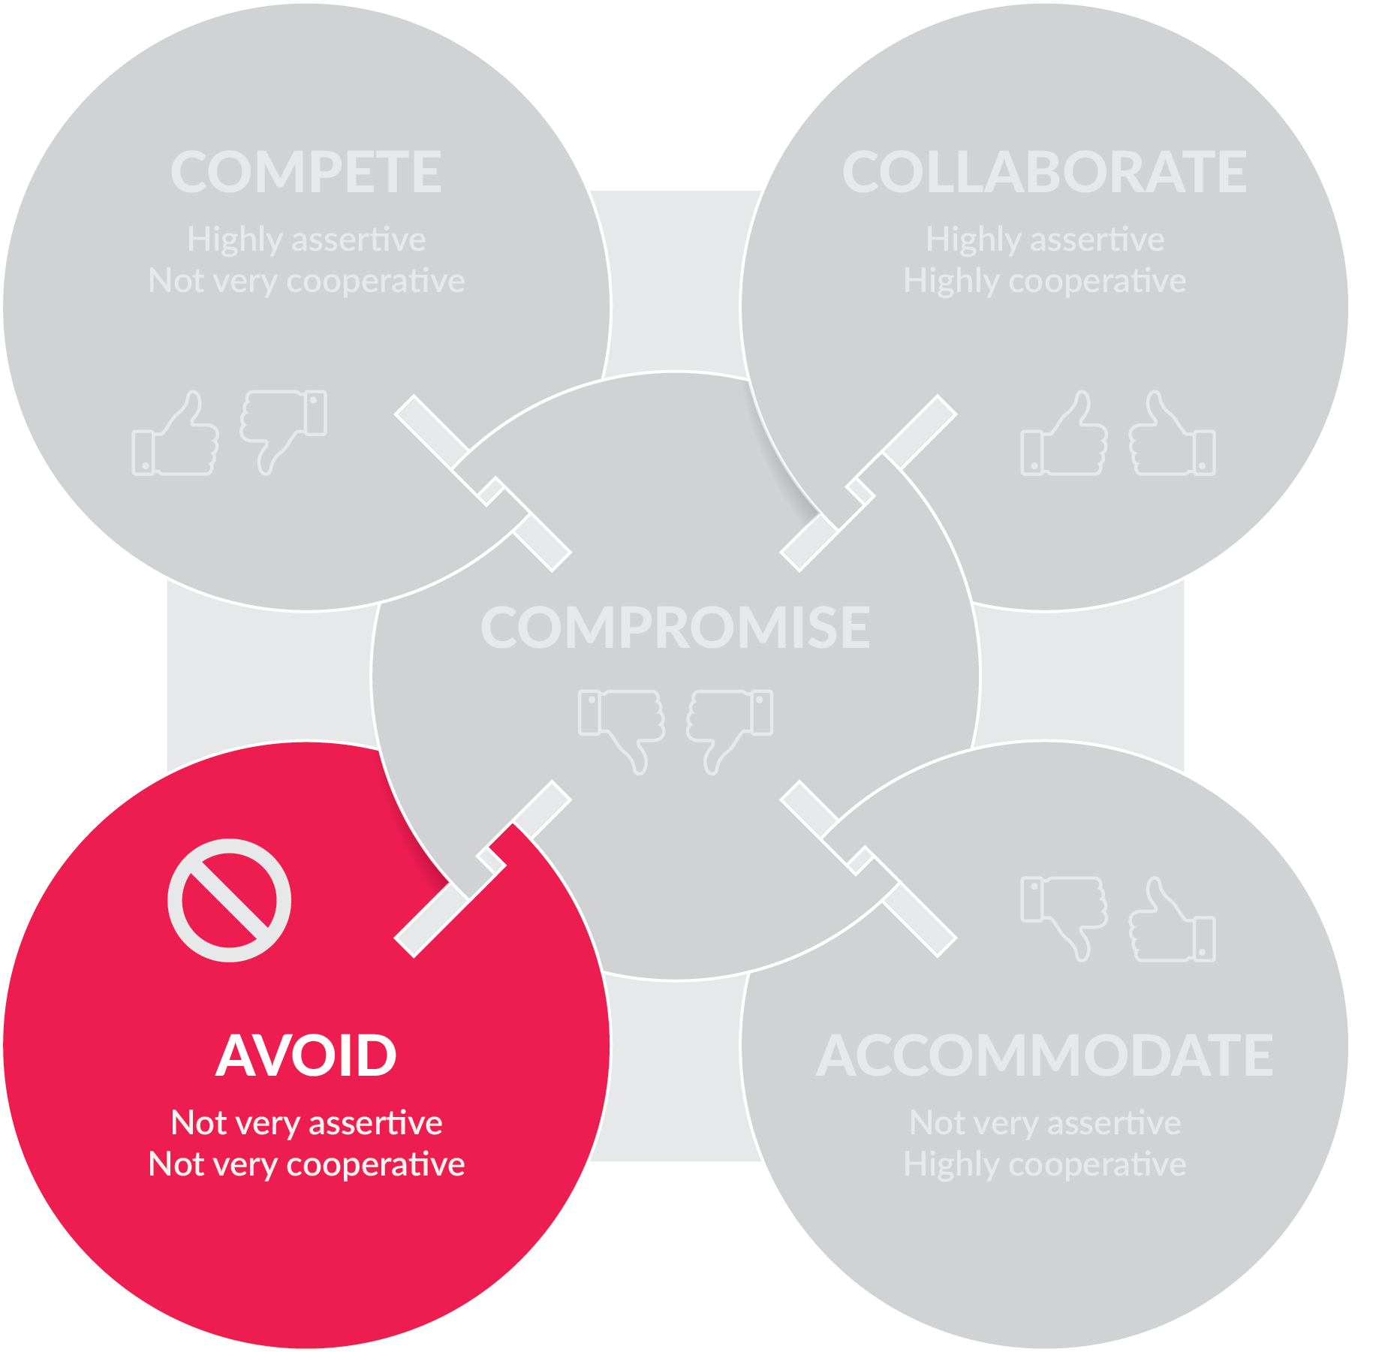
Conflict resolution
OPEN 10.7
Notes:
In the 1970s, Kenneth Thomas and Ralph Kilmann identified five main approaches to dealing with conflict that vary in their degrees of cooperativeness and assertiveness.
Avoiders tend to pretend the conflict does not exist.
This style is typified by delegating controversial decisions, accepting default positions, and not wanting to hurt anyone’s feelings.

Slide 16
Discussion
When is it appropriate to avoid conflict?
Notes:
It can be appropriate when victory is impossible; when the controversy is trivial; or when someone else is in a better position to solve the problem.
However, for the project manager – who we know is expected to be a decision-maker – avoiding is, in many situations, a weak and ineffective response.

Slide 17
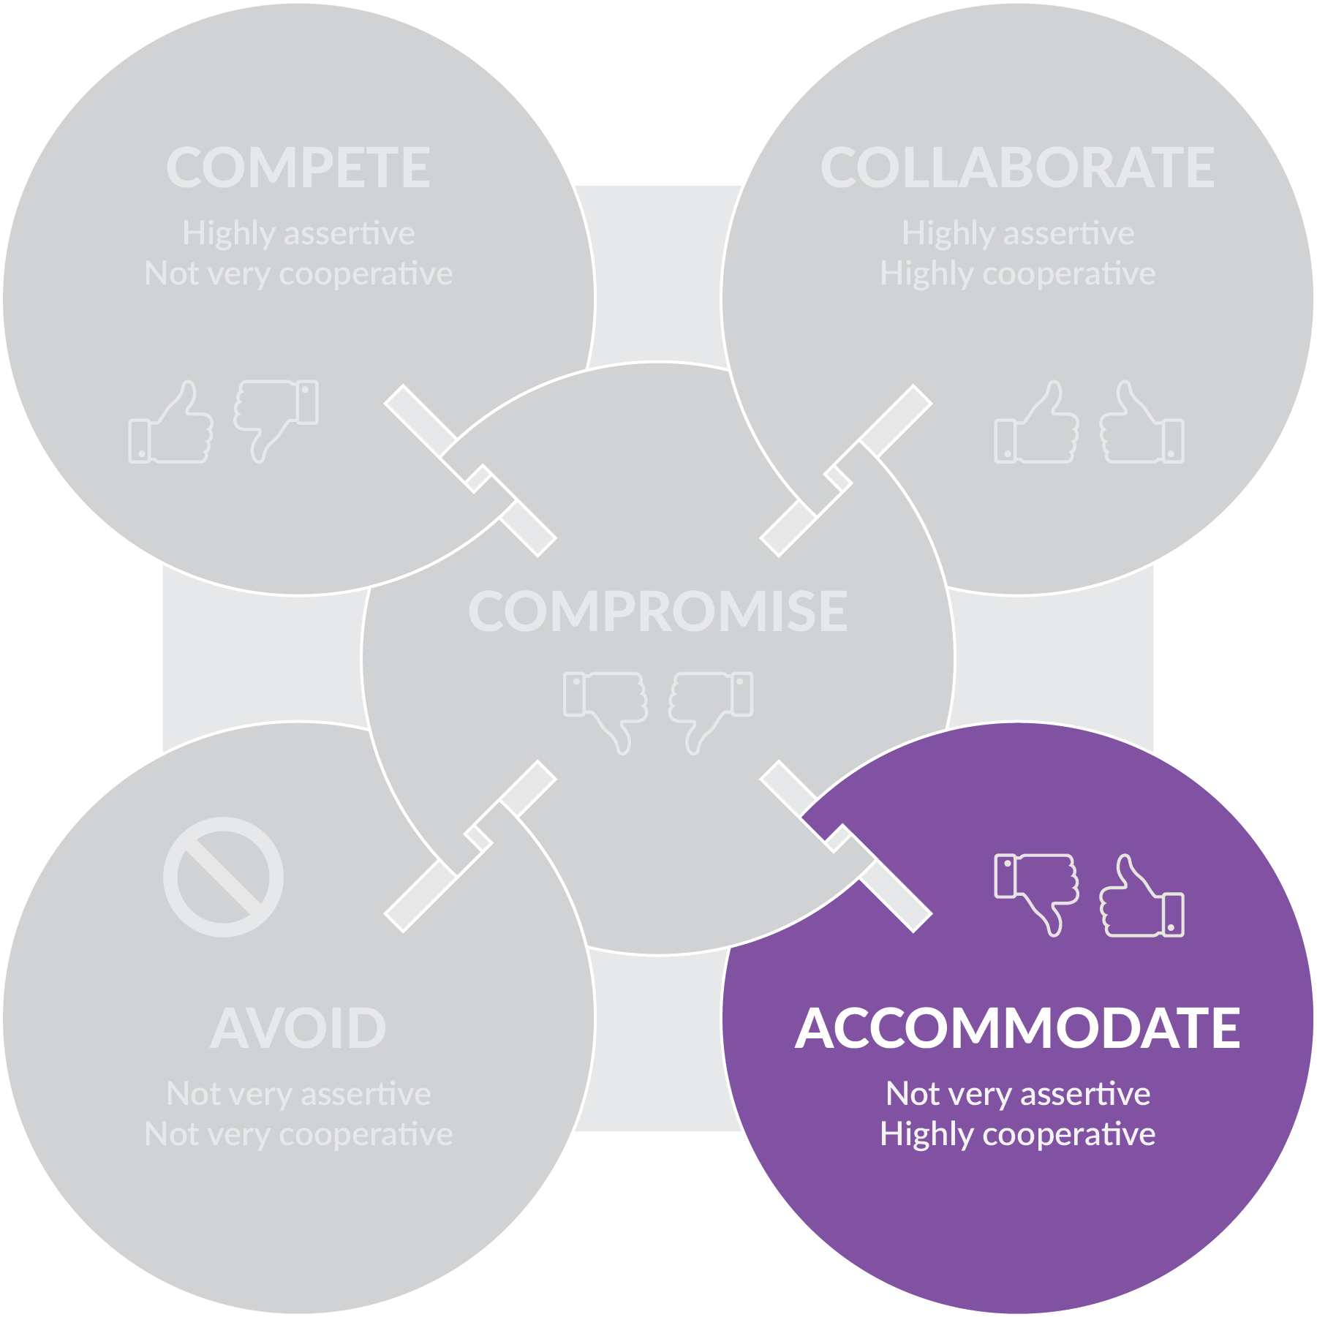
Conflict resolution
OPEN 10.7
Notes:
Accommodating indicates a willingness to meet the needs of others at the expense of the person’s own needs.
The accommodator often knows when to give in to others, but can be persuaded to surrender a position even when it is not warranted.

Slide 18
Discussion
When is it appropriate to accommodate others?
Notes:
Accommodation is appropriate when the issues matter more to the other party; when peace is more valuable than winning; or when you want to be in a position to collect on this ‘favour’ you gave.
However, people may not return favours, and overall this approach is unlikely to give the best outcomes to the accommodator.

Slide 19
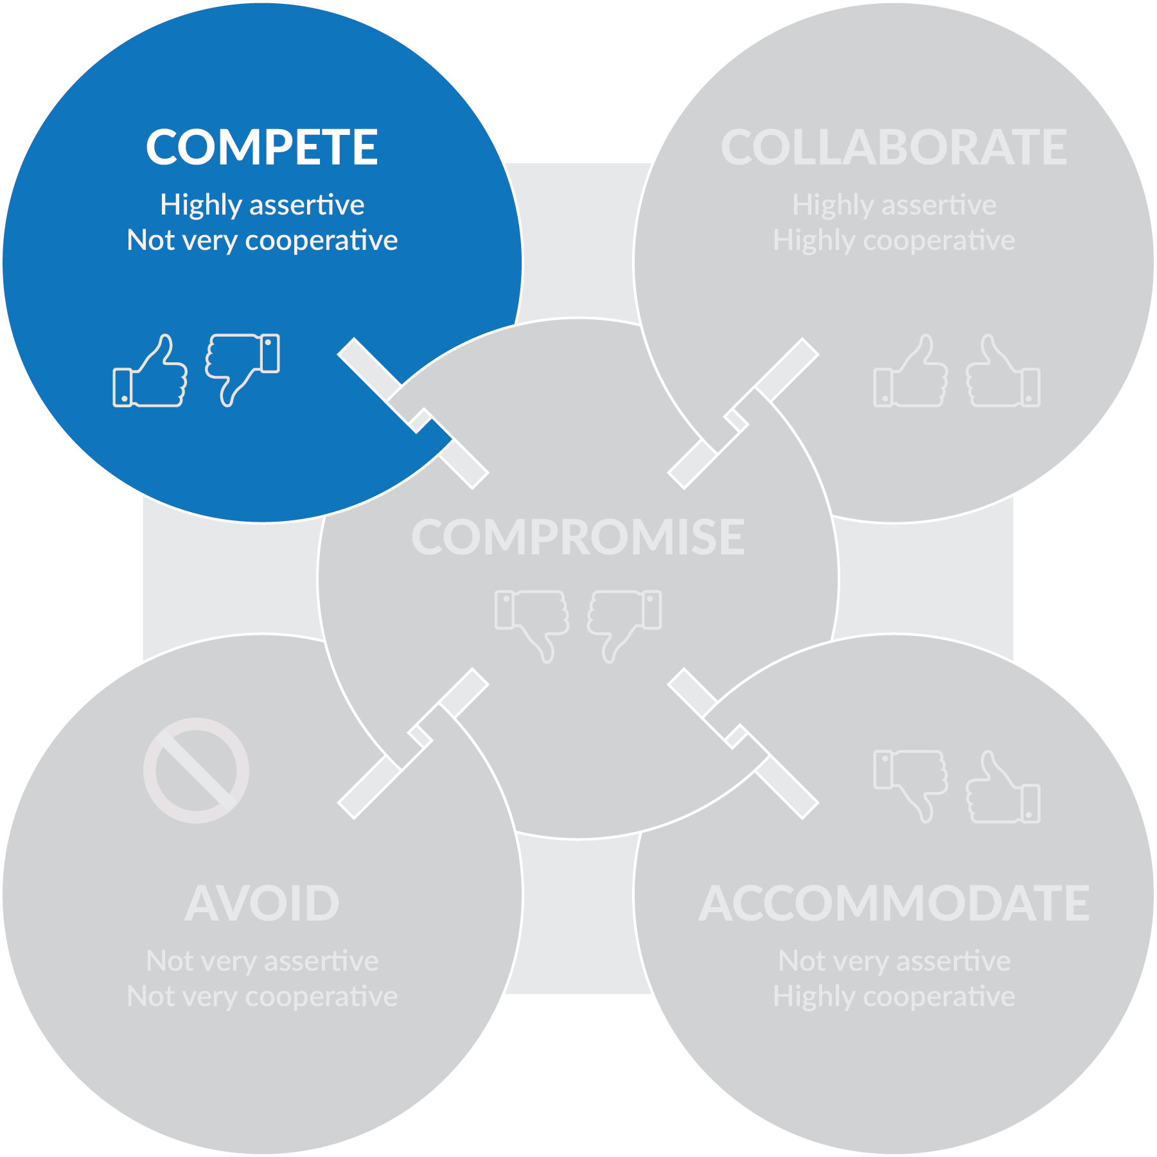
Conflict resolution
OPEN 10.7
Notes:
People who tend towards a competitive style take a firm stand, and know what they want.
They usually operate from a position of power, drawn from things like position, rank, expertise, or persuasive ability.

Slide 20
Discussion
When is it appropriate to ‘win’ conflict?
Notes:
This style can be useful when decisions need to be made fast (as is often the case in projects); when the decision is unpopular; or when defending against someone who is trying to exploit the situation selfishly.
However, it can leave people feeling bruised, unsatisfied and resentful when used in less urgent situations.

Slide 21
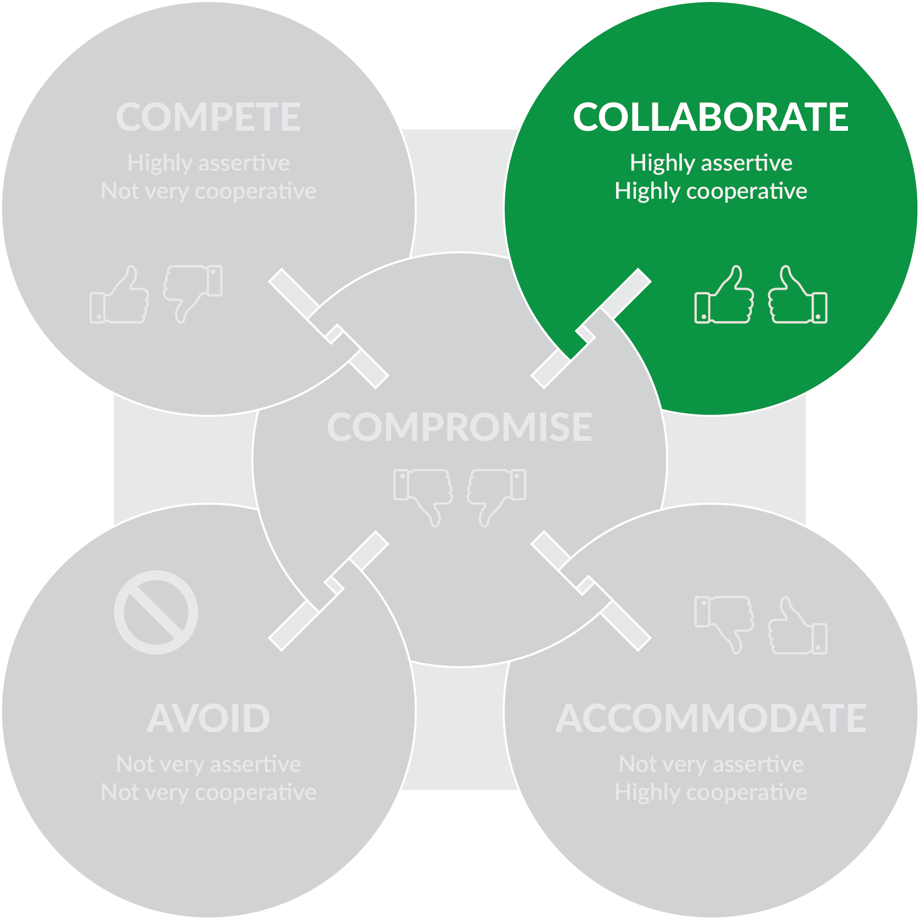
Conflict resolution
OPEN 10.7
Notes:
People tending towards a collaborative style try to meet the needs of all people involved.
These people can be highly assertive but, unlike the competitor, they cooperate effectively and acknowledge that everyone is important.
This style is useful when you need to bring together a variety of viewpoints to get the best solution; when there have been previous conflicts in the group; or when the situation is too important for a simple trade-off.

Slide 22
Discussion
When is it not appropriate to collaborate?
Notes:
Despite being seen as win-win, true collaboration takes much more time to achieve than the other responses, which is often at odds with the scheduling constraints of project delivery.
Collaboration should therefore be reserved for those conflicts where the win-win outcomes are worth these investment costs; ideally at the start of the project when the cost of change is low.

Slide 23
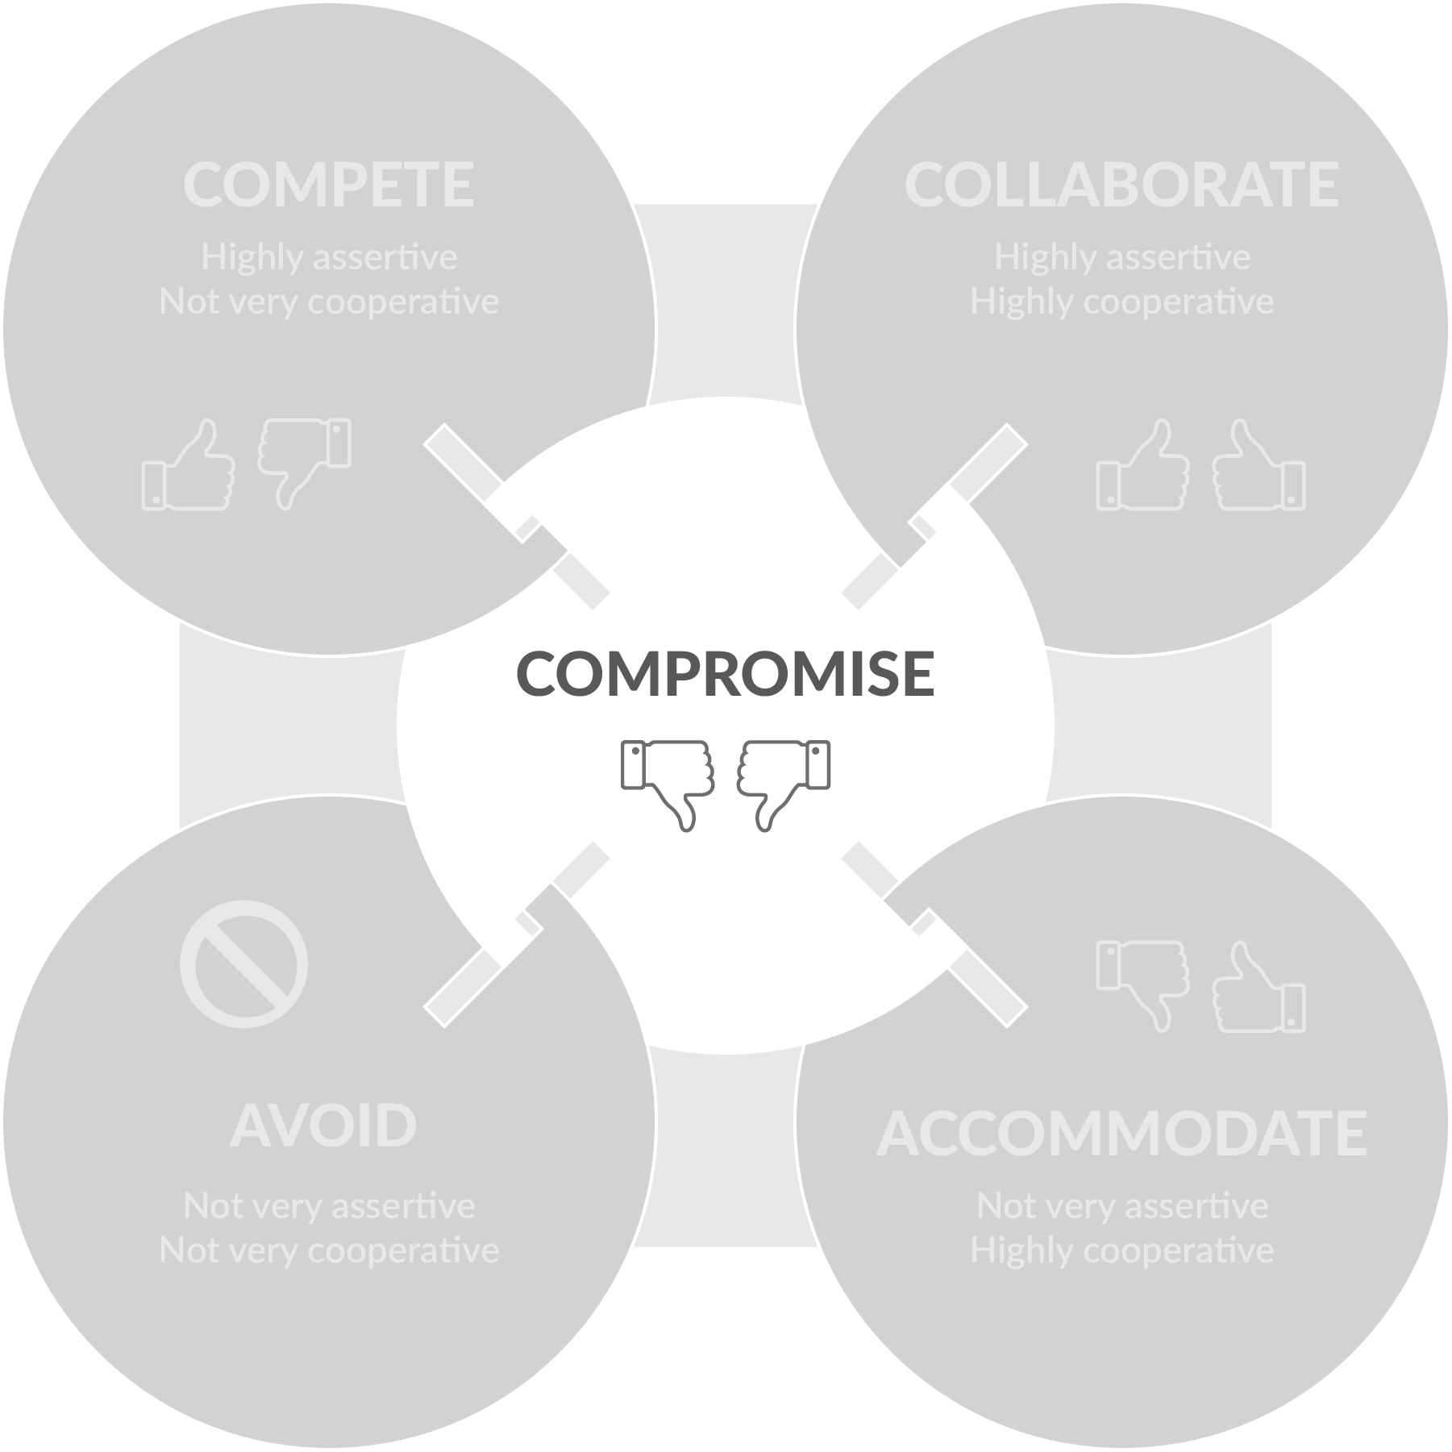
Conflict resolution
OPEN 10.7
Notes:
People who prefer a compromising style try to find a solution that will at least partially satisfy everyone.
Everyone is expected to give up something, and the compromiser themself also expects to relinquish something.
*Note: The two-thumbs down in this graphic illustrate both parties giving something up - it does not imply compromise is a bad thing!

Slide 24
Discussion
When is it appropriate to compromise?
Notes:
Compromise is useful when the cost of conflict is higher than the cost of losing ground; when equal strength opponents are at a standstill; and when there is a deadline looming.
However, it may come at the cost of ‘dumbing down’ ideas.

Slide 25
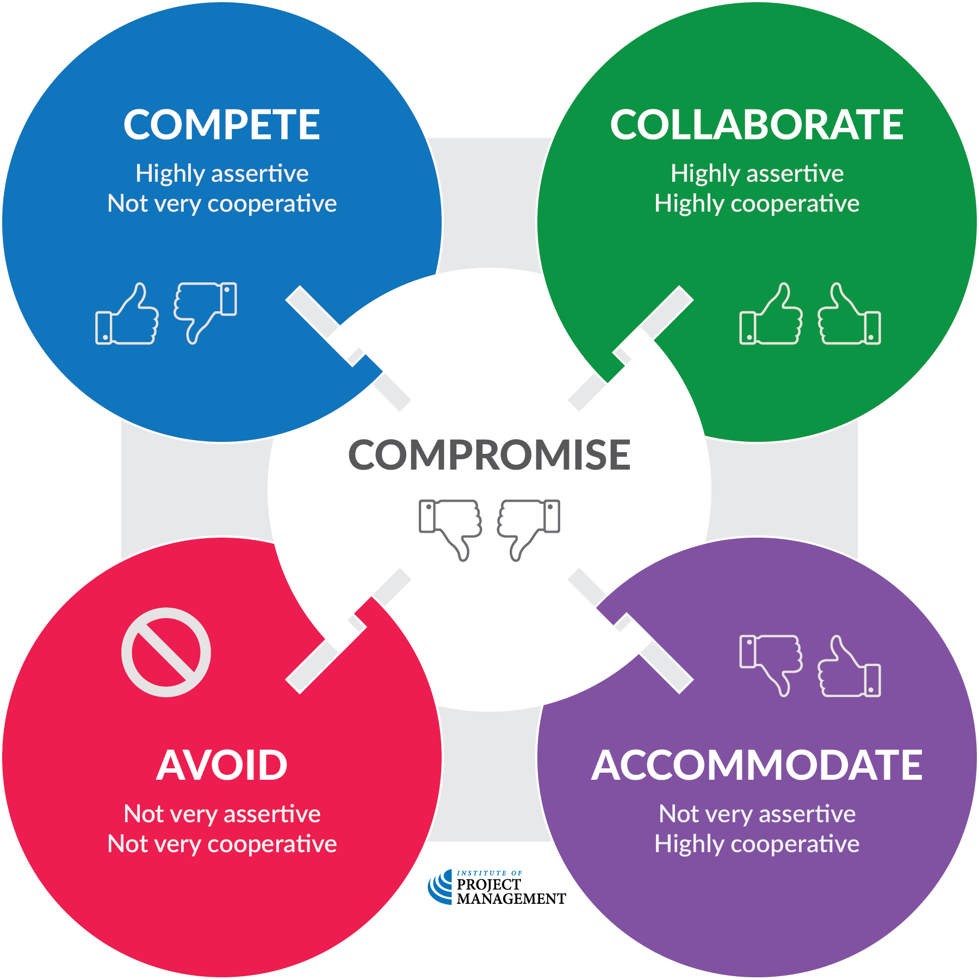
Conflict resolution
OPEN 10.7
Notes:
Ideally, you should adopt an approach that meets the needs of the situation, resolves the problem, respects people’s legitimate interests and mends damaged working relationships.

Slide 26
Activity 10.3
What is your preferred / default conflict resolution style?
Notes:
To be performed individually. Do not share responses.

Slide 27
Q2, Q8, Q13
Q4, Q9, Q12
Q1, Q5, Q7
Q6, Q10, Q15
Q3, Q11, Q14
Notes:
Keep answers private – do not share with group
Make clear that this is the preferred / default conflict res style – there is no ‘best’ approach, as discussed
Does this align with how you view yourself?
People typically have a preferred conflict resolution style that is a function of the extent they are both assertive and cooperative.
Once you understand the different styles, you can use them to think about the most appropriate approach (or mixture of approaches) for the situation you’re in.
You can also think about your own instinctive approach, and learn how you need to change this if necessary.

Slide 28
Notes:
Before breaking, ask students if there are any questions about what has been covered in the session so far.
Once answered, encourage students to stand up, get a drink, go outside and stretch.
If they are on Zoom, tell them to turn their camera and microphone off (you do the same)!
Make sure you tell them the precise time you will be restarting (eg 10:10am)
Don’t check your email – take a proper break!!

Slide 29
Notes:
How to Start a Movement
The second lesson – the bigger the group gets, the more boring (less innovative) it becomes. If you look carefully towards the end you’ll see shirtless guy grab his stuff and stomp off!

Slide 30
Activity 10.4
How do you get the most out of your leaders?
How do you ‘manage up’?
Notes:
Unfortunately, some project managers only pay attention to managing either those they report to or those who report to them.
PMs who only manage up may come across as sycophants; subordinates assume they don’t care about them and may withhold their respect or slack off in their work.
On the other hand, project managers who only manage down can’t advocate for their team or gain buy-in for the project’s endeavours from those further up the chain.
Successful managers pay attention to managing both directions, as well as communicating with their peers.
So how do you engage with and get the most out of your sponsor and senior stakeholders, especially (as is sometimes the case) if they have little understanding of their role?

Slide 31
Activity 10.4 – answer
Communicate
No surprises!
Bring solutions with your problems
Empathise
Understand their strengths, weaknesses and triggers
Know their preferences
Request (and accept) feedback
Notes:
Communicate
First of all (and at the risk of repeating ourselves) communicate!
As we have already discussed, good communication skills are necessary to succeed in almost every situation.
Some stakeholders are readers, meaning they prefer to receive information in written form; others are listeners, meaning they prefer to get their information verbally.
If you want your ideas to be heard, understood, and acted on, make it easy for your stakeholders by communicating in the manner with which they are most comfortable.
But make sure that the communication is two-way – you have to understand each stakeholder’s wants and needs.
Listen and ask questions if you aren’t sure; then feed the answers back to confirm that you heard them right.
No surprises
Don’t surprise stakeholders – even 'good' surprises can backfire on you!
Many experienced project managers can cite examples of bringing a stakeholder what they thought was good news, only to be horribly disappointed.
Regularly scheduled reports of progress should be supplemented by informal, exception driven updates.
Solutions
There are going to be problems with your project – every project has them.
But when you let your stakeholders know about those problems, give them your proposed solution(s).
That shows that you have thought the situations through.
Now there are stakeholders who seem to want to hear only good news; as they don’t want to hear about problems, they represent a particular challenge.
It is up to you to help them face problems head on with courage and innovation.
For the good of the project and the organisation, you must communicate problems and failures with the successes, but do so sensitively and appropriately.
Empathy
Understand, too, your stakeholders’ perspectives and agendas – that way, you can align your priorities with theirs.
Put yourself in their shoes.
While many people think that they have an understanding of their stakeholders' goals and pressures, they don’t always understand their strengths, weaknesses, aspirations, and work styles, or the pressures and constraints on them.
Exploring these will help you identify commonalities you never knew existed and gain a little insight on how to better interact effectively with them.
Preferences
Understand your stakeholders’ preferences, and try to conform to them.
If they want a daily report on what has been accomplished, give it to them. If they want the big picture and not the details, give it to them that way. If they want something in a specific format, give it to them.
That doesn’t mean that you can’t try to show them a better way, but remember to use tact and diplomacy.
If you get offside with a stakeholder, even over something minor, you may never be able to undo the damage.
One of the worst mistakes you can make is to assume you know what your stakeholder expects.
Many stakeholders don’t spell out their expectations, and the burden of discovery falls to you.
If they don’t give you the information that you need, initiate one or a series of informal discussions on ‘our’ objectives.
This can help your stakeholder clarify and communicate his or her ideas, plans, and needs to you; and it gives you the chance to communicate your own ideas as well.
Together, set realistic expectations that you both agree on.
They include expectations on schedule, costs, and the final product. The emphasis is on realistic.
Don’t set expectations too high or you will ruin your credibility when they are not met; but don’t intentionally set them low, either, as this may erode their confidence in you.
Strengths
You need to determine each stakeholder's strengths.
Whether those strengths are communication, seeing the big picture, resource management, new ideas, or something else, go to your stakeholder for their expertise.
Remember, though, that time is a precious commodity for most – every request made of the stakeholder uses up his or her time and resources, so make sure your requests are necessary.
Use their strengths, but if you can do it yourself, don’t waste their time.
Weaknesses
Recognise your stakeholders’ weaknesses and compensate for them.
Your stakeholders are not going to be good at everything – it is up to you to figure out where they are weak and provide your support in those areas.
You might just want to intentionally try doing something to make life easier for your stakeholder.
Maybe you can build the slides for their briefings, track the finances, monitor the schedule, or provide the support that they need in some area.
And perhaps your stakeholder will spend that extra time or effort that you saved them to advocate for your project’s needs.
Triggers
Be aware of your stakeholders’ hot buttons and pet peeves.
Is it being late to meetings or not contributing, sloppy memos or e-mails, swearing, a loud radio?
Sounds obvious, but whatever they are, consider them landmines to be avoided.
Ignoring them (or not understanding them) can sour your relationship with the stakeholder.
And that can mean an unsuccessful project because you didn’t get the support that you needed – or worst case, it can be career suicide for you.
Feedback
Finally, request feedback – and learn to accept it.
Request periodic feedback if you aren’t getting it – don’t wait for the end of project review to find out a stakeholder’s opinion of you and your work.
If you get bad feedback, discuss your concerns, but do it on a mature level, not emotionally or confrontationally.
As in a marriage, the best approach is non-adversarial.
Listen to what they say and try to act on it.

Slide 32
Discussion
How would you respond to the following ethical dilemmas?
A consultant invites you as a guest to a trade show
Your CEO intentionally misrepresents your project in the media
You are accidently cc’d on an email that reveals personal and confidential stakeholder details
Halfway through delivery, you learn your project can make significant savings by terminating staff and outsourcing production to another country
Your project’s sponsor becomes romantically involved with the client

Slide 33
Activity 10.5
What does it mean to be an ethical project manager?

Slide 34
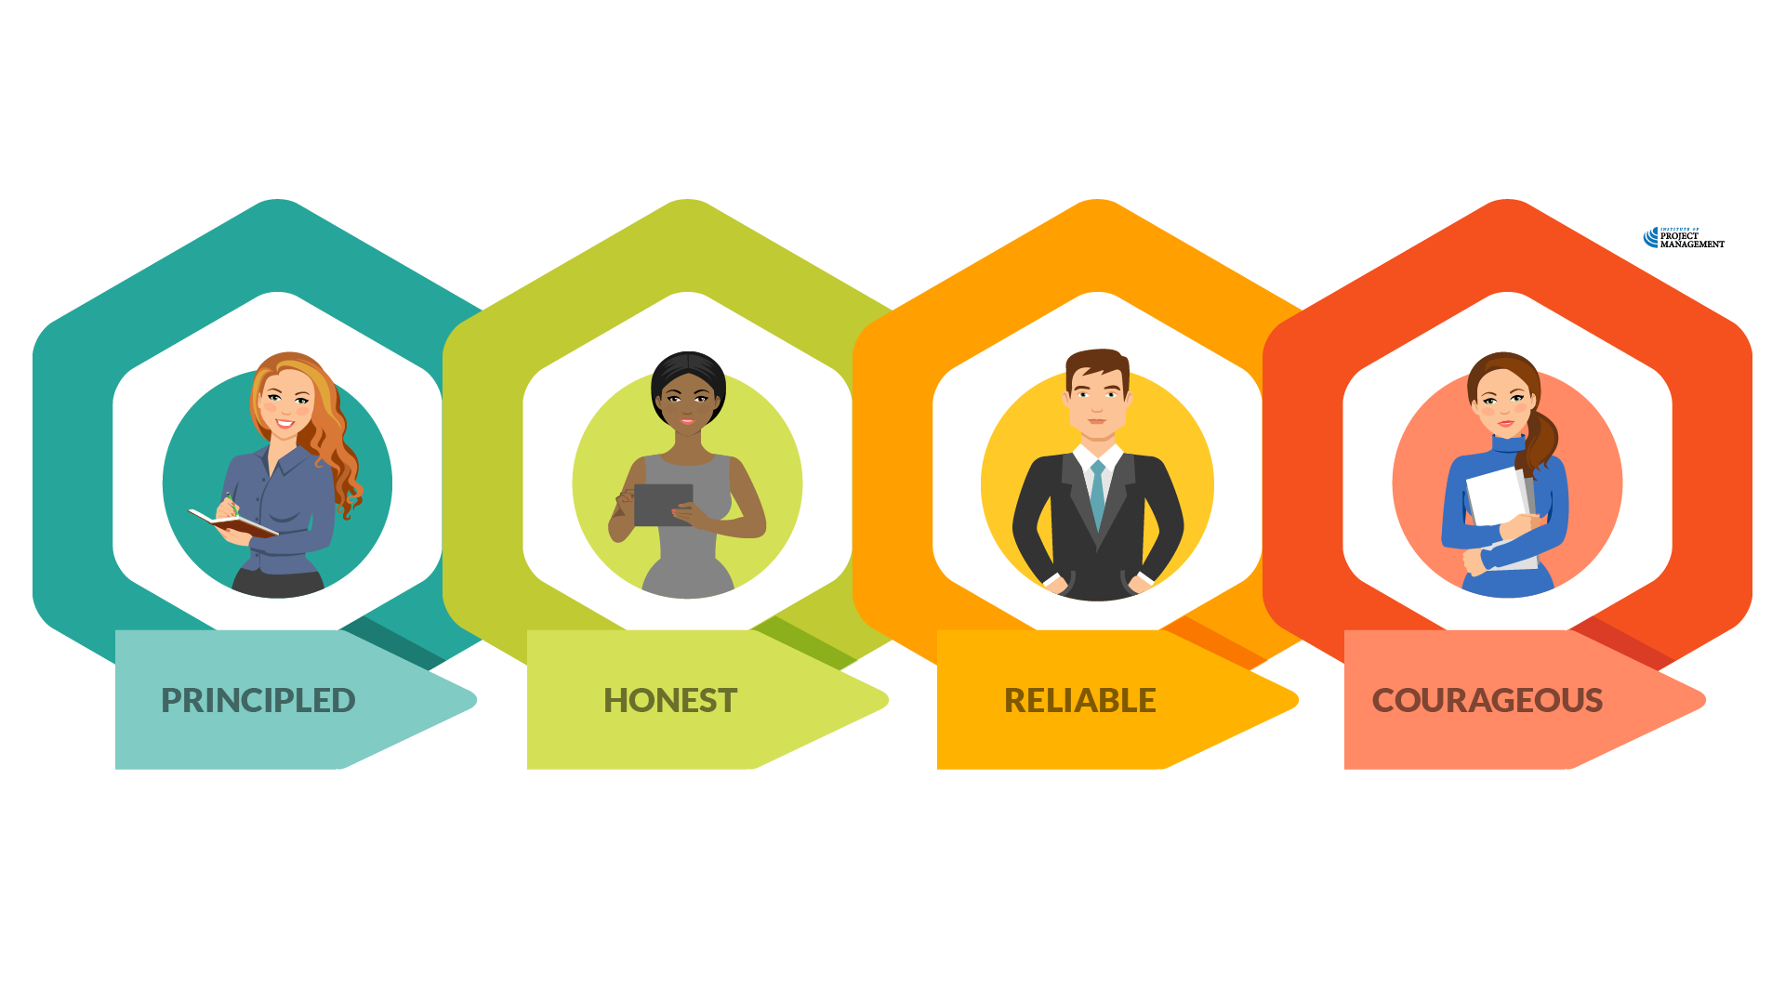
Activity 10.5 – answer
Notes:
A principled project manager has well-defined values, principles and purpose.
They have consciously articulated what is important to them and the behavioural boundaries they will not cross.
Many organisations have a code of conduct that spells out their ethical principles
An honest project manager is capable of self-reflection, admitting error and learning from their mistakes.
They are as honest with themselves as they are with others.
A reliable project manager tracks and keeps their promises, whether they are made in person or implied in the project plan.
They are also honest enough to recognise when promises cannot be kept and up-front enough to disclose this to others.
A reliable project manager is also consistent in their decision making – they treat all groups or classes of individuals with fairness and equity.
A courageous project manager does not hide bad news
They are willing to acknowledge both complexity and uncertainty, tackling problems head on as they arise.
Importantly, they do not turn a blind eye to the questionable ethical conduct of others.
As Lt General David Morrison once famously said, “The standard you walk past is the standard you accept.”

Slide 35
Activity 10.6
What are the attributes of the ‘perfect’ project manager?

Slide 36
Activity 10.6 – the PM paradox
Manager
Autocrat
Pursue perfection
Written communicator
Champion simplicity
Think small
Impatient
Reactive
Leader
Delegator
Tolerate ambiguity
Oral communicator
Acknowledge complexity
Think big
Patient
Proactive
Notes:
You can learn to master a Gantt chart in a day, but you will spend your whole career - sometimes imperfectly - learning how to lead projects.
Although everyone, everywhere needs to learn to work in teams, in projects you must also work with multiple, independent experts, often from multiple, independent companies, where each is reliant on all the others voluntarily giving their best.
Tom Peters suggests that in that case, there are seven paradoxes you must learn to master:
The perfect project manager needs to be a leader and a manager.
Today’s project managers, more so than in traditional settings, are only as good as their teammates’ commitment, energy and diverse skills.
So project managers must be leaders – visionaries and invigorators.
On the other hand, ‘management’ means being expert at the mechanics.
Stellar project bosses match a passion for inspiring others with a love for the nuts and bolts of the job.
The perfect project manager needs to be an autocrat and a delegator.
When the chips are down, the project manager must issue the orders, fast – for example, when the lights go out in the conference centre with 5,000 people streaming in!
On the other hand, she or he needs to be a masterful delegator: in that crisis (when the lights go out), lighting experts should own the problem and take the initiative to deal with the situation before the chief ever becomes aware of it.
The perfect project manager needs to tolerate ambiguity and pursue perfection.
After all, the essence of complex projects is ambiguity – the only constant is change.
Effective project managers handle uncertainty with cool and a sense of humour.
But they must have equal zeal for the tidy.
The downfall of botched projects is often caused by something trivial.
The perfect project manager needs well developed oral and written communication skills.
Most people have either a verbal or a ‘put it in writing’ bias – top project managers must have both.
In as much as you can insist on an audit trail of memos to document every this or that; dealing orally, on the fly, must come just easily.
However, project managers must also be compulsive about the written master plan and the daily to-do list.
The perfect project manager needs to acknowledge complexity and champion simplicity. Nothing is more complex than a sophisticated, multi-organisation project. Effective project managers must juggle a thousand balls of differing (and ever changing!) shapes and sizes.
On the other hand, they must be 'Keep It Simple, Stupid' champions, making sure that a few, essential values dominate the delivery (for example, nobody misses the 7am Monday meeting).
The perfect project manager needs to think big and think small. Project managers must appreciate both the forests and the trees. Those fixated with the ‘big picture’ will trip up over the particulars.
Yet project managers obsessed with excessive attention to detail may miss the main point. Success means seeing the relationship of the tiny to the large, and the large to the tiny at every moment.
The perfect project manager needs to be impatient and patient. Project managers must be action fanatics: get on with it; don’t dwell on yesterday’s hiccups. At the same time, they run a network with fragile egos, multiple cultures and complex relationships.
But of course, project managers don’t 'run' networks at all – they are, at most, first among equals. Forget the word 'sub-contractor' and think co-contractor. When one deals with equals, devoting lots of time to relationship building becomes as important as impatiently pushing for action.
To this I would add one other: Be proactive and reactive
The early stages of a project (initiation and planning) are all about proactively anticipating and putting in place management responses to the risks inherent in taking on your unique endeavour.
Despite this, risk can never be reduced to zero - you must be equally skilled at reacting to the ever changing stakeholder and operating environment, taking advantage of opportunity and leveraging change.

Slide 37
Leadership case study
Download the case study scenario
Submit a video discussing how you would respond to the various features of the case
You can refer to notes, but do not read a script
PowerPoint is good, but not required
Video must be at least 5-10 minutes
Notes:
Cert IV PMP students only

Slide 38
Reflection
What is the most interesting thing you learned today?
What is one thing you will start, stop or continue doing?
What is one thing you would like to learn more about?

Slide 39
Questions?
Coming next… managing change
Notes:
Stay around until everyone leaves the session to ensure they all get the chance to ask their questions.

Slide 40
Closing checklist
Classroom
Upload signed attendance sheet and any photos taken of work in progress
Zoom
Upload video with thumbnail and link to workshop
Student administration
Mark participating students as complete
Email absent students and notify of gap requirements (OPEN units)
Facilitator feedback – email paul@institute.pm
What worked well today?
How can we improve?

