Slide 1
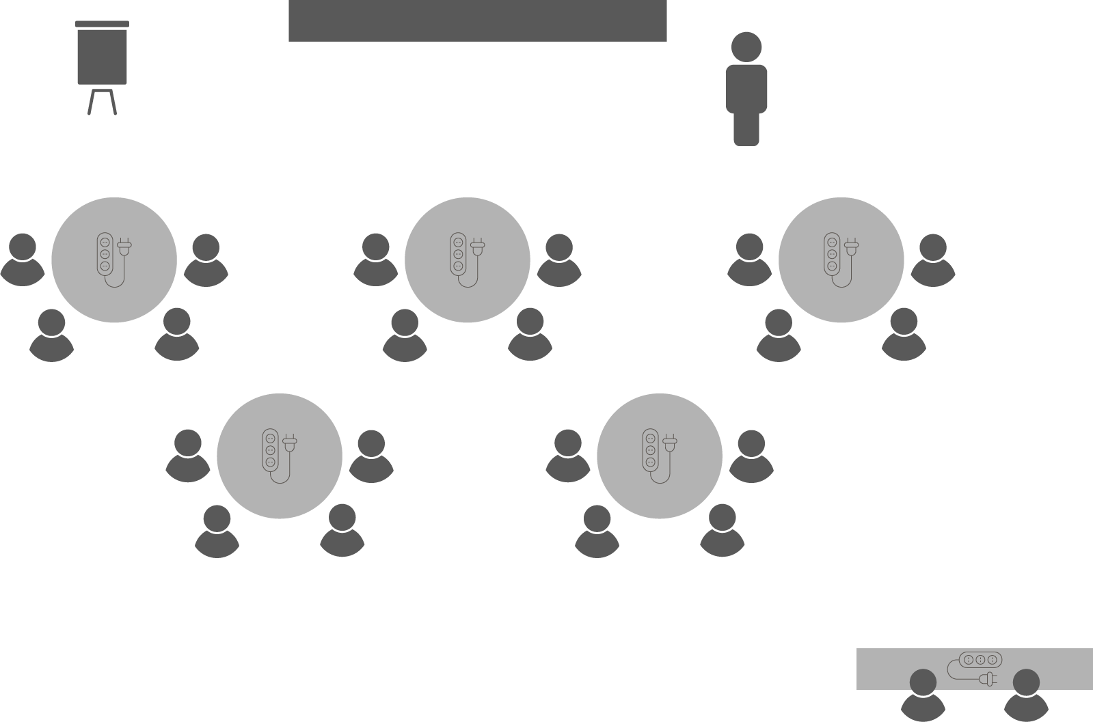
Opening checklist
Your preparation
Review notes, run a technical rehearsal
Rehearse examples / cases / stories to stimulate discussion
Classroom
Ensure students seated at tables of 3-5 and all facing the front
Have student name cards in place and ensure all sign in
Zoom
Rename yourself as host (under participants)
Set-up breakout rooms
https://support.zoom.us/hc/en-us/articles/206476313-Managing-Video-Breakout-Rooms
Welcome students as they arrive, let them know when starting
Notes:
Good luck!

Slide 2
Managing
Project Risk

Slide 3
Project risk management
Murphy’s Law
Anything that can go wrong, will go wrong
Notes:
In 1949, Captain Edward A. Murphy was an engineer working on Air Force Project MX981, a project designed to see how much sudden deceleration a person can withstand in a crash.
One day, after finding that a transducer was wired incorrectly, he cursed the technician responsible and said, “If there is any way to do it wrong, he’ll find it.”
The project manager, George E. Nichols, kept a list of ‘laws’ and added this one, which he called Murphy’s Law.
Shortly afterwards, the Air Force doctor who rode a sled on the deceleration track to a stop, pulling 40Gs, gave a press conference.
He said that their good safety record on the project was due to a firm belief in Murphy’s Law and in the necessity to try and circumvent it.
Aerospace manufacturers picked the phrase up and used it widely in their ads during the next few months, and soon it was being quoted in news and magazine articles around the world.
Murphy’s Law is these days best known as, “If anything can go wrong, it will.”
As a phrase that has its origins in project management, it goes to the heart of the risky nature of projects.
Extending this, the Northrop project manager Nichols’ Fourth Law says, “Avoid any action with an unacceptable outcome.”
Beyond the WBS, schedule and budget, you need to plan how you are going to manage risk throughout the life of your project.
That is the scope of this Session.

Slide 4
Definitions
OPEN 7.1
Risk
An uncertain event or condition
If it occurs, it will impact at least one project output / outcome
Issue
A risk (known or unknown) that has materialised
Trigger
An event that causes a risk to become an issue
Notes:
Note too our careful use of language: a risk is an uncertain event (in other words, it has not yet occurred) that may have one or more impacts on the project; whereas an issue is an event that has occurred and is impacting upon the project.
It is also important to flag that even though we generally think of risks as something negative (as in Murphy’s Law), the processes we follow here are equally reliable in addressing opportunities; that is, uncertain events that might have a positive impact on the project.

Slide 5
Known
Known
Internal
External
CONTROL
REACT
Unknown
Unknown
Internal
External
Notes:
Project management – everything we have discussed to this point – is risk management, in that we are through careful and detailed initiation and planning trying to reduce the risk of something going wrong with our project (in delivery) and future projects (through our closing processes).
Formal risk management commences once we have completed the project plan (WBS, schedule and budget) – we now stress test that plan and make appropriate accommodations, something we continue through the life of the project.
There are two types of project risk: known risks and unknown risks.
Known risks can be either treated directly or have contingent responses created for them.
All we can do for unknown risks is allocate a general reserve of time and money and hope for the best!
In this illustration, the purpose of risk management is to lower the waterline, make us less reactive and more proactive in how we manage our project and its potential issues.

Slide 6
OPEN 7.1
Notes:
Risk management is a 4-step cycle that commences with identifying all known risks

Slide 7
OPEN 7.1
Notes:
Next, we analyse and (as we did with stakeholders) prioritise the risks.
After all, not every risk is equally deserving of our urgent attention!
In fact the stakeholder prioritization and engagement model we introduced in Session 2 is based on this more widely understood risk management process.

Slide 8
OPEN 7.1
Notes:
As with stakeholders, our risk prioritization will determine how we respond to (or treat) each risk.

Slide 9
OPEN 7.1
Notes:
Treating risk though is not the end of the process!
As a risk is definitionally something that has not yet occurred, we must continue to monitor risks and appropriately respond to changes in the environment.

Slide 10
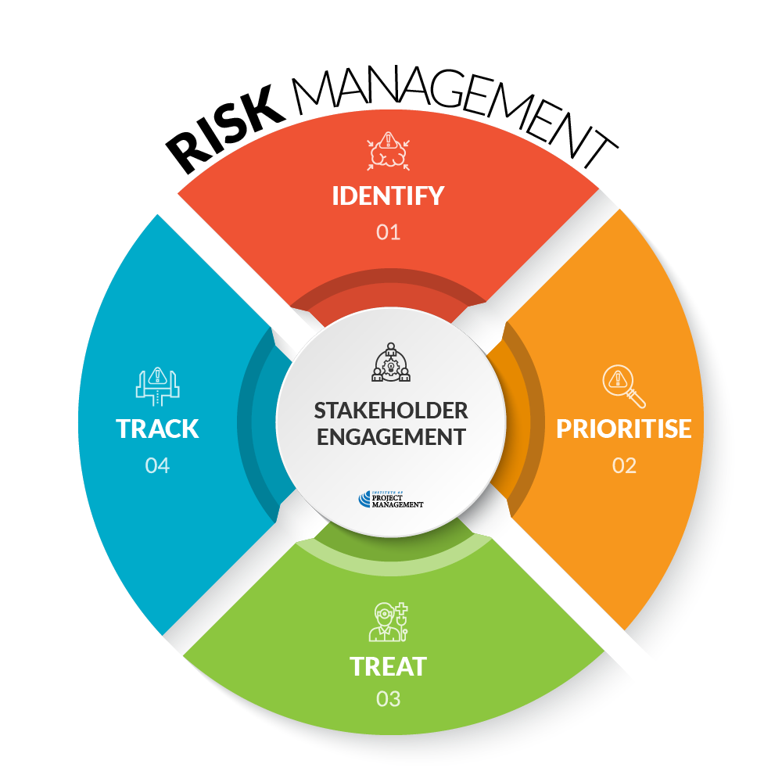
OPEN 7.1
Notes:
This may mean identifying or reprioritizing risks and making necessary changes to how we treat them!
As with all things project management, your engagement with stakeholders can make a significant difference to the efficiency and effectiveness of this process.

Slide 11
OPEN 7.2
Notes:
Let’s start with risk identification…

Slide 12
Typical sources of project risk
OPEN 7.2
Unknown stakeholders
Fuzzy scope / requirements
Poor estimates / under-resourcing
Project team capability
External dependencies
Health, safety and environmental factors
Decision / dependency bottlenecks
Changing stakeholder expectations / commitment
What else?

Slide 13
Brainstorm / mind-map – example
OPEN 7.2
Notes:
Mind mapping is a great brainstorming technique that can be used to identify different project risks and their relationships to each other.
Mind mapping converts ideas created through individual brainstorming into a single map to reflect commonality and differences in understanding, and generate new ideas.
A mind map is often created around a single word or text, placed in the centre, to which associated ideas, words and concepts are added.
Major categories radiate from a central node, and lesser categories are sub-branches of larger branches.
Categories can represent words, ideas, tasks, or other items related to a central key word or idea.
We will show you how to develop and use a mind map in the Unit on managing project risk.
Let’s look at risks to our hypothetical event – what if only 20 people (out of 200 expected) attend?

Slide 14
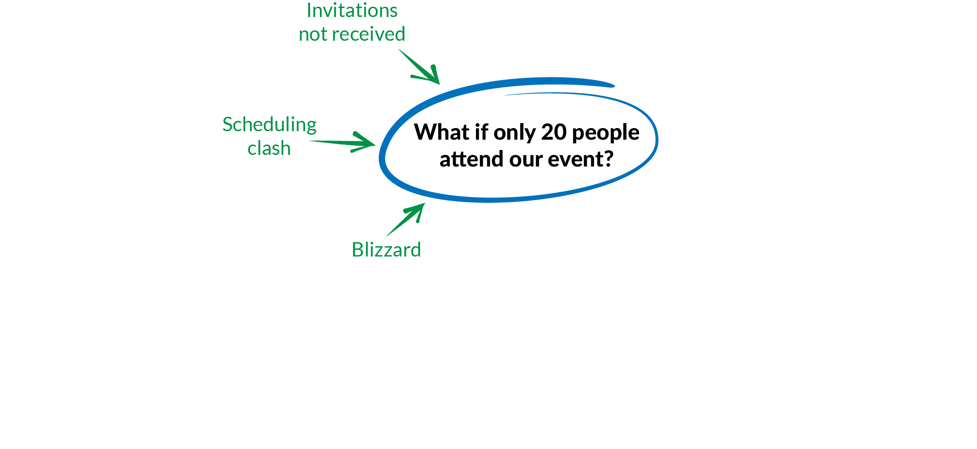
Brainstorm / mind-map – example
OPEN 7.2
Notes:
What are some of the things that could cause this to happen?
You may identify more than the 3 listed here, but we’ll keep it simple for the purposes of illustration.

Slide 15
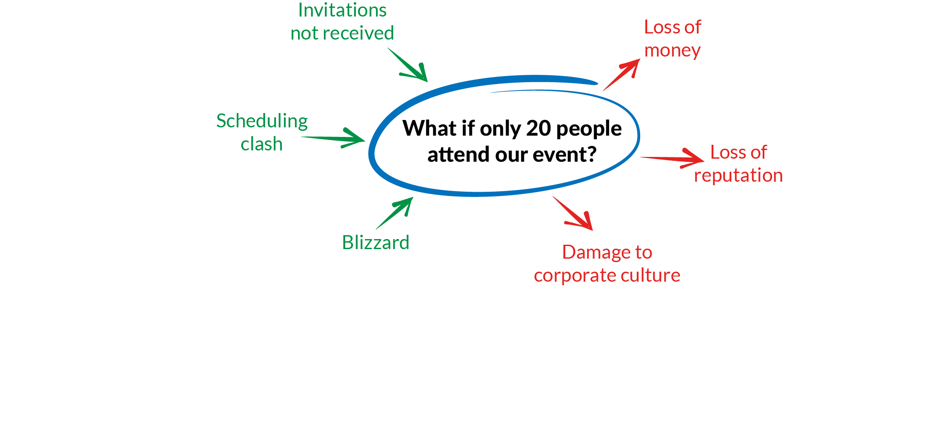
Brainstorm / mind-map – example
OPEN 7.2
Notes:
What does it mean for us if only 3 people attend – what are the consequences for (or impacts on) our project?

Slide 16
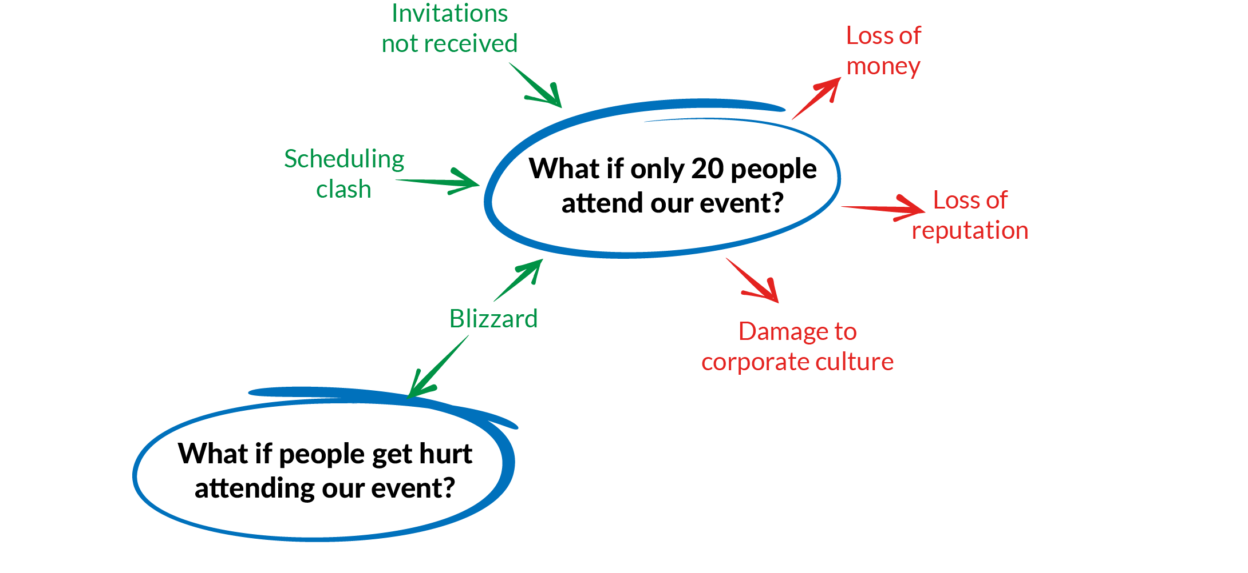
Brainstorm / mind-map – example
OPEN 7.2
Notes:
Now looking again at the causes, what is something else that might be triggered?

Slide 17
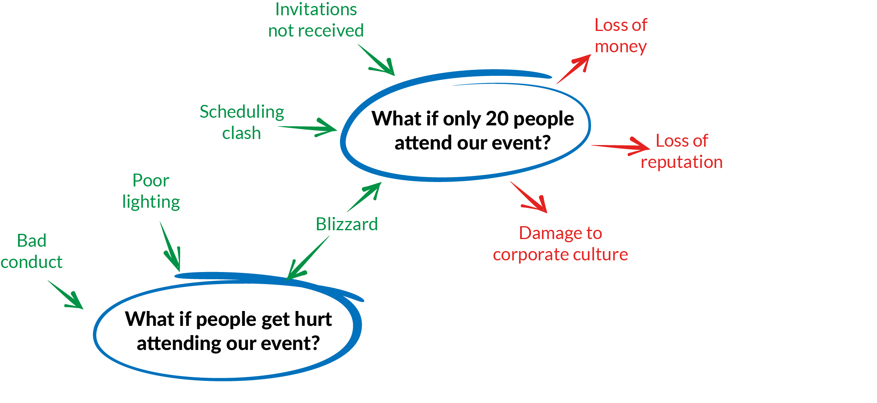
Brainstorm / mind-map – example
OPEN 7.2
Notes:
Are there other things that could cause people to get hurt?

Slide 18
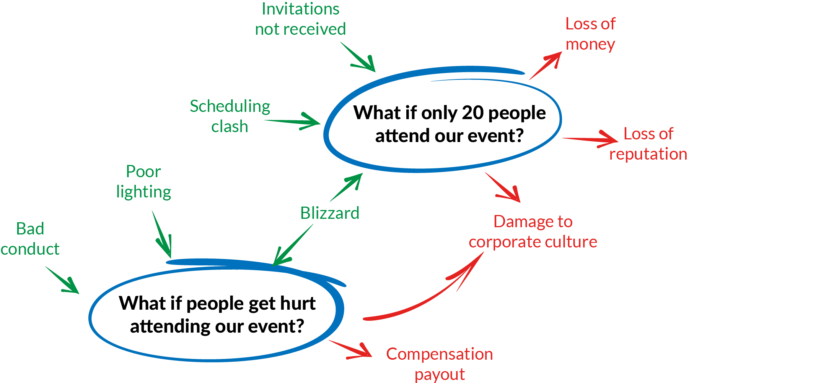
Brainstorm / mind-map – example
OPEN 7.2
Notes:
What are the impacts of people getting hurt?

Slide 19
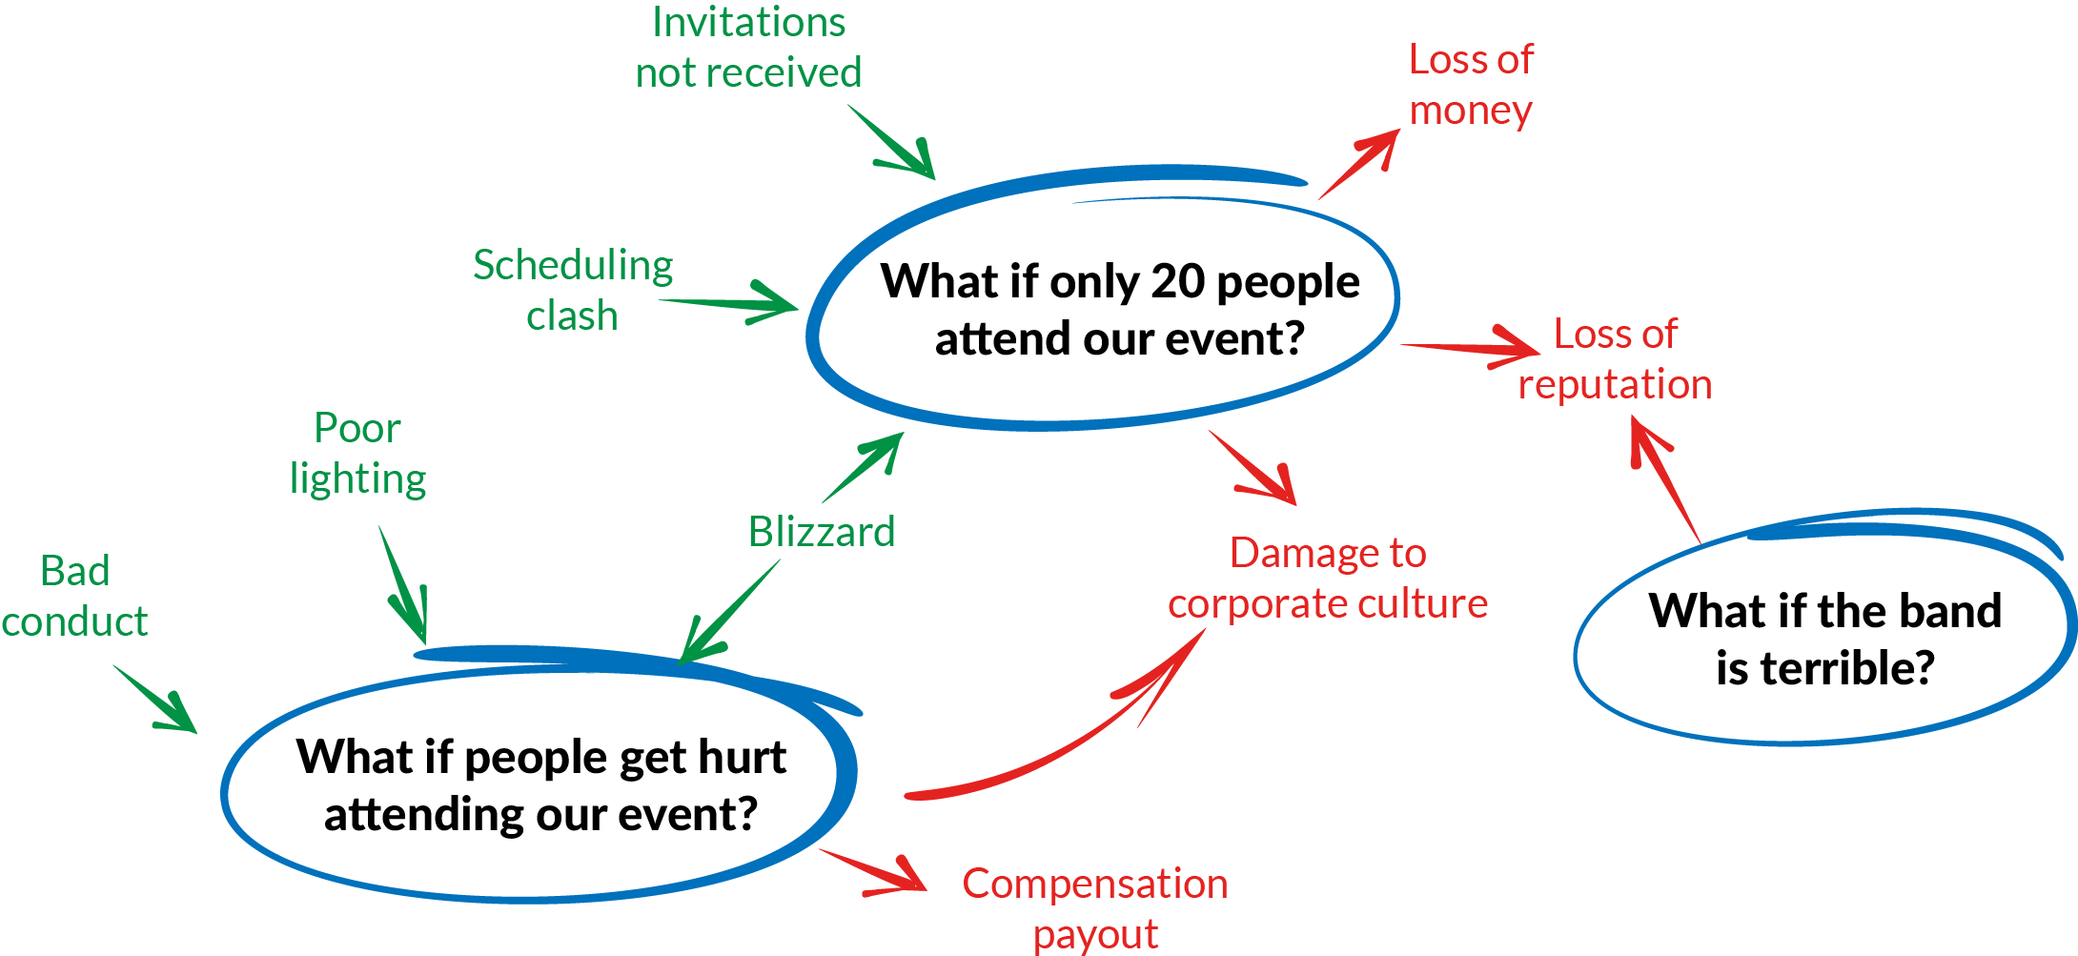
Brainstorm / mind-map – example
OPEN 7.2
Notes:
The same exercise can be done with other impacts.

Slide 20
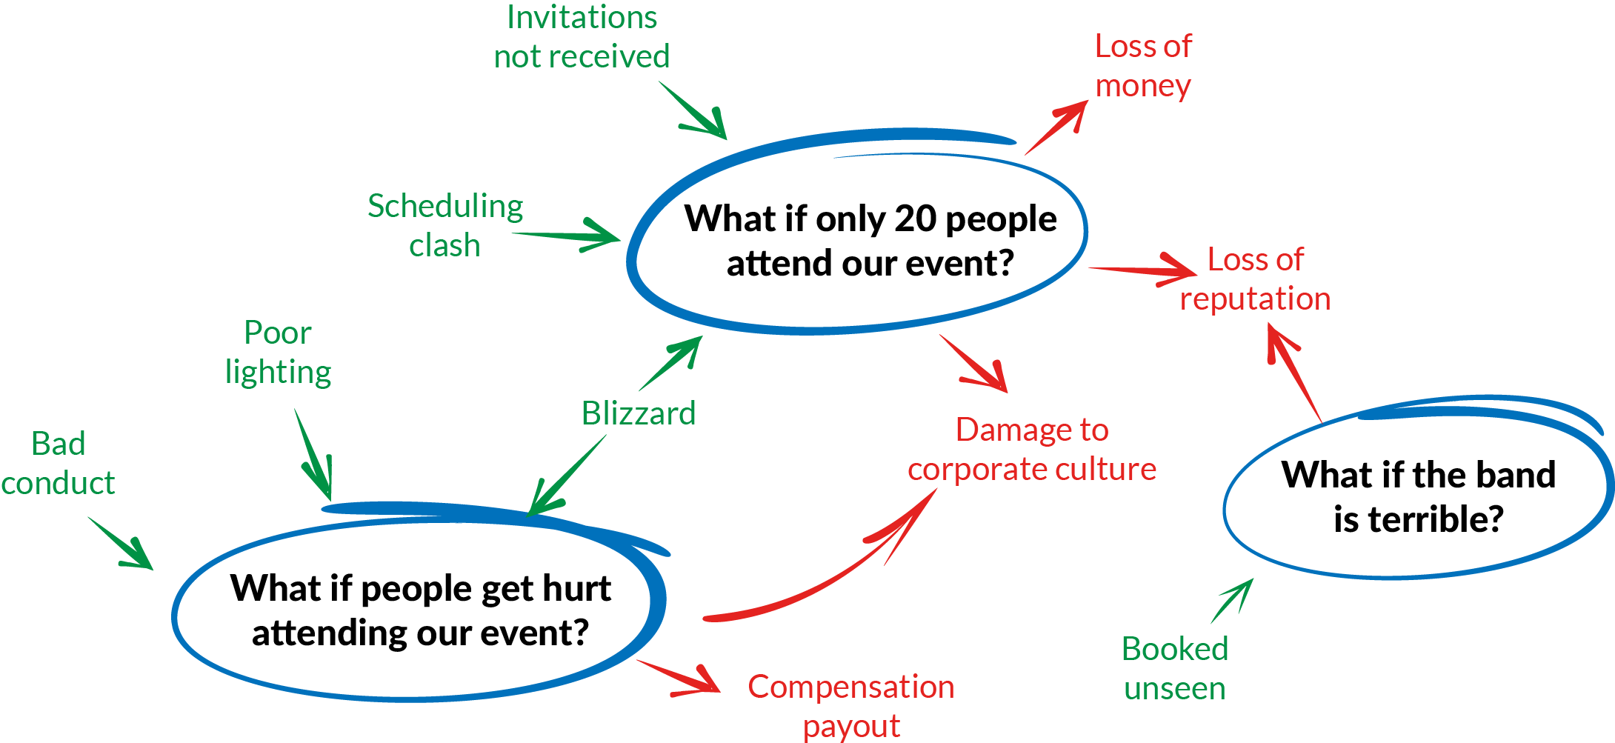
Brainstorm / mind-map – example
OPEN 7.2
A risk may have multiple triggers
An issue may have multiple impacts
Notes:
Traditional approaches to risk management have been a very linear series of if-then statements.
Actual risk is much more dynamic than that, which (as we will see) makes its management both simpler and more complex in different respects.

Slide 21
Activity 7.1
OPEN 7.2
Using a mind-map, identify some of the risks to your end of year celebration event
USE
STICKY NOTES
Notes:
Use sticky notes on butchers paper at each table
No such thing as a ‘stupid’ risk; consider them all, as prioritisation will follow!
Make sure you also capture both risks to outputs (project delivery) and outcomes / stakeholder acceptance

Slide 22
Critical success factors
OPEN 7.2
Early identification
Comprehensive identification
Recurrent identification
Multiple, diverse perspectives (objectivity)
Recognise the limitations of your sources & data
Notes:
Early identification
As we saw in the last Module, even though uncertainty is greatest at the start of the project, the cost of making changes is relatively low, so the earlier you begin the risk identification and management process, the better.
Comprehensive identification
A broad range of sources of risk should be considered to ensure that as many uncertainties as possible are identified.
Recurrent identification
Since not all risks can be identified at the start of the project, it is essential that risk identification continues throughout the project lifecycle.
This should be programmed periodically, such as at key milestones or when significant change occurs.
Risk identification should not be limited to formal events or scheduled reviews – the risk management process should allow for risk identification and escalation at any time in the life of a project.
Multiple perspectives
Engage as many stakeholders as possible in the risk identification process, including risk and subject matter experts.
Limiting risk identification to the project team is unlikely to expose all foreseeable risks.
Recognise limits
Be prepared to challenge your assumptions – assumptions are risks in and of themselves!

Slide 23
OPEN 7.3

Slide 24
Probability / likelihood of trigger event occurring
OPEN 7.3
Quantitative (statistical) methods
Qualitative (subjective) priority
Mean, median, mode
Three-point estimates
Expected value
Monte Carlo analysis
Regression / ANOVAs
Almost certain
Likely
Possible
Unlikely
Rare
56% chance of rain
Possible
Notes:
Quantitative risk analysis is a technique that uses statistical methods to illustrate the relationship between each risk and the project.
Statistical methods are for statisticians – PMs don’t need to know how to do them, but they do need to work with the statistical outputs.
Qualitative risk analysis, on the other hand, involves making judgement calls as to the probability (or likelihood) of an event occurring versus its potential impact (or consequence).
To make risks as comparable as possible, we will typically convert our quantitative analyses into qualitative measures.

Slide 25
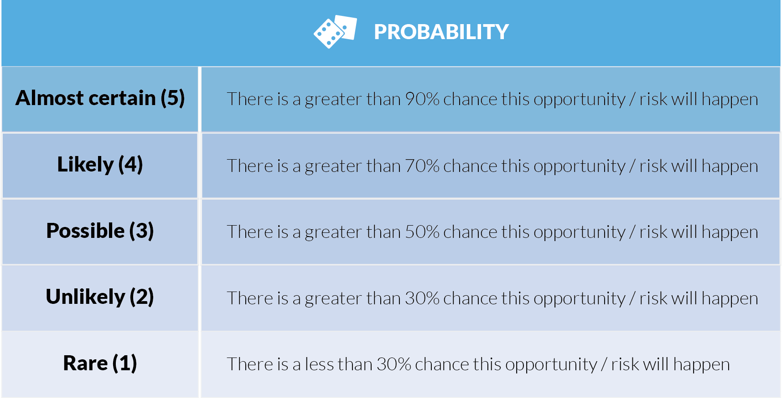
OPEN 7.3
Notes:
In the table shown here, probability is much more clearly defined.
Even though there is still an element of subjectivity (and potential stakeholder argument) as to whether or not a risk may occur once every 10 or 25 projects, when consensus is achieved, what we mean by ‘possible’ or ‘likely’ is commonly understood by all.
It should finally be noted that the same risk will have different probabilities on different projects, and should be independently assessed.
For example, there might only be a low probability that of rain disrupting a one week tennis tournament, whereas the probability of rain (the same cause) interfering with a 12-month construction project will be quite high.
It is for this reason that we can never perfectly cut-and-paste our risk analysis from one project to the next, a lesson that applies equally to our assessments of impact.

Slide 26
What if people do not attend?
OPEN 7.3
Trigger event | Rating (1-5)
Not enough notice Only 2 weeks scheduled between invitations being sent and event date | 4

Slide 27
What if people do not attend?
OPEN 7.3
Trigger event | Rating (1-5)
Not enough notice Only 2 weeks scheduled between invitations being sent and event date | 4
Too busy working Staff might not be able to attend because of conflicting projects | 3

Slide 28
What if people do not attend?
OPEN 7.3
Trigger event | Rating (1-5)
Not enough notice Only 2 weeks scheduled between invitations being sent and event date | 4
Too busy working Staff might not be able to attend because of conflicting projects | 3
Accident / injury / illness | 1

Slide 29
What if people do not attend?
OPEN 7.3
Trigger event | Rating (1-5)
Not enough notice Only 2 weeks scheduled between invitations being sent and event date | 4
Too busy working Staff might not be able to attend because of conflicting projects | 3
Accident / injury / illness | 1
Probability score | ?

Slide 30
What if people do not attend?
OPEN 7.3
Trigger event | Rating (1-5)
Not enough notice Only 2 weeks scheduled between invitations being sent and event date | 4
Too busy working Staff might not be able to attend because of conflicting projects | 3
Accident / injury / illness | 1
Probability score | 4

Slide 31
Activity 7.2
Choose one identified risk
Considering all potential triggers, what is its probability of occurring?

Slide 32
Impact / consequence if risk becomes an issue
OPEN 7.4
What is impacted?
Qualitative (subjective) priority
Scope / time / cost
Outcomes
Health and safety
Business as usual
Brand / reputation
Natural environment
Massive
Major
Moderate
Minor
Micro
Notes:
As with probability, we assign each risk an impact (or effect) score on a scale from one to five.
You can choose any labels or scoring system you like here, as long as it corresponds to your probability scale; in other words, you cannot have probability scored out of five and impact out of 100 if you want your subsequent analysis to work.
Note that you should avoid terms such as ‘catastrophic’ that solely imply a negative impact – remember, we are analysing opportunities as well as hazards.

Slide 33
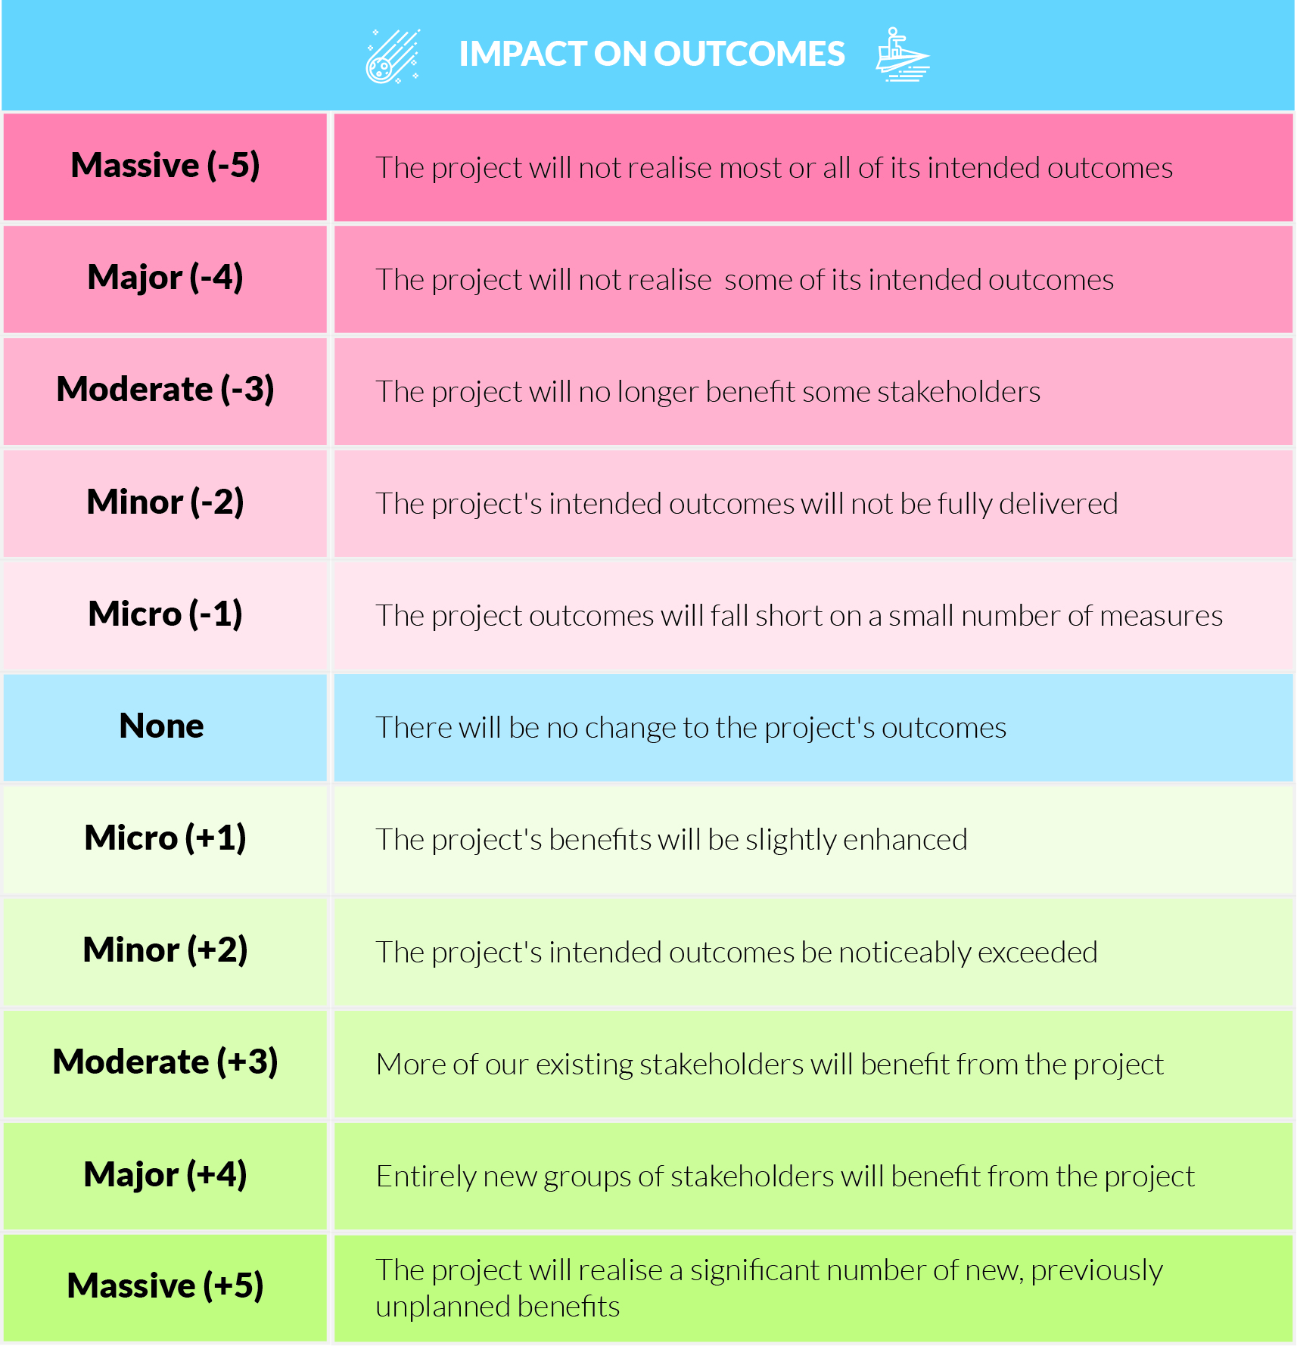
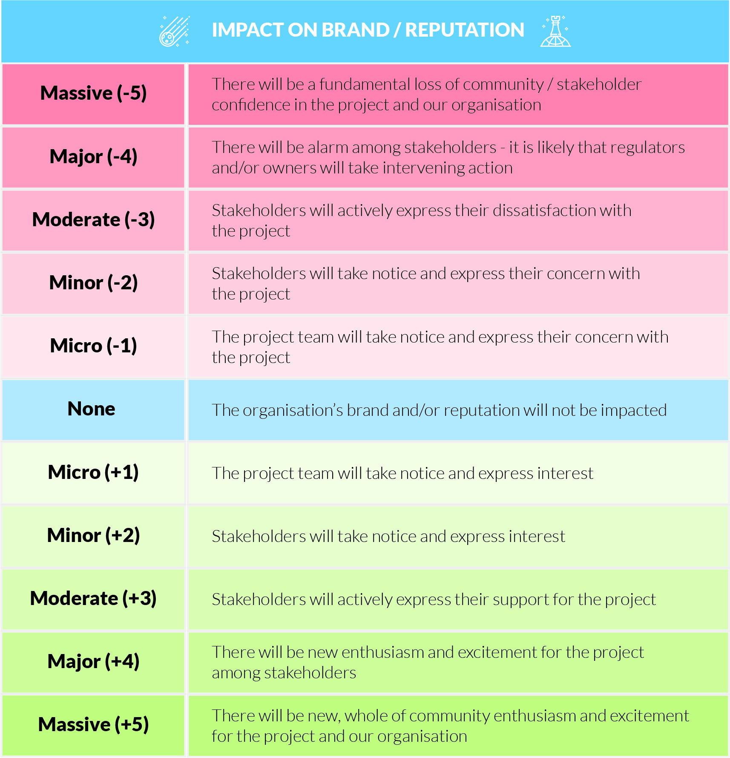
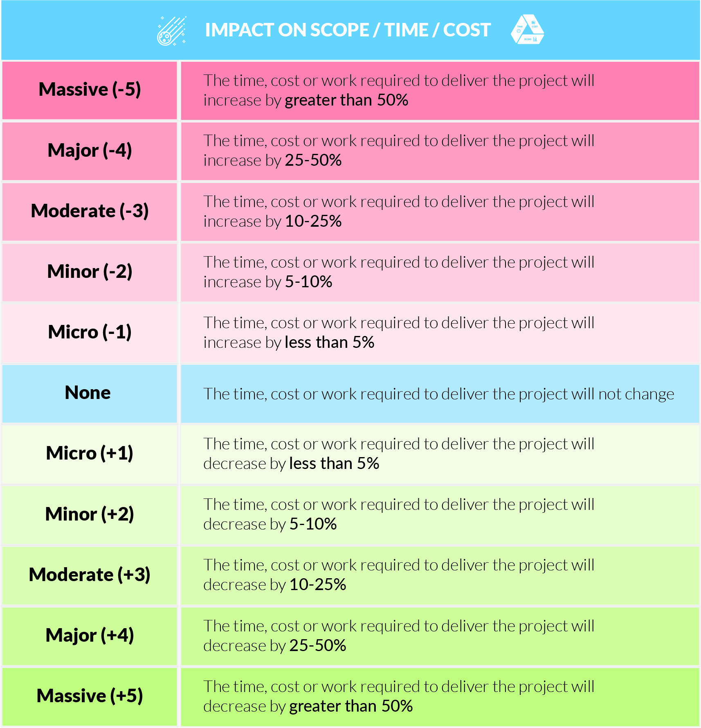
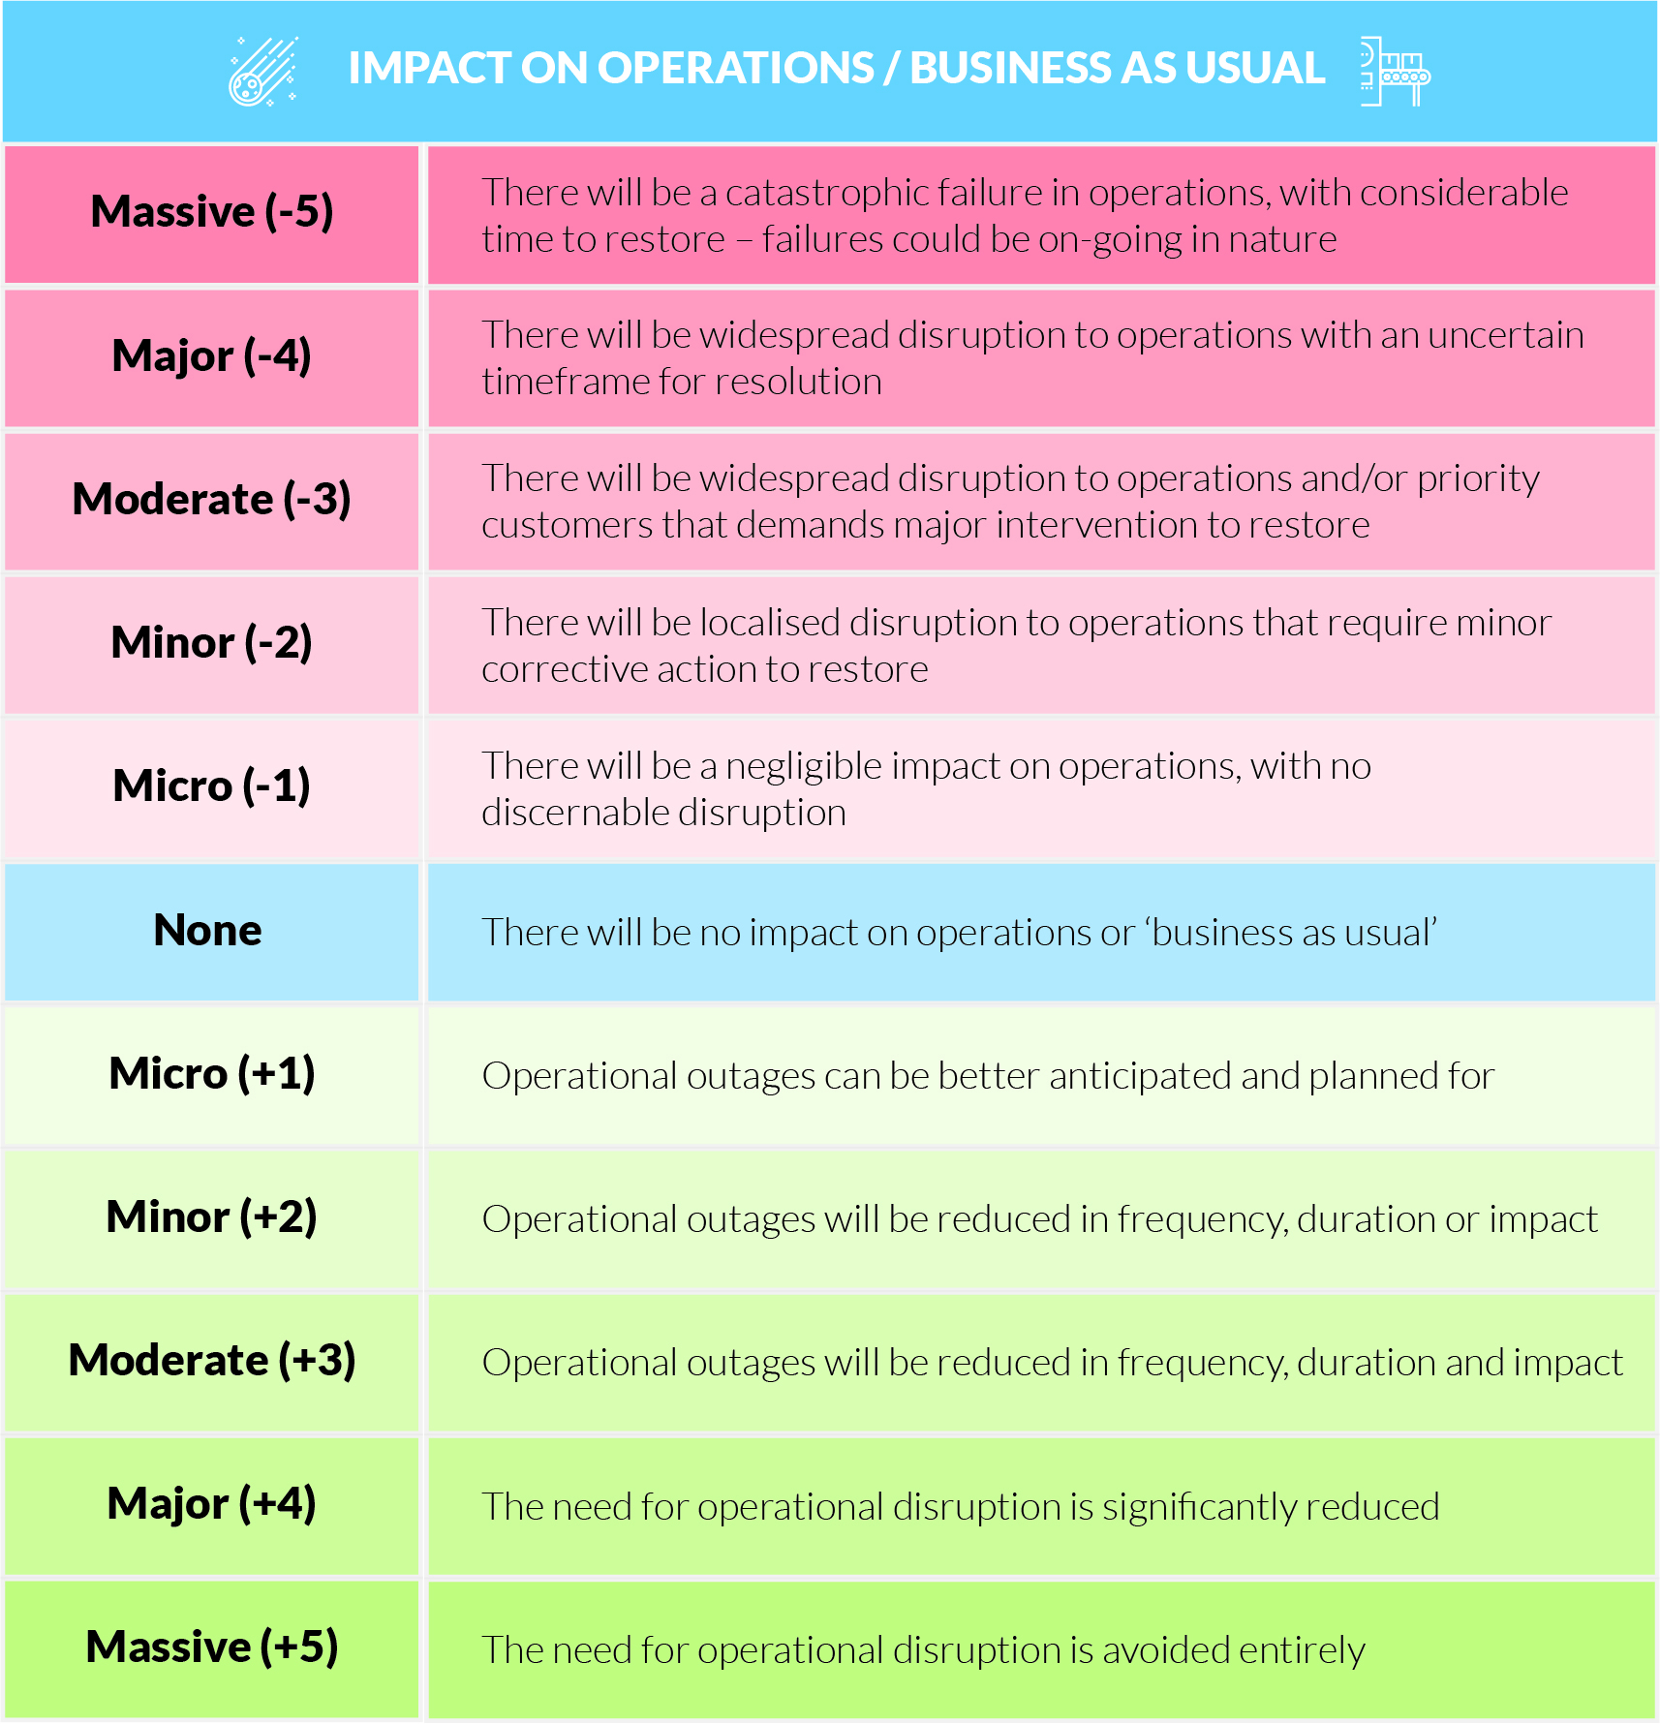
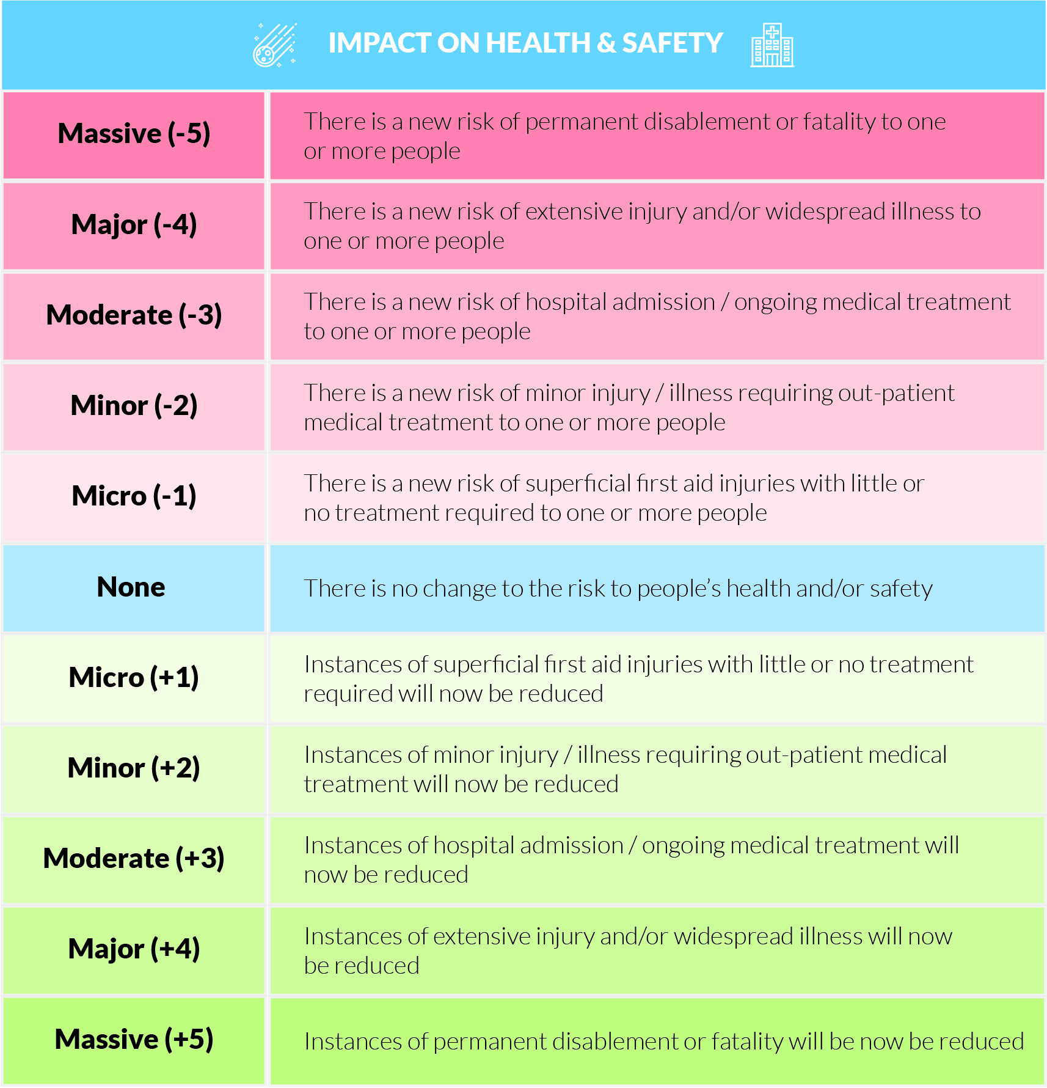
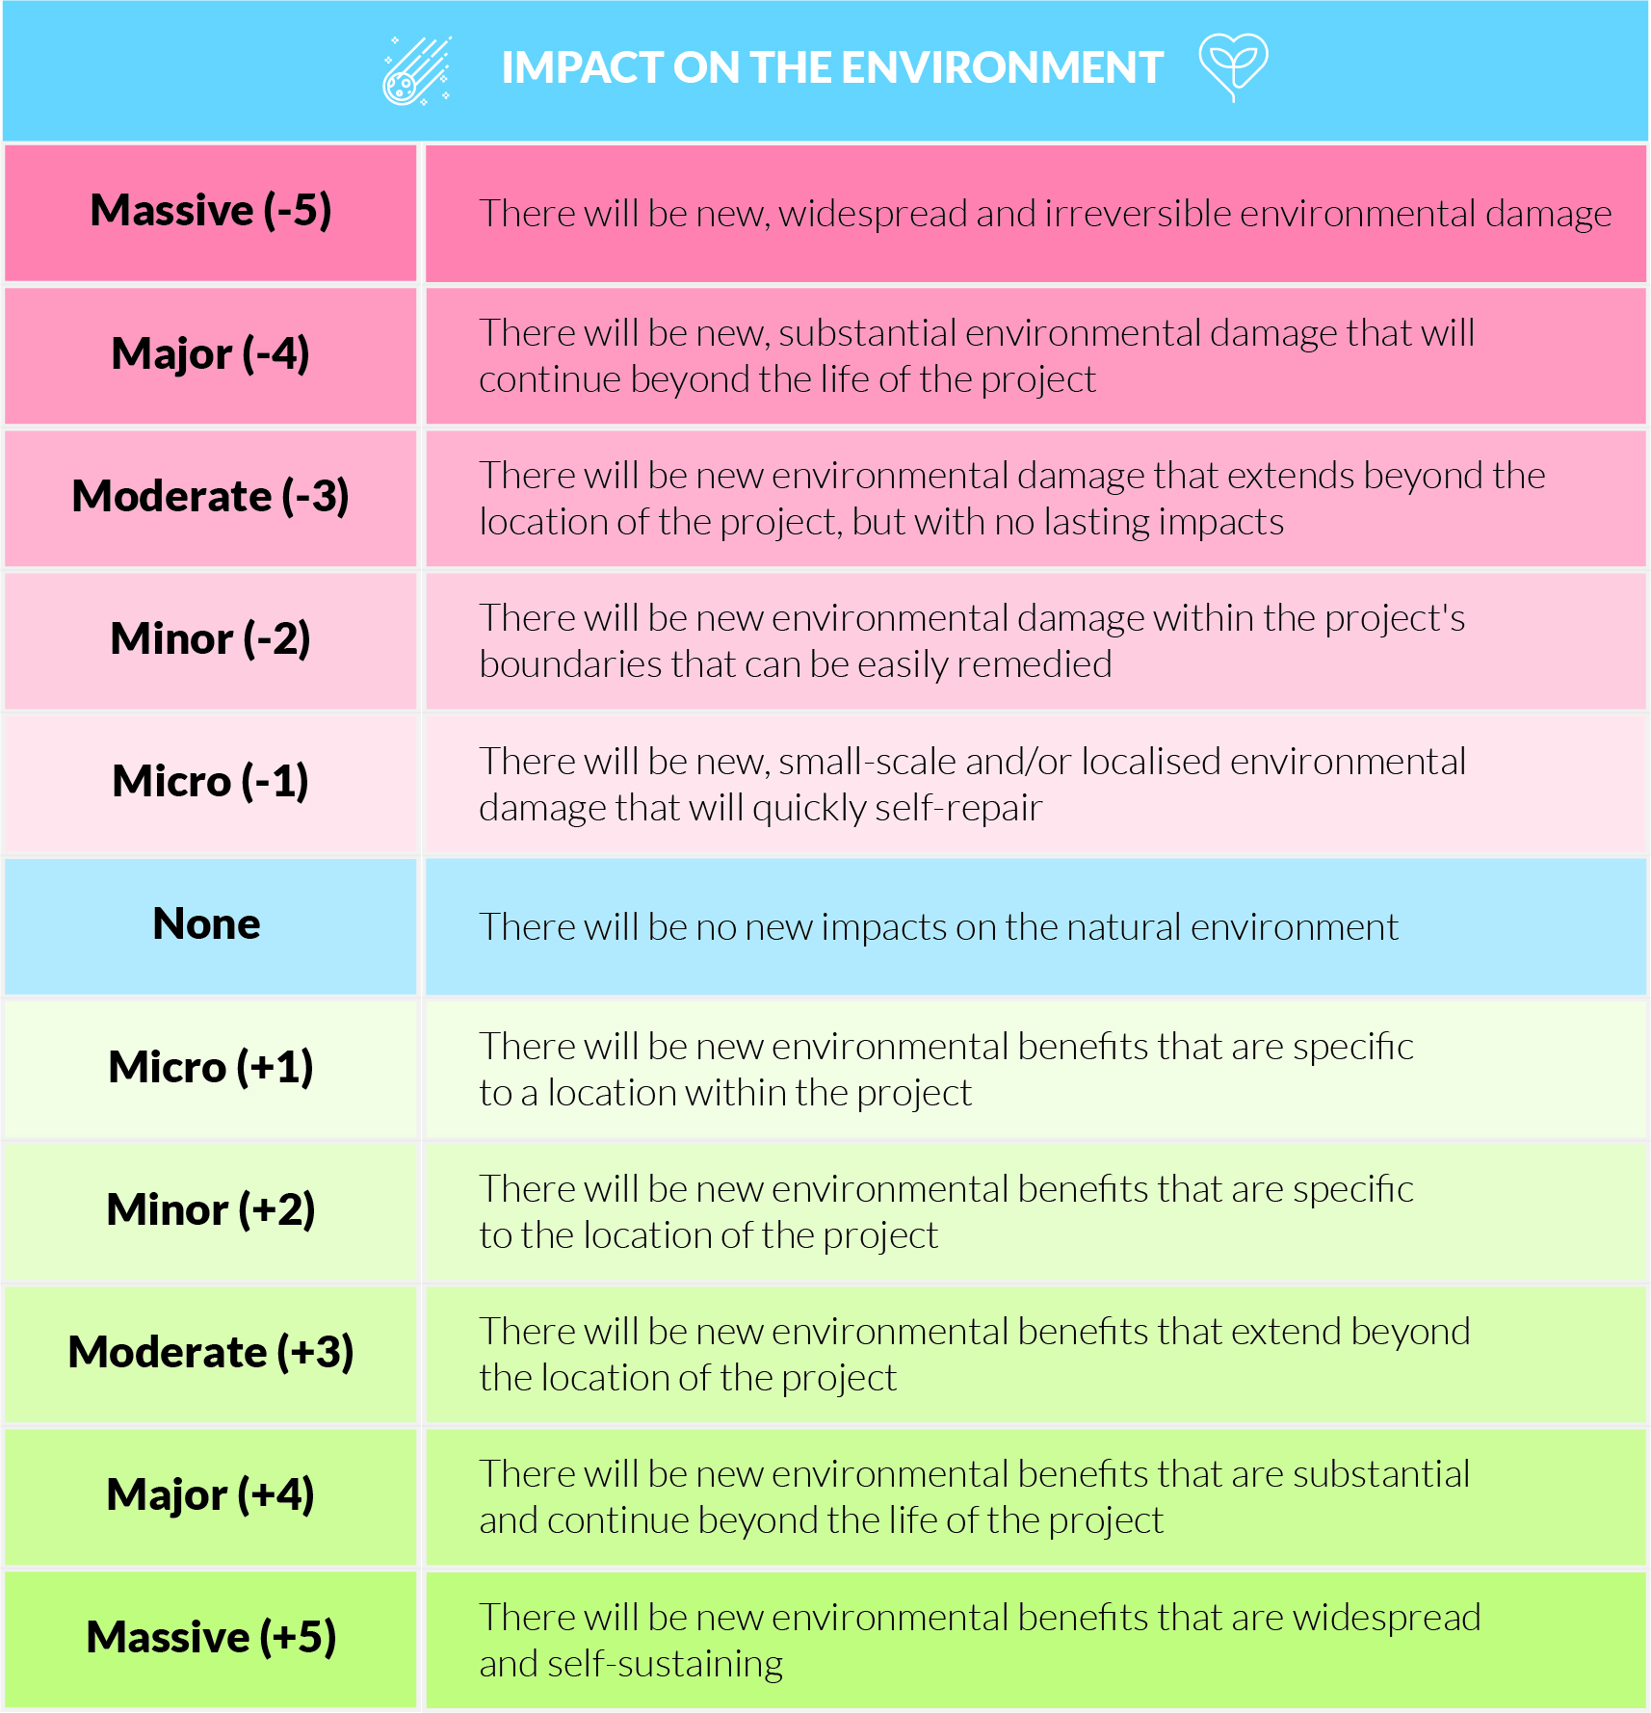
Impact / consequence if risk becomes an issue
Massive (-5)
Moderate (-3)
None
Moderate (+3)
Massive (+5)

Slide 34
What if people do not attend?
OPEN 7.4
Factor | Likely impact | Rating (±1-5)
Scope | No impact – no change to work required | 0
Time | No impact – schedule will not change | 0
Cost | No impact – paying a fixed price to venue | 0

Slide 35
What if people do not attend?
OPEN 7.4
Factor | Likely impact | Rating (±1-5)
Scope | No impact – no change to work required | 0
Time | No impact – schedule will not change | 0
Cost | No impact – paying a fixed price to venue | 0
Outcomes | Some groups miss out on intended benefits | -3

Slide 36
What if people do not attend?
OPEN 7.4
Factor | Likely impact | Rating (±1-5)
Scope | No impact – no change to work required | 0
Time | No impact – schedule will not change | 0
Cost | No impact – paying a fixed price to venue | 0
Outcomes | Some groups miss out on intended benefits | -3
Safety | No impact | 0

Slide 37
What if people do not attend?
OPEN 7.4
Factor | Likely impact | Rating (±1-5)
Scope | No impact – no change to work required | 0
Time | No impact – schedule will not change | 0
Cost | No impact – paying a fixed price to venue | 0
Outcomes | Some groups miss out on intended benefits | -3
Safety | No impact | 0
Operations | Staff too busy working | +1

Slide 38
What if people do not attend?
OPEN 7.4
Factor | Likely impact | Rating (±1-5)
Scope | No impact – no change to work required | 0
Time | No impact – schedule will not change | 0
Cost | No impact – paying a fixed price to venue | 0
Outcomes | Some groups miss out on intended benefits | -3
Safety | No impact | 0
Operations | Staff too busy working | +1
Reputation | Event devalued for all | -4

Slide 39
What if people do not attend?
OPEN 7.4
Factor | Likely impact | Rating (±1-5)
Scope | No impact – no change to work required | 0
Time | No impact – schedule will not change | 0
Cost | No impact – paying a fixed price to venue | 0
Outcomes | Some groups miss out on intended benefits | -3
Safety | No impact | 0
Operations | Staff too busy working | +1
Reputation | Event devalued for all | -4
Environment | No impact | 0

Slide 40
What if people do not attend?
OPEN 7.4
Factor | Likely impact | Rating (±1-5)
Scope | No impact – no change to work required | 0
Time | No impact – schedule will not change | 0
Cost | No impact – paying a fixed price to venue | 0
Outcomes | Some groups miss out on intended benefits | -3
Safety | No impact | 0
Operations | Staff too busy working | +1
Reputation | Event devalued for all | -4
Environment | No impact | 0
 | Impact score | ?

Slide 41
What if people do not attend?
OPEN 7.4
Factor | Likely impact | Rating (±1-5)
Scope | No impact – no change to work required | 0
Time | No impact – schedule will not change | 0
Cost | No impact – paying a fixed price to venue | 0
Outcomes | Some groups miss out on intended benefits | -3
Safety | No impact | 0
Operations | Staff too busy working | +1
Reputation | Event devalued for all | -4
Environment | No impact | 0
 | Impact score | -4

Slide 42
Activity 7.3
What would the impact be if your identified risk occurred?
Consider all impact criteria for the risk

Slide 43
Notes:
Before breaking, ask students if there are any questions about what has been covered in the session so far.
Once answered, encourage students to stand up, get a drink, go outside and stretch.
If they are on Zoom, tell them to turn their camera and microphone off (you do the same)!
Make sure you tell them the precise time you will be restarting (eg 10:10am)
Don’t check your email – take a proper break!!

Slide 44
Overall risk priority
OPEN 7.5
PROBABILITY x IMPACT
Notes:
Because we have finite time and resources to deliver our projects, not every risk can or even should be addressed.
Therefore, in order to arrive at the relative priority of risks, we express our final risk score as a function of cause and effect.
In other words, we rank each risk by multiplying its probability by its impact scores.

Slide 45
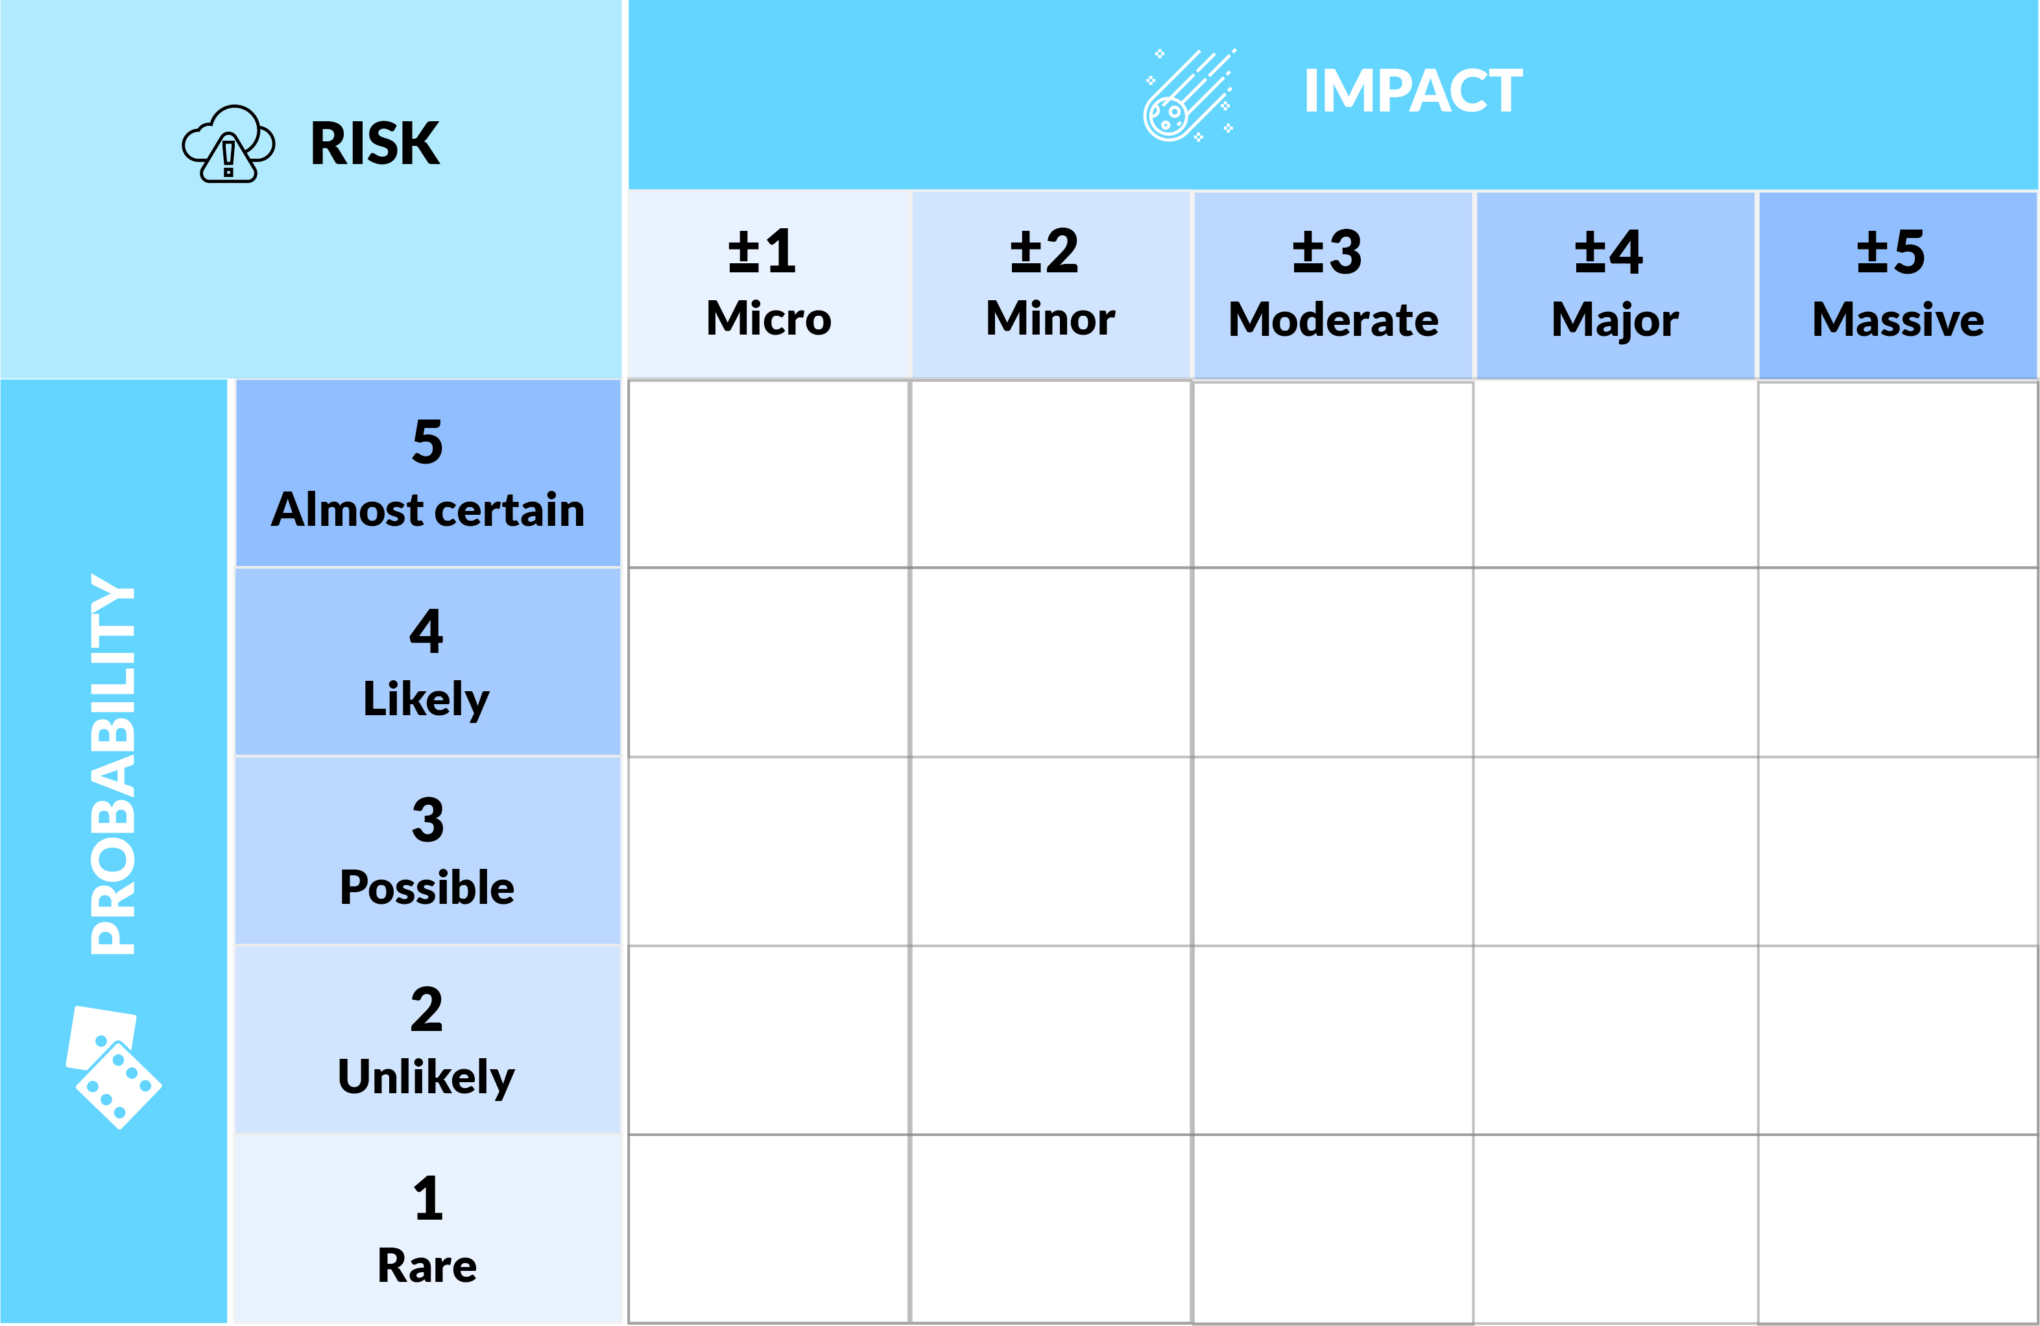
OPEN 7.5
People
do not attend
-16

Slide 46
OPEN 7.5
Accident / injury
-6

Slide 47
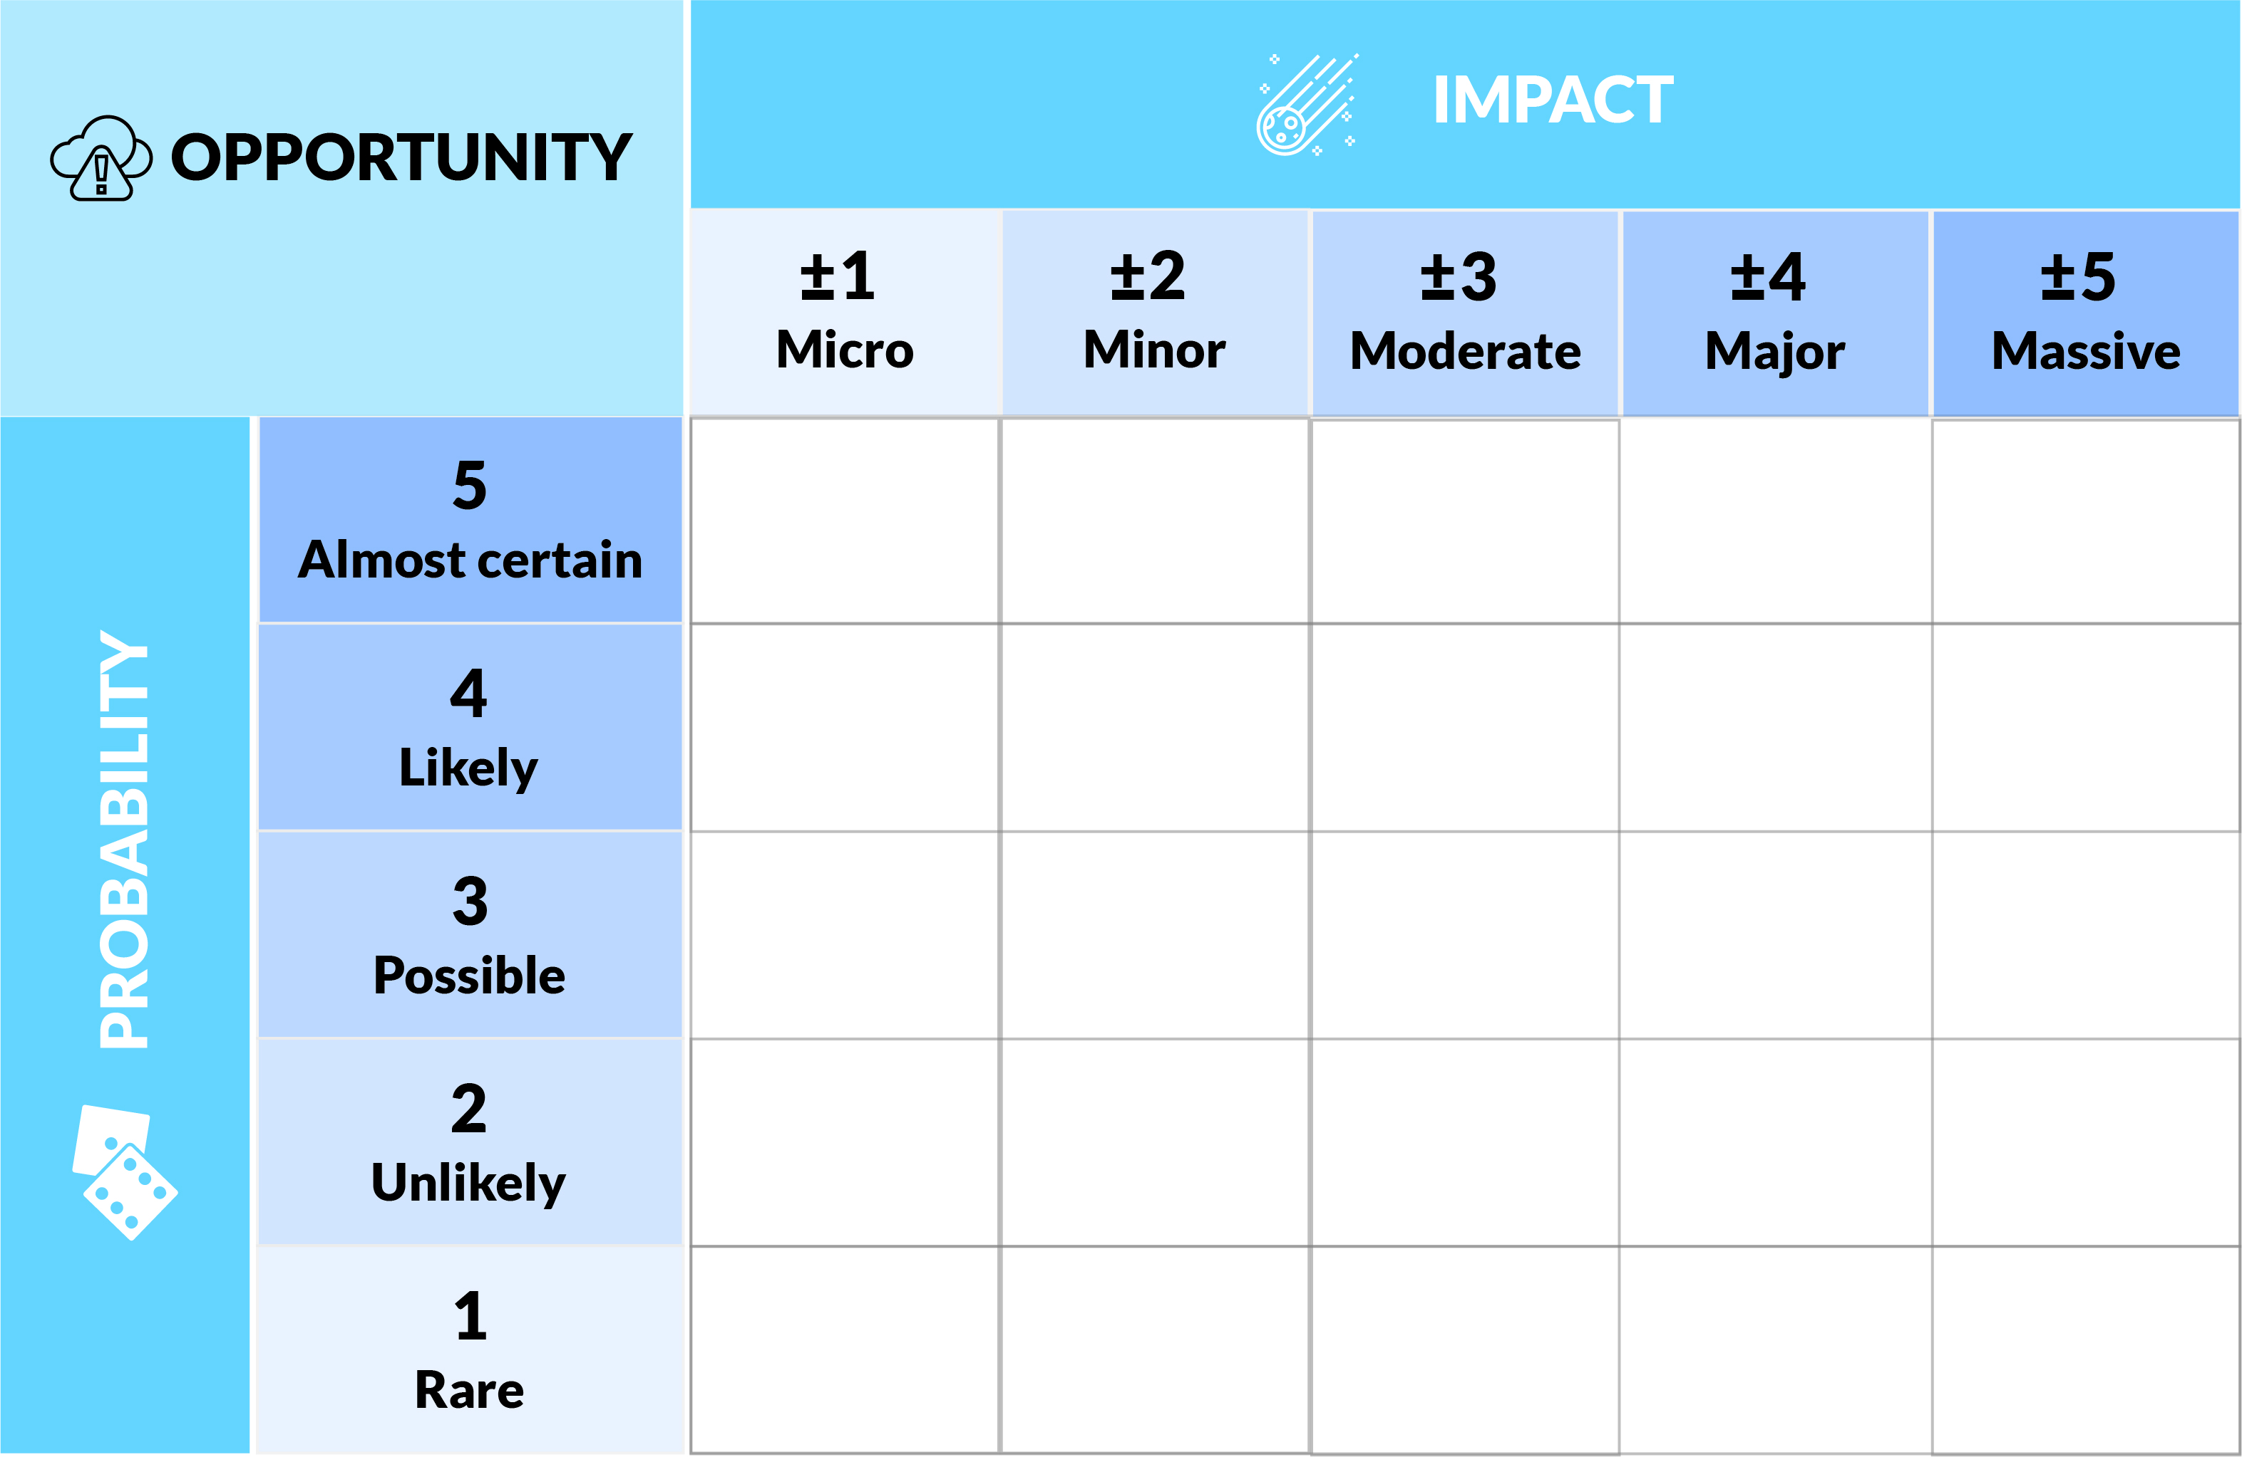
OPEN 7.5
Ryan Gosling
+5

Slide 48
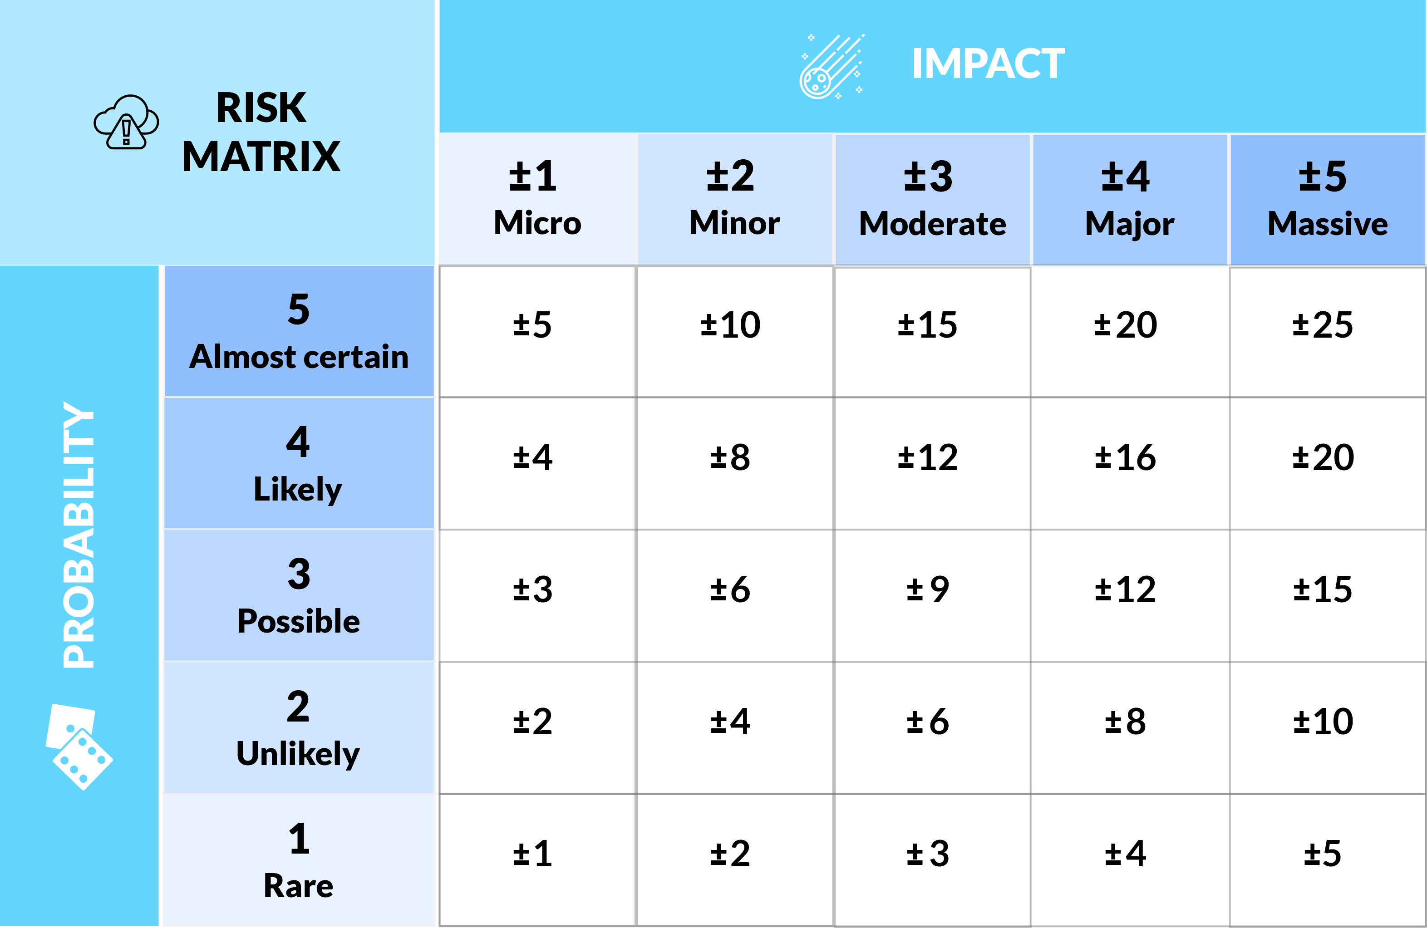
OPEN 7.5
Notes:
End by 1:15

Slide 49
Activity 7.4
Rate / score the risk you identified
Notes:
Do this as a quick, at your desk activity, rather than breaking them into groups – they will still need to update their pdf though!

Slide 50
OPEN 7.6

Slide 51
OPEN 7.6
RISK TOLERANCE / APPETITE / THRESHOLD
The degree, amount, or volume of risk that an organisation or individual will withstand
Notes:
When is a risk not a risk, but something the project can live with?
The terms risk appetite and risk tolerance refer to the degree of uncertainty someone is willing to accept, usually in anticipation of a reward.
For example, fast-tracking a project’s schedule is a risk often taken to achieve the reward created by an earlier completion date.
Individuals and groups adopt attitudes towards risk that influence the way they respond.
These risk attitudes are driven by perception, tolerances, and other biases, which should be made explicit wherever possible.
The problem, though, is that organisations and stakeholders all have varying degrees of risk that they are willing to accept.
Complicating this further, projects are, by their very nature, riskier undertakings than business-as-usual; therefore, the default risk settings of an organisation need to be adjusted to accommodate the risk / reward trade-off introduced by projects.
A consistent approach to risk should therefore be developed for each project or program of work, and communication about risk and its handling should be open and honest.

Slide 52
Treatment strategy
OPEN 7.6
Notes:
Just calling a risk low, medium or high adds nothing to the project unless there is an action linked to it.
That is why the response at each threshold needs to be clearly defined and consistently applied.
For this project, high risks require immediate action.
We must insert something into our project plan that says we will do X to ensure the risk either does not occur, is less likely to occur, or if it does occur, doesn’t impact us as badly as originally foreseen.
This necessarily involves creating a new task or group of tasks in our WBS, each of which needs to be costed and similarly inserted into our schedule.
A medium risk, on the other hand, requires us to establish a contingency.
A contingency is an action that is only exercised if the risk eventuates (becomes an issue).
For example, because our iPad might be damaged, we can set aside the price of a replacement iPad in our budget so that we have the money available to purchase a new one, if required.
The float in your schedule can also be used as a contingency, if required.
Because you can set aside either time or money as a contingency, the schedule and budget need to be updated accordingly.
We will discuss contingency planning in much greater detail shortly.
You should also monitor this risk, to see if the risk does materialise or its circumstances change.
The document we use to manage this is called a risk register – again, we will discuss this in more detail soon.
Finally, a low risk is one that we accept.
In doing so we acknowledge and monitor the risk in our register, but do not take any action or allocate any allowances to it unless circumstances change so as to escalate it to a higher threat level.
With the finite time and scarce resources available to projects, we do not have the luxury of fully treating every little risk as you might do in an operational setting.
That said, it is important that you carefully set your thresholds and related actions at levels that align to the expectations of stakeholders and the risk appetite of your organisation.

Slide 53
Treatment strategy
OPEN 7.6
Change probability
Transfer (eg outsource)
Change impact
Share (eg insurance)
Avoid
Remove risk source
Notes:
The ultimate objective of risk management is to identify treatments that reduce hazardous risks to acceptable levels.
Opportunities, on the other hand should be maximised – we want to increase the probability and impact of positive risks, so treatments should position us to take full advantage of them if/when the risks materialise.
Although our options are practically infinite, we theoretically have only three options.
Change the probability
Although we may not be able to avoid a risk entirely, we might be able to reduce its probability of occurrence.
For example, we might hold an outdoor event during the driest month of the year, to reduce the probability of rain damage.
Alternatively, we might intervene to increase the probability of an opportunity being realised.
In the Ryan Gosling example, we might offer him $1,000,000 for his time, which would change the probability of him helping from ‘rare’ to ‘almost certain’ overnight.
Change the impact
If we can influence probability, we can also change the impact of a risk, should it eventuate as an issue.
We can do this by transferring the risk to someone else (for example, by sub-contracting out specialist work), or sharing the impact of a risk with, for example, an insurance company.
Avoid
Avoiding a risk means deciding not to start or continue the activity that gives rise to the risk in the first place.
For example, if we don’t want our iPads to be dropped or damaged, don’t use iPads – stick to pens, paper and clipboards.
In this instance, we are effectively reducing the probability of the risk occurring to zero.

Slide 54
What if people do not attend?
OPEN 7.6
Actions
Send invitations 4 weeks in advance
Seek team leader support for staff time-off
Update WBS, schedule and budget to reflect this
Residual risk -8
New probability (2) x unchanged impact (-4)
Secondary risk
Event details may not be finalised before invites need to go out
Trigger event | Rating (1-5)
Not enough notice | 4
Too busy working | 3
Accident / injury / illness | 1
Probability score | 4
Trigger event | Rating (1-5)
Not enough notice | 2
Too busy working | 2
Accident / injury / illness | 1
Probability score | 2
Notes:
Short of avoiding a risk altogether, when we come up with a risk response, we are not always able to remove the entire risk.
A classic example is when you take out insurance to cover a risk event.
Let’s say that as a management consultant you identify the risk that you might unwittingly give out poor advice, and that leads to you being sued for damages by your client.
Your probability / impact assessment might determine that, whereas the risk of giving bad advice might be low, the impact of a large damages award against you would be massive – enough to send you bankrupt.
Your response therefore might be to share the financial risk of this event occurring with an insurance agency.
In the event that someone does sue you, the insurance agency agrees to pay your costs greater than $10,000 up to $10,000,000.
This type of insurance is fairly common, and is called professional indemnity or professional liability insurance.
The residual risk in this instance is the $10,000 you still have to pay if you are sued while insured, and any sum greater than $10,000,000 – time then for another probability / impact assessment!
The probability of being sued is still the same, but now the impact is only $10,000 which you feel is also low.
Whereas the impact of any cost award above $10,000,000 may still be massive, you know that the chance of being sued for that much multiplied by the probability of being sued in the first place is really, really, low – so low, it is not worth worrying about.
Therefore, having moved our risk from medium to low, you will probably accept the residual risk, checking occasionally to ensure that your assumptions are still valid.
Residual risk is therefore any risk left over or not addressed by your risk treatment.
It is important that you continue the risk management process with residual risks to the point where they are either eliminated or you are comfortable accepting them.
A secondary risk is a risk created by your risk response.
Let’s suppose you identify that there are too many near critical paths in your schedule, and that given the uncertainty of some of your time estimates, there is a medium to high probability that your schedule will slip (which means fall behind).
The impact of this would be late delivery of the project which would upset your client, allowing them to invoke penalty clauses in your contract.
You might therefore have a couple of choices.
You can respond by trying to remove the likelihood that the risk will occur, by assigning more resources to the project. The secondary risk of this – that is, the risk created by your response – will be an increase in costs, which will reduce your profit.
You could also try to change the consequences of the risk, by negotiating a new delivery date with the client. The secondary risk of this, however, might be a loss of business reputation.
What you need to do then is go back and analyse the two secondary risks – reduced profit and loss of reputation – to determine which is more acceptable to your stakeholders.
In other words, what is their likely tolerance of the alternatives?
Once again you could use the probability / impact assessment technique; but if there is no obvious winner, you can consult directly with stakeholders.
See too what we meant earlier by choices not being mutually exclusive?
In this case you might respond by increasing costs and delaying the schedule by small amounts, instead of adopting an all-or-nothing solution.

Slide 55
Treatment strategy
OPEN 7.6
Notes:
A contingency is a provision for an unforeseen event or circumstance.
In other words, it is something you reserve in your project plan that can be accessed and used when a risk eventuates.
There are three basic types of contingencies we can reserve in projects, and (perhaps unsurprisingly) they can be traced back to the triple constraints.
Tolerance in the specification (by that, we mean how much you are allowed to deviate from scope)
Float in the schedule (which could be naturally occurring or artificially imposed through leads and lags), and
Money in the budget.

Slide 56
Discussion
OPEN 7.11
Your CEO thinks she is Jimi Hendrix, and there is a 50:50 chance she will set fire to someone’s guitar…
…the entertainment will cost $10,000 if she behaves, OR
…it will cost $15,000 if she runs amok
How much should we allow in our budget for entertainment?
Notes:
Take a vote:
Who says $10,000?
Who says $12,500?
Who says $15,000?
Who avoided voting (to reduce the probability and impact of being wrong)?

Slide 57
Discussion – answer
OPEN 7.11
Allocate $10,000 (quiet night) in the budget + $5,000 (damages) contingency
If we incur damages, the PM has immediate authority to access the contingency
If we have a quiet night, the contingency disappears – it does not roll over into a ‘general’ contingency
Notes:
If you said $15,000, that’s all well and good, but remember Parkinson’s Law?
If you have a quiet night, there is a real risk that the project team will spend closer to $15,000 than $10,000 just because they can.
By allocating the full amount regardless of the circumstances, you are inviting (and potentially rewarding!) inefficiency.
If you said $12,500: congratulations – you applied the expected monetary value technique!
I assume your rationale is that if there is a 50% chance we need an extra $5,000, we should allow the base amount plus $2,500 as a contingency.
Unfortunately, the reality is that if nothing happens, you will have more money than you need for the task, and if guitars get smashed you won’t have enough.
From a practical standpoint, neither outcome is ideal.
Best practice actually says we should budget $10,000 for the task and allow a $5,000 contingency reserve that is exclusively linked to the trigger event – hitting rock.
By having the contingency pre-approved in this way, the project manager is encouraged to work as efficiently as possible within a realistic budget, while at the same time retaining the flexibility to respond in real time to foreseeable issues.

Slide 58
Contingency reserves
OPEN 7.11
Known
Unknowns
Pre-authorised reserve of time or money
Best maintained at the task level
Returned to the business when risk retired
Enables speedy response in a crisis
Encourages more comprehensive risk identification and management
Notes:
The contingency reserve is an allocation of time or money to respond to the risks that were identified in the risk analysis process; Donald Rumsfeld might call these the known unknowns
Contingency reserves should be clearly identified in the project plan at the WBS task level, and as more precise information about the task becomes available, the reserve may be used, reduced, or eliminated.
Properly applied, contingency reserves:
Discourage project managers from padding estimates
Motivate them to perform comprehensive risk analyses, and
Give them the autonomy to respond to anticipated issues as they arise.

Slide 59
Management reserves
OPEN 7.11
General cash reserve maintained for “surprises”
Best maintained at the program / portfolio level
Usually a fixed percentage of the program’s total time and budget
Distributes risk across multiple projects
Gives greater flexibility in a crisis
Unknown
Unknowns
Notes:
For projects run as part of a program or portfolio, the management reserve is often a single pot of cash set aside to cover all of the projects in the group.
This general allocation decouples management reserves from individual projects, giving executives greater flexibility in responding to problems, especially across diverse projects where the risks are varied.

Slide 60
What if people do not attend?
OPEN 7.11
Contingency plan
Using the same venue, change function room size and catering based on the number of RSVPs received
Update schedule, budget and risk register to reflect this
Secondary risks
May not be able to accommodate the entertainment

Slide 61
What if people do not attend?
OPEN 7.11
Factor | Likely impact | Rating
Scope | No impact | 0
Time | No impact | 0
Cost | No impact | 0
Outcomes | Some groups miss out on benefits | -3
Safety | No impact | 0
Operations | Staff too busy working | +1
Reputation | Event devalued for all | -4
Environment | No impact | 0
 | Impact score | -4
Likely impact | Rating
Small number of additional tasks | -1
No impact | 0
Minor savings | +1
Some outcomes not realised | -2
No impact | 0
Staff too busy working | +1
Minor concern from some | -2
No impact | 0
Impact score | -2

Slide 62
Activity 7.5
Mindful of your risk appetite, what priority is your risk?
Notes:
Do this as a quick, at your desk activity, rather than breaking them into groups – they will still need to update their pdf though!

Slide 63
Activity 7.6
Update your risk register entry with action / contingency plan(s)
What is your residual risk rating?
Are there any secondary risks introduced?

Slide 64
OPEN 7.15

Slide 65
Risk register
OPEN 7.14
Summary
Detail
Identification number
Risk description
A risk owner
Probability / impact ratings
Risk treatment
Probability and impact detail
Contingency plan
Secondary risks
Last / next review date

Slide 66
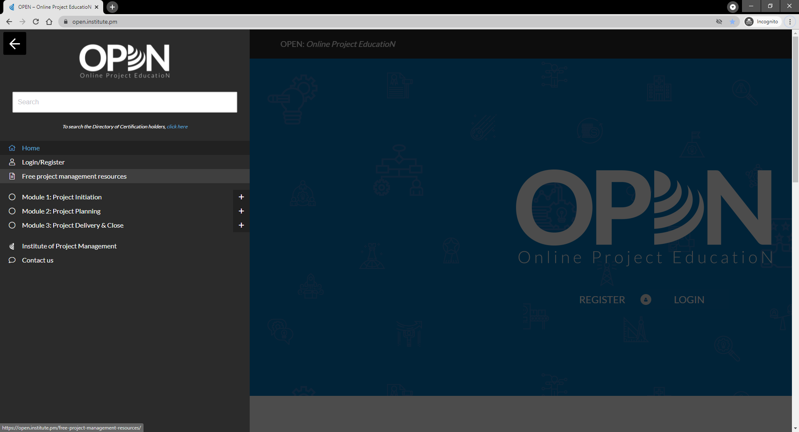

Slide 67
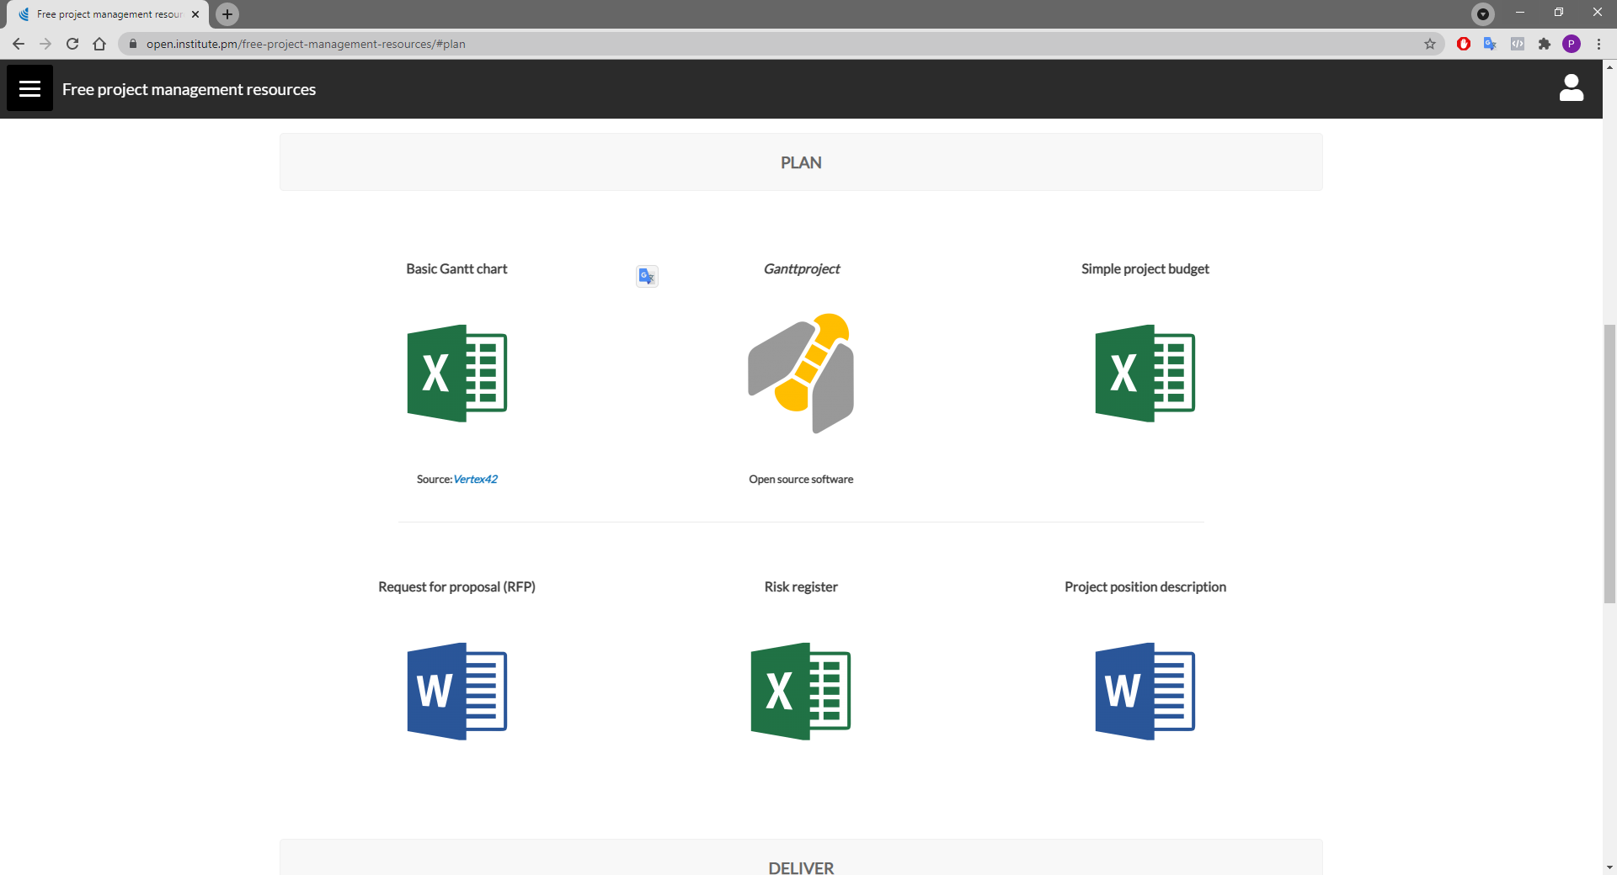

Slide 68
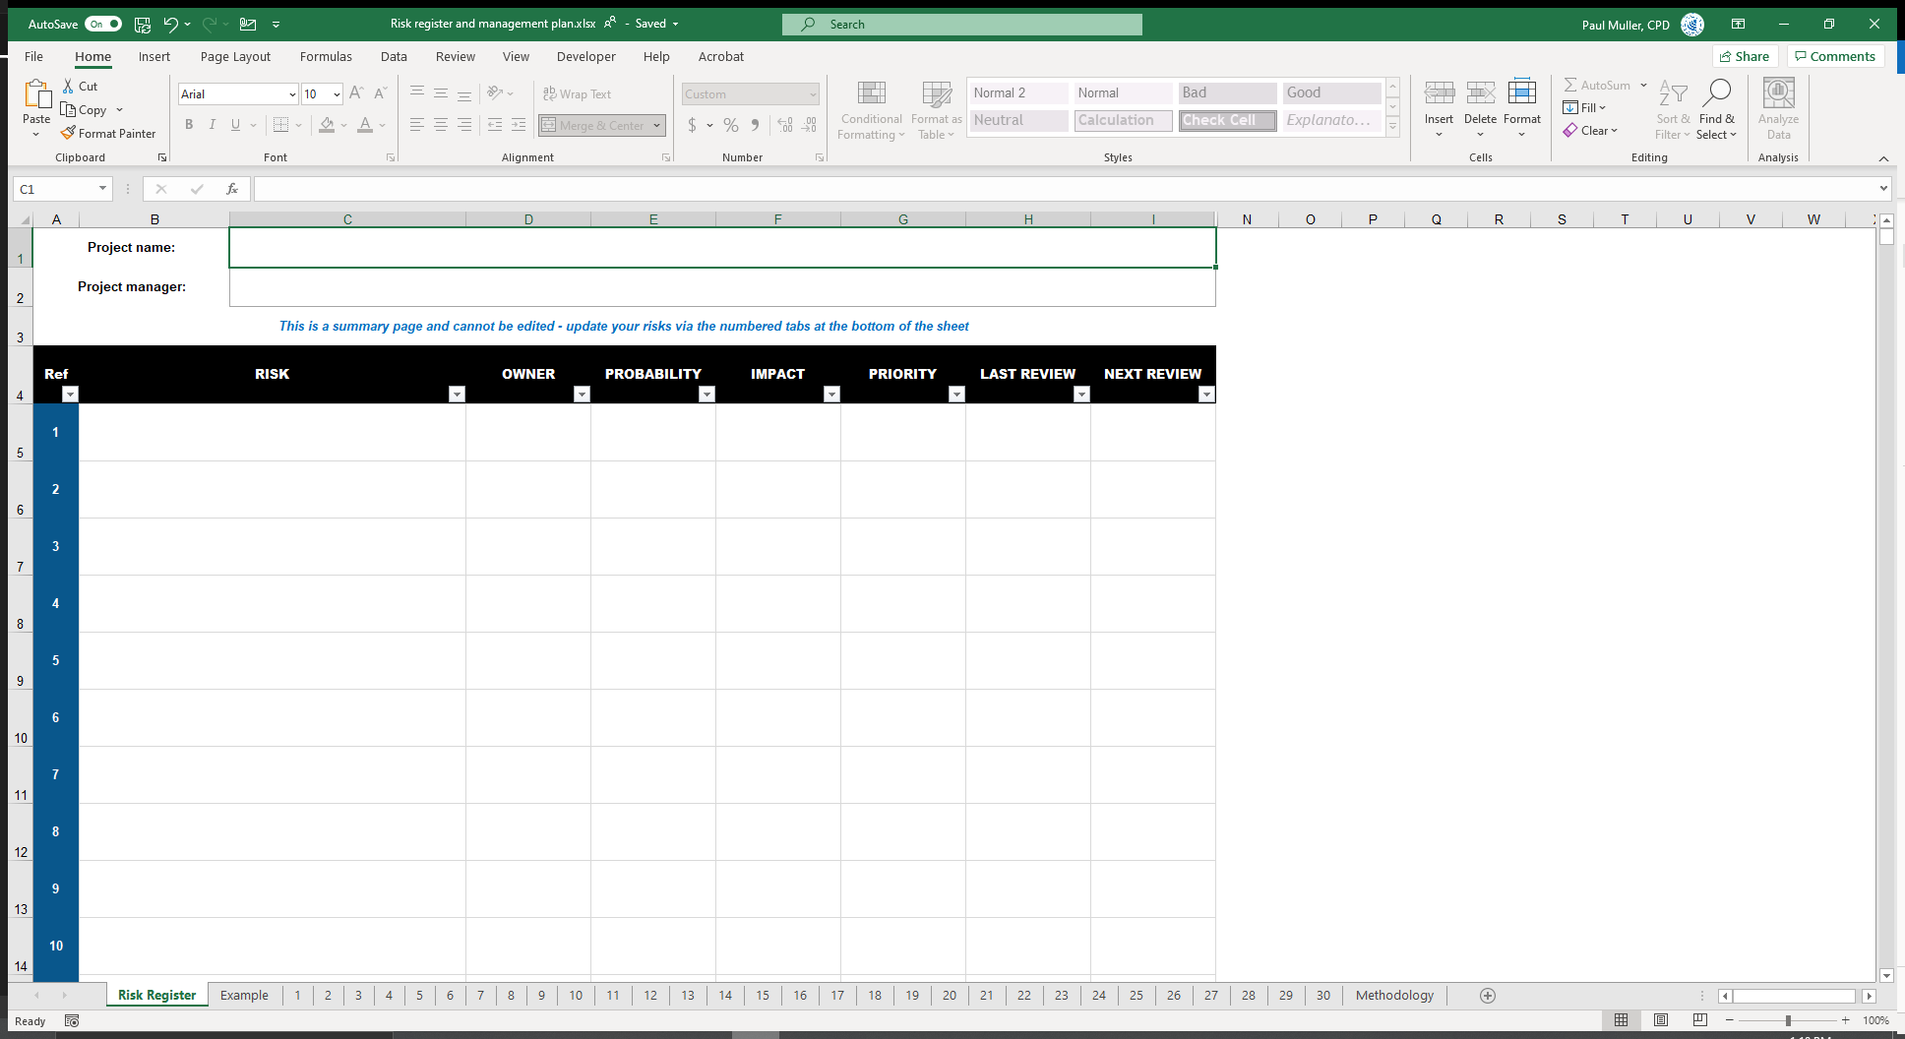
Workplace Celebration Event
Only these fields are editable on the summary page
Cormac McLaggen

Slide 69
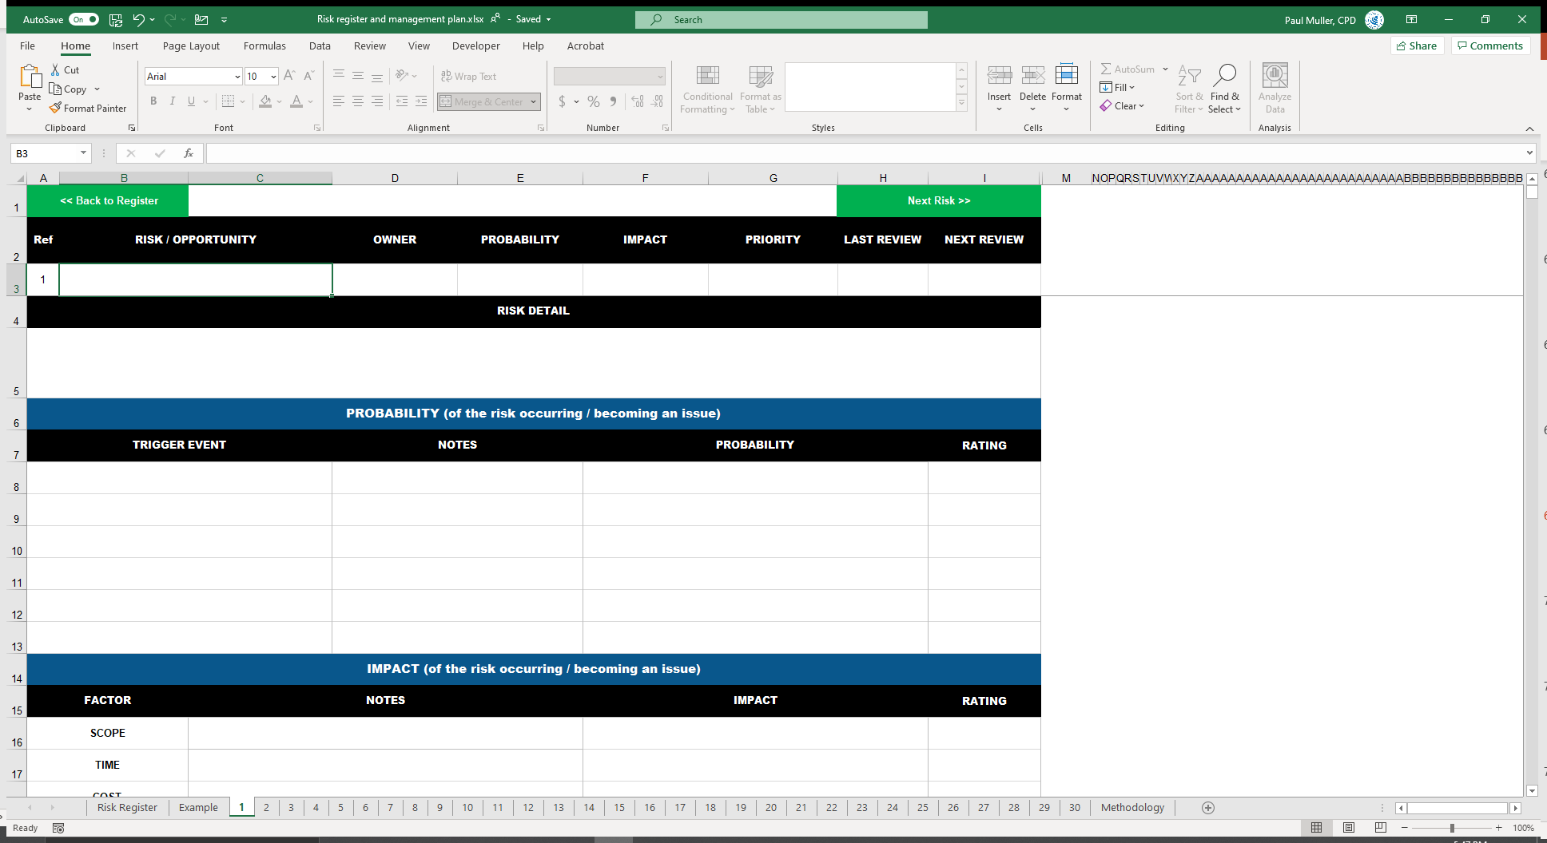
Each tab is a new risk

Slide 70
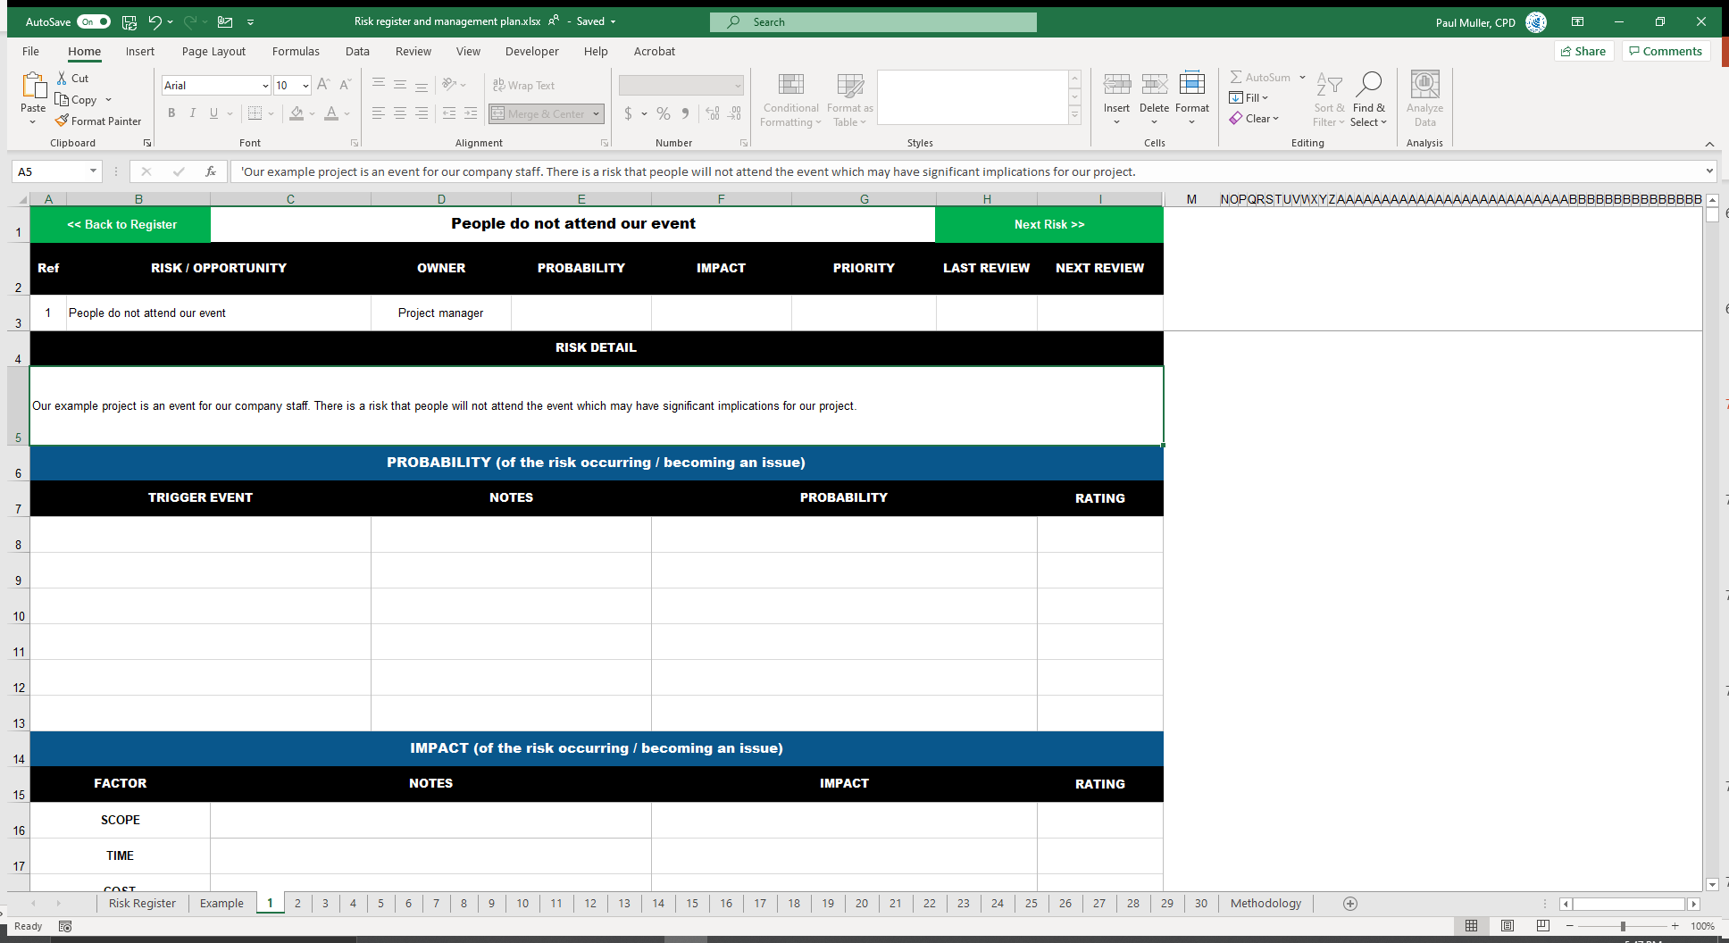
Start filling out risk info

Slide 71
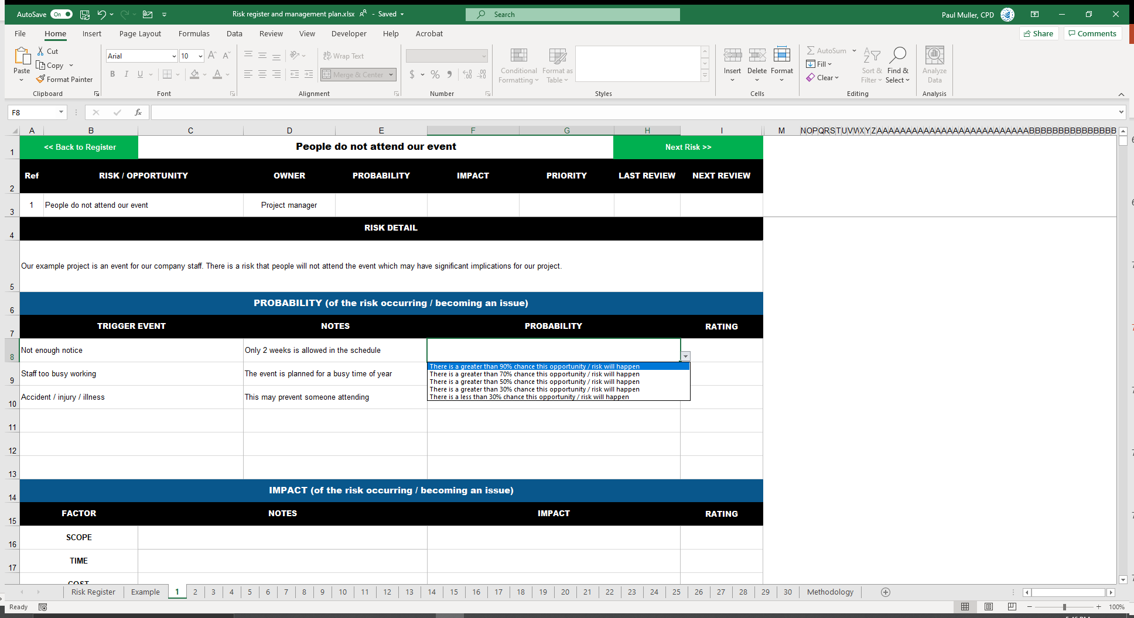
What is the probability of the trigger events occurring?

Slide 72
It will also update here
A rating will be assigned

Slide 73
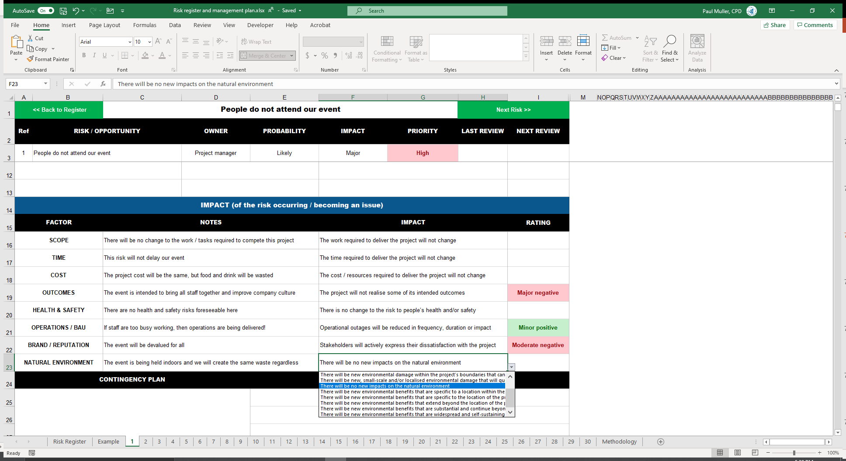
A priority is calculated
Repeat the process for impacts

Slide 74
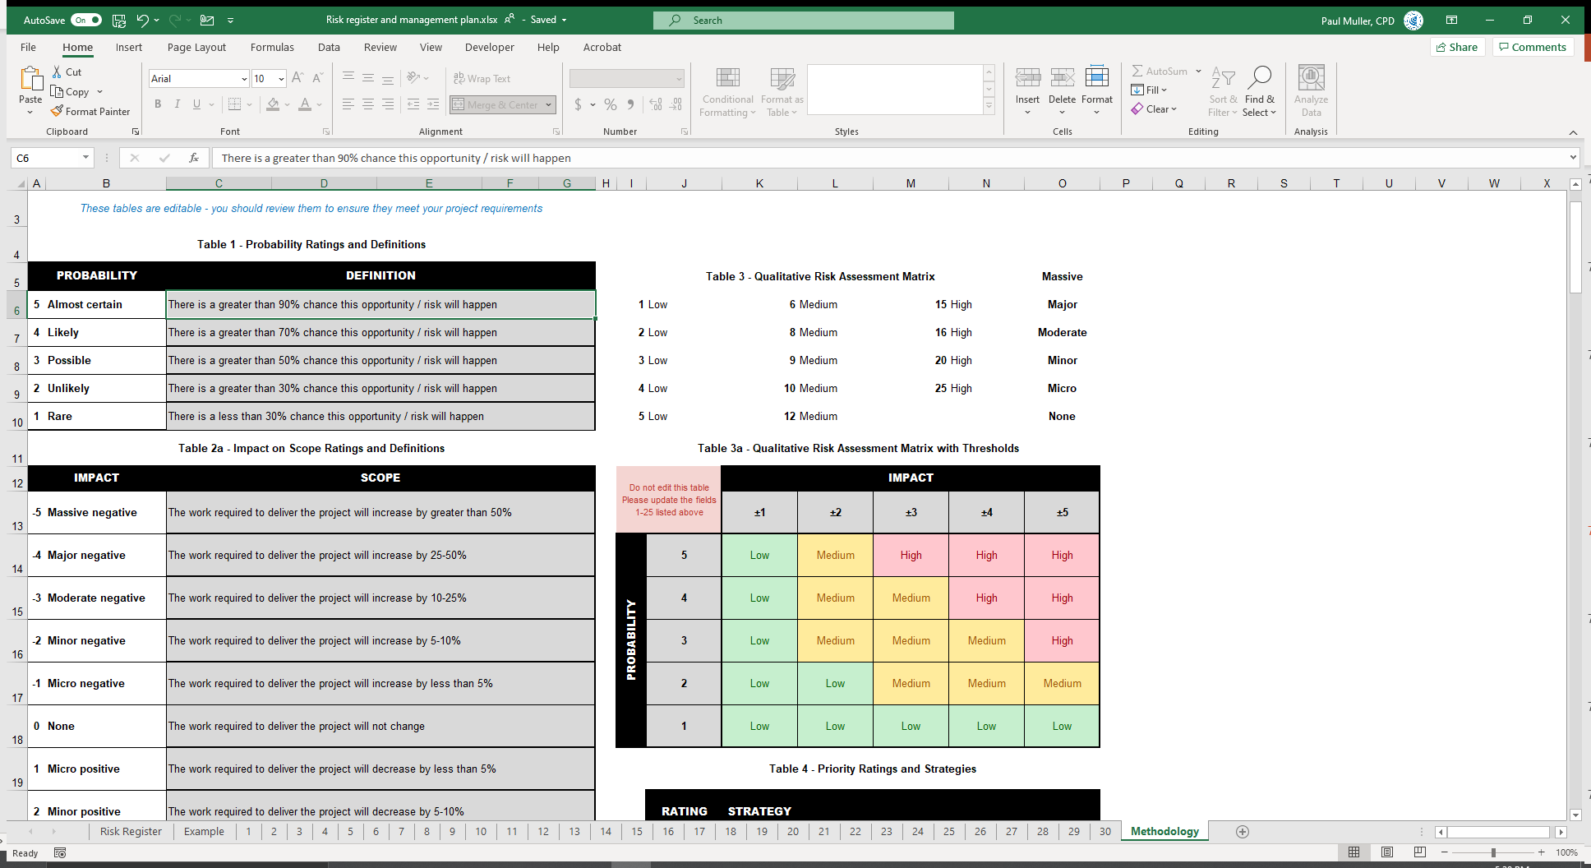
Advanced users can update and edit all fields via the Methodology tab

Slide 75
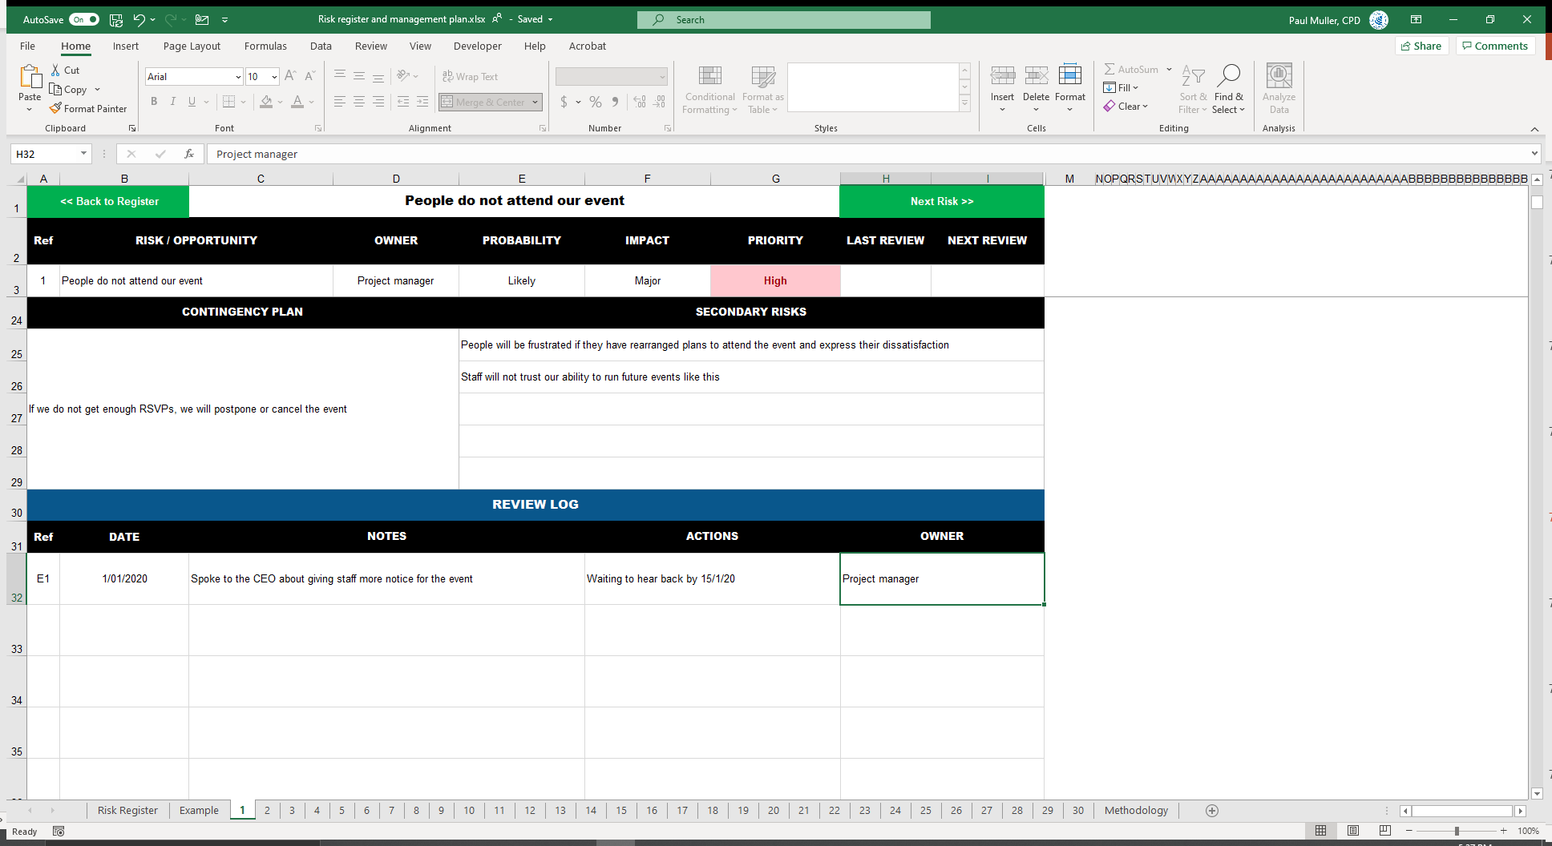
Additional information:
Contingency plans
Secondary risks
Review log

Slide 76
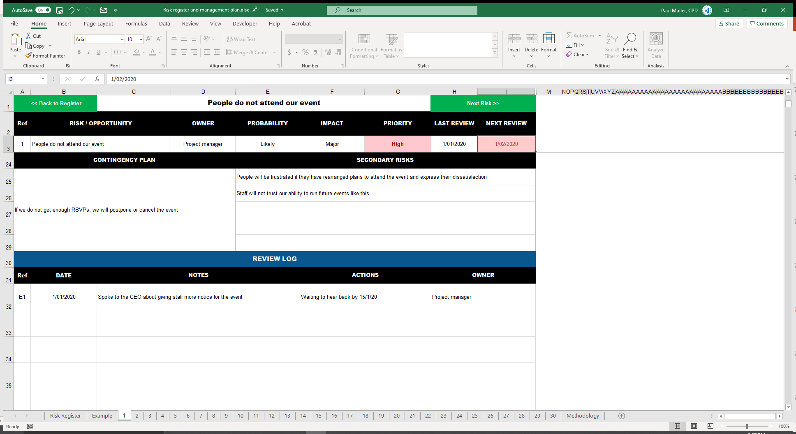
Don’t forget last & next contact
Overdue contacts are highlighted in red

Slide 77
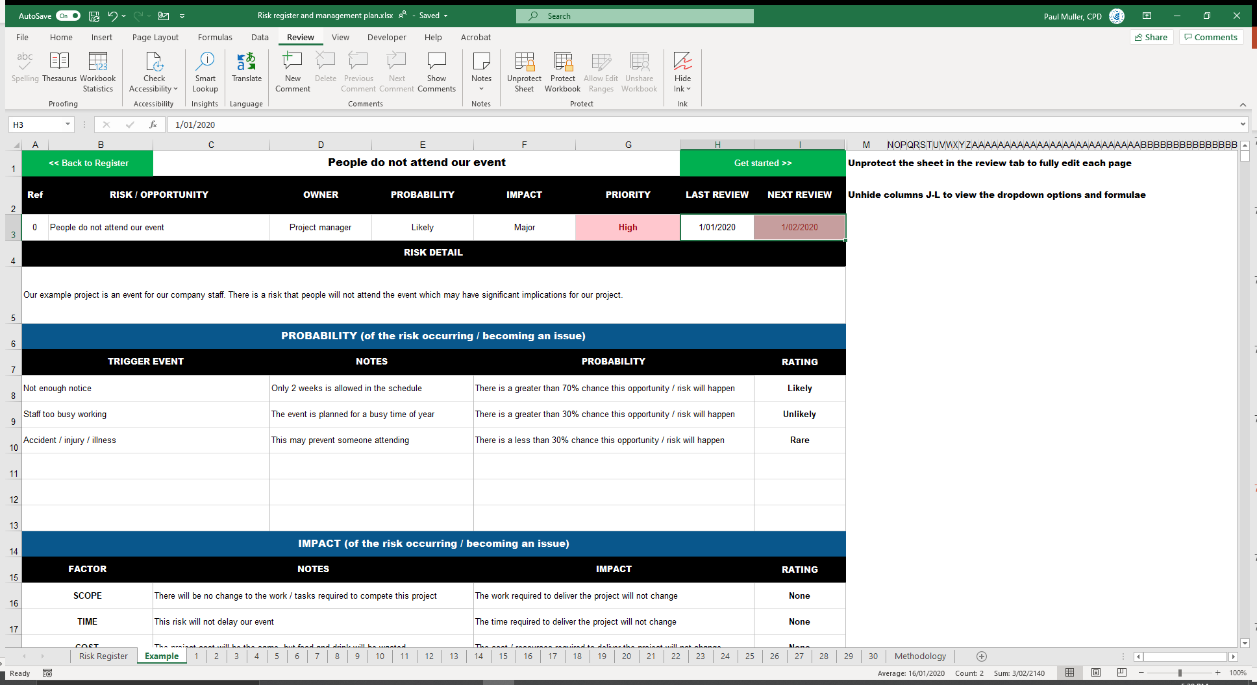
You can find all this info on the Example tab

Slide 78
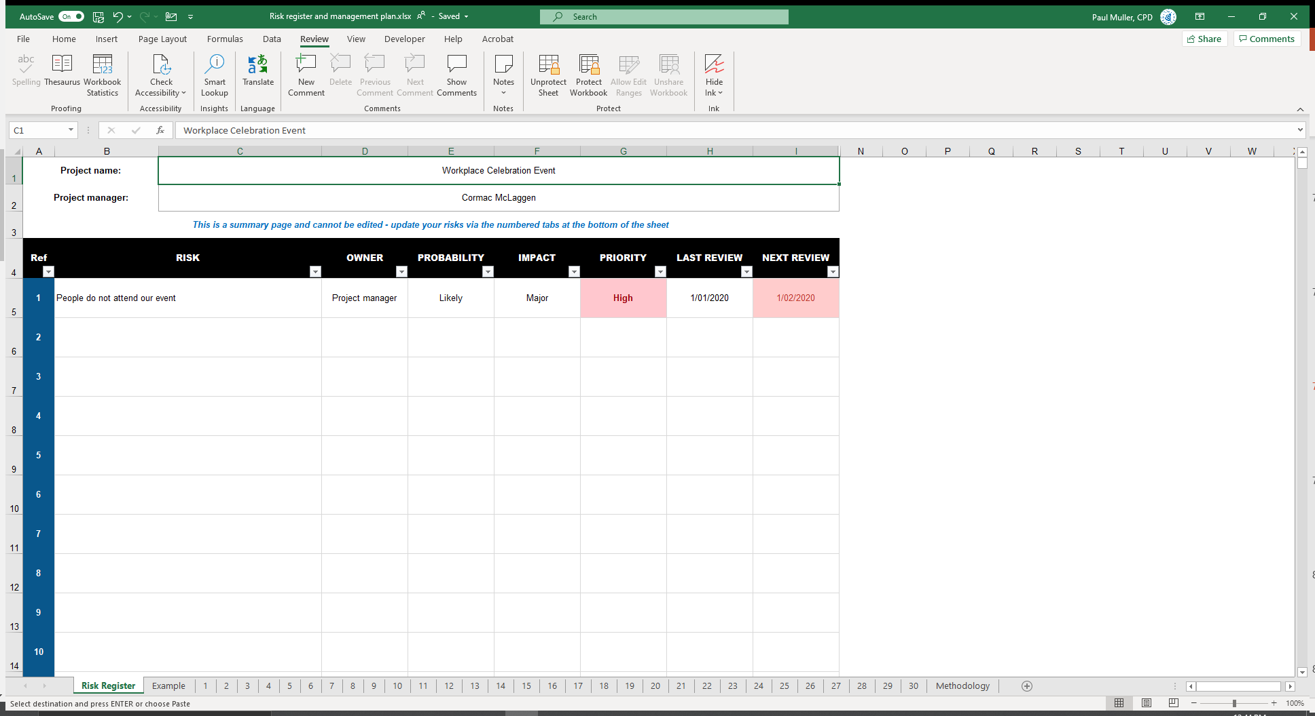
There you have it!
Filtering (but not sorting) is also available

Slide 79
Monitoring risk
OPEN 7.15
Notes:
Monitoring and controlling risks is the process of tracking identified risks, identifying new risks, implementing risk response plans, monitoring residual risks, and evaluating risk management effectiveness throughout the project.
The risk register records all the information about every individual risk.
It also assigns ownership and accountability for each risk to relevant project team members.
Yet at the heart of successful risk management is the need for open, inclusive stakeholder communication.

Slide 80
Monitoring risk
OPEN 7.15
Notes:
Monitoring risk is done through regular status as well as the less formal processes of observation and analysis that go into the delivery of every task.
Each risk owner needs to report periodically to the project manager on the effectiveness of the plan, any unanticipated effects, and any correction needed to handle the risk appropriately.

Slide 81
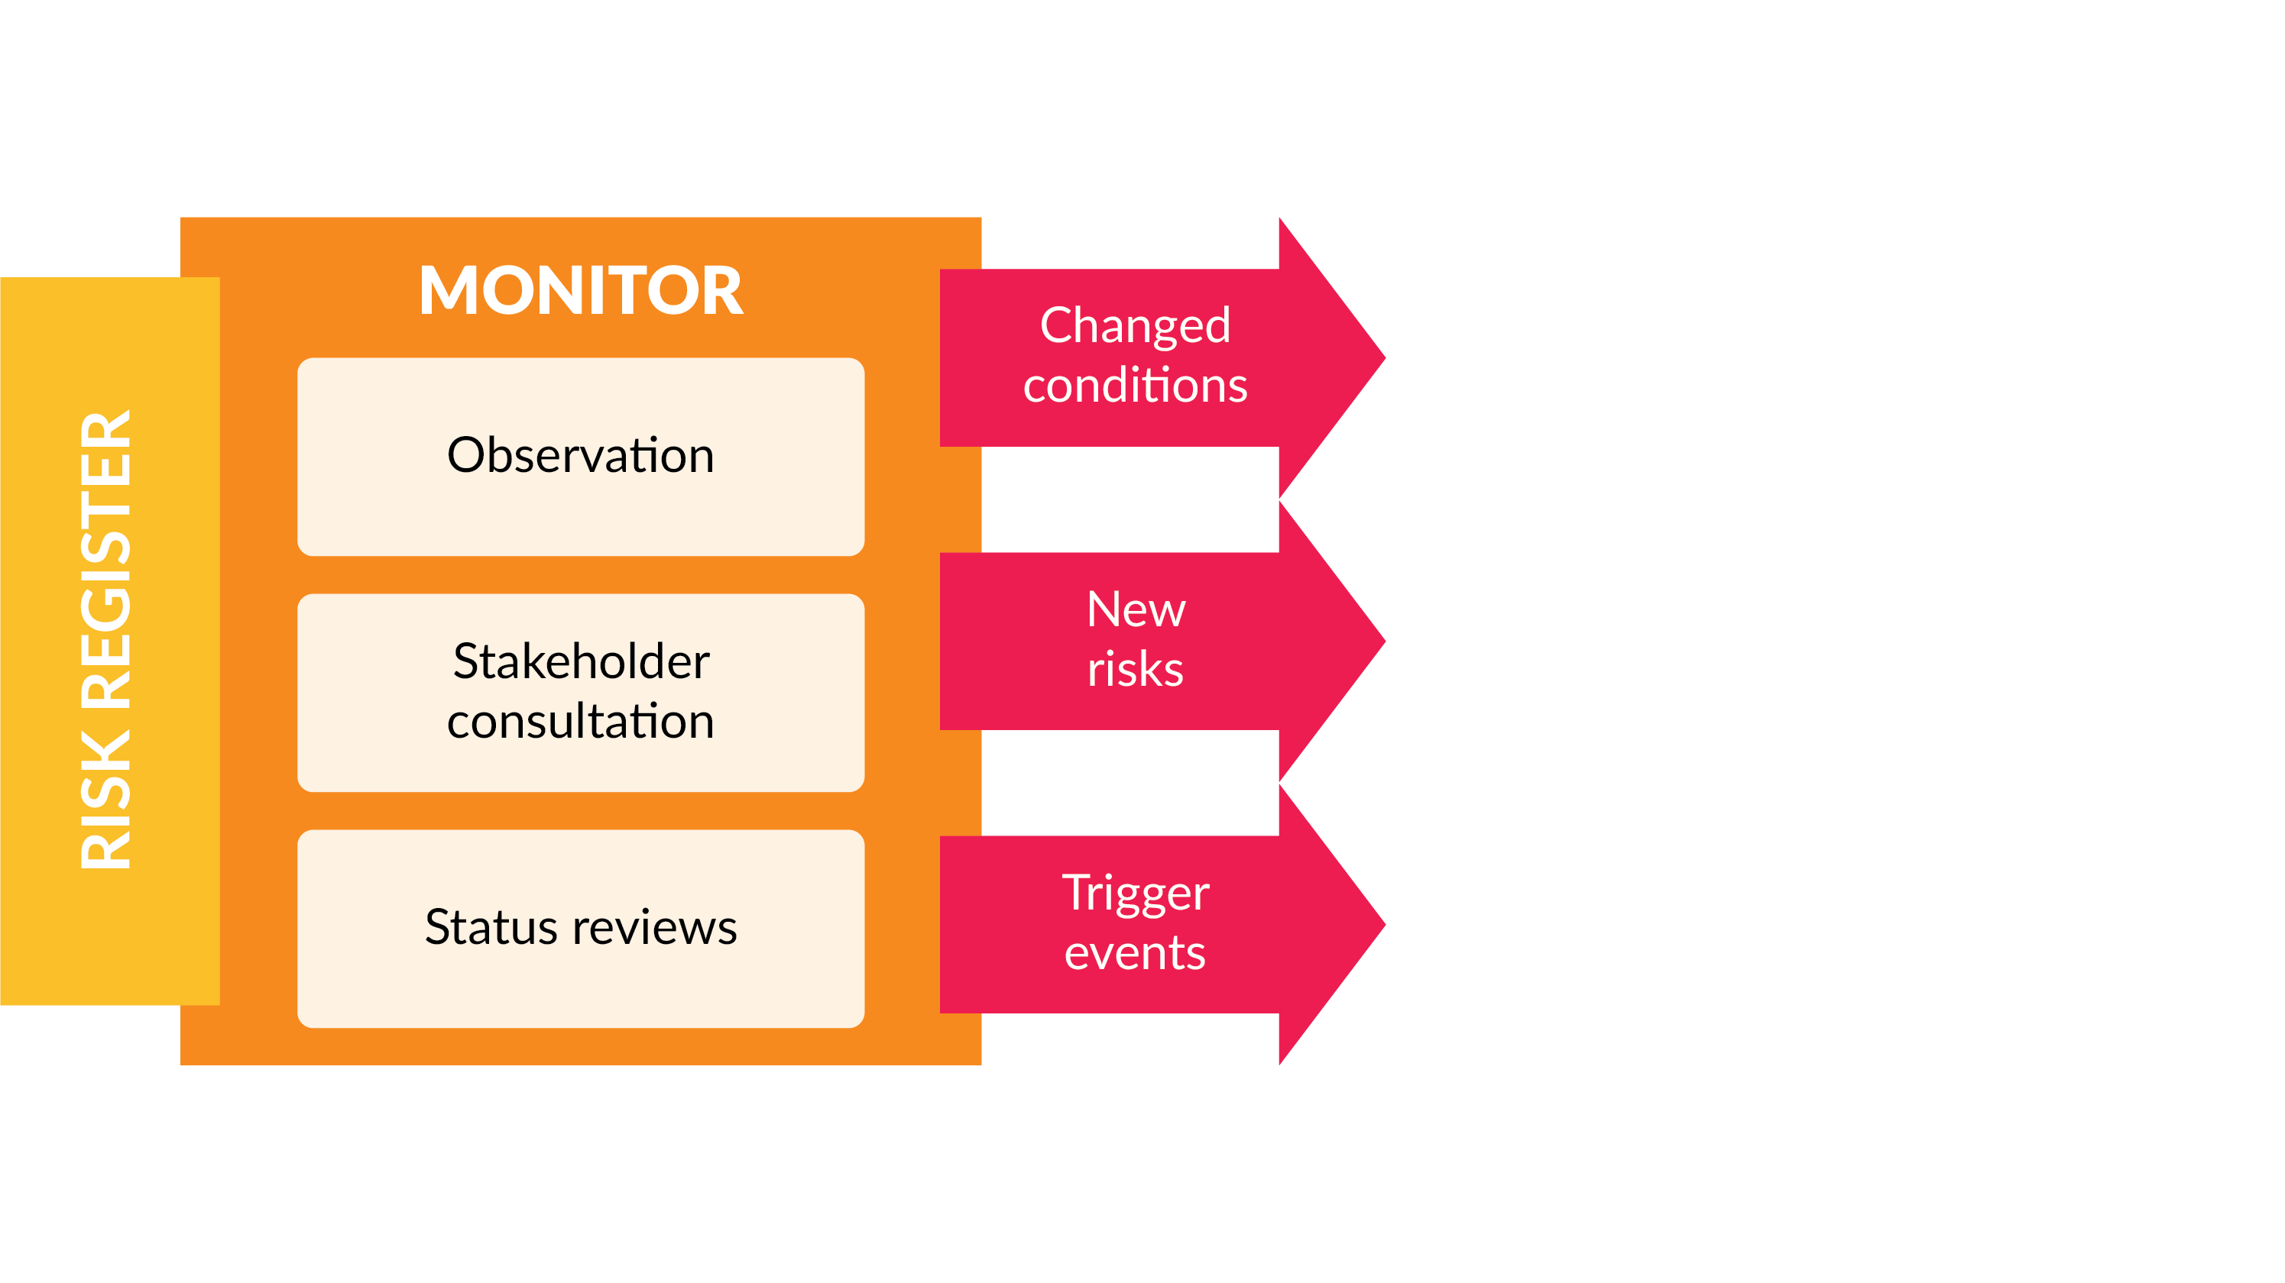
Monitoring risk
OPEN 7.15
Notes:
All stakeholders, but especially project team members, should be alert to changing conditions, triggers, symptoms, and warning signs that risks are likely to be realised, as well as new or emerging risks.
It is for that reason that project risk management should be regularly canvassed, whether at formal gatherings of the Steering Committee, informal corridor catch-ups, or in general stakeholder conversations.
As any practising project manager will tell you, the last thing any decision-maker needs is surprises!

Slide 82
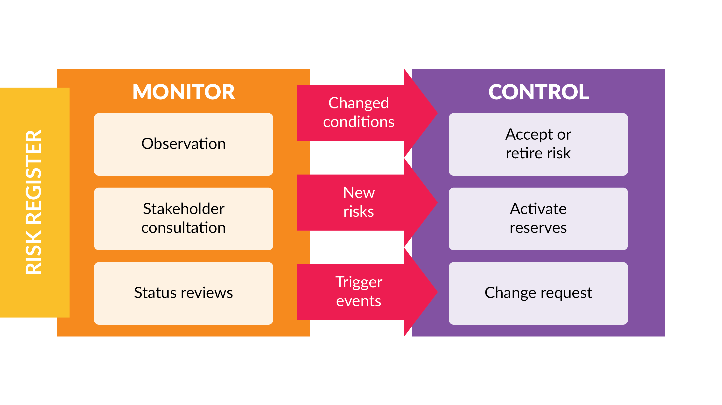
Controlling risk
OPEN 7.15
Notes:
Identification of a risk that has either a changed probability or impact or has actually escalated into an issue will require activating controls.
Control can involve choosing alternative strategies, executing a contingency or fall-back plan, taking corrective action, and/or making appropriate, authorised changes to the project plan.
It can also involve more passively accepting a risk or retiring it from the risk register (if, for example, the probability or impact reduces to zero).

Slide 83
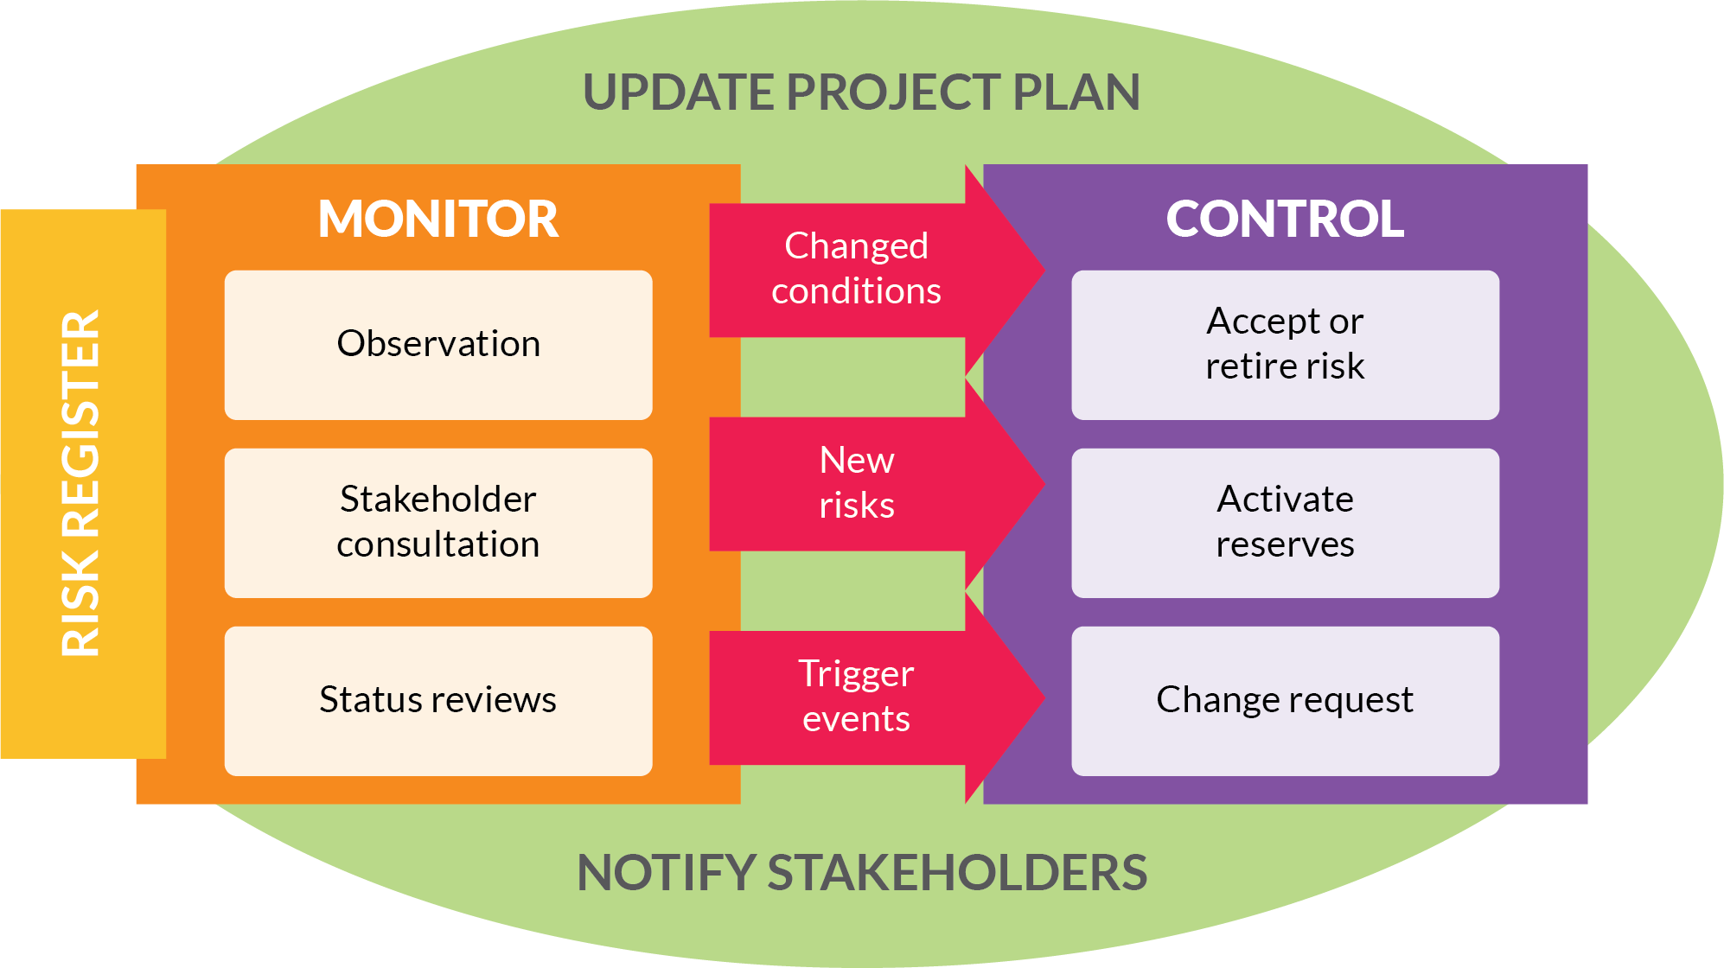
Controlling risk
OPEN 7.15

Slide 84
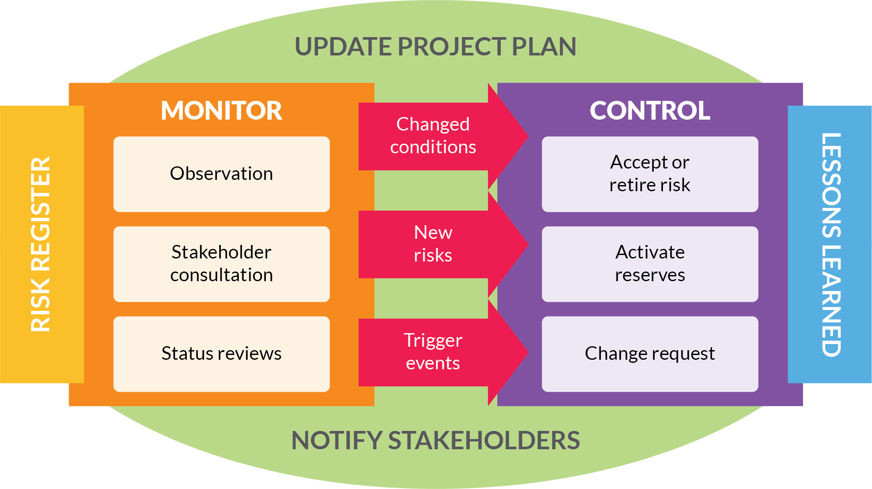
Tracking risk
OPEN 7.15
Notes:
Lessons learned should also be documented for easy retrieval when the project is formally closed and reviewed.
Lessons might include the discovery of new risks not identified in the planning process that may be relevant to future projects, as well as risk management process improvements (such as when and how to engage stakeholders).

Slide 85
Activity 7.7
How can you encourage better risk management practices in your projects?
Notes:
Risk management becomes easier the more often it is practised.
The amount of time required for risk management will vary, depending on the risks that have been identified, their priority, and complexity of response.
Nonetheless, frequent discussions about risk make it more likely that people will identify and manage risks and opportunities for you!
And although some of the project planning processes are linear (for example, the WBS needs to be prepared before the schedule), others are much more dynamic.
Risk is often the confounding element.
Every time you identify a new risk (or change to an existing risk) that is above your threshold of comfort in the planning stage, the chances are that your plan – that you might have believed was complete – will need to be reworked.
This is unfortunately true of every stage of the project, but remember what we showed earlier in this program?
The cost of change is lowest at the start of the project; therefore, you would much rather discover and plan for these risks now than have them materialise as very expensive issues once you are in project execution mode.
For that reason, even though proper risk management will save you money at every point in the project lifecycle, the sooner you start, the more you save.

Slide 86
Risk register
Prepare a risk register and management plan
Relevant professional or personal project
Use template provided, or
Project risk register from your workplace
For example: Safe Work Methods Statement (SWMS)
Does not have to be the same project used for the other activities
You can also use the case study project
Minimum of five (5) entries
Notes:
Cert IV PMP students only

Slide 87
Reflection
What is the most interesting thing you learned today?
What is one thing you will start, stop or continue doing?
What is one thing you would like to learn more about?

Slide 88
Questions?
Coming next… agile

Slide 89
Closing checklist
Classroom
Upload signed attendance sheet and any photos taken of work in progress
Zoom
Upload video with thumbnail and link to workshop
Student administration
Mark participating students as complete
Email absent students and notify of gap requirements (OPEN units)
Facilitator feedback – email paul@institute.pm
What worked well today?
How can we improve?

