Slide 1
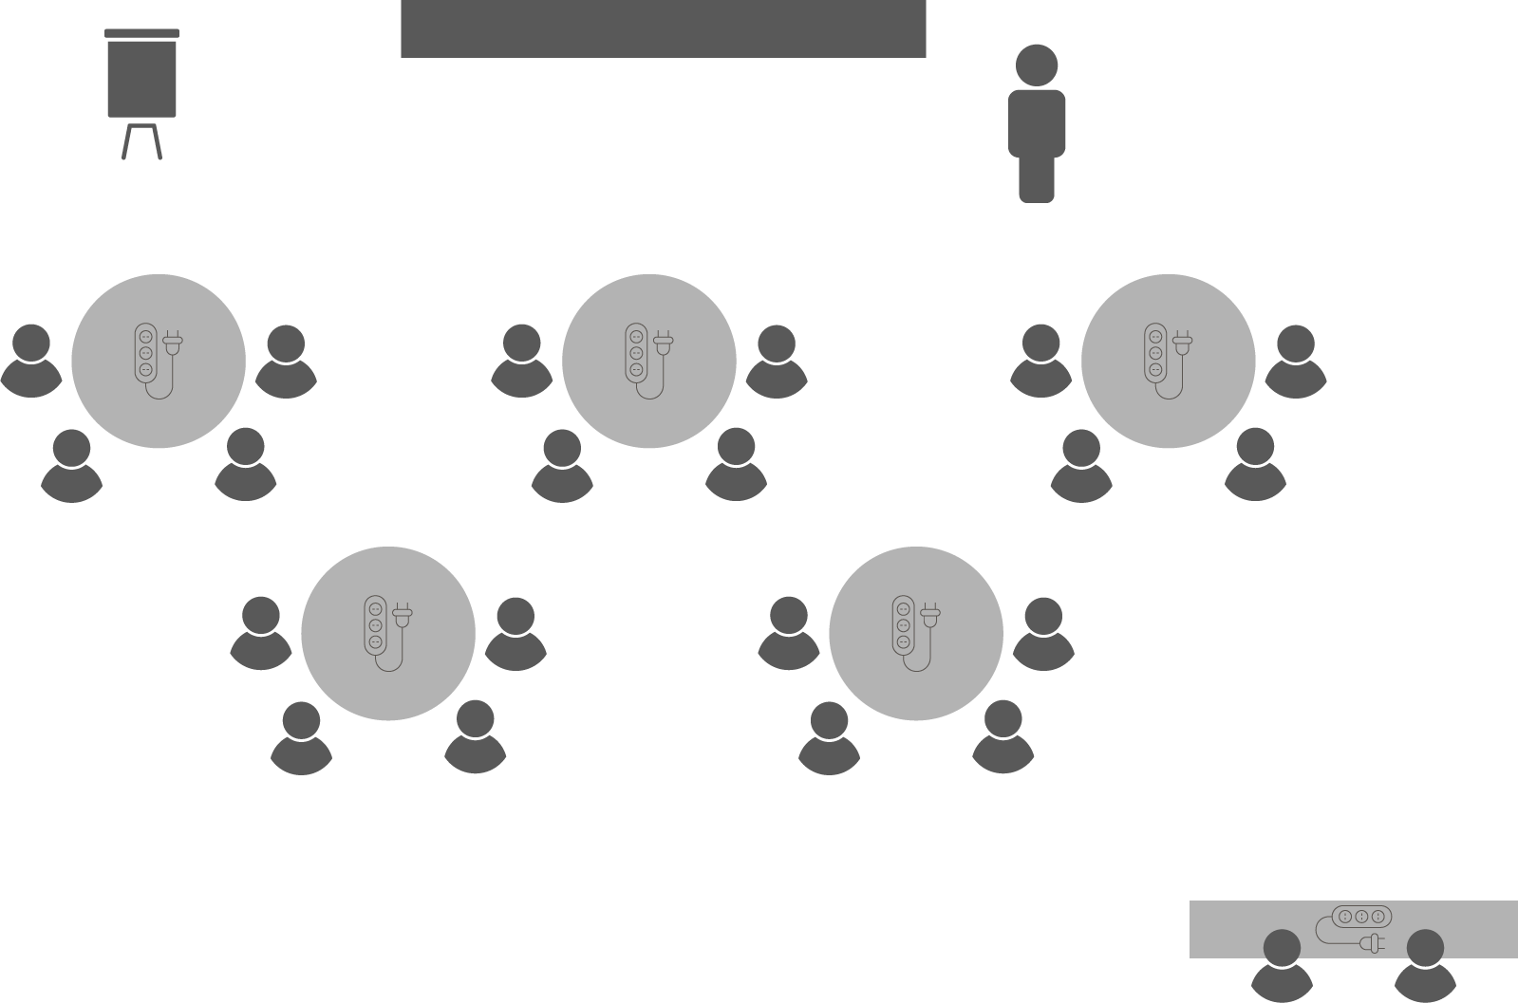
Opening checklist
Your preparation
Review notes, run a technical rehearsal
Rehearse examples / cases / stories to stimulate discussion
Classroom
Ensure students seated at tables of 3-5 and all facing the front
Have student name cards in place and ensure all sign in
Zoom
Rename yourself as host (under participants)
Set-up breakout rooms
https://support.zoom.us/hc/en-us/articles/206476313-Managing-Video-Breakout-Rooms
Welcome students as they arrive, let them know when starting
Notes:
Good luck!

Slide 2
Managing
Project Teams

Slide 3
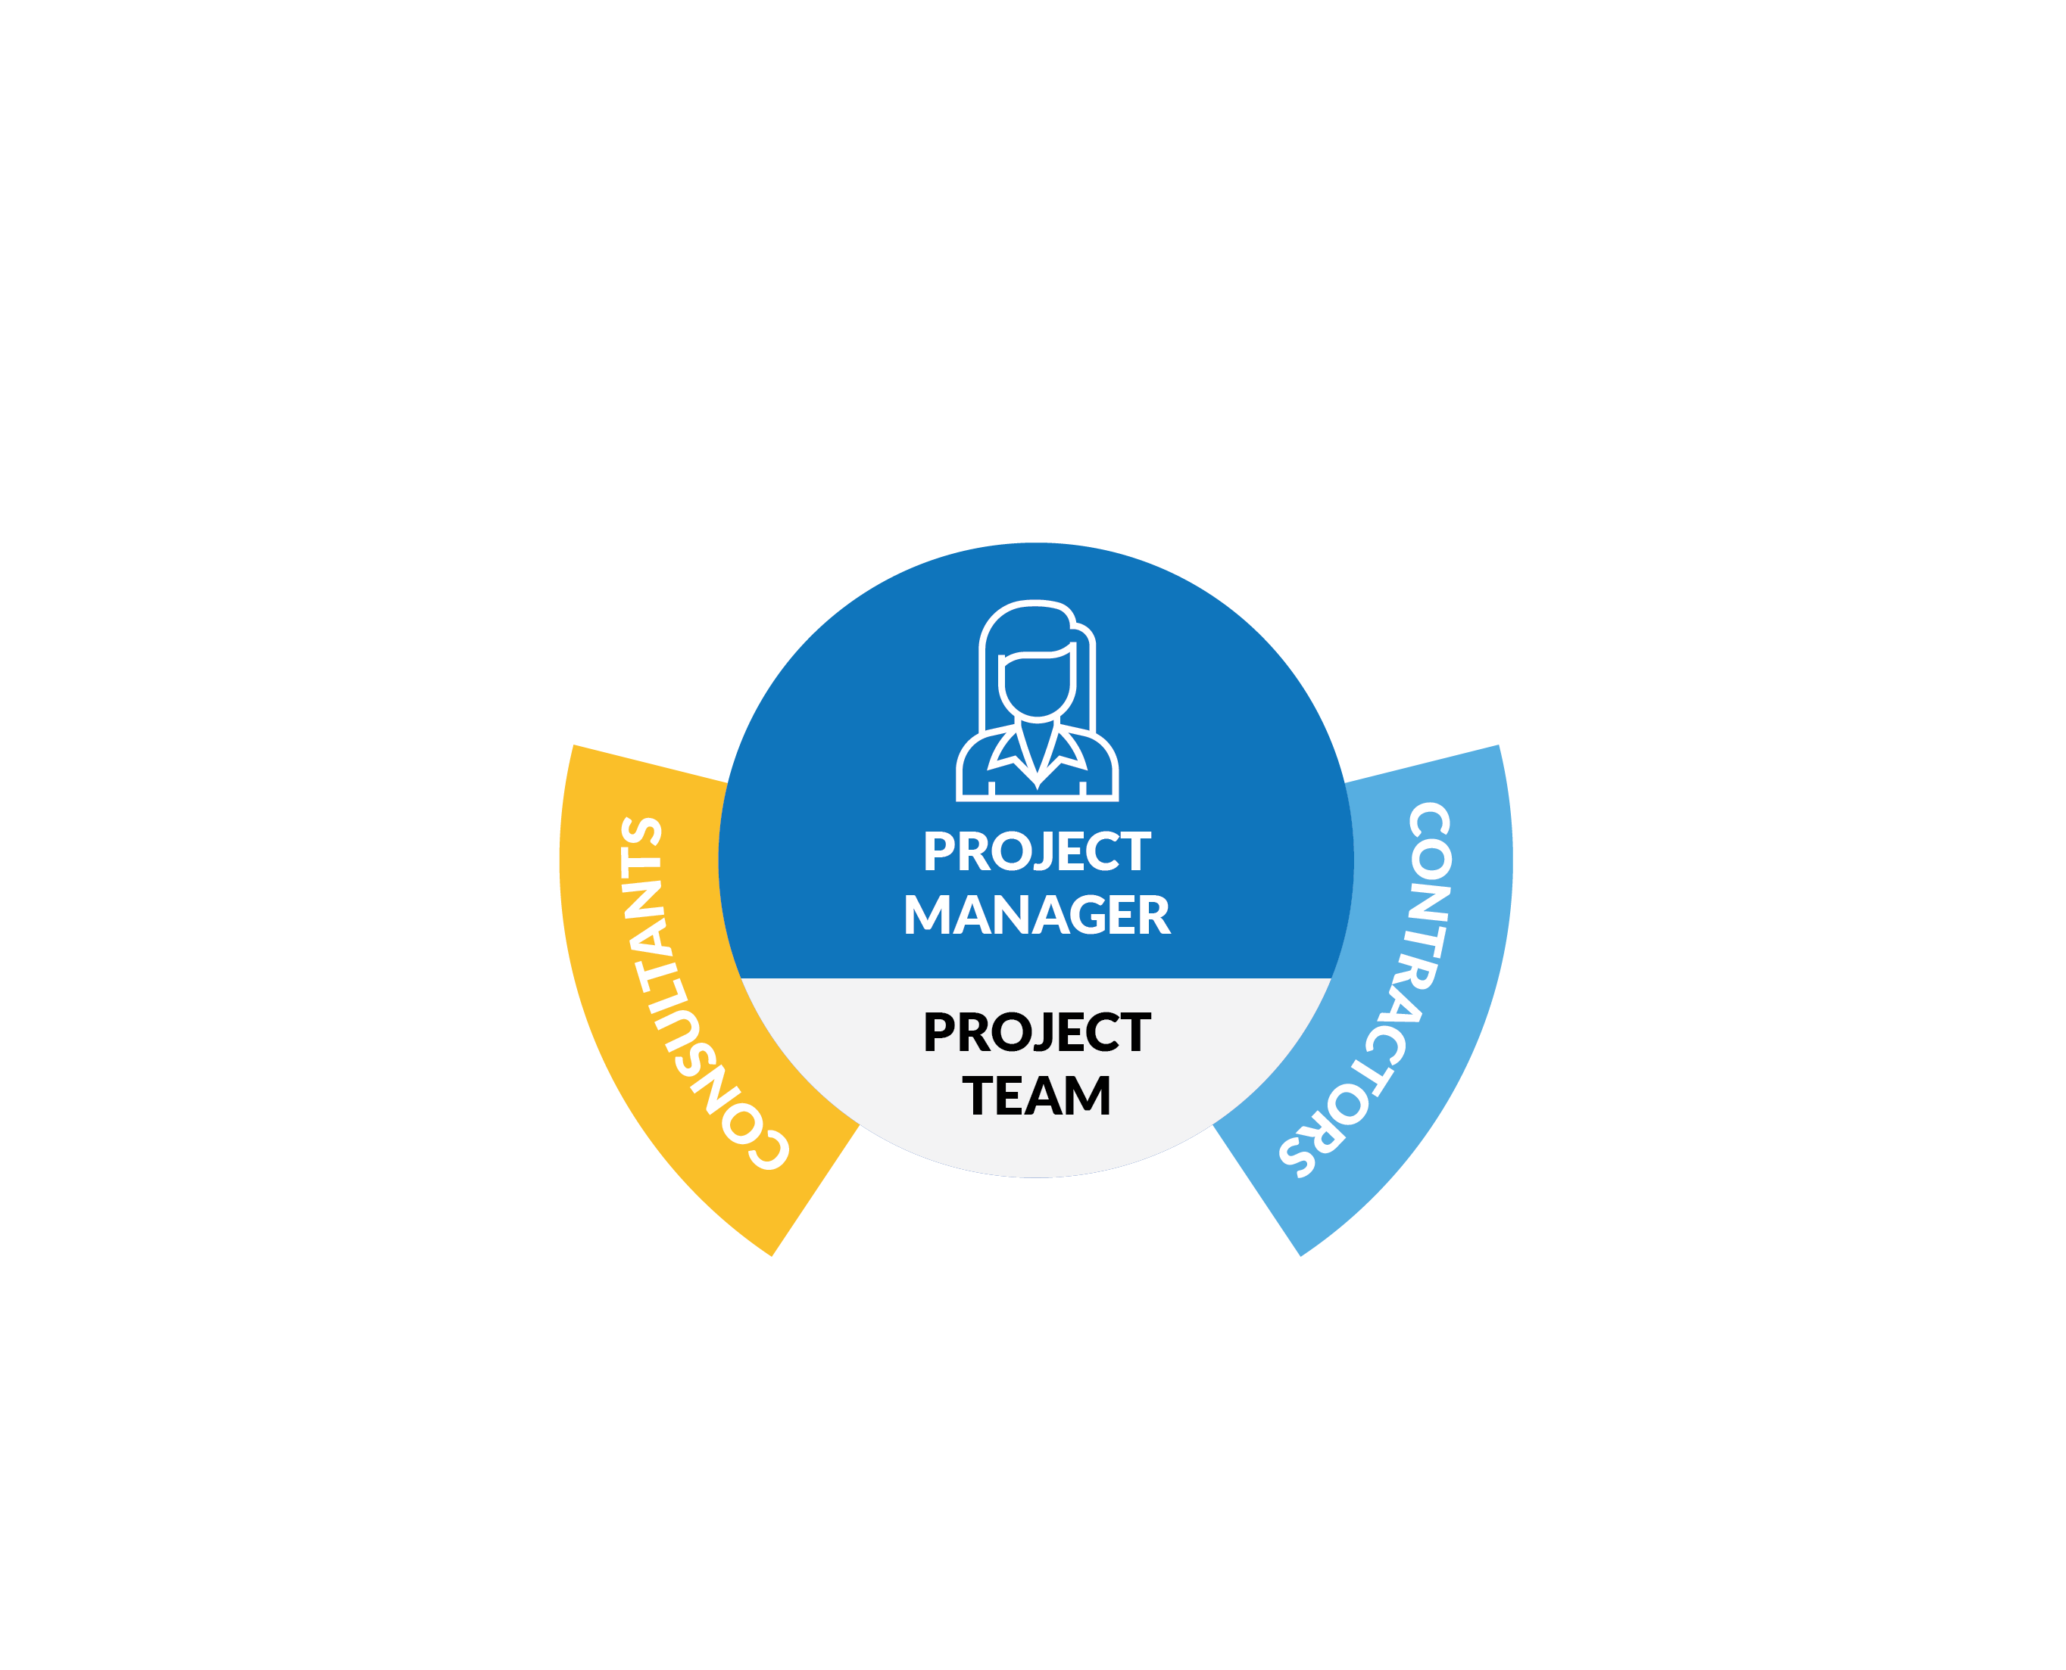
Activity 9.1
What does your project ‘dream team’ look like?
How will you acquire them?
Notes:
The ideal project team is a diverse mix of technical experts who can optimally deliver the tasks allocated to them.
They should also have a least basic project management skills that enable them to deliver tasks on time, to budget and scope, understanding how their work fits into the overall project (for example, any dependencies related to it).
Have students think specifically think as well about the personality / behavioural attributes they identify with ‘good’ team members
Acquisition can be looked at in two ways – where they find them (eg networks, advertisements, procurement process) and how they screen / select / recruit them (eg interview process / questions)

Slide 4
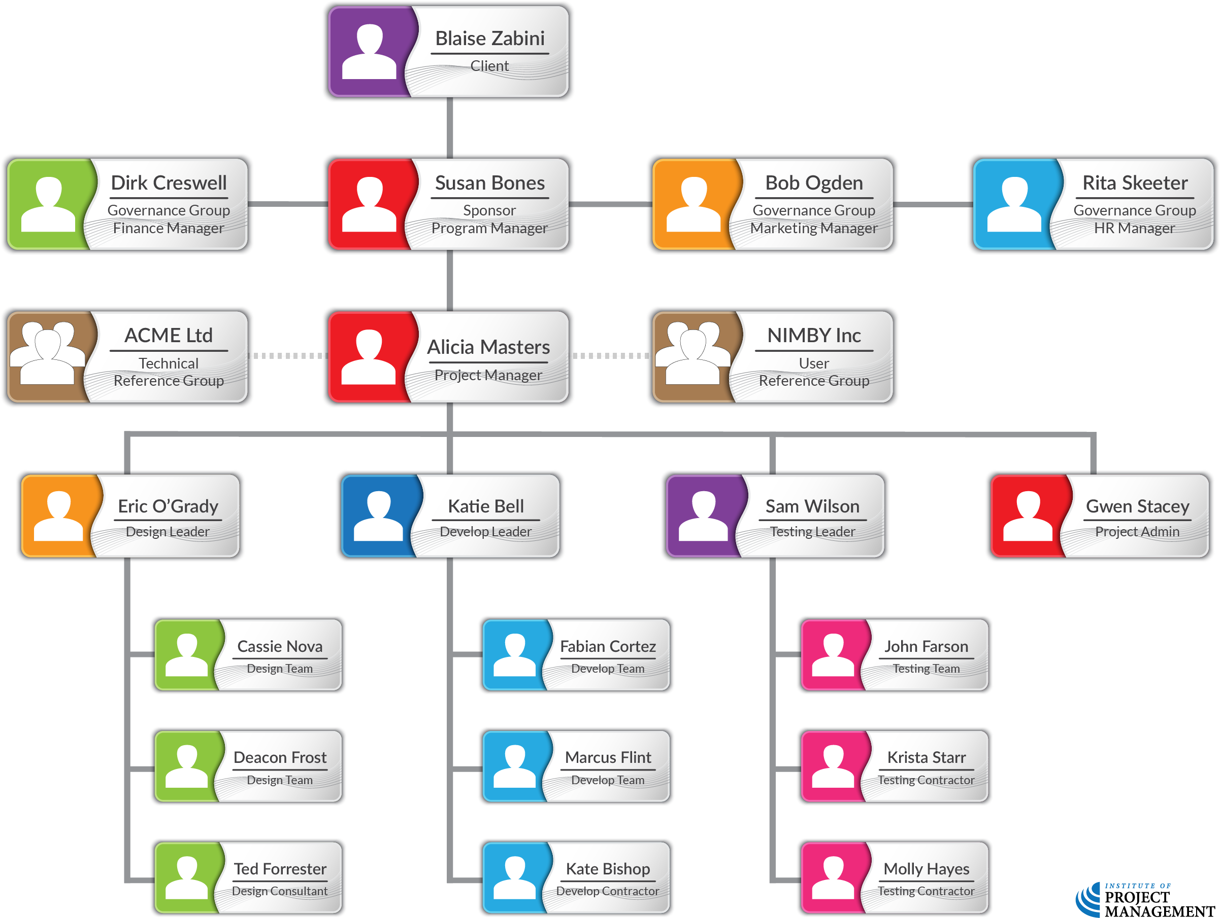
Organisational chart
OPEN 8.4
Notes:
The traditional, hierarchical organisational chart structure can be used to show positions and relationships in a graphic, top-down format.
It can be formal or informal, highly detailed or broadly framed, depending on the needs of the project.
And as indicated in the previous Module, the WBS itself may also be structured by team and/or individual levels of responsibility.
This chart shows the typical project relationships – talk them through it

Slide 5
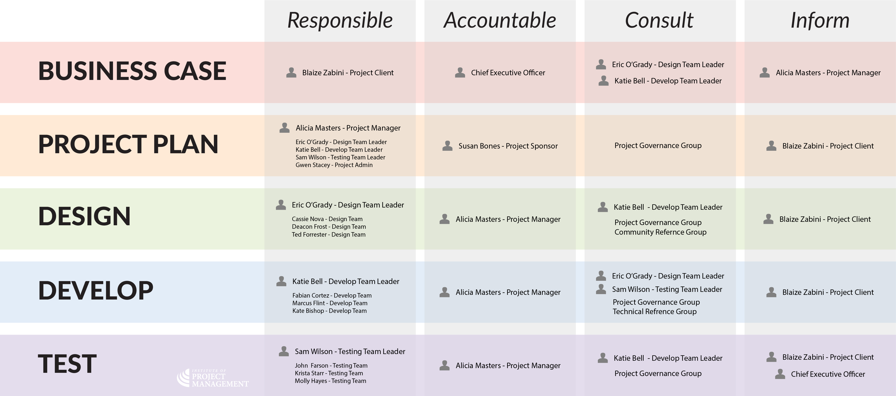
RACI matrix
OPEN 8.4
Notes:
A RACI (responsible, accountable, consult, and inform) chart, is another way of graphically expressing this information.
This chart maps the work to be done against the level of engagement required from each team member or stakeholder.
As a complement to the power x interest matrix, this is often used to map key, internal relationships through delivery

Slide 6
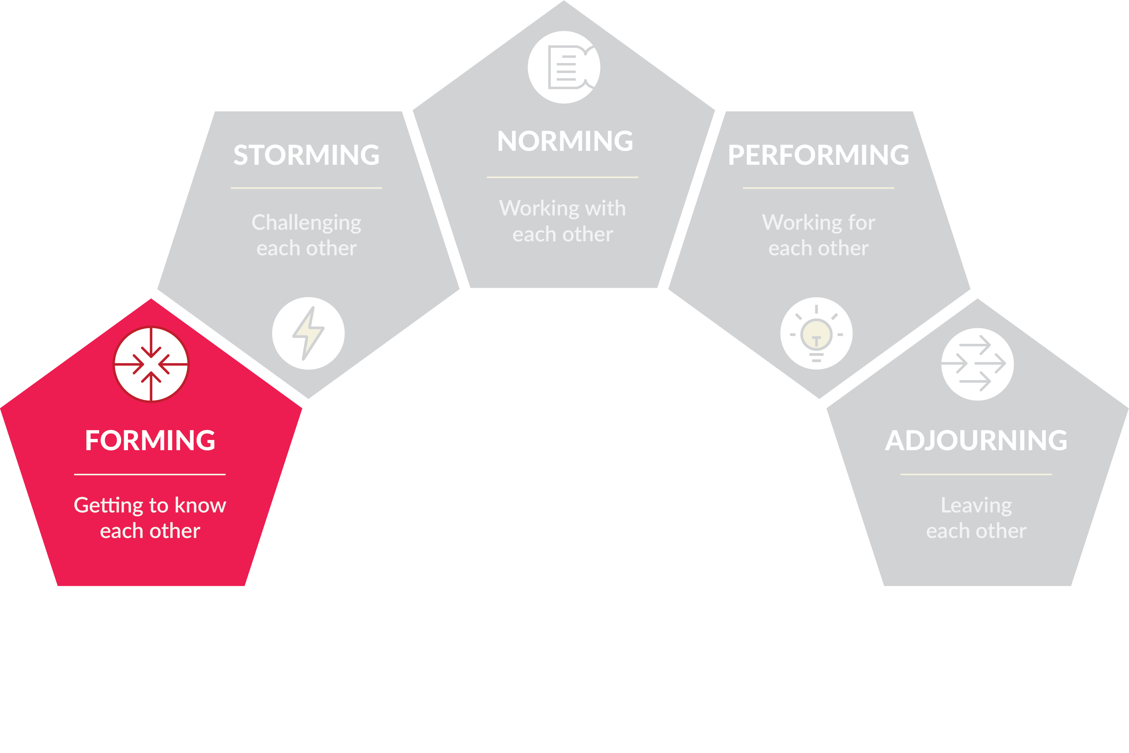
Team development
OPEN 10.2
THE TEAM FEELS…
Unclear about purpose
Not yet committed
Tentative
THE TEAM NEEDS…
Direction
Where do I
fit in?
Notes:
There are five different stages of team development that are as relevant to leading projects as they are to more traditional, business-as-usual settings.
Psychologist Bruce Tuckman first came up with the memorable phrase ‘forming, storming, norming, and performing’ back in 1965.
He used it to describe the path to high performance that most teams follow, later adding a fifth stage that he called ‘adjourning’ (and others often call ‘mourning’, maybe because it rhymes better).
Teams initially go through a ‘forming’ stage in which members are positive and polite.
Some members are anxious, as they haven’t yet worked out their place – others are simply excited about the task ahead.
As leader, you play a dominant role at this stage: other members’ roles and responsibilities are less clear, so assist in clarifying them.
The forming stage is also usually fairly short, and may only last for the single meeting at which people are introduced to one-another; however, it may take a little longer to settle when establishing virtual teams.

Slide 7
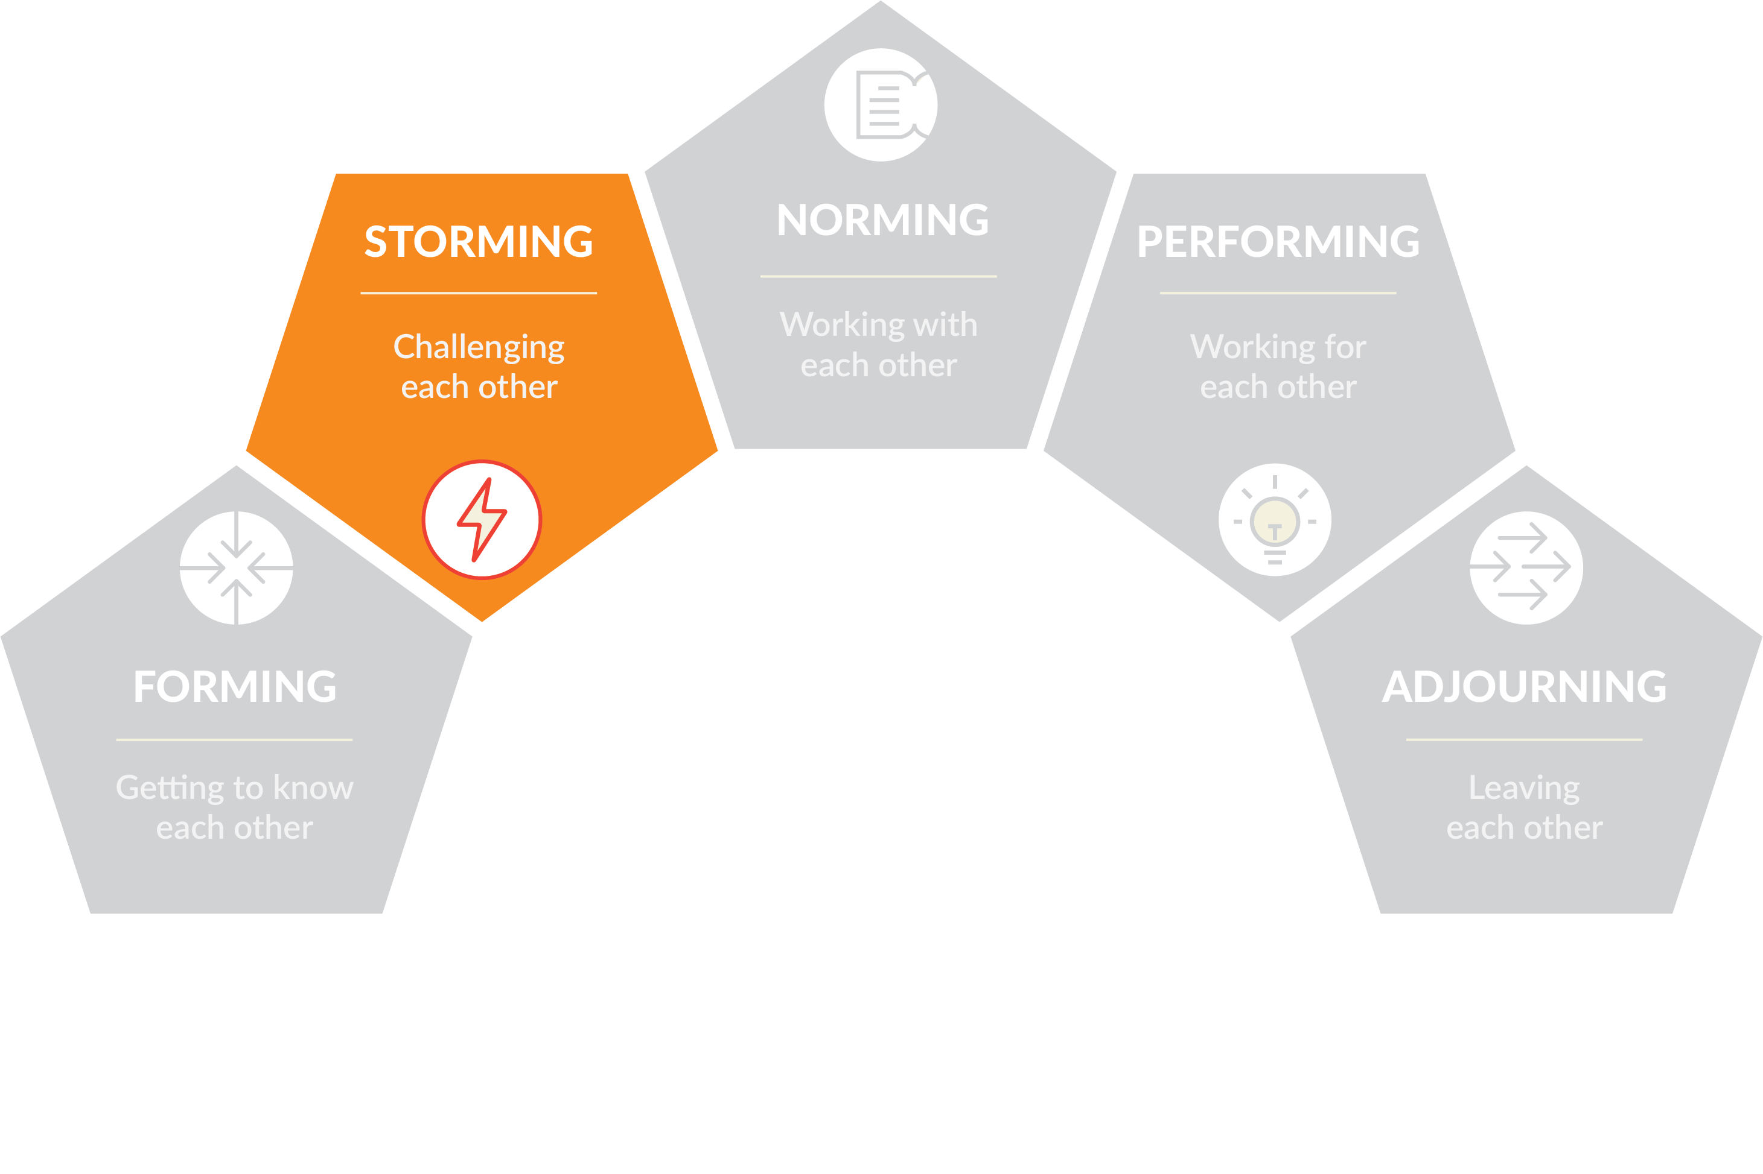
Team development
OPEN 10.2
THE TEAM FEELS…
Confusion about priorities
Independent of others
Tension
THE TEAM NEEDS…
Guidance
Who is in charge of what?
Notes:
Once reality sets in, your team moves into a ‘storming’ phase.
Your authority may be challenged as others jockey for position and their roles are clarified.
The ways of working start to be defined and, as leader, you must be aware that some members may feel overwhelmed by how much there is to do, or they may be uncomfortable with the approach being used.
Some may react by questioning how worthwhile the project is, and some may resist taking on tasks.
This is the stage when many teams fail, and even those that stick with the project may feel that they are on an emotional roller coaster, as they try to focus on the job in hand without the support of established processes or relationships with their colleagues.
At this point you should confirm and reinforce process and structure, defining communication methods and channels.
Work to build good relationships among team members, especially providing support to those team members who are less secure. This is also a good time to arrange a social or a team-building event.
Remain positive and firm in the face of challenges to your leadership or the team’s goal.
You might also like to explain the ‘forming, storming, norming, and performing’ idea so that people understand why conflict is occurring, and appreciate that things will get better in the future.
Conflict management is something we will explore in more detail later in this Unit.

Slide 8
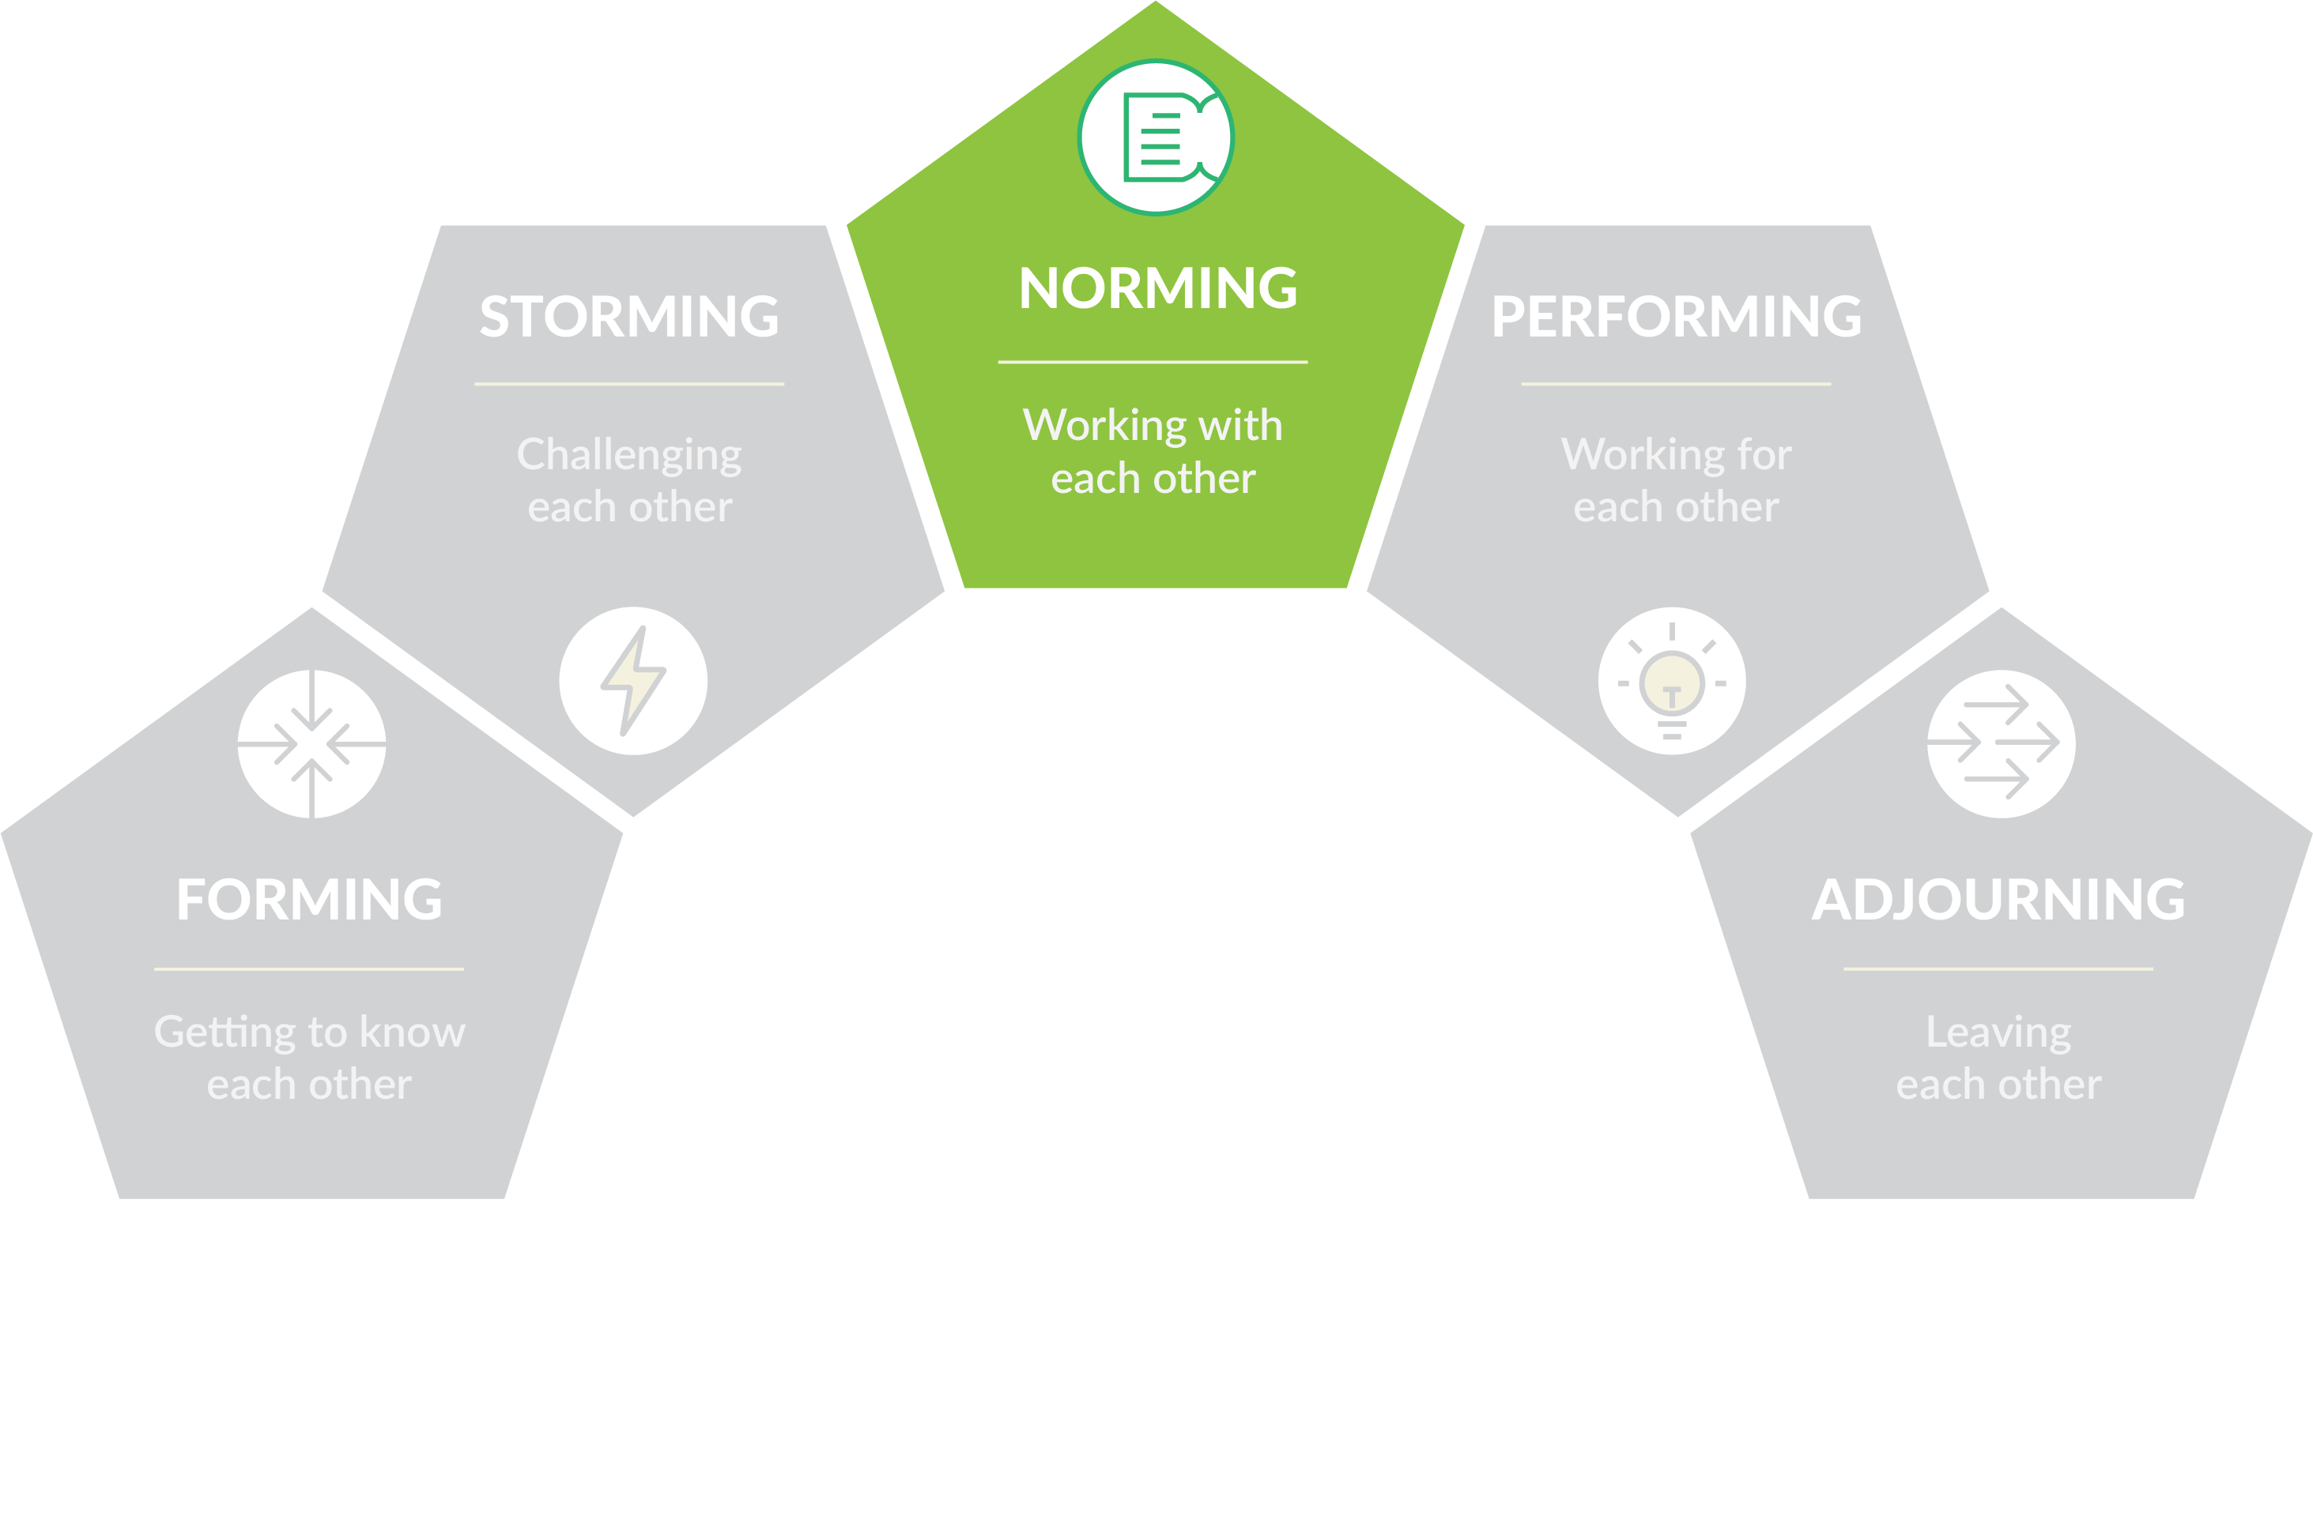
Team development
OPEN 10.2
THE TEAM FEELS…
Ownership
Cohesion
Confidence
THE TEAM NEEDS…
Facilitating
What’s next?
Notes:
The team gradually moves into a ‘norming’ stage as work flows and relationships are established.
Team members come to respect your authority as a leader, and others show leadership in specific areas.
They also develop a stronger commitment to the goals of the project, and you start to see good progress towards them.
Now that team members know each other better, they are able to ask each other for help and provide constructive criticism.
As a leader, you can step back and help the team take responsibility for progress towards the goal.
There is often a prolonged overlap between storming and norming behaviour; and as new project processes or phases are entered, the team may lapse back into typical storming stage behaviour.
Having led them out of storming once though, you should be able to master the transition to norming again in less time.

Slide 9
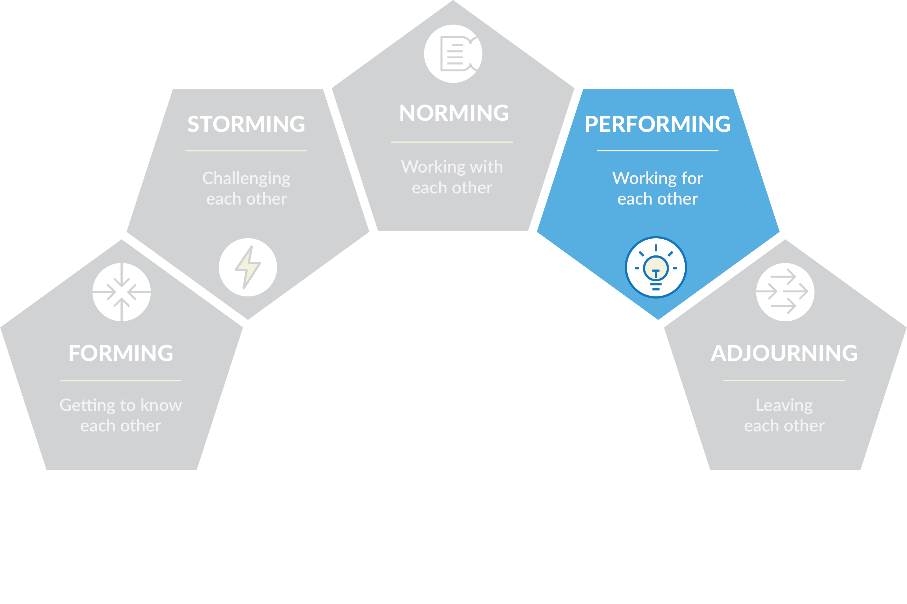
Team development
OPEN 10.2
THE TEAM FEELS…
Shared responsibility
Proactive
Happy
THE TEAM NEEDS…
Autonomy
How can I help?
Notes:
When the team reaches the ‘performing’ stage – and not every team does – hard work leads directly to progress towards the shared vision of the project, supported by the structures and processes that have been set up.
Individual team members may join or leave the team without affecting the performing culture.
As leader, you are able to delegate much of the work and can concentrate on developing team members.
Once the team has achieved high performance, you should aim to have as light a touch as possible. You will now be able to start focusing on stretch goals and other areas of work.

Slide 10
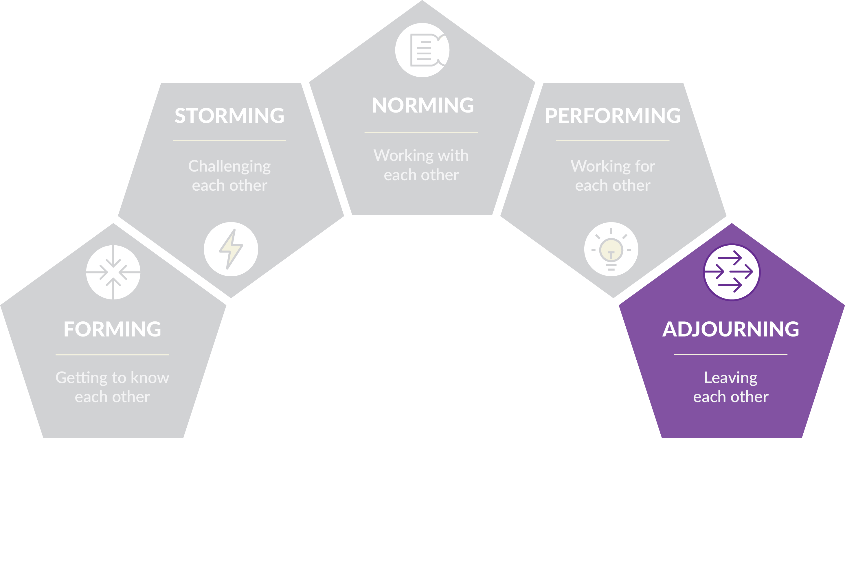
Team development
OPEN 10.2
THE TEAM FEELS…
Closure
Sadness
Separation
THE TEAM NEEDS…
Empathy
What happens to me now?
Notes:
Project teams are finite by definition, and even permanent project offices may be disbanded through organisational restructuring.
The break-up of the team can be hard for members who have developed close working relationships with other team members, particularly if their future roles or even jobs look uncertain.
The ‘adjourning’ or ‘mourning’ stage is important in reaching project, team and personal conclusions.
When breaking up a team – even if the project was unsuccessful – take the time to celebrate its achievements.
From the team perspective, this is less about lessons learned and more about promoting a positive workplace culture for future project delivery.

Slide 11
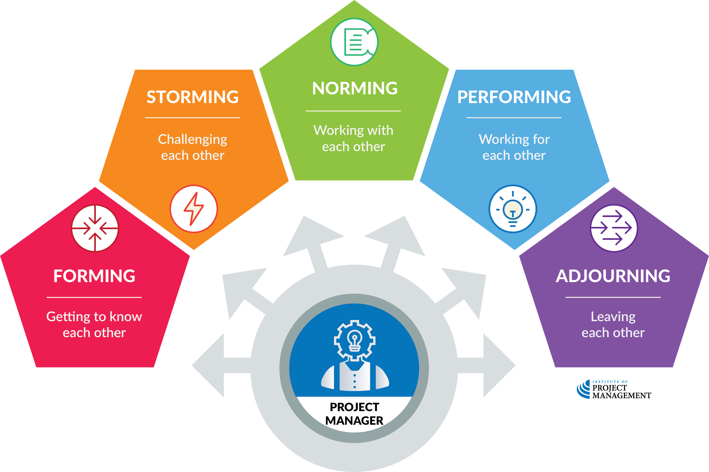
Team development
OPEN 10.2
Notes:
Teams are formed because they can achieve far more than their individual members can on their own, and while being part of a high-performing team can be fun, it can take patience and professionalism to get to that stage.
Effective team leaders can accelerate that process and reduce the difficulties that team members experience by understanding what is needed to move through the various stages of team development.
What this model suggests is that the strategy you employ should be a dynamic response to the circumstances of the project and the evolving state of the team.
Once again, there is no single, cookie-cutter solution to the dilemma of team development; rather, as with leadership style, your response depends on your being open to and aware of changes in the project environment.
It must be noted that performing is the exception rather than the rule, especially in projects.
Performing teams take years to develop – think of championship-winning sports teams.
Within the triple constraints and the tensions that otherwise exist, more often than not norming is the acceptable standard

Slide 12
Activity 9.2
What are challenges in developing virtual teams?
How should you respond?
Notes:
Whereas operational work units are usually co-located, meaning they are all working together under one roof, project teams often work remotely, only ever communicating via email, video conference and other file-sharing technologies.
The project that developed OPEN, for example, was managed from Australia, but had specialist team members working on it in China, India and the USA.
It also outsourced smaller parcels of work to Romania, Croatia and the Netherlands!
The virtual team format is very compelling in that it makes it possible to:
Form teams of people from the same company who live in widespread geographic areas
Add special expertise to a project team that would not otherwise be available
Accommodate employees who work from home offices
Form teams of people who work different shifts or hours, and
Include people with mobility limitations or disabilities.
So how can you be a better virtual project manager?
Trust
Situations like these require you to trust your people. Micromanaging just won't work over distances of hundreds or thousands of miles.
Your leadership style (which we will discuss in the next Unit) should relax from authoritarian to delegative.
It is nonetheless important, though, that you adhere to the good practice principles of delegation we discuss shortly.
Over-communicate
As we know, the early and iterative identification of things that can and have gone wrong in projects is a critical factor for success.
If there is a delay in realising that something is amiss, the impacts may be felt exponentially across time, cost and/or scope.
Regular communication thus becomes an even more critical factor for project success.
After all, when you’re around each other, a lot of information is picked up through informal discussions and office chatter.
While separated this won’t happen, you need to put effort into communicating more and not assuming people know.
Importantly, comprehensive project documentation that is maintained in real-time - and that is easy to access and search - becomes a critical backstop to the other communication media introduced and critiqued in Unit 4.
Leverage technology
There are numerous platforms to communicate with, share work on, and track projects.
Use them - they will be crucial.
But be aware technological interdependence is critical when working over distance.
Although it has improved in recent years, basic incompatibility issues still exist even between PC and Mac operating systems.
Team members using different software, or even different configurations of the same software, can bring serious chaos to otherwise straightforward projects.
You should therefore endeavour to harmonsie operating systems and reduce the number of different platforms users need to login to, if for no other reason than to ensure efficient task performance.
Be human
When you see your coworkers at work, you inevitably ask how they’re doing and what’s up in their life.
Don’t stop just because you’re working remotely.
That human connection is often the difference between teams that are norming / performing and storming.
Be patient
Understand that things will move a little slower when you are working in a virtual space.
You and your people will be doing something unfamiliar, so it’s going to take a little longer to get things done.
Everyone is adjusting to a different system and not being together.
That said, there’s a good chance you’ll identify some improvements to your normal processes as a result of this new form of engagement!

Slide 13
Activity 9.3
Contracts are exchanged – we’re ready to start!
What are some of the administrative things you should do when commencing a contract?
Notes:
A contract start-up meeting is a good way to begin as it allows you to establish a working relationship with your supplier and to develop a shared understanding of key aspects of the contract, including commercial, operational, performance and administrative expectations.

Slide 14
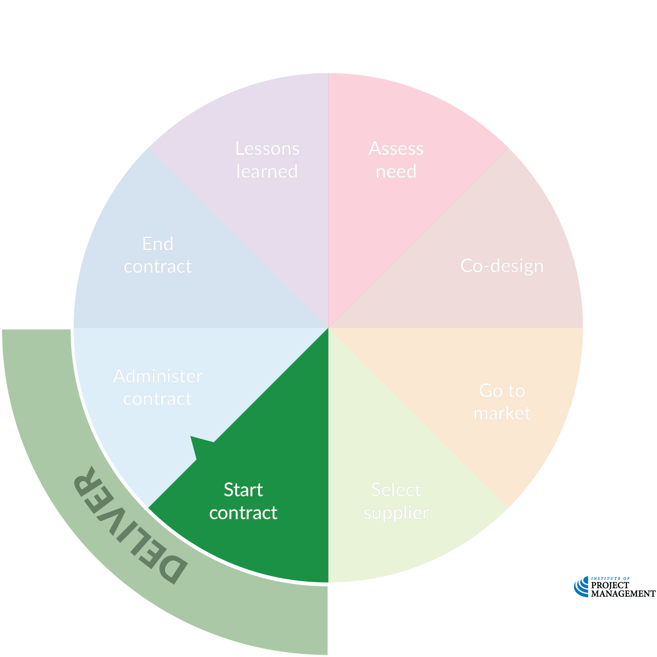
Contract kick-off
Review the contract and collateral – note any gaps, ambiguity or inconsistency
Identify and allocate roles, responsibilities and delegations
Update the stakeholder register
Record (sub-)contractor insurances, licences and accreditations
Develop internal contract and risk management plans
Review contractor’s project and risk management plans
Organise relevant introductions, inductions and access to premises and systems
Establish reporting and recordkeeping requirements and protocols, including variation handling
Notes:
Good contract management requires a complete set of the contract documentation (including the supplier's initial proposal and subsequent correspondence) and a clear understanding of each party’s obligations.
If you were not involved in the sourcing process talk to the procurement team to understand any significant issues or risks relating to the contract and the procurement process, particularly details of any negotiations and the rationale for any changes.
They will also be able to detail the drivers for the assessment of value for money so you will understand what provisions you should keep an eye on during the contract performance phase.
With this information, you should commence updating your project management plan and related documents to include all aspects relevant to contract delivery, including:
Key activities: A summary of key activities to be completed (including milestones/dates, contract expiry, notice periods, extension options, contract review timings and processes etc) and who is responsible for each activity - WBS / schedule.
Roles and responsibilities: A list of the main individuals involved in the contract, their positions, contact details and their responsibilities (for both the procuring entity and the supplier) - stakeholder register.
Risk management: Details of risks that have been identified and how and by whom they will be managed - risk register.
Contract governance: Details of stakeholder engagement, contract oversight, process for the escalation of issues or disputes, internal reporting including content, frequency, and distribution of any reporting within the procuring entity (for example, monthly reporting to the senior management team).
Supplier reporting: The frequency and content of the supplier’s reporting and timeframes for acceptance of reports including details of the reporting from subcontractors.
Meetings: A schedule of meetings and any standing agenda items, the process for the production and agreement of minutes and turnaround times.
Performance management: Details of how performance will be managed, including the reporting of Key Performance Indicators (KPIs) or Service Level Agreements (SLAs), how data will be gathered, verified and calculated, details of remedies or withholds etc.
Training needs: Contract management requires a broad range of knowledge and skills. Assess if you and the people on the contract management team have the necessary skills and knowledge to manage the contract. If not, consider organising training to address any shortfalls, obviously the sooner the better, as there are lead times to build appropriate capability.
Delivery and acceptance: Details of the acceptance process or specifics around the delivery of goods or services including standards to be met and audit requirements around those standards, compliance certificates etc.
Payment arrangements: Details of pricing including payment terms, milestones payments etc.
Supplier access and security: Details of requirements for access to facilities or information systems and security requirements (either personnel or cyber).
Insurance and guarantees: Details of any insurance certificates, bank guarantees or indemnities provided by the supplier, any expiry or renewal dates and storage location details.
Contract variations: Details of the process as defined in the contract for requesting variations to the contract and details of delegates.
Extension options or contract renewal: Details of options and information about review of the contract and the process for extending the contract as well as the lead-time needed for any re-application.

Slide 15
Notes:
Before breaking, ask students if there are any questions about what has been covered in the session so far.
Once answered, encourage students to stand up, get a drink, go outside and stretch.
If they are on Zoom, tell them to turn their camera and microphone off (you do the same)!
Make sure you tell them the precise time you will be restarting (eg 10:10am)
Don’t check your email – take a proper break!!

Slide 16
Activity 9.4
What are the signs that someone is unwilling to accept delegated responsibility?
What are the signs that someone is unable to complete a delegated task?
How should you respond to each?
Notes:
As a project manager, you will regularly need to delegate tasks.
Among other things, the project plan documents how those tasks are broken down, scheduled and resourced; but how do you know your team can actually deliver?
Having delegated the work, how much now do you need to intervene?
That all depends on the person’s readiness (R) for delegation.
Readiness is a function of their willingness and ability (skill) to make a decision and/or perform a task.

Slide 17
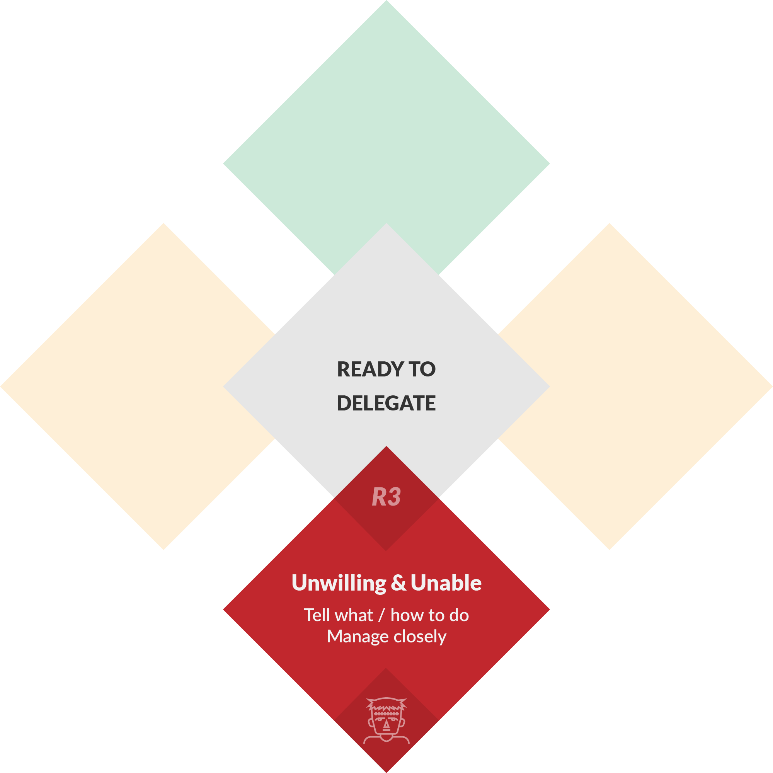
Delegation
OPEN 9.10
Notes:
A person who is unable and unwilling is said to have a very low state of readiness for delegation – ideally, you should not be delegating to this team member at all.
Nonetheless, if it is a requirement of the project or a legacy of the team you have inherited, you should give this individual very clear and detailed direction on what is required and manage them closely throughout.

Slide 18
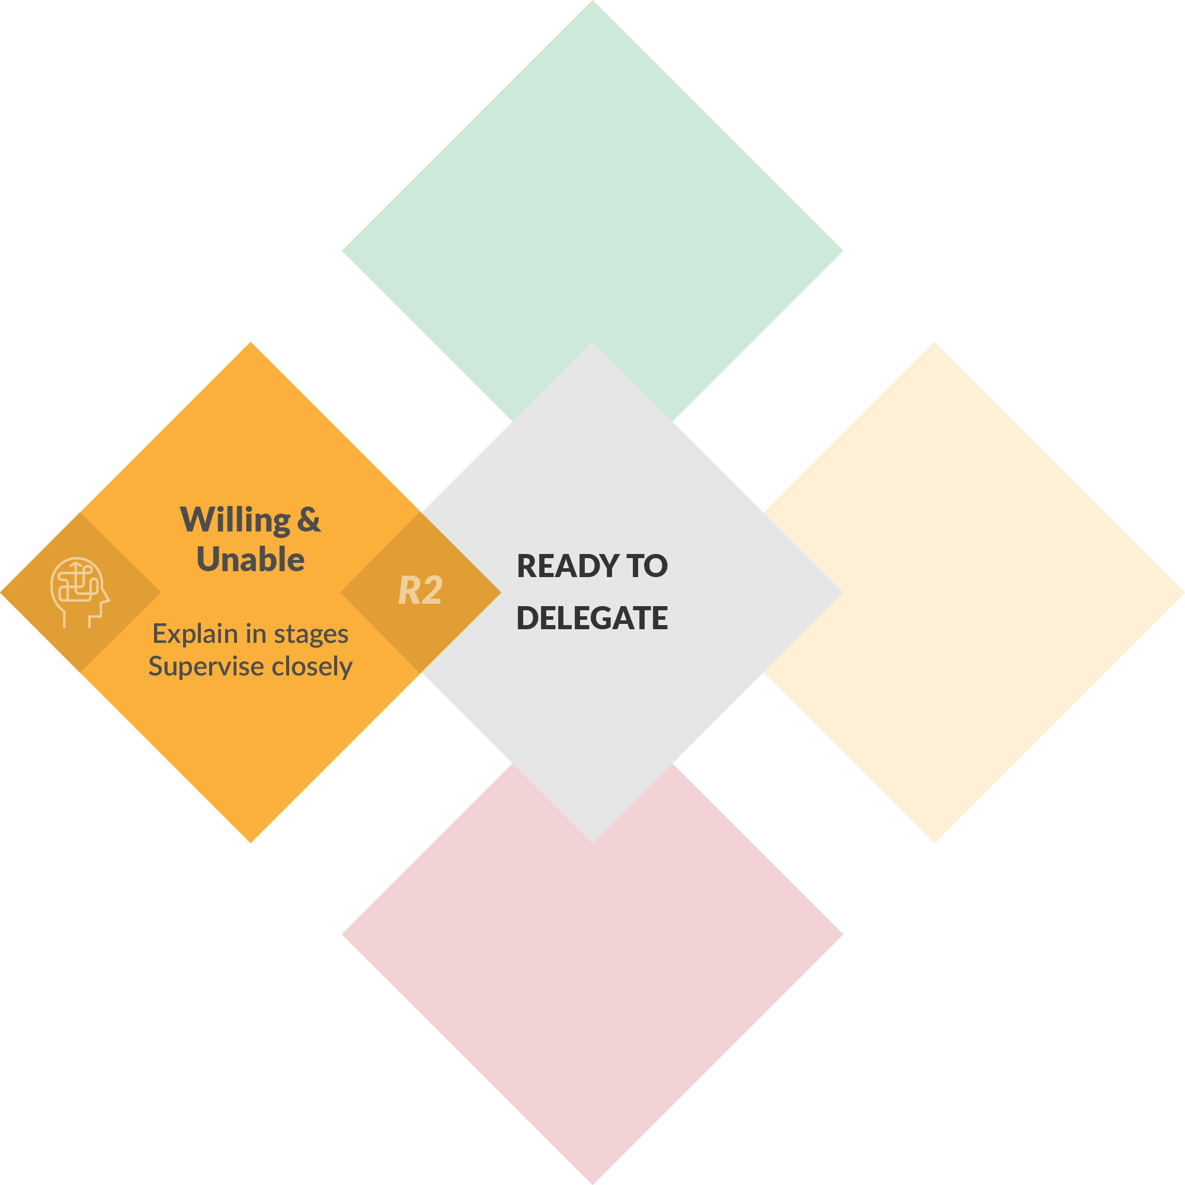
Delegation
OPEN 9.10
Notes:
Rather than directing a person who is unable but willing, you should explain the process to them in detail and again supervise them closely.
Signs someone is unable to complete a task might include errors in their output, incomplete work and/or dissatisfied stakeholders.
Other responses might therefore include giving them more time to work, providing mentoring or formal training, and having them reflect on their work for lessons learned.
Because they are willing to have a go, you should harness their enthusiasm, while ensuring they do not step outside the parameters of the job.

Slide 19
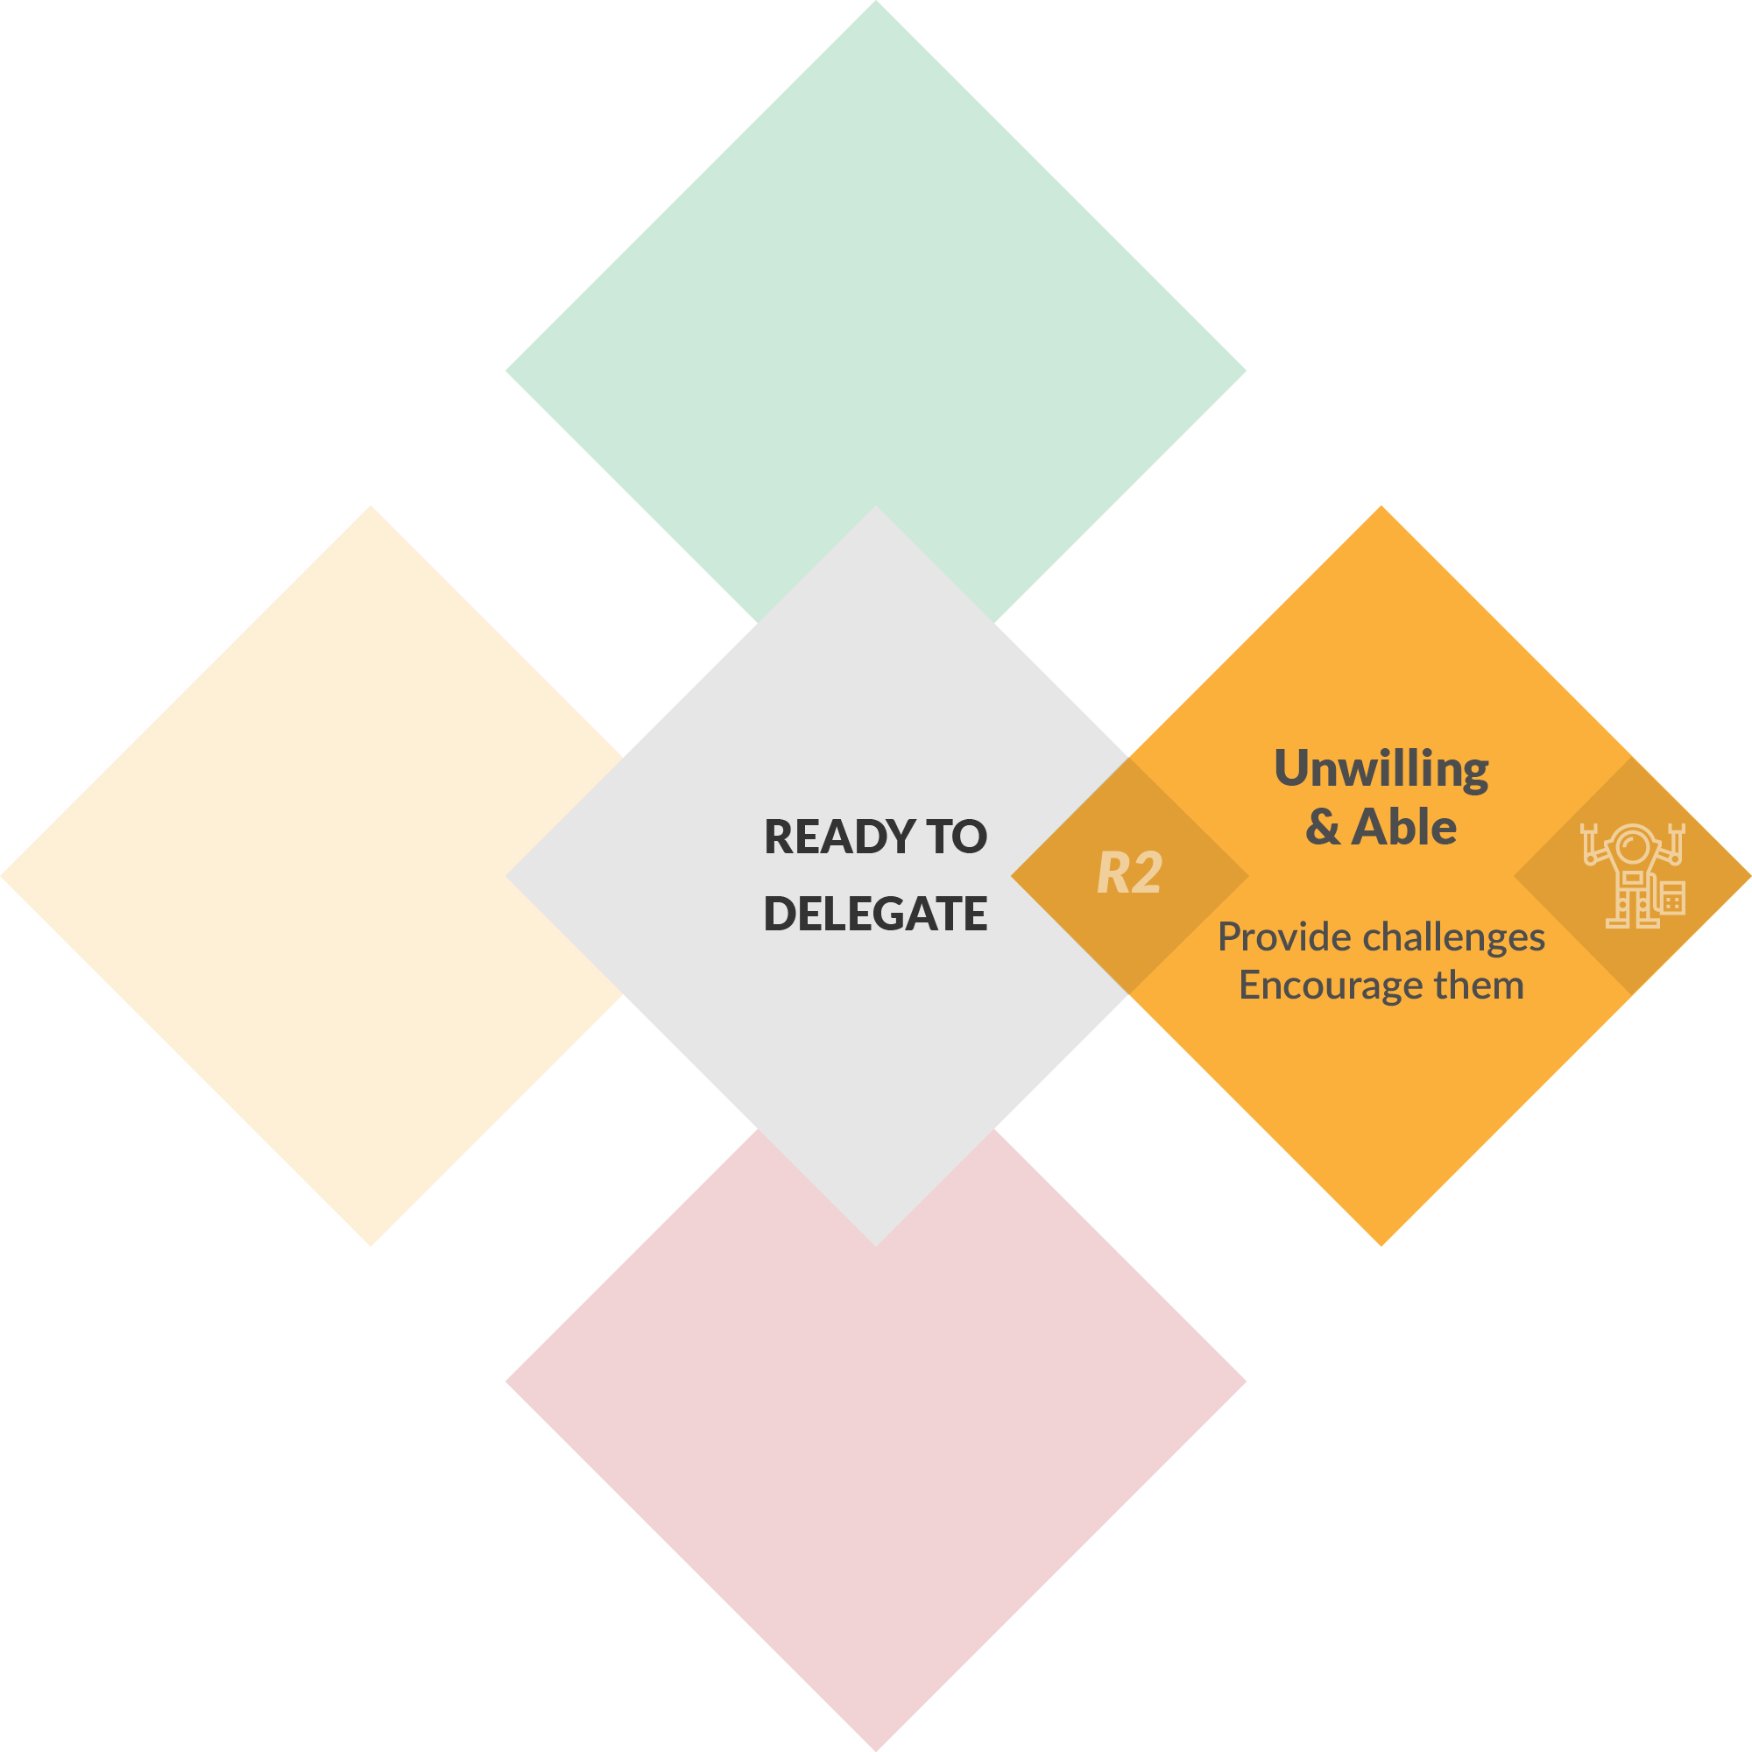
Delegation
OPEN 9.10
Notes:
Occasionally you will encounter a person who is able but unwilling to accept delegated responsibility.
Unwillingness will often manifest in avoiding the task or decision altogether, and may be because they feel overworked, underpaid, they resent the task or they just resent you – it could actually be any one or combination of several reasons.
Ideally you should identify the source of their unwillingness and address it directly, but this may not always be practical or possible.
For example, you may not have the budget to address their perceived pay deficit, but they keep showing up to work anyway.
Either way, you should provide encouragement and regular positive or constructive feedback on their performance, and look to challenge their potentially under-utilised skills in new and interesting ways.

Slide 20
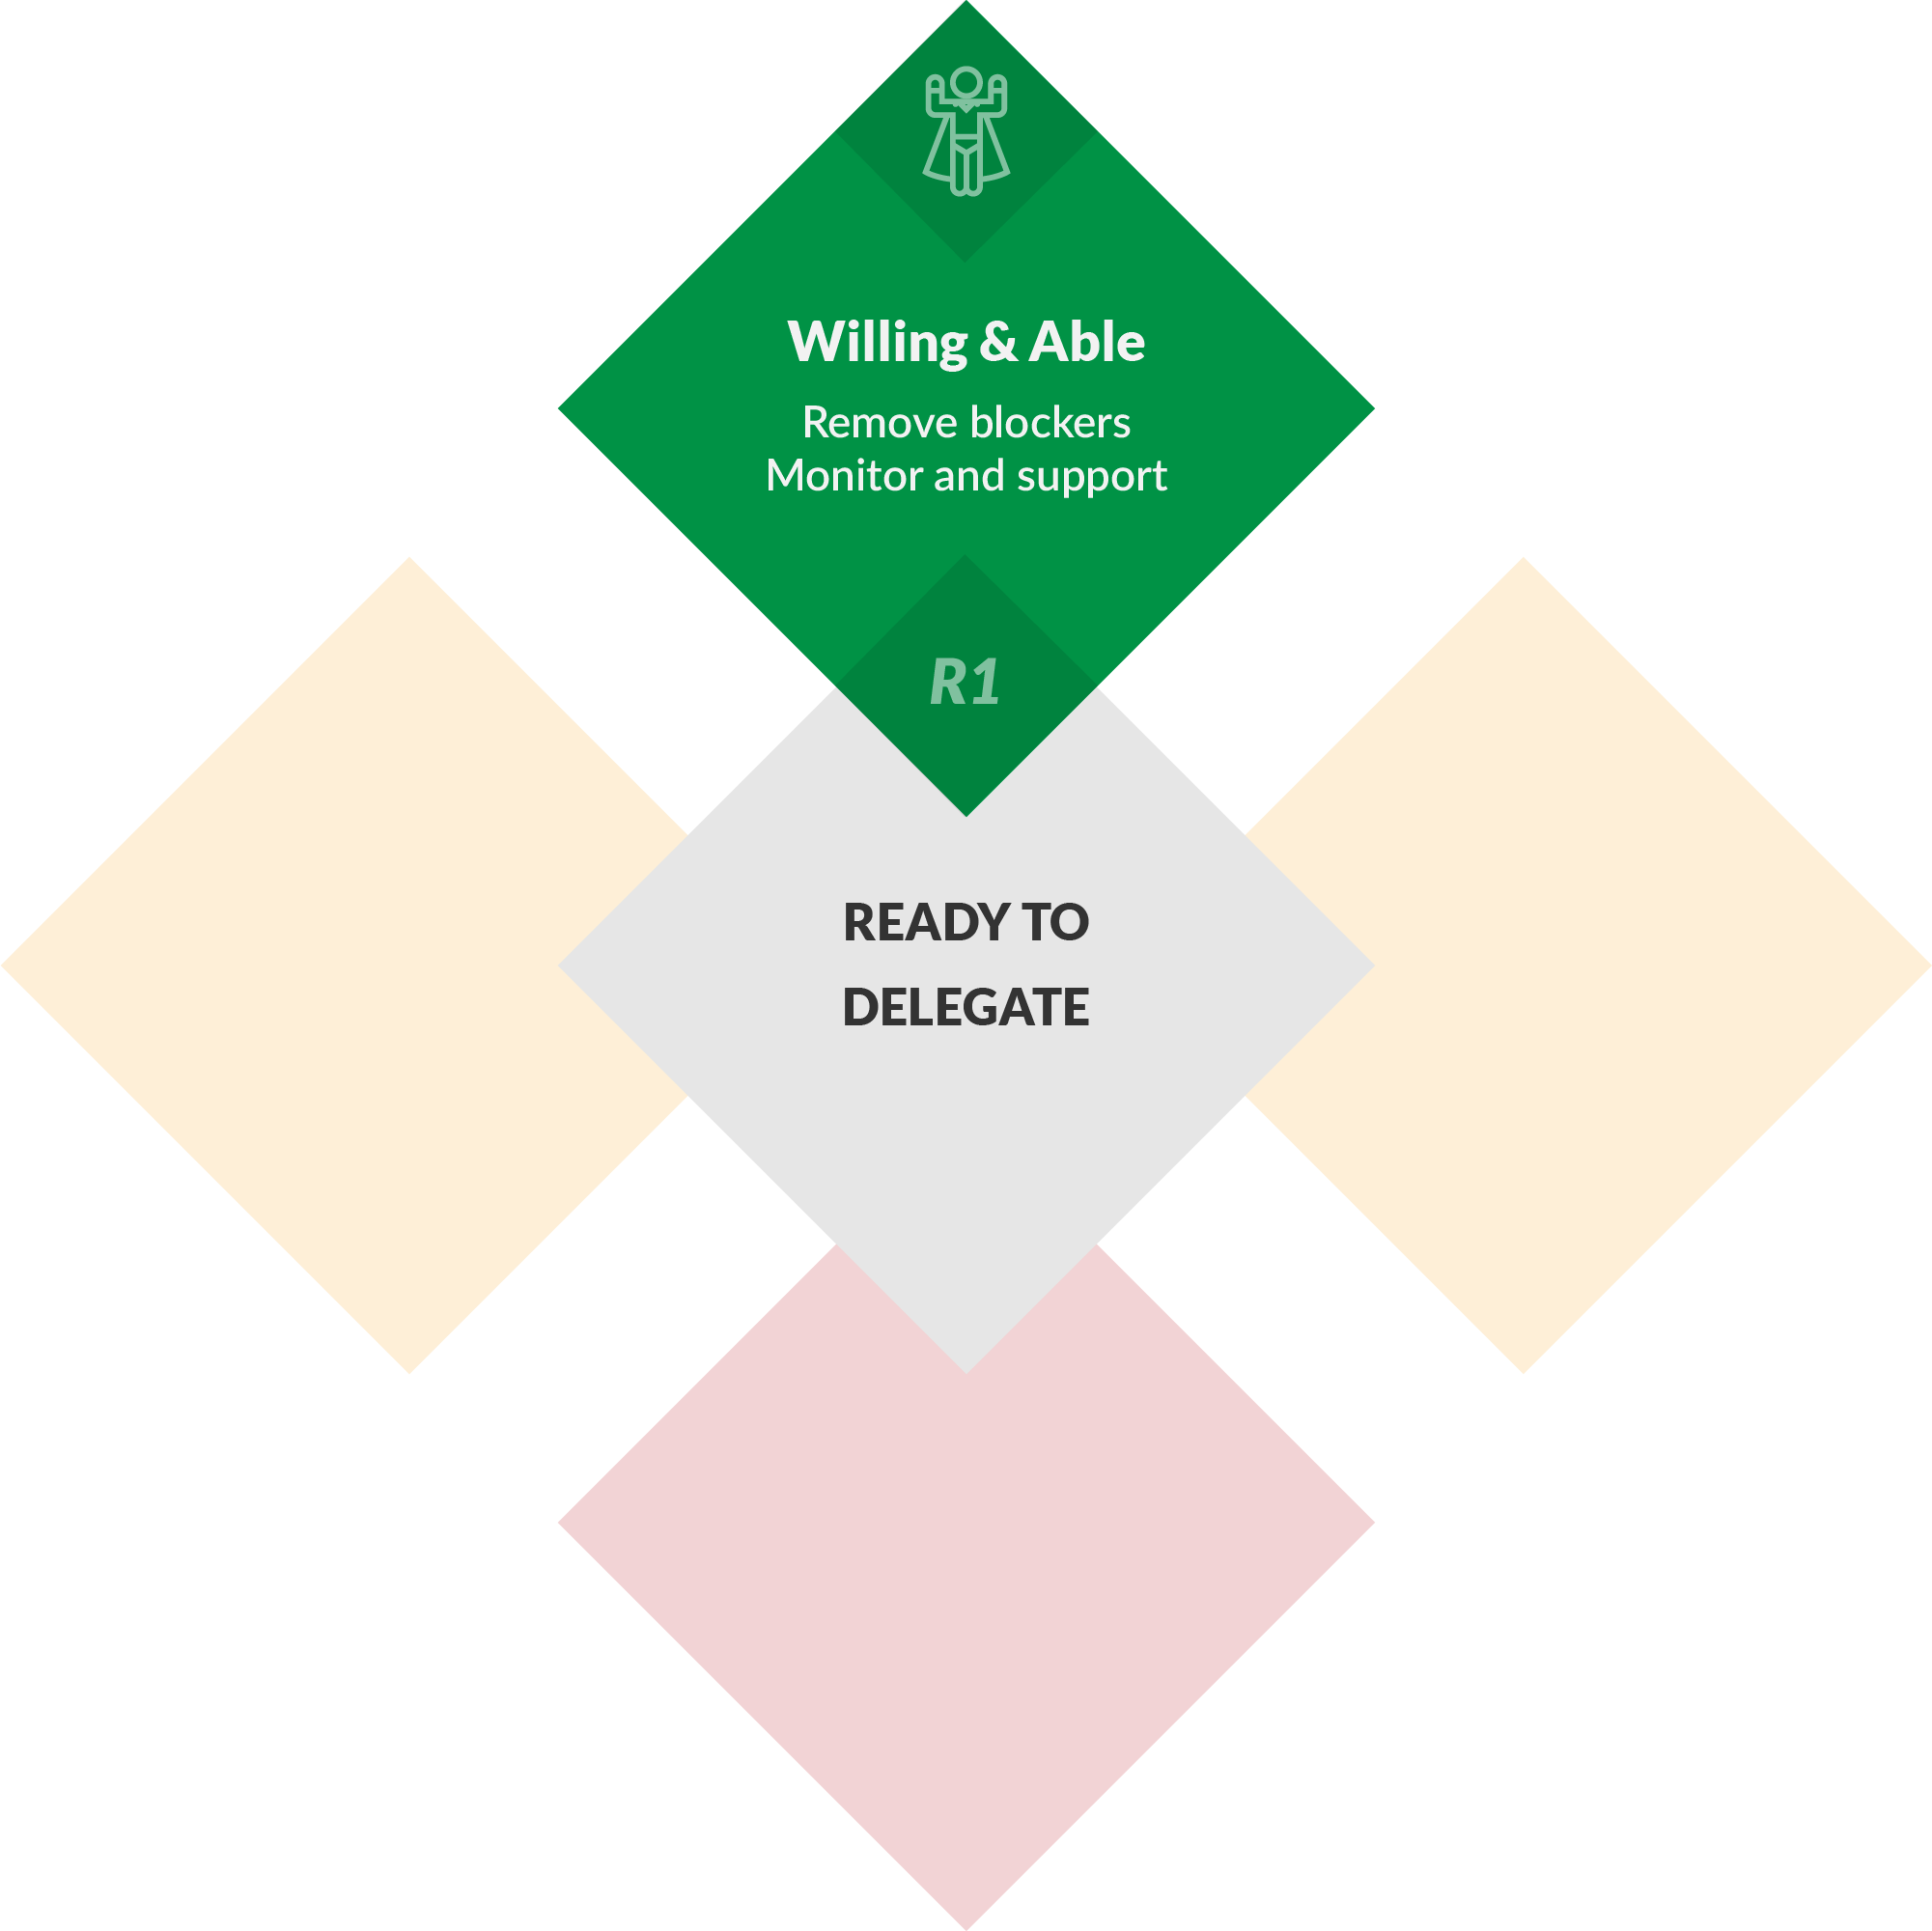
Delegation
OPEN 9.10
Notes:
Ballistic – set and forget – delegation is only appropriate for people who are both willing and able to meet your expectations.
Ok, forget is a bit extreme; you should always observe and monitor their effort.
Nevertheless, a project team member at this stage of readiness is the least of your worries, and the bulk of your attention and intervention should be directed elsewhere.

Slide 21
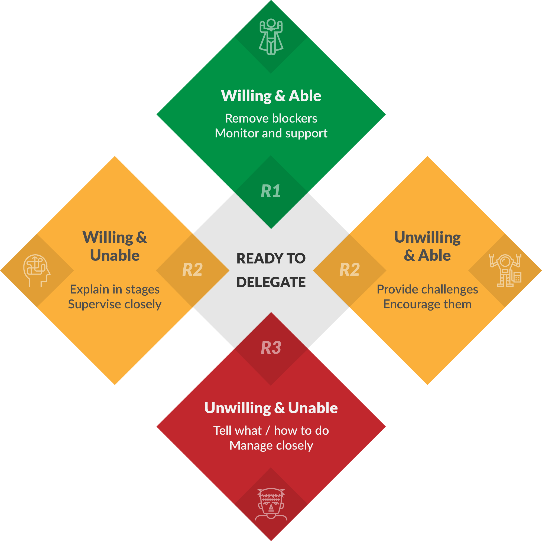
Delegation
OPEN 9.10
Notes:
That said, a person will have inevitably have multiple, simultaneous states of readiness that depend on the circumstances of the project and the tasks assigned to them.
Willingness especially can fluctuate from day to day and often due to factors that are well outside your control.
The project manager’s skill lies in being alert to and recognising these often subtle variations and contextualising their response appropriately.

Slide 22
Discussion
Skill and will refer to a person’s readiness for delegation
What hills (barriers) might we unintentionally place in the way of their performance?
Notes:
If someone fails to complete a delegated task, it may not have anything to do with their readiness or competence - it may instead be a failure of our management.

Slide 23
Discussion - answer
Poor / vague / inadequate instructions (scope)
Unclear task priorities
Insufficient time
Insufficient resources
No context for work
Management style (eg micro-management for willing and able)
Slow feedback / decisions
Red tape – too much project management!
Notes:
You should be conscious when evaluating task and team performance of the influence and impact of your delegation decisions.

Slide 24
Activity 9.5
How should you manage staff member under-performance?
Would you manage contractor under-performance differently?
Notes:
The primary reason project team members under-perform is because of a failure of management or leadership.
As we discussed in the earlier topic on delegation, if we have made reasonable task assignments (responding appropriately to the unique combinations of skill and will each person brings to their role), we must still ensure that we are not placing any 'hills' in the way of their performance.
In those limited circumstances where a team member's personal issues impact their performance, you may need to make allowances to ensure project delivery targets are met; noting that you may also be able to reset stakeholder expectations without penalty if you approach the matter with sensitivity.
The key, though, is to act early.
The longer you take to identify and respond to under-performance, the more time and resources it will take to resolve the issue.
The cost of change principle - including the implications for uncertainty and risk - apply equally here!
Very occasionally, such as in the case of a team member actively disrupting delivery, you need to remove under-performing individuals from the project.
Most organisations have a process for this within their business-as-usual activities, so is it that different for projects?
Well, yes and no.
Because many project team members are engaged as contractors, you can look to the terms of their contract as to how under-performance can be managed and their services terminated.
Legal advice in this regard may also be useful, depending on the size and nature of the contract.
Regardless, though, of whether they are directly employed or contracted, your first step in managing under-performance should be to talk to the team member’s line manager (if they do not report directly to you), and your organisation’s human resource manager or other, independent experts.
This will ensure you follow workplace and statutory processes relating to escalation, representation and formal notices.
You will also need to document evidence of non-performance, including records of relevant meetings or conversations you may have had with the individual.
At an appropriate time, you can then have an open conversation with the under-performing team member.
Discuss all the issues and the impacts they are having on the project and other team members
Listen
Mutually identify potential causes to address – don’t just treat the symptoms
Agree to resolution strategies
Set SMART goals to achieve this in the form of a formal performance plan, including interim targets, and
Outline the potential consequences for continued under-performance.
As highlighted in the last lesson, the sooner you identify and address problems, the easier they are to resolve.
Nonetheless, you may need to have a number of these meetings, with escalating degrees of formality, if change is not realised and the project continues to be jeopardised.
Yet quite often in projects our objective is not to sack a team member; rather, it is to have them reassigned out of the project.
Noting that this is a less severe form of separation, you should therefore always aim for reassignment over dismissal, as this is generally a quicker path and results in the least disruption to your project and the team.
It should be pointed out that all of this assumes that high levels of team member support have proven ineffective. Separating team members from the project should always be a last resort.

Slide 25
Activity 9.6
How should you recognise and reward good performance?
When should you recognise and reward good performance?
Notes:
You should consciously recognise and reward good performance.
People are motivated if they feel they are valued in the organisation, and this value is demonstrated by the rewards given to them.

Slide 26
Activity 9.6 – answer
Prefer team over individual rewards
How?
When?
Praise
Payment (bonuses)
Prizes
Privilege
Professional development
Promotion
Above expected performance
Compared to what?
Criteria (eg KPIs, project plan)
Past performance
Norms (eg culture)
Don’t make it token!

Slide 27
Time to catch-up
No homework this week!
Get up-to-date with your:
Stakeholder register
Concept canvas & risk profile
Gantt chart
Request for proposal
Risk register
Next session – leadership case study
Notes:
Cert IV PMP students only

Slide 28
Reflection
What is the most interesting thing you learned today?
What is one thing you will start, stop or continue doing?
What is one thing you would like to learn more about?
Notes:
Reflection questions not only highlight key learnings; they drive the continual improvement of our teaching and learning resources

Slide 29
Questions?
Coming next… project leadership
Notes:
Stay around until everyone leaves the session to ensure they all get the chance to ask their questions.

Slide 30
Closing checklist
Classroom
Upload signed attendance sheet and any photos taken of work in progress
Zoom
Upload video with thumbnail and link to workshop
Student administration
Mark participating students as complete
Email absent students and notify of gap requirements (OPEN units)
Facilitator feedback – email paul@institute.pm
What worked well today?
How can we improve?

