Slide 1
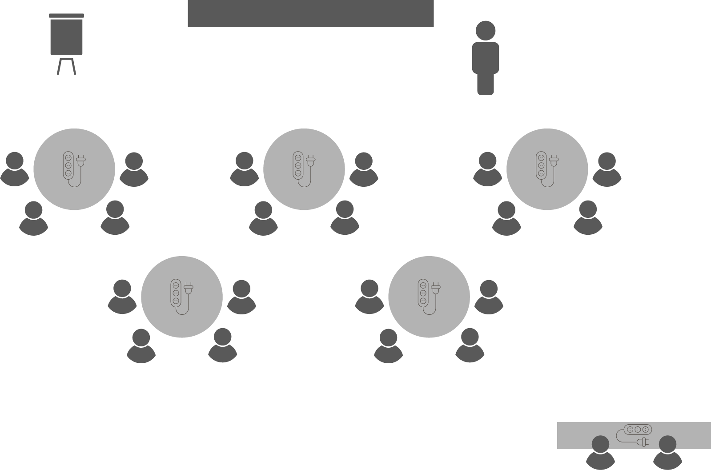
Opening checklist
Your preparation
Review notes, run a technical rehearsal
Rehearse examples / cases / stories to stimulate discussion
Classroom
Ensure students seated at tables of 3-5 and all facing the front
Have student name cards in place and ensure all sign in
Zoom
Rename yourself as host (under participants)
Set-up breakout rooms
https://support.zoom.us/hc/en-us/articles/206476313-Managing-Video-Breakout-Rooms
Welcome students as they arrive, let them know when starting
Notes:
Good luck!

Slide 2
Procurement

Slide 3
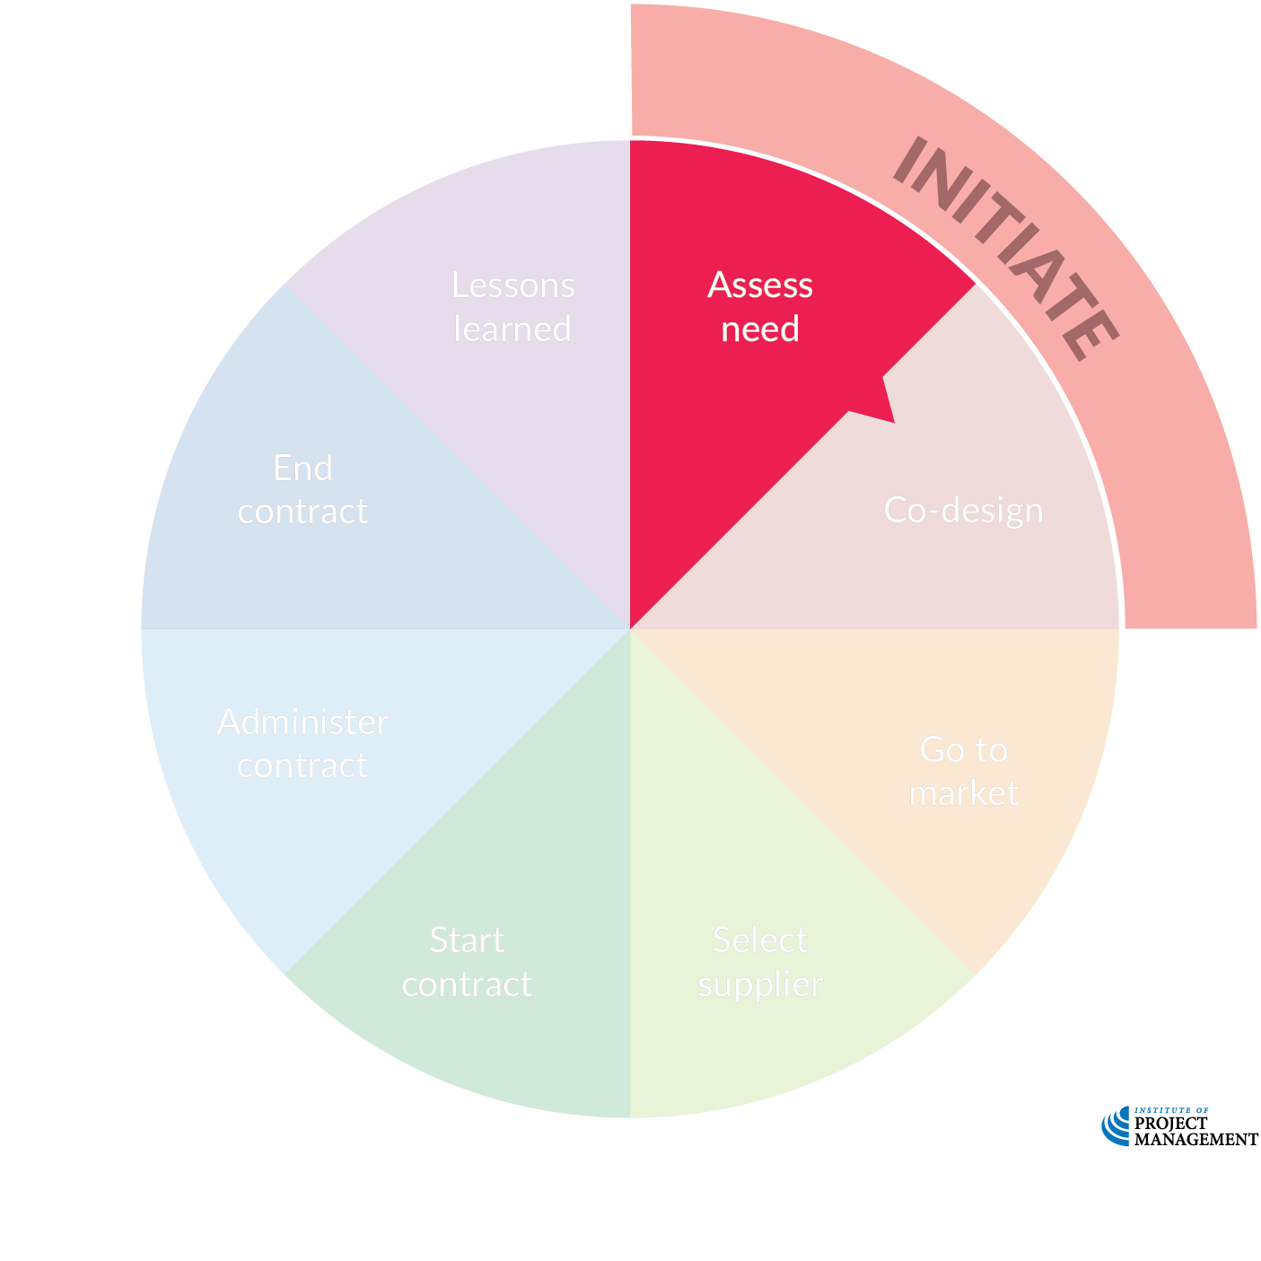
Procurement lifecycle
OPEN 5.7
Notes:
The procurement process captures everything from planning the procurement, conducting a tender, negotiating and entering into a contract, administering that contract and successfully bringing it to a close.
As with projects, every procurement has a life with a clearly defined start and finish.
The procurement initiation process therefore inevitably resembles the project initiation process.
We begin by determining the need for the procurement based on:
Whether this is something the project needs
Whether this is something we can do ourselves (or if an outside individual or organisation can do it for us)
What the likely cost is going to be
In many instances, this is a straightforward consideration; however, every procurement is unique and we have all at different stages of life made purchases we have come to regret!

Slide 4
Procurement lifecycle
OPEN 5.7
Notes:
Co-design (sometimes called participatory design) is a fancy way of expressing something we have already emphasized a number of times throughout this course – the importance of early and inclusive stakeholder engagement in arriving at your project (or, in this case, procurement) solution.
Co-design intentionally includes and centres end-users in this practice.
From a project perspective, if the procurement is going to be one of many inputs into the finally delivered project, then end-users might be the project team; alternately, if the procurement is the entire project then by co-design we really mean the complete, end-to-end process of business case development.

Slide 5
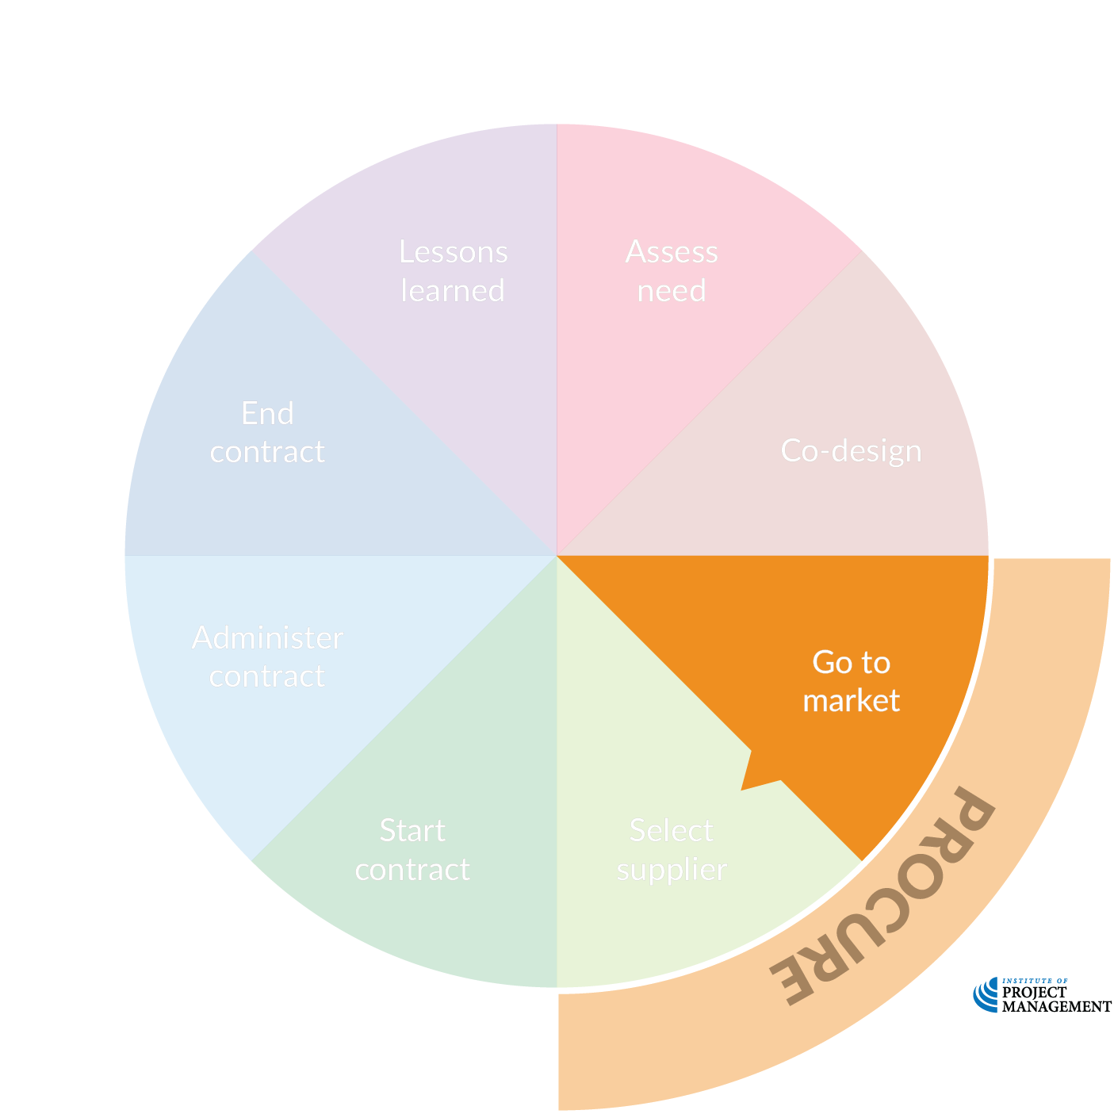
Procurement lifecycle
OPEN 5.7
Notes:
There’s no one-size-fits-all way of approaching the market.
The best approach usually depends on the value, complexity, and timing of the procurement.
It can also depend on the nature of the market itself, as well as on your procurement goals.
For instance, if you buy the same goods or services frequently, you may be best served by a selective tendering process using a list of prequalified suppliers.
Alternatively, if it’s unclear where to find a supplier -- or whether a supplier even exists for the service you're envisioning -- you may get the best result with an expression of interest (EOI).
This will help you determine whether suppliers can meet your requirements.

Slide 6
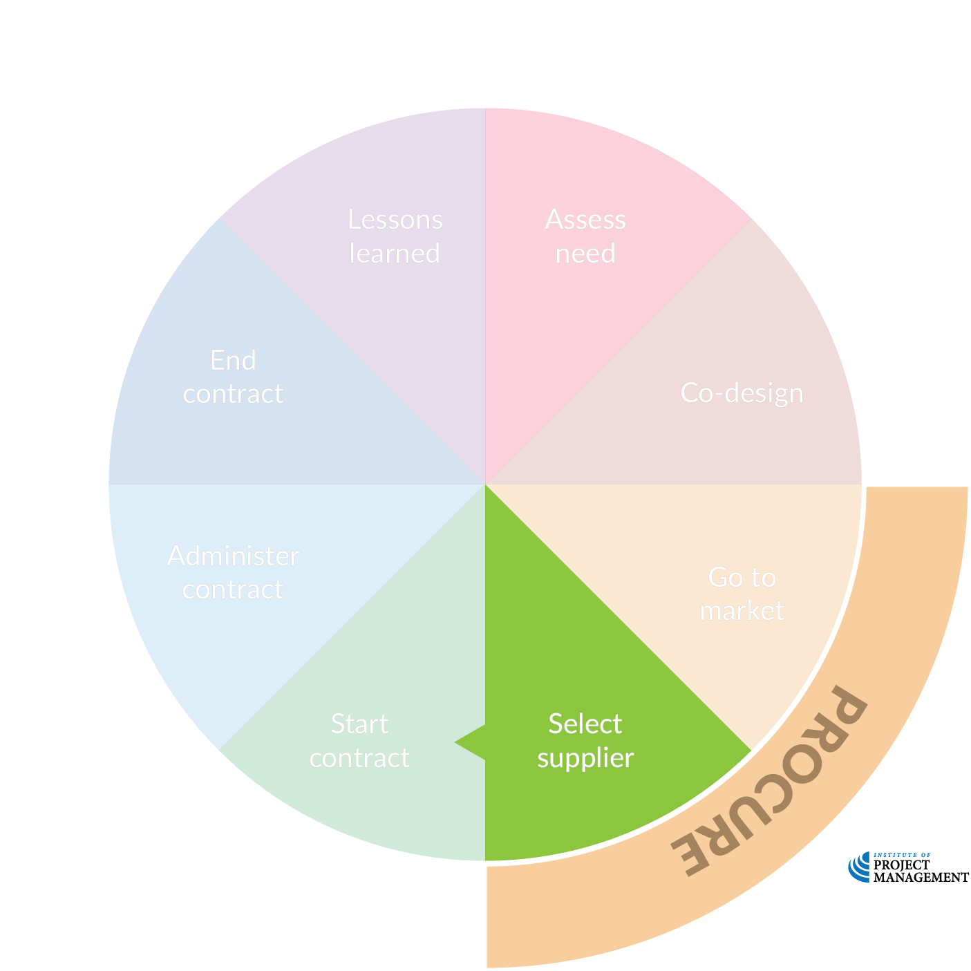
Procurement lifecycle
OPEN 5.7
Notes:
The selection of a preferred supplier from the available options in the market should follow a formal, structured process.
This ensures that the 'best’ supplier is chosen objectively, without real or perceived bias and in the best interests of both the organisation and its project.
On larger procurements, it also may be desirable to enter into negotiation with a preferred supplier before committing to a contract.
Doing so clarifies both the outputs and processes to be followed, ensuring quality is both assured and controlled.

Slide 7
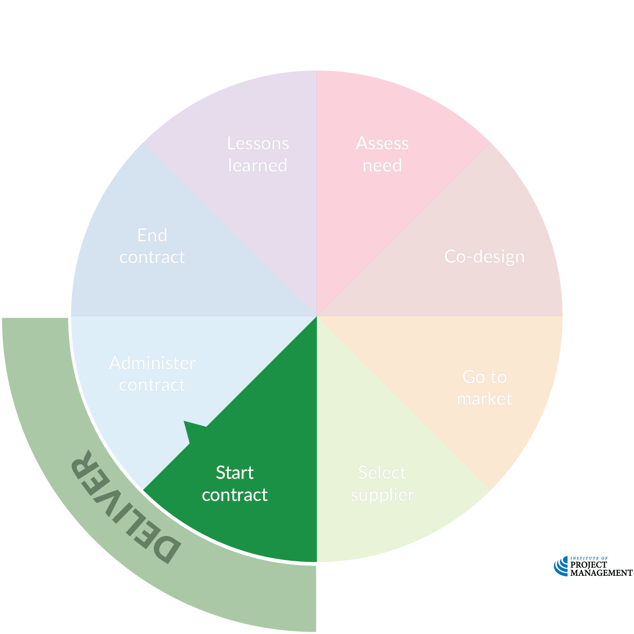
Procurement lifecycle
OPEN 5.7
Notes:
The kick-off meeting between the project team and its contractors may be the first contact between the parties, as negotiation may have taken place at another level in the organisation.
Either way, this is a critical milestone that sets the foundation for the relationship between parties and project success.

Slide 8
Procurement lifecycle
OPEN 5.7
Notes:
Contract administration is more than just accepting updates and hoping for the best.
Managing conflict and change are crucially important skills for every project manager, and doing so within the framework of a contract presents its own unique challenges.

Slide 9
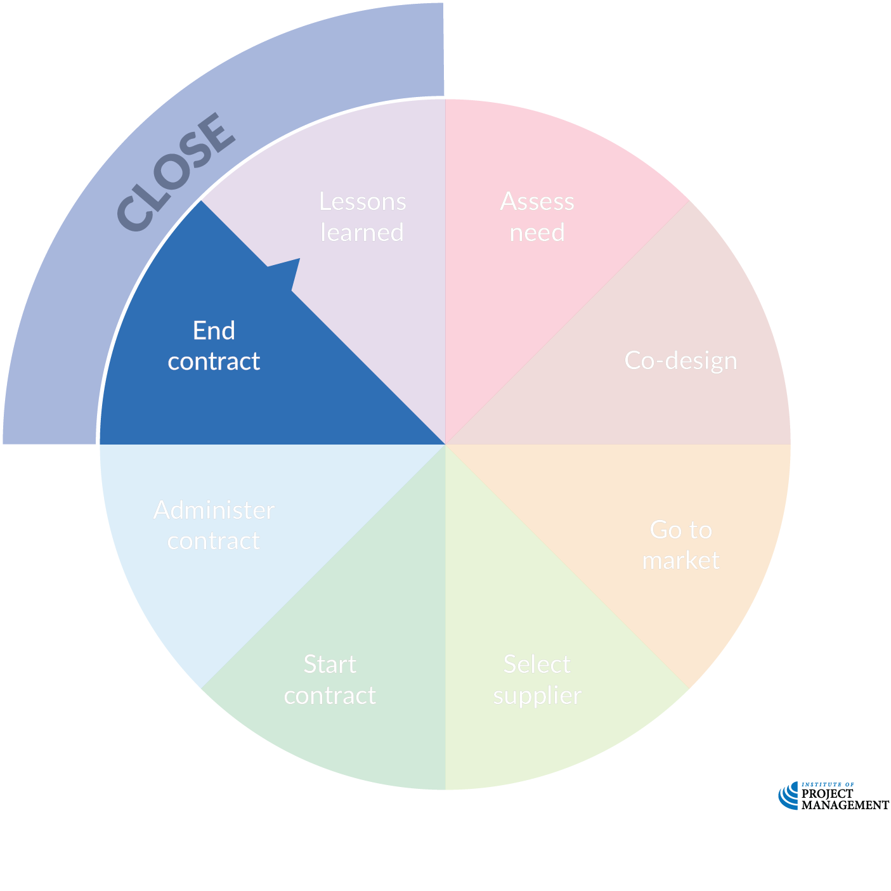
Procurement lifecycle
OPEN 5.7
Notes:
Successful performance is the ideal outcome of every contract; however, there are a number of specific remedies available to parties when things don't go right.
Each country has its own legal principles in this regard, and the project manager should be at least basically familiar with them.

Slide 10
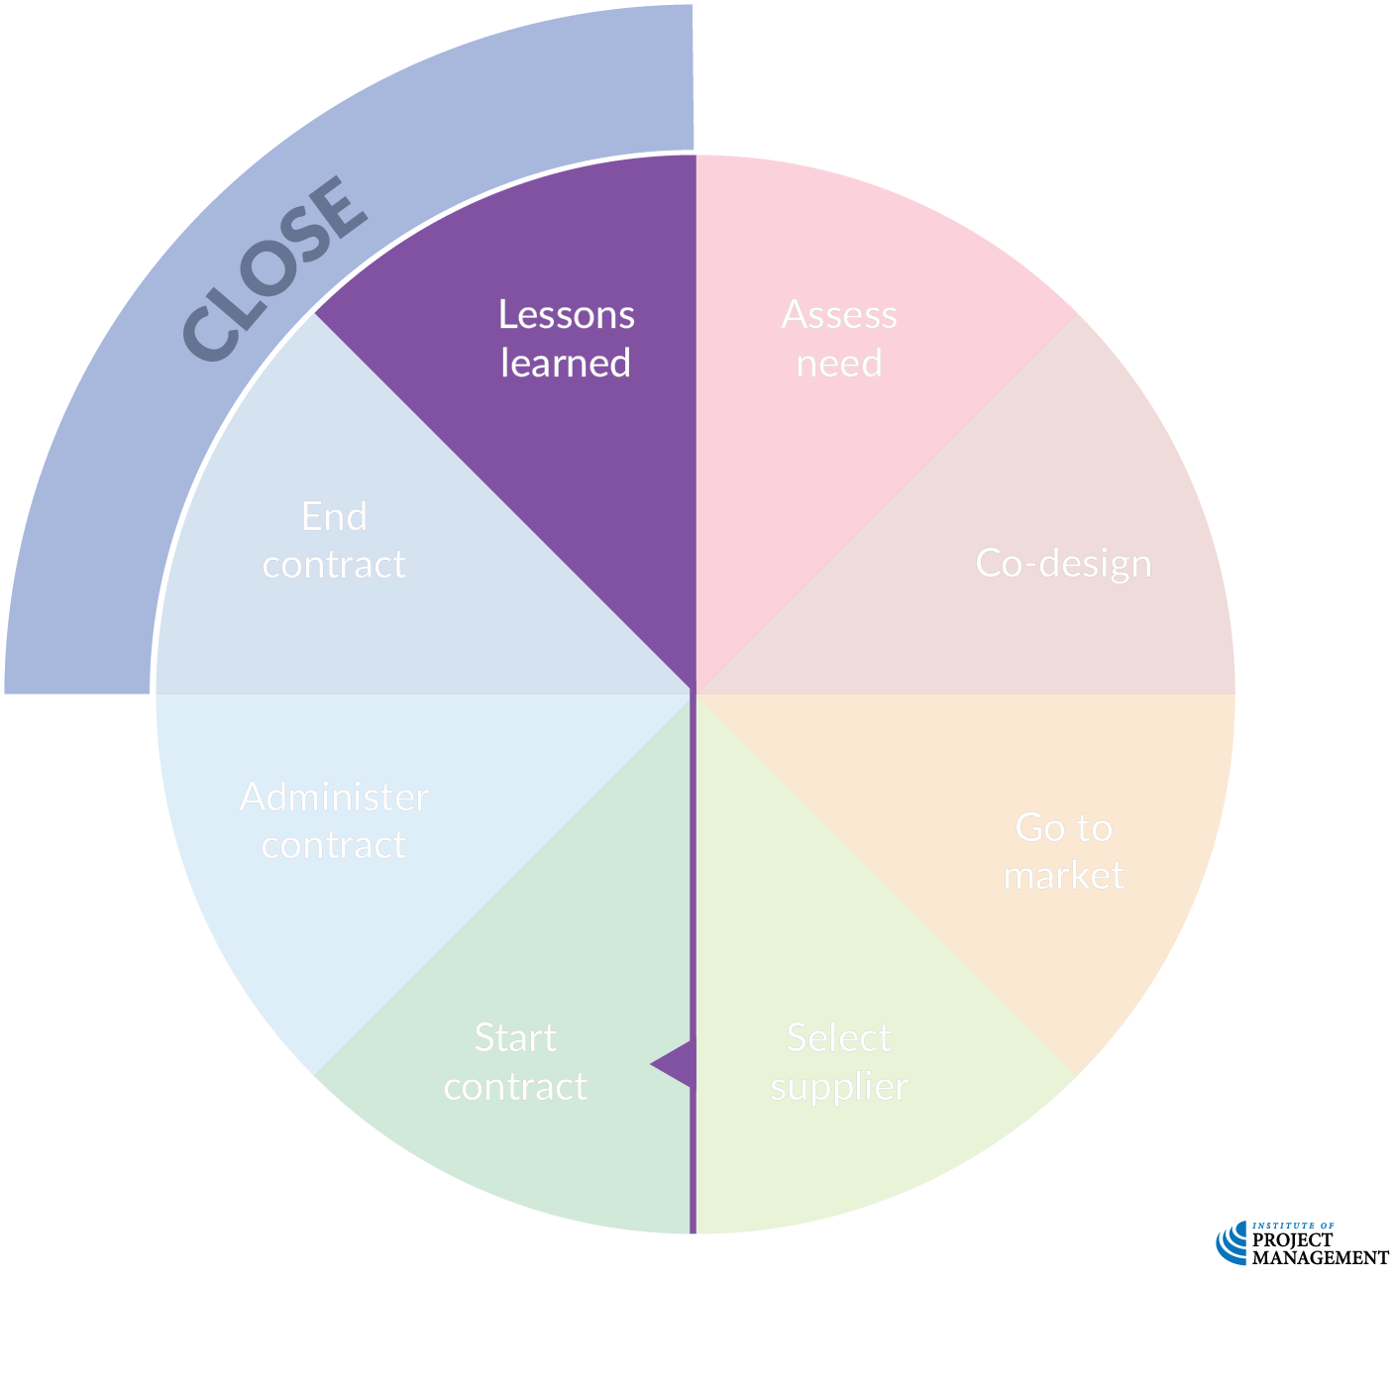
Procurement lifecycle
OPEN 5.7
Notes:
Organisations that fail to capture and embed the lessons - both good and bad - they learn from the procurement process are doomed to stagnate or even fail.
It is important that every contract is reviewed upon close to guarantee success is leveraged and missteps are not repeated.
Given the time gap as well between supplier selection and closing out the contract, it may also be useful to conduct a retrospective at the end of the procurement process as well.

Slide 11
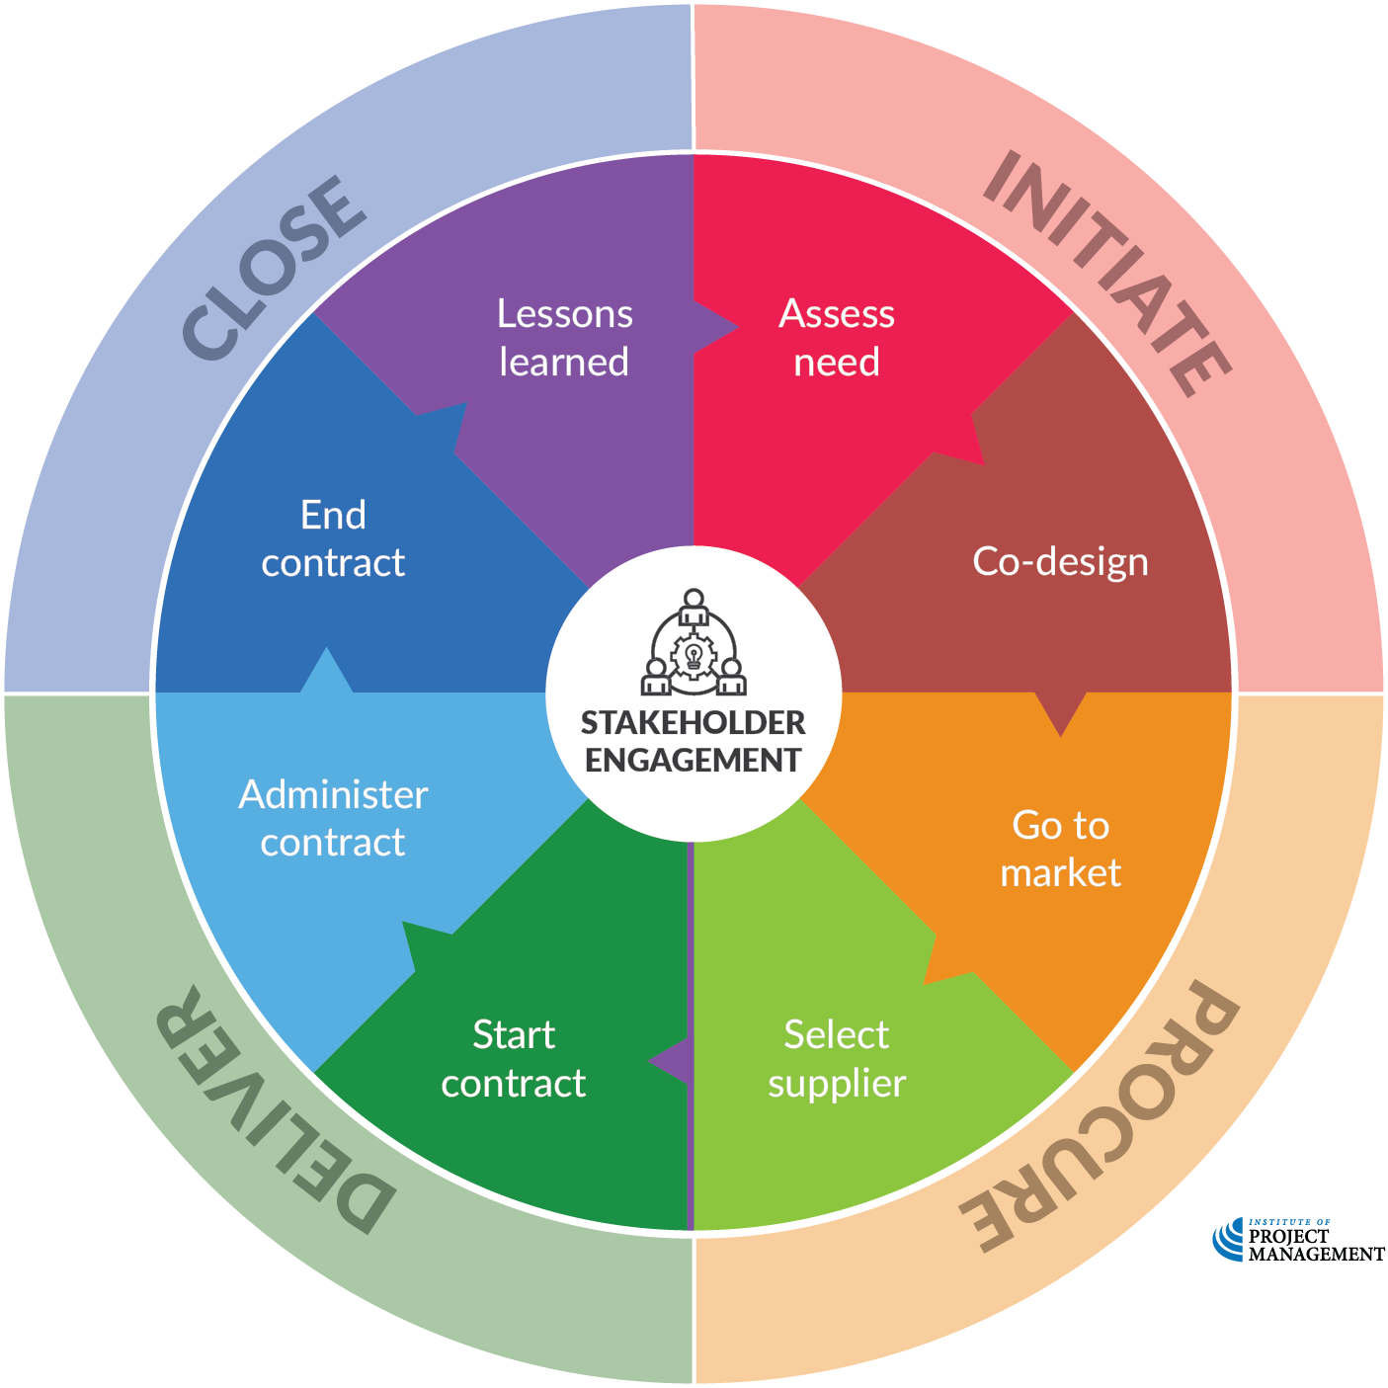
Procurement lifecycle
OPEN 5.7
Notes:
As always, successful procurement depends upon the comprehensive identification, prioritisation and engagement of stakeholders as per the principles and good practices discussed in Session 2.

Slide 12
Procurement policies
OPEN 5.6
Delegated authorities
How much can individuals spend? What specifically can they purchase?
Competitive process
When can we direct purchase? When should we get three quotes? When should we invite proposals?
Preferred suppliers
Do we have pre-approved contractors / vendors for certain work?
Codes of conduct
How can we ensure the fair conduct of bids?
Sustainability guidelines
Other formal / informal practices
Notes:
Beyond the legal constraints to procurement, most organisations have a suite of policies and procedures that will either directly or indirectly inform each purchase.
Some of these policies may be informal, in that they are the accepted way of doing things round here.
Others may be more specific, and include the following:
Delegated authority
A delegated authority is a limit placed on the decision-making authority of an employee.
A project manager, for example, may have the authority to make minor changes to the project plan and exceptional purchases up to the value of $500.
The sponsor may have the authority to sign off on purchases up to $2,500; whereas, larger amounts not already authorised in the project plan may have to go to the steering committee for approval.
Having clear delegations of authority not only provides role clarity, but allows necessary procurements to be made quickly and with the minimum of bureaucratic intervention.
Competitive processes
In order to ensure the best value for their procurement money, organisations may stipulate that purchases greater than $10,000 need to consider at least three quotes from competing suppliers.
Procurements greater than $50,000 may require a formal tendering process.
There may also be organisational rules that govern how tenders are conducted, a process we will explore in more detail in the rest of this Session.
Preferred suppliers
To speed the procurement process, many organisations maintain a panel of preferred suppliers.
These are businesses that are pre-approved to supply goods and/or services to the organisation.
These pre-approvals may exempt them from parts or all of the tender process, on the basis that they have previously proven their ability to meet the demands of the procuring organisation.
Government agencies, not-for-profit groups and some firms may also extend preferential treatment to certain classes of suppliers, such as local traders and minority- or women-owned businesses.
Codes of conduct
Organisations may also have policies that deal with the following specific risks to obtaining the best value for money from suppliers:
Conflicts of interest
Gratuities and kickbacks
Misuse of confidential information
All organisations should also have complementary processes that deal with disciplining employees who violate the procurement policies or codes of conduct, and debarring and/or suspending vendors under specific circumstances.
We will discuss some of these specific ethical considerations in greater detail later in this course.

Slide 13
Procurement lifecycle
OPEN 5.7
Notes:
Given the obvious consistency between procurement and project initiation, we won’t spend a lot of time in this Session on these activities

Slide 14
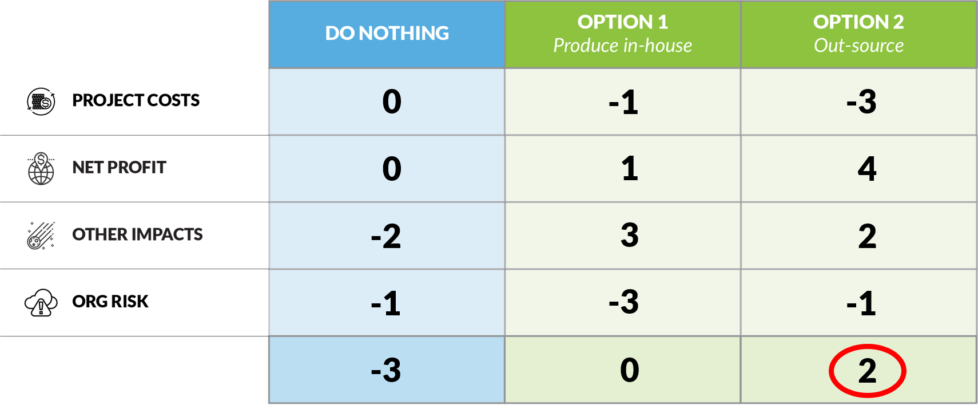
Needs assessment
OPEN 5.7
‘Make or buy’ business case
Option zero – does the project need these goods or services?
Option 1 – what are the costs / impacts / risks of doing it ourselves?
Option 2 – what are the costs / impacts / risks of using someone else?
Notes:
In Session 3 we did a multi-criteria analysis on the make-or-buy business case – we will return to MCA again shortly!

Slide 15
Procurement lifecycle
OPEN 5.7

Slide 16
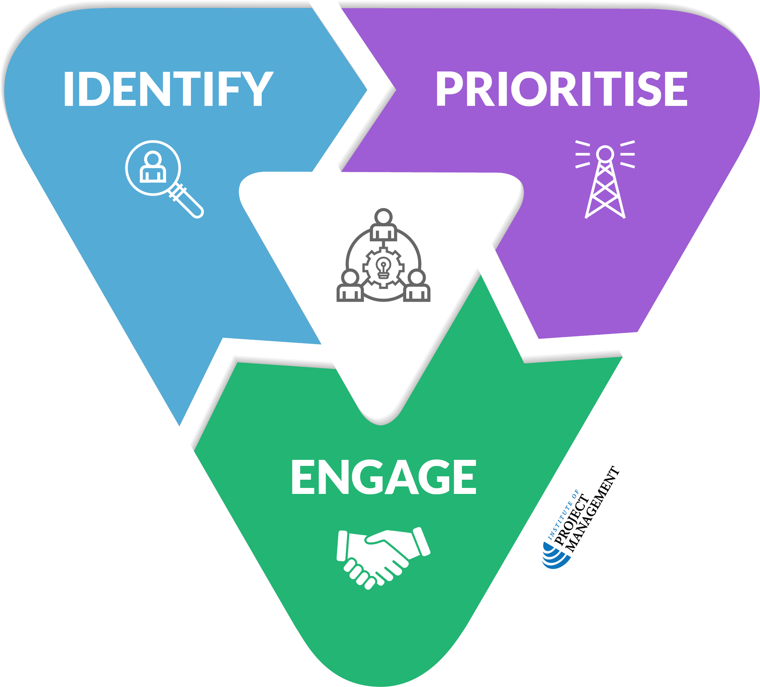
Co-design
OPEN 5.7
Engage stakeholders to scope procurement
Higher risk procurements require more detailed engagement
Align internal expectations to market capability (scope, time and cost)
There are limits to how much free advice you can expect!
Notes:
The stakeholder engagement methods and model should be familiar by now.
Consider using the risk profile tool (the one we use to assess the risk to our organisation of an option or project) to determine the level of risk and subsequent effort that need to be put into a procurement.
Make sure too that your investors are realistic in what they can get for their money with a procurement – even though they might think a procurement will only cost $500,000, but when you factor in the costs of acquiring and managing the procurement as a project it might be $750,000 or more.
Consider too total costs of ownership (new v used car example)!
Finally, especially when purchasing advice or services, be aware that stakeholders will only engage up to a point before there is an expectation of payment for services.
Involvement, collaboration and empowerment are typically remunerated activities.

Slide 17
Procurement lifecycle
OPEN 5.8
Notes:
This procurement phase is where we will focus the rest of this session.
The specifics of procurement delivery and close are included as talking points in the other relevant sessions.

Slide 18
Procuring goods and services
OPEN 5.8
Approaches to market
Expression of interest (EOI)
Outcomes mostly known, highly uncertain scope
Request for proposal (RFP) / request for tender (RFT)
Complex but well-defined scope with clear outcomes, several known providers
Request for quote (RFQ)
Off-the-shelf product or service in highly competitive market, low risk procurement
Notes:
EOI
An expression of interest (EOI) works best when you’re unsure of the goods or services you’re procuring, or you're not clear on the best way to supply them.
You use an EOI to find out whether suppliers are both capable of performing the specific work and interested in undertaking it.
Typically, an EOI only elicits responses to a broad set of criteria.
It rarely includes definitive solutions or final costs. For that reason, you don’t need to include price criteria, and you ultimately don't award a contract.
Instead, once you’ve completed the process, you usually shortlist potential suppliers and invite them to tender.
For this reason, an EOI is considered to be one of the multi-stage procurement processes.
An EOI can:
help you test the market to find out whether a good or service exists
keep suppliers’ costs down, as you only invite suppliers to respond to the resulting tender if they've demonstrated they can realistically supply the goods or services (as revealed during the EOI stage)
keep your own costs down, as there are fewer responses to evaluate during the resulting tender stage
provide several suppliers an opportunity to compete for your business
encourage healthy market competition.
RFP / RFT
In an open request for tender (open RFT), any supplier can submit a tender. In their responses, each tenderer must demonstrate how they satisfy the evaluation criteria and meet any specific requirements.
An open RFT can work best when:
there’s a broad and competitive market for goods or services
that market is dynamic and subject to change
your procurement is high value, or
there’s likely to be a lot of interest from suppliers.
An open RFT encourages healthy market competition and can be an effective way to ensure value for money and can be an attractive approach when you’re unsure of pricing or don’t know which supplier can best satisfy your procurement needs.
RFQ
A request for quote (RFQ) is usually most effective when you’re procuring low-risk, low-to-medium-value contracts. You understand the goods or services well, but you're not sure what the final cost of procurement will be.
Use an RFQ when you plan to buy well-defined goods or services using a contract with standard terms and conditions.
An RFQ can be an efficient way to receive quotes from a pool of prequalified suppliers.

Slide 19
What is in a RFP?
OPEN 5.8
Context – introduce your organisation and project
Draft statement (scope) of work
Key delivery milestones / indicative budget
Selection criteria
Conditions for participation
Licences, insurances, availability, corporate structure etc
Response guidelines (when & how to submit)
Contact information / how to request further information
Proposed contract
Notes:
Draft statement of work
The statement of work describes the resources (goods and/or services) required by the project.
In many respects, this will resemble a project charter, and contain information such as scope inclusions / exclusions, time frame for delivery, indicative cost, and any assumptions or constraints.
A balance must be struck between providing sufficient detail to ensure project requirements are met, and giving tenderers enough freedom to provide creative and innovative solutions.
For that reason, this document should be considered a draft only and the deliverables may be subject to negotiation with the preferred tenderer.
Evaluation criteria
Tender specifications should be accompanied by information about which requirements are the most important and how tender bids will be evaluated according to these requirements.
The evaluation criteria are not a part of the statement of work, but must be part of the information package sent to potential tenderers to give them all the same opportunity to respond to your priorities.
Conditions for participation
The conditions for participation limit the number of businesses that may be eligible to tender for the work.
If, for example, the procurement demands specialist knowledge or resources, it might be prudent to limit potential suppliers to those with the proven expertise to deliver the work.
Such suppliers might be drawn from a panel of pre-approved or preferred suppliers.
Although limiting the number of tenderers reduces competition, it may significantly simplify the management of the tender process.
Essential requirements extend the conditions of participation by listing certain non-negotiables that the successful tenderer must either have or provide.
These might include things like certifications, insurances and references.
Tenders that do not meet these criteria should be disqualified from consideration.
Desirable requirements – things that might be considered favourable but are not critical to performance – may also be listed.
Proposed contract
A draft copy of the contract that the successful tenderer will be expected to enter into should also be attached.
Although specific terms may be subject to negotiation, this gives tenderers clarity about the legal nature of the relationship they are potentially entering into.

Slide 20
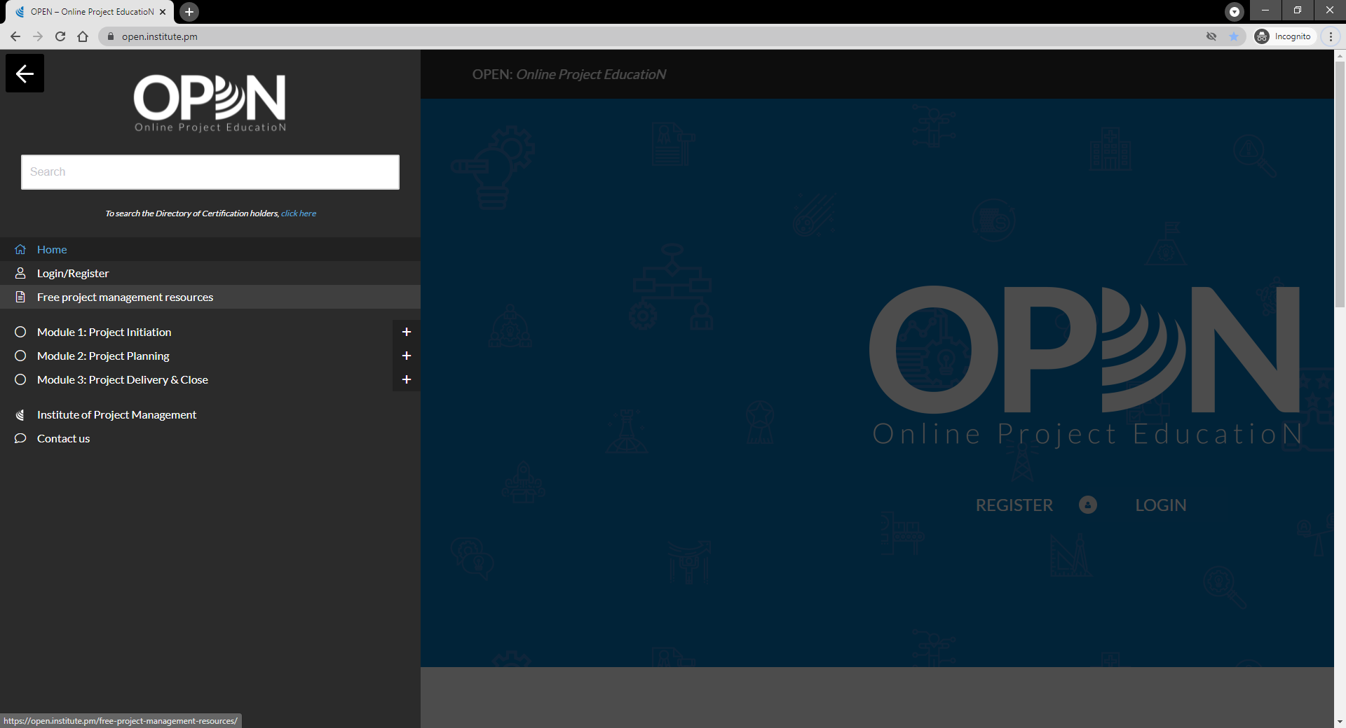

Slide 21
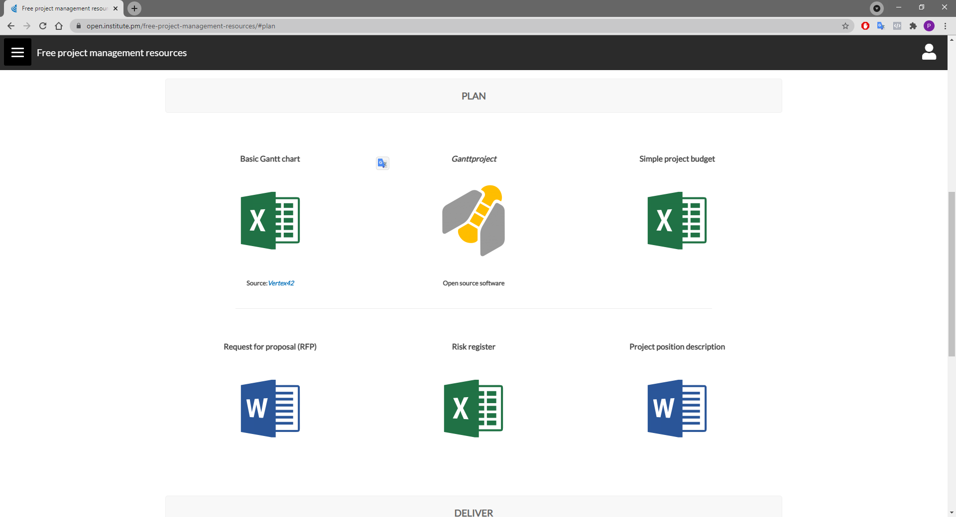

Slide 22
Activity 6.1
OPEN 5.8
How should you manage questions or requests for information once the EOI / RFP is published?

Slide 23
Activity 6.1 – answer
Clear scope of work, processes and criteria reduces questions!
Create forums for questions
Info nights, site visits, question forms
Have a single point of contact – ideally not the purchaser
Have a defined Q&A window
Allow enough time for people to update responses
One person asks – everyone gets the answer
Answer all questions (even the dumb / repeated ones)

Slide 24
Procurement officer / manager
OPEN 5.8
Manages the RFP process for purchasers – process expert
Ensures RFP documentation is complete and accurate at all stages
Publishes RFP and acts as sole point of contact
Manages supplier questions and communicates replies to all (addenda)

Slide 25
Procurement officer / manager
OPEN 5.8
Assesses eligibility of proposals (conditions of participation)
Supports evaluation panel – can act as independent (non-voting) chair
Notifies un/successful bidders
Captures and actions lessons learned

Slide 26
Activity 6.2
OPEN 5.9
You have been instructed to book the entertainment by RFP
What will be your selection criteria?
Notes:
Take a variety of responses, perhaps one per group until all exhausted, and we will consider a broad set of selection criteria after the break.
Note the difference between conditions for participation and selection criteria when taking responses.

Slide 27
Notes:
Before breaking, ask students if there are any questions about what has been covered in the session so far.
Once answered, encourage students to stand up, get a drink, go outside and stretch.
If they are on Zoom, tell them to turn their camera and microphone off (you do the same)!
Make sure you tell them the precise time you will be restarting (eg 10:10am)
Don’t check your email – take a proper break!!

Slide 28
Procurement lifecycle
OPEN 5.9

Slide 29
How do we know the price is right?
OPEN 5.9
Commercial norms
Market prices
Benchmark other bids
Historical prices
Pricing data on similar items
Independent cost assessment
Just tell them your budget?
Total cost of
ownership (TCO)
Notes:
Should you just tell them your budget?
Although some organisations prefer to hide their budget for fear of being ripped off, in a functionally competitive market (ie multiple, competing suppliers), bidders will generally try to impress on quality within the price (eg by adding features or improving the service options), or just compete outright on price regardless.
Your budget also helps clarify expectations and the scope of work required in circumstances where it might otherwise have been vague.
A budget range may also be preferable to giving an exact budget – the market will quickly let you know if your expectations are unrealistic but either informing you directly or not bidding at all!

Slide 30
How do we assess supplier quality?
OPEN 5.9
Understanding of need
Technical capability and approach
Risk appreciation
Past performance / references
Business size & type
Guarantees / warranties
Intellectual / property rights
Values alignment
Notes:
Understanding of need - How well does the tenderer’s proposal address the procurement statement of work?
Technical capability and approach - Does the tenderer have, or can the tenderer be reasonably expected to acquire, the technical skills and knowledge needed? Do the tenderer’s technical proposed methods, techniques, solutions, and services meet the quality requirements?
Risk appreciation - Does the tenderer have, or can the tenderer be reasonably expected to develop, management processes and procedures to ensure a successful project? How much risk is embedded in the statement of work, how much risk will be assigned to the selected tenderer, and how does the tenderer mitigate risk?
Past performance / references - What has been our past experience with selected tenderers? Can the tenderer provide references from previous customers?
Business size & type – Is this their core business? Does the tenderer have, or can the tenderer reasonably be expected to obtain, the necessary financial resources? Does the tenderer’s enterprise meet a stipulated category of business (such as small-to-medium enterprise, or Indigenous owned)?
Guarantees / warranties - What does the tenderer propose to warrant for the final product, and through what time period?
Intellectual / property rights - Does the tenderer assert intellectual property or other rights over their output? In other words, will we fully own the deliverable?
Values alignment – Does the tenderer engage in business that goes against our core values? For example, if we are an environment charity, is the proposed sponsor of our event a mining company?

Slide 31
Activity 6.3
OPEN 5.9
Give an example of a conflict of interest
How should conflict of interest be managed?

Slide 32
Activity 6.3 - answer
An individual (or someone ‘close’ to them) personally benefits from an action they take or decision they make on behalf of an organisation
For example: sharing inside information, awarding a contract
Even if they (think they) can be objective, the conflicted individual should:
Declare the conflict and
Recuse themselves from the process (not just the decision)
It is the organisation’s responsibility to provide a fair and transparent process
The perception of a conflict is as damaging as an actual conflict
Sometimes, it may not even be appropriate for a conflicted supplier to bid

Slide 33
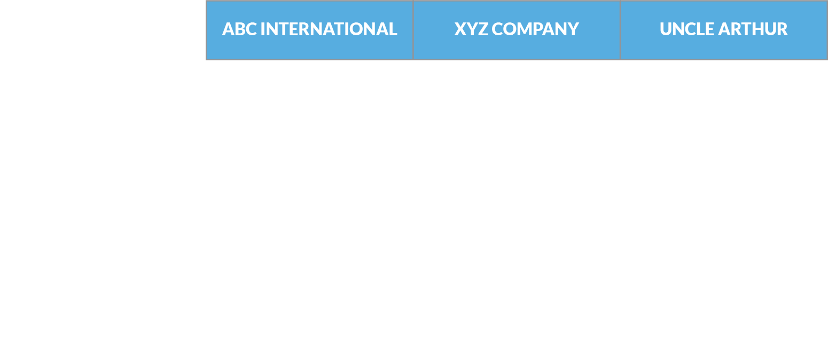
Multi-criteria analysis (MCA)
Tender shortlist
Notes:
We have a shortlist of 3 tenderers for our project.
ABC is a multinational company.
XYZ is a national company.
Uncle Arthur is a local supplier.

Slide 34
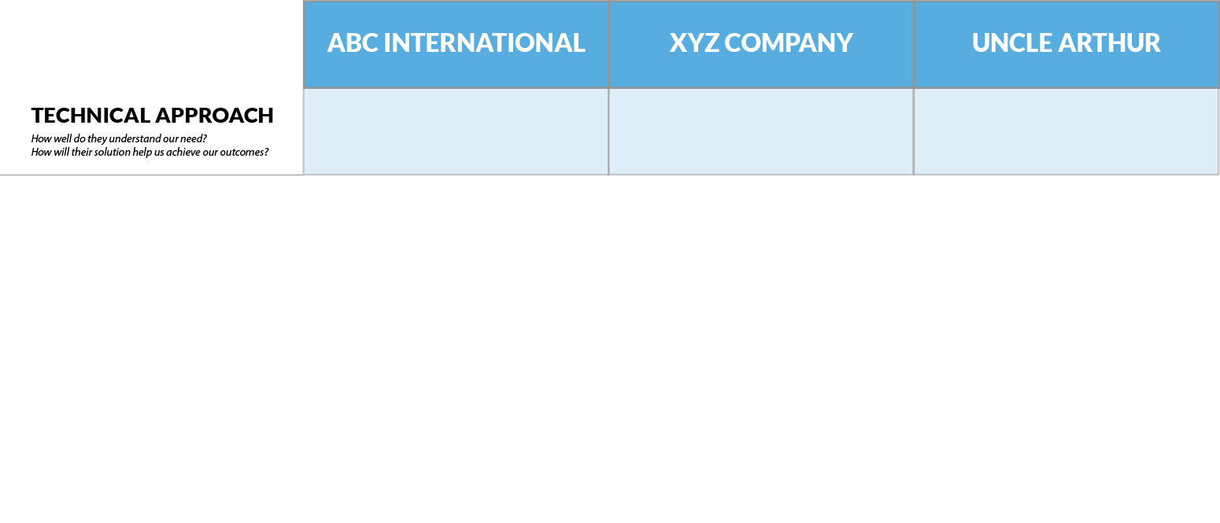
Multi-criteria analysis (MCA)
3
5
2
Notes:
ABC has given a very generic response in their tender, well-polished but obviously cut and paste from multiple similar RFPs.
XYZ has written a clearly thought out and well-designed solution that is specific to our needs.
Uncle Arthur clearly does not have much experience tender writing but seems like he could deliver in a pinch.

Slide 35
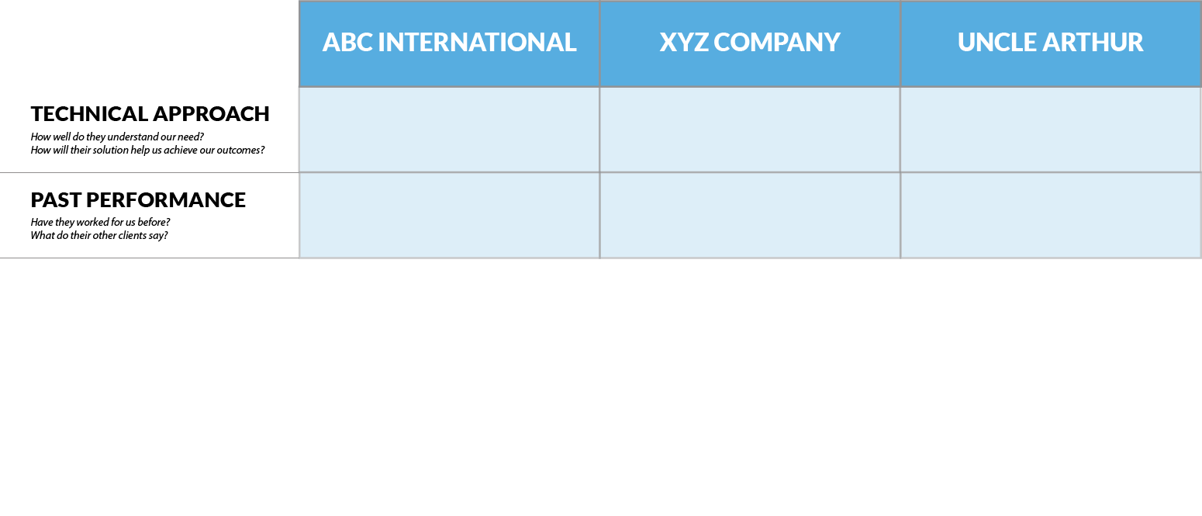
Multi-criteria analysis (MCA)
3
5
2
5
3
2
Notes:
ABC has references from kings, presidents and captains of industry.
XYZ has good client references from across the country.
Uncle Arthur has some modest references from small local suppliers.

Slide 36
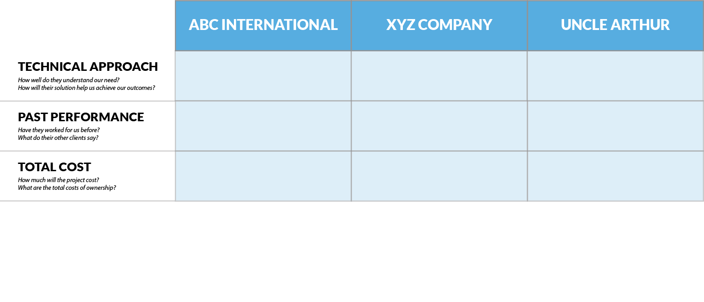
Multi-criteria analysis (MCA)
3
5
2
5
3
2
4
3
5
Notes:
In this instance, rather than working a -5 to +5 scale, we are saying a low cost gets a high score, and vice versa.
ABC has a competitive price, presumably because of the scale they work at and their generic approach.
XYZ had a very customized package, but it comes at a higher cost (therefore lower score).
Uncle Arthur is very cheap.

Slide 37
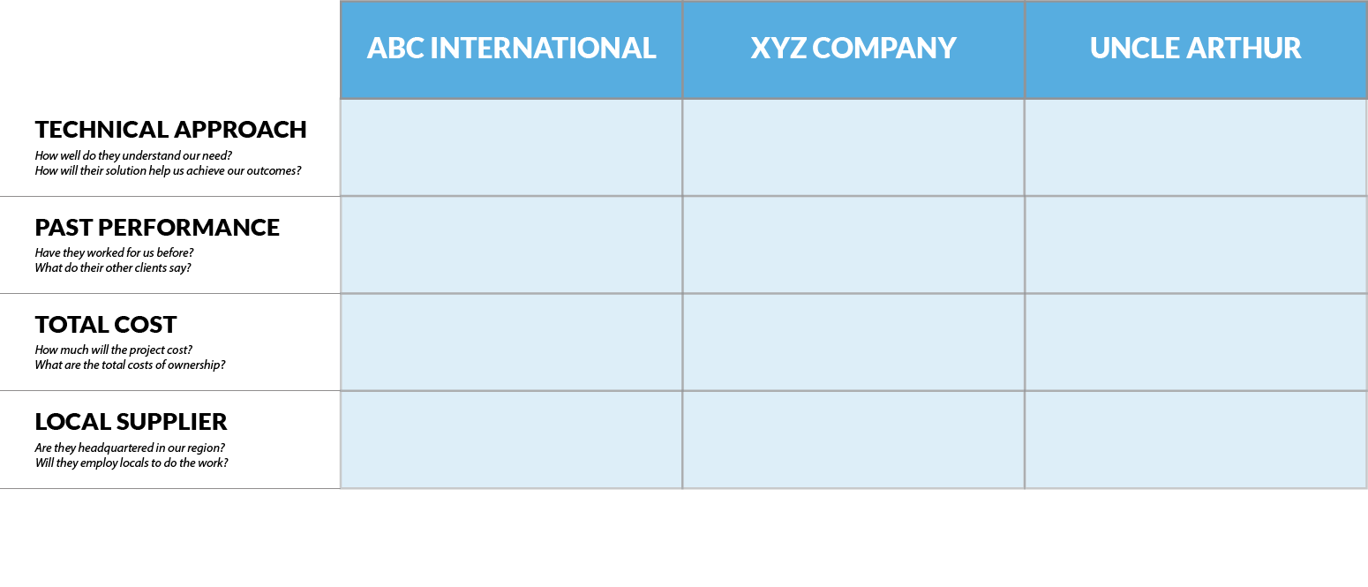
Multi-criteria analysis (MCA)
3
5
2
5
3
2
4
3
5
0
2
5
Notes:
We strongly prefer to work with a local supplier.
ABC doesn’t rate as an off-shore, multinational.
XYZ is headquartered inter-state, but does have a local office.
Uncle Arthur’s sole premises is just down the road, so he scores most highly here.

Slide 38
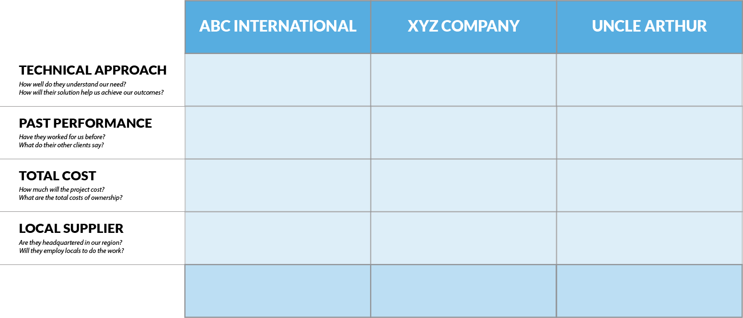
Multi-criteria analysis (MCA)
3
5
2
5
3
2
4
3
5
0
2
5
12
13
14
Notes:
On this basis, Uncle Arthur would be our preferred supplier, but does that really feel like the best choice?

Slide 39
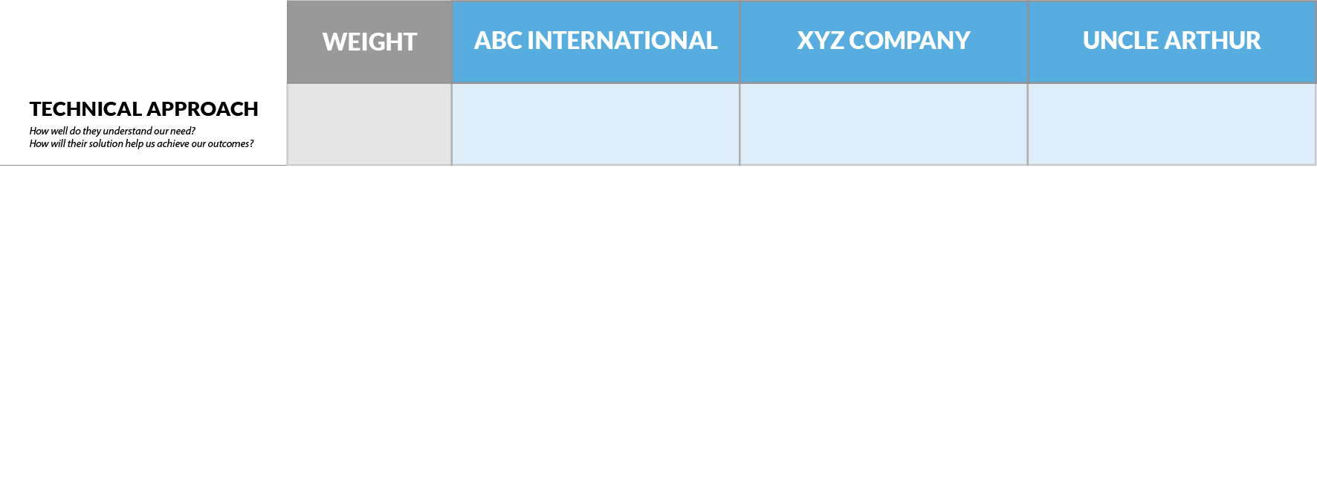
Weighted MCA
x4
(3) 12
(5) 20
(2) 8
Notes:
Let’s weight our criteria according to our preferences.
Most important to us is the technical approach of our contractor, so we ‘weight’ this criteria by a factor of 4.
New scores are revealed (the raw (original) score being shown in grey in brackets).

Slide 40
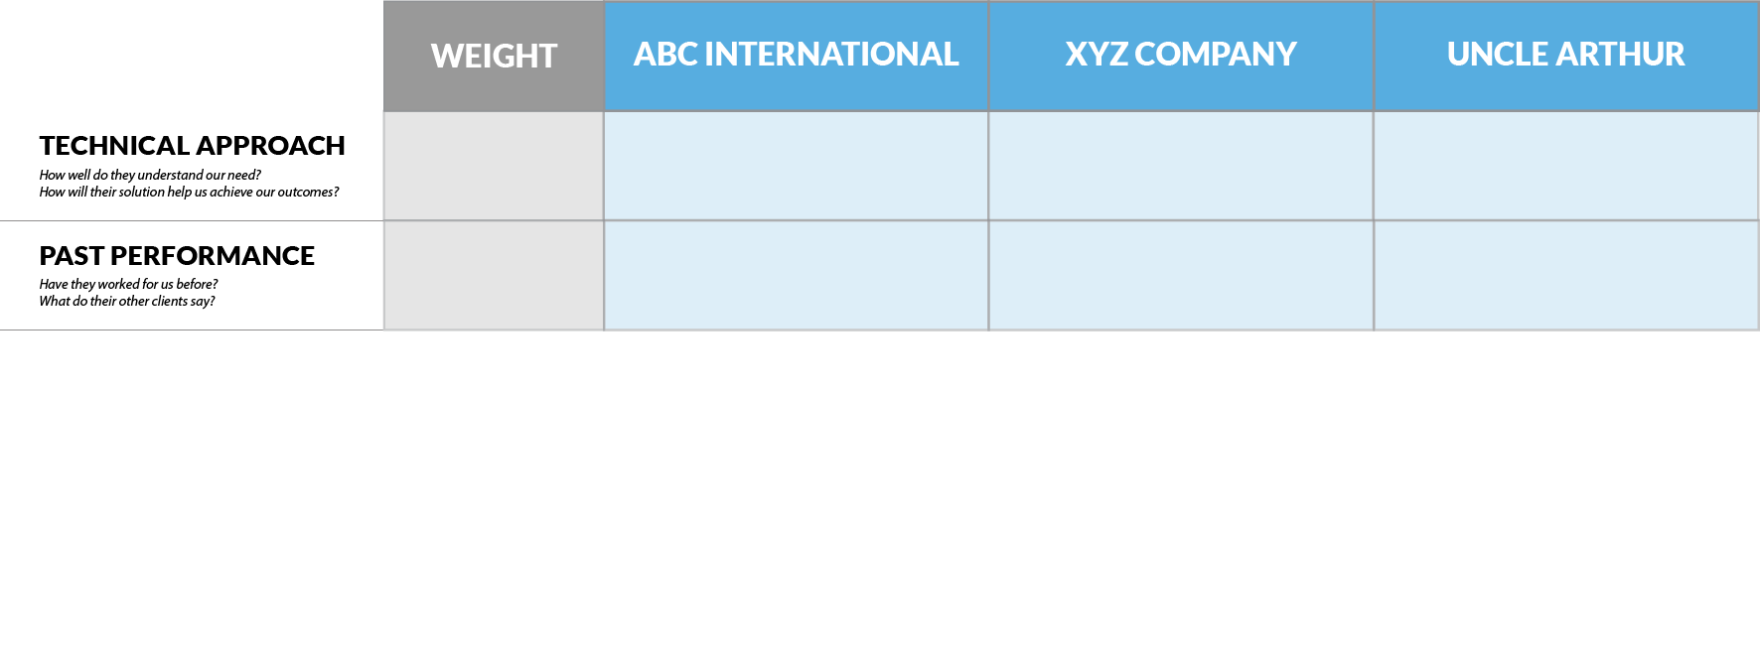
Weighted MCA
x4
(3) 12
(5) 20
(2) 8
x3
(5) 15
(3) 9
(2) 6
Notes:
Past performance is slightly less important, but we will still weight it by a factor of 3.
Walk through the changes.

Slide 41
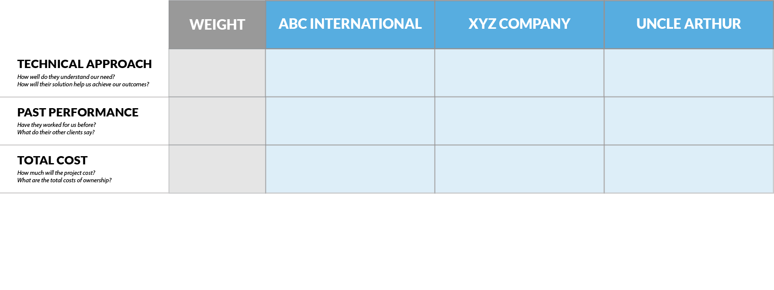
Weighted MCA
x4
(3) 12
(5) 20
(2) 8
x3
(5) 15
(3) 9
(2) 6
x2
(4) 8
(3) 6
(5) 10
Notes:
Cost is less important again, so is weighted 2x.

Slide 42
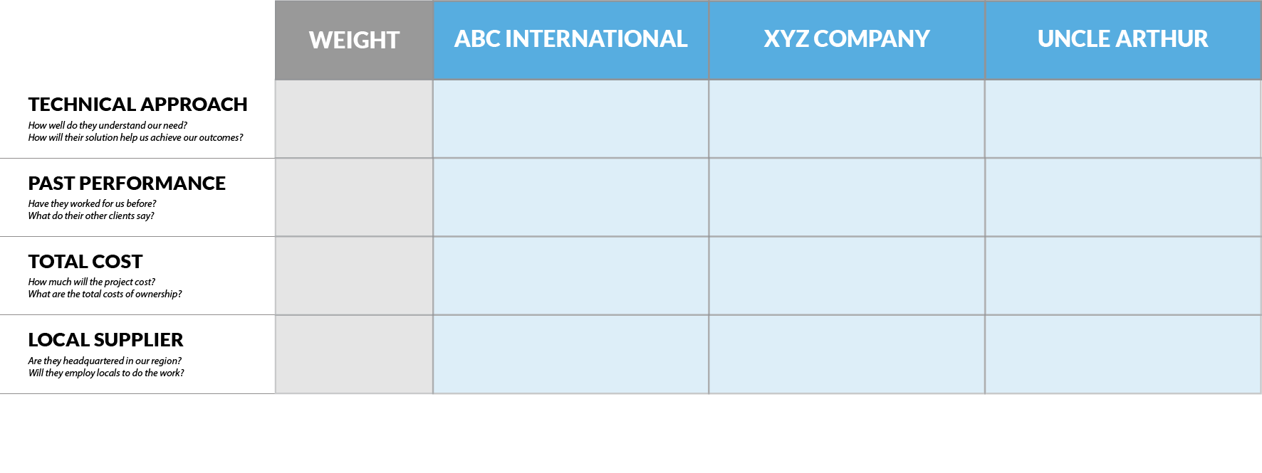
Weighted MCA
x4
(3) 12
(5) 20
(2) 8
x3
(5) 15
(3) 9
(2) 6
x2
(4) 8
(3) 6
(5) 10
x1
(0) 0
(2) 2
(5) 5
Notes:
Local supplier is still a criteria, but less important than the others.

Slide 43
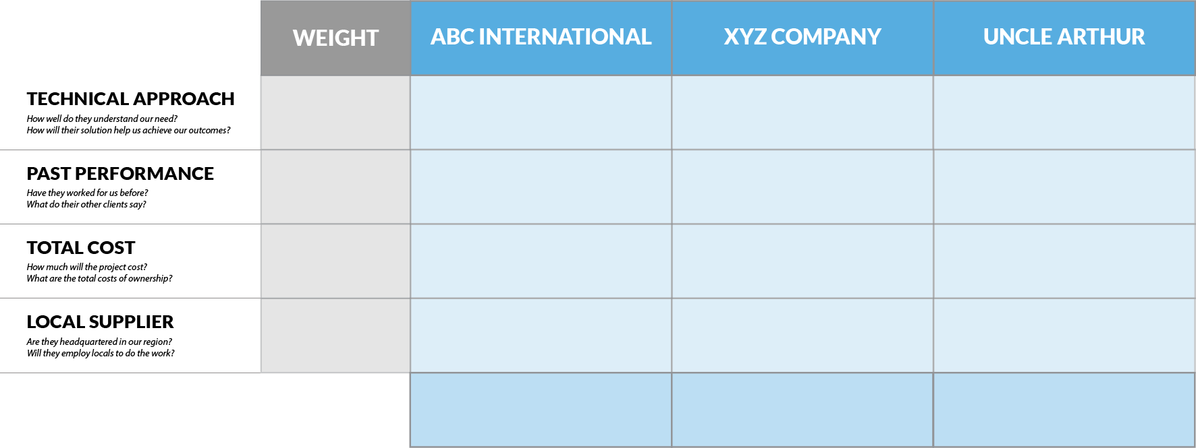
Weighted MCA
x4
(3) 12
(5) 20
(2) 8
x3
(5) 15
(3) 9
(2) 6
x2
(4) 8
(3) 6
(5) 10
x1
(0) 0
(2) 2
(5) 5
(12) 35
(13) 37
(14) 29
Notes:
On this basis, XYZ is chose and ABC is our alternate / back-up.
Weightings will always be subjective, can be expressed in any combination, and like the raw scores shown, must be clearly and transparently defined (cf stakeholder register definitions of power and interest.)

Slide 44
Discussion
OPEN 5.10
You’ve identified a preferred supplier and are ready to engage!
Why negotiate the contract?
Notes:
Why negotiate?
To confirm the contract details or obtain better value for money
To achieve a full understanding between the parties
To establish or refine the statement of requirements and/or the performance regime
To clarify issues or objections to contract provisions
To explore any complex or one-off issues
To identify new opportunities
Importantly, as we are setting up a relationship with the supplier that will last throughout contract delivery (and hopefully into future contracts!) we want this to be a friendly, integrative process, whereby both parties ideally benefit.
This is quite different to the common / popular perception of negotiation as a competitive process, such as when buying a used car!

Slide 45
Activity 6.4
Share your negotiation tips and tricks!

Slide 46
Negotiation tips and tricks
Don’t disclose that the other party is certain to win the contract
Put yourself in their shoes
What are their objectives?
What is valuable to you, but low cost to them?
Keep issues that are not negotiable to a minimum
Be prepared to trade-off less important requirements (or short-term gains) to achieve outcomes that are central to objectives
Listen
Never feel rushed – use silence
Don’t negotiate with yourself – wait for the counter offer
Acknowledge counter-arguments / objections
Gather evidence – bring proof
Don’t be distracted by personality, behaviour or hygiene
Don’t leave unresolved issues
Be ready to walk away

Slide 47
Closing the procurement phase
Lessons learned register
Notify unsuccessful bidders
When do we do this?
Evaluation committee de-briefing
Give market feedback
What level of detail should we provide?
Improves quality of future responses
Provides surety that procurement process was fair and transparent
Helps them learn and grow as a business
Receive market feedback
Who should we consult?
What should we ask?
Process audit and review
Did we complete all the steps?
Did the steps aid or hinder process?
Review RFIs
End-user de-briefing (contract administrator, output owner)
Notes:
Stop and ask each of the italicised questions to the group before moving on each point.
When do we do this?
Once the contract is finally awarded – not while you are still in negotiation!
What level of detail should we provide?
Detail specific to the tenderer’s response – do not share info on other tenderers
Who should we consult?
Successful and unsuccessful bidders, but also think about suppliers who didn’t respond
What should we ask?
How did you find out about the RFP?
Were the tender docs clear and easy to understand?
Was the scope of work sufficiently detailed?
Were the criteria specific and relevant to what we were asking for?
How well did we respond to questions?
Was the level of effort required in developing your bid proportionate to the value of work you hoped to win?
Are we an organisation you’d like to work with in the future?
What did we do well? What can we do better next time?

Slide 48
Request for proposal
Prepare a request for proposal (RFP) for a procurement related to a relevant professional or personal project:
Relevant information about the requesting organisation
An overview of the project the proposal relates to
A detailed scope of work
Expected delivery date
Budget constraints
Detailed selection criteria, including weightings and evidentiary requirements
Conditions for participation (both administrative and organisational)
Contact information, including request for information protocols
Notes:
Cert IV PMP students only

Slide 49
Reflection
What is the most interesting thing you learned today?
What is one thing you will start, stop or continue doing?
What is one thing you would like to learn more about?

Slide 50
Questions?
Coming next… risky business

Slide 51
Closing checklist
Classroom
Upload signed attendance sheet and any photos taken of work in progress
Zoom
Upload video with thumbnail and link to workshop
Student administration
Mark participating students as complete
Email absent students and notify of gap requirements (OPEN units)
Facilitator feedback – email paul@institute.pm
What worked well today?
How can we improve?

