Slide 1
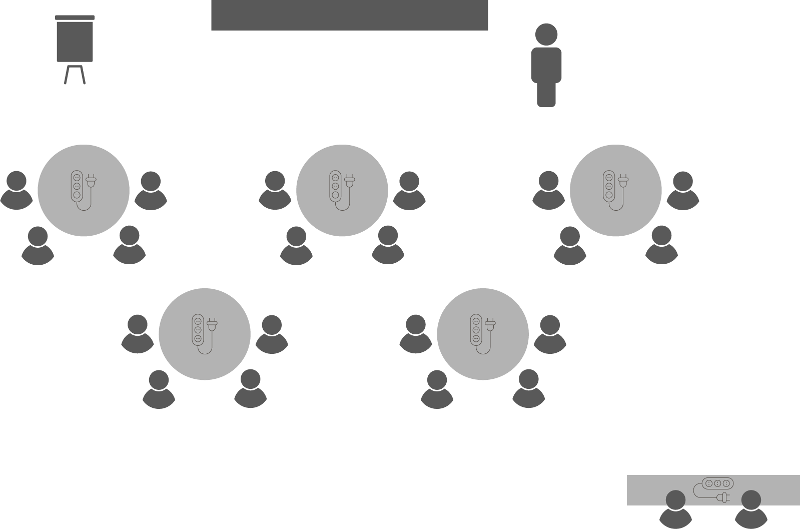
Opening checklist
Your preparation
Review notes, run a technical rehearsal
Rehearse examples / cases / stories to stimulate discussion
Classroom
Ensure students seated at tables of 3-5 and all facing the front
Have student name cards in place and ensure all sign in
Zoom
Rename yourself as host (under participants)
Set-up breakout rooms
https://support.zoom.us/hc/en-us/articles/206476313-Managing-Video-Breakout-Rooms
Welcome students as they arrive, let them know when starting
Notes:
Good luck!

Slide 2
Project
Communications

Slide 3
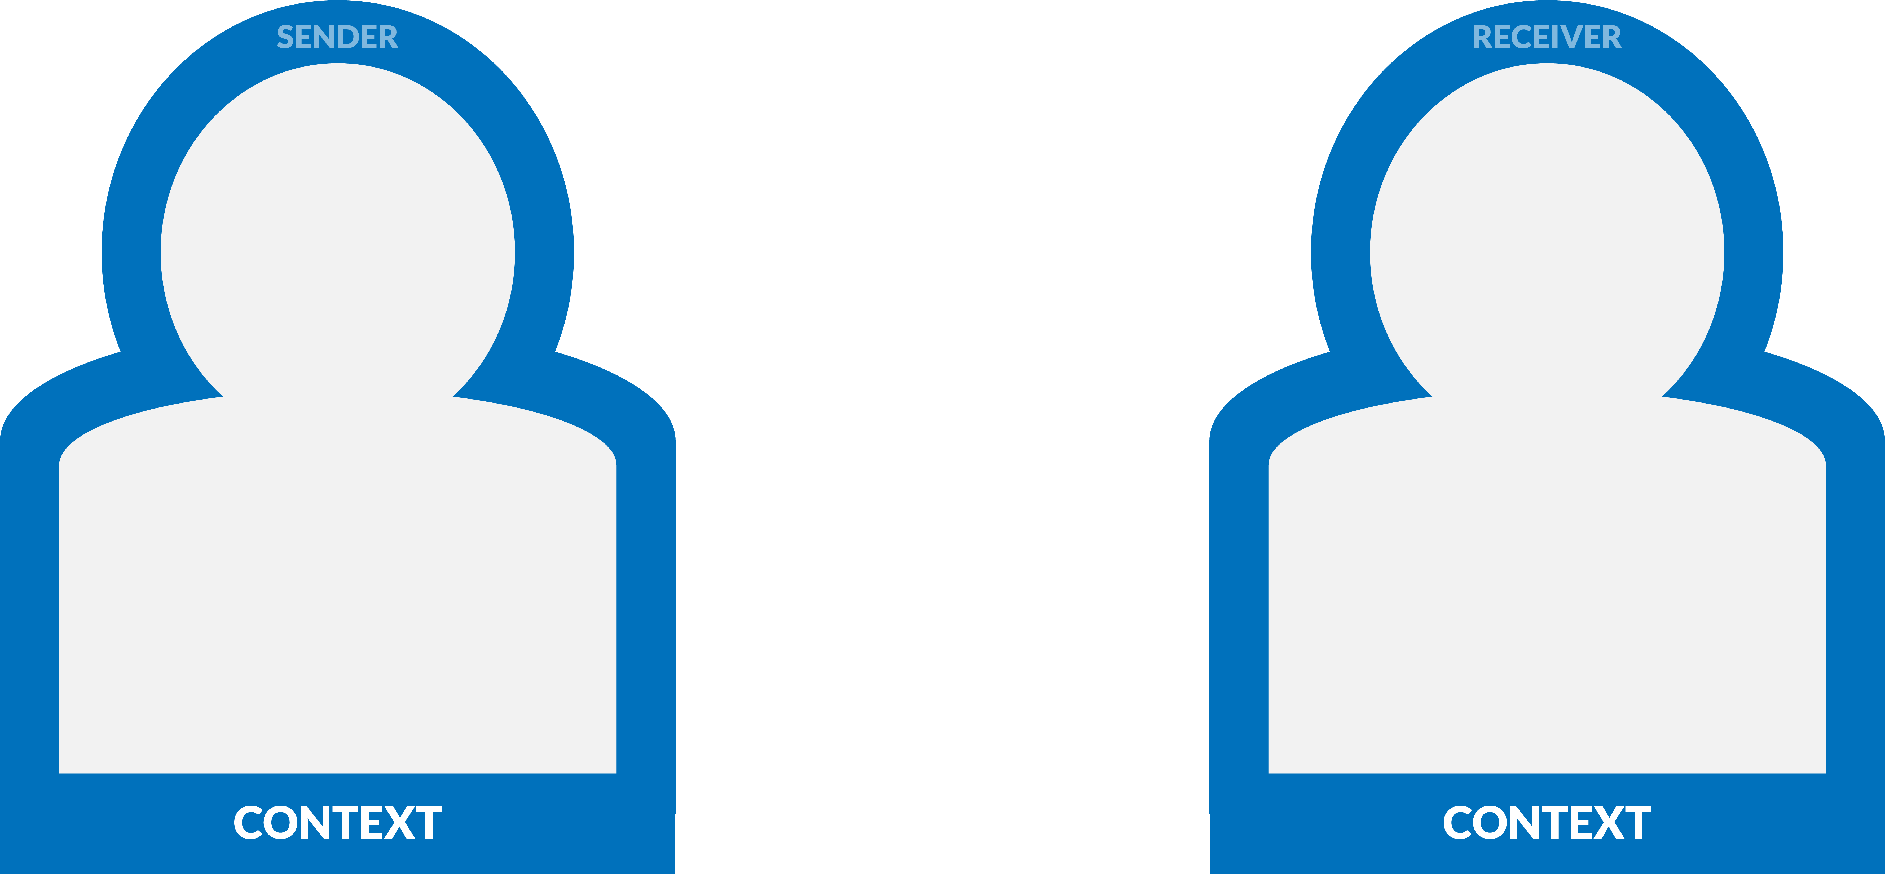
Communication
Notes:
Every communication requires a sender and a receiver.
Context is situational and unique to each communication. It is the sum of each party’s:
National, familial, social and workplace cultures
Lifetime experiences (up to and including your experience with the party or parties you are communicating with)
Personality – how you typically behave
Mood – how you feel in the moment

Slide 4
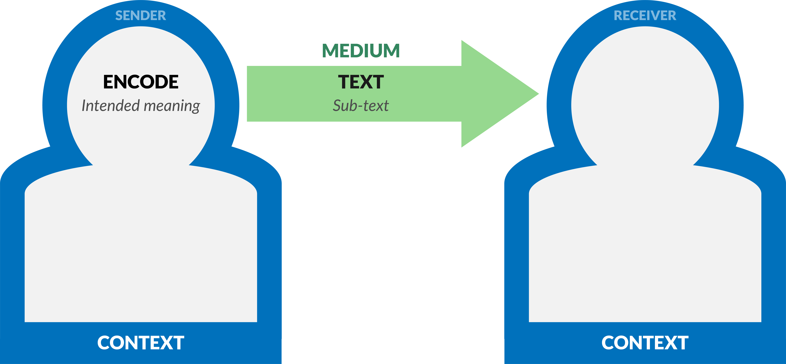
Communication
Notes:
The sender takes the information they wish to communicate and encode it in their preferred medium.
Encoding is the process of composing your message as a verbal or written statement.
That statement can then be transferred into and channelled through any variety of media, including over the telephone, in an email, as a written report or a project plan.
Sub-text in verbal communication includes paralinguistics (speed of voice, intonation, tone, volume, articulation, pronunciation etc) and body language.
Sub-text in written communication includes formatting, font, tone, and the use of punctuation, images, emoticons and the like.

Slide 5
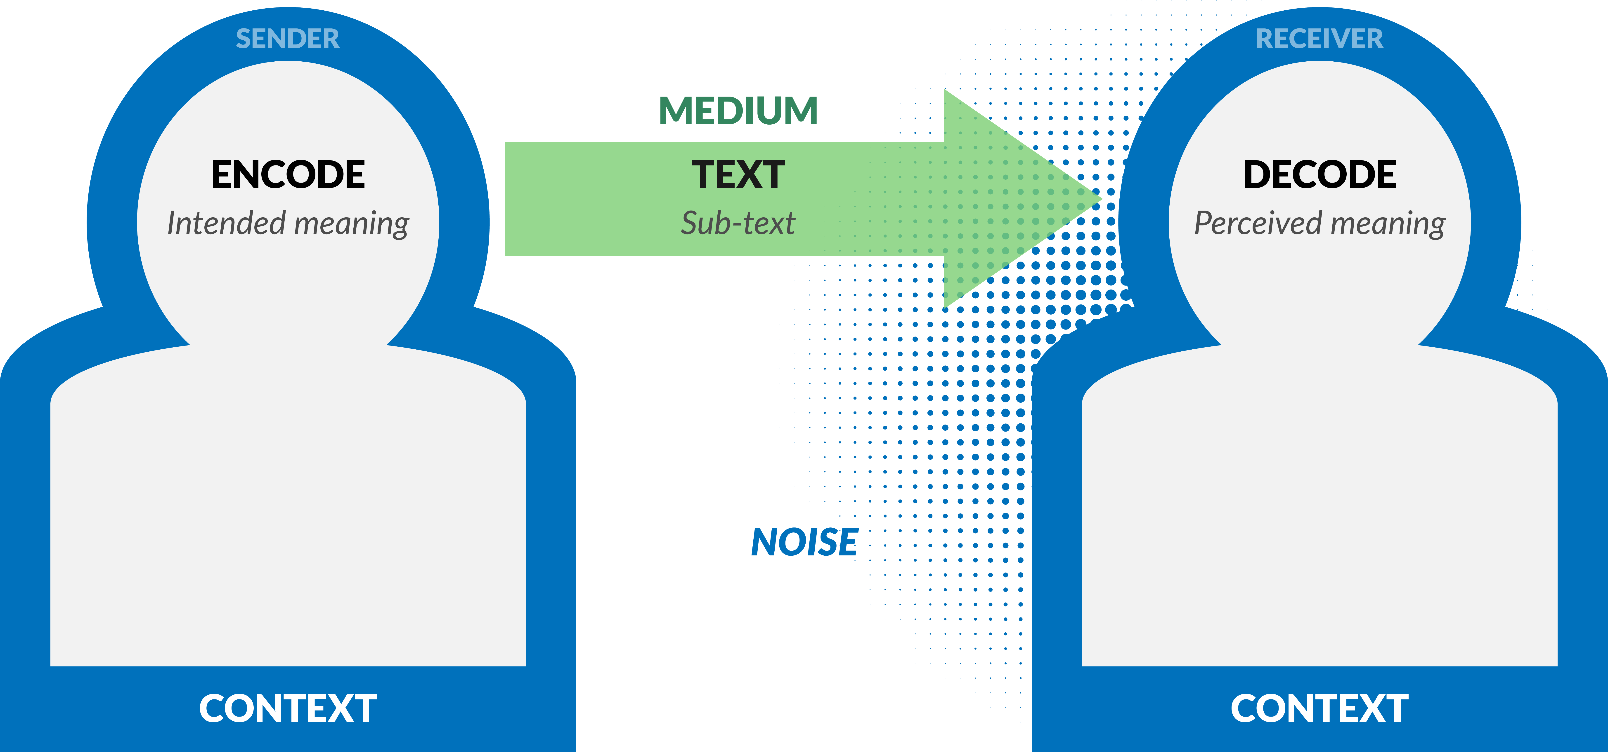
Communication
Notes:
On the way to the receiver, the message is subject to noise.
Noise in this instance refers to anything that might interfere with the transmission and decoding of the message by the receiver.
It can be literal noise (for example, speaking on a phone while riding a noisy train), or figurative noise, such as a distraction or even an absence of something, such as a lack of background context for the message.

Slide 6
Communication
Notes:
Inherent in the model is an action to acknowledge a message.
Acknowledgement, however, only means that the receiver signals receipt of the message – it does not imply agreement.
If people do not understand why a message is being sent, or the broader circumstances it is alluding to, then receivers are likely to decode your message in totally unanticipated ways!
The final action is the response to a message, which means that the receiver has decoded, understands, and is replying to the message.
The sender is therefore responsible for making the information clear and complete so that the receiver can receive it correctly, and for confirming that it is properly understood.
The receiver is responsible for making sure that the information is received in its entirety, understood correctly, and acknowledged.

Slide 7
Discussion
How can (and does) project communication go wrong?
Notes:
Take examples from the floor – essentially each of these transaction points represents a potential for communication failure – it is a wonder we are able to communicate at all!
How does knowing this make you a better project leader?
Well, for one thing it shows the importance of clarity in communication.
Each of these elements represents a point at which the communication could be distorted or fail.
At all times you should keep your messages simple and easy to understand, staying mindful of the context they exist in and the noise that might disrupt them.
More importantly, being an effective communicator depends as much on your ability to listen as it does on your ability to talk or write.

Slide 8
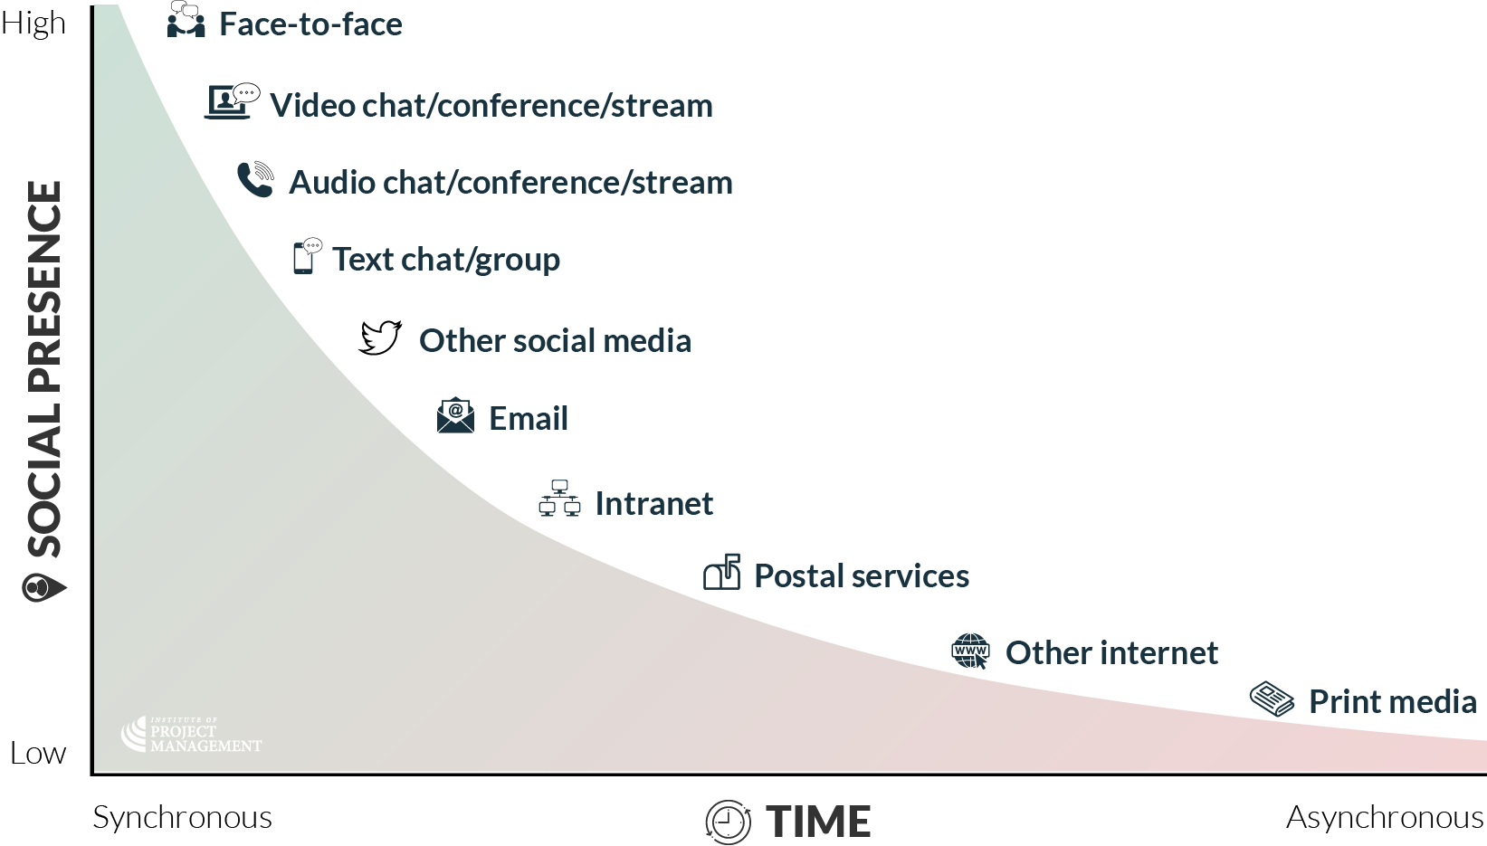
Communication media
Notes:
Social presence refers to the proximity of the communicating parties.
At the highest level, the parties are in the same room and can see, hear, smell and even touch each other.
Video and audio technologies to some extent bridge the physical divide; however, even highly visual written communication channels lack social presence.
Synchronicity is a function of time – here it is used to refer to the lag between sending and receiving a message.
A conversation between two people is synchronous; whereas, ‘slower’ communications that inject a significant pause between the sender sending and the receiver receiving a message, are progressively more asynchronous communications.

Slide 9
Communication media
Notes:
Social presence refers to the proximity of the communicating parties.
At the highest level, the parties are in the same room and can see, hear, smell and even touch each other.
Video and audio technologies to some extent bridge the physical divide; however, even highly visual written communication channels lack social presence.
Synchronicity is a function of time – here it is used to refer to the lag between sending and receiving a message.
A conversation between two people is synchronous; whereas, ‘slower’ communications that inject a significant pause between the sender sending and the receiver receiving a message, are progressively more asynchronous communications.

Slide 10
Activity 4.1
Choose one of the following project communications media:
Face-to-face
Email
Phone
Video-conference
Social media
What are its pros and cons?
How can we respond to its risks?
Notes:
Assign one media to each group
Face to face
Professor Albert Mehrabian famously coined the 55/38/7 rule, finding:
55% of meaning is communicated through body language
38% is in tone of voice, and
7% is in the actual words spoken.
Although this is by no means a universal truth, communicating with one or more people while you are in the same room often facilitates greater understanding between parties.
It goes beyond simple information transfer, allowing you to observe carefully each others’ body language, facial expressions and gestures.
By being both social and synchronous, the greater understanding also promotes trust between parties, which ultimately benefits productivity.
That said, its effectiveness exponentially declines the more people you have in the room, to the point where an exchange of ideas reduces to a more unilateral presentation of information.
Meeting and coordination costs – including the cost of participants’ time – may also motivate a more efficient communication solution.
Accordingly, we should reserve face-to-face communication for high value and context critical dialogues and decisions.
Email
Email is by far the most ubiquitous communication medium in modern business.
It is quick, global, easy to use, can hit multiple recipients in a single stroke, and provide a permanent (and often legal) record of correspondence.
As with all media, though, there is an appropriate time and place for its use, and some of those benefits can also work against you.
Talking to many businesses, you will find email is actually over-used: information is overloaded; people get unnecessarily cc’d on things; there is pressure to reply; messages often lack context – attempts at humour are regularly misunderstood; and once sent, things are all-but impossible to recall.
The best emails are simple, to the point, specific in the action they require of the receiver, and reinforced through other messaging, such as a telephone chat.
Phone
If Mehrabian’s 55/38/7 maxim is true, then audio only communication media (such as the telephone) risk comprising the meaning of a message by as much as 55%.
That said, if a person’s body language is wholly consistent with their tone and the words they choose, the communication still works.
This might also be understood as the cost of convenience – the cheaper and more efficient a media, the less effective it might be.
For that reason, you should always prefer more synchronous and social media for important, complex and/or sensitive messages.
Video-conference
Video chat is no longer a novelty given that most phones now provide the capability.
Enterprise solutions also offer the convenience and means to file and screen share, text chat in-system and record sessions.
Yet even if participants understand and use the technology perfectly – and this can never be guaranteed – there is still a loss of interpersonal contact and the benefits that follow.
It is especially difficult to see if all receivers are engaged and understanding your message.
Pro tip: try and avoid talking group-to-group; where possible, have each participant on their own device or screen!
Social media
Benefits - internal
Knowledge sourcing - project teams can share and start conversations about lessons learned in real time
Knowledge sharing - snippets of organisational best-practice, including changes to policy and procedure, can be pushed and promoted to the network
Knowledge gamification - project teams can be incetivised and engaged with lessons learned, policy, procedure and best practice through frequent (but not obtrusive) polls, quizzes and contests
Communities of practice - project teams can quickly and safely 'ask the experts' in their organisation for help resolving project issues or challenges they are facing
Benefits – external
Identify and connect with new stakeholders
Micro-target stakeholders by their demographics and interests
Monitor stakeholder levels of power and interest, as well as any issues or risks they discover
Inform stakeholders of progress, changes and the management of their risks and issues
Consult stakeholders on key project decisions
Involve stakeholders in reference or pilot groups, or as project participants (for example, in market research or clinical trials)
Recruit project teams, including staff, consultants and contractors
Risks
Stakeholder conversations
Many project managers use social media to push information to stakeholders without recognising that people expect conversations on these channels. Because unanswered comments or feedback often give rise to anxiety, frustration and anger, PMs must ensure that sufficient resources are dedicated to reciprocal engagement.
Don’t feed the trolls!
The conventional social media wisdom is to ignore intentionally provocative, derogatory or inflammatory comments, as it only encourages more of the same – it is a battle you are unlikely to win!
That said, if public commentary is enabled, it should be moderated in as close to real time as possible to ensure (if nothing else) your feed is not spam-botted to death.
Data privacy
Especially when using social media to recruit stakeholders, you should ensure that any identifying or otherwise sensitive information you gather is properly secured.
Security includes not just protection from hackers, but also limiting access internally in your project to only those with a need to know.
Work-life balance
Project team members may default to using their personal profiles to represent the project on social media.
This can create a reputational risk for your organisation is these profiles are equally visible and contain content that may offend segments of the community.
You should also be conscious of the need to turn off from project chat outside of work hours, something that is difficult to do in a 24/7 media cycle.

Slide 11
Discussion
What are the risks of not sharing enough information with our stakeholders?
What are the risks of sharing too much?
If in doubt, where should we err (under- or over-share)?
EFFECTIVE v EFFICIENT communication
Notes:
Cast your mind back for a second to the power / interest matrix – what risk do you see in under-communicating (not telling enough) to our highly powerful and interested stakeholders?
Aristotle once stated that nature abhors a vacuum. In physics, this means that nature contains no vacuums because the denser surrounding material would immediately fill the void.
In our setting, this means that the absence of information (under-communication) will often lead to stakeholders making unsupported assumptions and leaping to erroneous conclusions about your project.
They also tend to ‘worst-case’ scenarios, assuming that you would have told them if there was good news.
The related risk with under-communication is that people will not have the information necessary to make good decisions.
As stated earlier, the more assumptions we use to fill our information gaps, the greater the margin of error (or lesser confidence) we will have in our estimates.
Under-communicate at your peril!
If you are unsure where the balance lies, you should always tend towards over-communication; yet over-communication comes with its own risks too.
In this instance, you may be investing resources (time and money) into communicating things people don’t want or need to know – resources that could be better spent on managing other aspects of the project.
Beyond the obvious risk of annoying stakeholders, you also risk making people blind to your important messages – those ones you really need them to act on.
Think about your own inbox… do you read every word of every message your mother sends you three times a day? Has it ever got you in trouble?
Over-communicating information may also risk inviting input and contributions from stakeholders who have no legitimate value to add.
This can result in you doubling again the resources you spend on communication in managing these new expectations.
Err slightly toward over-communication, but don't over-do it!
Effective communication is providing information in the right format, at the right time, and with the right impact.
Efficient communication refers to finding the balance between under- and over-communicating information.
Redundancy – the need to repeat and reinforce messages – may be necessary if a message needs to be widely broadcast and/or is highly critical.
Reactively redundant managers pester team members after the event with increasingly irritating messages via the same channel.
For example: once a milestone is missed, the reactively redundant manager begins sending daily emails asking for information.
Good project leaders are proactively redundant when communicating – they repeat and reinforce key messages using multiple channels in anticipation of an event or requirement.
For example: a phone conversation is followed up with a confirmatory email, and a quick text message to check-in in the lead-up to a deadline.

Slide 12
Activity 4.2
How does personality impact people’s communication style?
When should you vary your approach?
Notes:
Get examples from different personality types in the room
As a project leader, you should be willing to adjust your communication strategy to any situation or context.
In order to get the most out of others, this includes modifying your own behaviour and approach in response to the personality style they are expressing in the moment.
To do this effectively, you will need to:
Observe
Listen and watch for personality cues; be open to someone else's style, values and perspective.
Adapt
Find common ground with someone who is different; this could be your speed of speaking or the terms you use (for example, talking about facts vs. feelings).
Connect
Watch for body language and get feedback from others to see if you are being understood; check your own thoughts/feelings. Do you feel harmony or discord?

Slide 13
Notes:
Before breaking, ask students if there are any questions about what has been covered in the session so far.
Once answered, encourage students to stand up, get a drink, go outside and stretch.
If they are on Zoom, tell them to turn their camera and microphone off (you do the same)!
Make sure you tell them the precise time you will be restarting (eg 10:10am)
Don’t check your email – take a proper break!!

Slide 14
Notes:
Every Meeting Ever
https://www.youtube.com/watch?v=K7agjXFFQJU

Slide 15
Activity 4.3
How many hours per week do you spend in meetings?
What makes for a terrible meeting?
Notes:
In getting responses, do a show of hands for the first question:
1-5 hours
5-10 hours
10+ hours
Typically the more stakeholders you have to manage, the more time you spend in meetings versus ‘working’
Examples of terrible meetings should be numerous!

Slide 16
Agenda
OPEN 9.7
A meeting is a project!
Agenda – mini-project plan for your meeting…
Why are we meeting (business case / charter)?
What are we going to talk about (scope)?
How long are we going to spend on each item (time)?
Who needs to be there (stakeholders)?
Notes:
A meeting is a project – it has a start, finish and a unique output
An agenda is the mini-project plan that no good meeting should be without!
Business case / charter
What are the meeting objectives? What are the (measurable) outcomes we are aiming for? How will we know the meeting has a been success?
Scope
What are we going to talk about? What is out-of-scope?
Time
How long will we meet for? How long will we spend on each (scope) item? Are we programming breaks and/or the opportunity for people to get up and move around?
Stakeholders
Who needs to be there? Note that what you can realistically achieve in terms of engagement will be constrained by the number of stakeholders in the room. A small meeting of 2-5 people can allow for collaboration; a medium sized meeting of 6-15 people might enable consultation; whereas, larger meetings it may only be possible to inform attendees via presentation only.

Slide 17
Meeting planning
OPEN 9.7
Other considerations
Risks – what could possibly go right / wrong?
Resources
What information do decision makers need before the meeting?
How long before the meeting do they need it?
What do they need in the meeting to assist decision making?
Notes:
Risk What could possibly go right or wrong? Will some people try to dominate the meeting? Will the technology work? What if someone cannot attend?
Resources
What information do decision-makers need before the meeting?
How far in advance of the meeting do information and resources need to be prepared and shared?
What resources (pens, paper flipcharts, whiteboards, AV) will be required in the meeting?

Slide 18
Environment
OPEN 9.7
Where we meet…
How we meet…
Accessible
Natural light / fresh air
Comfortable facilities
Regular (catered) breaks
Encourage movement
Set ground rules
Encourage participation
Manage etiquette / conflict
Visibly record meeting
Summarise & share results
Notes:
How we meet…
It is important, too, that meeting ground rules are clearly understood and agreed to, such as turning off mobile phones.
You should also visibly make a real-time record of the meeting, and ensure that results, decisions and actions required are summarised and distributed.
This record is called the minutes of the meeting.
The meeting chair – that is, the person who sets the agenda and runs the meeting to plan – is therefore responsible for prioritising these considerations and allowing sufficient time for each agenda item.
They must also ensure that they get the full participation of each attendee; otherwise, why invite them in the first place!?

Slide 19
Meeting conduct
OPEN 9.7
Formal
Agile / scrum
Welcome
Attendance / apologies
Minutes of the previous meeting
Business of the meeting
Agenda item 1
Agenda item 2
Agenda item 3…
Other business
Next meeting time & date
What did I do yesterday (or since we last met)?
What will I do today (or until we next meet)?
What is in my way (issues / risks)?
Other approaches
Management by exception (PRINCE2)
No status meetings – only meet if things are going wrong
Notes:
Disagree with PRINCE2 – we should still meet, but only in order to confirm progress, allow questions and introduce new considerations from stakeholders.
An important and often overlooked consideration with time is that we often stick to our diaries instead of being true to our intended outcomes.
In other words, if the meeting is scheduled to run one-hour, we spend one-hour in the meeting no matter what.
It is rare, however, that the objectives of the meeting will be perfectly fulfilled in exactly 60 minutes.
In fact a well-run meeting will usually finish ahead of time.
Don't be afraid to finish a meeting early once you get what you need from it!

Slide 20
Activity 4.4
How can you get the most out of individuals in groups?
Notes:
Parkinson's law of triviality is the argument that meeting participants invariably give disproportionate weight to trivial issues.
In explaining his 'other' law, Cyril Northcote Parkinson gives the example of a fictional committee whose job is to approve the plans for a nuclear power plant.
He suggests they will spend the majority of their time on discussions about relatively minor but easy-to-grasp issues, such as what materials to use for the staff bike shed.
This will be time spent at the expense of discussing the proposed design of the plant itself, which is far more important and a far more difficult and complex task.
Getting the most out of meeting participants therefore requires skillful facilitation on the part of the meeting's chair.

Slide 21
Active facilitation
Gentle intervention
Use silence
Ask questions to clarify
Repeat / re-phrase
Persuasive intervention
Asking questions to change or move on
Suggest choices or processes
Share own ideas or opinion
Directive intervention
Force a decision by recommending, choosing or directing
Notes:
Gentle interventions are appropriate when:
An issue is complex or challenging
There is ample time for consideration, and/or
A person is having difficulty articulating their point
Gentle interventions might include:
not rushing to fill silences (giving others a chance to speak)
repeating or rephrasing another’s words to demonstrate understanding and encourage further contributions, and/or
asking questions to clarify points.
Persuasive intervention is used to challenge or advance arguments, and can involve:
Asking questions to change
‘What’s missing in your proposal?’
Asking questions to move on
‘Can we spend 10 more minutes on this and move on?’
Suggesting choices
‘Can we focus on these two proposals?’
Suggesting process
‘Let’s brainstorm solutions to this problem.’
Sharing ideas
‘In my experience, this usually works best.’
Directive intervention is used to force decisions and might include:
Guidance
‘My recommendation is ...’
Choosing for the group
‘The majority are in favour of Option B, so we will adopt it.’
Directing
‘Group 1, you are to prepare a full analysis of Option C.’

Slide 22
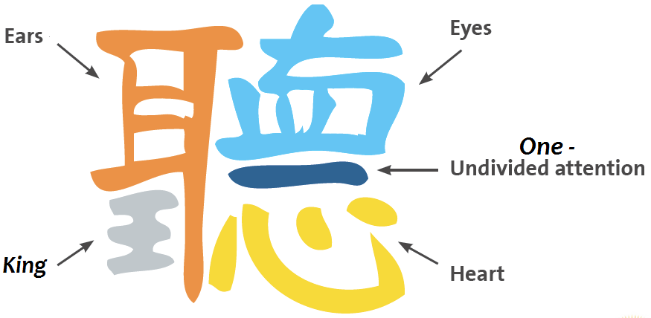
Active listening
Stop…
…what you are doing (moving)
…what you are thinking (talking)
Observe…
…body language and non-verbal cues
Look interested – get interested!
Go
Ask questions to clarify
Repeat / re-phrase
Evaluate and respond
Notes:
Active listening is a bit of buzz phrase that is used to extend the idea of listening beyond just the use of our ears.
Stop
Active listening places a degree of the responsibility for eliminating noise on the receiver.
In other words, you need to stop: stop what you are doing, stop what you are thinking, stop moving, and (obviously) stop talking.
Have you ever been speaking with someone on the phone and heard them typing away on their keyboard in the background?
Annoying, isn’t it?
Have you ever been the person doing the typing?
Active listen requires that you shut out distractions and noise and focus on the sender and their message.
Observe
In other words, observe: observe their body language – what non-verbal cues are they sending with their message?
Are they looking nervous or distracted? Do their physical actions (for example, arrogance) align with their spoken words (such as an apology)?
Here’s a little trick – if you look interested, you get interested.
Non-verbal cues can also be gleaned from written messages.
We now universally accept that sending messages in ALL-CAPS is the textual equivalent of shouting.
You will see emojis in emails these days to give context to messages, but they can also be awkward unless there is a level of familiarity between the parties.
Poor formatting of written documents, as well as frequent errors of spelling and grammar, can also be taken as a sign of disrespect.
Go
Active listening does not end there, though; how you respond is very much part of the process.
Repeating or rephrasing key points to demonstrate understanding, or asking pertinent questions, are all signals back to the sender that you are interested and engaged.
Indeed, the Chinese character for ‘listen’ brings together the characters for ears, eyes, heart and the number one, for undivided attention.

Slide 23
Groupthink
OPEN 9.8
Groups do not merely fail to correct the errors of their members; they amplify them
Groups fall victim to cascade effects, as group members follow the statements and actions of those who spoke or acted first
Groups become polarised, taking up positions more extreme than those they held before deliberations
Groups focus on what everybody knows already—they don’t take into account critical information that only one or a few people have
Notes:
This occurs within a group of people when the desire for harmony or conformity in the group results in an irrational or dysfunctional decision-making outcome.
In other words, group members try to minimise conflict and reach a consensus decision without critically evaluating alternative viewpoints.
They do this by actively suppressing dissenting viewpoints, and by isolating themselves from outside influences.
This often occurs when groups fall victim to cascade effects, as group members follow the statements and actions of those who spoke or acted first.
Groups can also tend to focus on what everybody already knows, without taking into account critical information that only one or a few people (often outside the group) may have.
At the other extreme, groups can become polarised, taking up positions more extreme than those they held before deliberations, as tensions rise and conflict escalates.
Look to any recent political debate for an example of this!

Slide 24
Activity 4.5
Give an example from your own observation or experience of groupthink in action
How can you prevent groupthink?
How should you manage groupthink?
Notes:
When discussing, invite one or two people to volunteer non-political examples of groupthink – avoid controversy!
Prevention is proactive
Management is reactive – what do we do if we suspect it is occurring

Slide 25
Activity 4.5 – answer
Preventing groupthink
Managing groupthink
Expect groupthink
Beware “Yes, Boss” syndrome
Engage diverse groups
Engage outsiders / experts
Explicitly define group values / behaviours
Encourage healthy debate
Nominal group technique – shuffle groups
Allow enough time to make important decisions
Don’t shoot the messenger
Challenge assumptions / consider alternatives
Appoint a devil’s advocate
Manage conflict
Speak last – junior-most person goes first
Encourage all to contribute (active facilitation)
Temporarily exclude senior / management
Tactical pause
Test decisions outside the group
Notes:
It is the responsibility of the meeting chairperson to be alert to and manage groupthink using their wit, charm and the interventions described here.

Slide 26
Time to catch-up
No homework this week!
Get up-to-date with your:
Stakeholder register
Concept canvas
Risk profile
Next session – project plan
Notes:
Cert IV PMP students only

Slide 27
Reflection
What is the most interesting thing you learned today?
What is one thing you will start, stop or continue doing?
What is one thing you would like to learn more about?
Notes:
Reflection questions not only highlight key learnings; they drive the continual improvement of our teaching and learning resources

Slide 28
Questions?
Coming next… project planning
Notes:
Stay around until everyone leaves the session to ensure they all get the chance to ask their questions.

Slide 29
Closing checklist
Classroom
Upload signed attendance sheet and any photos taken of work in progress
Zoom
Upload video with thumbnail and link to workshop
Student administration
Mark participating students as complete
Email absent students and notify of gap requirements (OPEN units)
Facilitator feedback – email paul@institute.pm
What worked well today?
How can we improve?

