Slide 1
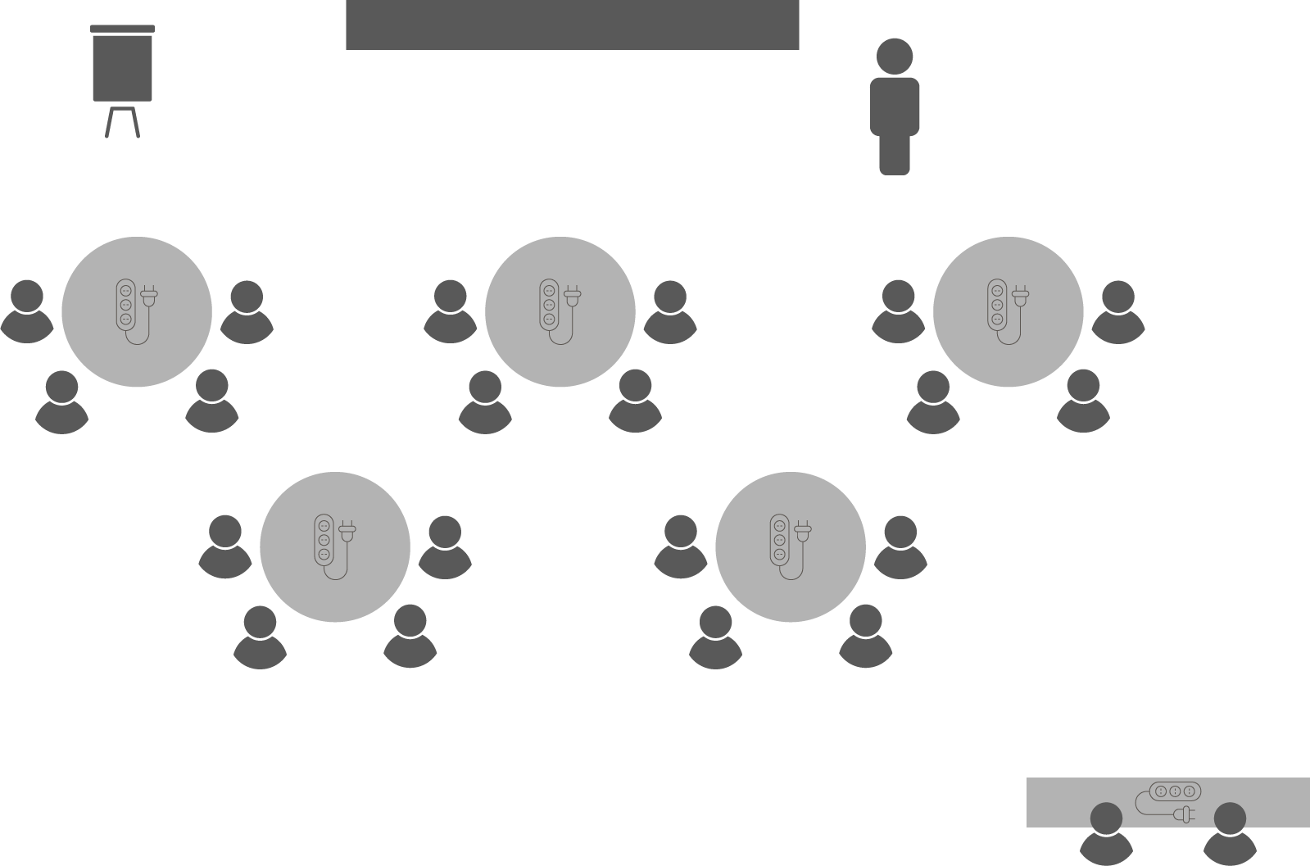
Opening checklist
Your preparation
Review notes, run a technical rehearsal
Rehearse examples / cases / stories to stimulate discussion
Classroom
Ensure students seated at tables of 3-5 and all facing the front
Have student name cards in place and ensure all sign in
Zoom
Rename yourself as host (under participants)
Set-up breakout rooms
https://support.zoom.us/hc/en-us/articles/206476313-Managing-Video-Breakout-Rooms
Welcome students as they arrive, let them know when starting
Notes:
Good luck!

Slide 2
Project
Frameworks

Slide 3
Activity
Who are you?
Where are you from?
What is the best project you’ve ever been part of outside your current role?
Notes:
Make sure you positively respond and comment on each student introduction!
This is how you start to create a safe space for their contributions

Slide 4
What is a project?
OPEN 1.1
A temporary endeavour
undertaken to create
a unique product, service or result
Notes:
There are countless definitions out there – this is the PMBOK one

Slide 5
What is a project?
A temporary endeavour
undertaken to create
a unique product, service or result
Notes:
Temporary – every project has a start and finish (even if not every finish is successful!)
Product, service or result – the deliverable(s) or output(s) of the project
Unique – because no two projects ever start and finish at exactly the same time, in the same place, with the same people and under the same conditions, every project is fundamentally unique. Even repeating a simple project you have completed before will throw up a different result (either in terms of process or outcomes) because – if nothing else – presumably you have learnt from experience and are doing something differently.

Slide 6
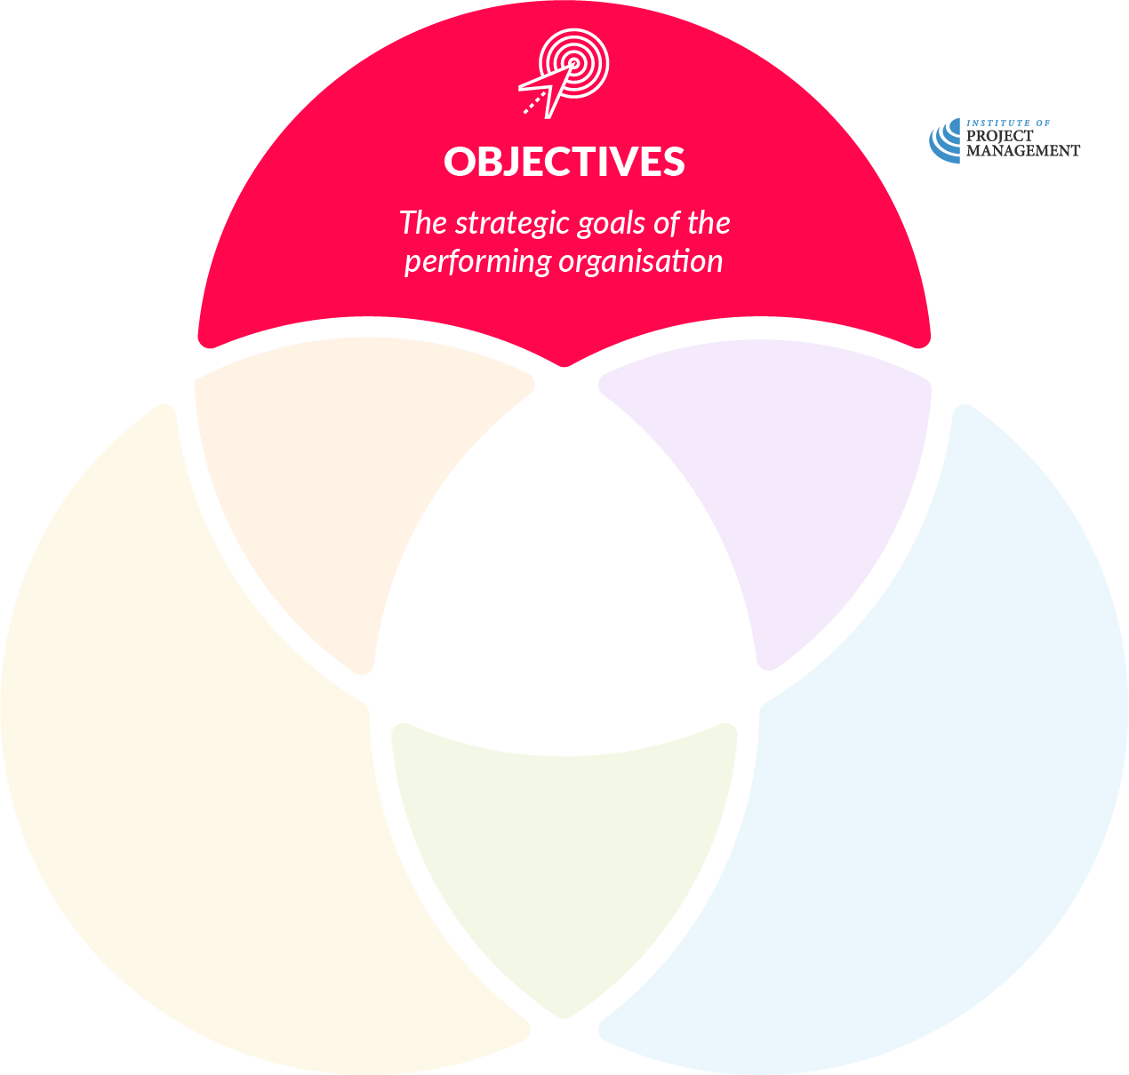
Operations
Notes:
Just like the individuals who make it up, every organisation has a number of objectives it hopes to achieve.
These might be as simple as making a financial return for shareholders; not-for-profit businesses might also aim to contribute to the community in some way.
An organisation's objectives can often be found in its strategic plan, or inferred from what it does on a day-to-day basis.
Objectives may also include cultural goals, such as values or behaviours that the organisation aspires to.

Slide 7
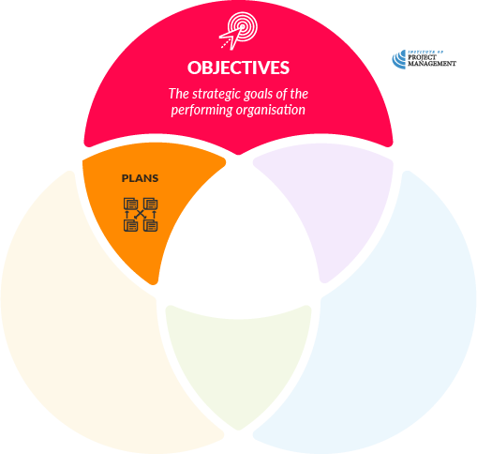
Operations
Notes:
Organisations further develop specific departmental plans that convert the strategic objectives into a set of accountable actions.

Slide 8
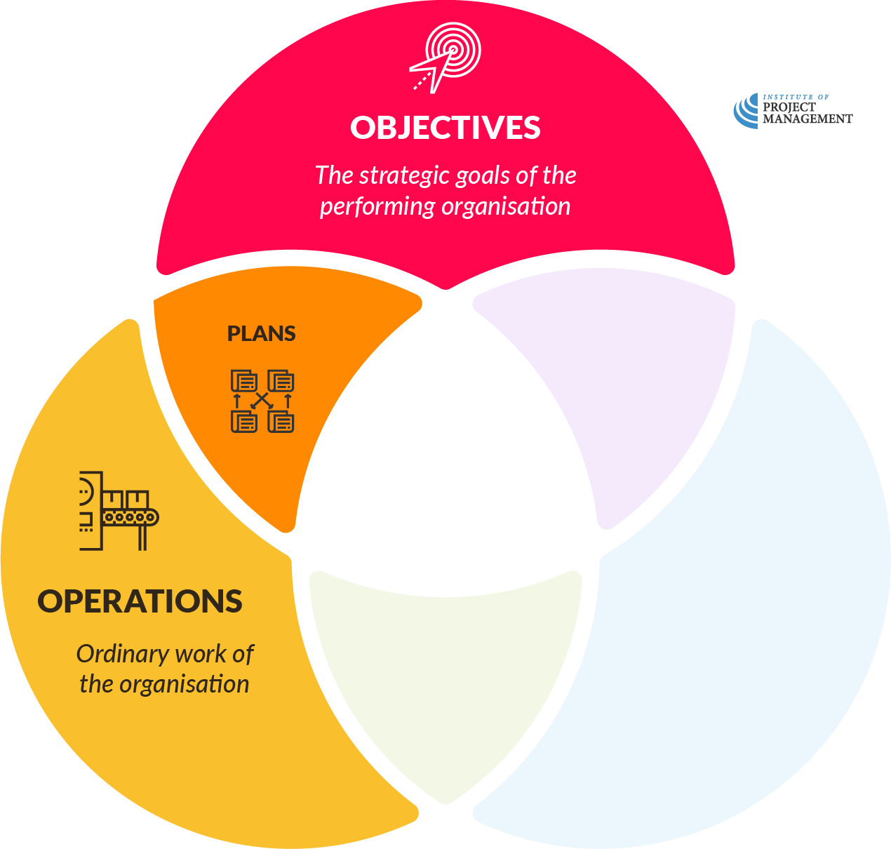
Operations
Notes:
These day-to-day activities are the operations of the enterprise.
This process is what we call ‘business as usual’ for organisations, and should be quite familiar to you.

Slide 9
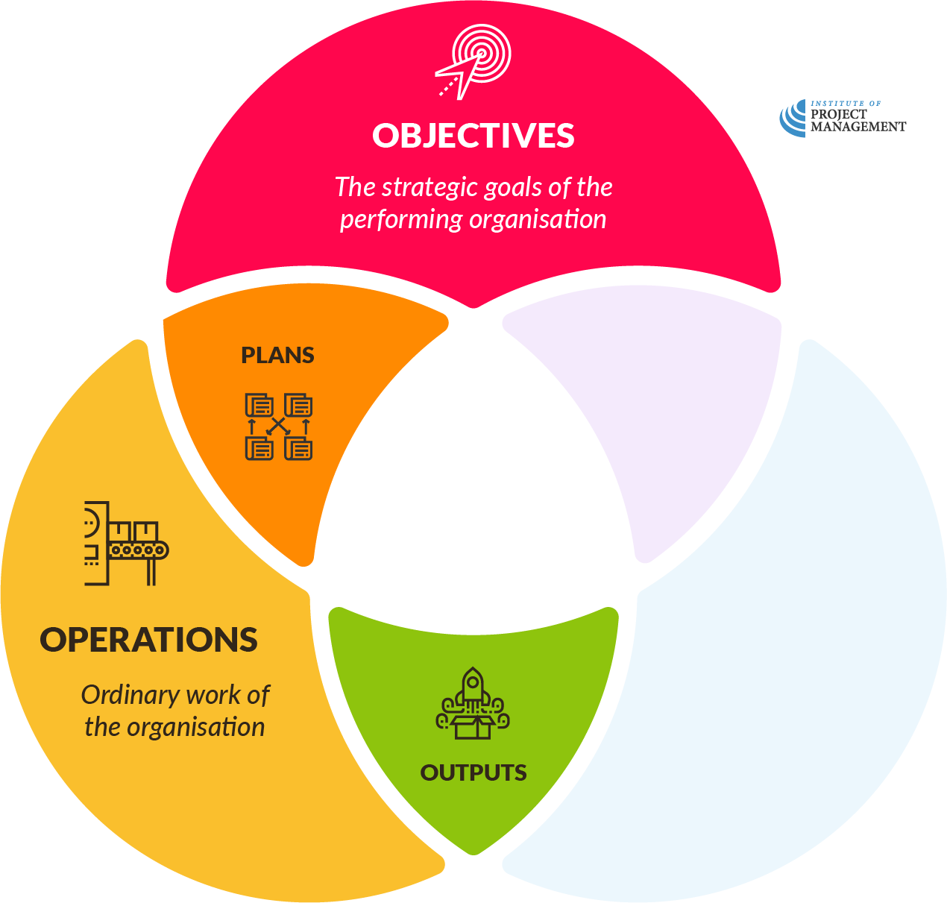
Operations
Notes:
The purpose of business operations is to produce any number of defined outputs.
Outputs can include goods for sale, services for clients or payroll for staff – pretty much anything the organisation delivers on a routine, regular basis.

Slide 10
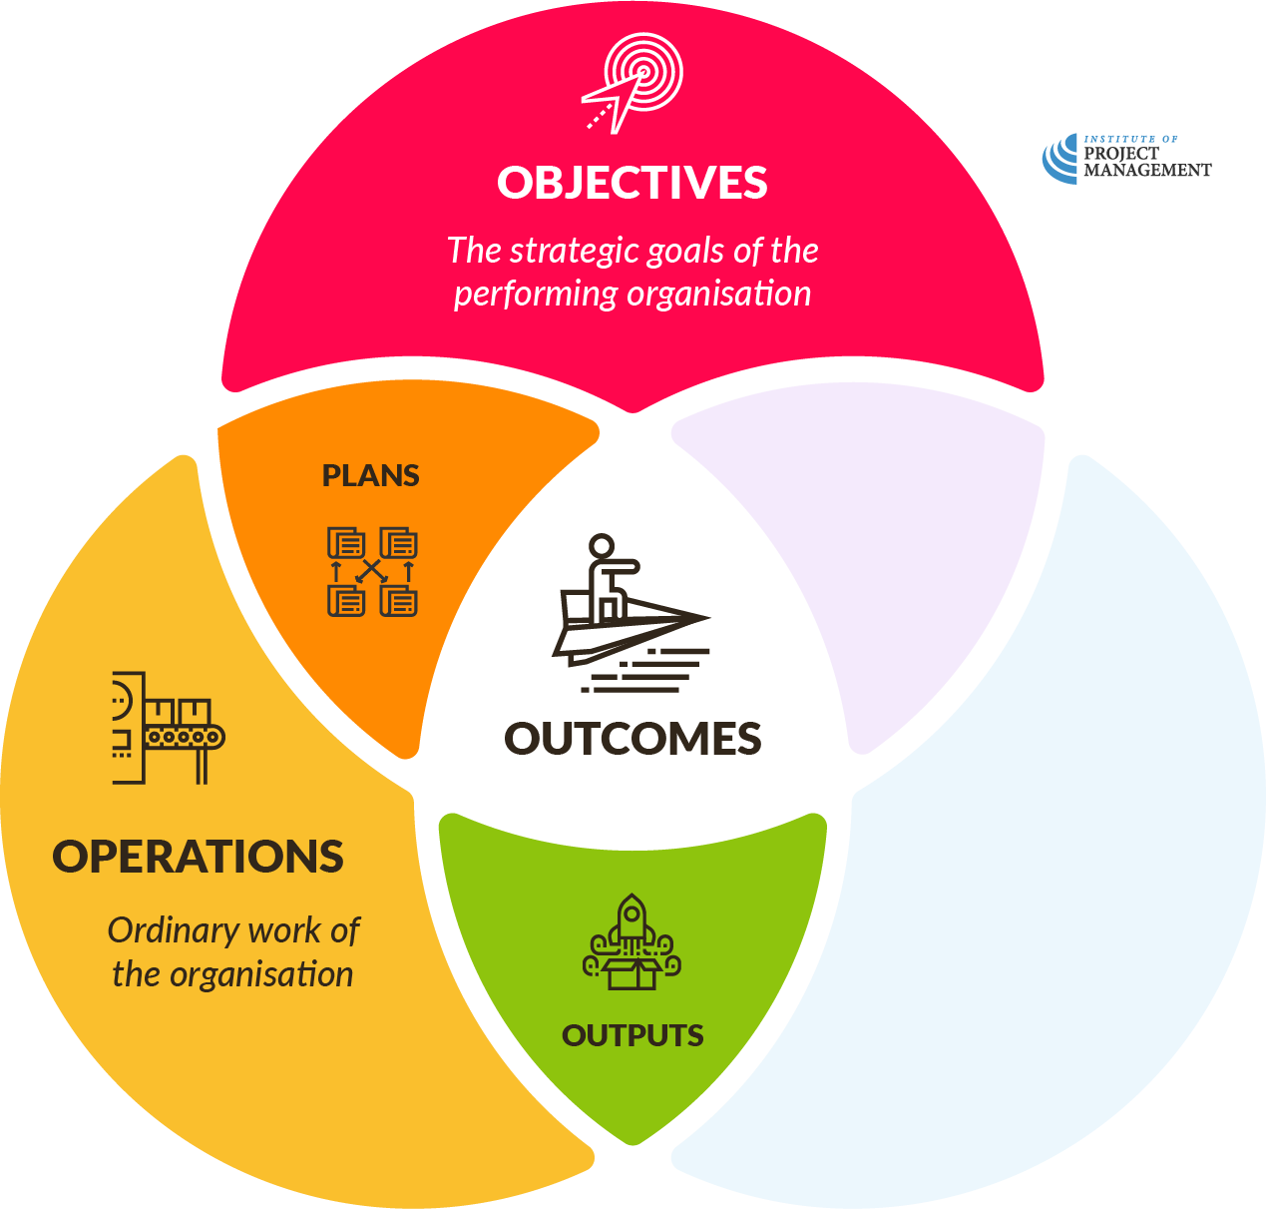
Operations
Notes:
These outputs are then converted into outcomes; either through market-based transactions (where the outcome would be revenue), or other less tangible qualities, such as new knowledge and skills.
Outcomes will then inform the objectives of the organisation, or pass lessons learned back to operations, and so the loop is closed.

Slide 11
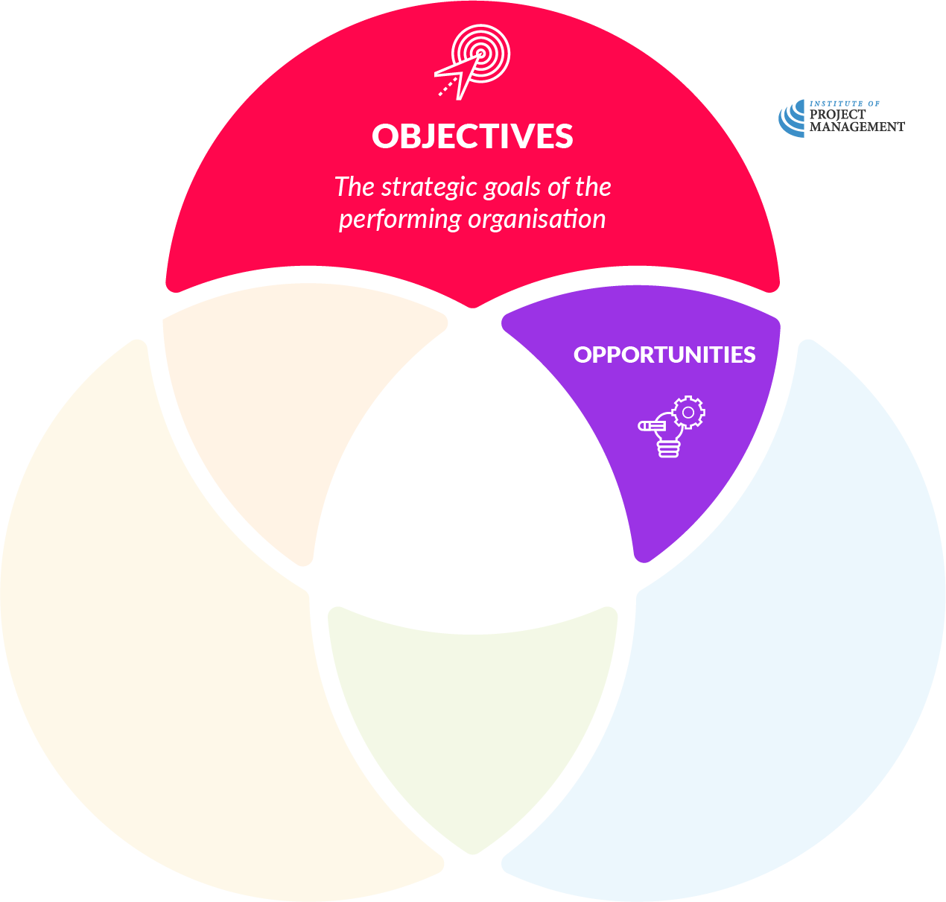
Projects
Notes:
Our organisational objectives also give rise to new ideas, which we convert (through a process we will discuss later in this Module) into opportunities.
These opportunities sit outside our operational business activity, and present new challenges for the organisation.

Slide 12
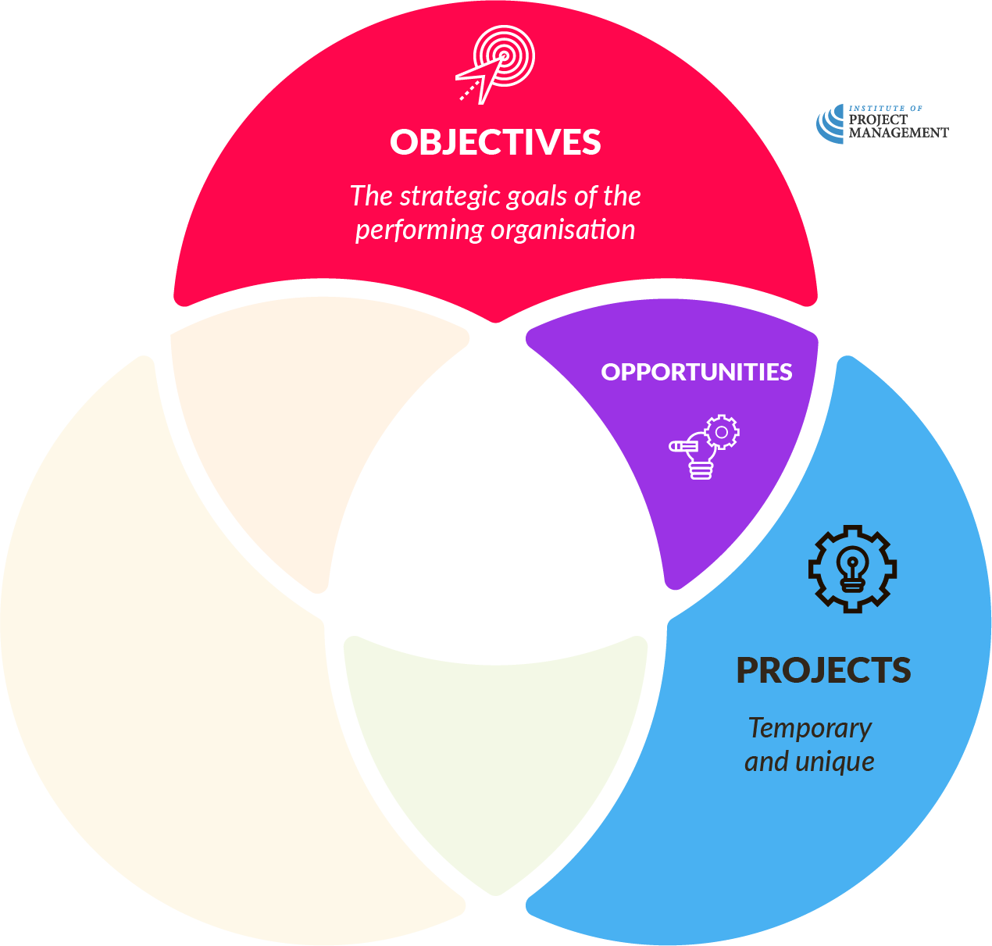
Projects
Notes:
Projects are the temporary, unique activities we undertake to realise these opportunities.

Slide 13
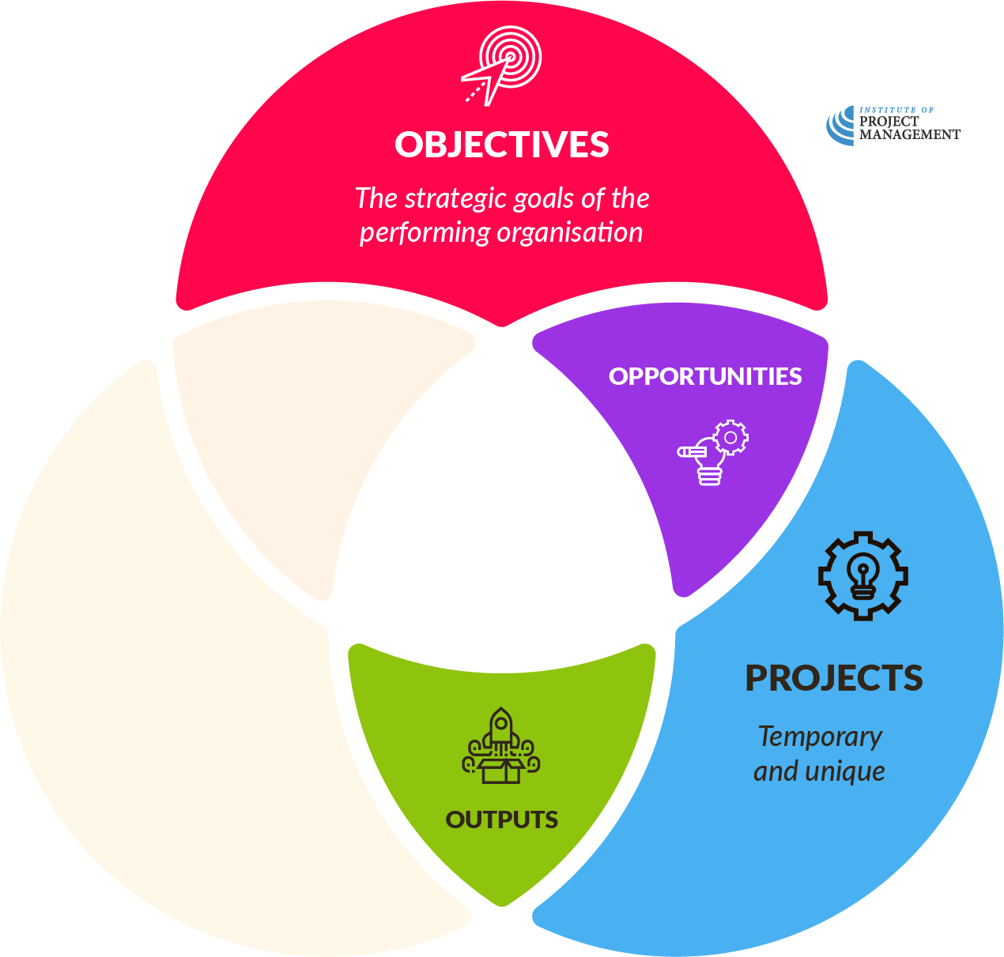
Projects
Notes:
As discussed in our definition, they also deliver outputs (products, services and results).

Slide 14
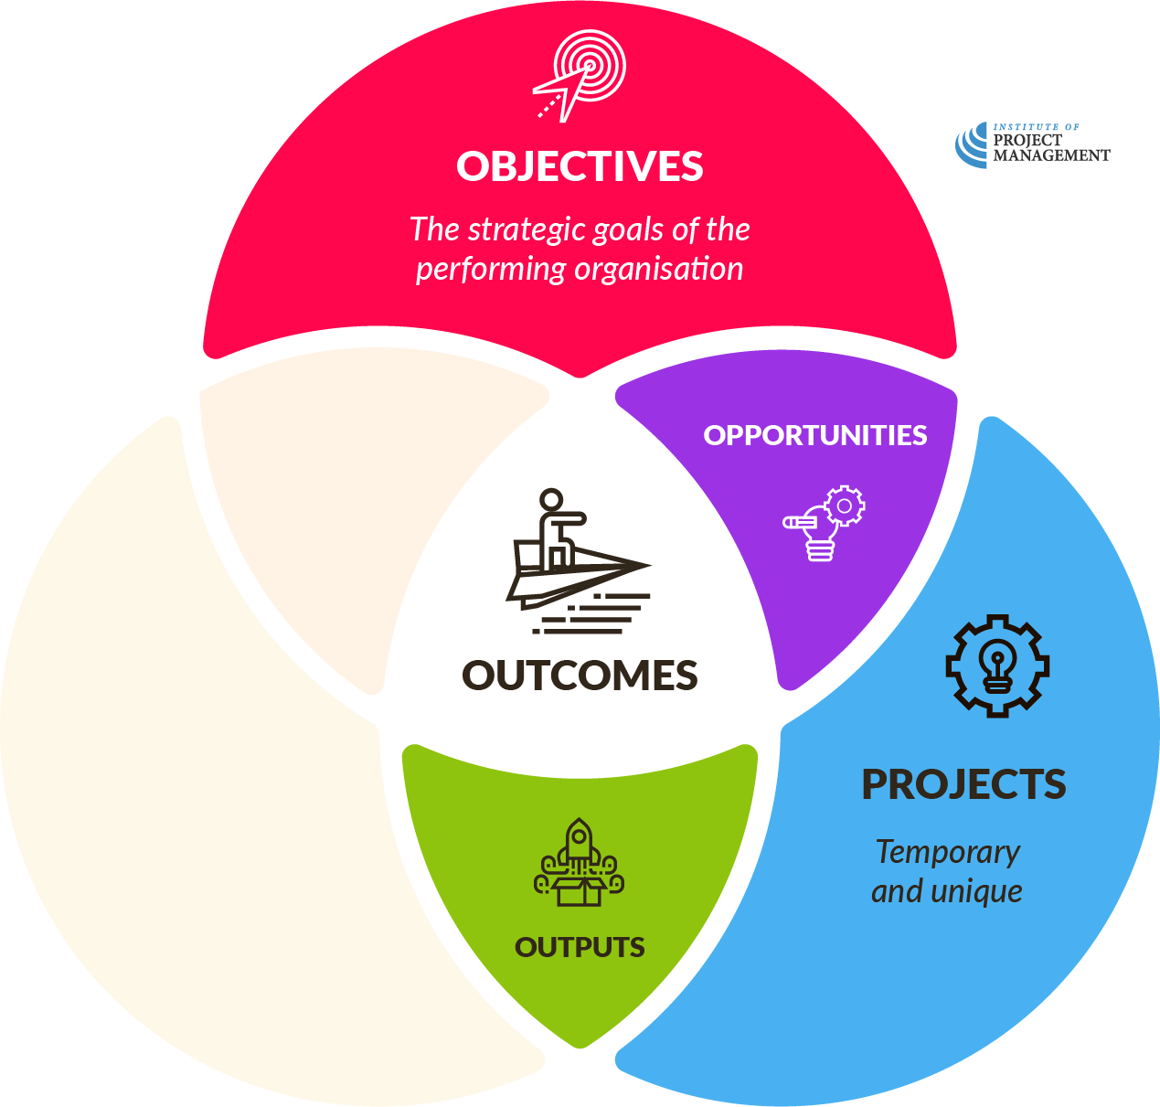
Projects
Notes:
These outputs can either be released directly to the world to realise new outcomes for the organisation, or returned to operations to improve how we go about our business.

Slide 15
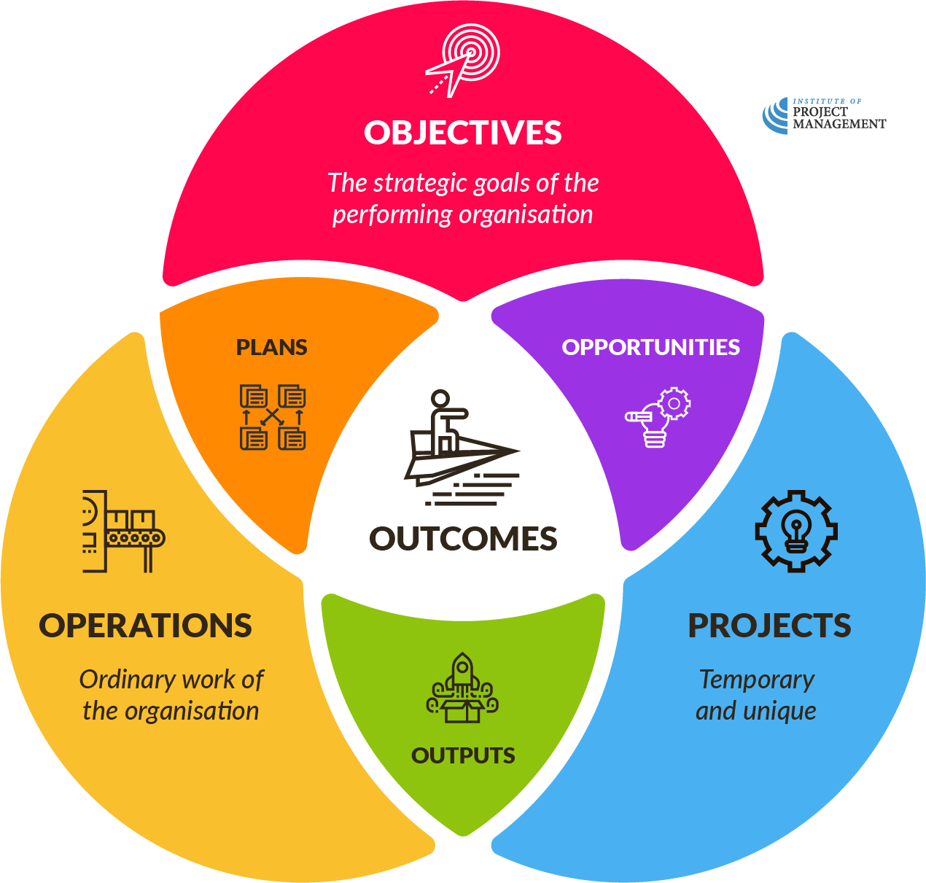
OPEN 1.2
Operations
Projects

Slide 16
Discussion
This course is a project!
What are the outputs of this course?
What do you think are its intended outcomes?
How does it align to your personal / professional objectives?
How might it align to an employer’s objectives?
Notes:
A discussion is a facilitator led conversation that anyone from the session can respond to – don’t break them into groups.
Where there are multiple questions, use the animation to reveal, ask and address each question one at a time.
Spend no more than 5-10 minutes on a discussion.
Be sure to respond positively and enthusiastically to each student contribution!
Output – Certification / Qualification
Outcome – Knowledge; skills; new / stronger networks (classmates) etc
Personal / professional objectives – promotion; new job; skills to do home renovation etc
Employer objectives – productivity; reduced errors, waste, variances etc

Slide 17
Projects
OPEN 1.3
Operations
Temporary / unique
Routine / cyclic
Notes:
We have already established that the temporary and unique nature of projects distinguishes them from the cyclic nature of business as usual – or operations – management.

Slide 18
Projects
OPEN 1.3
Operations
Temporary / unique
Routine / cyclic
Uncertain performance
Based on precedent
Notes:
For this reason, projects demand significant planning, beyond the routine planning that goes into an operational effort.
Indeed, two-thirds of this course is devoted to planning, or more properly, all the things you need to do before you pick up that hammer.
Admittedly, very few project plans are ever perfectly executed. However, it is generally agreed that the better the plan, the better the project.
We will talk in this course about just how much is enough.

Slide 19
Projects
OPEN 1.3
Operations
Temporary / unique
Routine / cyclic
Uncertain performance
Based on precedent
Significant planning
Routine planning
Notes:
It is this very uniqueness that makes projects much more uncertain in their performance.
Business as usual, by contrast, is grounded in precedent, in that what we do today is pretty much what we did yesterday and the day before that.
Even projects with a cash flow, such as those delivered under contract, demand strict management of their finances and reserves.

Slide 20
Projects
OPEN 1.3
Operations
Temporary / unique
Routine / cyclic
Uncertain performance
Based on precedent
Significant planning
Routine planning
Up-front finance
Self-financing
Notes:
Another big difference between projects and business as usual is the way they are financed.
For an organisation, operations are generally self-sufficient, in that they pay for themselves with the revenue they generate.
Projects, on the other hand, often do not produce a cent of income until they are finished – everything is an expense until that point.

Slide 21
Projects
OPEN 1.3
Operations
Temporary / unique
Routine / cyclic
Uncertain performance
Based on precedent
Significant planning
Routine planning
Up-front finance
Self-financing
New & complex relationships
Established relationships
Notes:
Project teams and stakeholders are also often brought together for the first time in the delivery of a project.
Their working and reporting relationships can be unfamiliar, as the simple, well-understood hierarchies of day-to-day work are suddenly disrupted and made complex.

Slide 22
Projects
OPEN 1.3
Operations
DISRUPTIVE CHANGE
ORGANIC CHANGE
Temporary / unique
Routine / cyclic
Uncertain performance
Based on precedent
Significant planning
Routine planning
Up-front finance
Self-financing
New & complex relationships
Established relationships
Notes:
In fact, 'disrupt' is exactly what projects do.
In creating new future states, they disrupt the orthodoxy - an orthodoxy that is used to (and probably prefers) realising change through the gentler, organic process of continual improvement.

Slide 23
Project lifecycle
Notes:
If projects have a beginning and end, then what goes on between is known as the project’s life.
One way to understand the life of a project is as a series of four key, loosely consecutive phases.
Project initiation is the process of converting our idea into a project.
It involves researching and workshopping the idea among stakeholders, establishing whether it is something we can and should do, and testing the best way of realising it.
As part of the project initiation process we will develop a robust business case for the project, and formally commit to the idea via a project charter.

Slide 24
Project lifecycle
Notes:
Once we commit to the idea as a project, we can then start planning the most efficient and effective path to delivery.
This will involve taking an inventory of all the resources available to us, and determining their optimal use.
We express this through a scheduled and costed breakdown of all the tasks needed to complete the project, with corresponding budget lines.
We also take the opportunity to ‘look around corners’ and anticipate what could go wrong and how we might respond.
This might give rise to ancillary risk, and stakeholder, procurement and communication management plans.

Slide 25
Project lifecycle
Notes:
Unfortunately, as the late General Helmuth von Moltke pointed out: No plan survives contact with the enemy.
In projects (as in life) once we start delivering (or executing) our plans, we must be prepared to report on and react to the constantly evolving internal and external environments.
This is where the critical skills of project leadership are brought to bear.
Although they really inform and govern the entire lifecycle, your ability to respond to and influence change will often be the difference between project success and failure.
And that is why, as part of the delivery process, we regularly revisit, fine-tune and update our project plan.

Slide 26
Project lifecycle
Notes:
Finally, once we deliver our project’s output – the product, service or result that was once a humble idea – there are a number of closing activities we should undertake to ensure that:
the project outputs are successfully assimilated into their new life (and outcomes realised), and
we learn from our performance, so that the next project we deliver is that much better again.

Slide 27
Project lifecycle
OPEN 1.5
Notes:
Ultimately, project management is the process of monitoring and controlling each of these stages.
The project lifecycle is the roadmap we will use for this course.
Each phase – initiation, planning, delivery and close – will be broken down by context into its dependent set of actions.
It is nonetheless important to appreciate that learnings introduced in the first Module may be equally relevant and applicable to the downstream processes of planning and delivery.

Slide 28
Activity 1.1
Reflect on how your organisation delivers projects…
What works well?
What could they do better?
Notes:
In Activity 1.1, you should recognize each issue each group raises and show where in the course we are most likely to address it.
Activities are always group work done via table discussion or Zoom breakout rooms
Each group should have of no less than 3 and no more than 5 participants – rebalance groups if participants have to leave (even if just for one activity) and numbers drop below 3.
Remind students to update their assessment pdfs during the discussion – they can continue to do so during your wrap-up as well.
Each activity should take 5-10 minutes in the group and 5-10 minutes of you bringing them together and connecting the discussion to the current question and what follows.
Pause the Zoom recording when students are in breakout and resume it when all are back.
Typically, you invite one respondent to speak on behalf of each group.
Once each group has had the chance to respond, invite any additional comments from the floor.
If you have a large number of groups, you may need to limit responses to a single point or a sub-section of groups.
Please make sure every student gets asked (or gets the chance) to contribute during each session.

Slide 29
Notes:
Before breaking, ask students if there are any questions about what has been covered in the session so far.
Once answered, encourage students to stand up, get a drink, go outside and stretch.
If they are on Zoom, tell them to turn their camera and microphone off (you do the same)!
Make sure you tell them the precise time you will be restarting (eg 10:10am)
Don’t check your email – take a proper break!!

Slide 30
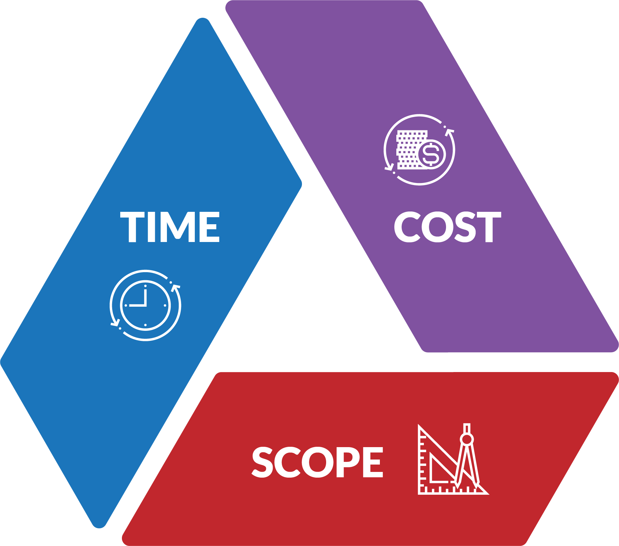
The triple constraints
?
Notes:
Because projects are defined by their start and finish, they have a finite and necessarily limited time for completion.
Similarly, they have a set amount of money or resources (cost) to do the work with.
When we talk about a project’s scope, we are referring to all the things that need to be done to successfully deliver our project.
This will include all our technical or functional requirements, such as putting up the four walls and roof of a house, as well as the project management requirements, such as planning, managing delivery and closing the project.
Each is a constraint in its own right, but what do they come together to also constrain?

Slide 31
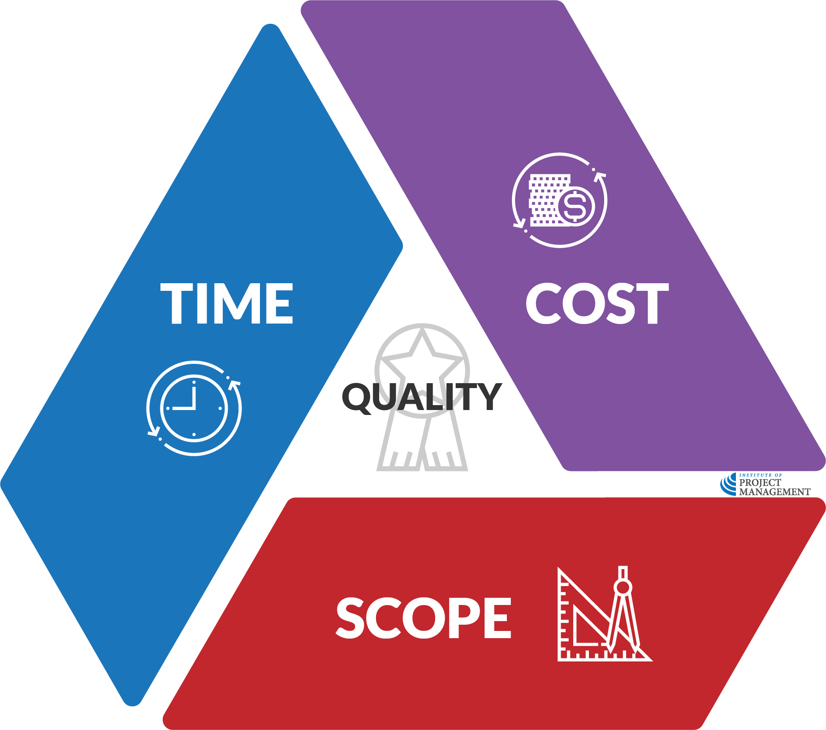
The triple constraints
Notes:
At the centre of this triangle is quality. It’s at the centre because changes to time, cost and scope all impact upon (or constrain) quality.
As project managers, we often use this triangle to illustrate why agreement on these factors is necessary, and how seemingly minor changes to scope, time or cost can have significant repercussions.
Let’s see how…

Slide 32
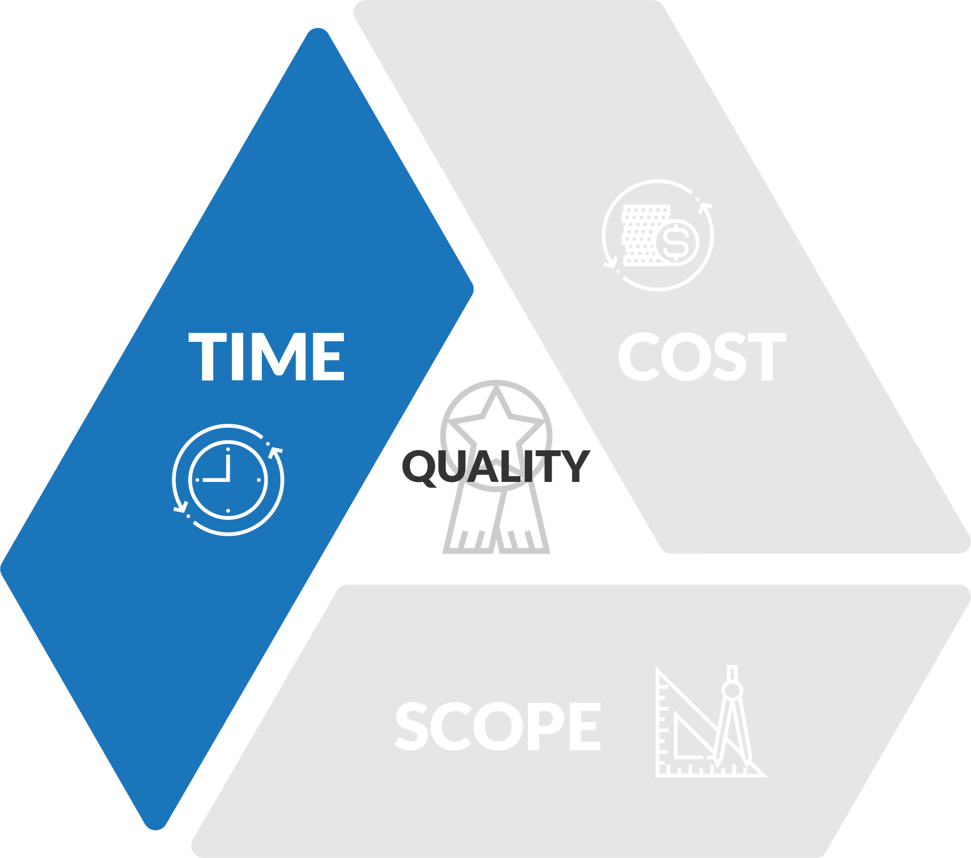
The triple constraints
Notes:
Ideally, we would like to complete our projects as quickly as possible.
It is no secret, however, that the more we rush tasks, the more likely it is that we will fail to set out what it is we intended to achieve.
Therefore, if we reduce the time available to a project, we potentially reduce its quality.
Conversely, the more time we make available, the more likely it is we can anticipate, identify and address the various issues that arise during the performance of our project.
For example: If we leave our holiday shopping until the last minute (reducing time without changing cost or scope), the quality of our purchases may suffer.

Slide 33
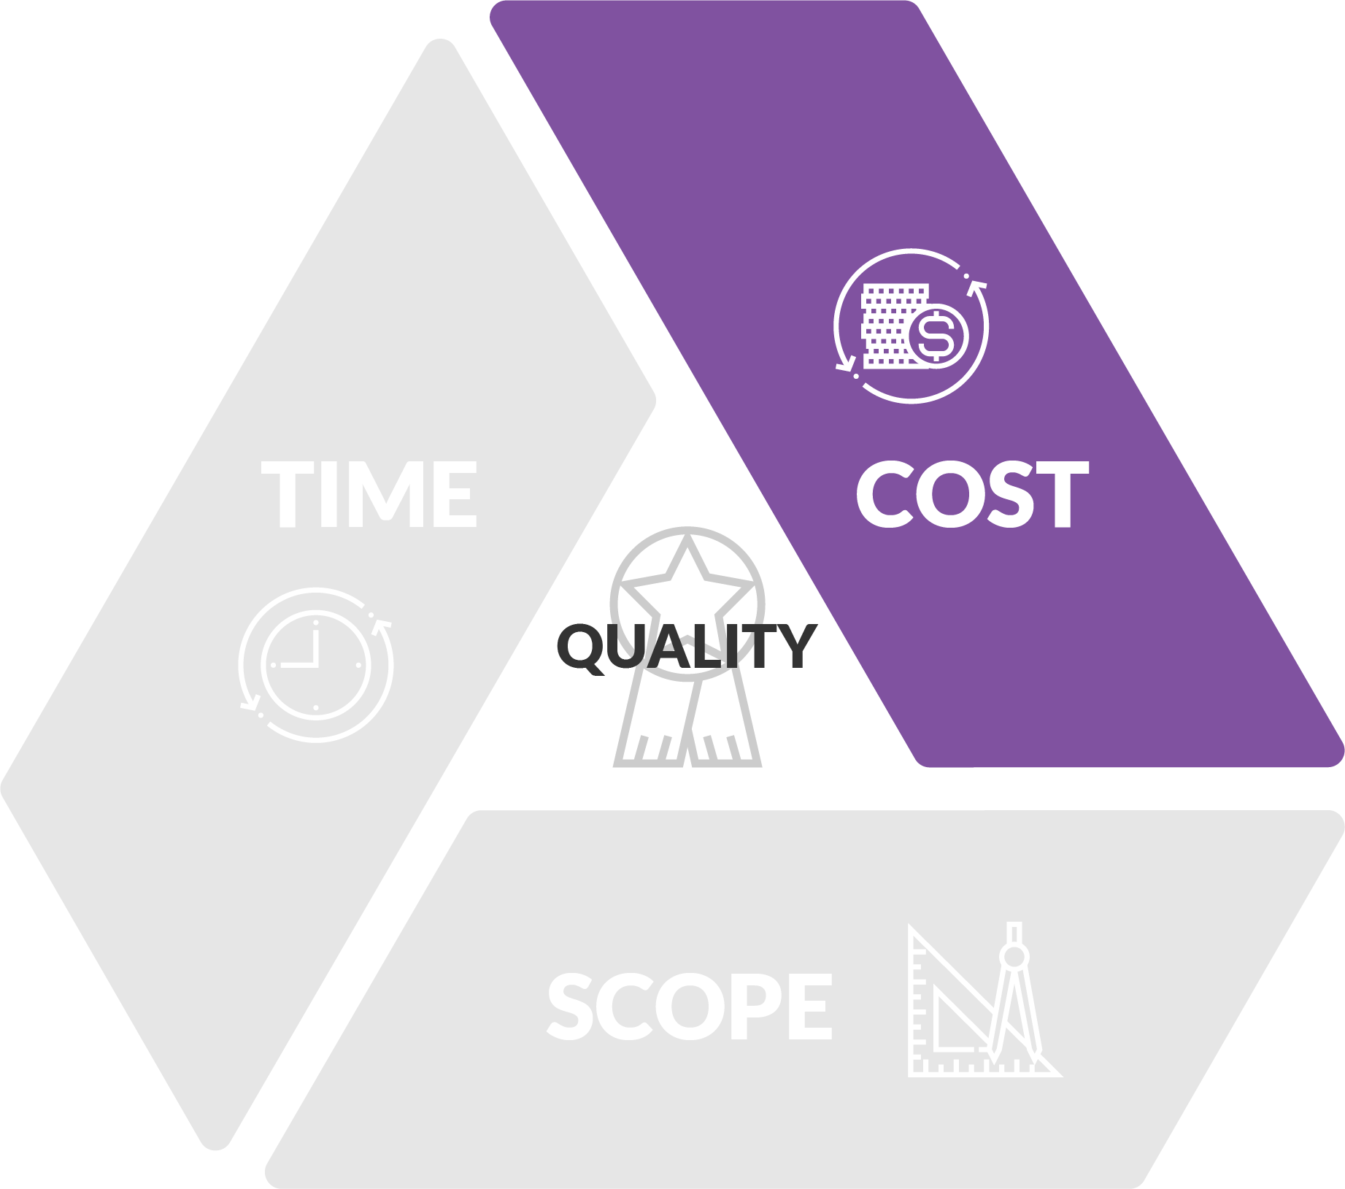
The triple constraints
COST = RESOURCES
Notes:
Similarly, the more money we have at our disposal, the more likely it is that we can meet our objectives.
Keep in mind when we say cost, we really mean resources, such as labour, materials, equipment and infrastructure.
Cost is just a shorthand way of referring to all of these things, as all these resources are ultimately recorded in dollars spent.
So, assuming that the project’s scope and available time are held constant (that is, they remain unchanged), increasing a project’s budget will theoretically give us more resources to complete the job, improving the quality of outcomes.
By the same token, if we are required to do the same work in the same time, but with less money, we may jeopardise the quality of our project and its deliverables.
For example: If we increase our budget for holiday shopping (increase cost without changing time or scope), the quality of purchases is likely to increase as well.

Slide 34
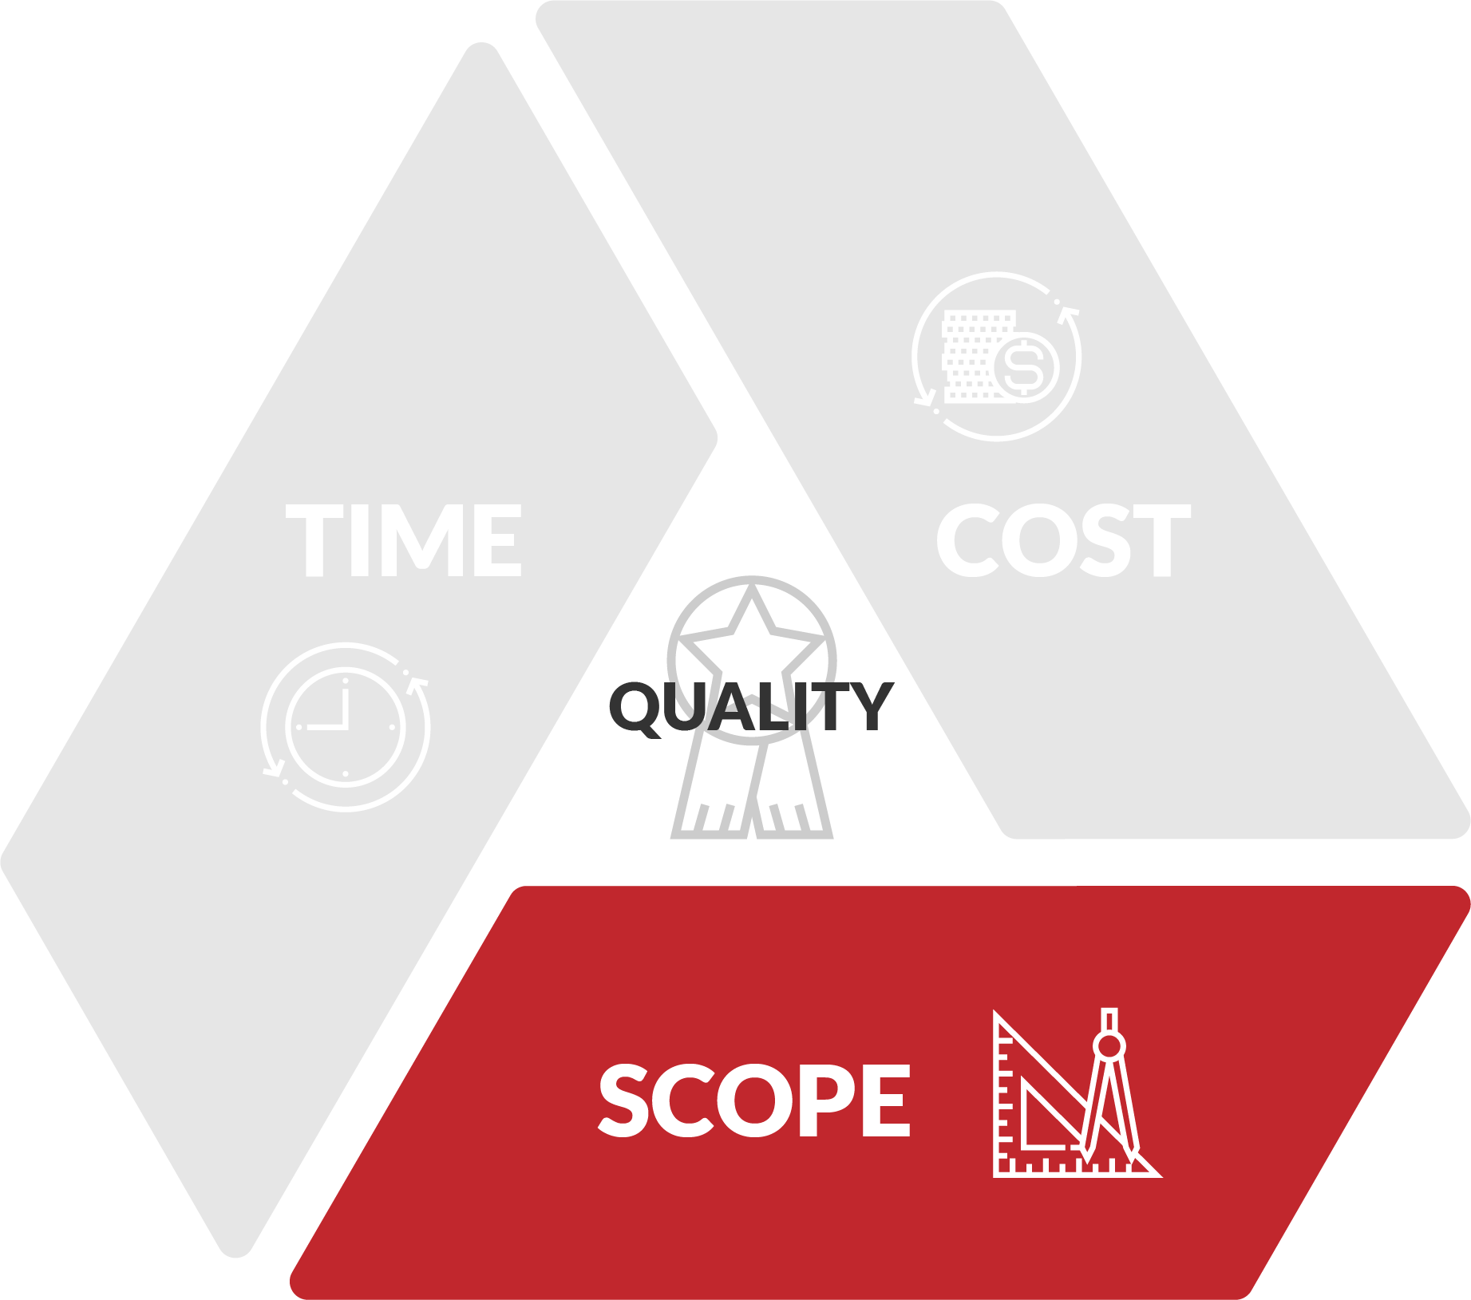
The triple constraints
Notes:
Scope, though, is a different story.
When we talk about a project’s scope, we are referring to all the things that need to be done to successfully deliver our project.
This will include all our technical or functional requirements, such as putting up the four walls and roof of a house, as well as the project management requirements, such as planning, managing delivery and closing the project.
If we increase the scope of a project – for example, we need our house to be bigger – but expect delivery by the same deadline and for the same cost, we make the project more complex, and complexity is potentially the enemy of quality.
After all, the simpler a project is, the easier it is to manage and deliver.
Likewise, if we enlarge the project management processes – for example by imposing a large number of reporting requirements – we have once more added complexity to our project.
Now this might be necessary to ensure quality, but without factoring in a proportionate increase to our schedule and budget, we have actually made the project harder to deliver by theoretically squeezing out other tasks.
Therefore, an inverse relationship is observable: as long as time and cost are held constant, increasing scope is likely to decrease quality.
For example: If we suddenly realise we need to purchase more gifts (increasing scope without changing time or cost), we are likely to reduce the quality of what we are able to achieve.

Slide 35
The triple constraints
Notes:
Finally, you should understand quality as both a process and an outcome.
Quality as an outcome refers to whether or not our deliverable or output meets the client’s requirements.
In other words, does it do what we said it would?
Quality as a process not only includes how we manage time, cost and scope, but other related activities such as risk and stakeholder management.
This quality management process, that some refer to as integration – that is, the way we bring all the process elements together – is essentially what project management and this course are all about.

Slide 36
The triple constraints

Slide 37
The triple constraints
OPEN 1.7
Notes:
The mathematically minded among you may appreciate the triple constraint relationship being expressed in the equation illustrated.

Slide 38
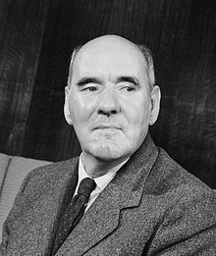
Can you have too much time or money?
Work expands to fill the available time for completion
Cyril Northcote Parkinson (1909-1993)
If you have extra time (or money!) you will use it
Good project managers balance / optimise the triple constraints
Parkinson’s Law
Notes:
Note that we have been using words like “potentially” and “likely” throughout this discussion.
Parkinson's Law suggests just giving more time to a project might only result in people dropping their productivity to fill the slack.
Similarly, if you give one project $5000 to complete the work and an identically scoped project $10,000, chances are they will both find a way to spend all of their budget!
Changes to scope, time and cost will only change the quality of the deliverables by default if there is no management intervention; and this is where the skill of the project manager comes in.
For example, a poorly defined scope – and by that we mean we only have a vague idea of what it is we are setting out to do – is far less likely to deliver a quality outcome than a slightly more complex project that is really well defined, understood and agreed to.
Similarly, an experienced and effective project manager will usually be able to do more with less. In other words, given the same constraints as a less experienced and effective colleague, he or she should be able to deliver a higher quality product, service or result.
See also: the law of diminishing returns / gold plating

Slide 39
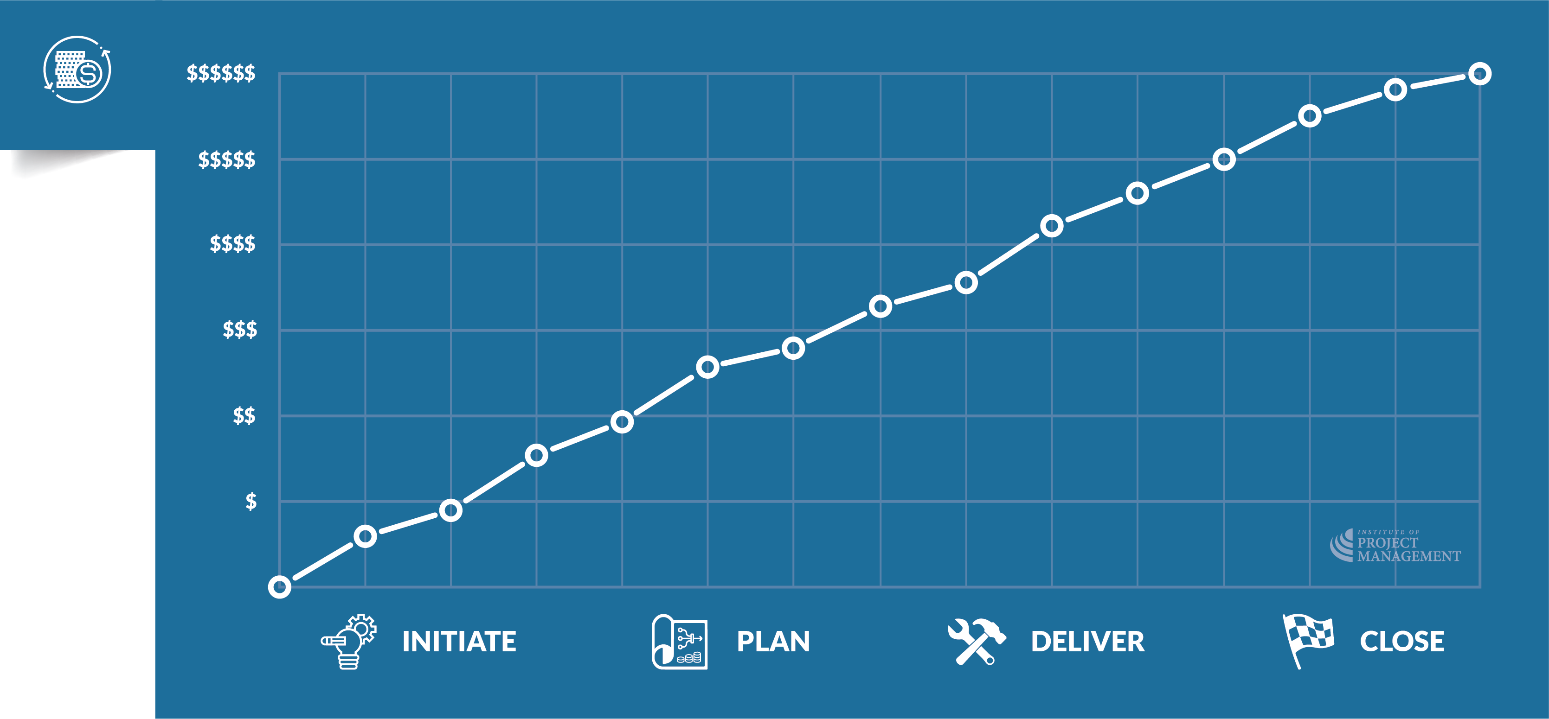
The cost of change
Notes:
The further you get into a project, the more expensive it is to change your mind...
Unfortunately, the cost to change things exponentially increases the further we get into a project.
For example, it is much easier to change the design of a house when it is just a series of drawings on paper than it is to change the design once construction has started.
And the further you get into construction, the more expensive the more expensive 'good ideas' become!

Slide 40
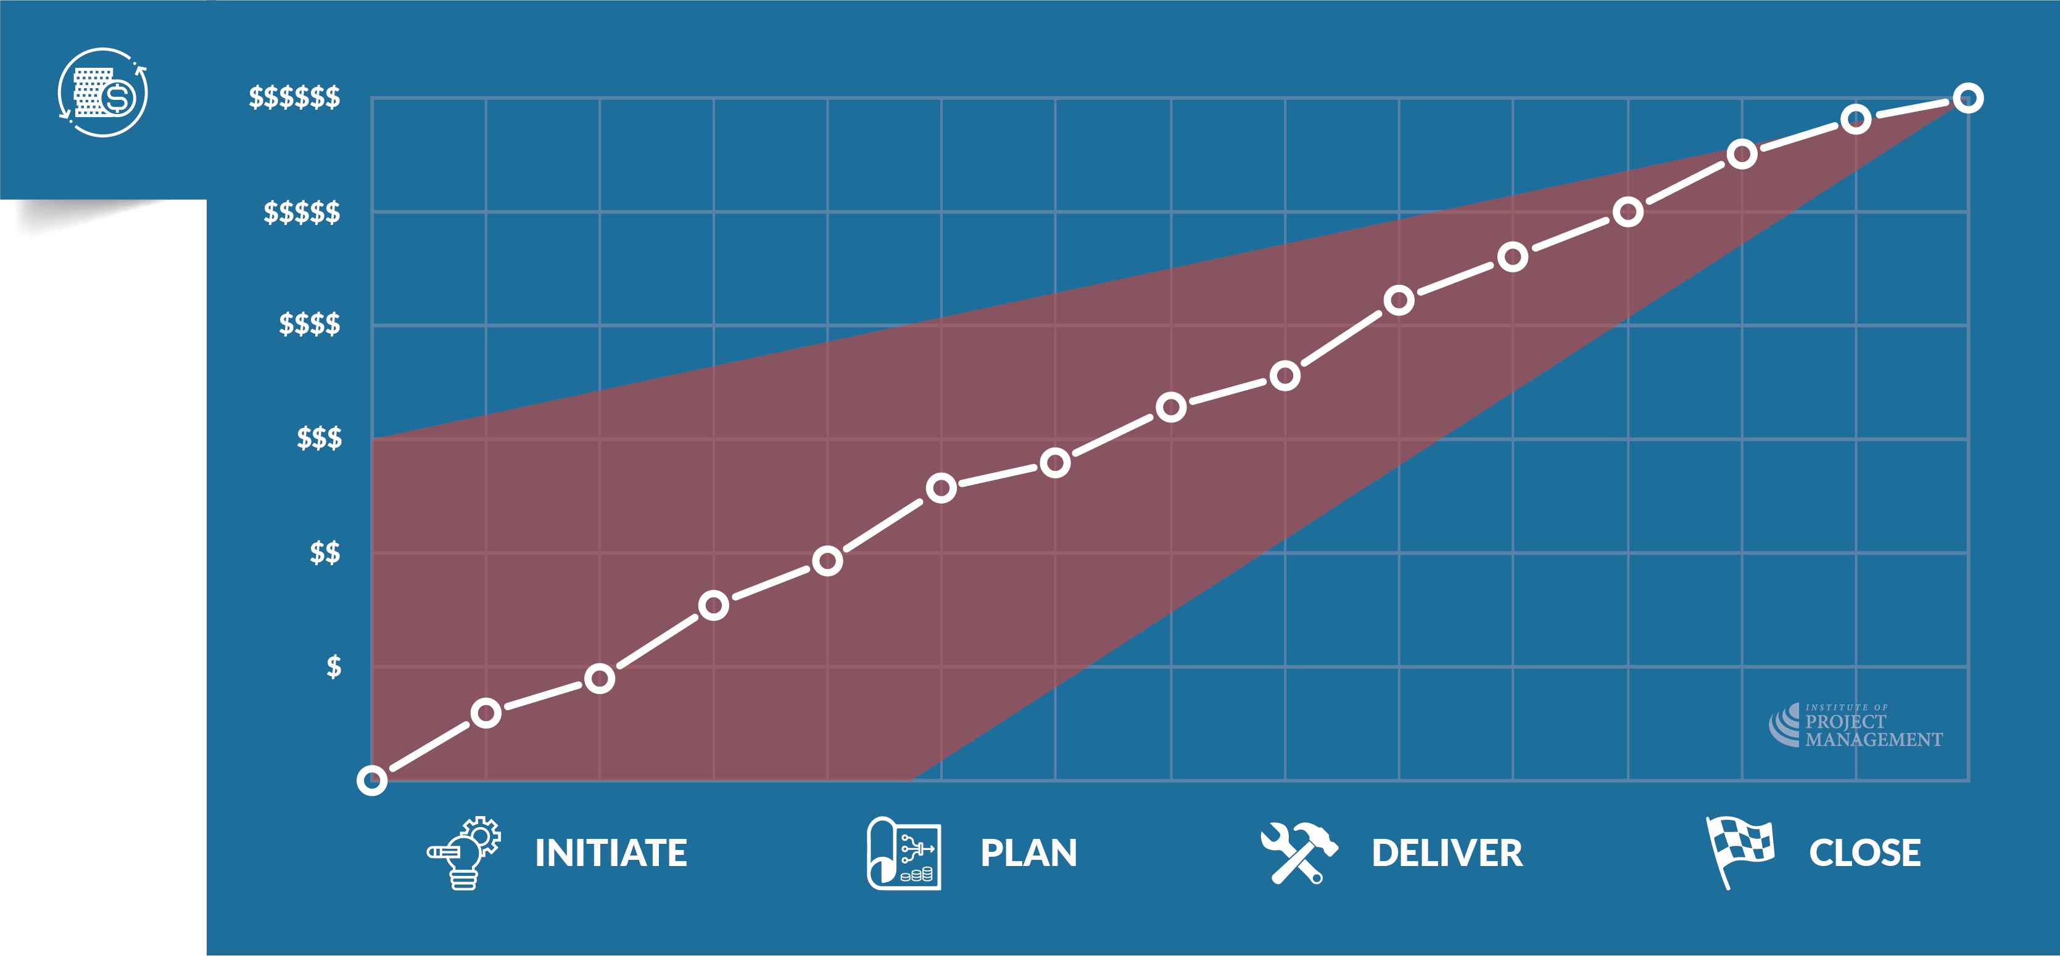
The cost of change
Notes:
We already know that projects inherently have a much greater degree of uncertainty about them than the business-as-usual activities of an organisation.
This is because every project is, in some way, unique. The red shading here illustrates that uncertainty is greatest at the start of the project, and reduces the further we get into project delivery.
This is because the assumptions and estimates that go into our business case (at the project initiation stage) are far more prone to error than those we make in project planning and delivery, where we benefit from more accurate and detailed information.

Slide 41
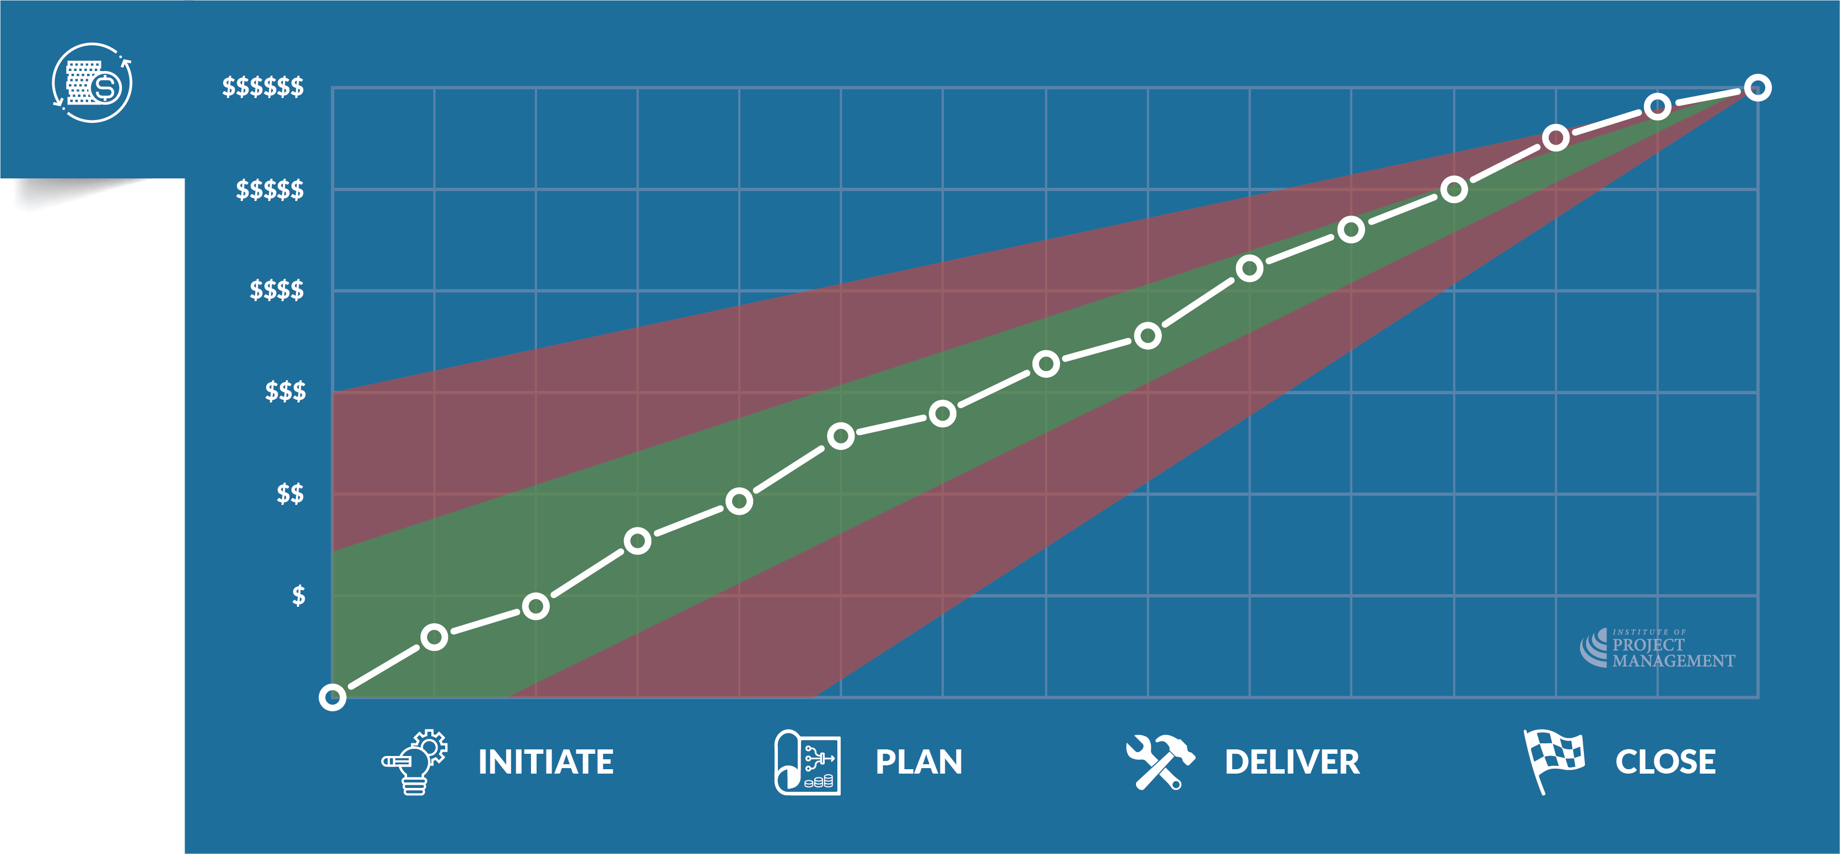
The cost of change
OPEN 1.6
Notes:
Good planning (shown here in green) not only reduces the level of uncertainty that inevitably attaches to a project, but can save significant money downstream by reducing the need for change.

Slide 42
Activity 1.2
OPEN 1.10
In your opinion, why do projects underperform or fail?
Notes:
Great discussion generator – you might like to limit each group to one or two responses and go around the groups a few times until all responses are exhausted.
Once again, show where in the course we will address each issue they raise (eg poor communication – session 4; vague scope – sessions 3 and 5).

Slide 43
Notes:
Annual survey of project practitioners, global, all industries
Survey sample size = 4455
Focus on the % figures on the top left, illustrating the need for good project management (and project managers!)

Slide 44
Activity 1.3
OPEN 1.8
What are the benefits of a project methodology?
Notes:
A methodology is a body of common practices, procedures, tools and techniques.
A project management methodology will therefore be the sum of the knowledge, resources and assets that an individual or organisation might acquire and apply to assure the successful delivery of their projects.
The good news is that over the last 50 years or so, there has been a concerted effort by project managers to professionalise their discipline.
At the core of this has been the development of some universal standards for the management of projects.
These standards can be literally bought off the shelf and applied to your projects today, saving you thousands of hours of time, effort and mistakes to learn from.

Slide 45
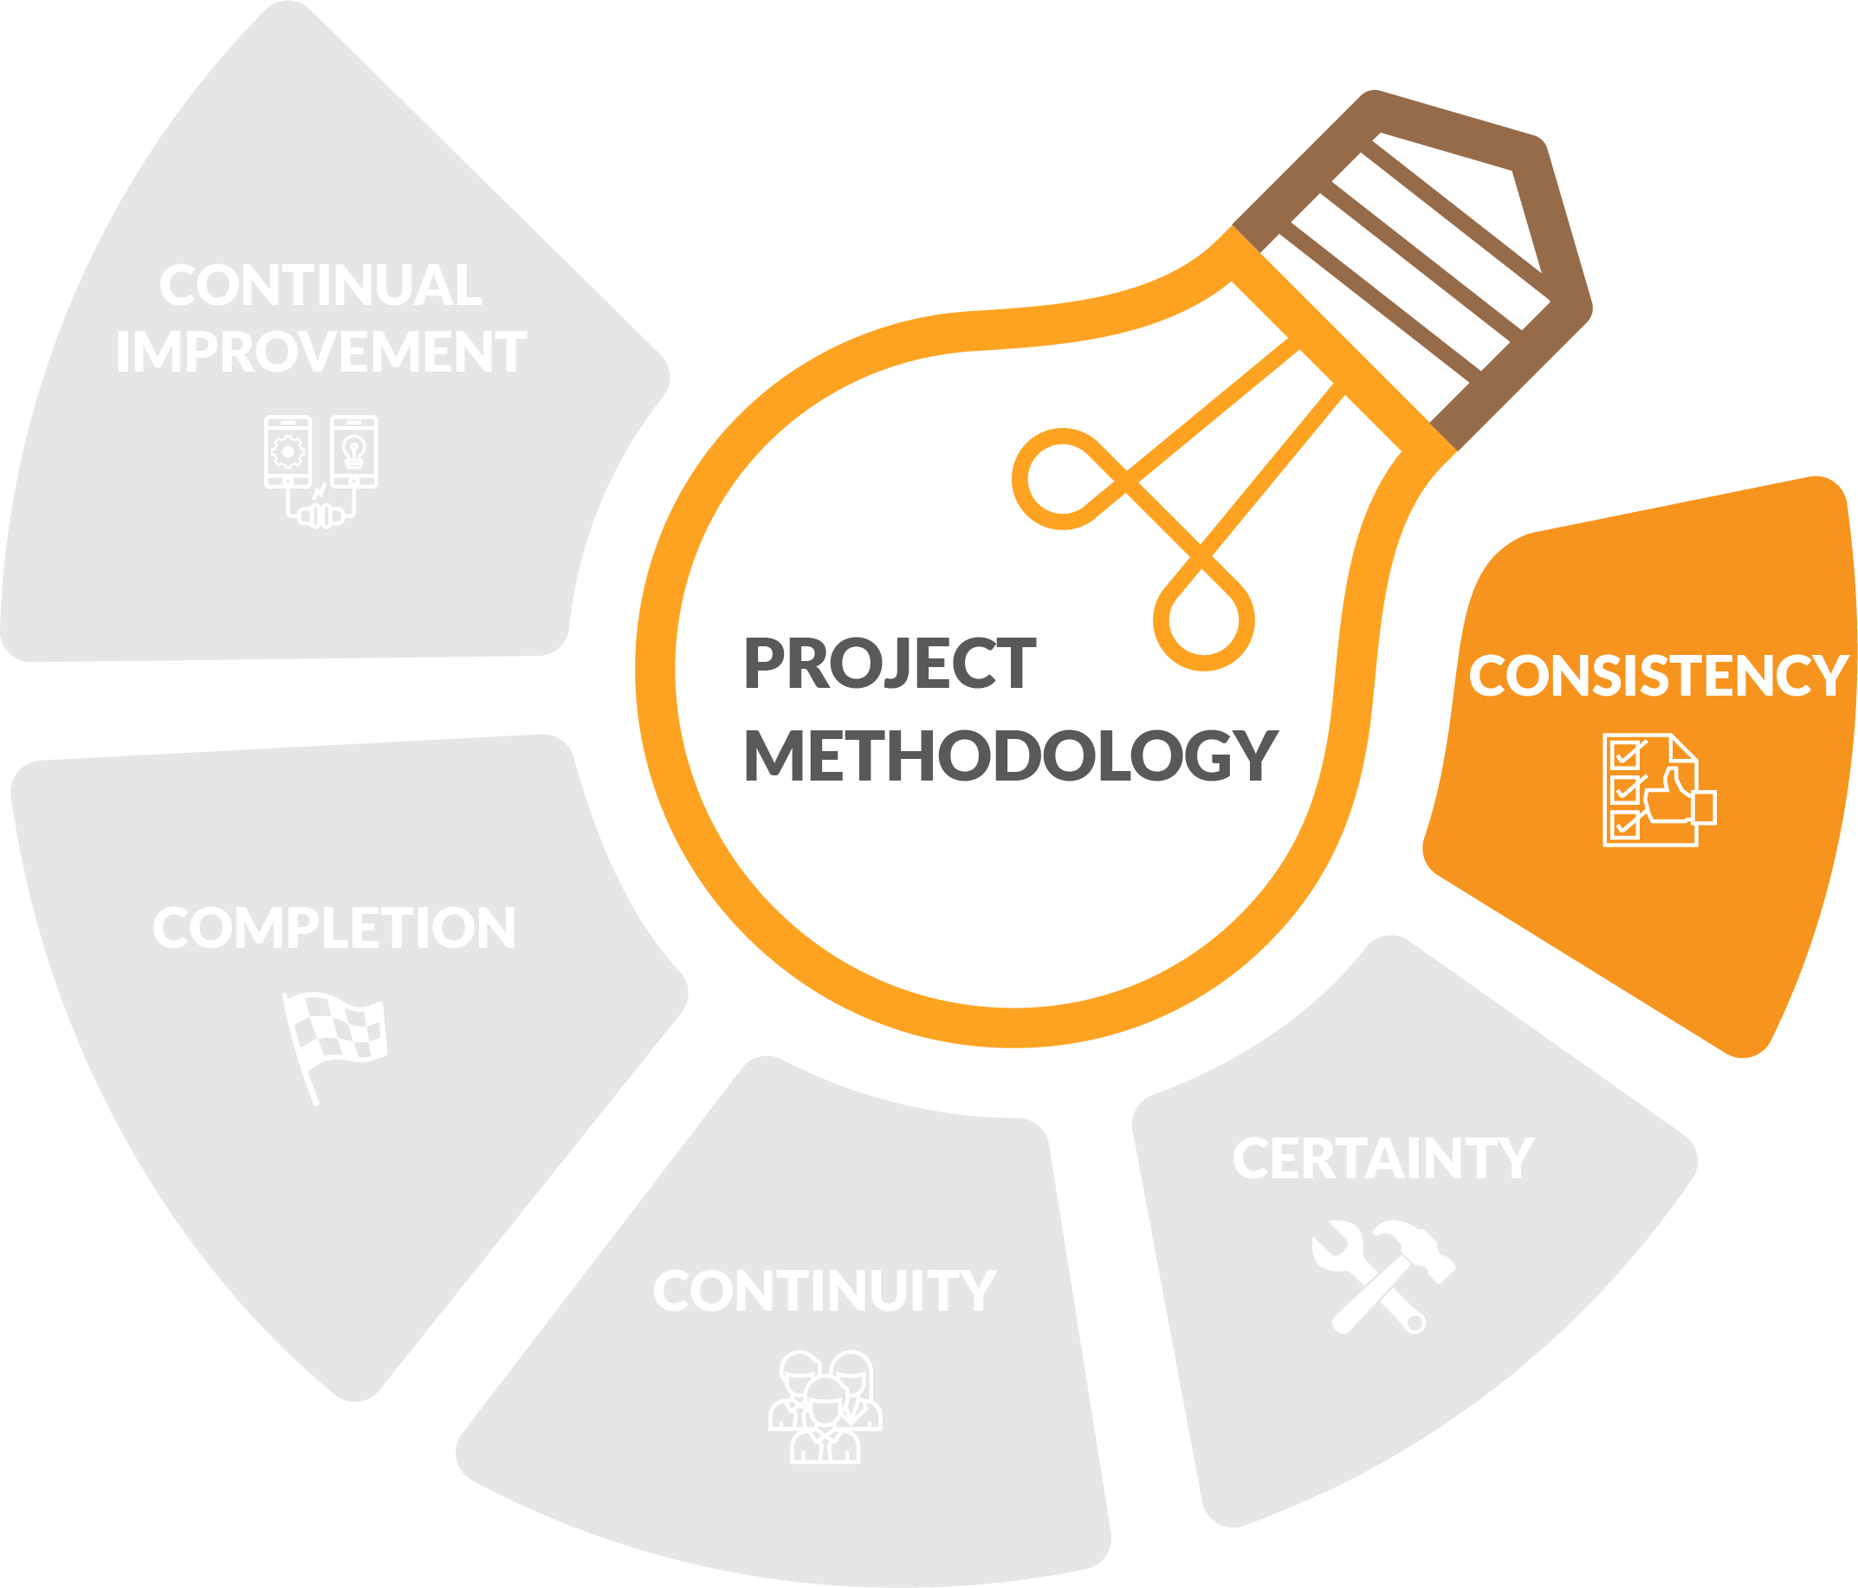
Methodology benefits
Notes:
A methodology is foremost a communication asset, enabling a common language for project management in the workplace.
Within that framework, standardised (templated) project tools enable consistent reporting and accountability across programs and portfolios.
This ensures stakeholders and decision makers do not have to reinvent or reinterpret organisational processes for each new project.

Slide 46
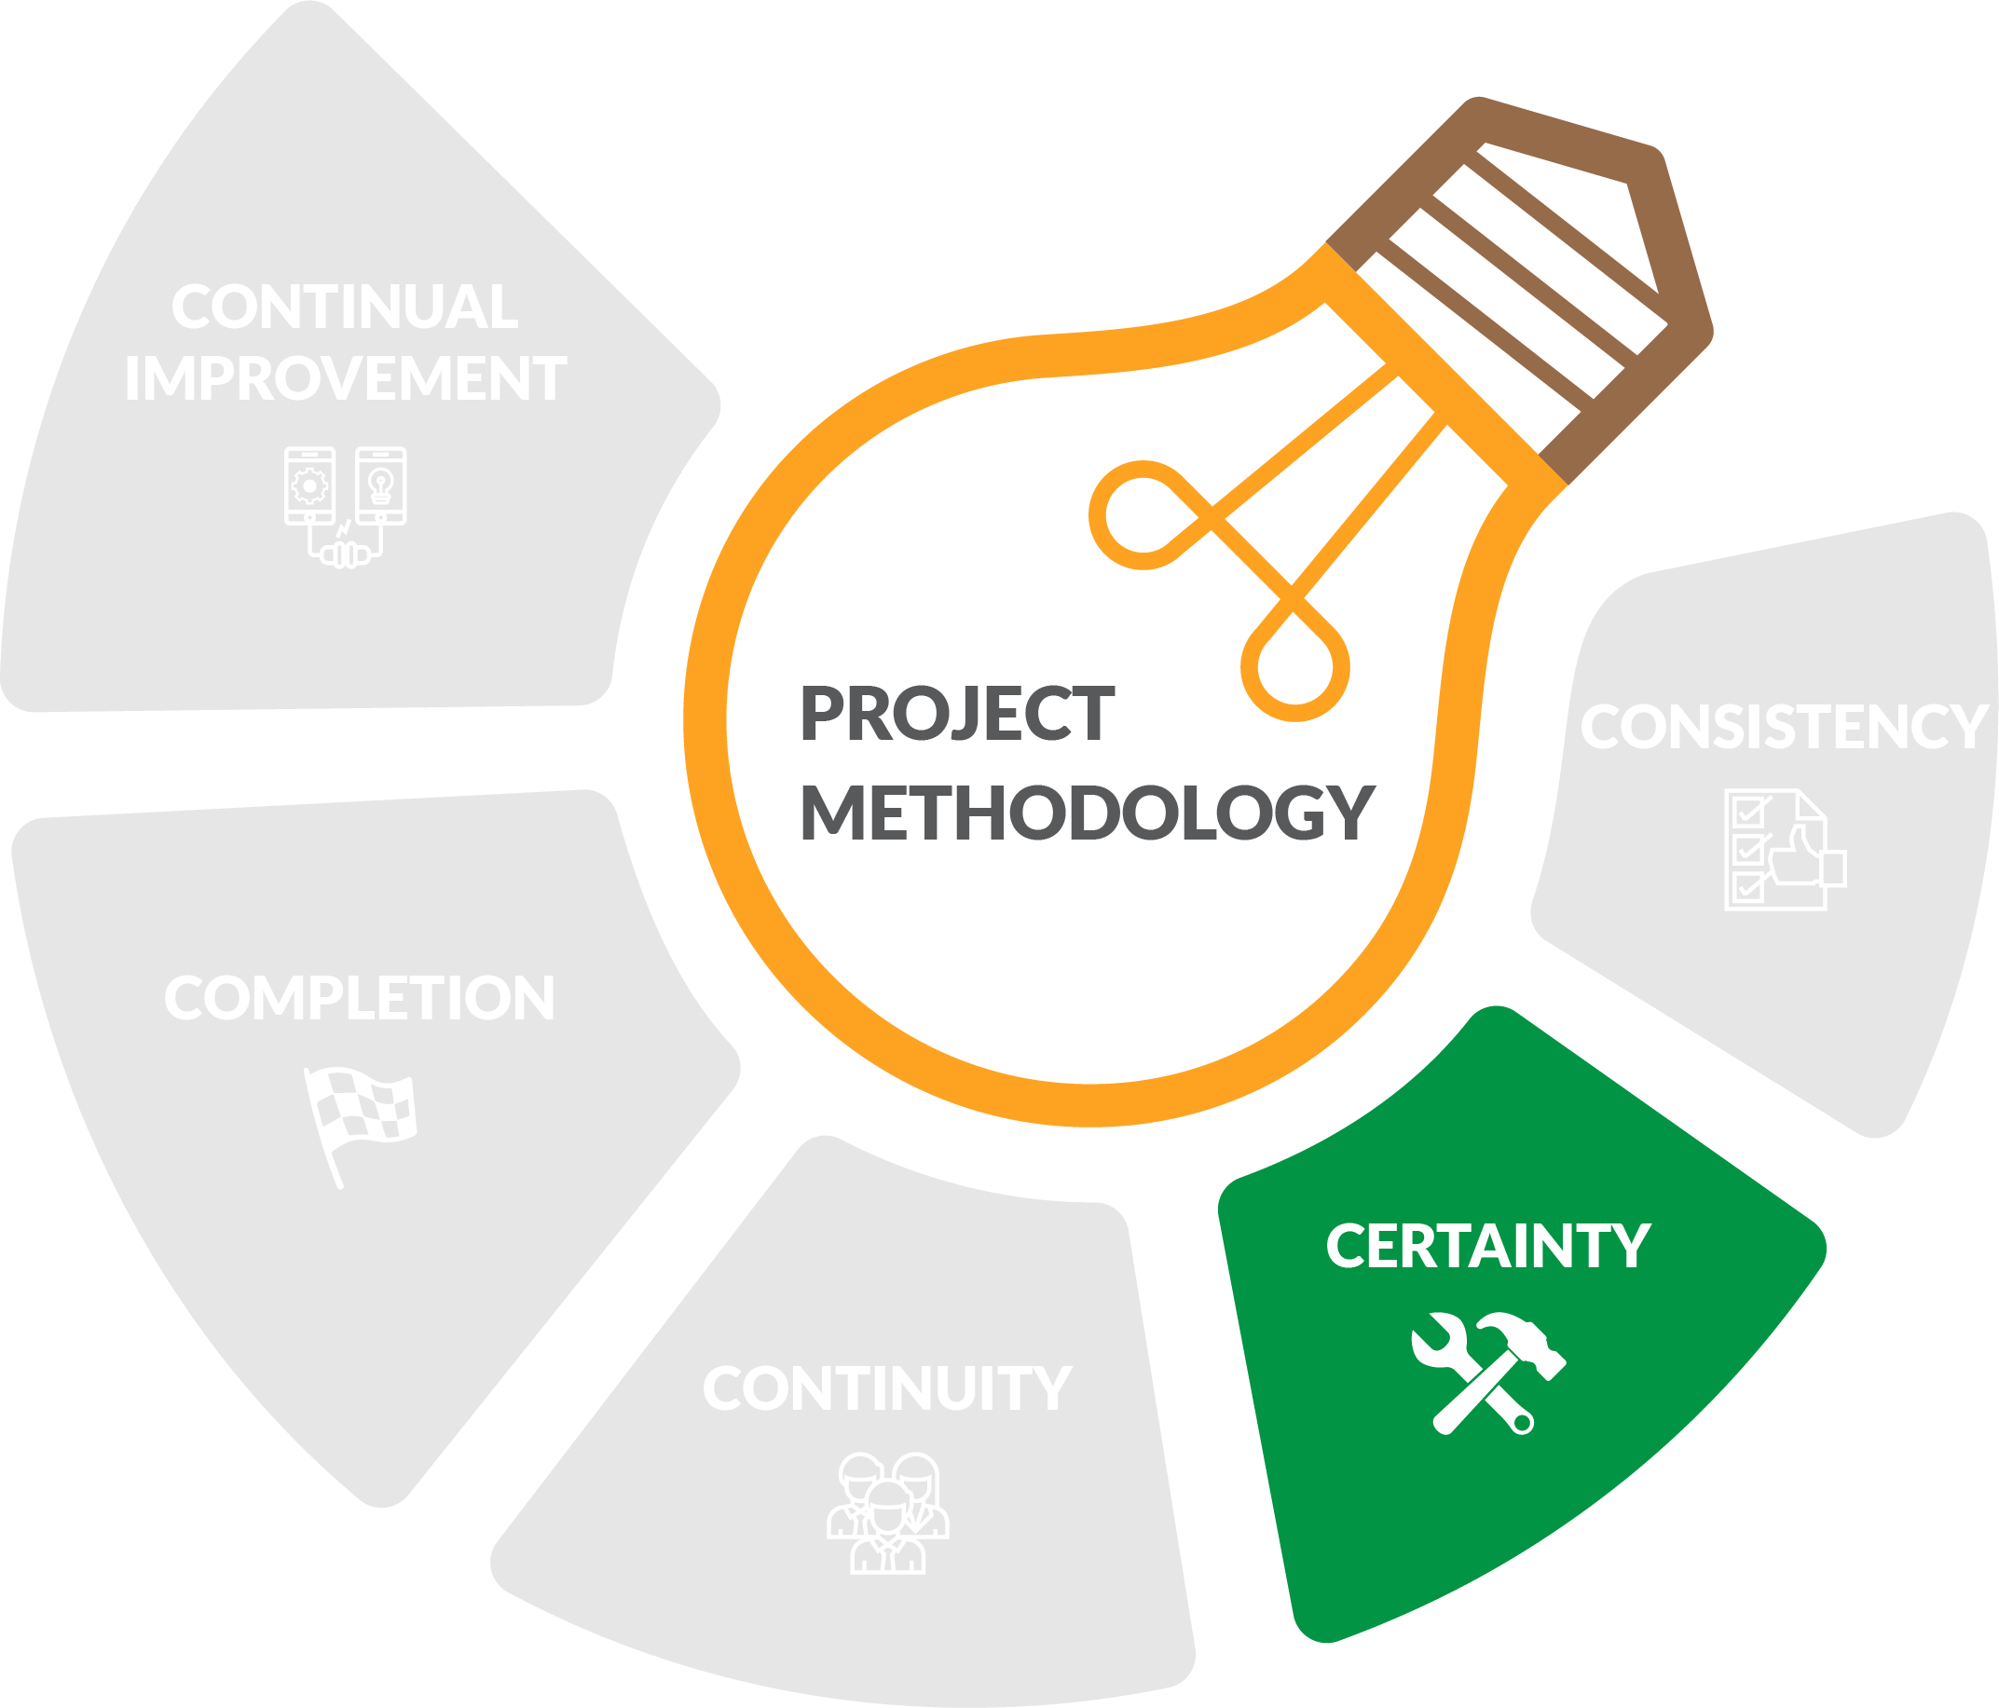
Methodology benefits
Notes:
Adhering to a methodology better guarantees resources are available when needed, and project delivery is on-time and on-budget. Promises made to stakeholders are also easier to keep.
Documenting project decisions within this framework can also protect the project manager if there is a dispute about what has been agreed.
With established processes in place, problems are solved faster, there is greater compliance with organisational and regulatory standards, and less re-work is required.

Slide 47
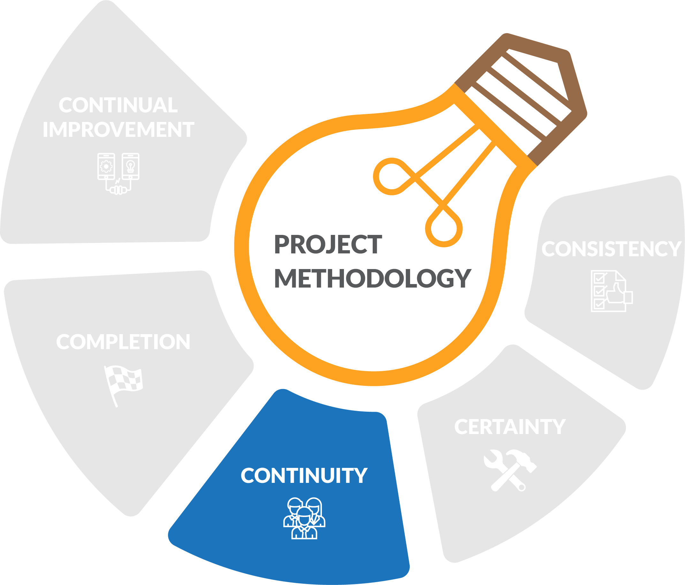
Methodology benefits
Notes:
Project documents and the methodology that embraces them are a convenient and effective way of keeping project stakeholders up-to-date, acting as the 'single source of truth' for the project.
A well-documented and maintained methodology also facilitates a smooth transition when project personnel, requirements or even the operating environment change.

Slide 48
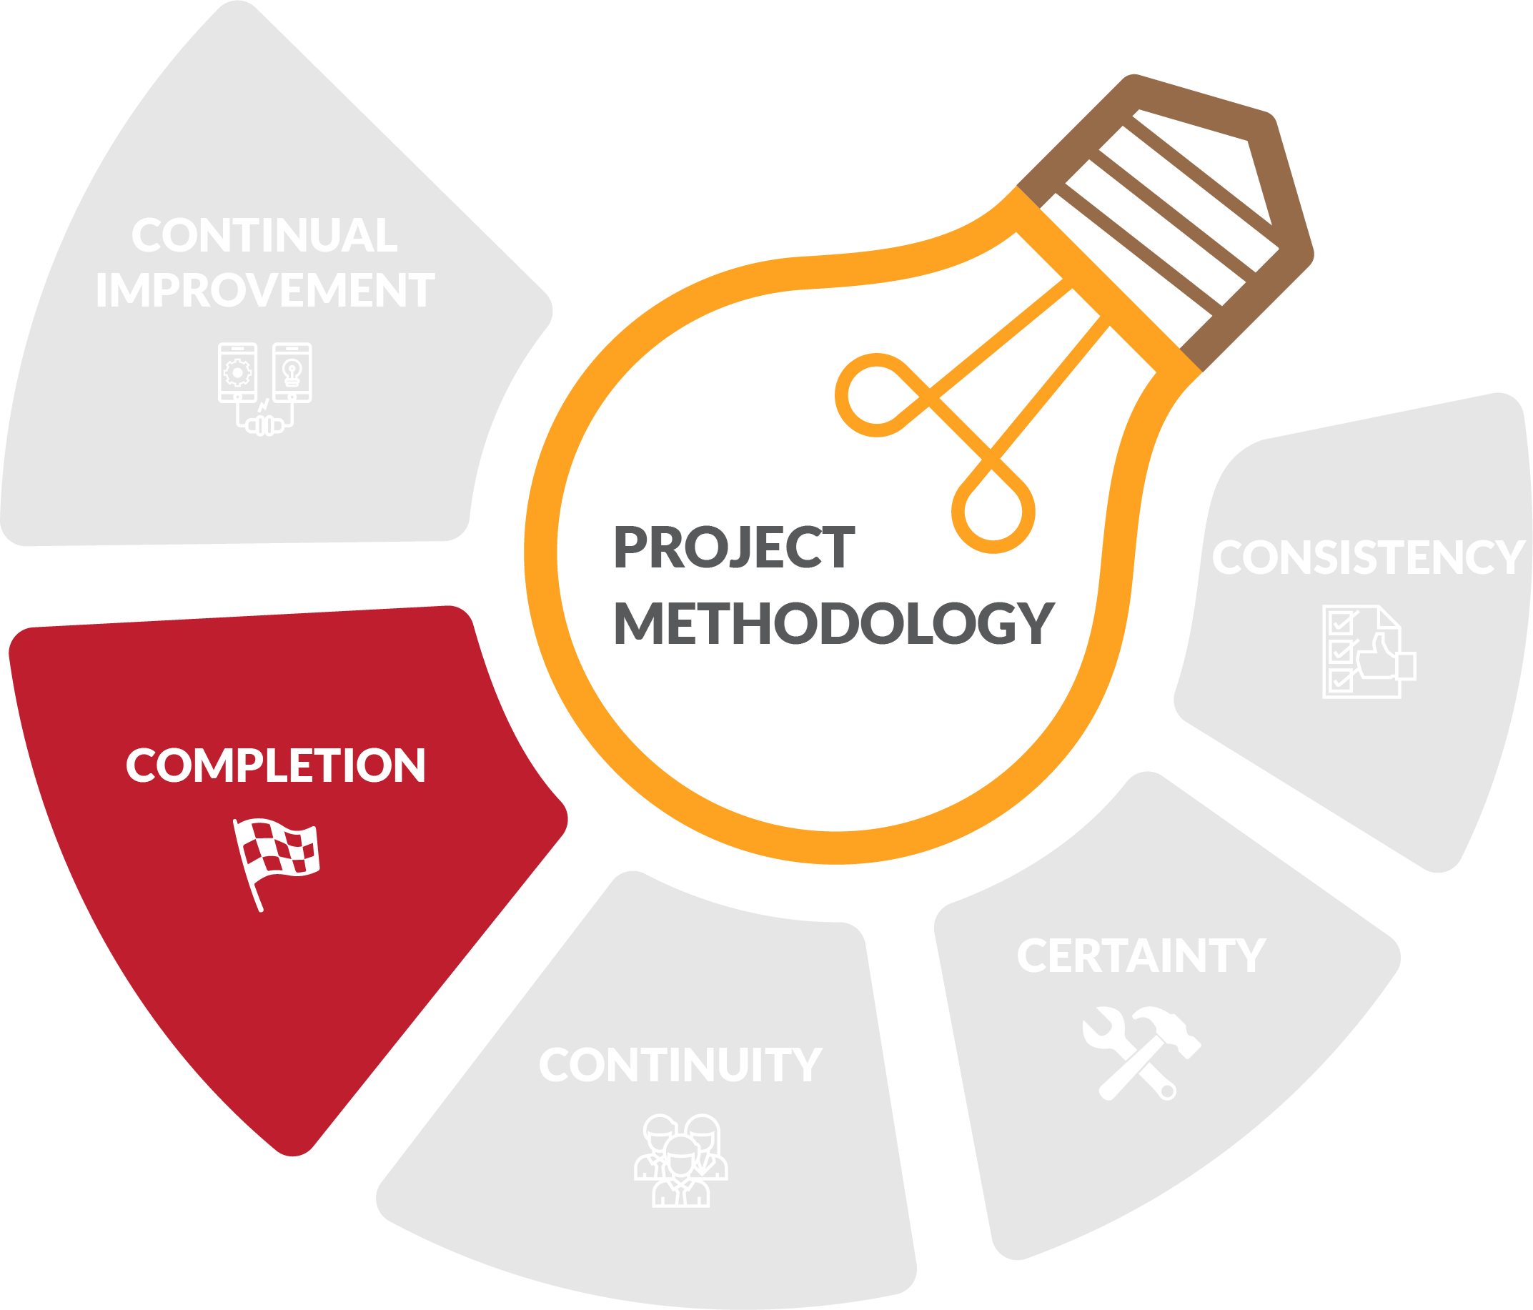
Methodology benefits
Notes:
All of this means that projects are delivered faster and benefits are realised earlier, reducing investment costs and enhancing the reputation of your organisation.
This ultimately has a positive impact on organisational performance and staff morale.

Slide 49
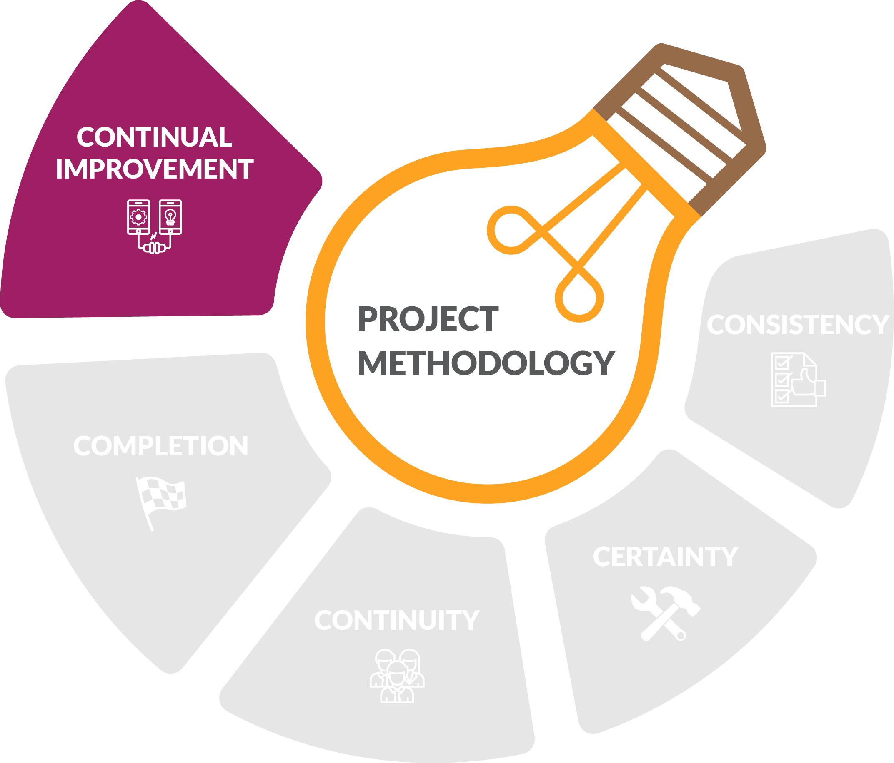
Methodology benefits
Notes:
Post-implementation, methodology outputs become a knowledge base for the organisation; a library that can be built on to template future project delivery and enable a culture of project excellence.
Organisations who operate without a formal project methodology will always find it harder to learn from failure and leverage success.

Slide 50
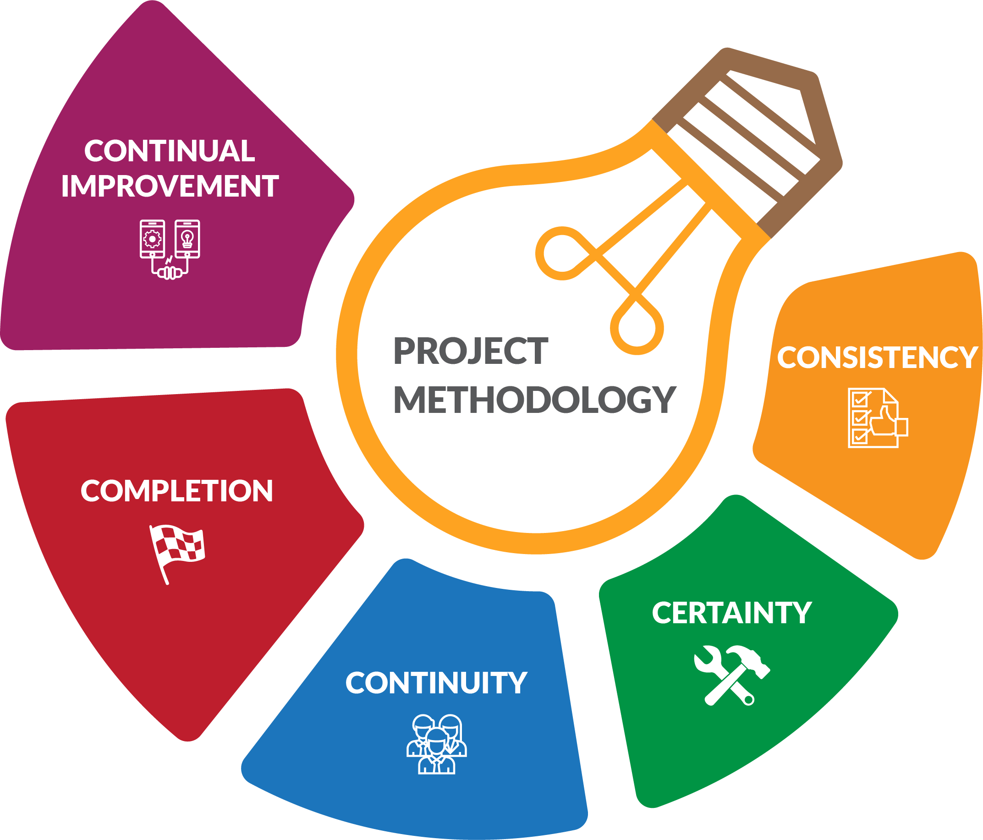
Methodology benefits

Slide 51
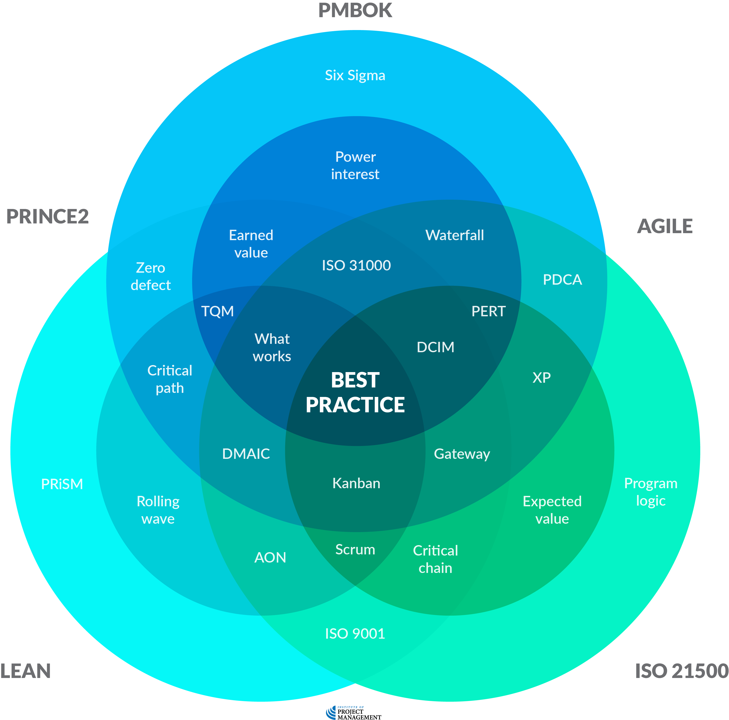
Which is best?
Notes:
The generic nature of these methodologies means that they require different emphases at different points, depending on the nature of the project undertaken.
Some aspects of your chosen methodology can be discarded entirely, while you might need to invent others from scratch, especially if your industry has specific compliance requirements.
The other problem is that these off-the-shelf methodologies are often stand-alone.
This is all well and good, but the chances are that your organisation already has methods for performing tasks or managing processes.
Therefore slavishly adopting a PM methodology that you learned on a nifty course might actually cause inefficiencies and tension in a workplace that already has its own hard-won body of assets and knowledge.
As with all things project management, balance is the key.
Our expectation is that by the end of this program you will be able to use the proven, good practices we introduce to develop an individually or organisationally unique best-practice project management framework.
In other words, you will be able to take what already exists within your organisation – along with what you find in courses, software, templates and the Googleverse – and use your expert judgement to arrive at the optimal method for delivering successful results.
Keep in mind, too, that the global body of knowledge expands and evolves every day.
The best project managers stay plugged in to industry news and developments, constantly refreshing their knowledge and organically improving their practice.
See also: software v methodology

Slide 52
Discussion
Can we ever over-document our projects?
Notes:
Sometimes all a good project plan does is document your failures with greater precision.
Although this scenario is the exception, it is possible to have a perfectly documented project that somehow finds a way fail.
Importantly, project documents should support and enable project delivery, as opposed to getting in the way.
Sometimes the constraints of documentation can frustrate the work of the project.
This will manifest as general inefficiency, missed opportunities and poor staff morale – don’t be overly bureaucratic!
It is also well documented that using the same format or template over and over can cause users of the output to miss important items that may need to be included.
In the same way, ‘save-as’ syndrome – where new plans for a project are just copy-and-pasted version of a similar project – can not only cause errors to be repeated, but stagnate independent and creative thinking.
It is important to note that while following a documented process may be a minor nuisance to the project team, the positive outcomes enjoyed by all stakeholders usually make the process worthwhile.
That said, not every process needs to be used on every project.
If using a template adds time to a task because you are doing so much modifying and deleting while trying to shoehorn your project into the defined format, then you need to either seek advice or let it go and start from scratch.

Slide 53
Reflection
What is the most interesting thing you learned today?
What is one thing you will start, stop or continue doing?
What is one thing you would like to learn more about?

Slide 54
Questions?
Coming next… raising the stake(holder)s
Notes:
Stay around until everyone leaves the session to ensure they all get the chance to ask their questions.

Slide 55
Closing checklist
Classroom
Upload signed attendance sheet and any photos taken of work in progress
Zoom
Upload video with thumbnail and link to workshop
Student administration
Mark participating students as complete
Email absent students and notify of gap requirements (OPEN units)
Facilitator feedback – email paul@institute.pm
What worked well today?
How can we improve?

