Slide 1
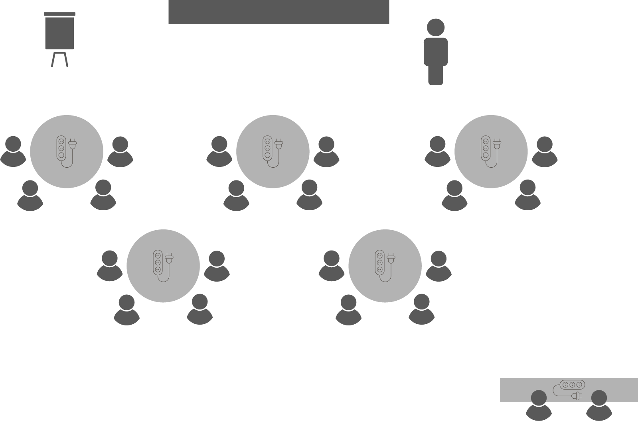
Opening checklist
Your preparation
Review notes, run a technical rehearsal
Rehearse examples / cases / stories to stimulate discussion
Classroom
Ensure students seated at tables of 3-5 and all facing the front
Have student name cards in place and ensure all sign in
Zoom
Rename yourself as host (under participants)
Set-up breakout rooms
https://support.zoom.us/hc/en-us/articles/206476313-Managing-Video-Breakout-Rooms
Welcome students as they arrive, let them know when starting
Notes:
Good luck!

Slide 2
Project
Stakeholders

Slide 3
Who is a stakeholder?
OPEN 2.0
An individual, group or organisation who…
…can influence, AND/OR
…is impacted by, AND/OR
…is (or would be) interested in…
…a decision, activity or outcome of the project
Notes:
Literally – someone who has a stake (or has something at stake) in your project.

Slide 4
Who is a stakeholder?
An individual, group or organisation who…
…can influence, AND/OR
…is impacted by, AND/OR
…is (or would be) interested in
…a decision, activity or outcome of the project
POWER
INTEREST
≠ AWARENESS
Notes:
Each stakeholder can be said to have a high or low level of power (or influence) over a project; in the same way, they could be said to have a high or low level of interest in the project, its outputs and outcomes.
Note, though, that power and interest should not be confused with awareness.
For example, I might not be aware that the government is planning on building a nuclear waste dump next to my house, but you can guarantee that if I did discover this fact, I would be very, very interested!
So even though your boss might not know what you are planning, they still retain the power to completely change things when they find out.
Therefore, when analysing a person’s power and interest we should act as if they are aware, even if they do not know about our project just yet (and even if we do not plan on informing them, which comes with its own set of risks).

Slide 5
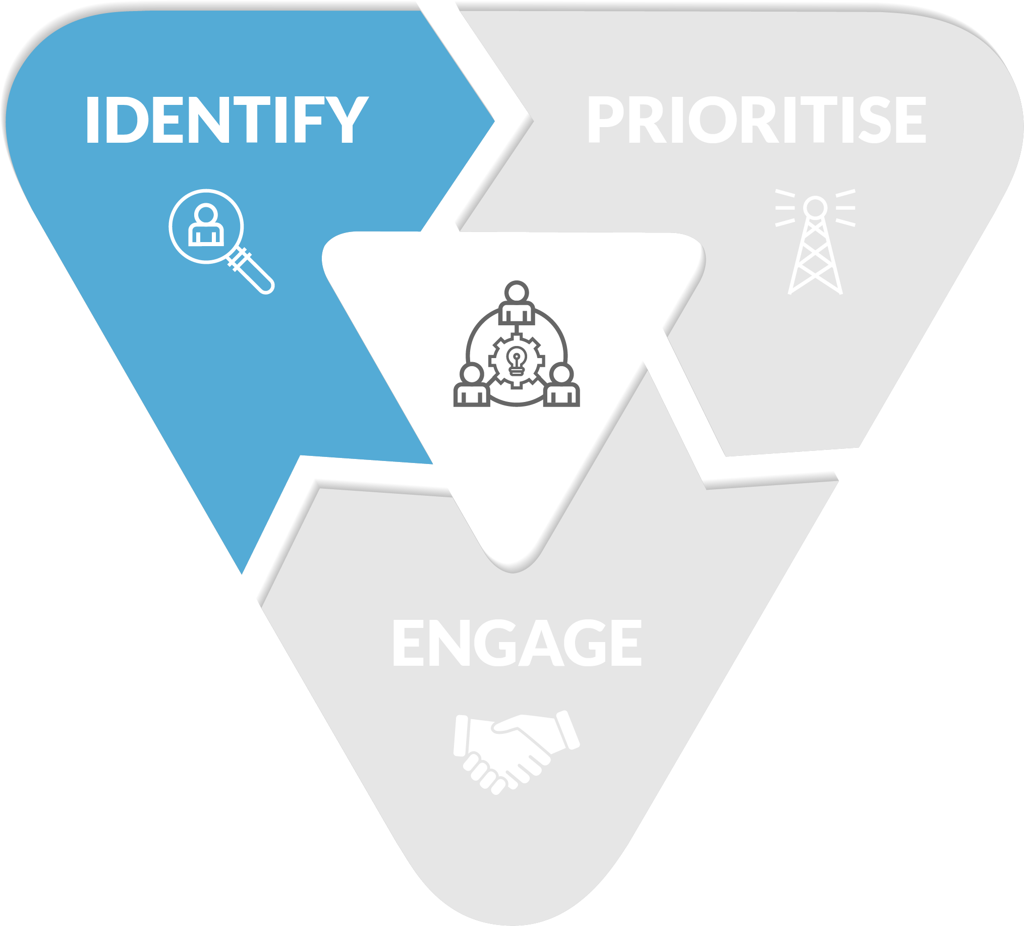
Stakeholder management process
Notes:
We know from the last session that the cost of change increases the further you get into a project.
Identifying and engaging stakeholders as early as possible in a project's life will not only allow you to consider all options and points of view in arriving at the optimal project solution; it will prevent you discovering things 'too late' to do anything about them.
The last thing you will want or need is a government inspector (you failed to identify) showing up near the end of project delivery and informing you that your project is non-compliant and needs to start again!

Slide 6
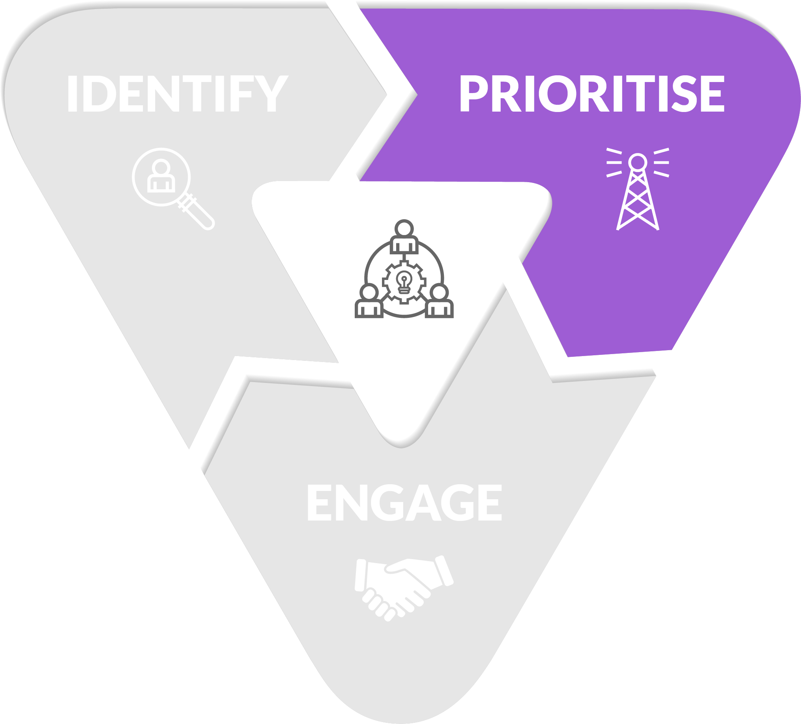
Stakeholder management process
Notes:
Not every stakeholder is equal!
Some will have more power or influence over your project than others; some will have higher levels of interest.
And because we have constrained time and resources with which to deliver our project, we need to make decisions about who deserves our attention the most.

Slide 7
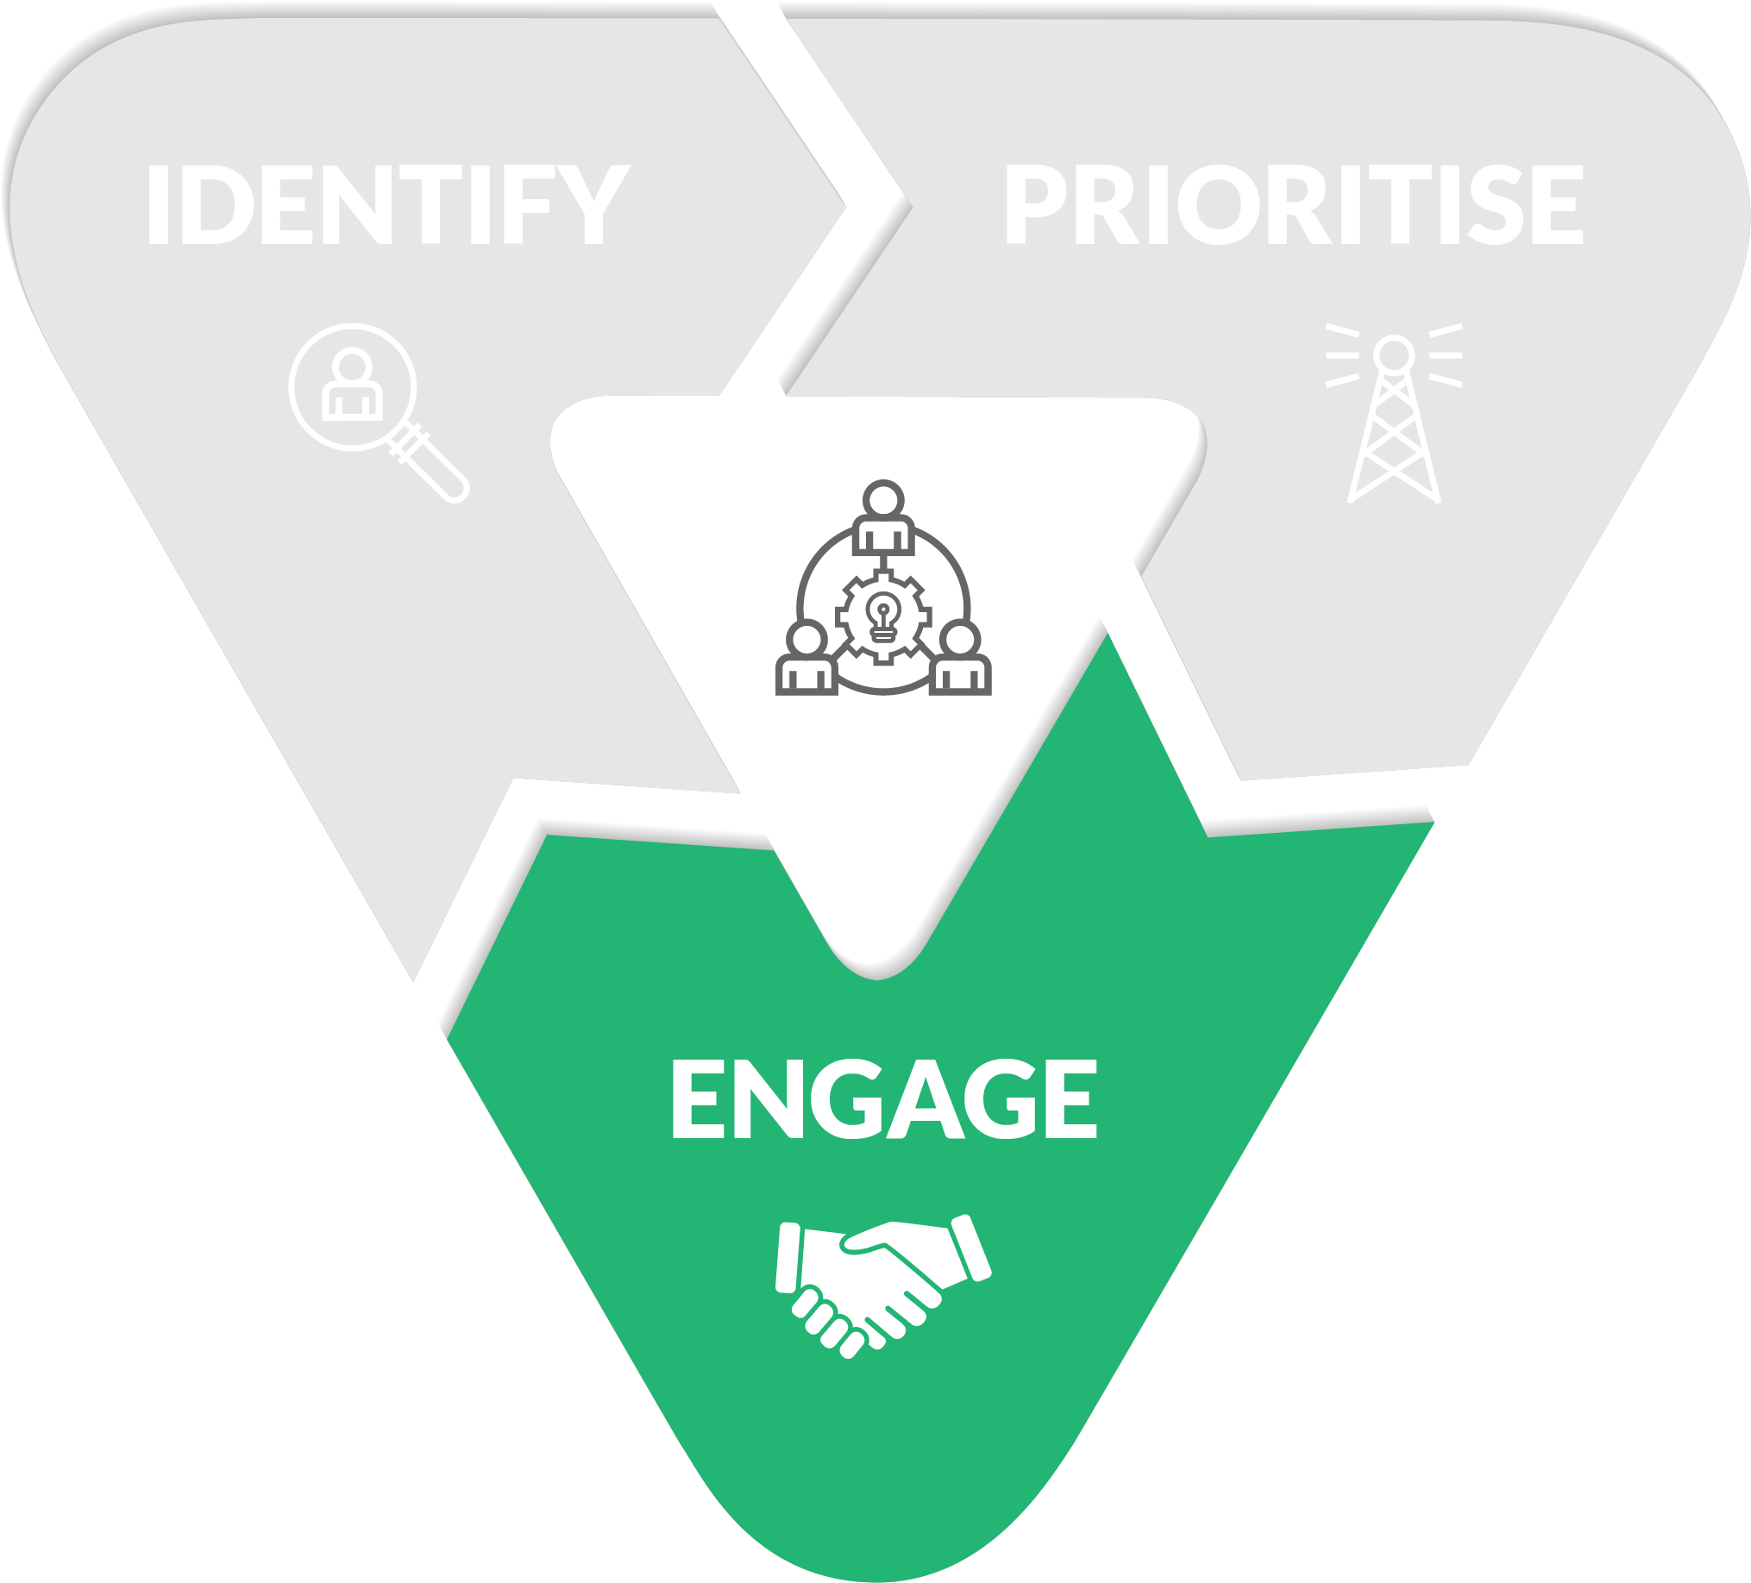
Stakeholder management process
Notes:
Stakeholder engagement refers to the means and extent to which we involve our stakeholders in our project.
There are a range of engagement strategies we will introduce in this Unit that range from passive to active and all points in between.
The option you choose will depend at first on each stakeholders’ priority, but can also be influenced by the needs of the project.

Slide 8
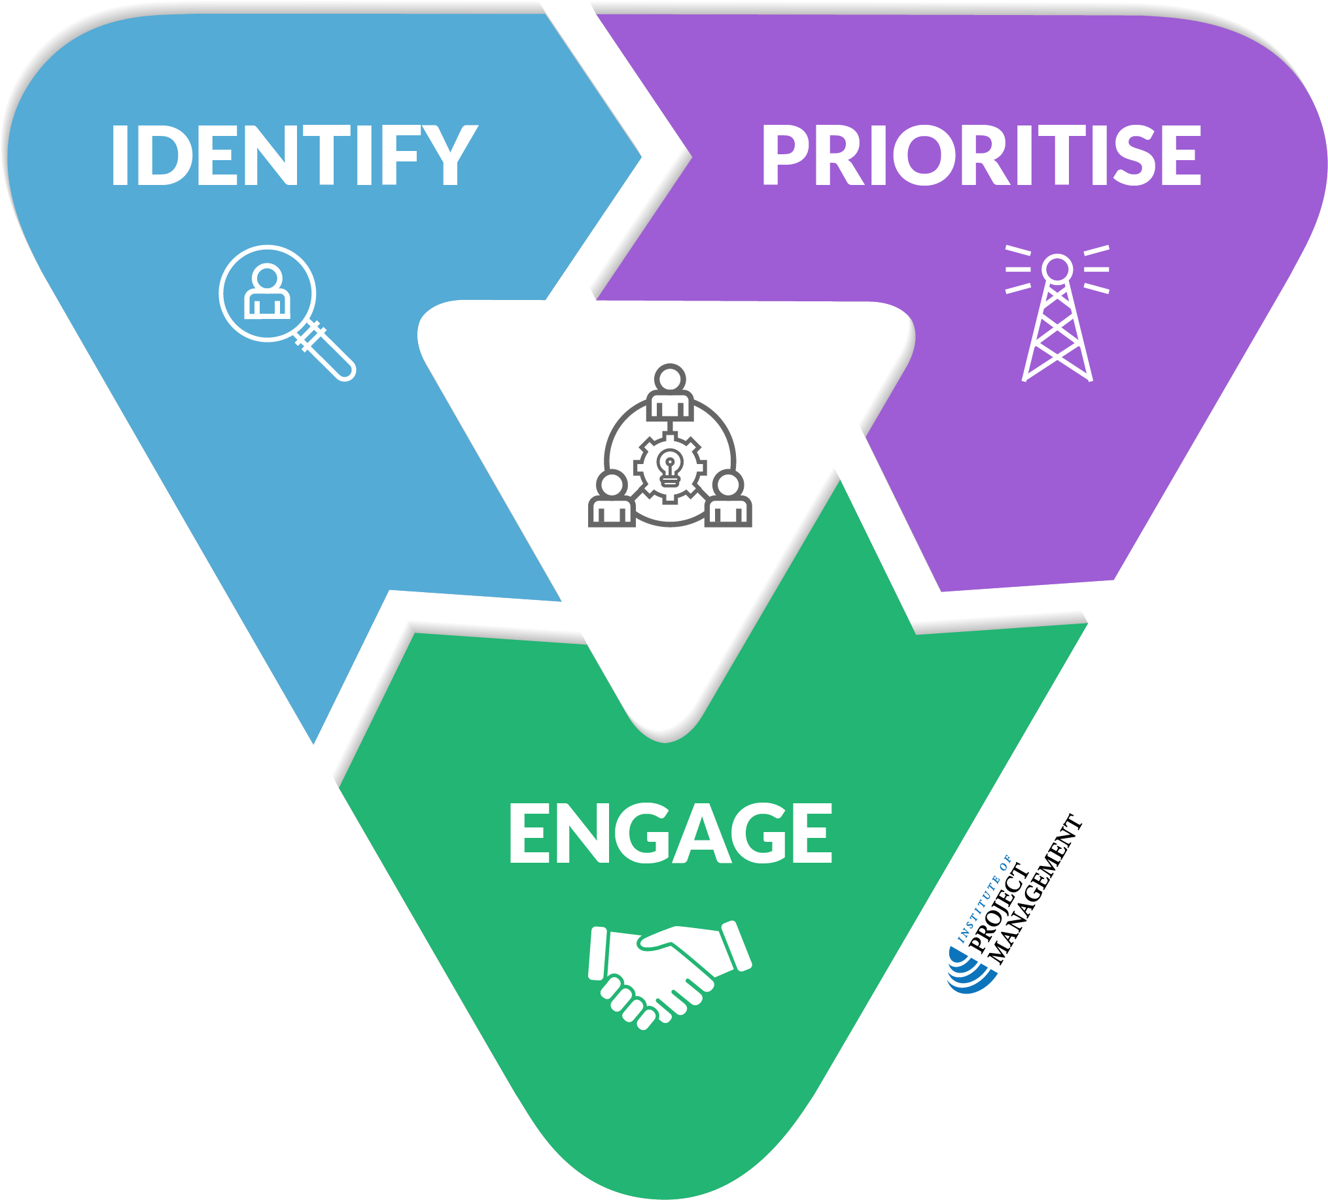
Stakeholder management process
OPEN 2.1
Notes:
This process is what we will work through in this session

Slide 9
Stakeholder identification
Notes:
Step 1 – stakeholder identification

Slide 10
Activity 2.1: The project
Our CEO wants to recognise and reward the achievements of the team over the last 12 months
Who are the individuals, groups or organisations who…
…can influence, AND/OR
…are impacted by, AND/OR
…are (or would be) interested in…
…the decisions, activities or outcomes of this (potential) project?
Notes:
This is a mini case study we will build out and work through in this workshop series.
For public groups (ie people with different employers, backgrounds and experiences), the following context may be required:
Our organisation is a not-for-profit enterprise
It has 250 staff

Slide 11
Direct stakeholders – project manager
Assist with business case
Develop project plan
Manage the triple constraints
Manage risk
Lead and manage stakeholders
Manage conflict
Report on project performance
Manage change
Contribute to review
Notes:
Note that the project manager may not even be aware of the project until the business case is complete and they are asked to plan and deliver it.
The project review may also be done by a third party, independent of the project manager.

Slide 12
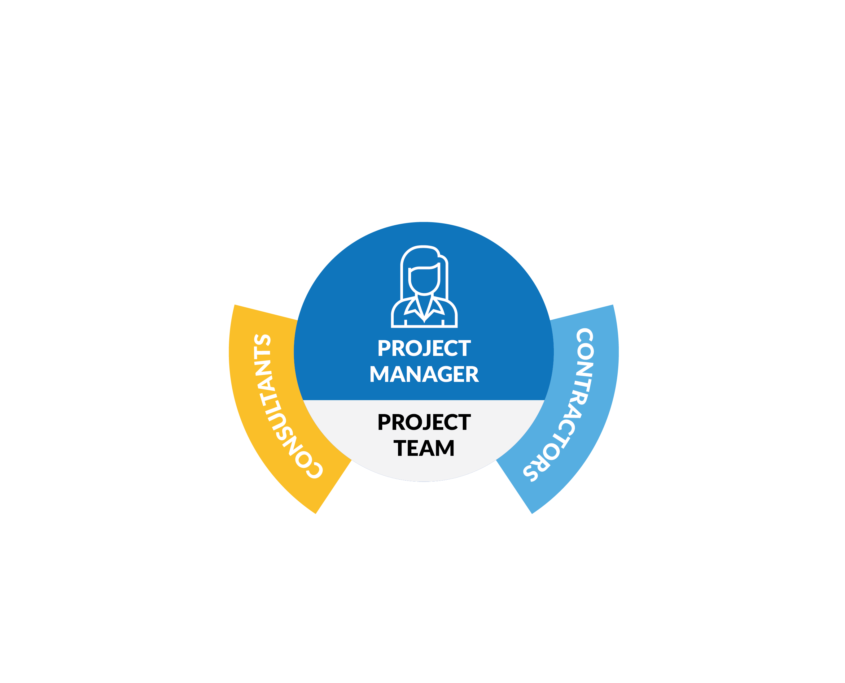
Direct stakeholders – project team
Includes anyone responsible for project tasks
Employees
Contractors
Consultants
Deliver tasks
Technical skills (eg engineering)
Manage tasks
Project management skills
Notes:
Contractors typically deliver goods (ie things), consultants typically deliver services (ie knowledge, advice)

Slide 13
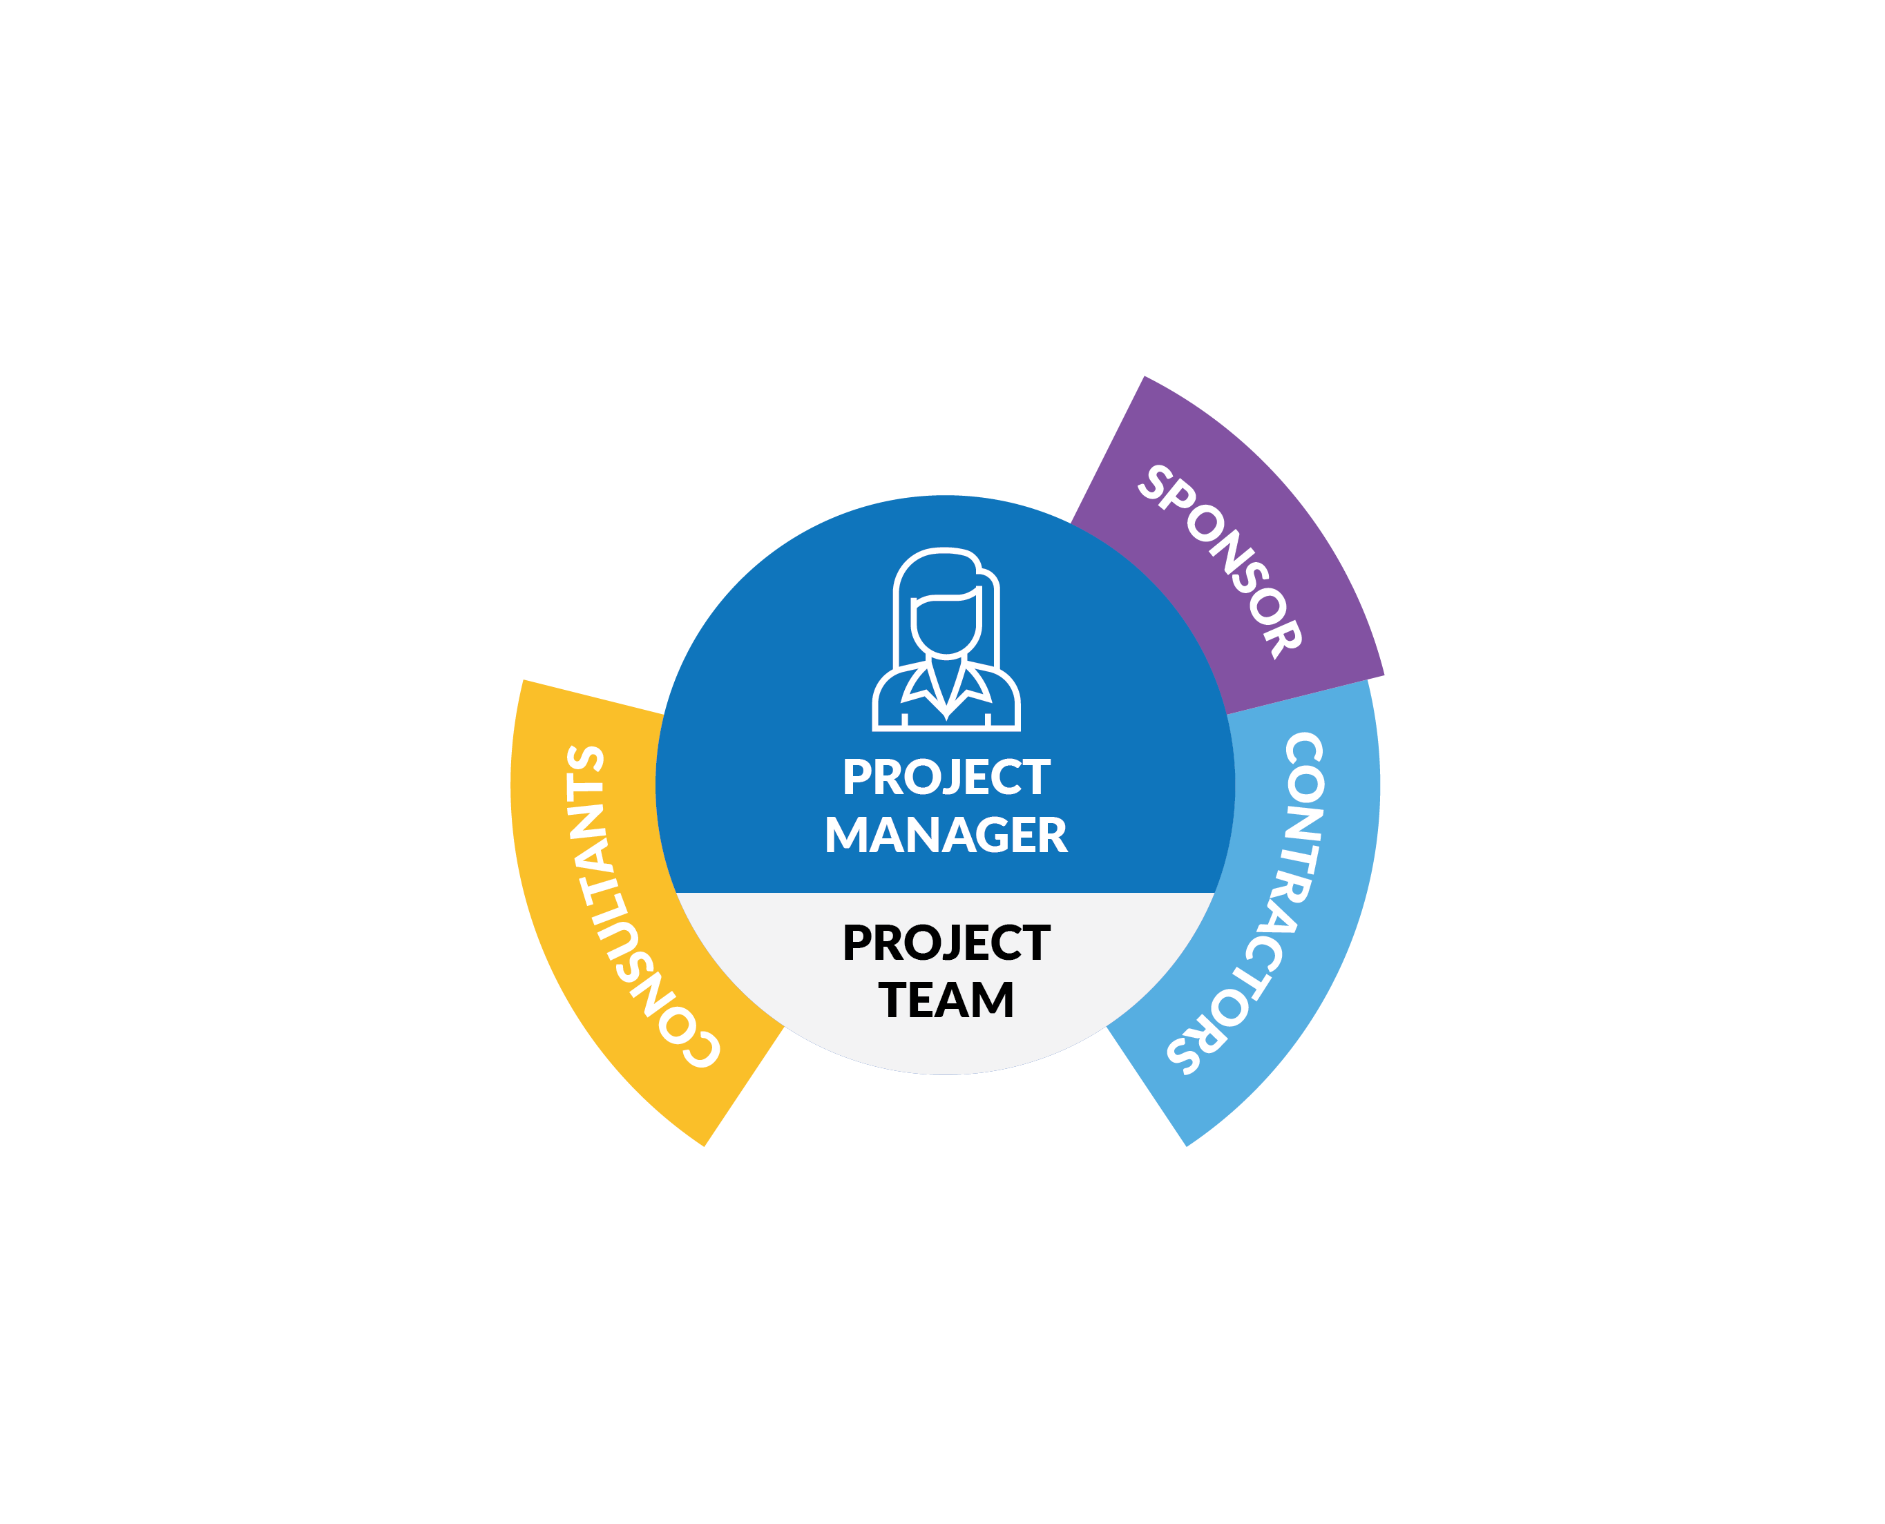
Direct stakeholders – project sponsor
Champion the project
Link to organisation
Provide resources
Assure project delivery
Support the project manager
Authorise minor changes
Mediate conflict
Notes:
Note that the sponsor may not be the project manager’s day-to-day (business as usual) manager.
If, as a project manager, you don’t know who your sponsor is, then ask who do you go to first within your organisation when you need more money or resources for your project?

Slide 14
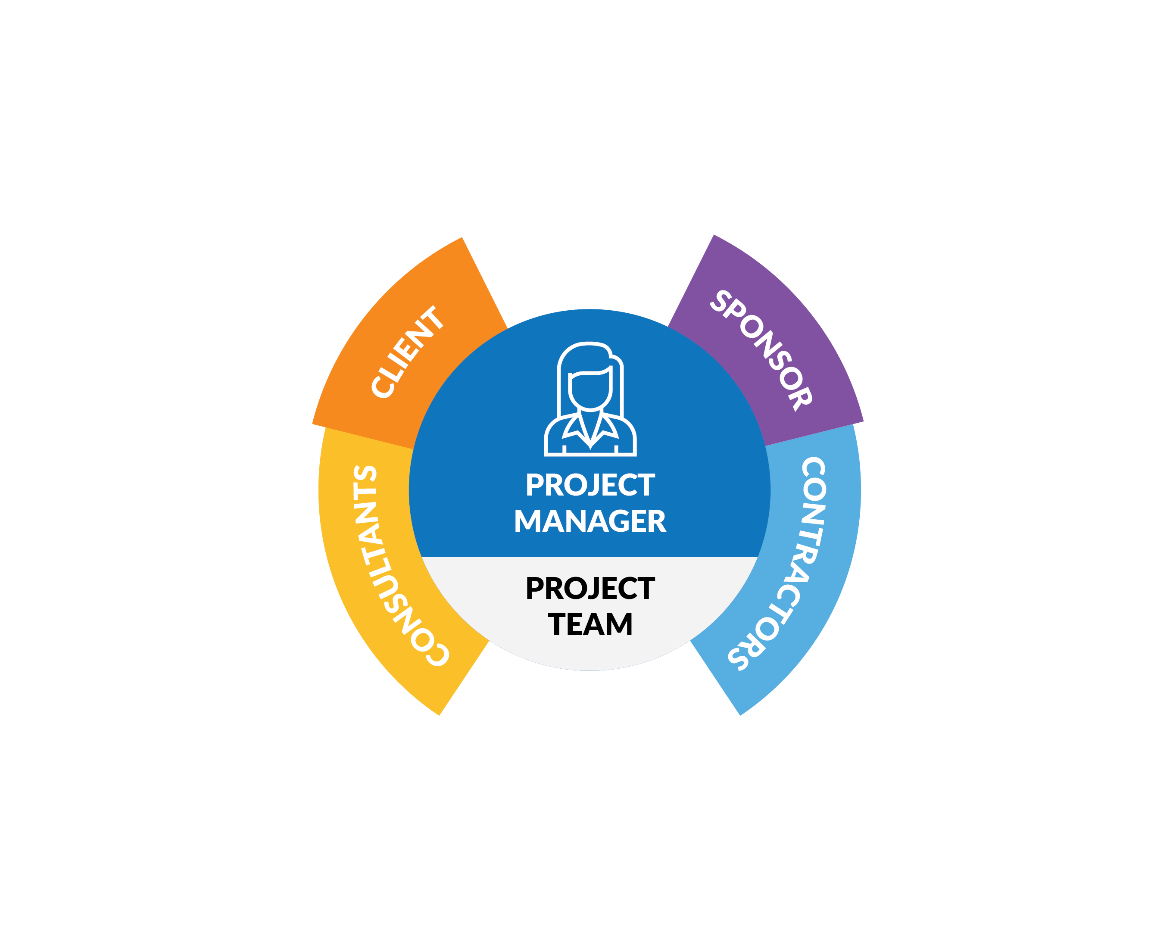
Direct stakeholders – project client
Initiates and finances the project
Accepts (or not) project output(s)
Internal client
Other department
May also be the sponsor
External client
Third party
Pays for the project
Notes:
It is critical that clients (especially external clients) are kept engaged throughout the life of the project, especially when changes to scope are contemplated.

Slide 15
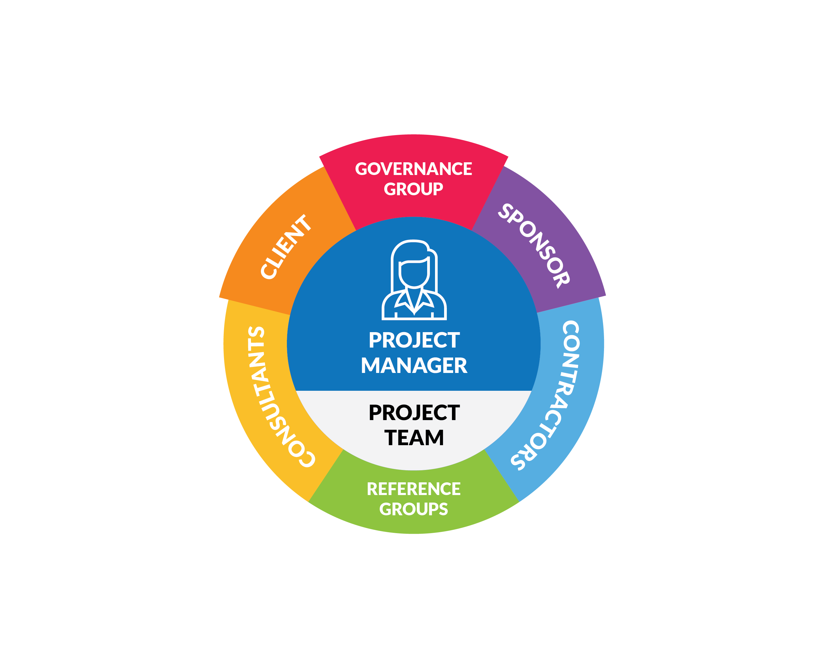
Direct stakeholders – support groups
Governance group
Steering committee / CCB / PCG
Represent stakeholders
Identify strategic risk
Resolve conflict
Authorise major changes
Reference groups
Specialist advice only
May be ad hoc
Notes:
Governance group
Change control board (CCB)
Project control group (PCG)
The very first job of the steering committee is often to approve the project plan, releasing resources and defining the limits of the project manager’s authority.
More broadly, they accept regular reports – usually monthly – from the project manager on progress to date, known issues, and changes to the risk profile of the project.
On smaller projects a governance group may not be required - a sponsor is sufficient to assure successful delivery.
Reference group
As the name suggests, the project will refer to the group for technical or expert advice.
Panels can be drawn from key organisational staff, consultants or community representatives, depending on the problem that needs to be solved.
As such, reference groups are often ad hoc, formed in response to a specific issue or for a single purpose, and may not last the life of the project.
Larger organisations may also convene standing technical reference groups that cover most or all of the projects in a program or portfolio of work..
Consisting of organisational subject matter experts drawn from teams such as finance, risk, human resources, legal, media and the like, they come together to provide advice to the project manager and/or governance group on significant decisions, or make themselves individually available on-demand (as a panel) for routine consultation and advice.

Slide 16
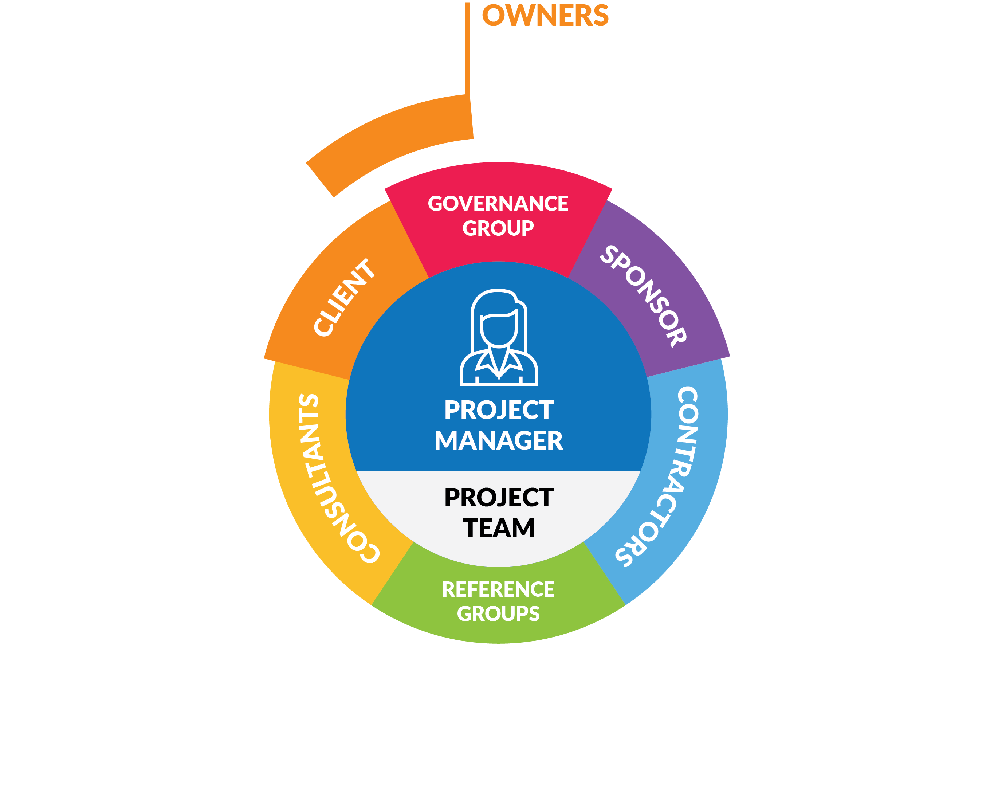
Indirect stakeholders
Notes:
Indirect stakeholders are less involved in, but potentially impacted by project delivery.
They may also have considerable influence over the project, even if they do not choose to exercise it.
As such, they should be specifically identified by name and organisation – the categories listed in the taxonomy below are just a quick reference to get you started.
The organisation's members or owners are impacted to that extent that the organisation is diverting resources and investing its reputation at least in some small way in the project.
The owners are usually represented by a Board of Directors or equivalent committee.

Slide 17
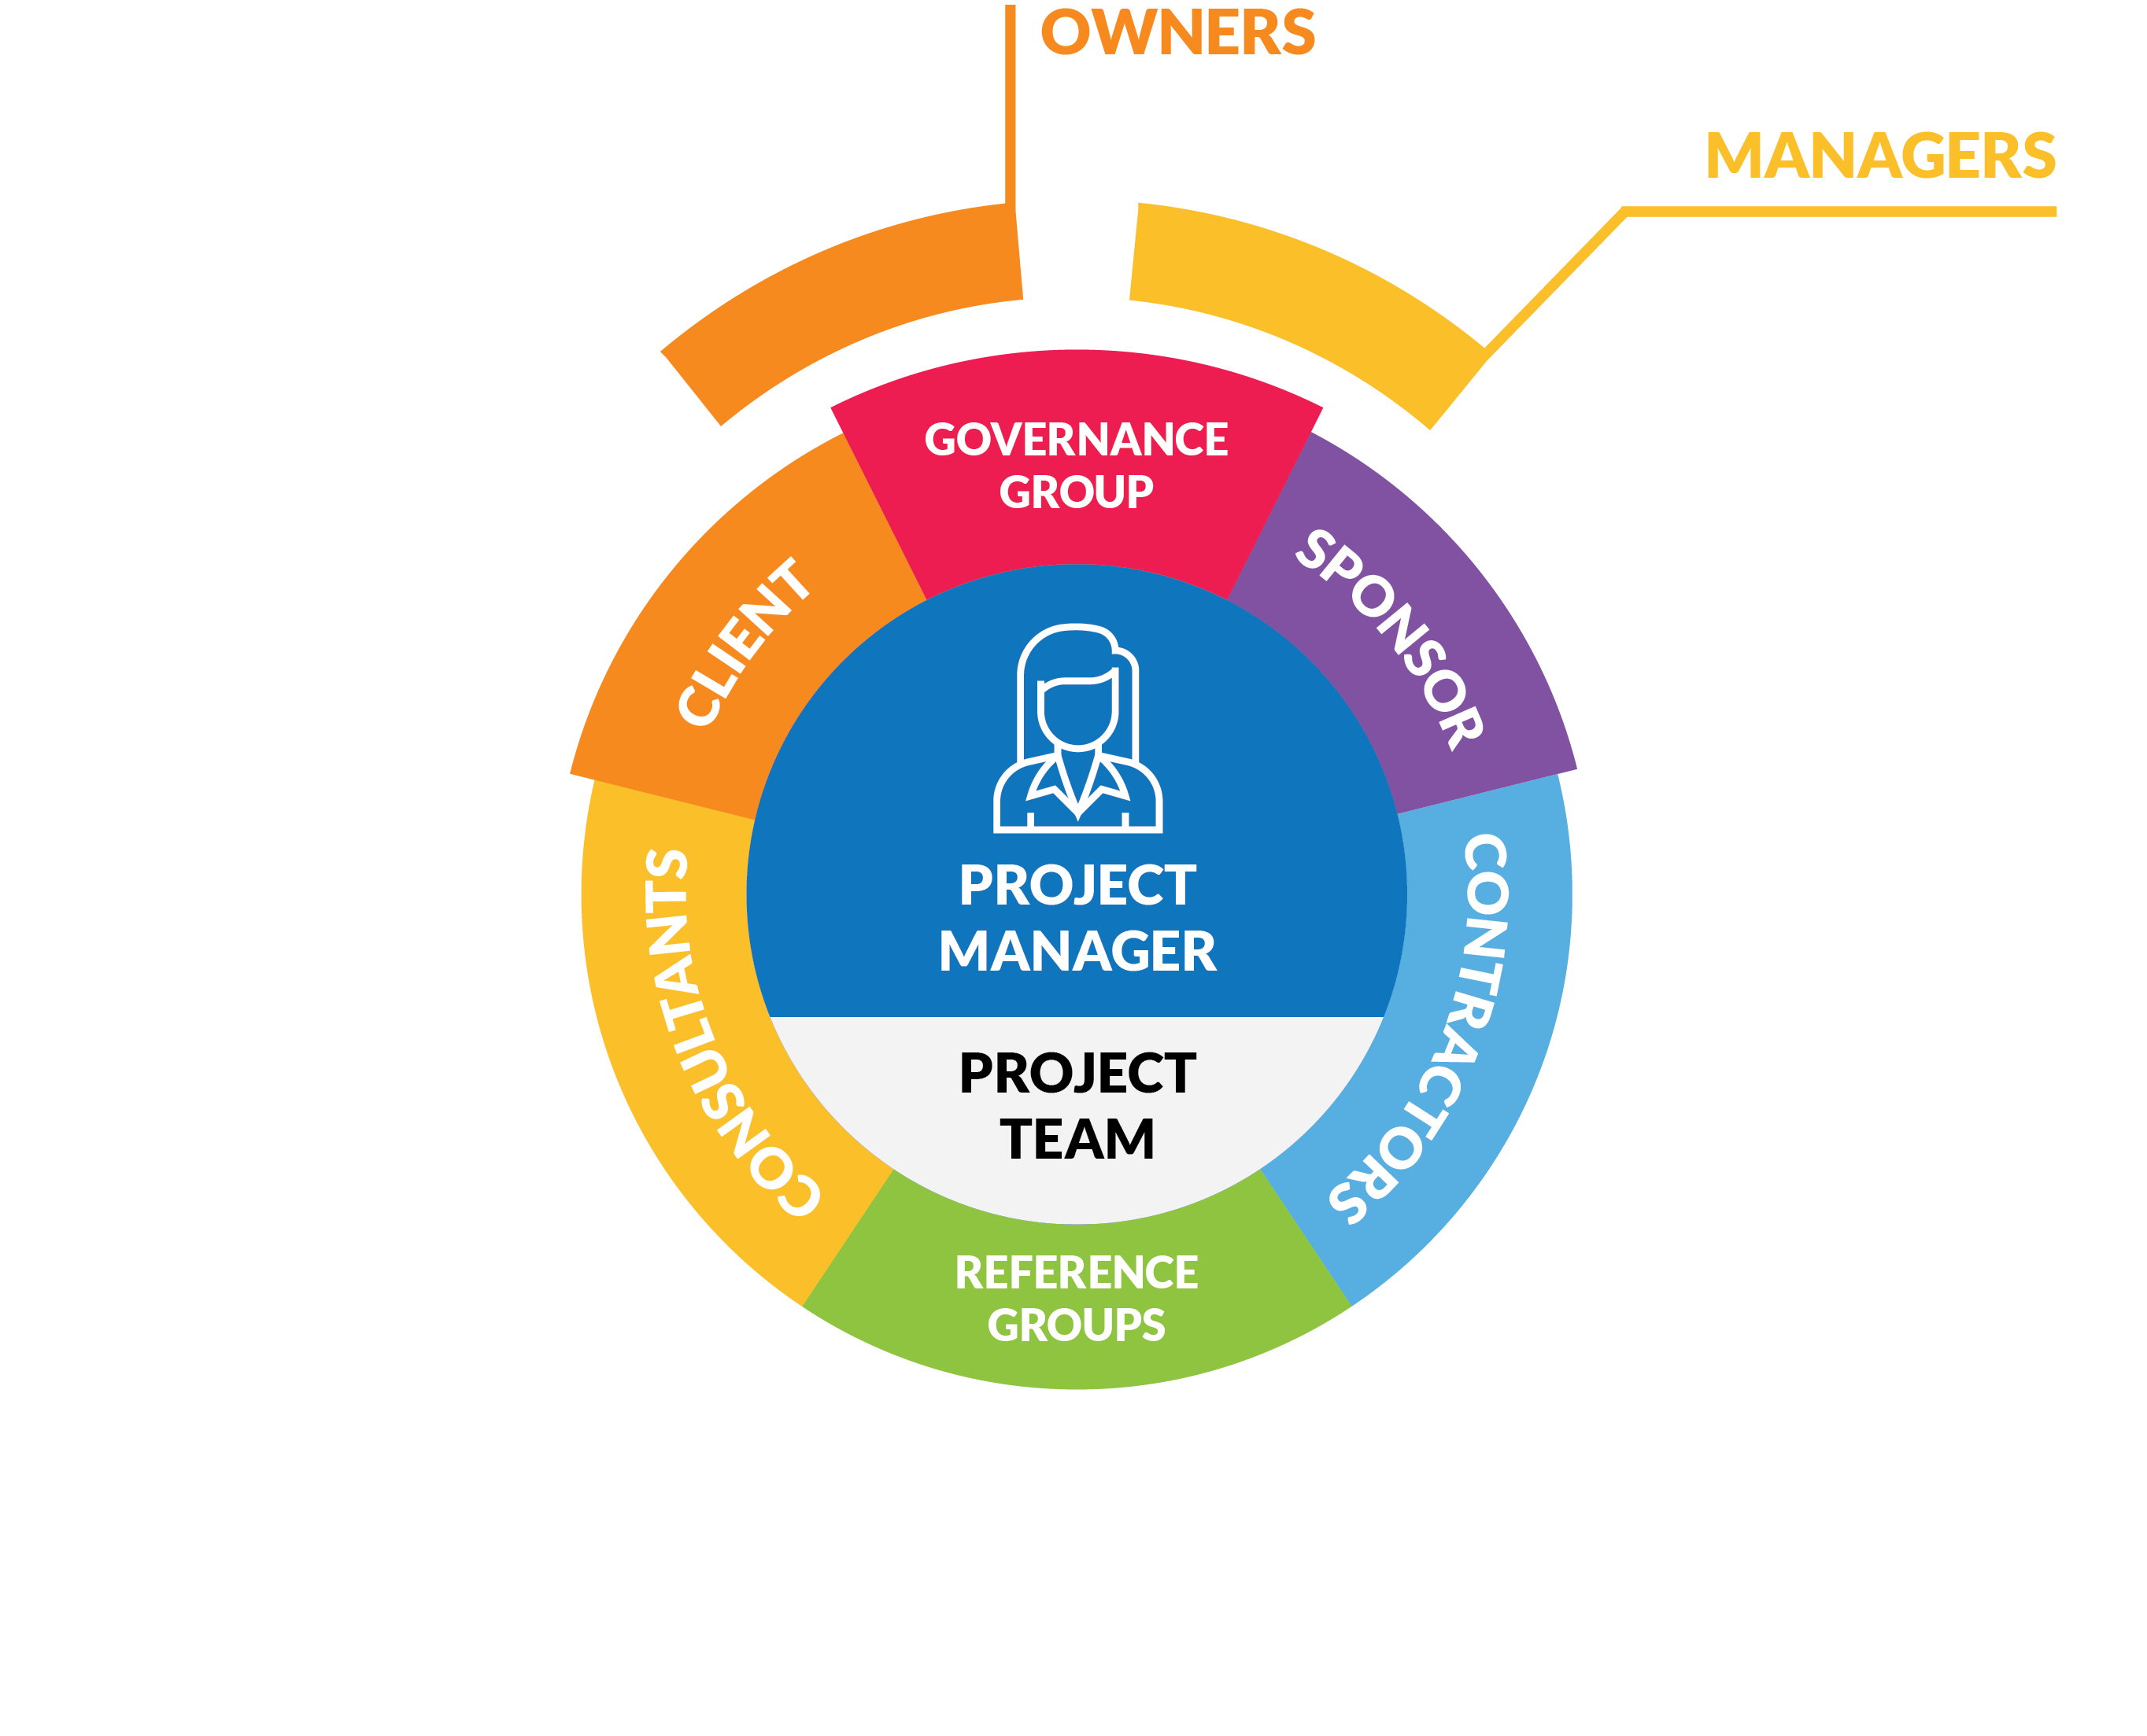
Indirect stakeholders
Notes:
The Chief Executive Officer (CEO) of the organisation delivering the project may only have a passing or casual interest in it; however, as the direct link to the owners, they can significantly influence the project's direction.
Department managers are also often required to divert staff and other resources to a project, and may be suspicious, resentful or even hostile to it.
A good project manager and sponsor will respect these interests and communicate progress and benefits to impacted managers on a regular basis.

Slide 18
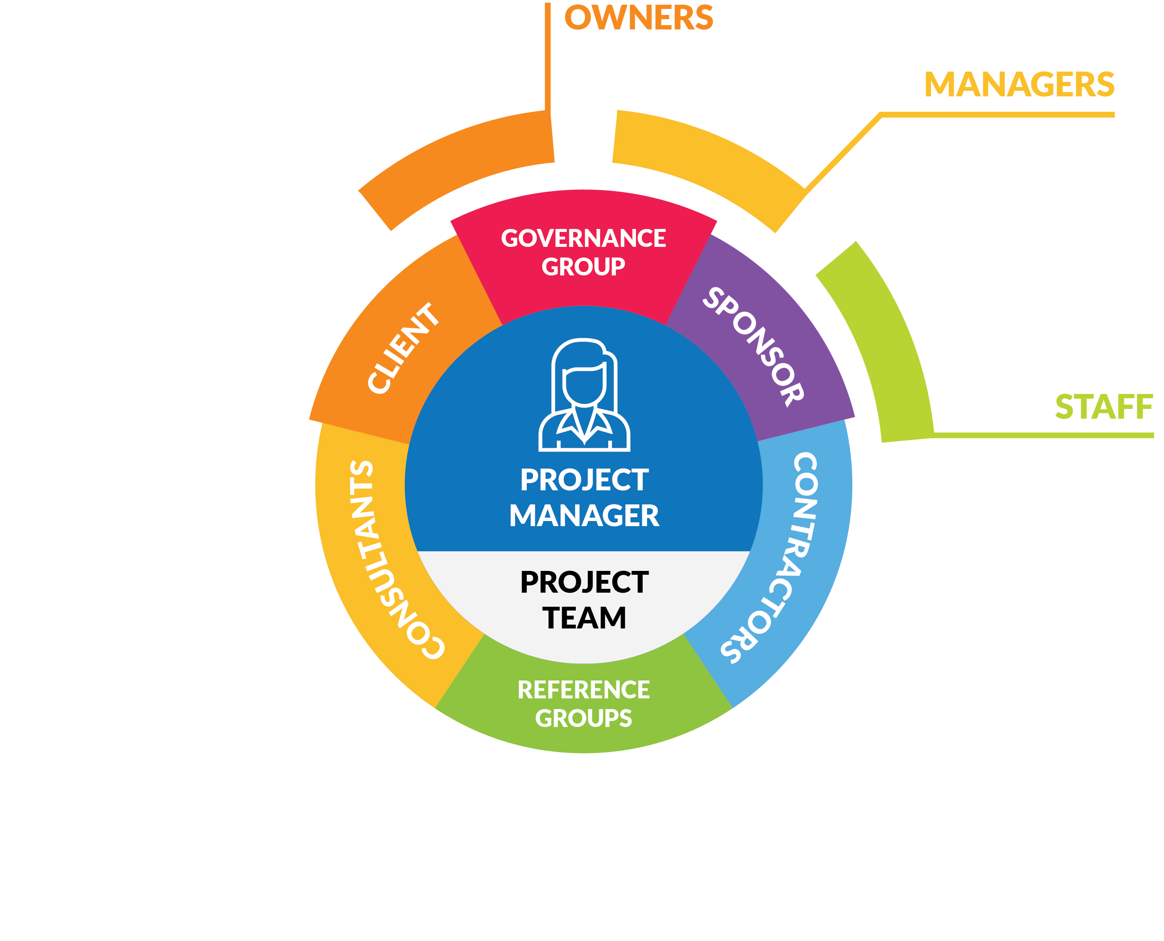
Indirect stakeholders
Notes:
Staff of the performing organisation not directly participating in a project may experience the same frustrations as their managers, but without the authority to act.
Organisations should be aware of projectitis, the condition where project teams are glorified at the expense of operational staff, causing a rift or tension between the two.

Slide 19
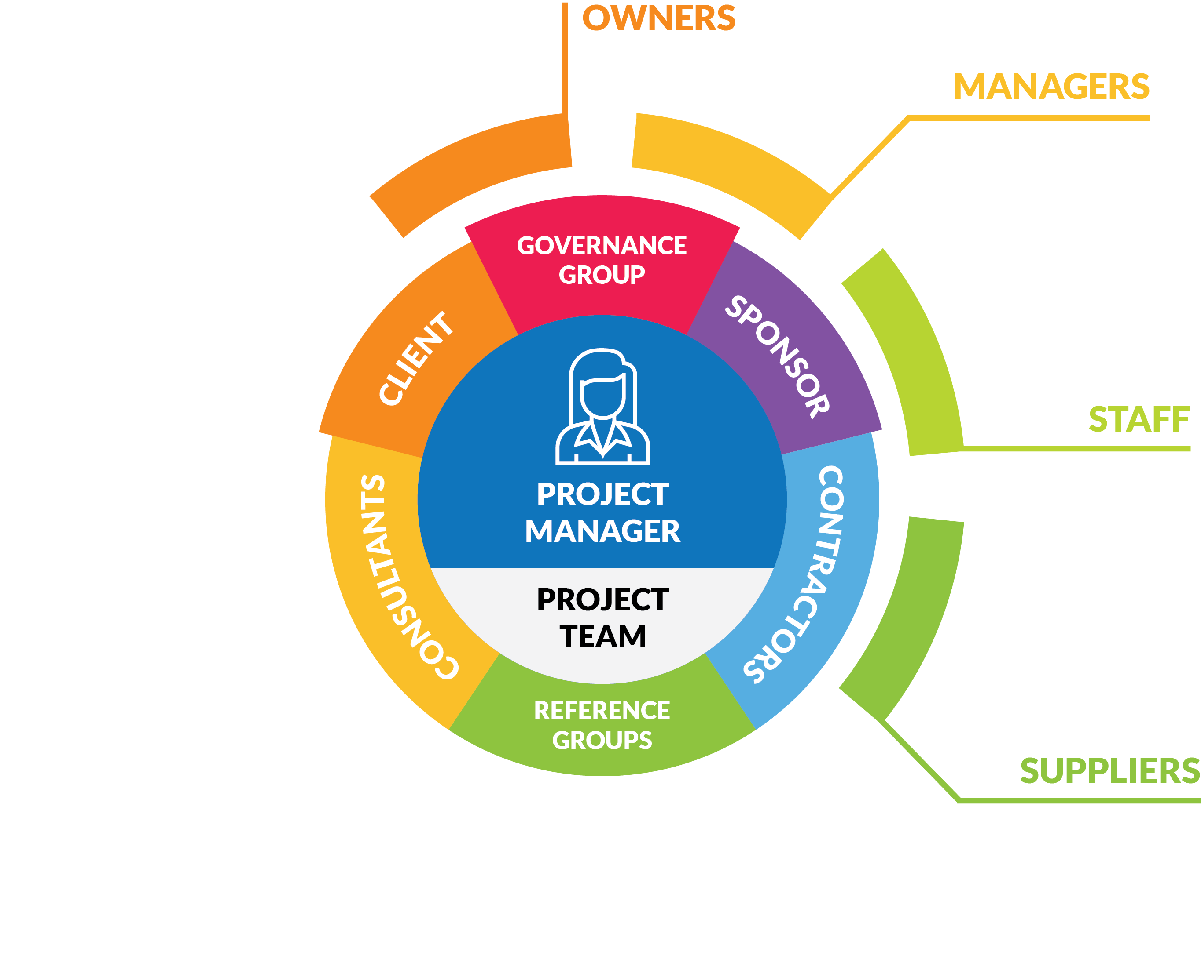
Indirect stakeholders
Notes:
Although contractors and consultants supply labour and knowledge to a project, other suppliers will also provide the materials, equipment and infrastructure necessary for successful delivery.
We will consider all supplier relationships as part of the procurement lifecycle as we move through this course.

Slide 20
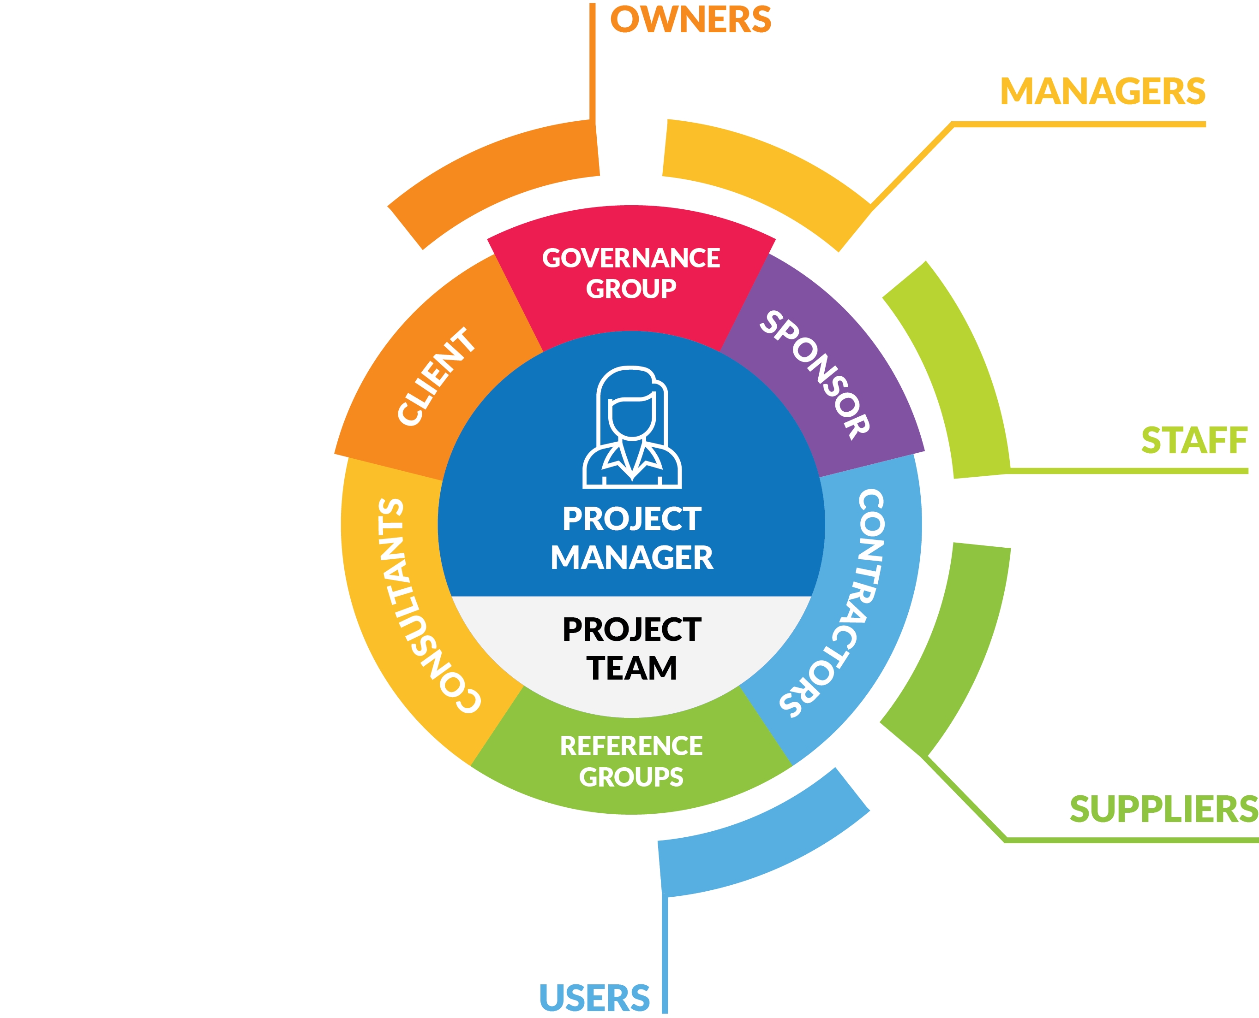
Indirect stakeholders
Notes:
Although a project's client may also be a user of its outputs, there is actually a difference between the two.
To illustrate this distinction, the client of a new medicine might be a pharmaceutical company; whereas, users are the hospitals, family doctors and patients who actually purchase, dispense and consume the medicine.
Each actor in the consumption chain has an aligned, and often legally protected, interest in the project, its output and outcomes.

Slide 21
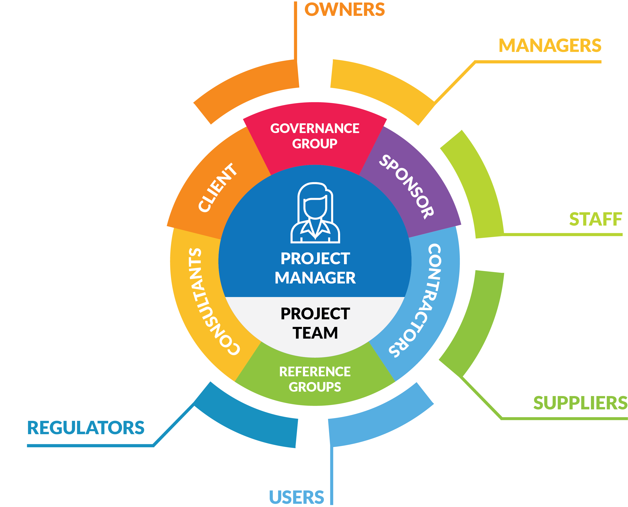
Indirect stakeholders
Notes:
Representing these interests of users and the community at large, are government appointed regulators, such as health and safety authorities, corruption watchdogs and the courts.
It is important that project teams ensure their processes and outputs meet legislative (as well as organisational) expectations.

Slide 22
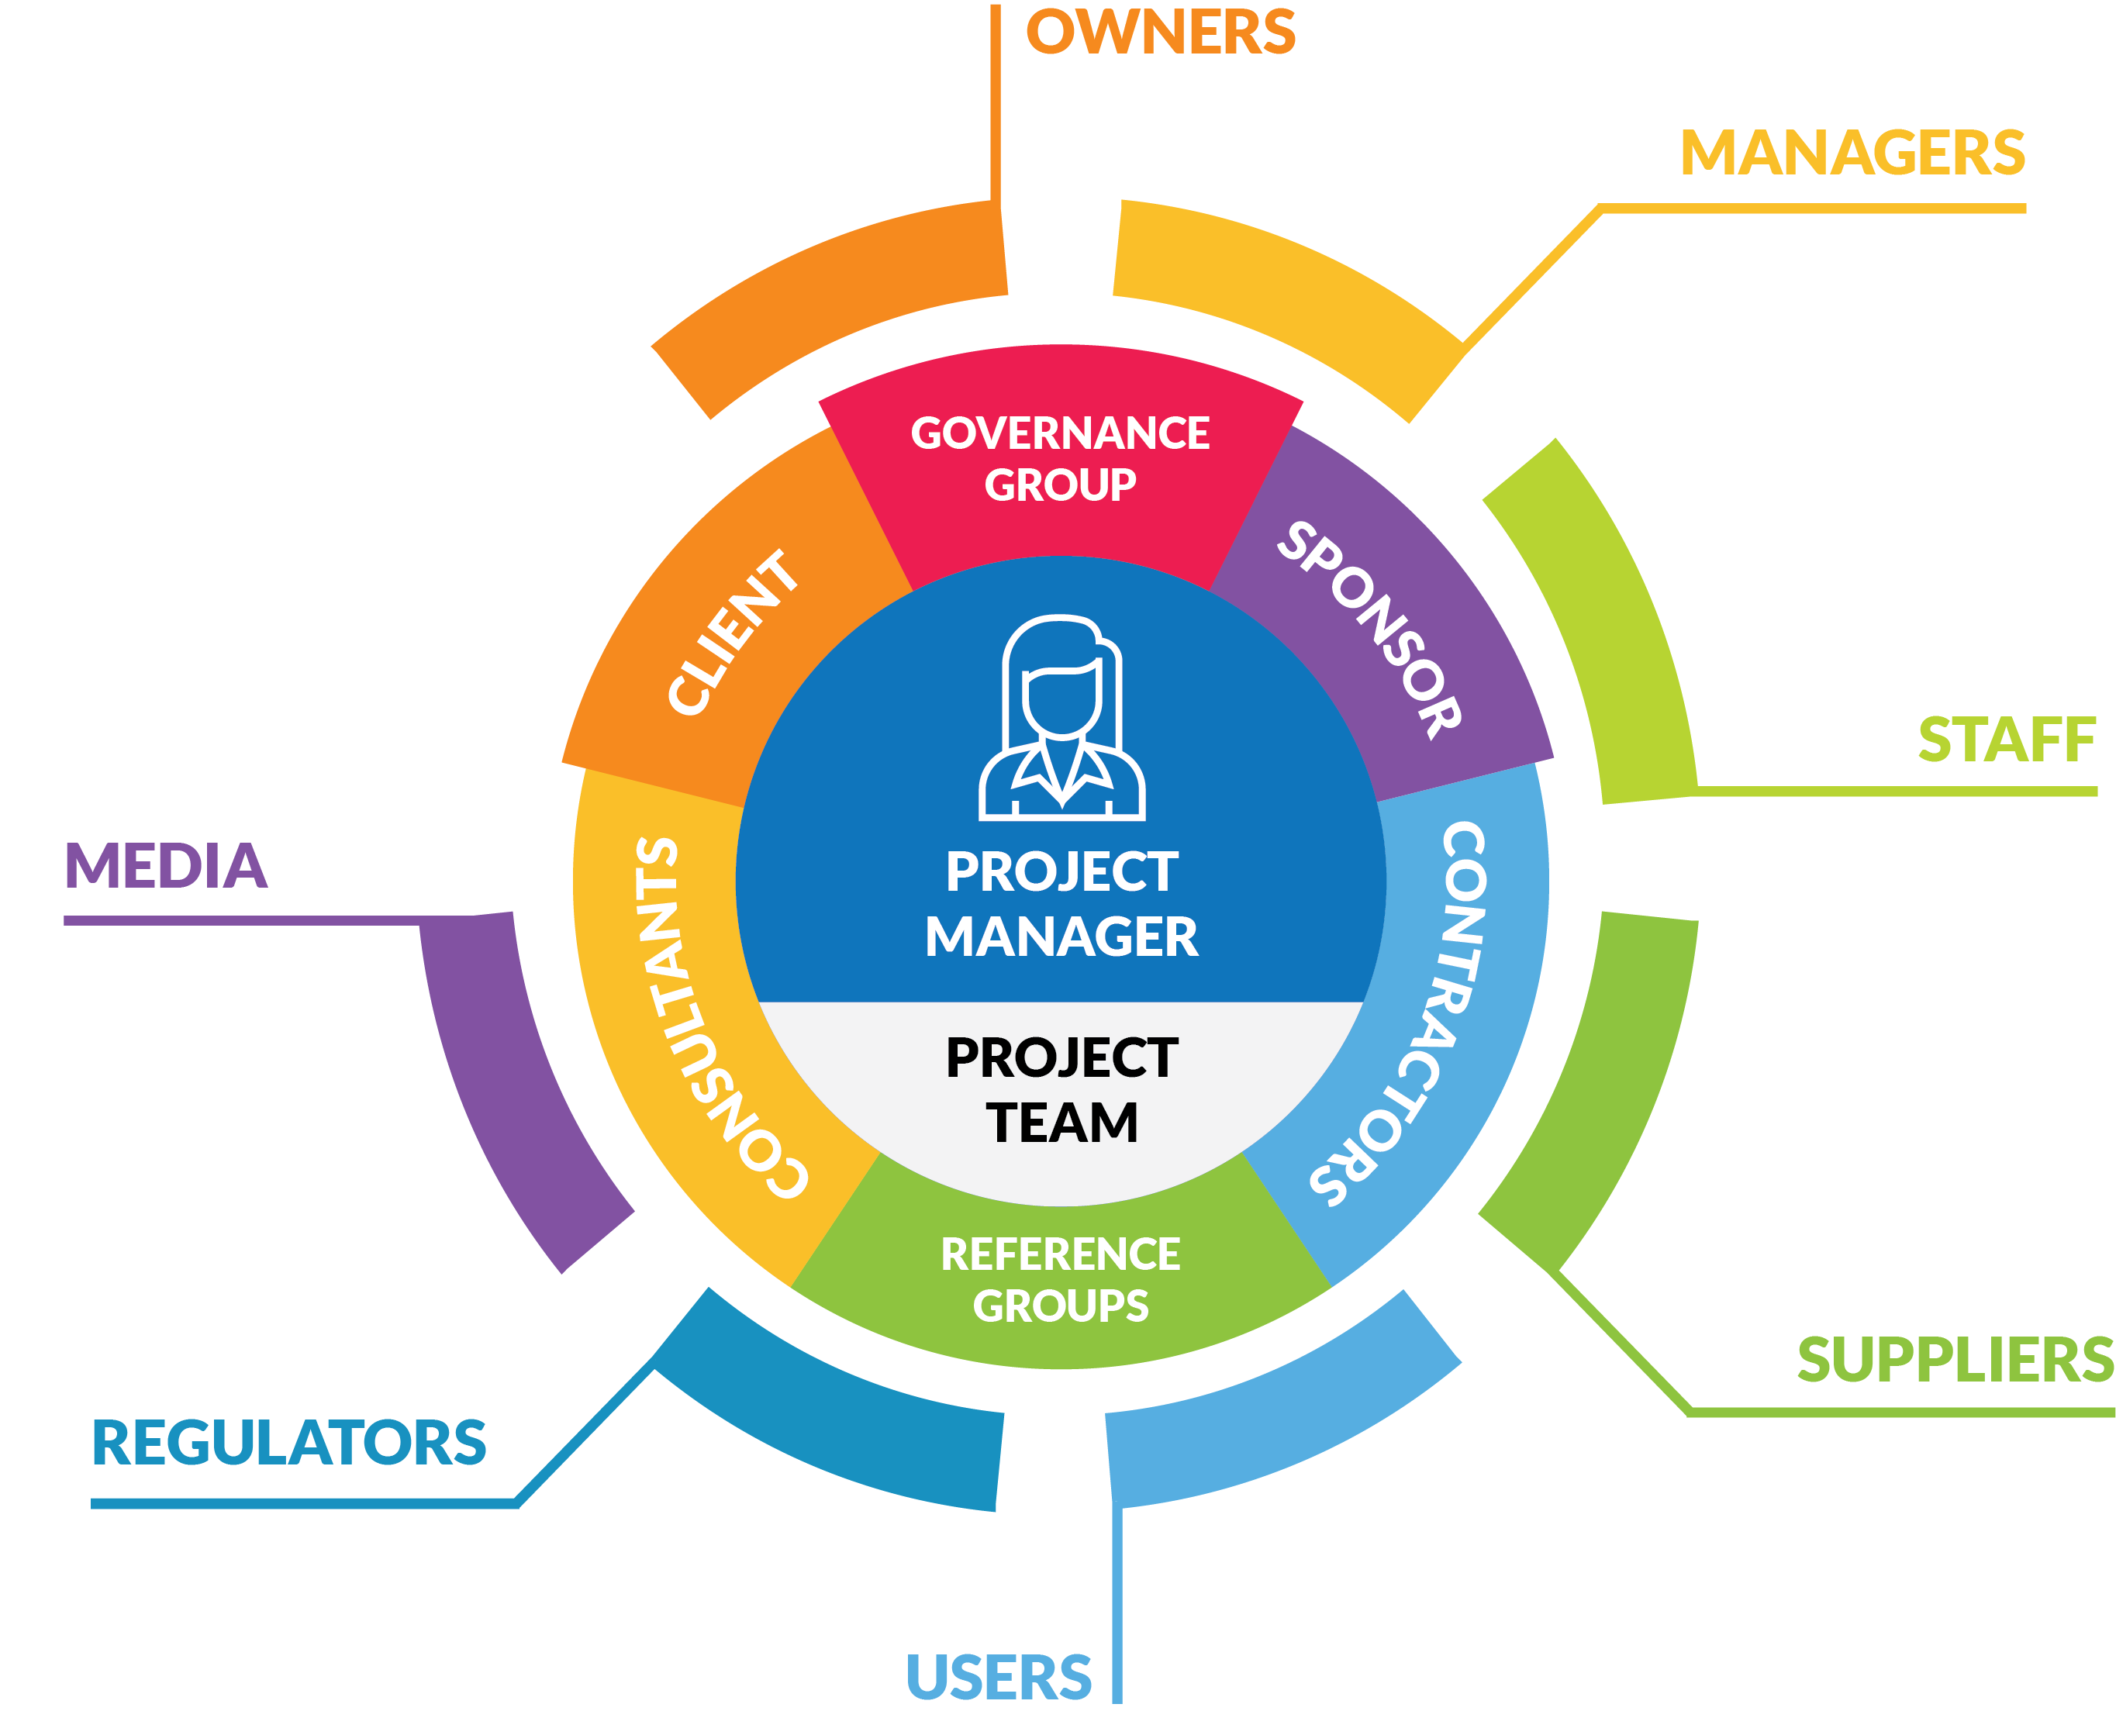
Indirect stakeholders
Notes:
Special interest groups (such as unions and consumer advocates) and the media act as a further check on the limits of what projects can and cannot do.
Depending on the nature of your project, falling foul of the media might make it difficult to work in your industry again.
Falling foul of the regulators may land you in jail!

Slide 23
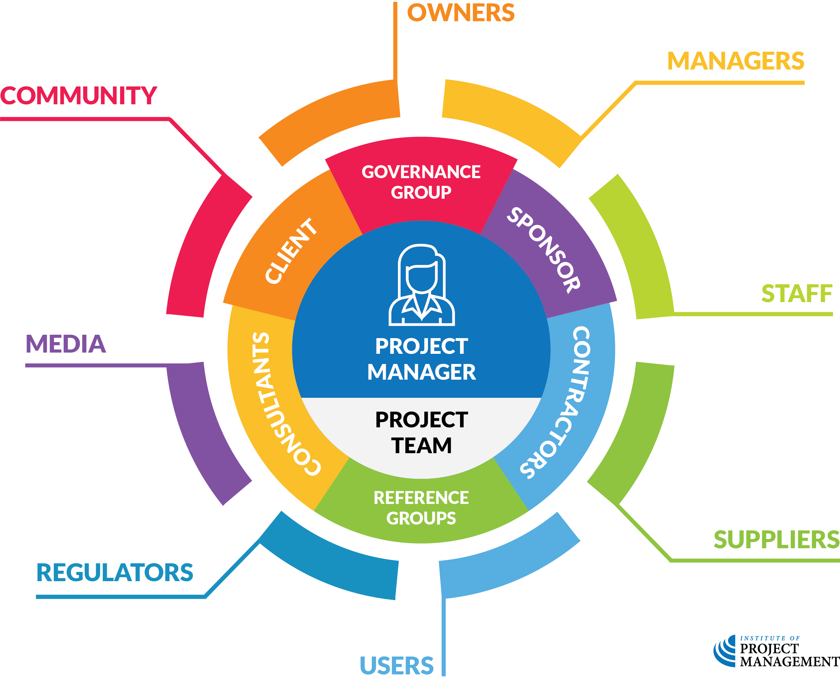
Project stakeholders
OPEN 2.2–2.4
Notes:
There is today an increasing expectation that organisations consider the impact their projects will have on the wider community, including non-users of the product, service or result produced.
Some obligations in this regard are enshrined in law, such as the liability of product manufacturers; however, others are broader and concern the brand or reputation of the commissioning firm.

Slide 24
Activity 2.2
OPEN 2.7
What do stakeholders typically expect of their project manager?
What can stakeholders do for their project manager?

Slide 25
Activity 2.2 – answer
Stakeholders expect you to:
Make every effort to understand their needs
Acknowledge and address those needs ASAP (even if they can’t be perfectly met)
Always engage with them professionally
Keep your promises
Stakeholders can provide you:
Feedback
Expertise
Networks
Advocacy
Notes:
Answer slides are only to be used as a summary once the activity and discussion debrief have been completed.
You should be able to say, yes, we got this point and this one, but stop and explain in more detail when something wasn’t covered in the discussion.
Keep your promises – keep in mind that your statements on project milestones, deadlines, budgets and the features of your deliverables (in fact, the entire project plan) are all ‘promises’ in the mind of the stakeholder; promises that they will hold you accountable to.
For that reason, you should put these statements in their appropriate risk context if you want to have any hope of managing stakeholder expectations.
This is something we explore in project planning.

Slide 26
Notes:
Before breaking, ask students if there are any questions about what has been covered in the session so far.
Once answered, encourage students to stand up, get a drink, go outside and stretch.
If they are on Zoom, tell them to turn their camera and microphone off (you do the same)!
Make sure you tell them the precise time you will be restarting (eg 10:10am)
Don’t check your email – take a proper break!!

Slide 27
Stakeholder prioritisation
OPEN 2.6
Notes:
Given that projects have a limited amount of time and resources available to them, we cannot realistically expect to service and satisfy every single stakeholder (even if that is what they want).
We therefore need to prioritise our stakeholders in a way that will meaningfully guide us on how to manage them.
Many project managers use a simple classification model that groups stakeholders by their level of real or potential authority or power over the project and their corresponding level of interest in it.
Importantly, these values are independent of each other.
Just because a person has a high level of power over a project doesn’t mean they have a low or high level of interest in it – in fact, their interest could be at any level.
Similarly, high or low interest says nothing about a person’s level of influence or authority.
After all, just because I am interested in the Football World Cup, doesn’t mean I get a say in its delivery!

Slide 28
OPEN 2.6
Notes:
Stakeholder power refers to their level of authority or influence over a project.
Stakeholders with 'high' power can direct significant changes to your project’s time, cost and/or scope; whereas, stakeholders with 'low' power have minimal influence at best.
The following table defines power across five dimensions, from very high to very low.
As a rule, we prioritise the needs of high power stakeholders over the needs of their low power peers.
Definitions like these are usually mandated in the methodology of an organisation to facilitate a common understanding across projects, programs and portfolios of work.
Although you are free to use these definitions in your own organisation, they are not doctrine – you should modify them if appropriate to align with the unique contingencies of your project and organisational environments.

Slide 29
OPEN 2.6
Notes:
Stakeholders can have high or low interest in a project, but that interest can also be positive or negative
Positively interested stakeholders generally feel good about the project, its potential outcomes and the impact it will have on their person and/or community.

Slide 30
OPEN 2.6
Notes:
Negatively interested stakeholders are opposed to the project.
This negative interest is rooted in their belief that the potential outcomes and the impacts they will have will ultimately harm them and/or their community.
Once again, be sure to adopt definitions such as these in your methodology at the organisational level, as our different projects usually have a number of stakeholders in common.

Slide 31
Overall stakeholder priority
OPEN 7.5
POWER x INTEREST

Slide 32
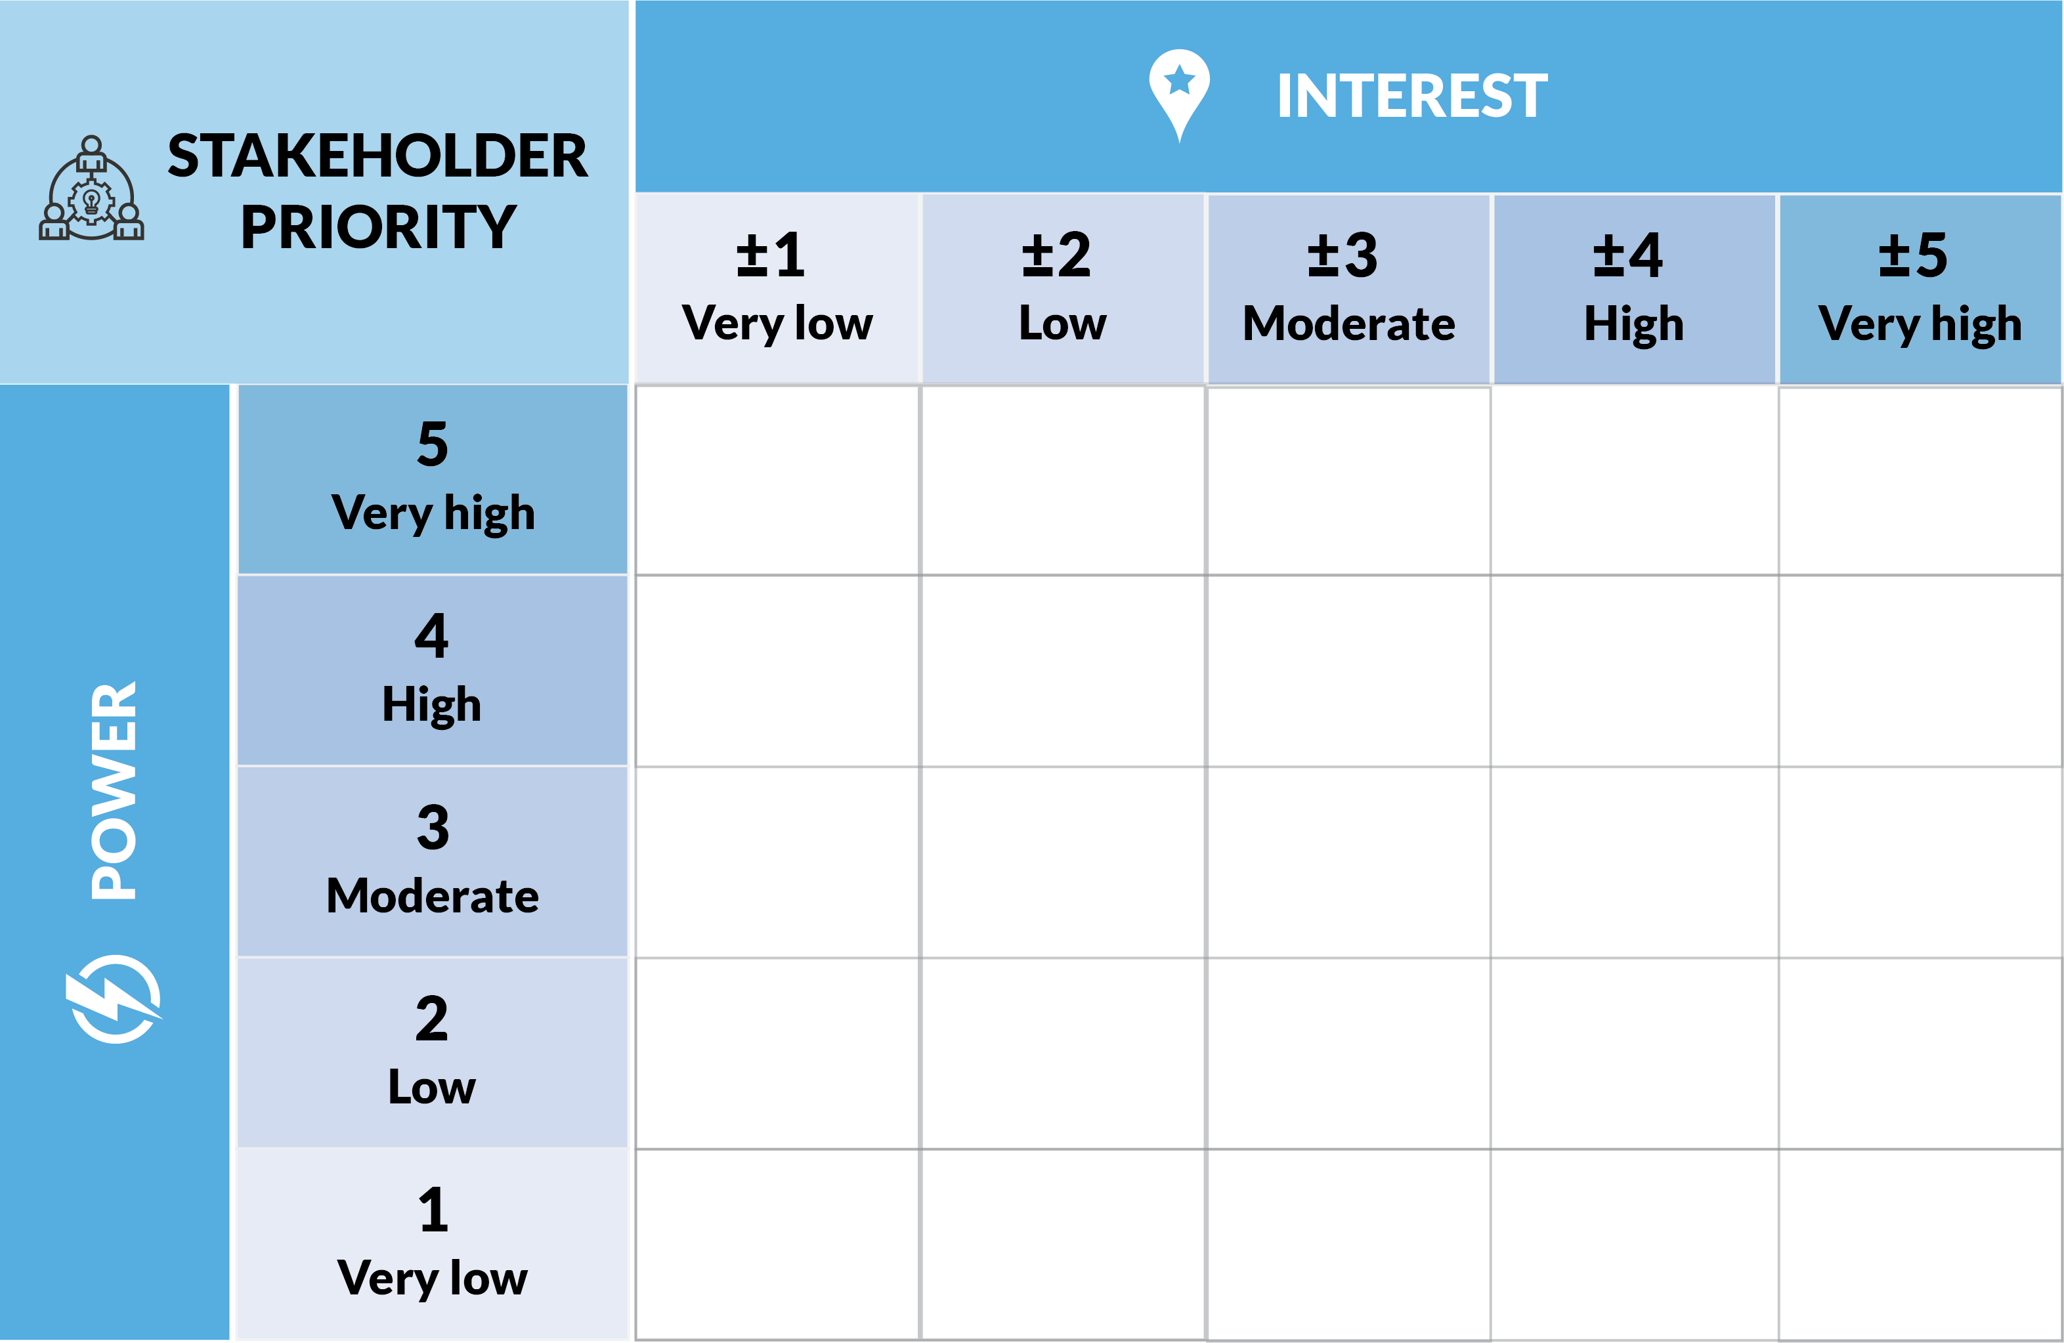
OPEN 2.6
Resident
-4
Notes:
We have identified a concerned local resident as a stakeholder in our project.
We have not yet made them aware of the project; however, we expect they will be opposed to it given their record of enmity toward similar projects in the past.
That said, as an individual, there is not a lot they can do about our project one way or another.
Using the definition tables, we therefore agree on the following power and interest ratings:
Very low power: This stakeholder cannot directly impact the project
High negative interest: This stakeholder believes that the financial and/or social costs of the project are greater than any potential benefits it may realise

Slide 33
OPEN 2.6
Supplier
+9
Notes:
Our next stakeholder is a supplier of project essential materials.
If this supplier proves difficult or fails to deliver on time, they would have a minor impact on the project’s schedule and/or budget (especially if we had to use another supplier at the last minute, or we were paying our team to stand around waiting).
That said, our supplier does want our project to succeed, because that means they get paid!
Moderate power: This stakeholder can have a minor impact on the project’s schedule and/or budget (from our earlier definition)
Moderate positive interest: This stakeholder sees benefit to themselves in the project and will be annoyed if the project fails (from our earlier definition)

Slide 34
Discussion
Which stakeholder deserves the highest priority…
… the resident (-4)?
… the supplier (+9)?
Notes:
You might like to run a quick vote or poll:
Hands up who says the resident?
Hands up who says the supplier?
Hands up who forgot to put their hand up?
The supplier is the higher priority stakeholder.
Stakeholders are prioritised by their level of interest in a project, regardless of whether that interest is positive or negative.
However, this does not give us licence to ignore the resident. As we shall see, it just means we take a different approach. The state of positive or negative interest is only used to signal what the project manager can expect from their interactions with the stakeholder.

Slide 35
Activity 2.3
OPEN 2.6
Prioritise your stakeholders using the power / interest matrix
B
A
G
E
C
F
D
H
Notes:
Refer to the list generated at Activity 2.1
Note the interactive pdf has our stakeholder power and interest definitions added as comments you can hover over to reveal
Lead the discussion by going through stakeholders one-by-one, getting groups to justify their ratings (especially when the groups are in conflict) – what assumptions have they made
Extension question – what if all are high power / high interest?
Have we missed less obvious ones?
More detailed categorisation required?
Extra resources need to be allocated to stakeholder engagement

Slide 36
Stakeholder engagement

Slide 37
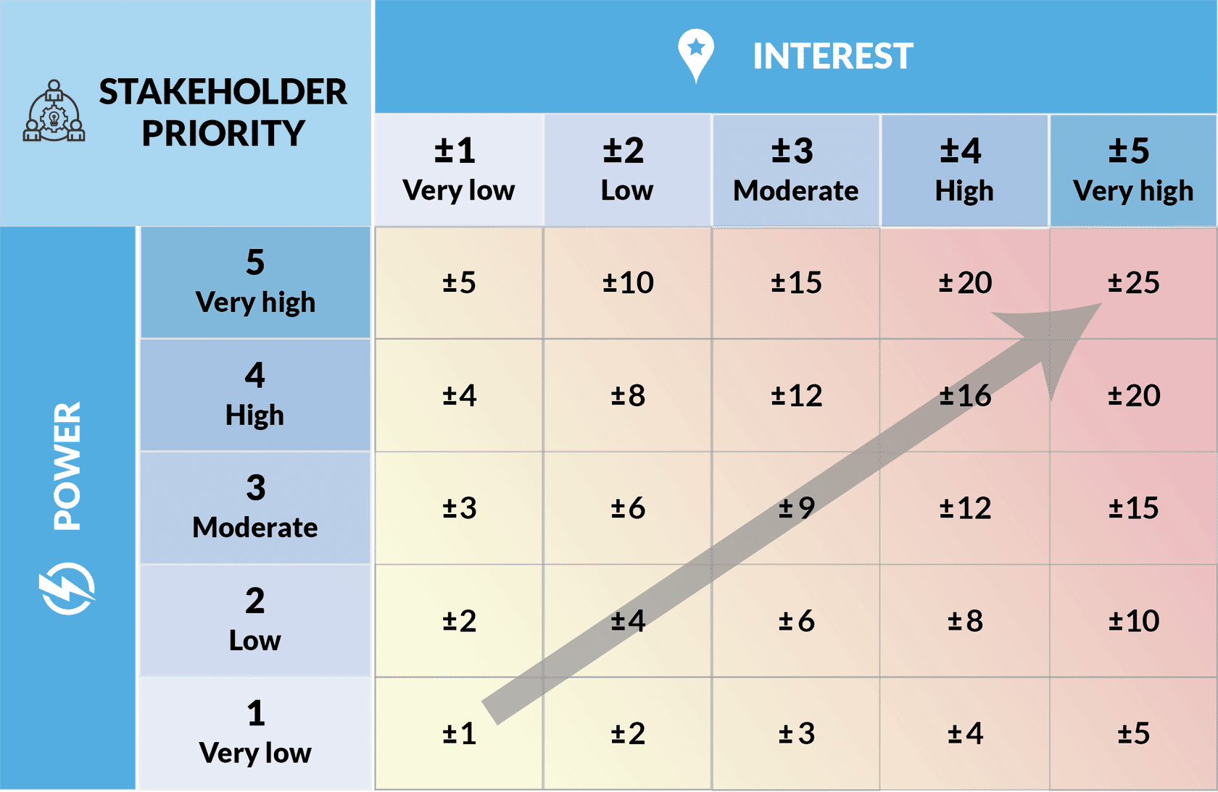
Notes:
Pre-populated, the power / interest matrix reveals a general ascendancy in score from the bottom left (very low power and interest) to the top right (very high power and interest).
The project team can use this scale to introduce thresholds, whereby the level of engagement intensifies in line with stakeholder priority.

Slide 38
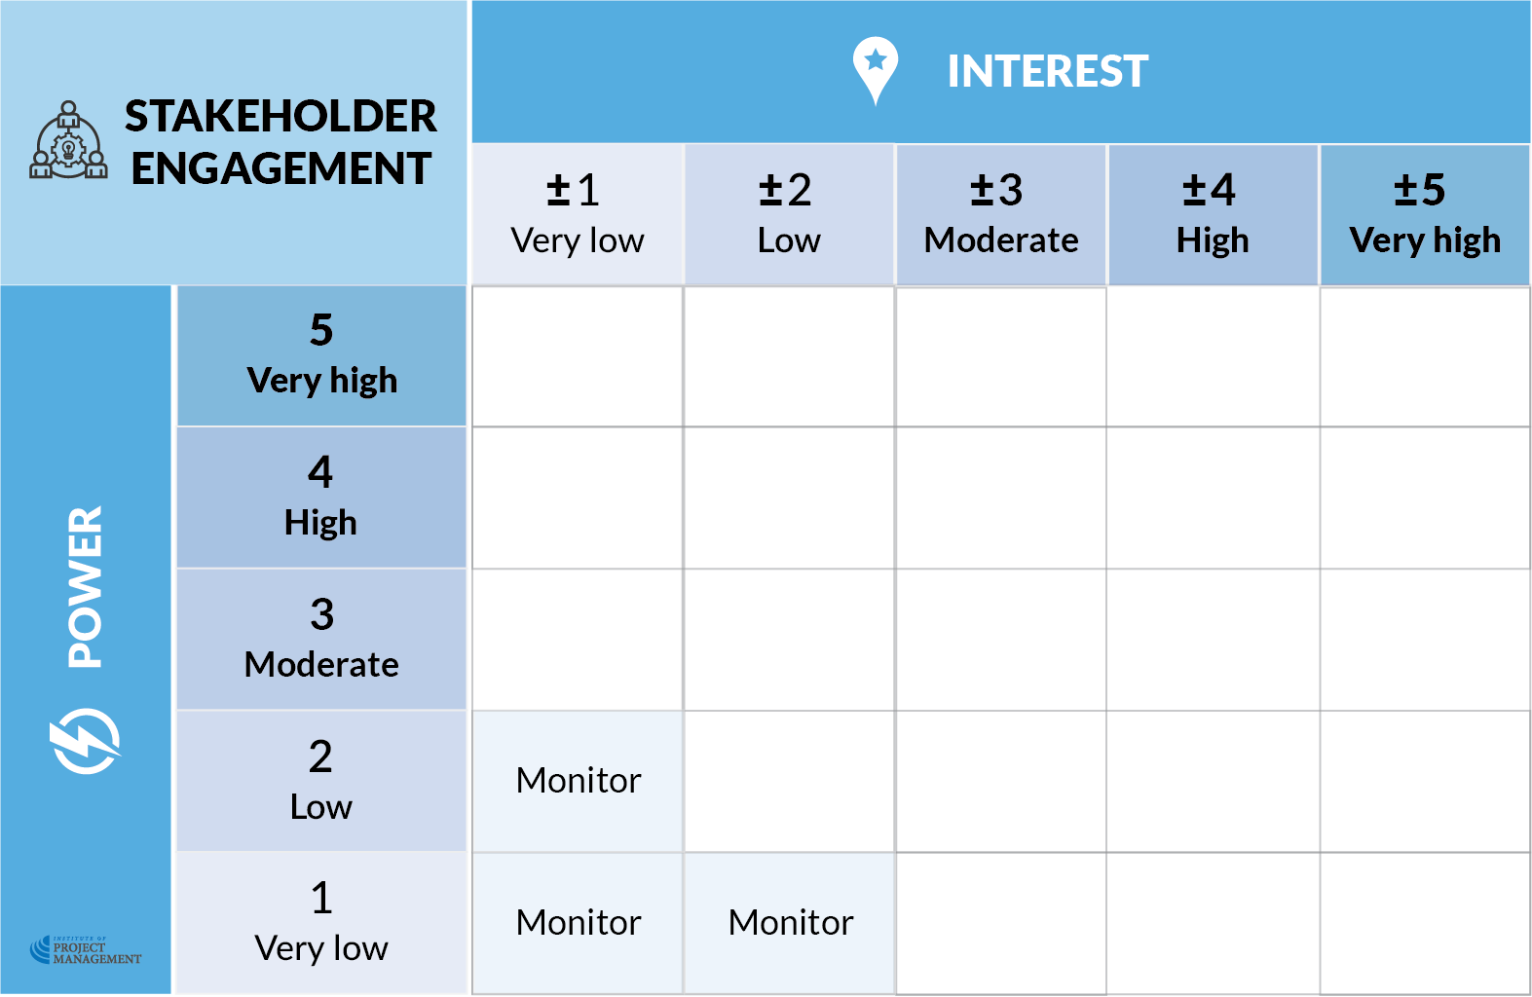

Slide 39
Notes:
By definition, stakeholders with very low interest and very low power don’t particularly care about our project and couldn’t really act if they wanted to.
As such, they only need be monitored for changes in their attitude or behaviour.
Monitoring involves identifying the media they engage with and staying abreast of it.
This might include regularly scanning newspapers, special interest publications, and web channels such as blogs and discussion forums.
You can also set Google Alerts to notify you via email when topics of interest emerge or change.
In this instance, we are not just interested in the content, but the commentary that attaches to it.
So what are we looking for? Guiding questions might be:
Are new phases or changes in the project likely to stimulate a higher level of interest from these stakeholders?
Will this interest motivate them to access and leverage someone who has greater power over the project?
You see, just because a person has no power, doesn’t mean that they can’t access it somewhere else!
Monitoring impacted stakeholders is a passive activity that does not require any stakeholder input.
As such, it is a low-cost engagement strategy that can act as an early warning system for higher-need stakeholder issues.

Slide 40
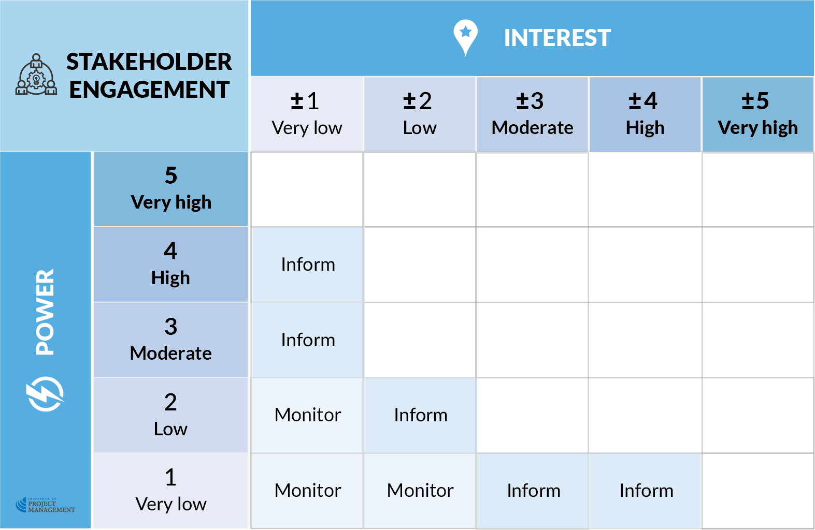

Slide 41
Notes:
Keeping stakeholders informed requires a commitment to providing balanced, objective, accurate and consistent information to assist them to understand the project, including any issues, alternatives, opportunities and/or solutions.
Informative media is generated within the project and broadcast to stakeholders through a variety of channels, including:
Press releases
Newsletters, bulletins & circulars
Advertisements
Open days / events
Social media and blogs
Importantly, the information you provide should be tailored to the expectations of the audience.
More often than not, this can be reduced to an understanding (from the stakeholder’s perspective) of how this project will impact me and my interests.
In addition to general status updates, residents may want information on service interruptions, suppliers will want information delivery access, and project team members will want to know how and when they are getting paid!
Although these communications are not in and of themselves an invitation to provide feedback, they can occasionally stimulate unexpected or unintended stakeholder interest.
For that reason, you should also continue to monitor (and, if necessary, action) this feedback.

Slide 42
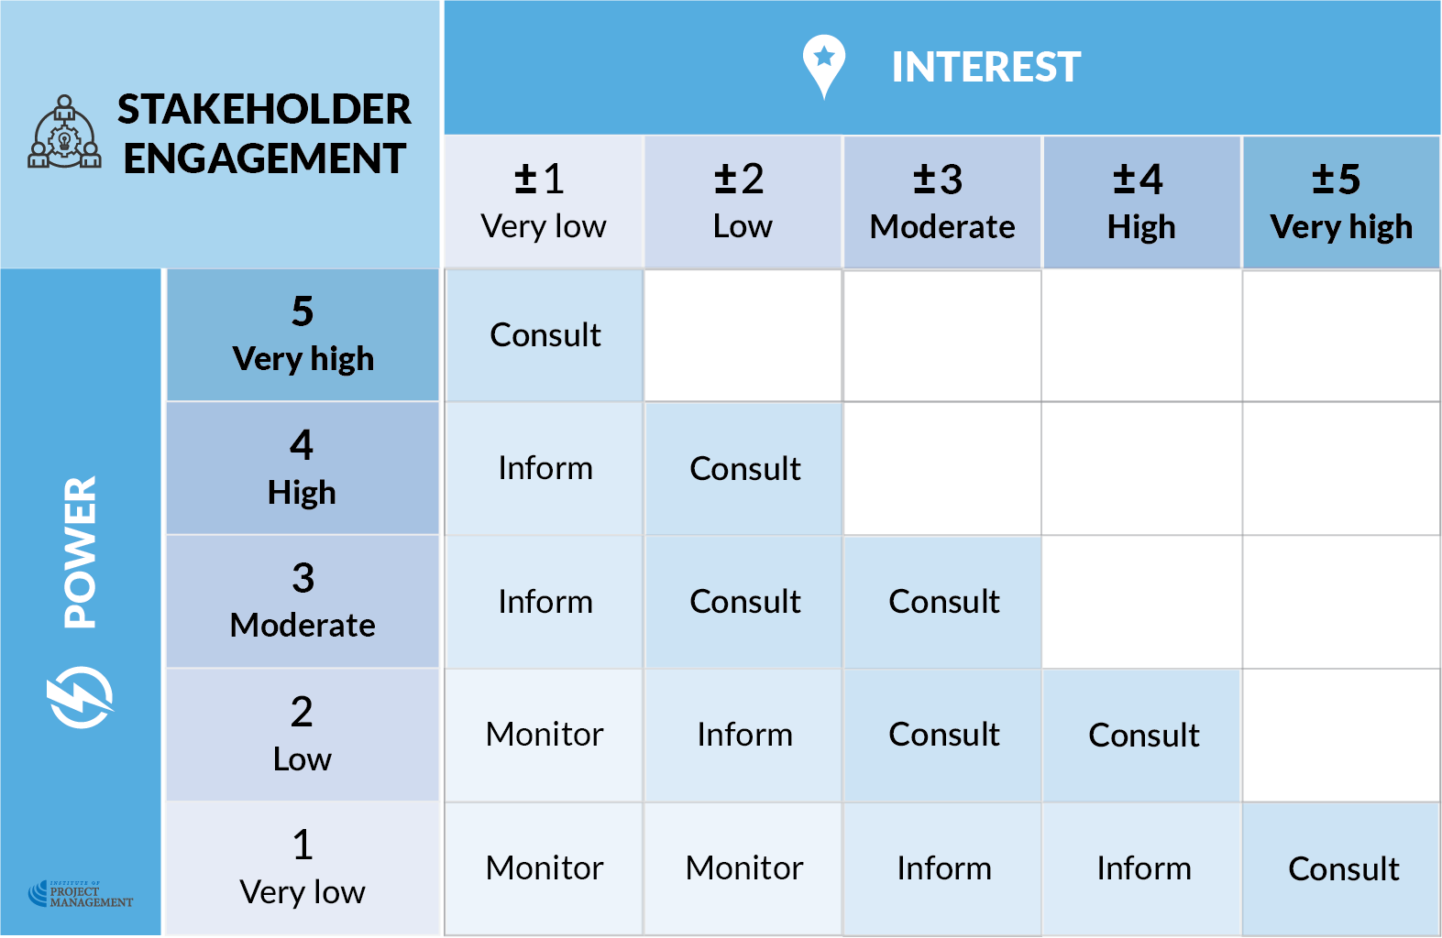

Slide 43
Notes:
Stakeholders in this spectrum with higher power tend to adopt a passive or business-as-usual attitude to the project, only exercising their power when provoked.
These exercises of power might manifest as unfavourable publicity, sanctions or the withdrawal of services that the project depends on.
To that end, keeping these stakeholders satisfied may involve going beyond merely keeping them informed.
You may also need to consult them on the project to ensure their concerns and needs are consistently understood and addressed.
Unlike informing, consulting relies on seeking and collating feedback that is then used as an input into decision making.
Consulting stakeholders might include:
Distributing surveys
Running focus groups
Inviting public comment (for example, on plans, models or prototypes)
Conducting interviews, or
Hosting open or closed forums.
Stakeholders with lower power but higher interest should also be consulted to ensure their voices are heard and the issues, risks and opportunities they identify are brought forward for consideration.
It is nonetheless important to note that it is possible to counter-intuitively provoke stakeholders by overwhelming them with demands for input.
Therefore, a more prudent approach may to be monitor, keep them informed and provide the opportunity for consultation, rather than requiring it.
The unstated expectation is that you as the project manager will make the decisions and not rely on them in this regard.

Slide 44
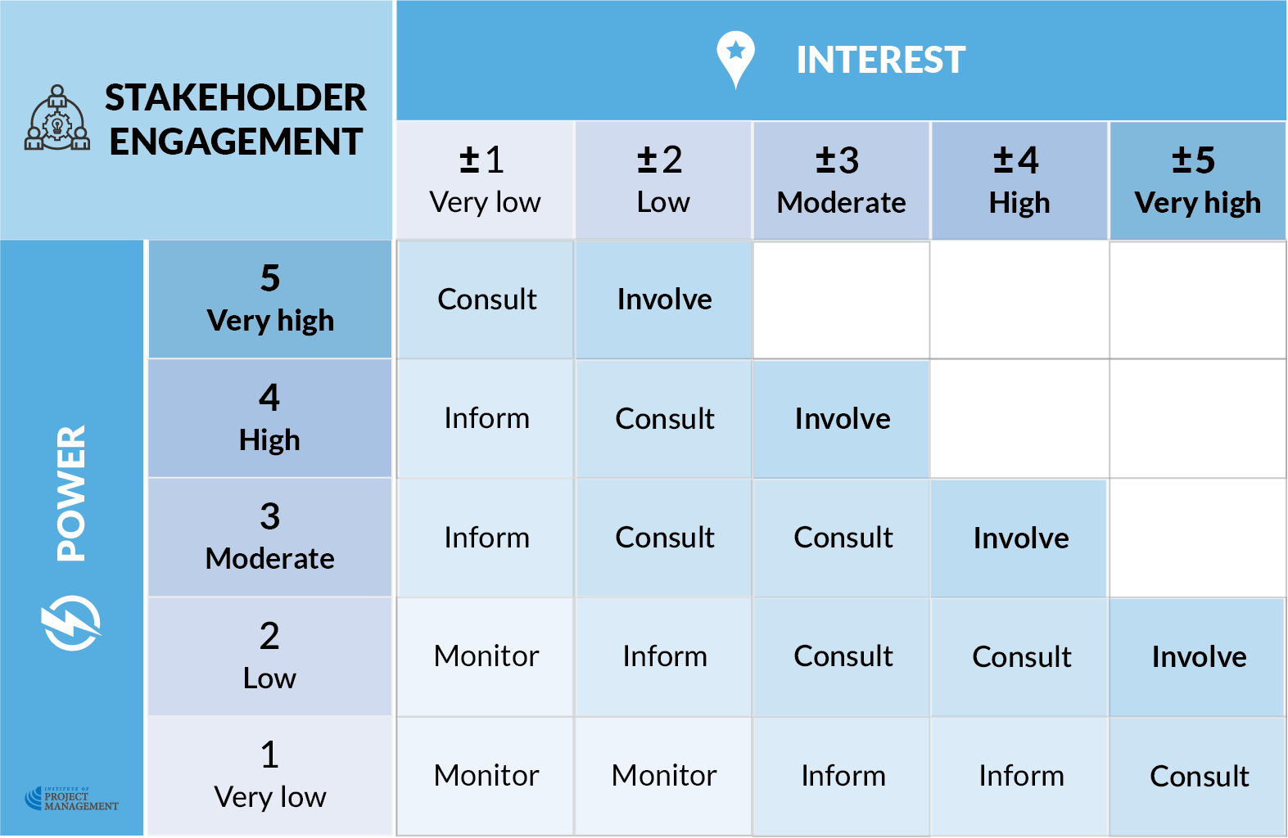

Slide 45
Notes:
Some stakeholders offer a level of expertise that is born of their high level of interest or experience in the field.
Certain suppliers, consultants or contractors fit into this category; although, this is by no means a definitive list.
Capitalising on their knowledge means going further than consultation to more fully involve them in your project.
The difference is that whereas you use the outputs of consultation to inform your own decisions, involvement implies a heavier reliance on the wisdom of the stakeholder.
Involving, for example, the marketing department or media team when designing a new product invites them to plug specific gaps in your project team’s knowledge.
One-on-one meetings, facilitated workshops and reference groups are ideal vehicles for more fully involving this group.
Some stakeholders, like government officials, become involved because it is a requirement of their employment; others – especially those who are strongly interested – will continue to give freely of their time.
That said, at this point you may have to start paying your stakeholders for their knowledge and time.

Slide 46
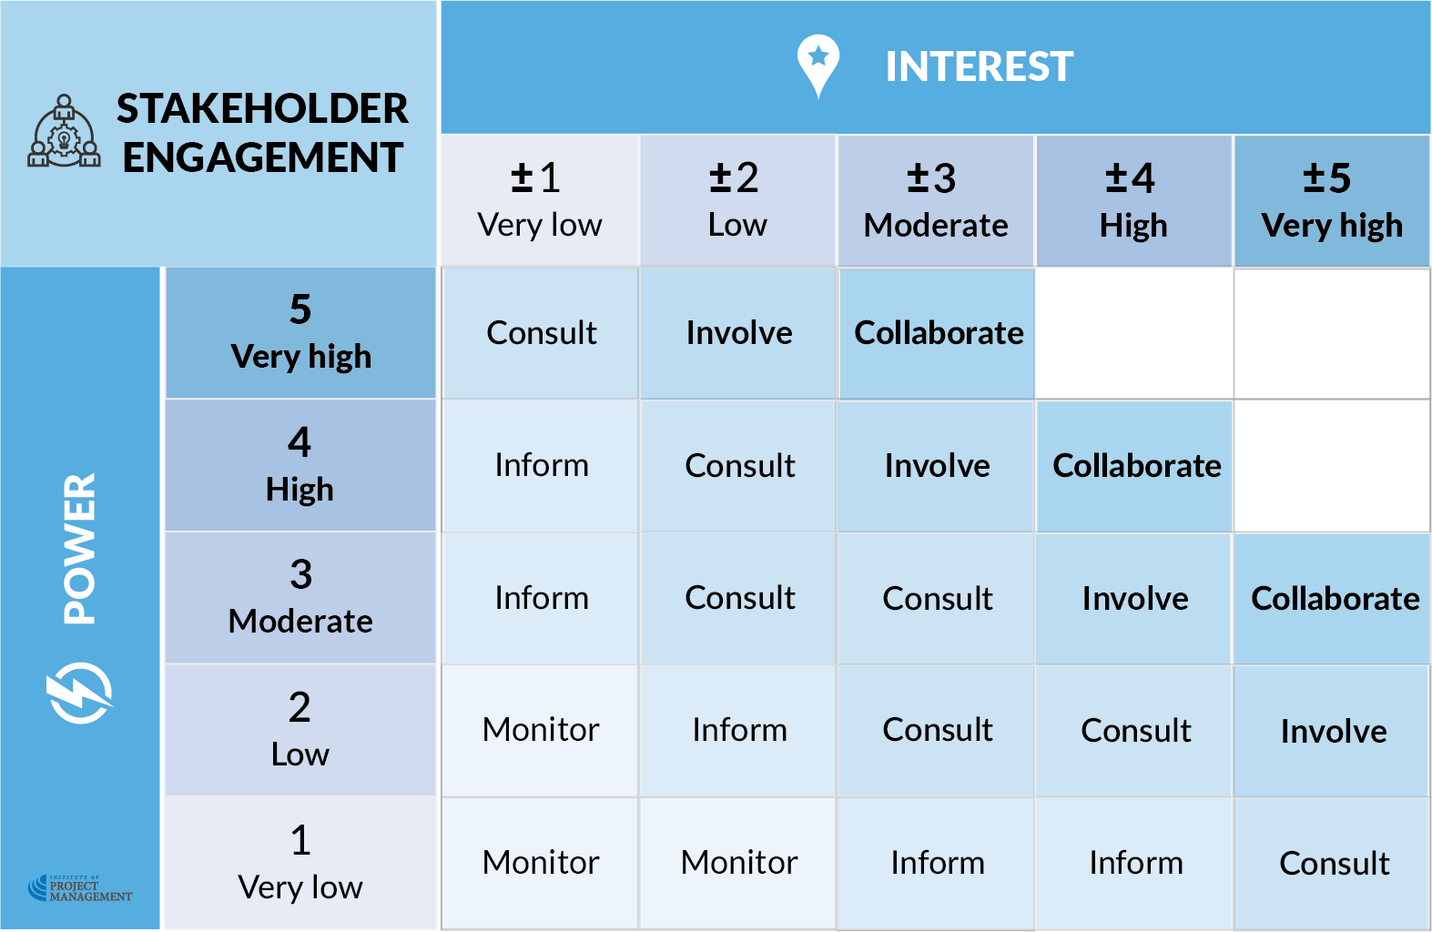

Slide 47
Notes:
Stakeholders who have this level of power and interest generally expect to be able to influence the project and its outcomes.
Therefore, as well as engaging with stakeholders in ways we've already discussed, you may need to consider more directly collaborating with them.
Extending involvement, collaboration implies a willingness to let the collaborating partner or group arrive at an ideal course of action, even though the project team will exercise the final decision-making discretion.
Although a level of compromise may be necessary to achieve the desired outcomes, genuine collaboration is about finding an optimal solution that builds on the innovative ideas of the group.
However, to be truly effective, successful collaboration demands a significant commitment of time and resources.
As such it is best reserved for more ambiguous or intractable problems that need solving.
And keeping in mind the incremental cost of change, it is ideally undertaken in the early stages of a project’s life.

Slide 48
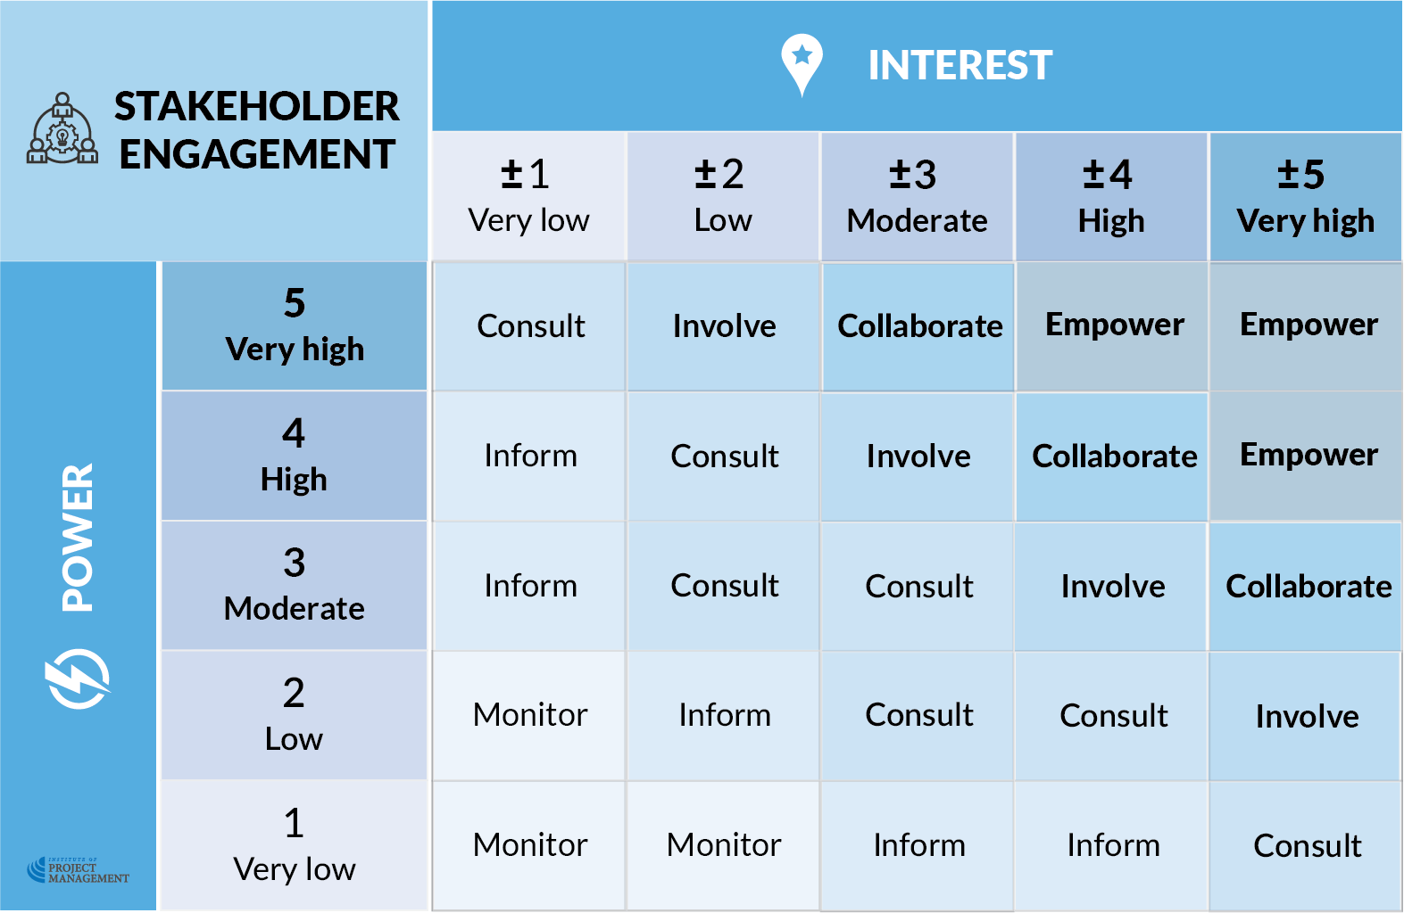
OPEN 2.7

Slide 49
OPEN 2.7
Notes:
Full empowerment ultimately grants decision-making authority to the stakeholder; although, as the level of power implied by the matrix suggests, it is a power they may already have!
That said, the project manager, in consultation with the sponsor, should clearly define and articulate the left and right limits of this privilege.
Senior stakeholders are usually empowered by invitation to the project's governance group.
This group should be assigned terms of reference that set out the purpose, structure and working arrangements of the committee.
Yet an important point to note is that although some stakeholders come with high or very high power as a default of their job title or status in life, the project manager can effectively grant this power to anyone.
For example, project team members are otherwise ordinary citizens empowered through their position description.
Indeed, each of the engagement methods discussed so far gradually empowers stakeholders by bringing them closer to the centre of decision-making.
Therefore, you can use your discretion by choosing to involve someone when their ordinary intersection of power and interest does not demand it.
The channels by which you keep moderate power / low interest stakeholders informed may also reach and engage very low power stakeholders you would typically only monitor.

Slide 50
Activity 2.4
OPEN 2.10
What do you think are some of the barriers to optimal stakeholder engagement?
Notes:
In other words, what issues, actions, attitudes or behaviours prevent you from engaging fully with your stakeholders?

Slide 51
Activity 2.4 – answer
Delay in or failure to identify or include stakeholders
Incomplete or ambiguous information and/or engagement intent
Stakeholder ability / access / disadvantage
Insufficient time allowed / other workload
Communication style / media used
Stakeholder conflict or distress
Stakeholder preconceptions of the project
Doubts about the capability, stability, availability or bias of the project team
Stakeholders feel their input is not valued and/or their time is being wasted
Staff turnover without handover or continuity documentation

Slide 52
Discussion
What information should you capture in a stakeholder register?
Does every project need one?
Notes:
If you have time, open the stakeholder register and walk students through it, particularly the example entry and cover page.
Note that it is fully editable via the methodology page.
Larger organisations may use CRM software (like Salesforce, Dynamics or Zoho) as their stakeholder register – in fact any organisation with a customer database effectively has one.
But do you keep one (as a separate file) and update it for each specific project?
Does every project need a stakeholder register?
A rule of thumb for any project document is that the benefit of having it must be greater than the effort required to produce it.
In this instance, you should really only prepare a separate, formal stakeholder register / communications plan if, within your project:
Stakeholders can expect to have multiple contacts from different project team members
Stakeholders (including the project team) are likely to change throughout the life of the project (something that can be expected in long projects), and/or
You need to evidence your engagement with stakeholders; for example, when there is a legislative or policy requirement for consultation, or when there is known group of hostile stakeholders.
That said, you should always follow the management process of identifying, prioritising and engaging your stakeholders, even if you don’t keep a register

Slide 53
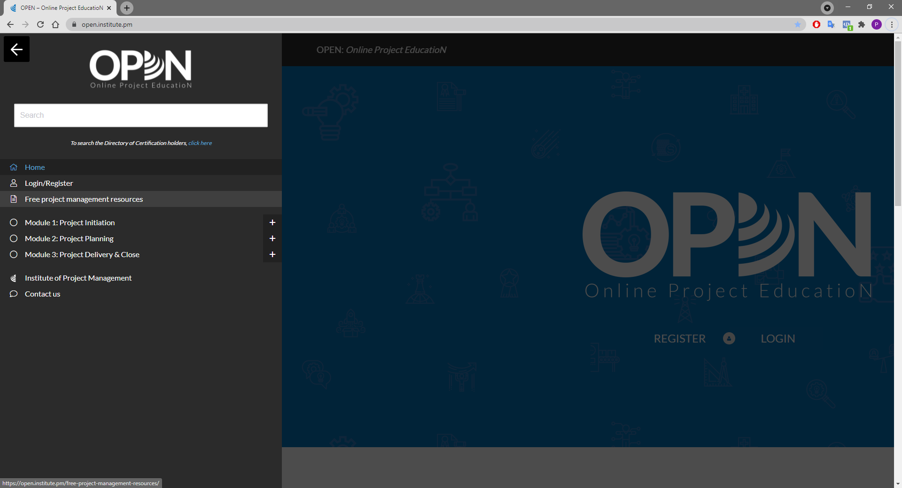

Slide 54
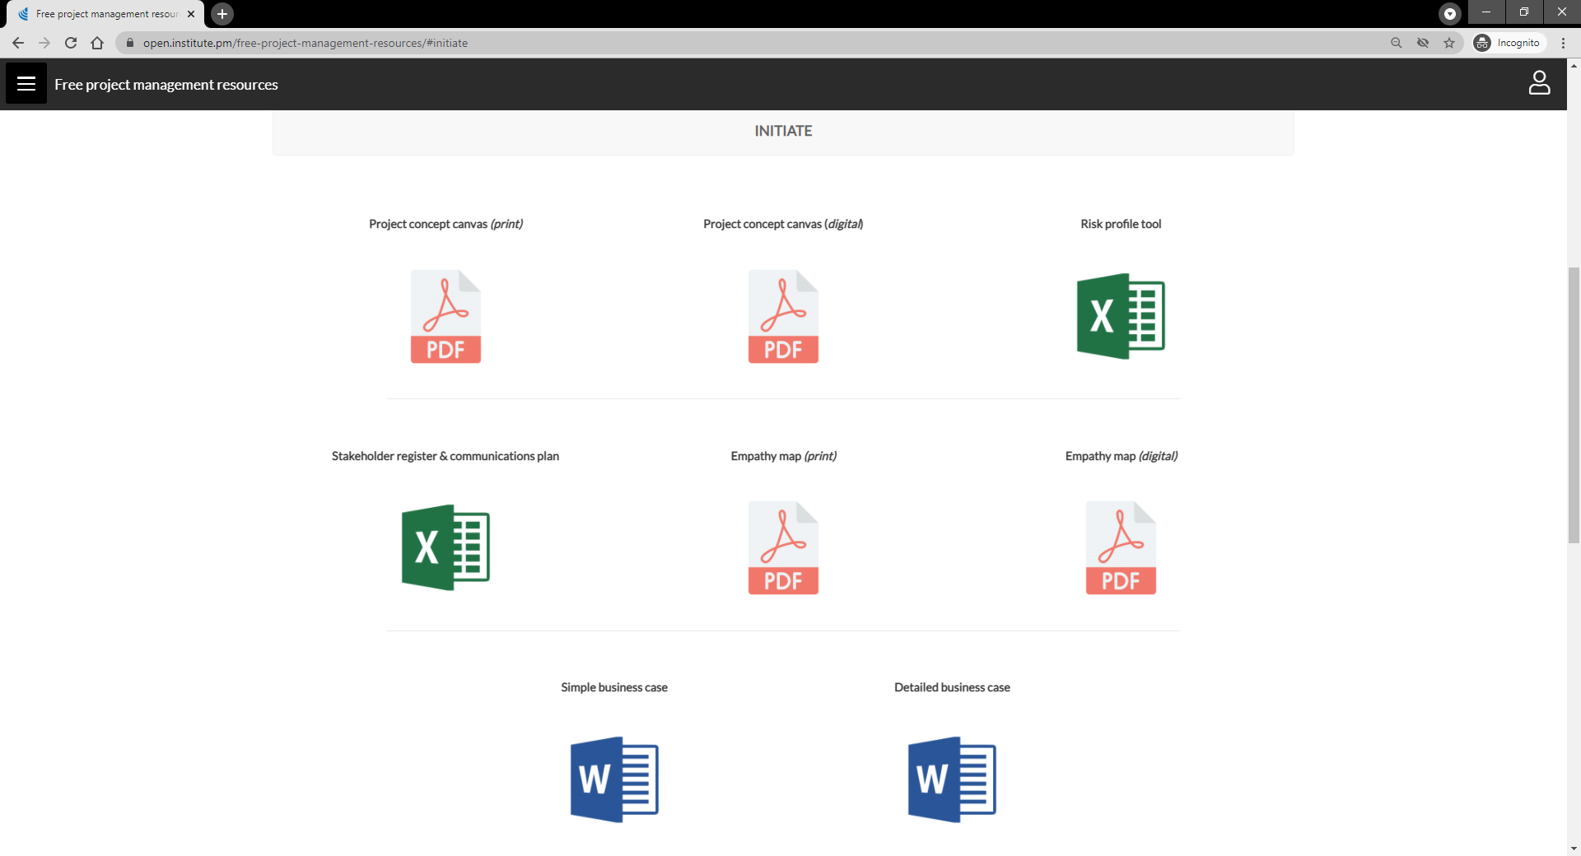
Notes:
Note the empathy map is for inclusion in our course on design thinking

Slide 55
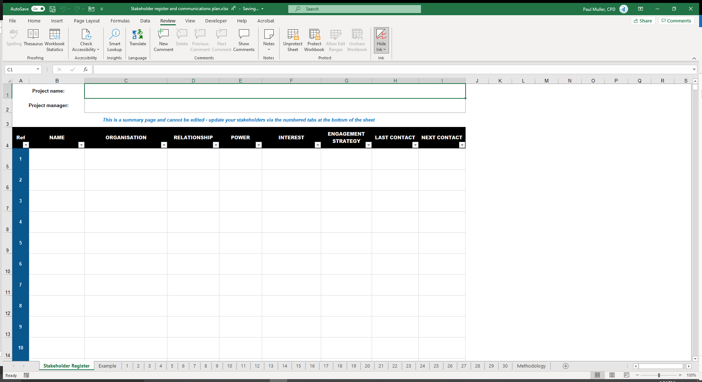
XYZ Project
Only these fields are editable on the summary page
Jenny Wong

Slide 56
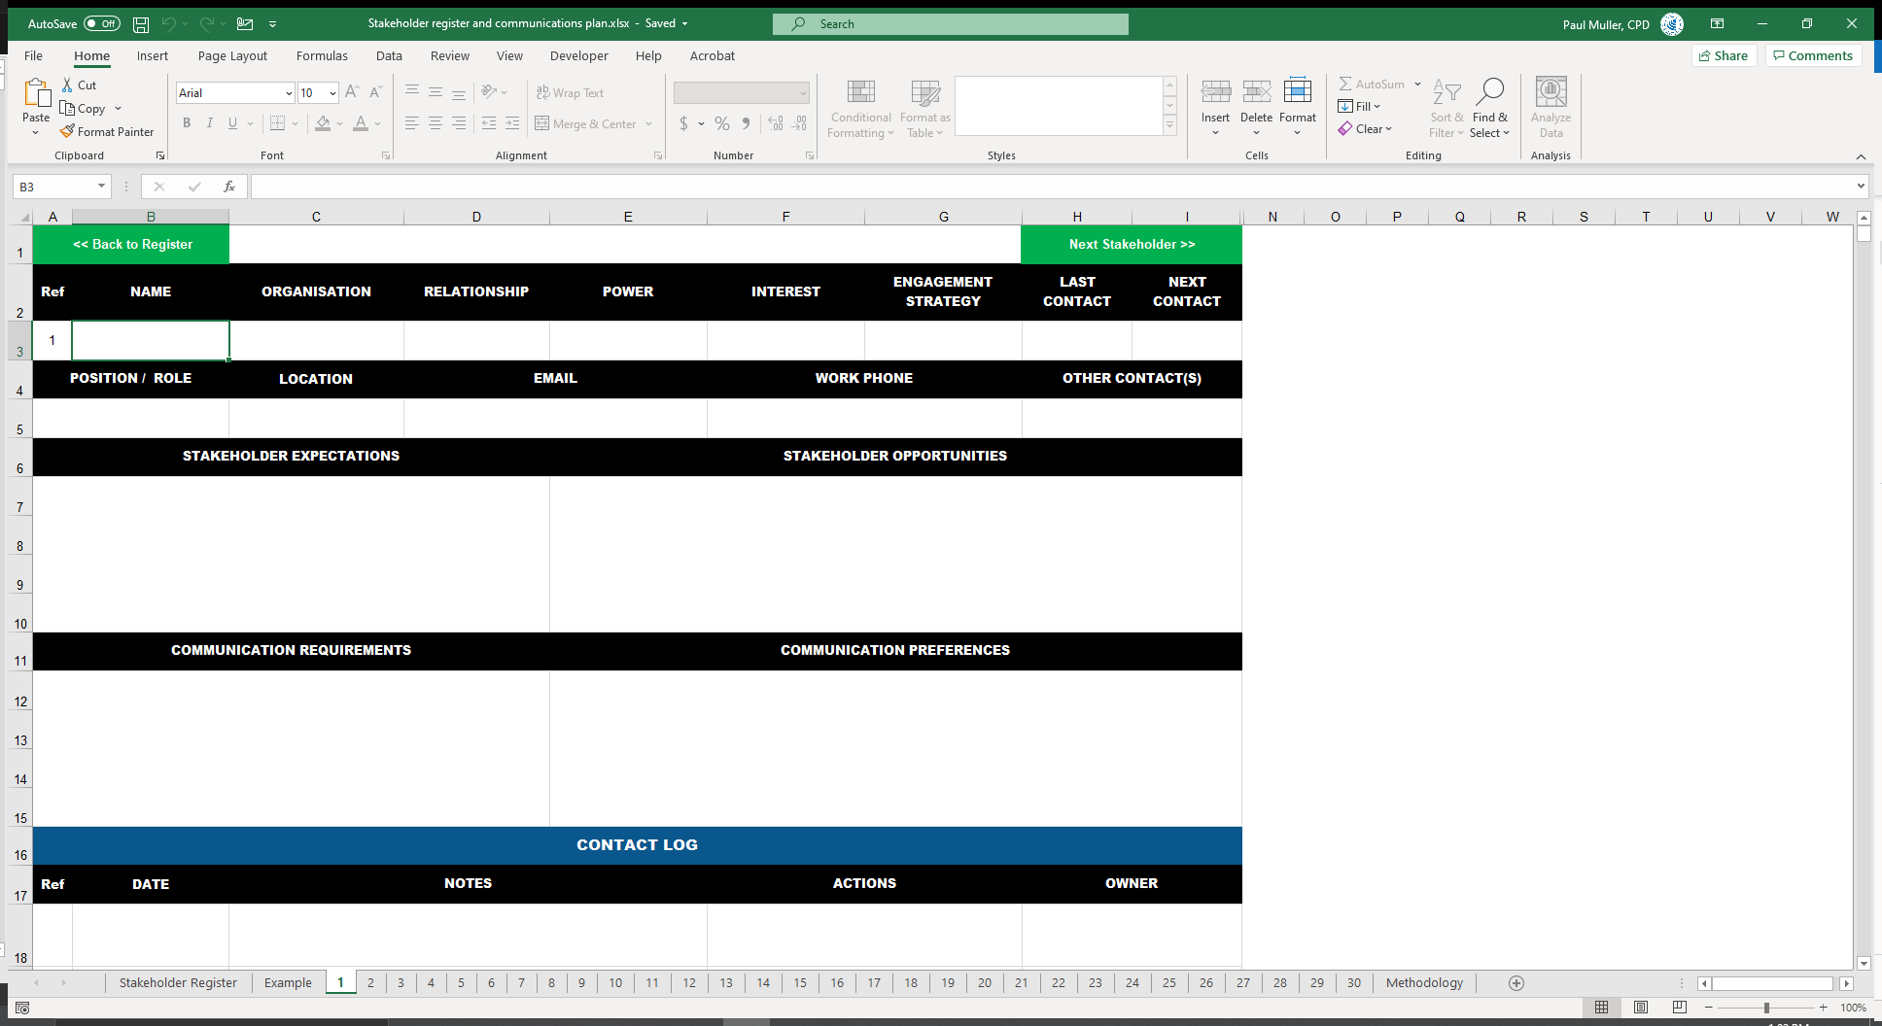
Each tab is a new stakeholder

Slide 57
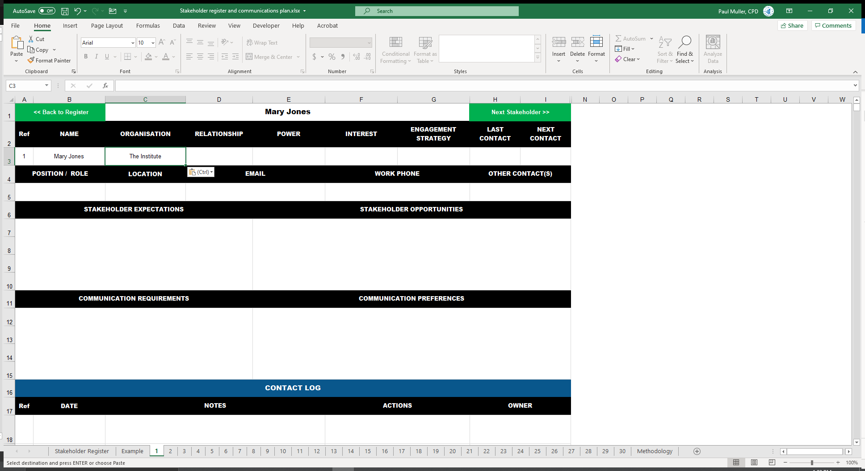
Start filling out stakeholder info

Slide 58
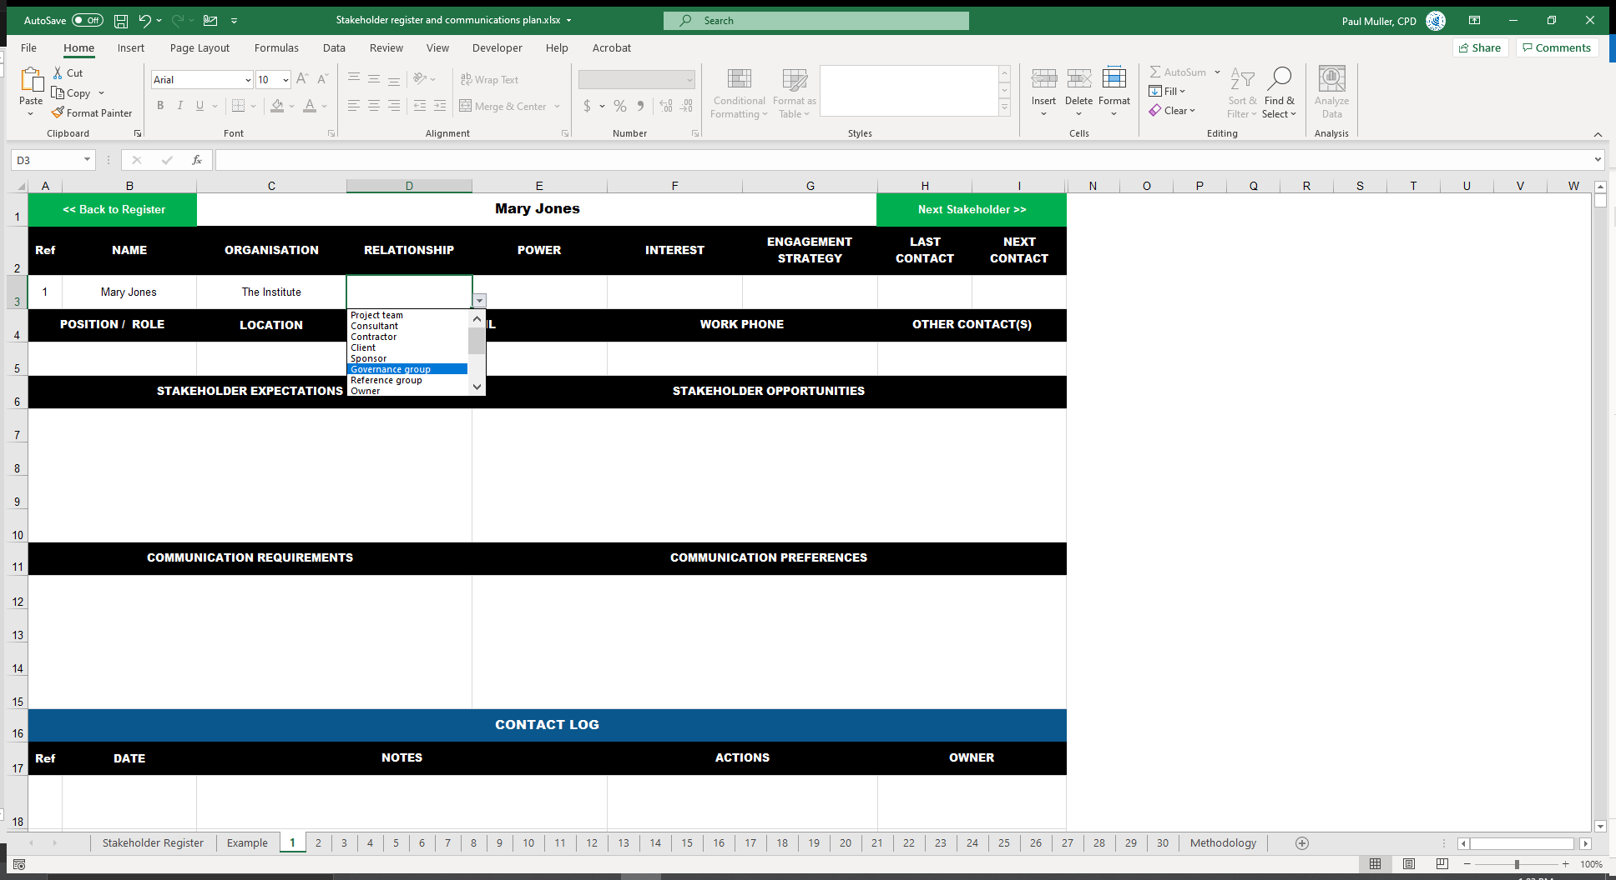
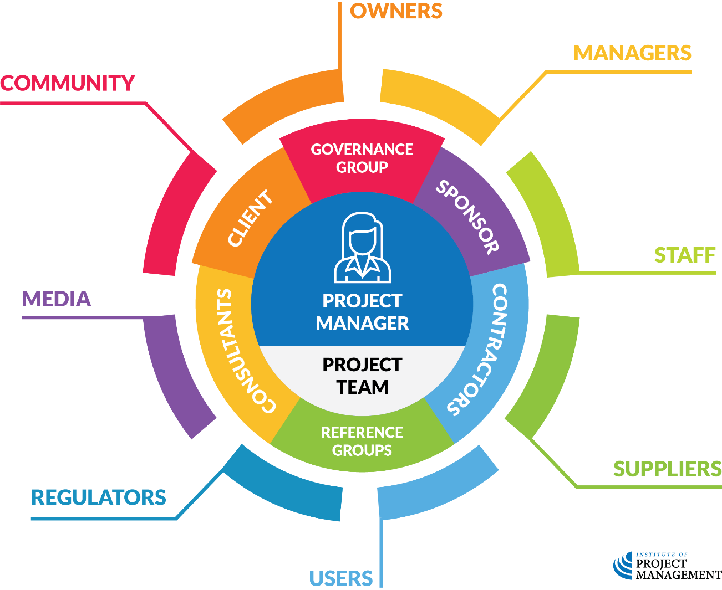
What is their relationship to the project?

Slide 59
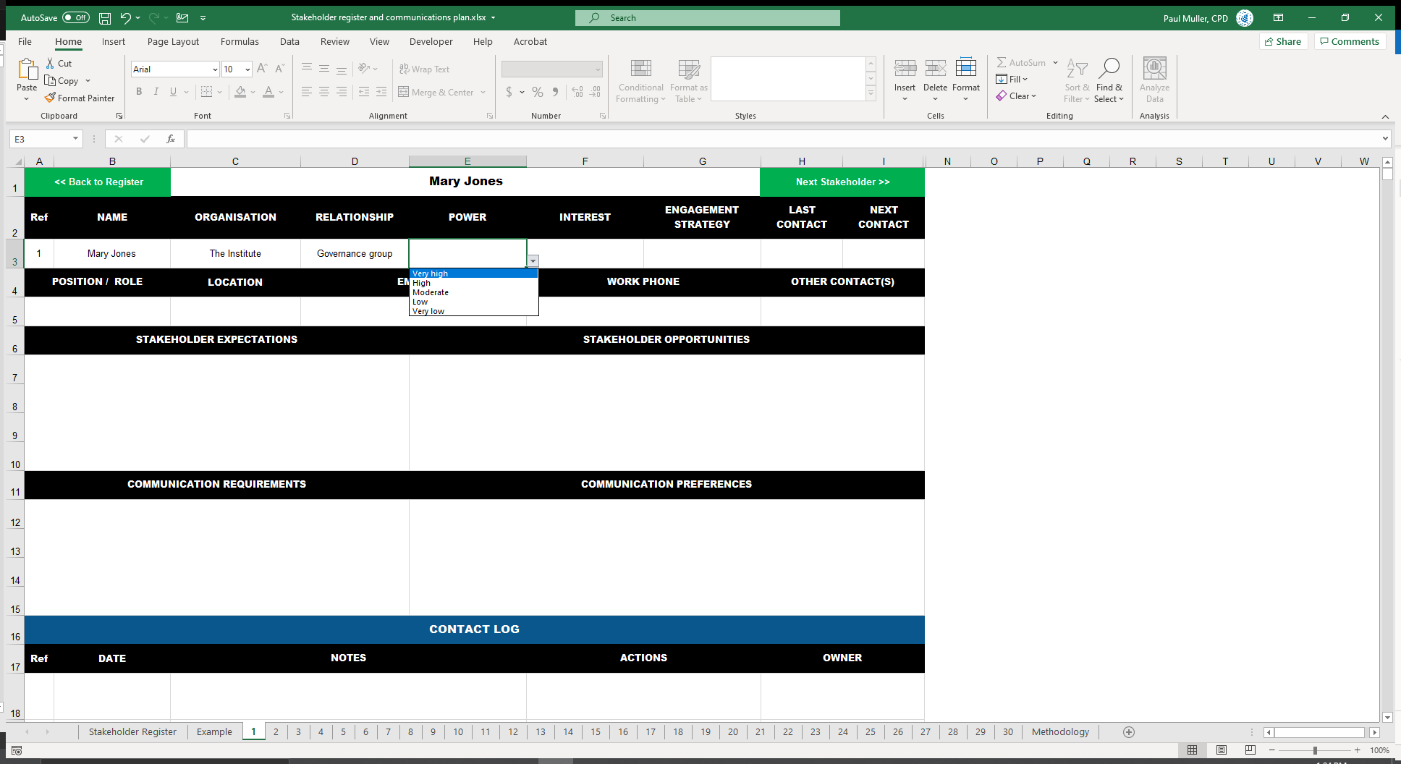
What is their level of power?

Slide 60
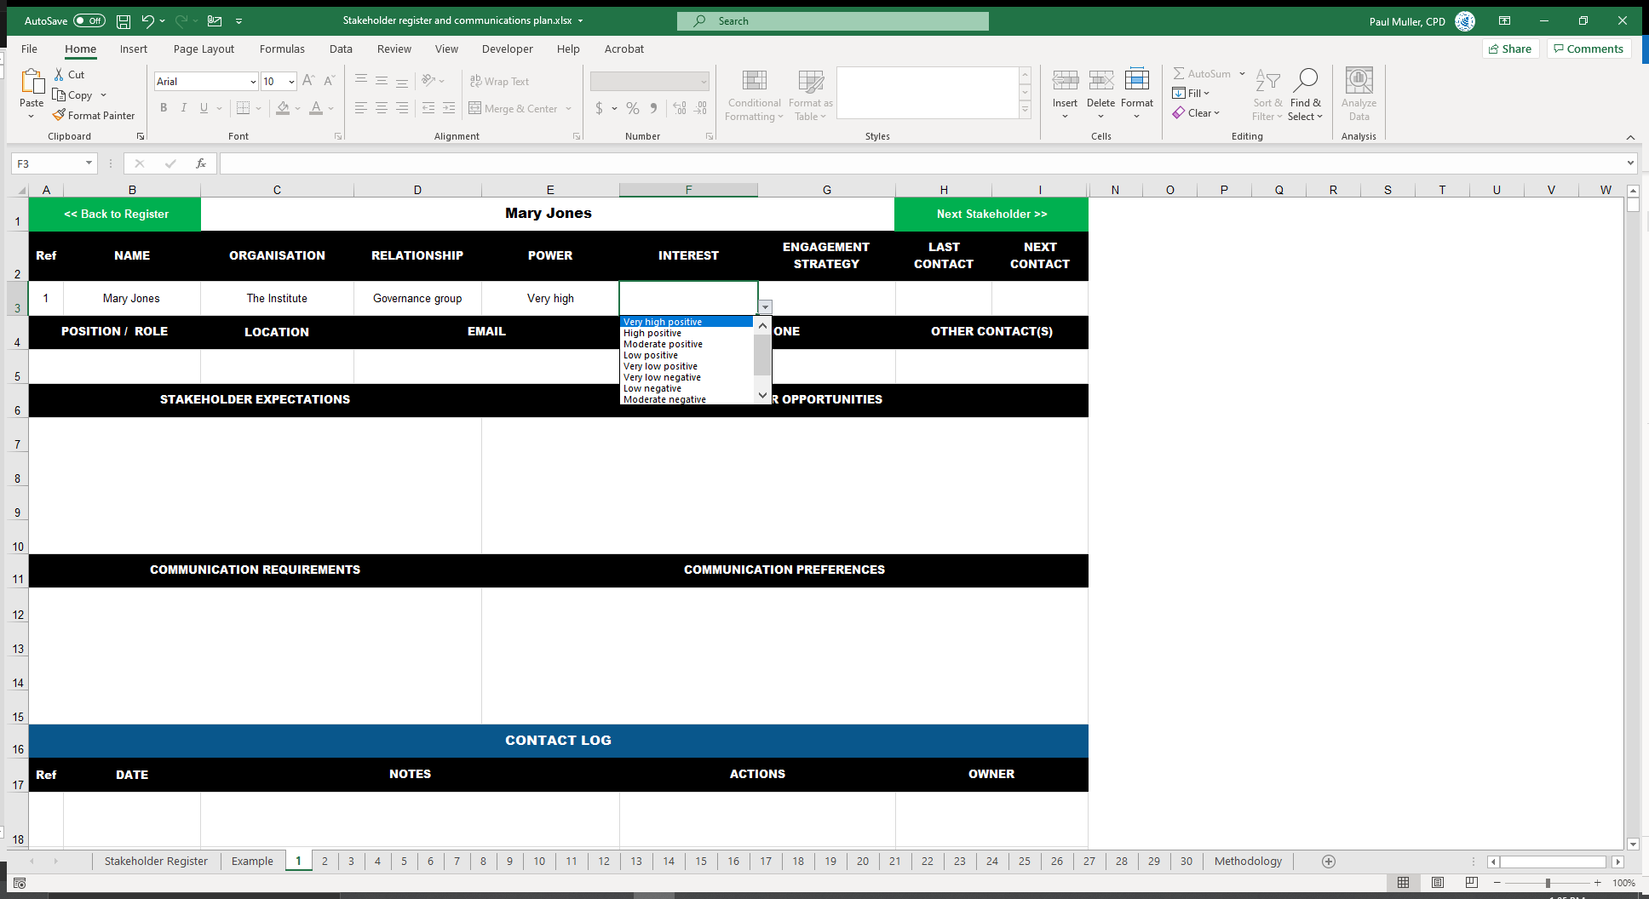
What is their level of interest?

Slide 61
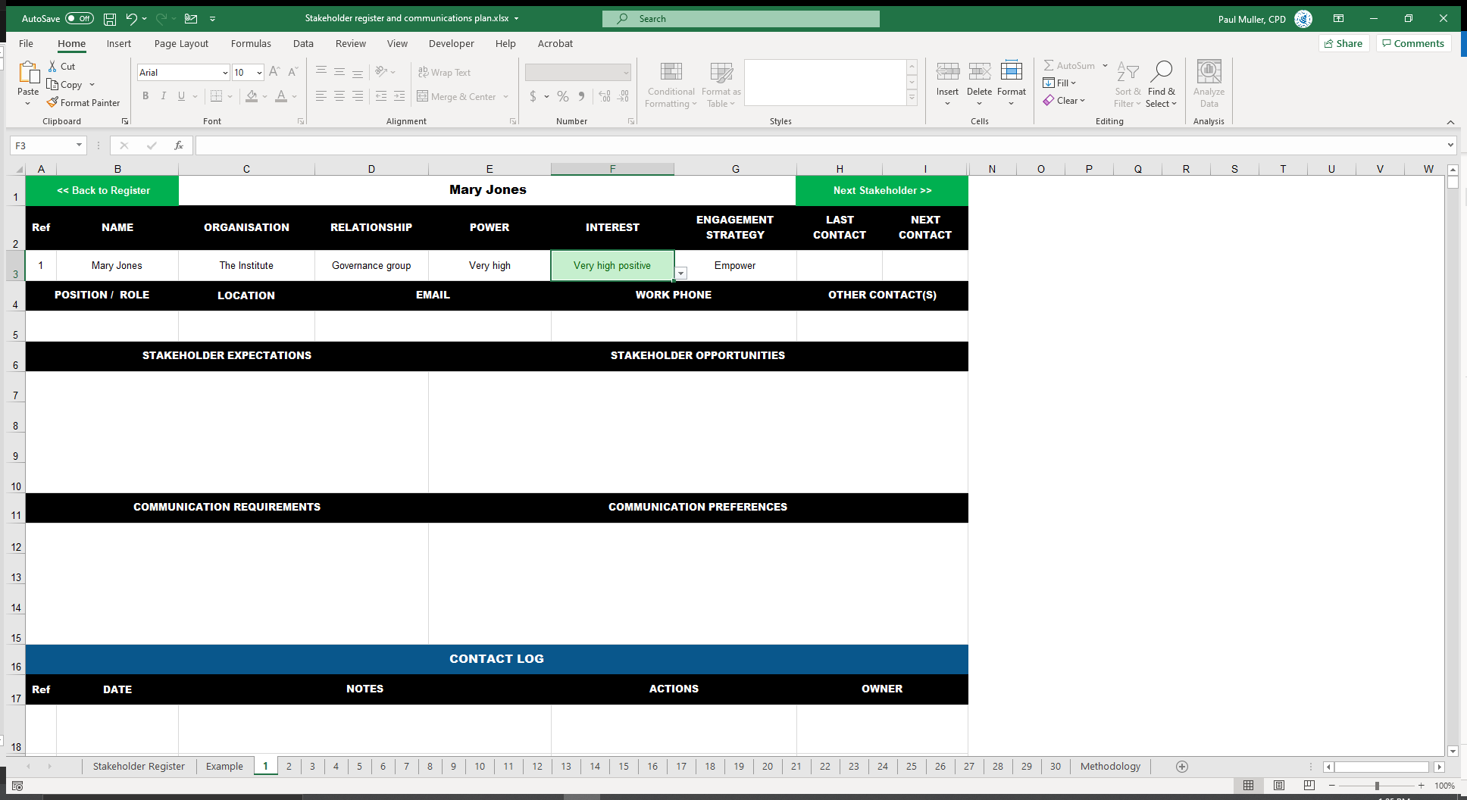
Strategy fills auto-magically!

Slide 62
Enter other contact info
Notes:
Always important to track last / next contact

Slide 63
Stakeholder expectations
What does this stakeholder expect of the project?
Do they have any particular scope, time, cost or outcome requirements?
Why are they positively or negatively interested in the project?

Slide 64
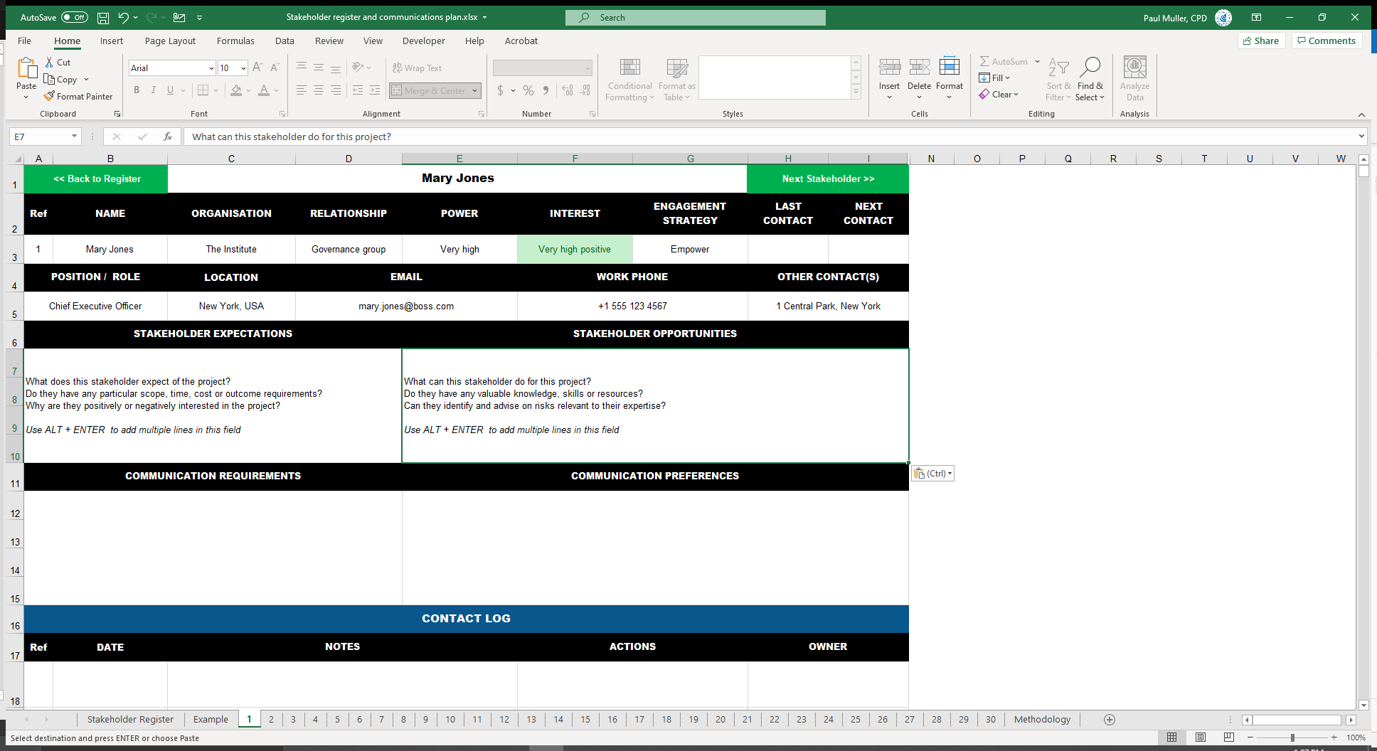
Stakeholder opportunities
What can this stakeholder do for this project?
Do they have any valuable knowledge, skills or resources?
Can they identify and advise on risks relevant to their expertise?

Slide 65
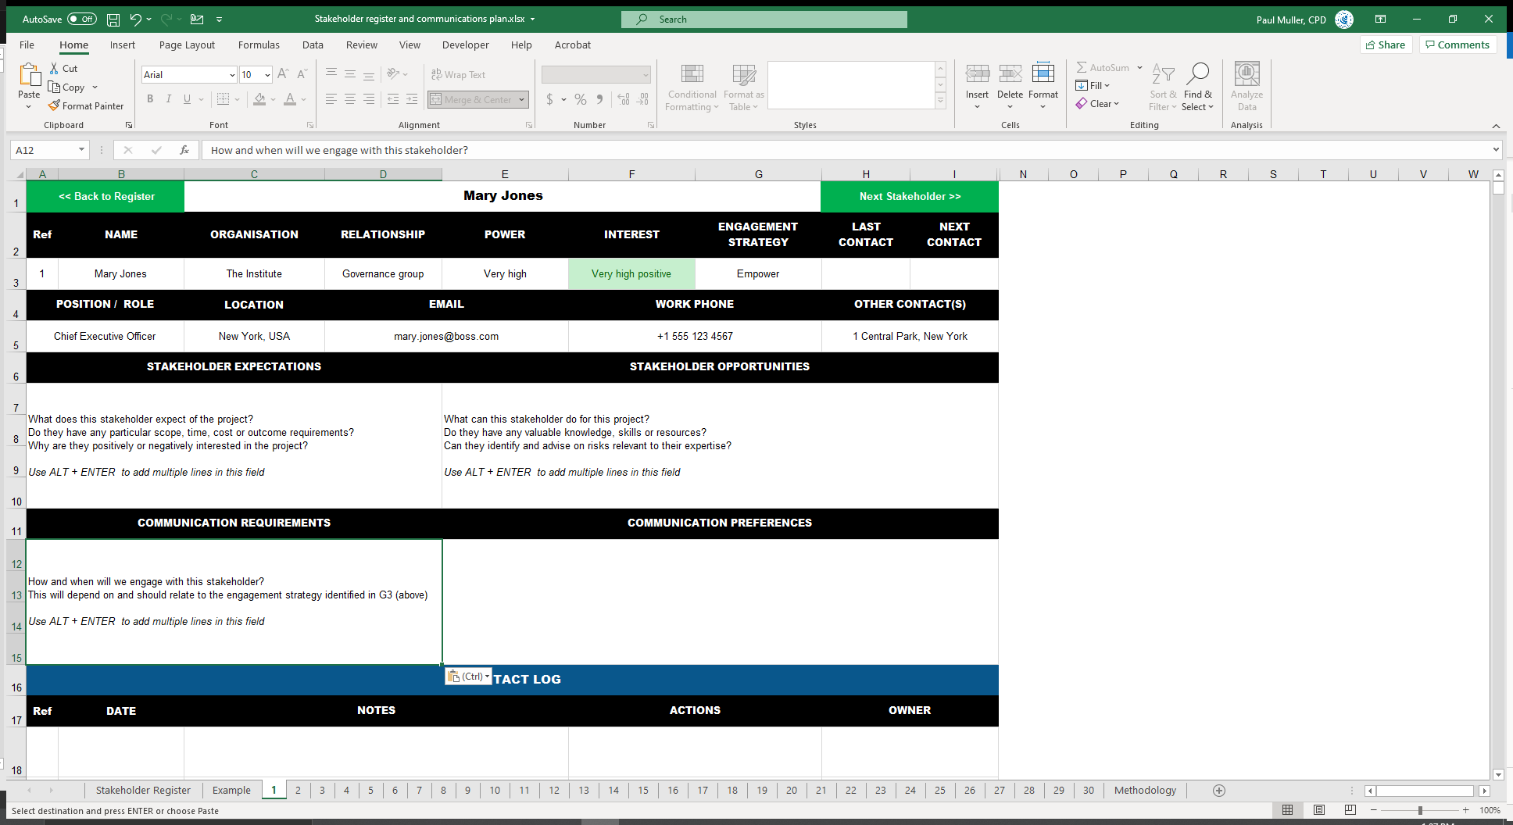
Communication requirements
How and when will we engage with this stakeholder?
This will depend on and should relate to the engagement strategy identified in G3 (above)

Slide 66
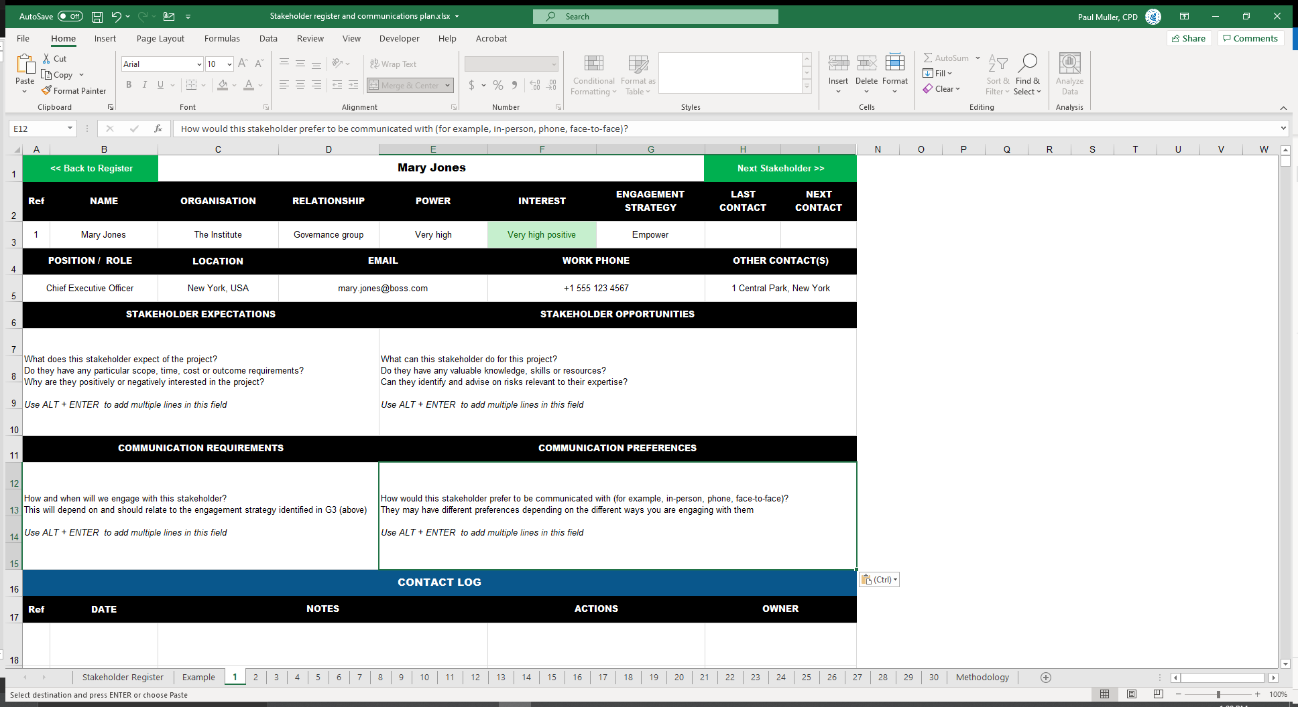
Communication preferences
How would this stakeholder prefer to be communicated with (for example, in-person, phone, face-to-face)?
They may have different preferences depending on the different ways you are engaging with them

Slide 67
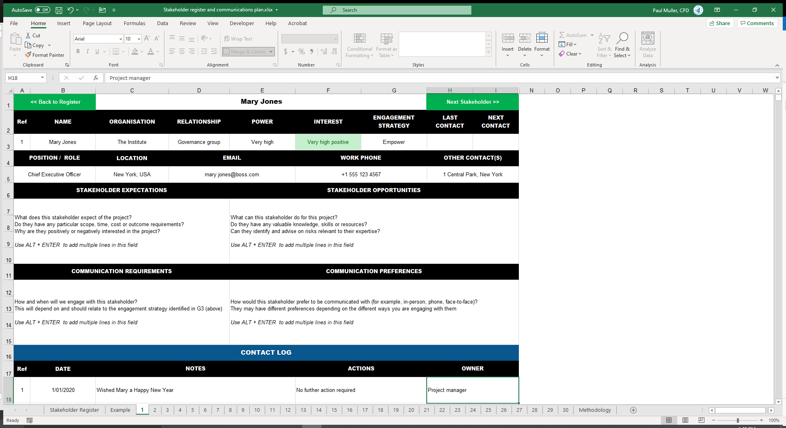
Record every contact

Slide 68
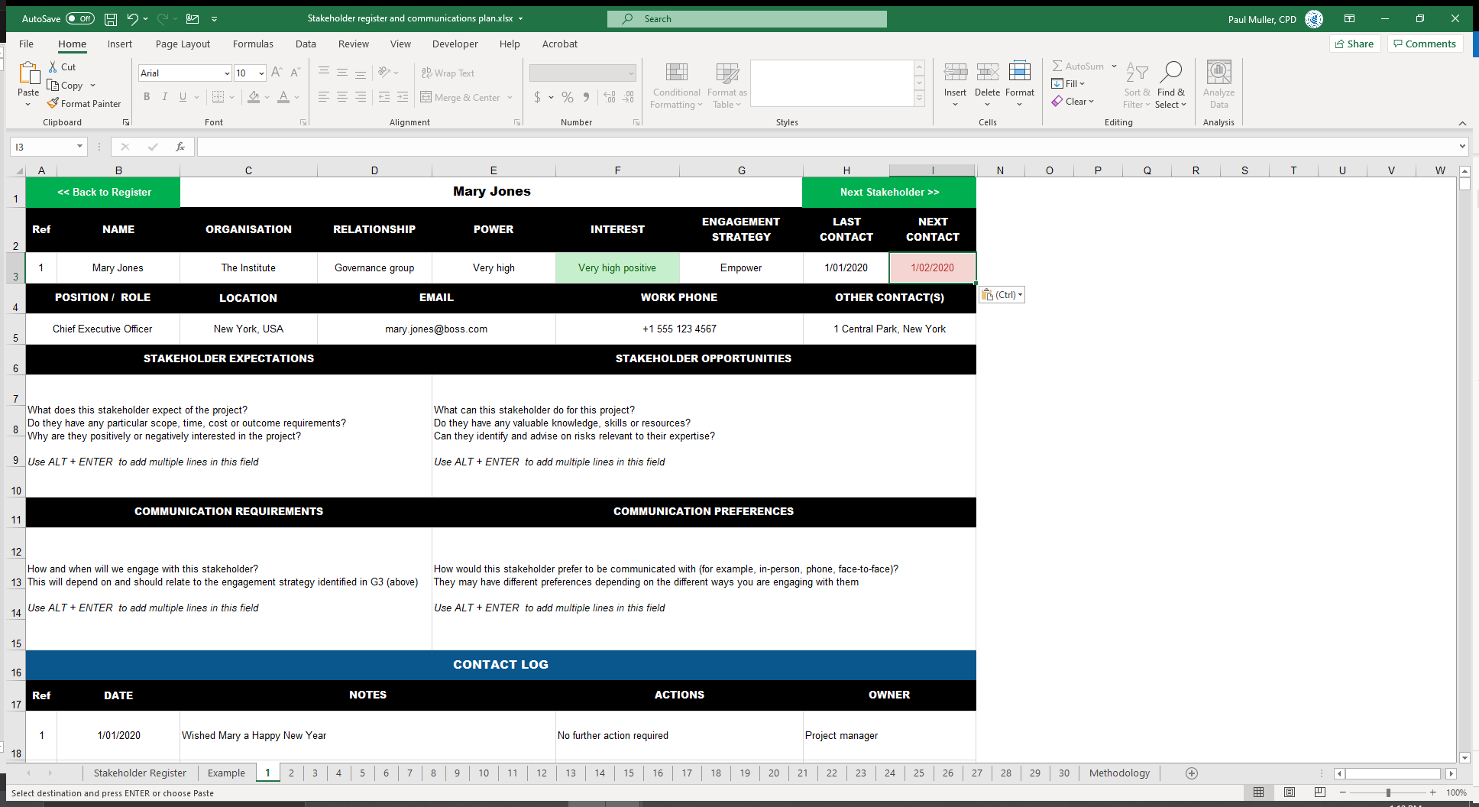
Update last & next contact
Overdue contacts are highlighted in red!
Maintain contact log

Slide 69
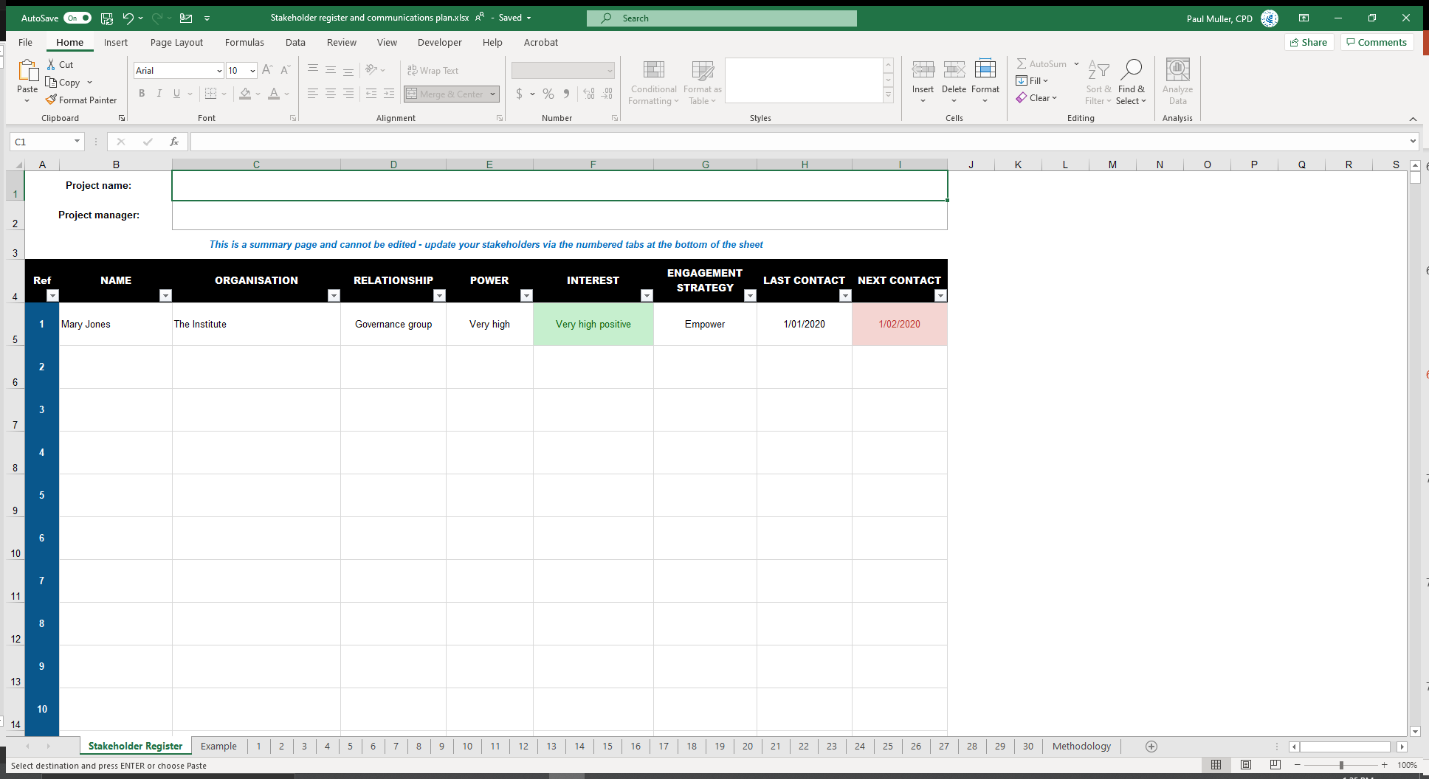
XYZ Project
Jenny Wong
There you have it!
Filtering (but not sorting) is also available

Slide 70
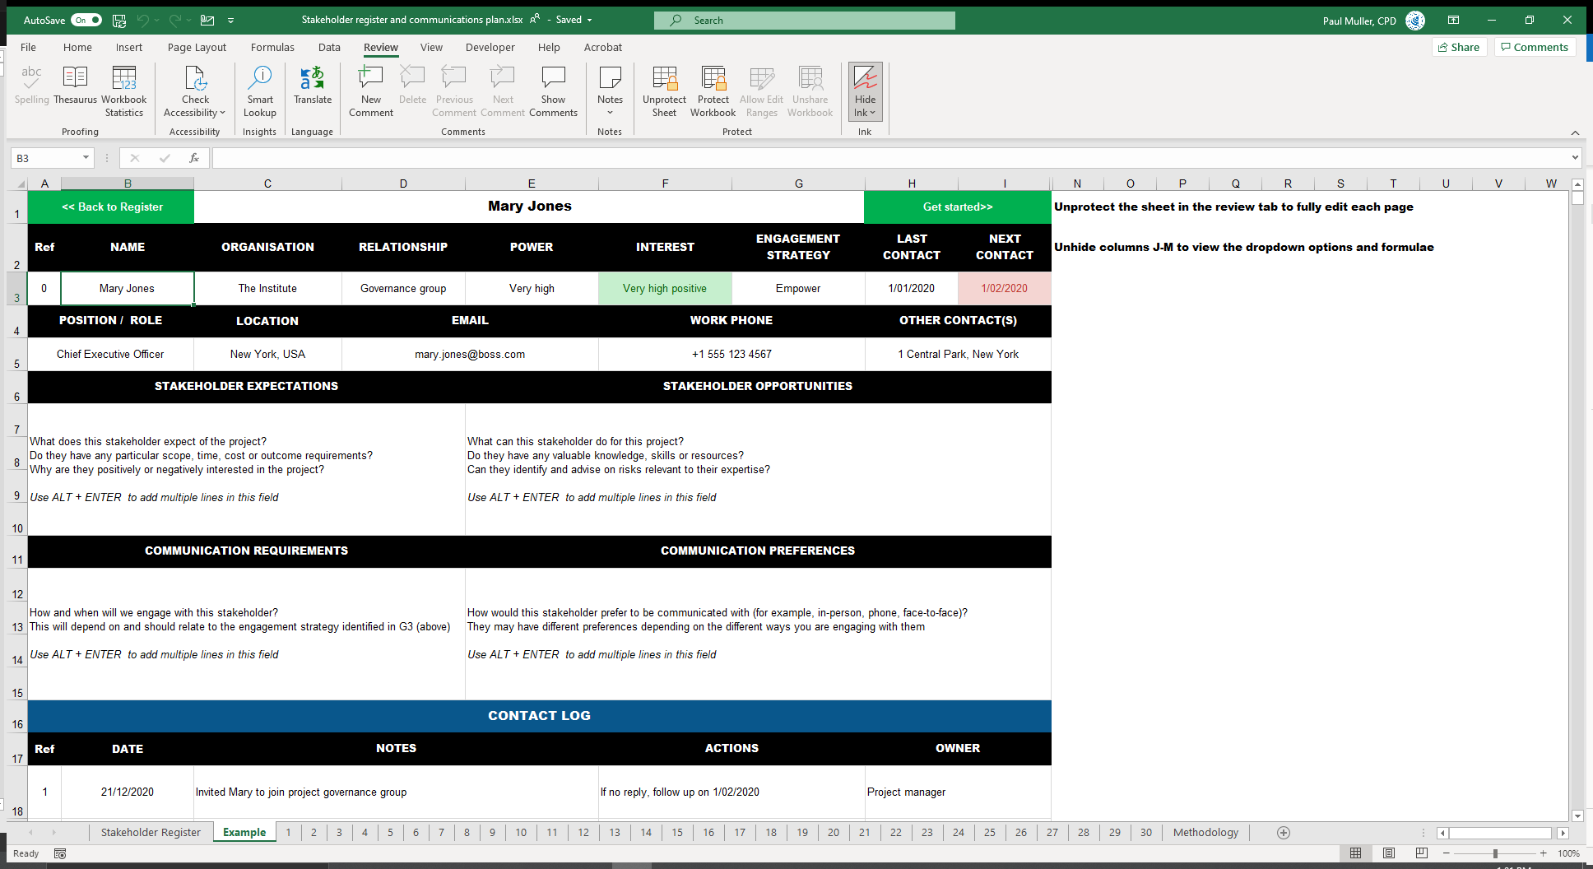
You can find all this info on the Example tab
Notes:
Field titles etc are locked to prevent accidental editing, but they are not password protected

Slide 71
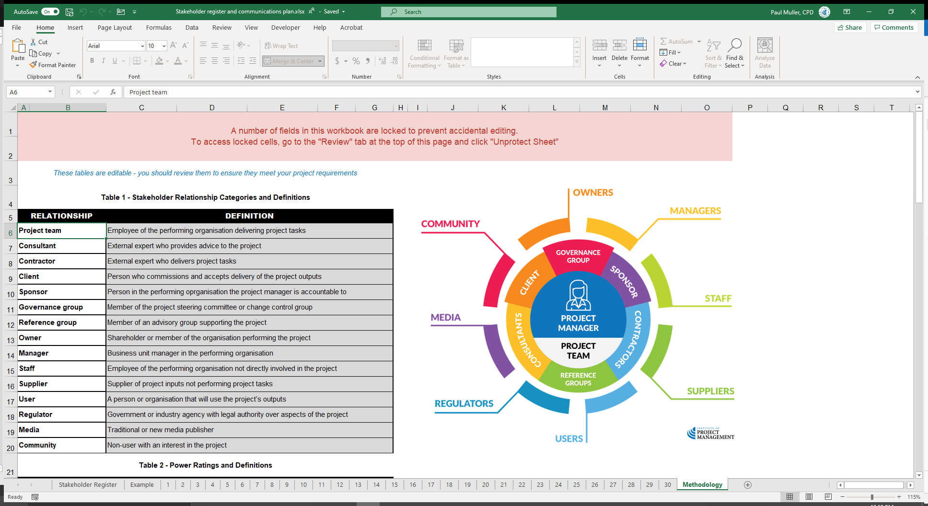
Advanced users can update and edit all fields via the Methodology tab

Slide 72
Stakeholder register
De-identify
personal
information
A project you have recently contributed to
Can be a personal or professional project
You do not need to be the project manager
You can also use the case study project
Use the template provided or one from your workplace
5 entries minimum
https://open.institute.pm/free-project-management-resources/
Notes:
Cert IV PMP students only

Slide 73
Reflection
What is the most interesting thing you learned today?
What is one thing you will start, stop or continue doing?
What is one thing you would like to learn more about?
Notes:
Reflection questions not only highlight key learnings; they drive the continual improvement of our teaching and learning resources

Slide 74
Questions?
Coming next… choosing the right project
Notes:
Stay around until everyone leaves the session to ensure they all get the chance to ask their questions.

Slide 75
Closing checklist
Classroom
Upload signed attendance sheet and any photos taken of work in progress
Zoom
Upload video with thumbnail and link to workshop
Student administration
Mark participating students as complete
Email absent students and notify of gap requirements (OPEN units)
Facilitator feedback – email paul@institute.pm
What worked well today?
How can we improve?

