Slide 1
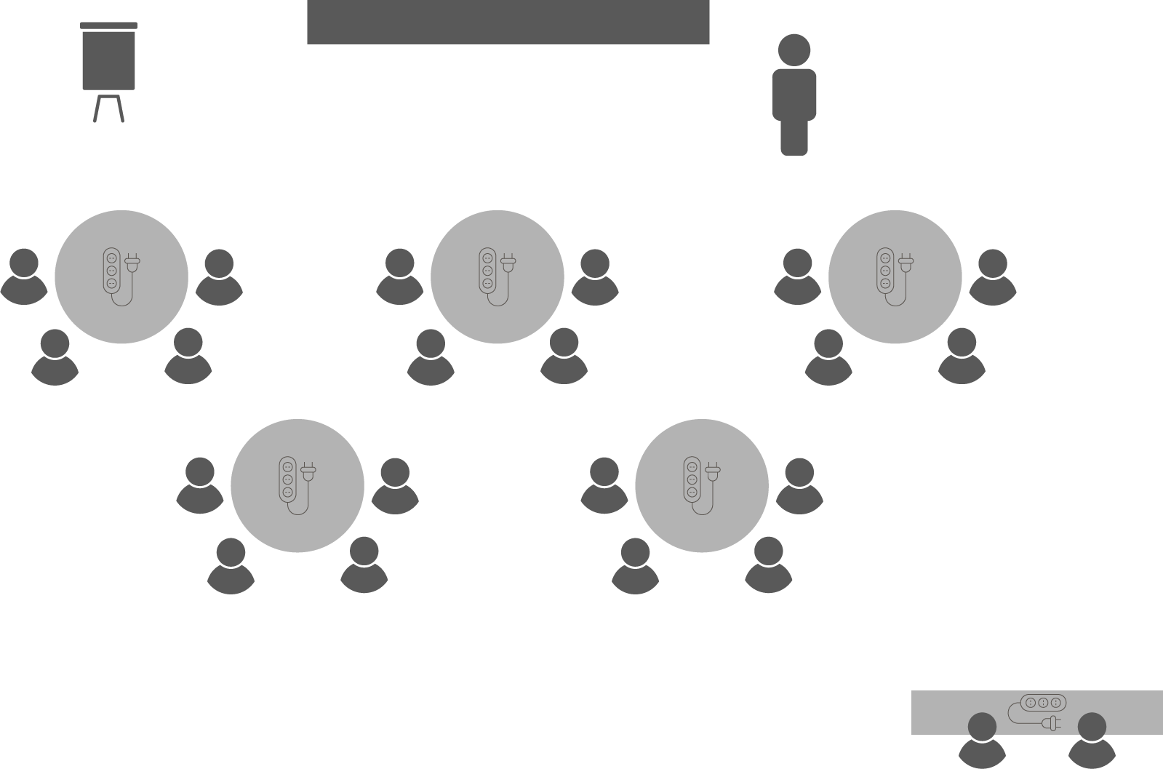
Opening checklist
Your preparation
Review notes, run a technical rehearsal
Rehearse examples / cases / stories to stimulate discussion
Classroom
Ensure students seated at tables of 3-5 and all facing the front
Have student name cards in place and ensure all sign in
Zoom
Rename yourself as host (under participants)
Set-up breakout rooms
https://support.zoom.us/hc/en-us/articles/206476313-Managing-Video-Breakout-Rooms
Welcome students as they arrive, let them know when starting
Notes:
Good luck!

Slide 2
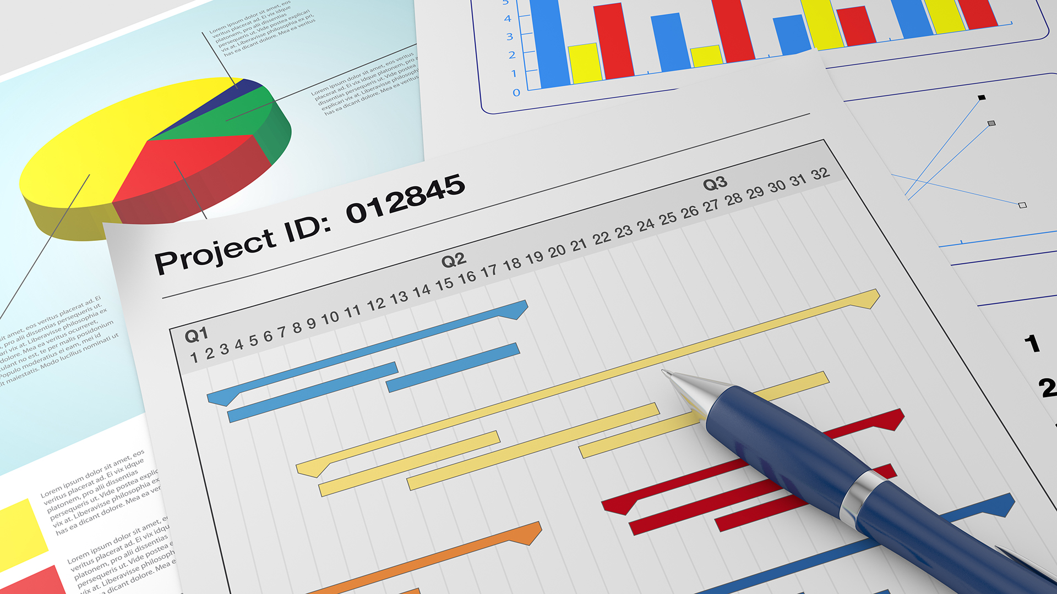
Requirements
Analysis

Slide 3
Notes:
The Expert
https://www.youtube.com/watch?v=BKorP55Aqvg&ab_channel=LaurisBeinerts

Slide 4
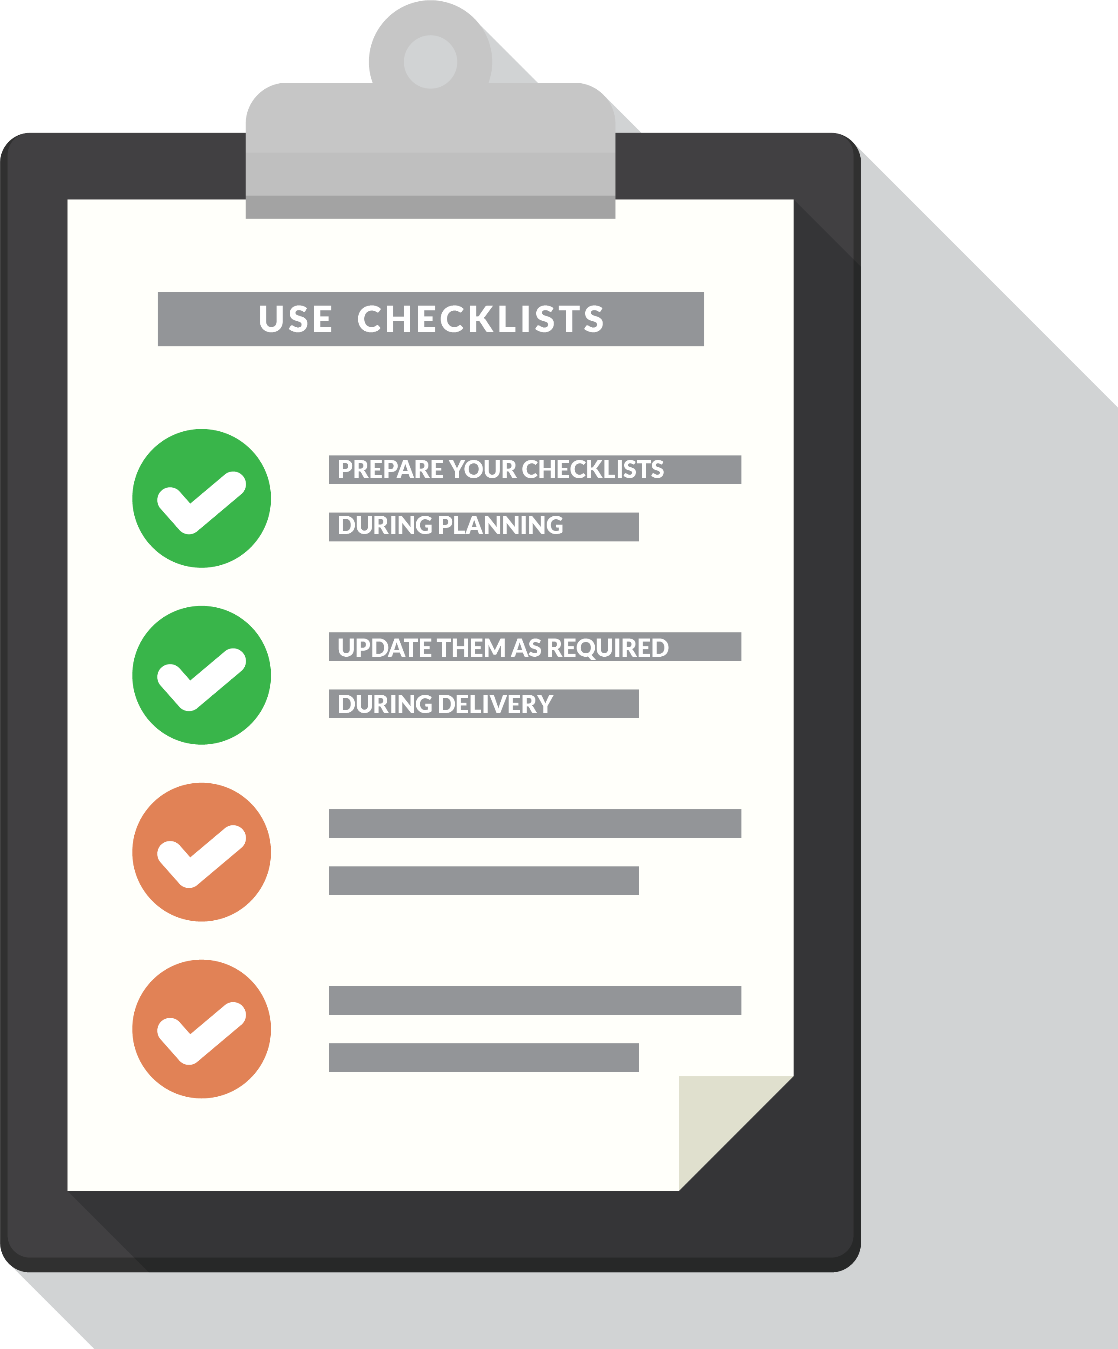
Discussion
OPEN 5.3
Consuming time and resources does not guarantee quality…
What will your stakeholders ‘accept’?
The client should define acceptance criteria in project initiation
What should you do if you’re assigned a project to plan and this hasn’t been done?
What should you do if stakeholders cannot agree?
Notes:
Acceptance criteria are the scope specifications that tell us how we know our task is finished.
They define the standards that meet the input requirements of the next task or person in the chain.
In other words, it doesn’t matter what the person delivering the task thinks is good enough (the task owner); it is the person or people accepting that output (the task clients) who decide whether or not it is fit for purpose.
Project manager may not be involved in initiation and first arrives at the project in planning
Q1: circle back if any ambiguity; remind the client that they represent stakeholder interests
Q2: take the time to resolve this – get their written agreement on what it is we are doing (eg handover checklist)
Useful at this time as well to understand client priorities – what is most important? Time? Cost? Scope? What is next priority?
This will be critical when making decisions on how to manage change later in the project

Slide 5
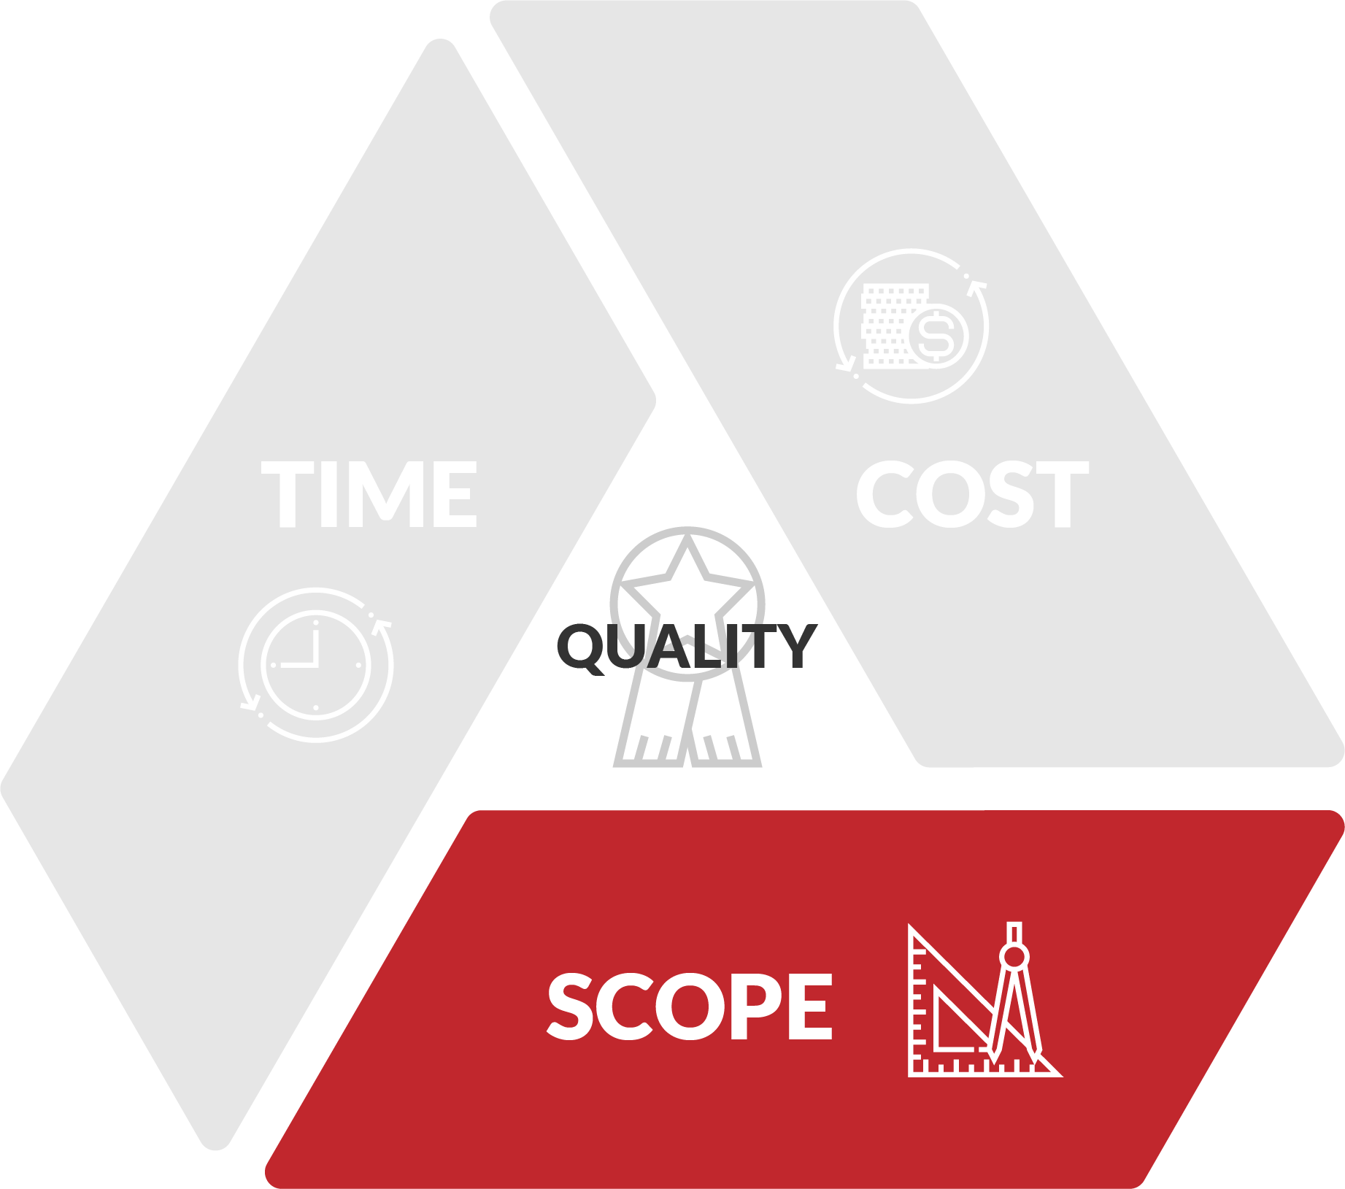
Work breakdown structure (WBS)
OPEN 5.1
A multi-level list of all the project tasks to be performed
Notes:
Ask first, who has never prepared a WBS?
Whoever says they never have, is wrong!
If you have ever made a list of any description (eg shopping list) then you’ve done it.
And if that list ever had a budget and schedule; congratulations, you’re a project manager ☺
The wedding project example shows a WBS as prepared in a MS Project document with points successively broken down

Slide 6
100% rule
OPEN 5.2
The 100% rule demands inclusion of all project work in the WBS
What are some of the commonly ‘forgotten’ tasks?
Project team induction / training
Quality assurance / control
Communications / engagement
Transfers
Lessons learned / review
Notes:
When preparing a WBS, we sometimes get so caught up in the detail of the deliverable, we forget that there is project management work to do as well!
This might include inducting and training project team members, reporting to stakeholders, preparing those reports, and reviewing the project when it is complete.
Each of these activities will take time (which someone will probably have to be paid for), and other resources too.
The 100% rule of project planning states that you should include all the work required, and nothing that isn’t.
Sounds a bit too obvious?
Well, because all subsequent planning is based on the WBS, when you discover – too late – that you’ve forgotten a task, you probably won’t have any time or money to get it done.
This can be a project killer.
Similarly, because the WBS is a complete statement of work, if you include activities that you’re not supposed to do, you are wasting time and money, and potentially stepping on someone else’s toes.
After all, our theory of triple constraints tells us that the more complex our scope is, the harder it is to achieve quality with finite time and resources.

Slide 7
Activity 5.1
OPEN 5.2
An end of year event has been chartered to celebrate our team’s success
200-220 guests
Formal dinner and entertainment
External venue / catering
Prepare a WBS for the project
USE
VERBS
Notes:
You should also use verbs (action words) to clarify what is required at each step and to focus attention on the deliverable.
Use sticky notes on butchers paper at each table – it is important they only do one post-it note per task
Do not reveal the budget
If working in person, about halfway through the activity, get students to compare their work with others – they will pick up things they didn’t consider and learn the value of stakeholder consultation

Slide 8
Discussion
OPEN 5.2
How far do we need to ‘break down’ each task?
Notes:
Why break down projects / tasks?
Clarity (you break down) - depends on experience of delegate (cf delegation)
Accountability (they break down til you're happy)
Levels of plan complexity
Greater detail = greater accuracy in estimates (time & cost / resources), easier to track
Too much detail = micro-managed, time lost in admin
Solution
High level plan - transaction points
Detailed plan for operators
Rolling wave planning - detailed first phase, high-level future phases --> agile

Slide 9
Project budget
OPEN 5.4
The cost of resources required to complete the project tasks
-20%
-10%
Actual
+10%
+20%
Bottom up
Top down
Business case
Project plan
Notes:
In the Session 3, we discussed the principles of estimation as they apply to the business case.
As indicated at the time, all those methods can be applied with equal rigour to the project planning phase.
Now we have adopted the preferred alternative as our project, we need to sharpen our estimates from a plus-or-minus 20 per cent margin of error to get within 10 per cent of what our actual costs might be.
How do we do that?
The method we applied in the business case was what we call a top-down estimating technique.
In other words, we looked at the project as a whole, and asked how much would this output normally cost, and how long would it take to deliver, if (for example) we purchased it on the open market?
Bottom-up estimating, by contrast, takes that bottom line of the WBS – the tasks at their finest level of detail – and asks how much will each of these elements independently cost, and how long will they take to deliver?
Because we are estimating the discrete units of cost and time and adding them together (or ‘rolling them up’ as it is sometimes known), we can be confident that our total estimate of project cost and time will be much more precise.

Slide 10
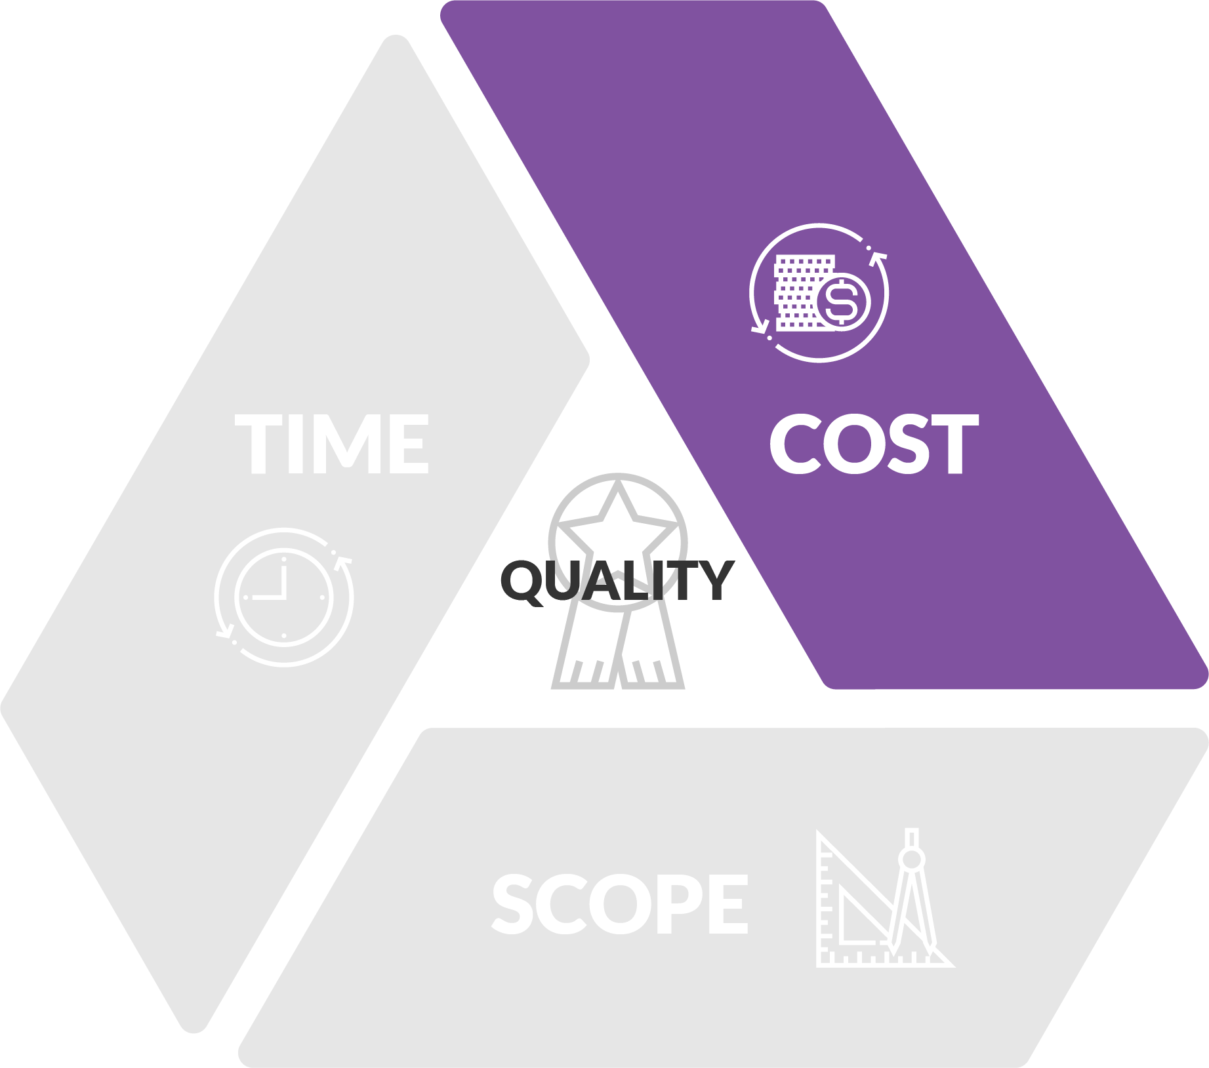
Direct project (output) costs
OPEN 3.6
How much will we spend to deliver each project task?
Equipment (assets)
Acquisition / depreciation
Materials
Contractors / consultants
Labour
No such thing as a “free” task or project!
Notes:
In order to make accurate estimates for our project budget, we need to firstly ascertain what the resource requirements are for each task.
This process is properly know as requirements analysis, although that term can also be applied to the entire WBS / scope definition process (as we have done in this Session).
In requirements analysis we ask, what do we need in the way of:
Equipment?
Materials?
Labour?
We can consult Google, expert stakeholders, or past project reports to get this data.
We can also apply analogous, parametric or other statistical techniques to fine-tune our estimates.
Note that some projects – especially internal ones – do not include labour costs, as they figure the staff are getting a salary / wage to work regardless.
Why it is important to cost labour no matter what?
High level (top-down) estimates (eg it will take Mary 3 months full-time work to deliver this project) are more prone to error than task level (bottom-up) estimates, which means we end up either overworking teams or Parkinson's law
We also need to accurately capitalise costs (in other words, include the cost of labour inputs when determining the value of the output delivered)
Lessons learned

Slide 11
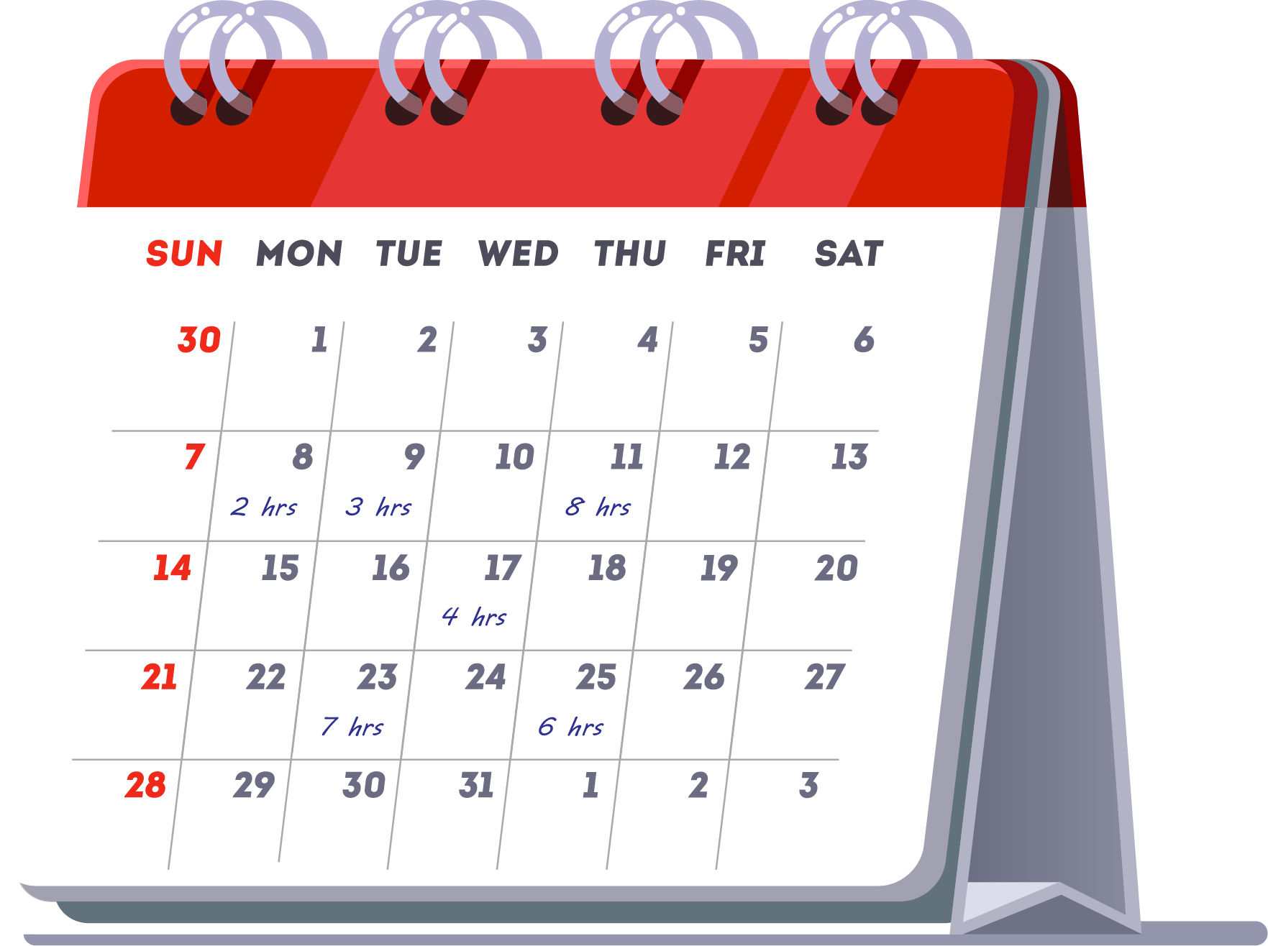
Task effort
OPEN 5.4
The hours of work needed to complete each task
Used to calculate labour budget
30 hours x $50 = $1,500
Not to be confused with task duration
…coming soon!

Slide 12
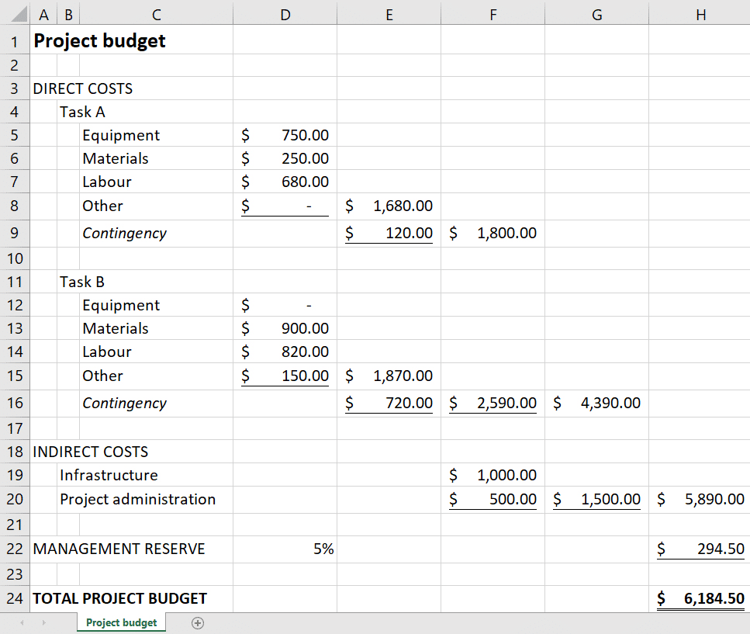
Indirect project (output) costs
OPEN 3.6
How will the business subsidise project delivery?
Management / PMO costs
Shared infrastructure
Office supplies
Communications
Travel & accommodation
Insurances / taxes
Indirect costs accrue over multiple project tasks
(or the whole project)
Notes:
Contingency and management reserves will be discussed in Session 7 on Risk

Slide 13
Activity 5.2
OPEN 5.4
The business case for your project estimated that it will cost $100,000 ±20%
What will you do if your project plan estimates it will cost $200,000?
What will you do if your project plan estimates it will cost $20,000?
Notes:
Q1: Questions to ask of your budget / plan…
Are we gold-plating? What can we reduce from scope without impacting outcomes?
Are we padding our estimates (ie intentionally over-estimating costs to give us a contingency / buffer)?
Are the outcomes realistic given the budget nominated in the business case?
If your project budget is still greater than what was anticipated by the business case range, the new costs should be re-evaluated against the value of the outcomes to see if the project is still worth pursuing.
The project client may then clarify the scope further for you; or authorise the extra money; or, if the outcomes are still desirable, break the project into more cash-flow manageable phases.
Q2: Questions to ask of your budget / plan…
What did we miss? What tasks / resources should we add to ensure outcomes are met?
Is the budget excessive given the outcomes intended?
Either way, your organisation will authorise the project’s budget based on what the plan tells us it will be; not the business case.
As you can imagine, though, there is no such thing as a 100 per cent perfect estimation method.
It is therefore important to document as completely as possible the assumptions that have gone into your estimates.
This not only aids the risk management process, but should help project stakeholders understand that estimates are not statements of fact.
Be careful not to let very loose estimates suddenly become make-or-break targets.
Remember, too, that the further we get into a project, the more uncertainty is reduced, and the more accurate our ability to estimate should become.
For that reason, you should constantly revisit and update the estimates you made in the planning process.

Slide 14
Notes:
Before breaking, ask students if there are any questions about what has been covered in the session so far.
Once answered, encourage students to stand up, get a drink, go outside and stretch.
If they are on Zoom, tell them to turn their camera and microphone off (you do the same)!
Make sure you tell them the precise time you will be restarting (eg 10:10am)
Don’t check your email – take a proper break!!

Slide 15
OPEN 6.2
TASK F
TASK G
Predecessor
Milestone
TASK A
TASK B
TASK C
END
Dependency
Network diagram
TASK D
TASK E
Notes:
Our next step in the planning process is to sequence the 10s, 100s or even 1,000s of tasks identified in the work breakdown structure.
We do so by analysing the relationships between tasks, which are known as dependencies.
Not every task depends on another.
For scheduling purposes, and assuming we have the resources to do so, these tasks can be performed consecutively (in other words, one after the other), or concurrently (that is, at the same time).
Dependent activities, however, must not only start consecutively, but be performed in the correct order.
When manually preparing a network diagram – and this is the best way to do it – you can use your WBS task sticky notes as nodes, placing them on a larger sheet of paper to draw in the dependent relationships.

Slide 16
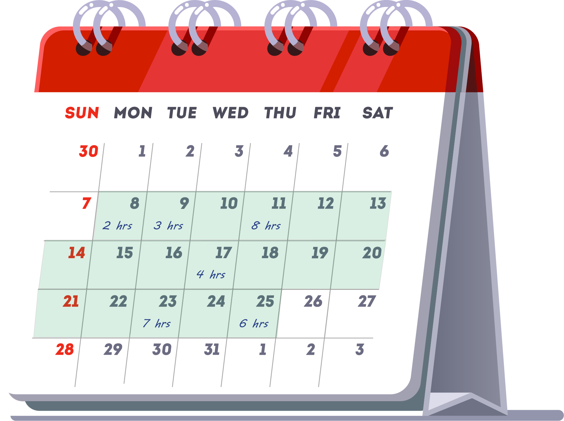
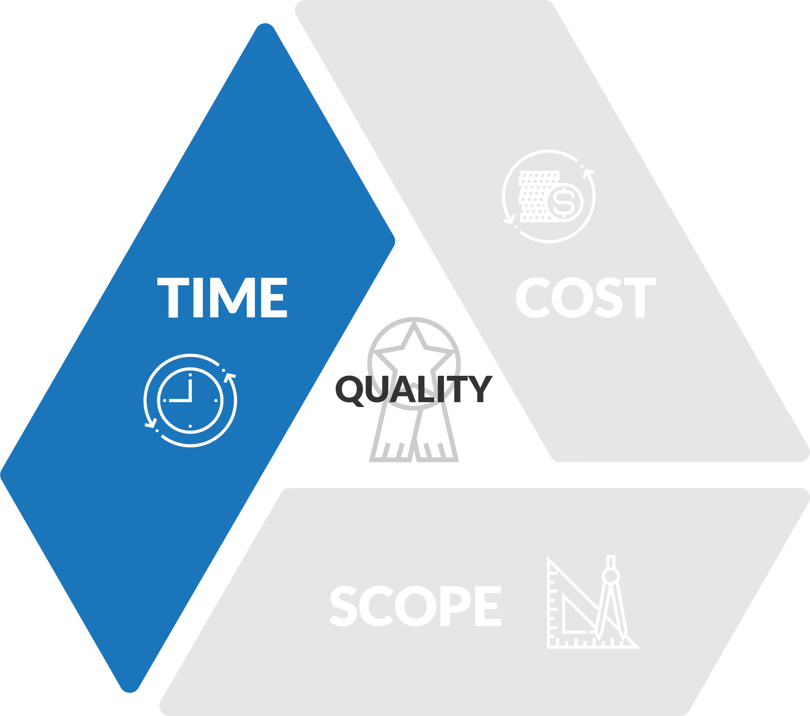
Task duration
Not to be confused with task effort
…told you!
OPEN 6.2
How long it will take to complete a task, from start to finish
Used to determine schedule
18 days

Slide 17
OPEN 6.2
5
9
ES
DUR
EF
TASK F
TASK G
LEGEND
LS
FLT
LF
7
6
12
TASK A
TASK B
TASK C
END
Task durations
10
13
TASK D
TASK E
Notes:
Having laid out our tasks by dependency in a network diagram – a process called sequencing – we can now add in those estimates of task duration.
There is a standard protocol for where you place each number on a node, for reasons that will soon become clear.
For now, make sure your estimate of activity duration is centred immediately above each task node.

Slide 18
OPEN 6.2
0
5
5
7
9
16
ES
DUR
EF
TASK F
TASK G
LEGEND
Cannot start until A & F are both finished
LS
FLT
LF
0
7
7
7
6
13
13
12
25
30
TASK A
TASK B
TASK C
END
Forward pass
7
10
17
17
13
30
TASK D
TASK E
Pass forward the
highest value
Notes:
Now we can take what is called a forward pass through the network to determine the early start and finish dates for each activity.
From here on, we use the 'end of day' as our point for determining and recording early and late start and finish values.
Therefore the start of Day 1 is recorded as the end of Day Zero.
The start of Day 8 is recorded as the end of Day 7.
You will see that this makes our calculations easier as we move through the forward and backward passes.
The earliest day Task A can start is (the end of) Day Zero.
As it will take 7 days to complete, this means that the earliest it can finish by is (the end of) Day 7.
Therefore the earliest day that Task B can begin is Day 7.
Given its estimated duration of 6 days, the earliest it can finish by is Day 13.
Task C gives us an early start of Day 13, and an early finish of Day 25.
The earliest a task can finish is calculated by adding the activity duration to the early start date: ES + DUR = EF
You will see that Task D cannot start until Task A is complete, so like Task B the earliest it can start is Day 7.
As Task D is expected to take 10 days, the earliest it can finish by is Day 17.
Therefore the early start and finish dates of Task E will be 17 and 30 days respectively.
Like Task A, Task F has no predecessor tasks, so it can begin on Day Zero and finish on Day 5.
Task G, however, has two predecessor activities: Tasks F and A.
Because it cannot start until both Task A and Task F are finished, Task G cannot actually start until Day 7.
Task G cannot start on Day 5, because it is still waiting for Task A to complete.
Therefore, Task G must start on the early finish date of Task A, the later of the two, predecessor, early finish dates.
By that same logic, the earliest our project can finish is Day 30 – the latest of the predecessor, early finish dates.
Note once again where we are placing the early start and early finish dates: at the top of each node, on the left- and right-hand sides respectively.

Slide 19
0
5
5
7
9
16
ES
DUR
EF
TASK F
TASK G
LEGEND
16
21
21
30
LS
FLT
LF
0
7
7
7
6
13
13
12
25
30
TASK A
TASK B
TASK C
END
0
7
12
18
18
30
At least one path must return to zero
Backward pass
7
10
17
17
13
30
TASK D
TASK E
Pass back the
lowest value
7
17
17
30
Finishing later than Day 7 will push out Task D’s ES
Notes:
We can infer from the previous example that the earliest this project can finish is Day 30.
This is because, of the three ‘final’ tasks in the network, the latest early finish can be found at Task E.
This now becomes the starting point for our backward pass.
A backward pass follows the same process as the forward pass, only in reverse.
Starting with the scheduled end date of the project, we work backwards to determine the latest we can possible finish and therefore start each activity.
Once again, watch exactly where we plot these numbers.
If we timed it so that Task G finished on the very last day of the project – Day 30 – then the latest we could start it would be Day 21.
The latest a task can start is calculated by subtracting the activity duration from the late finish date: LF - DUR = LS
That means that the latest we could finish Task F would be Day 21, and the latest we could start would be Day 16.
Similarly, if the latest we could finish Task E is Day 30, then the latest we could start it is Day 17.
Following the same process, the late finish and start dates for Task D would be Days 17 and 7.
Finally, let’s work back through the blue tasks.
The late start and finish dates for Task C would be Days 30 and 18; Task B would be 18 and 12 – but stop!
Task A has three dependent (or successor) activities – Tasks G, B and D.
Looking at the late start dates for each of these, what do you think the latest finish date for Task A might be?
Well the latest we can start Task G is Day 21, and the latest we can start Task B is Day 12.
This means if we started Task G on Day 12, it would not be the end of the world, as our network diagram suggests we can still start as late as Day 21.
But the latest we can start Task D is Day 7.
If we started Task D on Day 12 that would not give us enough time to finish D and E, meaning we would not meet our schedule target of 30 days.
Do you see?
If Task D started on Day 12, and it took 10 days to finish it, we could not start Task E until Day 22, which would mean finishing the project by Day 35.
That’s not good.
Therefore the latest we can finish Task A by is Day 7, which means the latest we can start it also happens to be the earliest we can start it, which is Day Zero.
It looks pretty obvious then that getting Task A started and finished on time is critical to our project’s success!
When a task has multiple successors, the latest it can finish will be the earliest of the late start dates that follow.

Slide 20
0
5
5
7
9
16
ES
DUR
EF
TASK F
TASK G
LEGEND
16
16
21
21
14
30
LS
FLT
LF
0
7
7
7
6
13
13
12
25
30
TASK A
TASK B
TASK C
END
minus
0
0
7
12
5
18
18
5
30
Float
(slack)
7
10
17
17
13
30
TASK D
TASK E
7
0
17
17
0
30
Notes:
Remember how we said in the last topic that it looks like getting Task A started and finished on time is critical to the project’s success?
What this is showing us in project management terms is that there is no slack, or float, on Task A.
Float is the difference between either the late start and early start date, or the late finish and early finish date: FLT = LS - ES = LF - EF
If you have done your forward and backward passes correctly, these two sums should always be the same.
Let’s see that in action.
As shown, the difference between the late start (Day Zero) and early start (Day Zero) is zero days. Similarly the difference between the late finish (Day 7) and late early (Day 7) is zero days.
Therefore Task A has a float of zero days; or to put it another way, Task A has no float.
Look, too, where we insert our float sum.
For Task B, the difference between the late start (Day 12) and early start (Day 7) is 5 days.
Similarly the difference between the late finish (Day 18) and early finish (Day 13) is 5 days.
Therefore Task B has a float of 5 days.
We can now go on and perform this sum on every node on our network diagram.
Thankfully, there are no tricks to this as there were with the forward and backward passes!

Slide 21
0
5
5
7
9
16
ES
DUR
EF
TASK F
TASK G
LEGEND
16
16
21
21
14
30
LS
FLT
LF
Near
critical
path
0
7
7
7
6
13
13
12
25
TASK A
TASK B
TASK C
END
0
0
7
12
5
18
18
5
30
Critical
path
7
10
17
17
13
30
TASK D
TASK E
7
0
17
17
0
30
Notes:
Critical paths are linked (dependent) tasks with zero or no total float.
In our example, the critical path flows from Task A to Task D to Task E.
The implication is that those are the activities whose schedule we must manage closely.
The mathematics of scheduling mean that every project will have a critical path – it is also possible for there to be multiple critical paths.
Projects can also have multiple near critical paths.
In this instance, the path from Task A to B to C is a near critical path – it, too, will warrant close attention.
Now think back to the discussion of estimating risk: if we have a low level of confidence in our time-to-complete estimates on a critical or near-critical path task, what do you think that might mean for project delivery?
It is also important to understand that the early and late start and finish dates are not the project schedule.
Rather, they indicate the time periods when the task could be scheduled – we will look at this in more detail in the next few topics.
People often confuse the critical path with critical tasks.
Critical tasks are work packages that are prioritised by stakeholders as 'important'.
A task can be critical because it has no float (putting it on the critical path); but it can also be critical because the sponsor says so.
Critical tasking is a subjective activity – the critical path, on the other hand, has a very specific meaning

Slide 22
Activity 5.3
OPEN 3.6
Reflect on the consequences of getting estimates of cost and time wrong
What are some possible causes of estimation error?
How can you improve confidence in your estimates?

Slide 23
Activity 5.3 – answer
Sources of error
Improving confidence
Unclear scope / missed activities
Poor historical / project records
Asking / pleasing the wrong people
Rushed estimates
Optimism bias
Unproductive / down time
Costs of scrap, re-work and spoilage
Price fluctuations
Deliberate low-balling (tenders) v padding
Bad luck
Define method(s)
Assign responsibility to the right people
Use multiple sources
Clarify assumptions
Assume normal (not best case) conditions
Use consistent units (time / cost)
Assume task independence
Allow sufficient time to estimate
Detailed breakdown of the work to be performed!

Slide 24
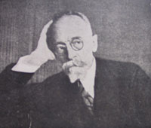
Gantt charts
OPEN 6.5
Karol Adamiecki (1866-1933)
Polish economist
Production scheduling tool – 1896
Henry Laurence Gantt (1861-1919)
British engineer
WWI ordinance production & delivery
Popularised in nation building projects of the Great Depression
Notes:
These days, most project management software will display the information in the network diagram in a particular form of bar chart known as a Gantt chart.
Originally developed by Polish economist Karol Adamiecki, it was Henry Laurence Gantt, a mechanical engineer and management consultant, who popularised these famous charts in the second decade of the twentieth century.
As a visual tool to show scheduled and actual progress of work, it was quite a radical concept and an innovation of worldwide importance.
One of the first recorded uses of Gantt charts was for the scheduling of ordinance projects back in the First World War.
The use of this technique was then popularised on large construction projects in the US like the Hoover Dam, started in 1931, and the interstate highway network which started in 1956.
Since the late twentieth century, the rise of personal computers, which has coincided with the professionalism of the project management discipline, Gantt charts have become a ubiquitous symbol of project management.
The first Gantt charts were nothing more than a series of tasks on the left hand side of a big sheet of paper or blackboard, with a calendar of dates running across the top.
All you had to do was mark out a bar to represent the length of time each task was to take, and colour it in as progress was made.
Milestones were also added to highlight the important elements of a project.
This enabled you to see an estimate of how long the entire project should take, as well as the task and overall project progress.
These fundamental principles remain unchanged by today's project software - 80% of users still probably don't use much more than these basic (yet powerful) features.
In the next few lessons, we will look at how to prepare a Gantt chart from the information in our network diagram.

Slide 25
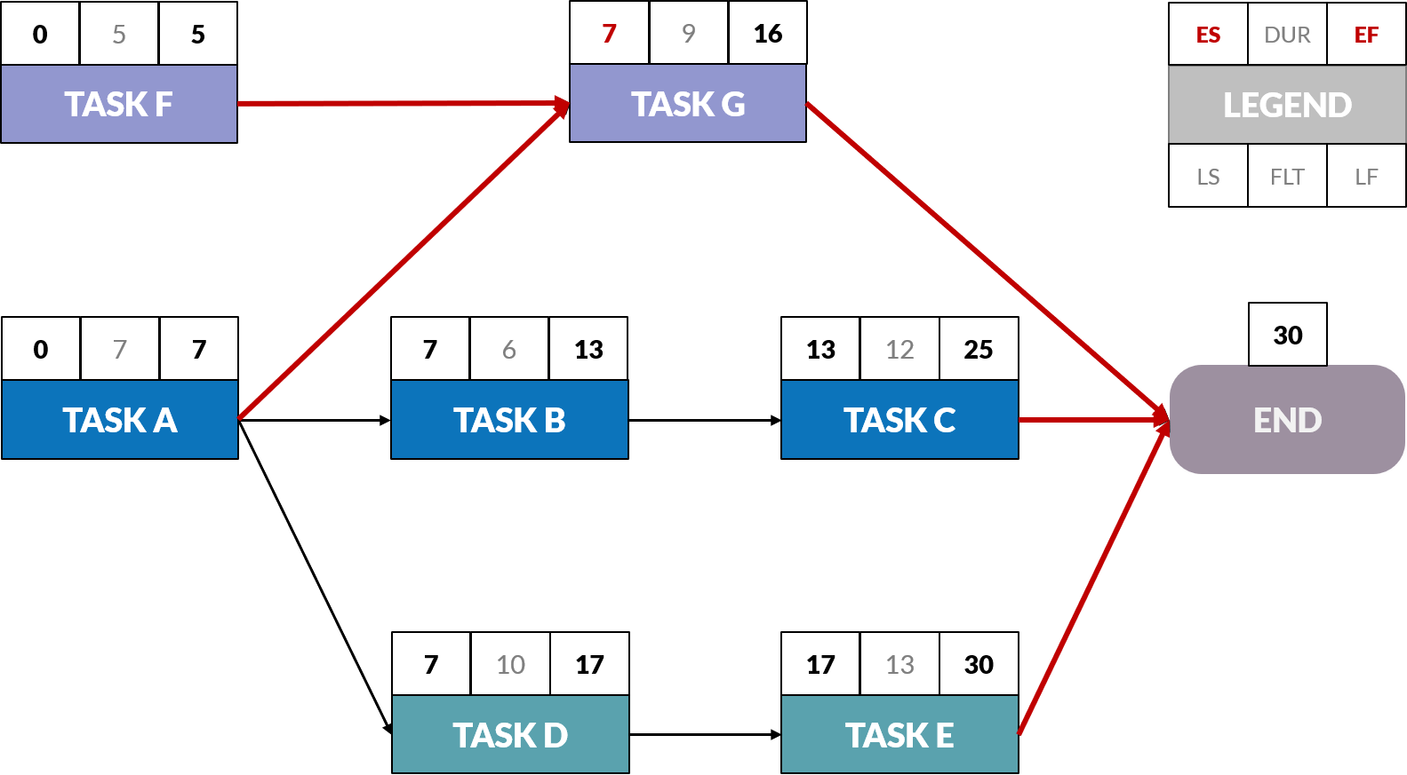
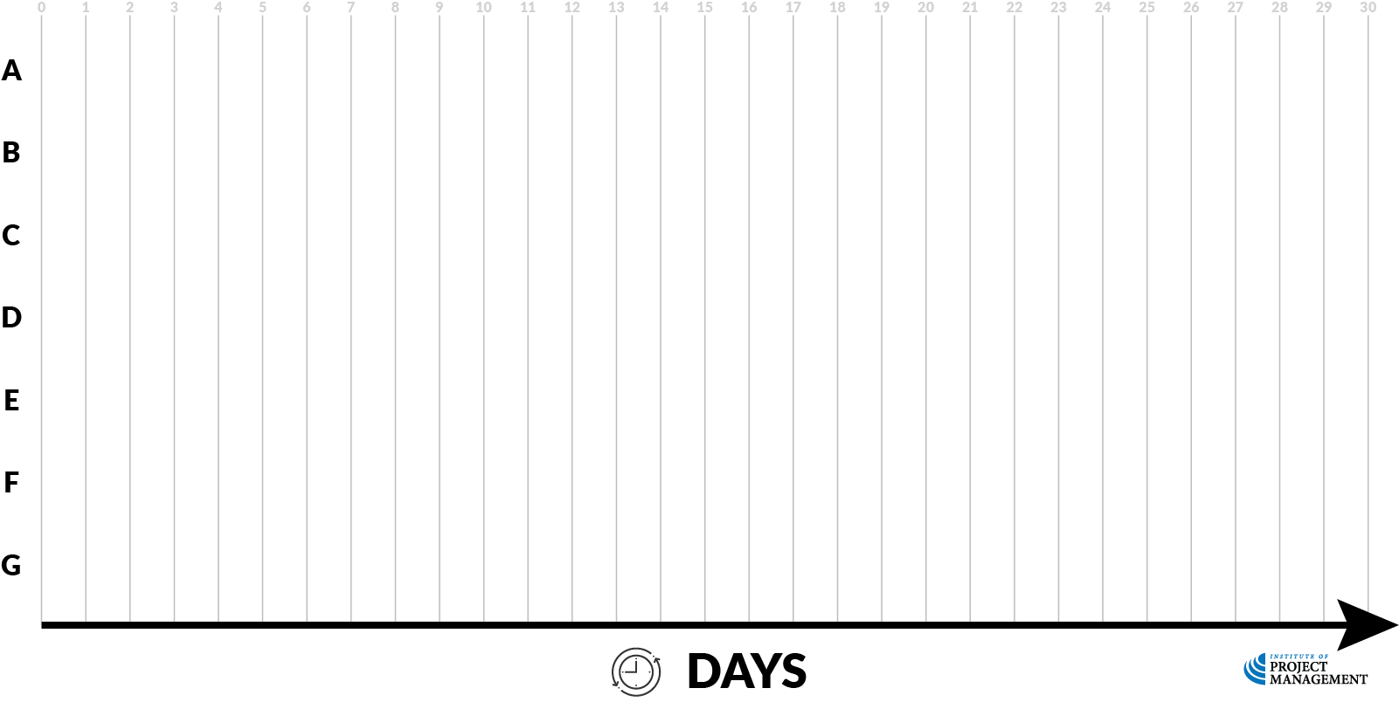
Gantt charts
Early start
A
Notes:
Let’s begin by taking Task A from the last topic and plotting it on our Gantt chart from its early start to its early finish date, the end of day 7.

Slide 26
Gantt charts
Early finish
A
Notes:
Let’s begin by taking Task A from the last topic and plotting it on our Gantt chart from its early start to its early finish date, the end of day 7.

Slide 27
Gantt charts
A
B
Notes:
Task B, now, runs from its early start – the end of day 7, which is really the start of day 8 – for 6 days until the end of day 13

Slide 28
Gantt charts
A
B
C
Notes:
Task C runs from 8 days to day 25.

Slide 29
Gantt charts
A
B
C
D
Notes:
Task D can start at the end of day 7 and run for 10 days to day 17

Slide 30
Gantt charts
A
B
C
D
E
Notes:
It is followed by the 13 days of Task E.
Now like Task A, Task F can start on day zero, but remember because Task G is dependent on both Task A and Task F finishing before it can start, it must start at the end of day 7 before it can run its 9-day course.
And there you have it – a basic Gantt chart!

Slide 31
Gantt charts
A
B
C
D
E
F
Notes:
Now like Task A, Task F can start on day zero

Slide 32
Gantt charts
A
B
C
D
E
F
G
Notes:
But remember because Task G is dependent on both Task A and Task F finishing before it can start, it must start at the end of day 7 before it can run its 9-day course.
And there you have it – a basic Gantt chart!

Slide 33
Gantt charts
A
B
C
D
E
F
G

Slide 34
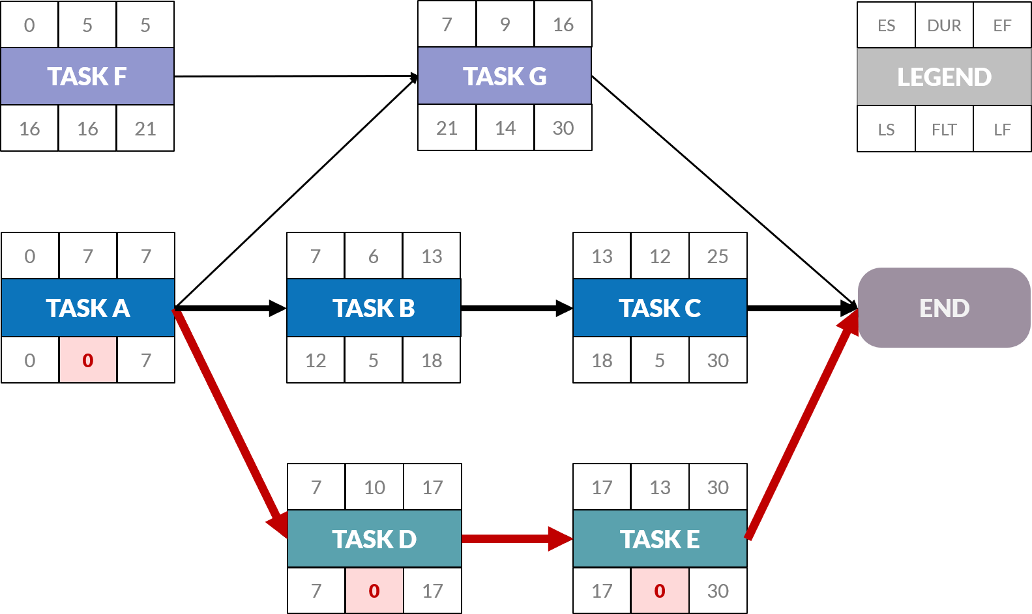
Gantt charts – float
A
B
C
D
E
F
G
Notes:
Continuing our example, we can now start to fill our Gantt chart in with some more information.
First of all, we can add our float to those tasks that have some. We will also use a different colour to illustrate it here.
Task A has no float; however Task B has a total of 6 days.
Let’s shade that out on our chart – it is no coincidence that the float ends on our late finish date for the task of day 18.

Slide 35
Gantt charts – float
5
A
B
C
D
E
F
G
Notes:
Continuing our example, we can now start to fill our Gantt chart in with some more information.
First of all, we can add our float to those tasks that have some. We will also use a different colour to illustrate it here.
Task A has no float; however Task B has a total of 6 days.
Let’s shade that out on our chart – it is no coincidence that the float ends on our late finish date for the task of day 18.

Slide 36
Gantt charts – float
A
B
C
D
E
F
G
Notes:
Task C has 5 days of float, which takes it to its late finish of day 30; whereas Tasks D and E have no float, because they are on the critical path.

Slide 37
Gantt charts – float
A
B
C
D
E
F
G
Notes:
Task F, however, is 16 days, taking us to the late finish of day 21

Slide 38
Gantt charts – float
A
B
C
D
E
F
G
Notes:
The 14 days of float attached to Task G will also take us to the end of the project.

Slide 39
Gantt charts – float
A
B
C
D
E
F
G

Slide 40
Gantt charts – dependency
A
B
C
D
E
F
G
Notes:
From here it is a simple case of adding in dependencies – these are usually inserted as drop down lines, with the critical path again highlighted in red.

Slide 41
Gantt charts – dependency
A
B
C
D
E
F
G
Notes:
Aided by project management software, a Gantt chart is the most recognisable output of the project planning process; however, it is important to note the limitations of this scheduling technique.
A common error made by those who equate Gantt charting with project design is that they attempt to build the WBS at the same time as they map the schedule – project management software actually makes this bad habit very easy to do.
Unfortunately, this practice makes it very difficult to follow the 100% rule introduced earlier.
Remember, the WBS should include 100% of the work defined by the project scope and capture all deliverables – internal, external, and interim – including project management activities.
It is important that the WBS should be fully (100%) defined before the project schedule is attempted.
And although a software-aided Gantt chart is useful and valuable for small projects that fit on a single sheet or screen, they can become quite unwieldy for projects with more than about 30 activities.
This points to another benefit of preparing your WBS manually first – by creating a logical hierarchy within tasks, you can more easily categorise and use the twirl features of your project management software to expand and collapse clusters of related tasks.
Moreover, schedule diagrams such as Gantt charts do not represent the size of a project or the relative criticality of tasks; therefore, the magnitude of a behind-schedule condition is easily miscommunicated.
If two work packages are the same number of days behind schedule, the larger task may have a greater impact on resource utilisation, something the Gantt chart will not show.

Slide 43
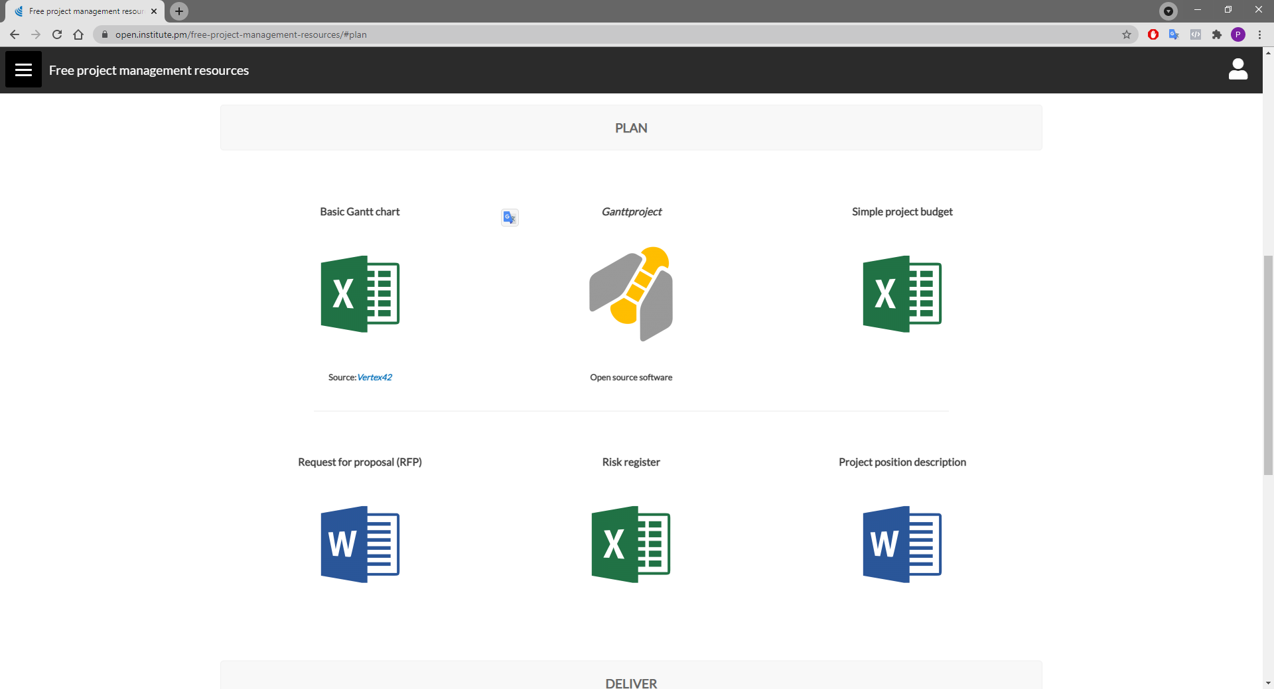

Slide 44
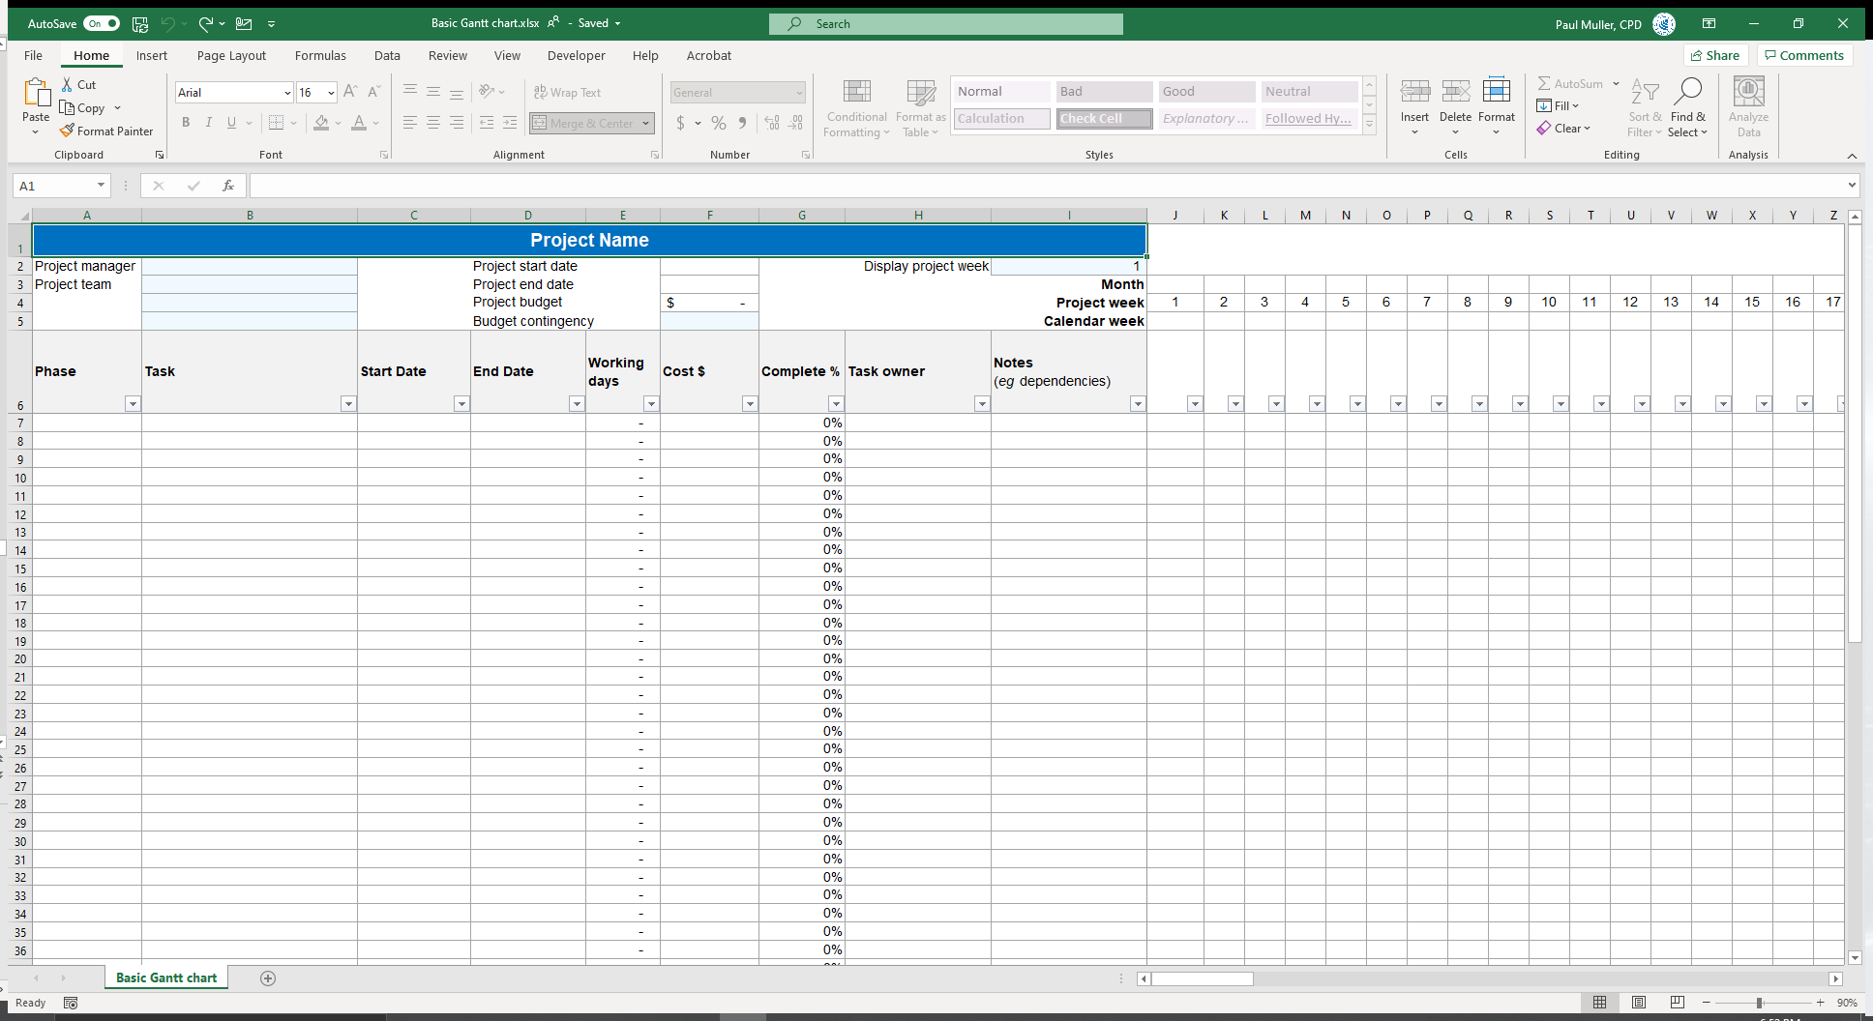

Slide 45
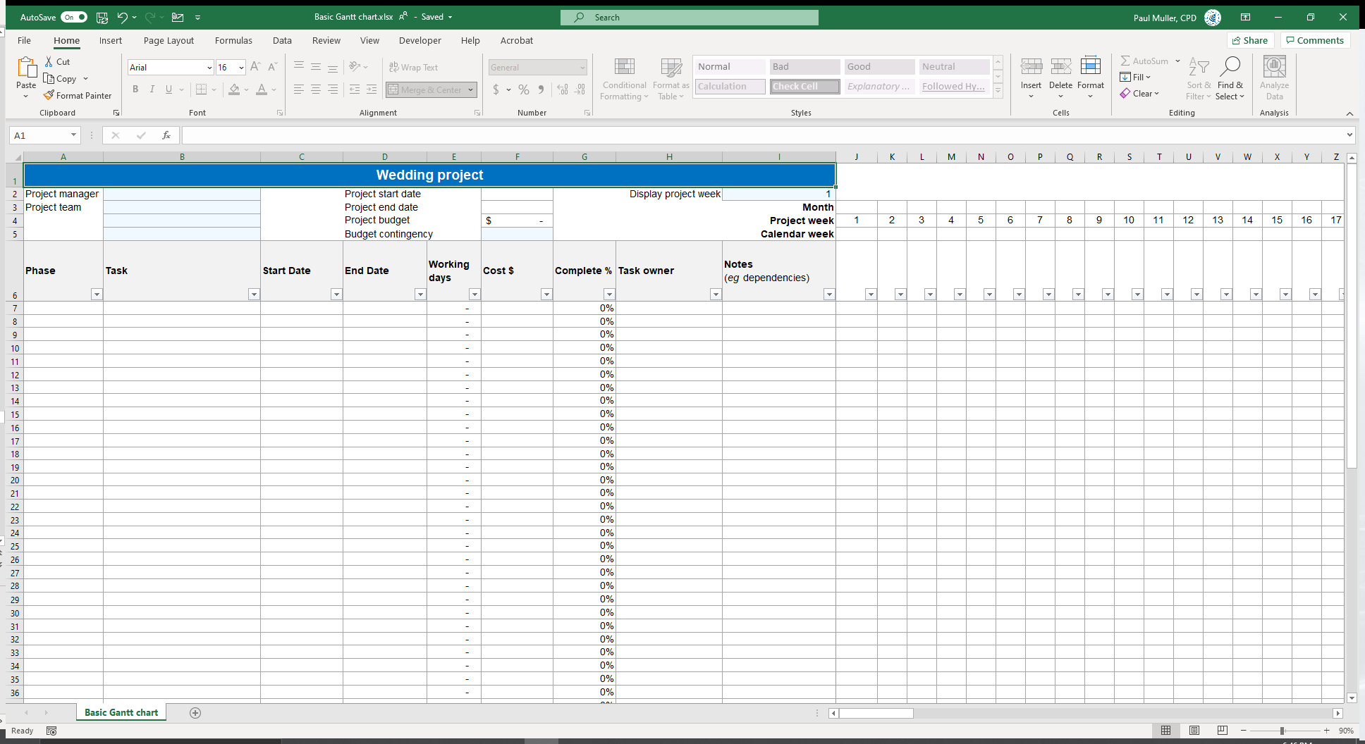
Give your project a name

Slide 46
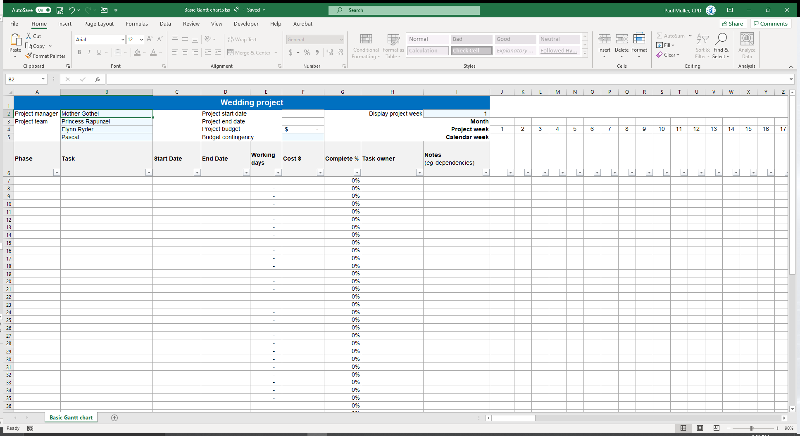
Add the project team

Slide 47
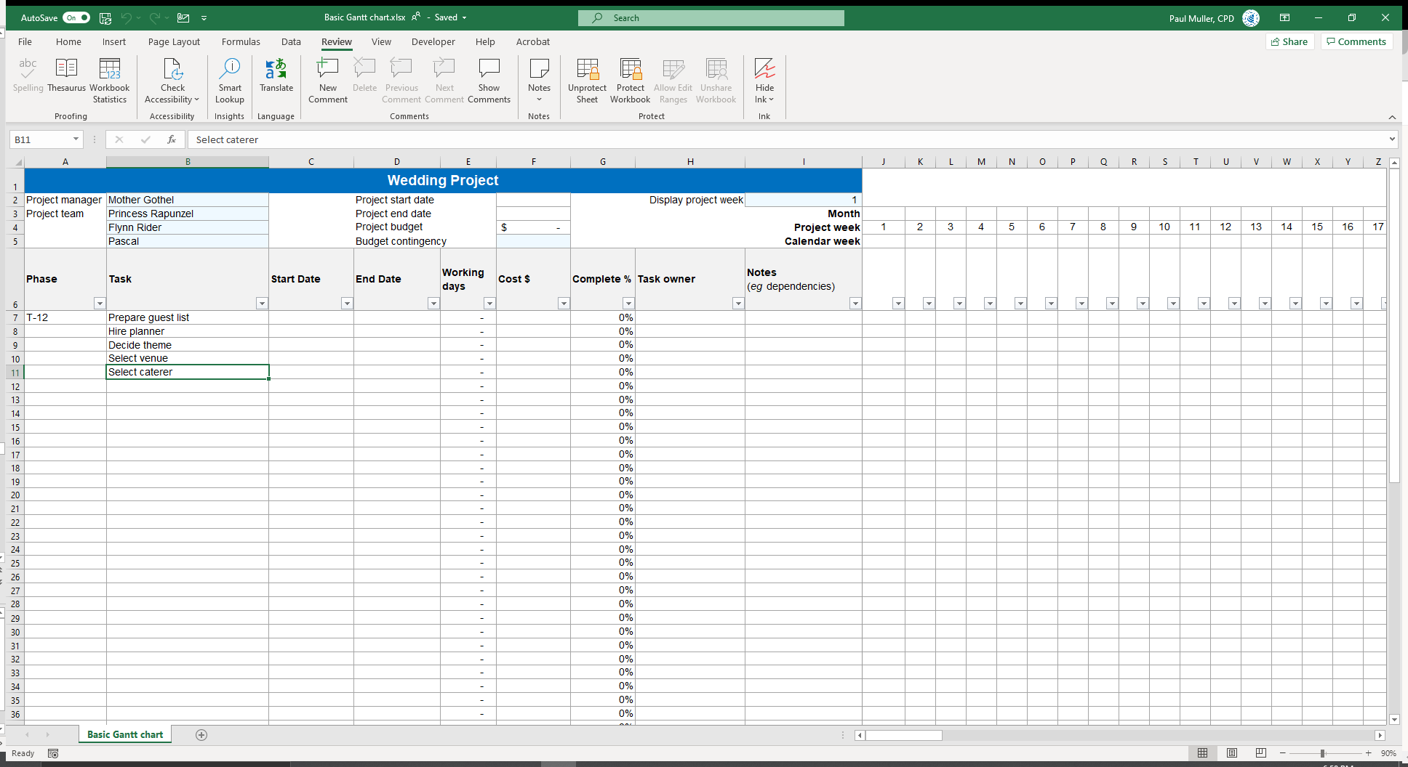
A phase is a group of tasks

Slide 48
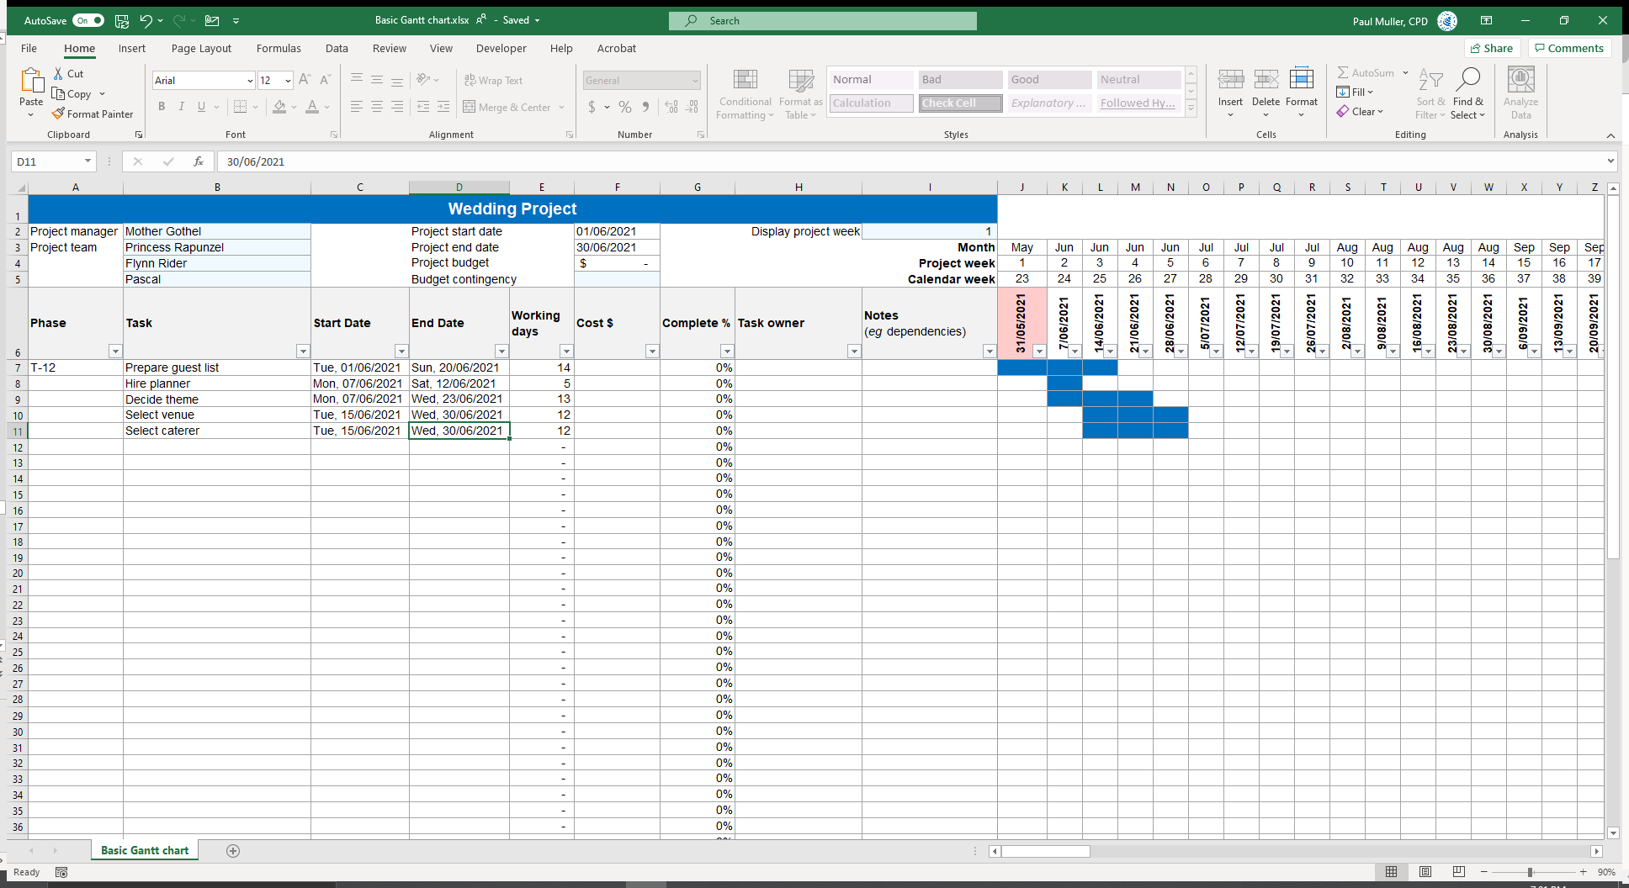
Add start and end dates
Notes:
Click 1: Working days (Mon-Fri) auto-calculated
Click 2: Project start and finish auto-calculated
Click 3: Gantt chart auto-populated
Click 4: Current week highlighted

Slide 49
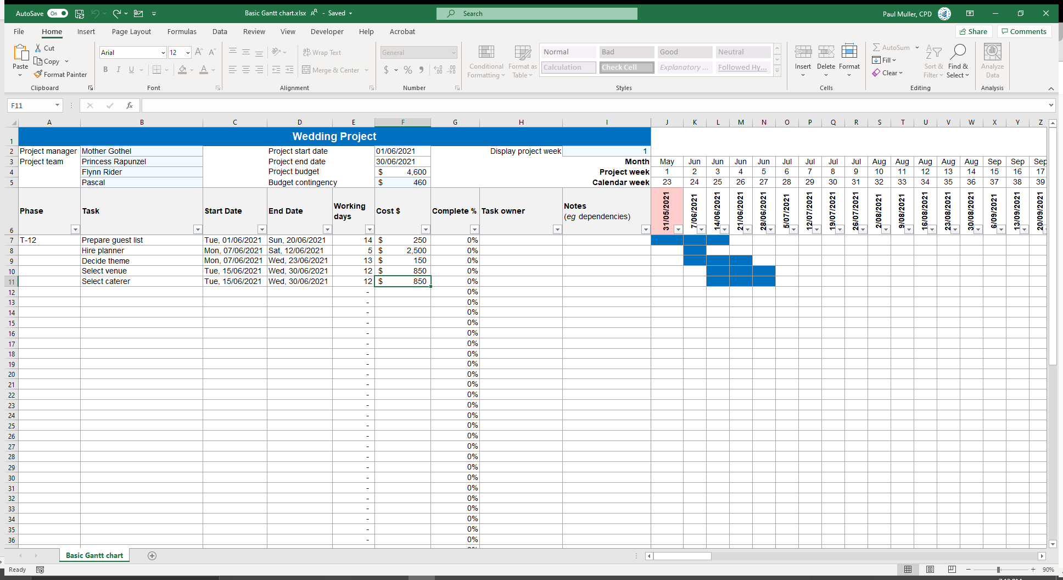
Add budget – include your labour!
Notes:
Click 1: Budget auto-calculates
Contingency defaults to 10% - can be overwritten (formula can be edited when sheet protection turned off)

Slide 50
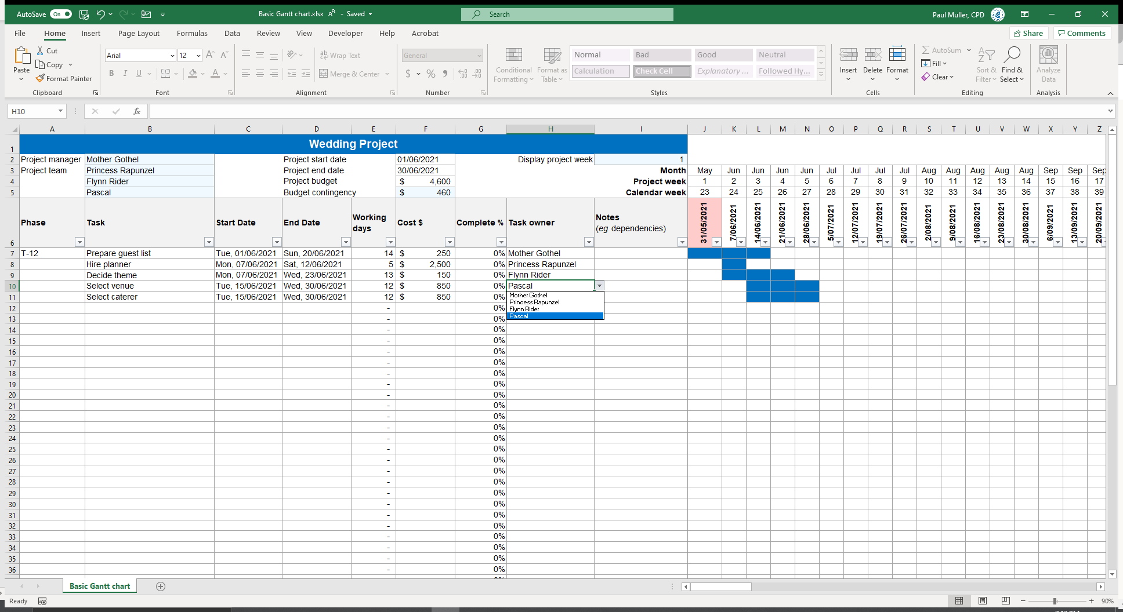
Assign task owners
Notes:
Drop-down list pulled through from project team

Slide 51
Add any notes (eg dependencies)

Slide 52
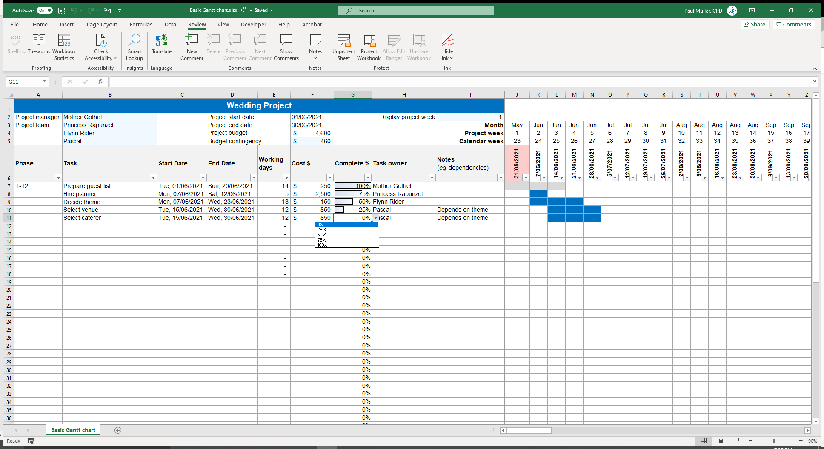
Track task completion as you go
Notes:
Click 1: Filter / sort fields (doing it by start date “normalizes” your Gantt chart)
Click 2: Unprotect sheet to edit formulas etc (not password protected)

Slide 53
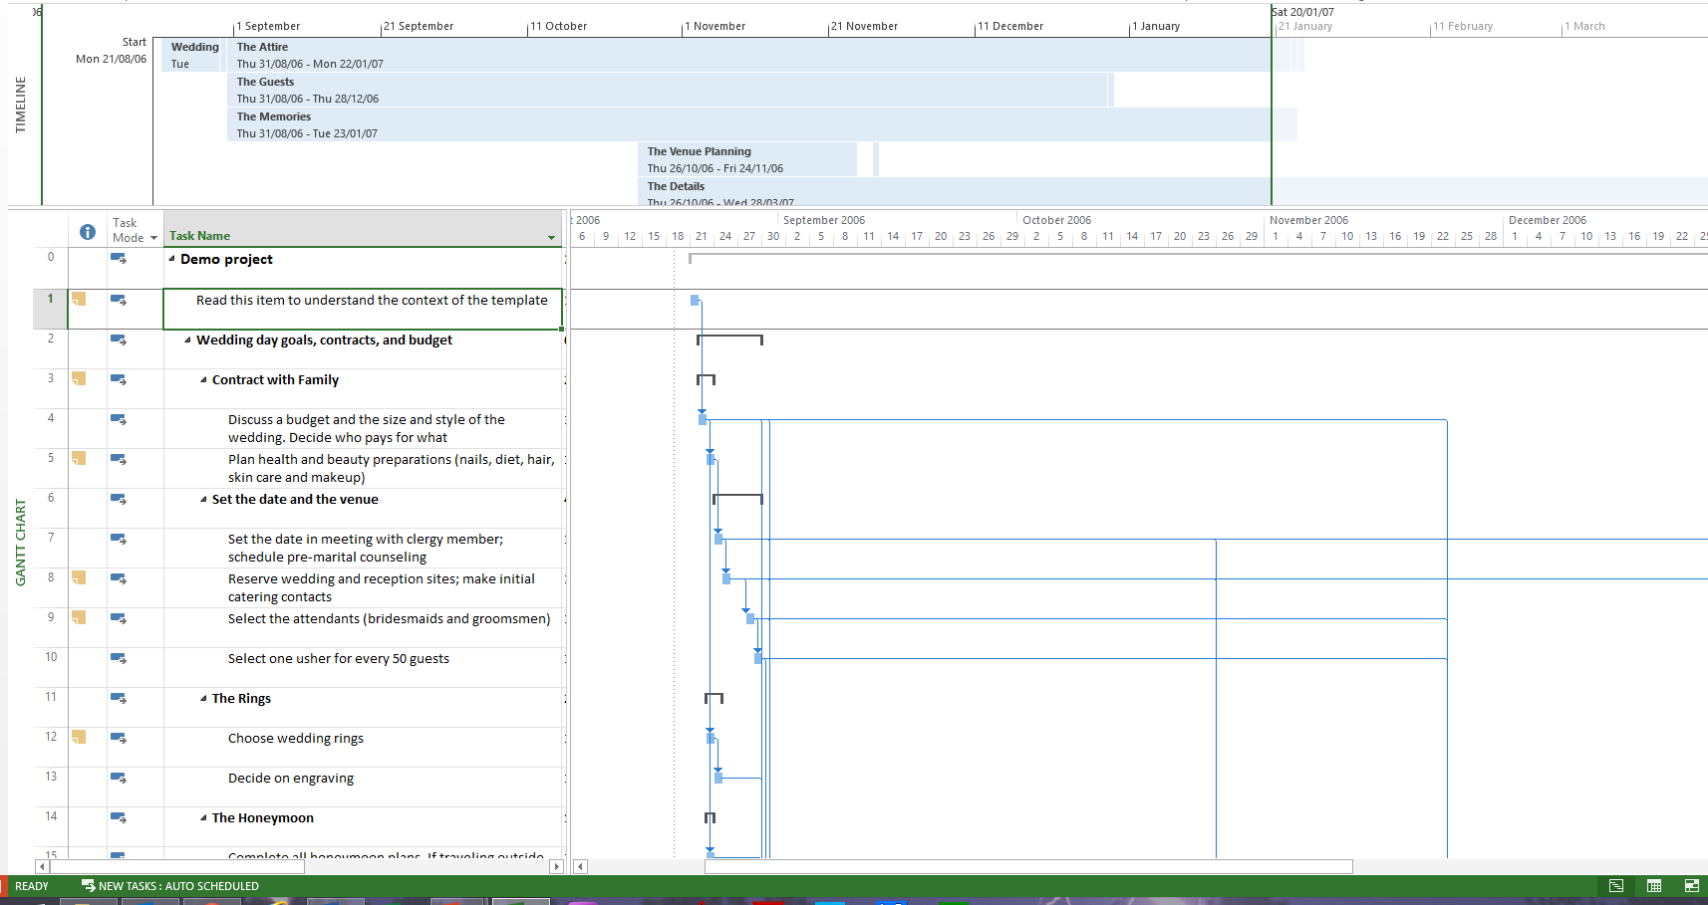
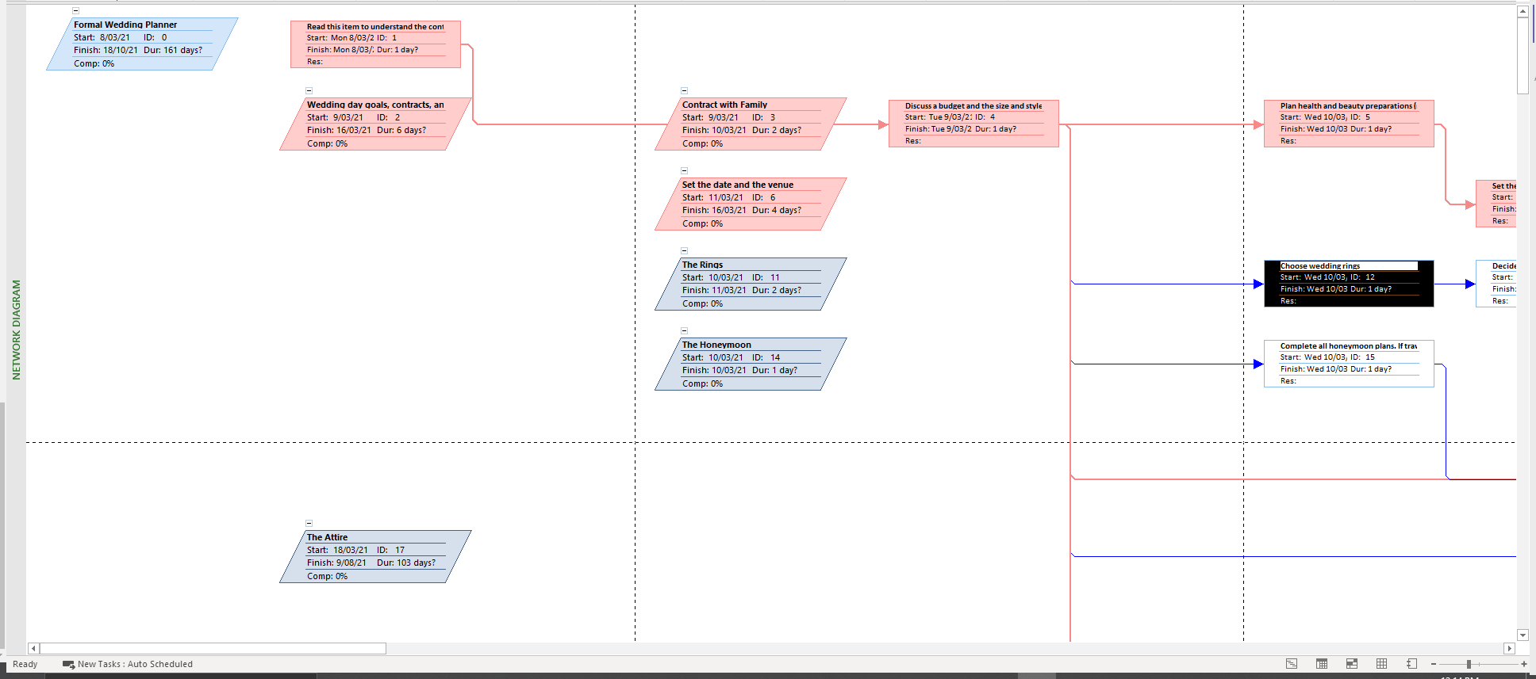
OPEN 6.6
Notes:
This is what a Gantt chart looks like in ‘proper’ project management software – Microsoft Project
A criticism is that although project management software can show schedule dependencies as lines between activities, displaying a large number of dependencies may result in a cluttered or unreadable chart –dependency spaghetti as it is sometimes called!
Some people also prefer the visual clarity of a network diagram.
The network diagram is a hidden feature of most Gantt software!
Personally, I find it much easier to follow and communicate the flowchart logic of a network diagram; however, I have trained my brain to intuitively decode a Gantt chart.
This is because Gantt charts, especially in their electronic form, give us much greater control over our schedule, especially when it comes to fine tuning.
This is something we will explore in more detail in Session 11.

Slide 54
Notes:
To try out Gantt software, here is a free app you can download to your desktop

Slide 55
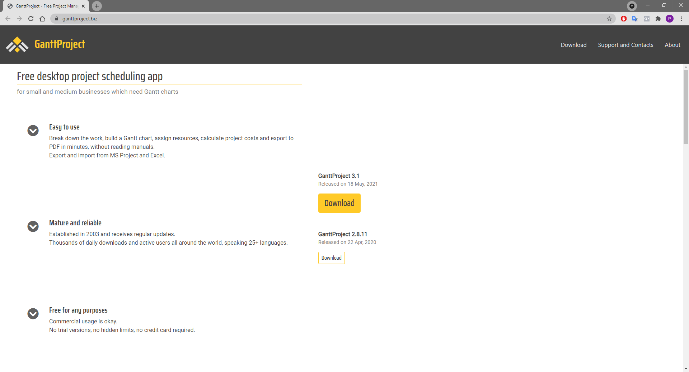
Notes:
Those doing the Cert IV may also choose to do their Gantt in this software

Slide 56
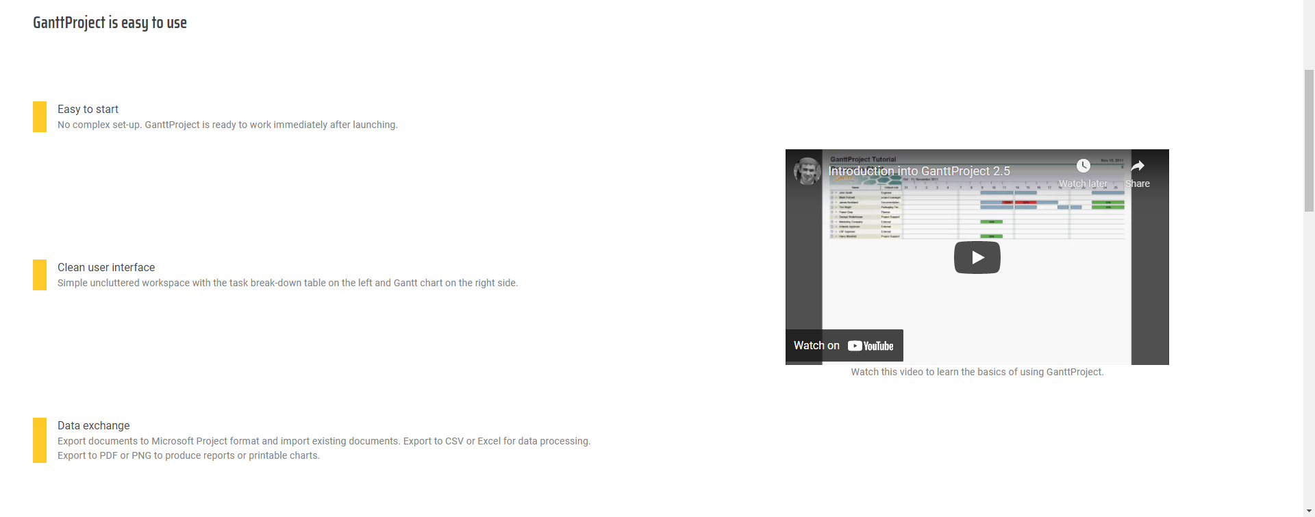
Notes:
You MUST watch this video explainer – it brilliantly explains everything you need to do to prepare a Gantt chart in GanttProject.
Scroll down on the download page to find the link.

Slide 57
Project plan
Using Gantt charting or similar software, prepare a WBS, schedule and resource plan
Relevant professional or personal project
Does not have to be the same project used for the other activities
You can also use the case study project
At a minimum, it must include at least 15 linked and resource-allocated tasks over two (2) hierarchy levels
Notes:
Cert IV PMP students only
If the software allows it, you should clearly mark dependencies and a critical path

Slide 58
Project plan
In addition to the tasks required to deliver the project’s outputs, you should (if relevant) include:
Project team induction / training tasks
Stakeholder engagement and communication tasks
Quality control and assurance tasks
Key project financing / cashflow milestones
Provision for a project reflection / review
Notes:
Cert IV PMP students only

Slide 59
Reflection
What is the most interesting thing you learned today?
What is one thing you will start, stop or continue doing?
What is one thing you would like to learn more about?

Slide 60
Questions?
Coming next… procurement

Slide 61
Closing checklist
Classroom
Upload signed attendance sheet and any photos taken of work in progress
Zoom
Upload video with thumbnail and link to workshop
Student administration
Mark participating students as complete
Email absent students and notify of gap requirements (OPEN units)
Facilitator feedback – email paul@institute.pm
What worked well today?
How can we improve?

